Slide 1
Notes on
Criminological Theory
Paul Brantingham
Feb 4, 2019

Slide 3
Crime and Criminality
Crime
Criminality
An event involving acts that violate some criminal law
An actual criminal action requires convergence of at least four elements in space-time:
  law,
  offender,
  target, and
  situation.
Convergence creates the criminal event.
Crime theory tends to assume the existence of a set of people who will readily give in to any provocation or temptation to crime.
Crime theories address the other three components of the criminal event
An individual’s propensity to commit an act in violation of some criminal law
It is assumed that :
  criminals – (persons who are easily provoked or tempted into law violation) are somehow pathologically different from
  most people, who are fundamentally non-criminal (that is, are highly resistant to both provocations and temptations).
Most traditional criminological theories address criminality, drawing on
  a variety of biological, psychological and social assumptions about the development of personality and sociality
  assumptions about the capacity of different communities to exercise effective control over the criminal impulses of individuals
  assumptions about the impact of the criminal justice system on criminality

Slide 4
Theories of Criminality
Innate or Induced?
Biological Theories
Social Theories

Slide 5
Psycho-Biological Criminality
Drive to commit crime
  Hydraulic impulse
Innate
  something within the individual organism
  outside the individual’s will
Mechanisms
  Inherited propensity
  Physiological damage
  Problem biochemistry
  Mental aberration

Slide 6
Some Empirical Basis
Propensity to commit crime appears to follow power law:
  Only ~20% of birth cohort ever commit a crime
  ~20% of offenders commit 80% of all crimes – “persistents”
  ~20% of persistents commit 80% of crimes by this group – “prolifics”
Males commit about 80% of all crimes
Minority groups show much higher rates of offending and victimization than majority groups
Convict populations have lower measured IQ on average than non-convicts
Crime persistence seems to run in families

Slide 7
Forms of Internal Explanations
Medical practitioners
  Alienists and Psychiatrists
  Anatomists
Biologists
  Darwin and evolution
  biochemists
Anthropologists
  Anthropometrists
  Constitutionalists
Psychologists
  IQ
  Pavlov
Geneticists
  genealogists
  Twin studies

Slide 8
Lombrosian Born Criminal
True Criminals are biologically different from non-criminals.
This biological difference can be seen in a set of visible physical stigmata on medical examination
True Criminals may also exhibit a variety of sensory abnormalities
Some criminals have damaged anatomies
Some quasi-criminals are socially produced

Slide 10
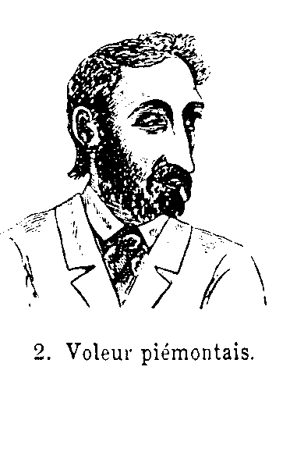

Slide 12
Anthropometry & Somatotypes
Physical Anthropology
Roots in Bertillion system
Key names:
  Goring - University of London
  Hooton - Harvard University
  Sheldon - Harvard University
  The Gluecks - Harvard University
  Wilson and Herrnstein - Harvard University

Slide 13
Mesomorphy

Slide 14
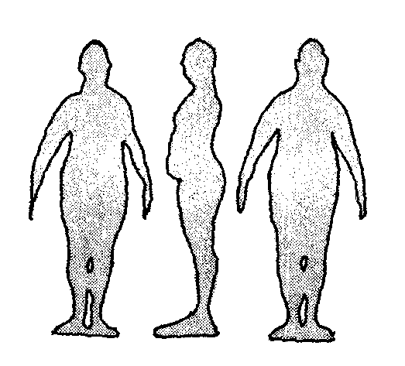
Endomorphy

Slide 15
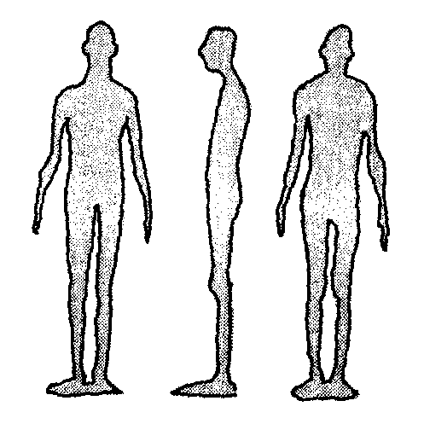
Ectomorphy

Slide 16
Chicago School Criminology
The Dominant American Voice

Slide 17
Chicago School Sociology
Ecology of Cities
Culture Conflict
Social Interactionism

Slide 18
Ecology of Cities
Growth
Competition
Equilibrium

Slide 20
Zone Rates of Delinquency
Chicago, 1927-1933
male delinquents’ residences
applies the Burgess zonal model of the city
centered on the “Loop”, Chicago’s central business district
shows concentrations of criminal residence in ZIT with radial decline outwards

Slide 22
Culture Conflict
Primary
  Competition between cultures to control behaviour
Secondary
  subculture/dominant culture conflict

Slide 23
Social Interactionism
Behavioral norms learned in social interaction with others
Reflexive Self
  I become what I think you think I am

Slide 24
Some Main Trends
Social Disorganization – Social Efficacy
  Local community control of bad behavior
Social Learning
  People are taught to be criminal
Labeling
  Society manufactures criminals by labeling people so
Strain Models
  Criminality as response to unfair social structure
Control Theory

Slide 25
Social Disorganization/Efficacy
Social Disorganization - Shaw & McKay (1930’s)
  occurs in transitional neighborhoods
  driven by growth from immigration
  sets up a primary culture conflict for immigrant children
  while primary conflict unresolved, a criminal subculture can recruit immigrant children, who learn criminal ways
Social Efficacy - Sampson (1990’s)
  ability of local community to meliorate or resolve primary culture conflicts for children in transitional areas
  prevents recruitment into criminal subcultures
  exercises other informal social controls

Slide 26
Social Learning
Criminal behavior is learned as imitation in intimate social interactions with people near and dear to you
Criminal behavior is a product of learned social attitudes
Key criminologists:
  Tarde (1900)
  Sutherland (1930’s)
  Jeffrey (1950’s)
  Akers (1970’s)

Slide 27
Differential Association
Criminal behavior is learned.
Criminal behavior is learned in interaction with other persons in a process of communication.
Criminal behavior is learned, for the most part within intimate personal groups.
Learned criminal behavior includes:
  techniques of committing the crime
  the specific direction of motives, drives, rationalizations and attitudes
The specific direction of motives and drives is learned from definitions of the legal codes as favorable or unfavorable
A person becomes delinquent because of an excess of definitions favorable to violation of law over definitions unfavorable to violation of law
  This is the principle of Differential Association
Differential association may vary in
  frequency
  duration
  priority
  intensity
The process of learning criminal behavior involves all of the mechanisms that are involved in any other learning
While criminal behavior is an expression of general needs and values, it is not explained by those general needs and values since non-criminal behavior is an expression of the same needs and values.

Slide 28
Labeling Theory
A theory of criminality owing to social interaction - I become what society acts like it thinks I am.
Labeling theorists
  John Wigmore - Condemnation by conviction
  Frank Tanenbaum - Dramatization of Evil
  Ed Lemert - Primary & Secondary Deviation
  Howard Becker, Outsider adaptation
  Clarence Schrag

Slide 29
Schrag’s version of Labelling
No act is intrinsically criminal
Criminal definitions are enforced in the interest of the powerful
A person does not become criminal by violation of the law, but only by the designation of criminality by the authorities
Since everyone conforms and deviates, people cannot be dichotomized into “criminal” and “noncriminal” groups
The act of ‘getting caught’ begins the labeling process
“Getting caught” and the decision making process of the criminal justice system are a function of offender characteristics not offence characteristics
Age, socioeconomic class and race are the major offender characteristics that establish patterns of differential criminal justice system decision making
The criminal justice system is established on a free will perspective that allows for condemnation and rejection of the identified offender
Labeling is a process that produces, eventually, identification with a deviant image and subculture, and a resulting “rejection of the rejecters”

Slide 30
Anomie and Strain
Durkheim (1890’s)
  anomie is the situation of ‘normlessness’ created by rapid social change
  in a state of anomie people no longer know what rules govern their behavior, so they feel free to do anything they want
  people are unhappy in anomie and increase self-destructive behavior such as promiscuity, crime and suicide
Merton (1930’s)
  anomie - a state of social strain - exists when some people who cannot achieve socially prescribed goals by socially prescribed means realize this fact
  such individuals are in an state of anomia
  adaptive choices available to such individuals are limited

Slide 31
Merton’s Adaptations to Anomie

Slide 32
Differential Opportunity
Cloward & Ohlin (1950’s)
Synthesizes Shaw & McKay’s social disorganization theory and Merton’s version of anomie
  resulting model often called “strain theory”
  sometimes called “subcultural theory”
When anomie hits, the adaptation the anomic individual makes is a function of criminal opportunities in the neighborhood

Slide 33
Differential Opportunity
Socially Defined
GOALS
Fame Status
Fortune
Structural
Blockage
(e.g., racism)
ANOMIE
Disorganized
Neighborhood
Fighting
Gang
Criminally
Organized
Neighborhood
Organized
Crime
Politically
Organized
Neighborhood
Terrorism
Most People
Legitimate means
fair share of
goals

Slide 34
Control Theories
Criminality is innate
  Hobbesian view of human nature
Law abiding behaviour is taught through social interaction
Criminal behaviour is a result of a failure in this socialization process
Key criminologists:
  Reckless
  Hirschi

Slide 35
Gottfredson & Hirschi’s (1990)
General Theory of Crime
Crime is produced by low self control
Low self control is the tendency to pursue immediate gratification without consideration of long term consequences

Slide 36
Low self control predicts a tendency to engage in:
  Crime
  gambling
  sex
  alcohol
  drugs
  smoking
  quitting jobs

Slide 37
Causes of Low Self Control
Low self control is the state of nature
Most people are socially taught self-control
Failure to teach people how to assess the long term pleasure/pain balance or consequences of any given act leads to law self-control.
Ineffective child rearing is main reason for this failure.
Some individual characteristics may make it harder to teach self control:
  low intelligence
  high activity levels
  physical strength
  adventuresomness

Slide 38
Crime Theory
The Pattern Theory of Crime

Slide 39
Fundamental Assumptions of Crime Pattern theory
Complexity of the criminal event
  Confluence of Offender-Target-Situation
Crime is not random.
Offenders and victims are not pathological in their use of time and space
  Least effort principle
Criminal opportunities and criminal events are structured by:
  Routine Activities
  The frictions of time and distance
  Activity Spaces and Awareness Spaces
  Social Networks

Slide 41
Areas Fitting Crime Template
Work
Home
Shopping & Entertainment

Slide 42
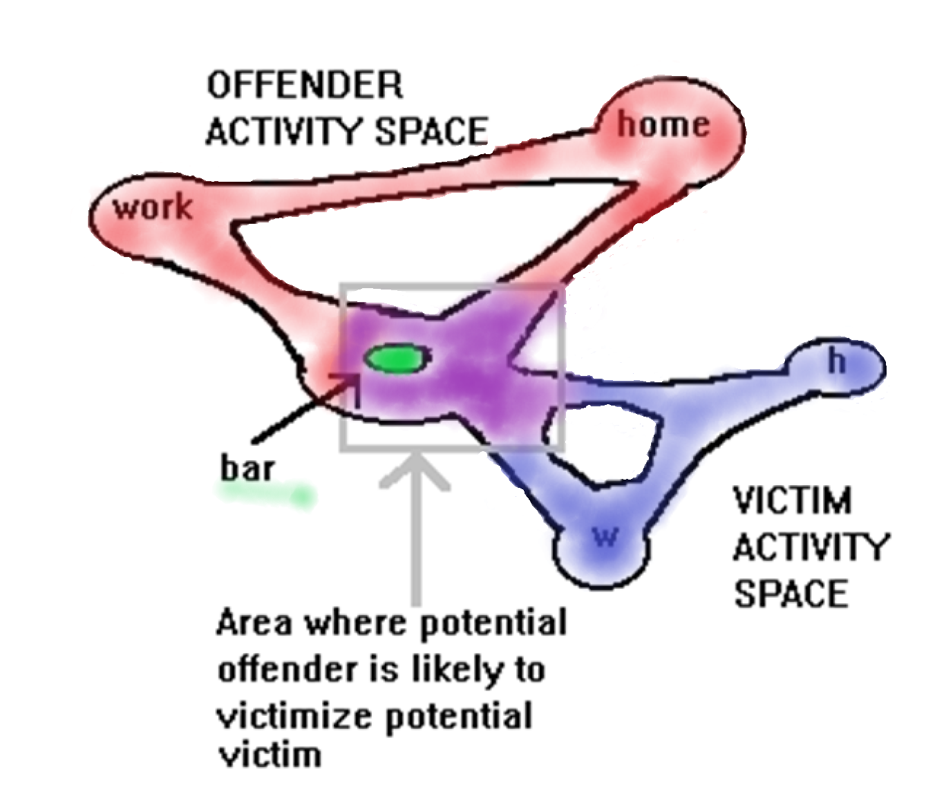

Slide 43
Urban Structure
Urban form and structure shape the activity patterns of everyone, including criminals and victims. Key aspects of urban structure considered in crime pattern theory include:
  Nodes
  Paths
  Edges
  Environmental Backcloth
Crime Generators and Crime Attractors

Slide 44
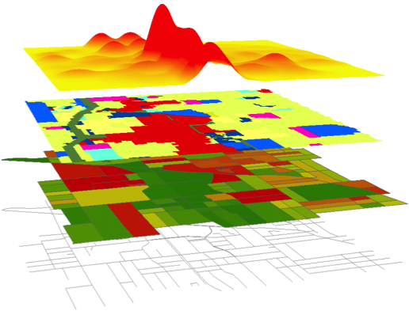
Multiple layers of a city for crime choice
Road network
Land use
City infrastructure
Pushes and pulls
Paths – nodes – edges
Attractors – generators
Notes:
Pat Brantingham

Slide 45
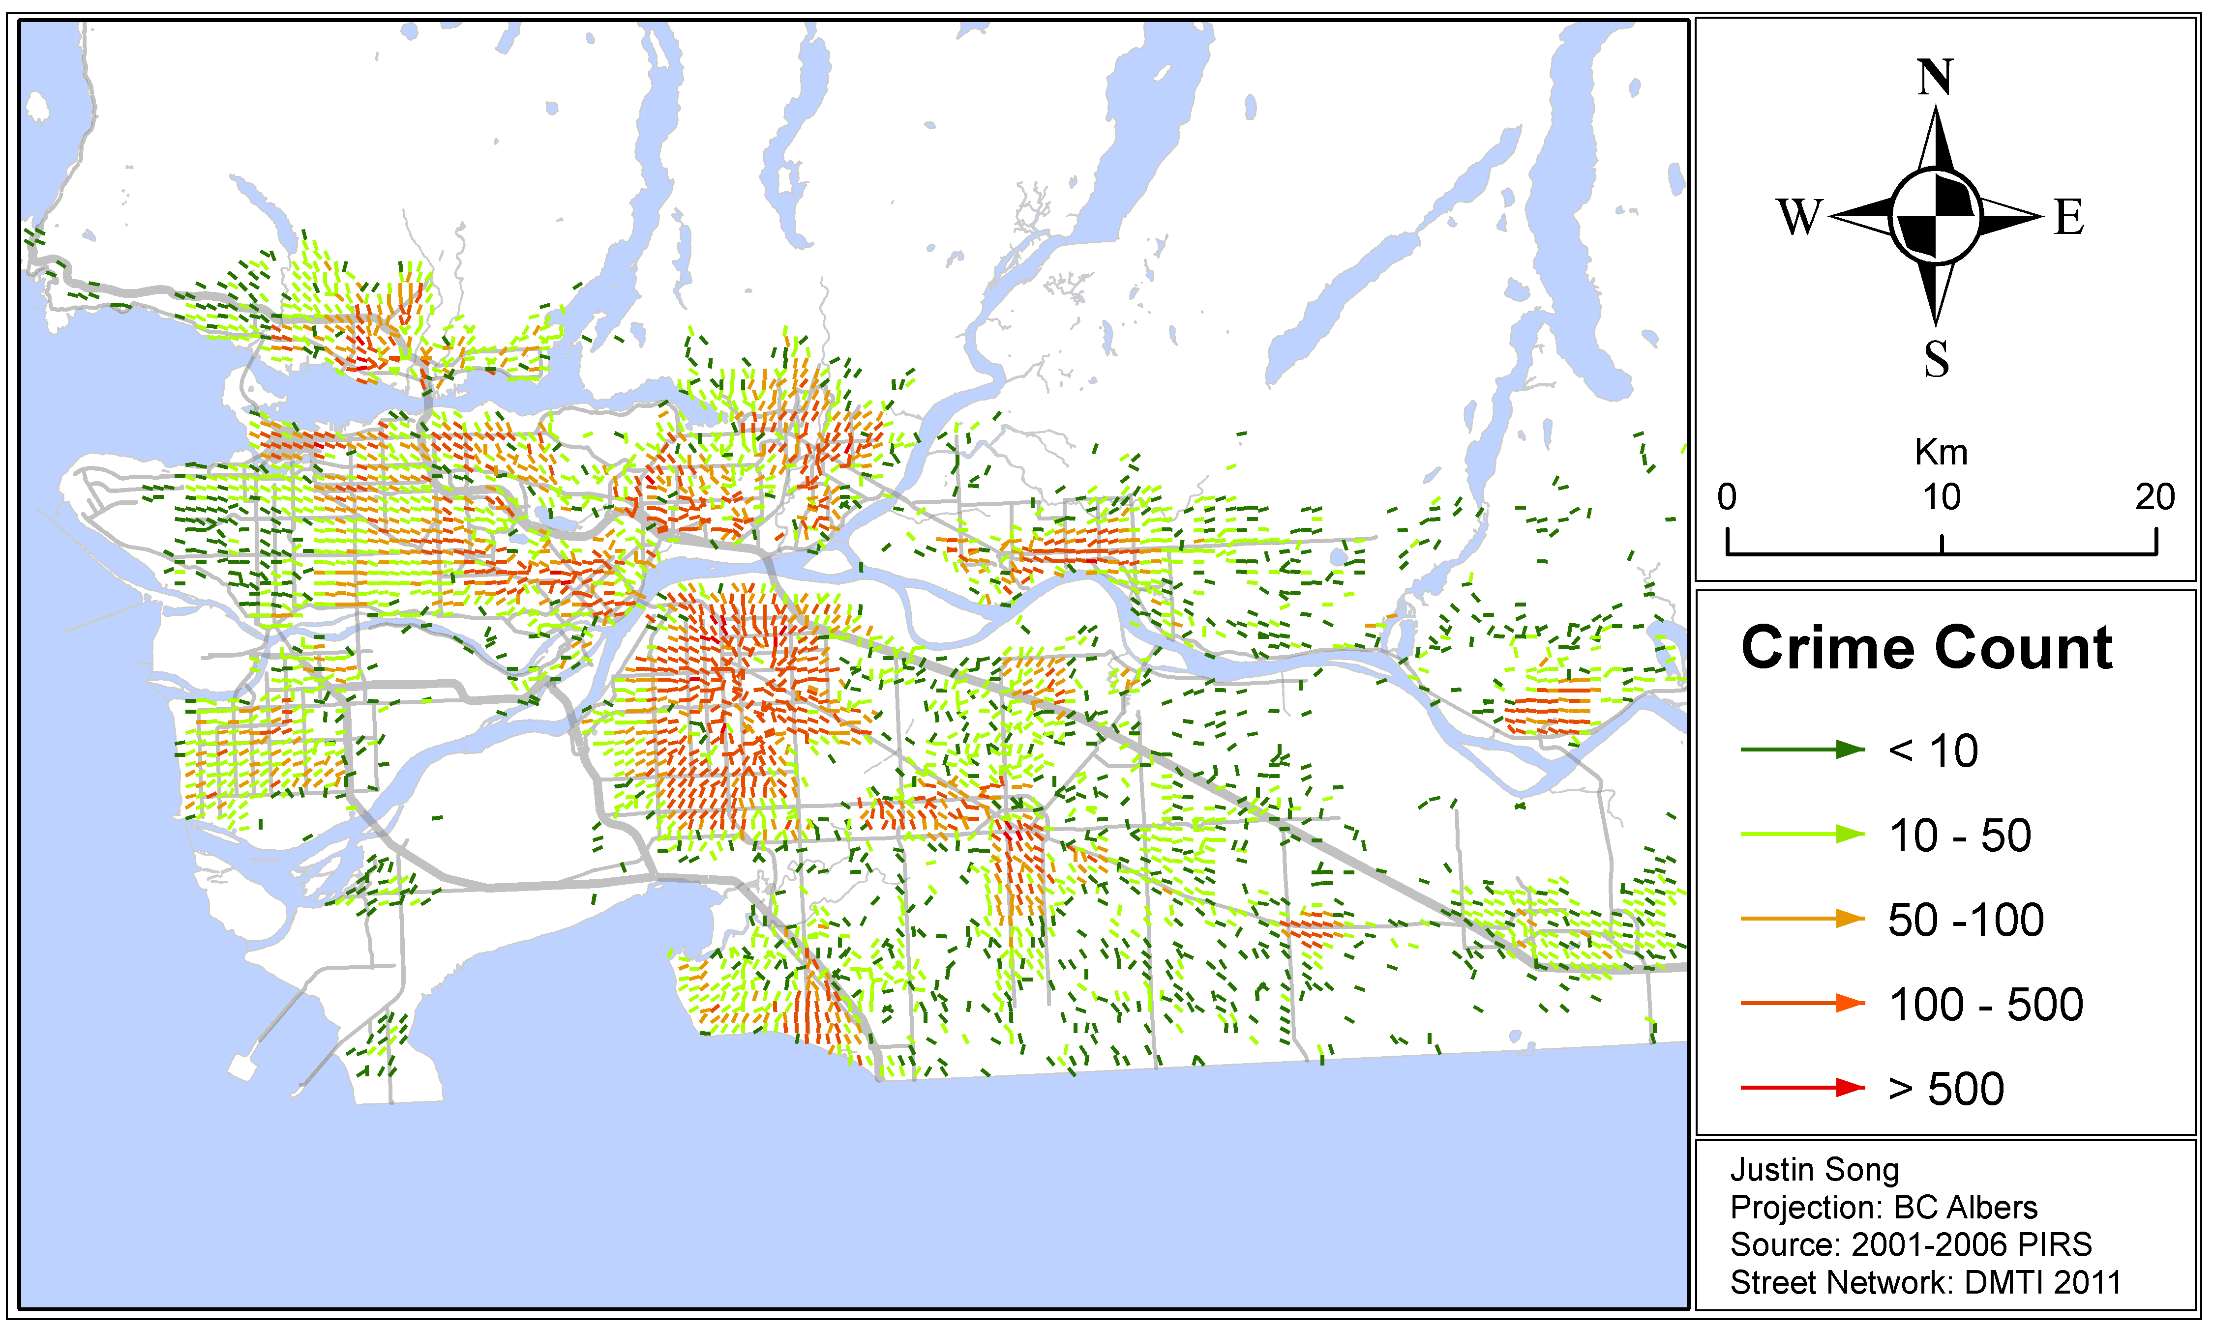
Offenders’ Journeys to Crime
Showing generator nodes

Slide 46
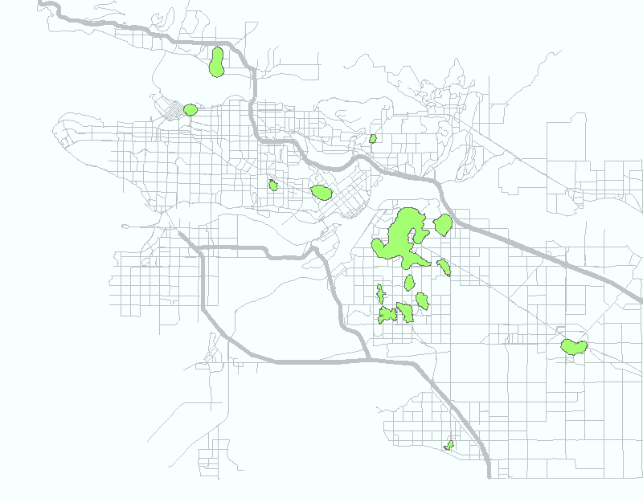
Offenders Home Hot Spot
(based on 213,906 data, Point Density (100m,500m) → Contour (>1000))

Slide 47
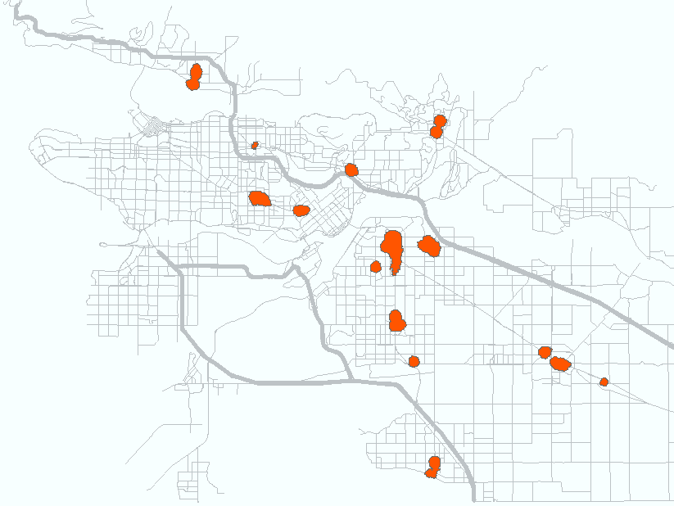
Crime Event Location Hot Spot
(based on 213,906 data, Point Density (100m,500m) → Contour (>1,500))

Slide 48
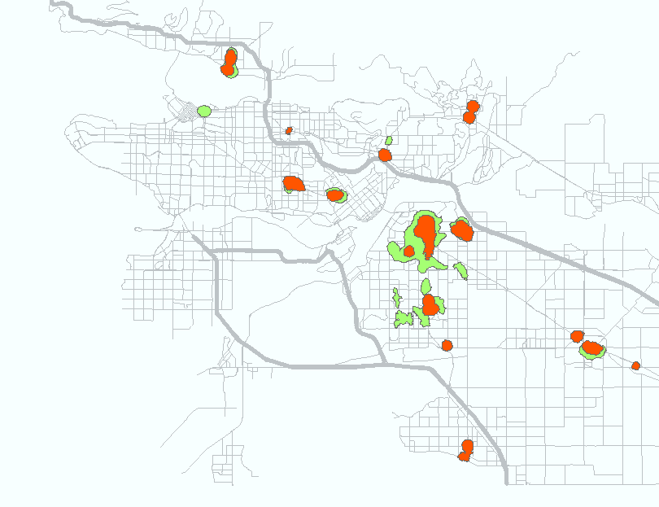
Crime Event / Offender Home Hot Spot
(based on 213,906 data, Point Density (100m,500m) → Contour )

Slide 49
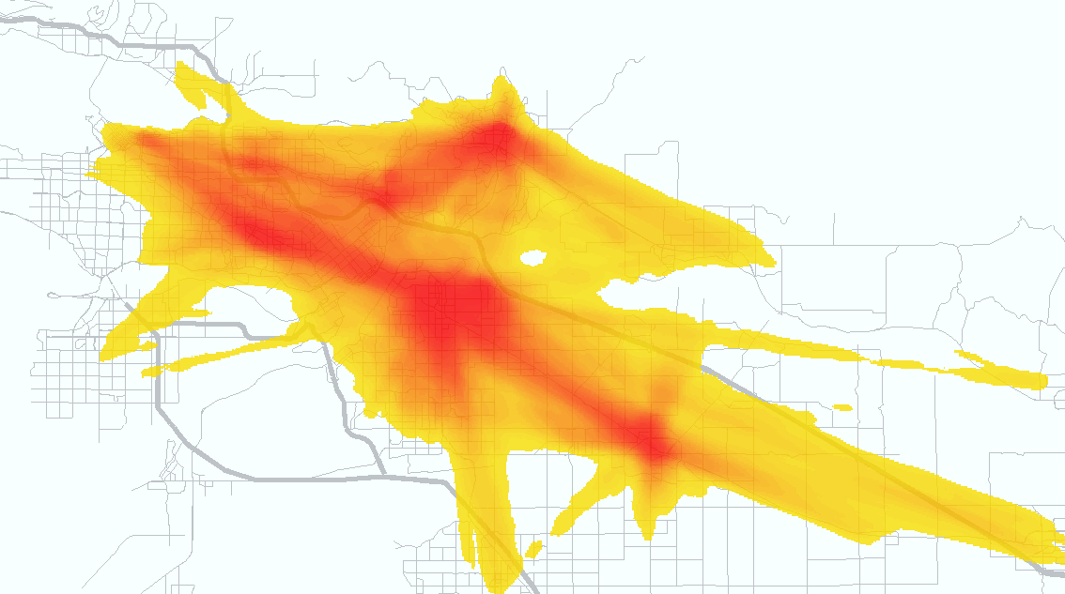
Crime Ridges
based on 213,906 data, All crimes outside Malls, Line Density(100, 500m)
Prof. Patricia Brantingham – J. Song (MSc.) – V. Spicer (PhD) – Prof. R. Frank (PhD)
Notes:
Home location to crime sites for Metro Vancouver…
Specialization- Gov’t, Edu, Commercial, Entertainment, Real Estate, Finances, clean and “dirty” industry…. Multi specialties
Major targets everywhere; mobility restricted by major transit, major roads
Major attractors- commercial/ entertainment facilities (mixed land use- condos, commercial, business, restaurants, bars, etc)

Slide 50
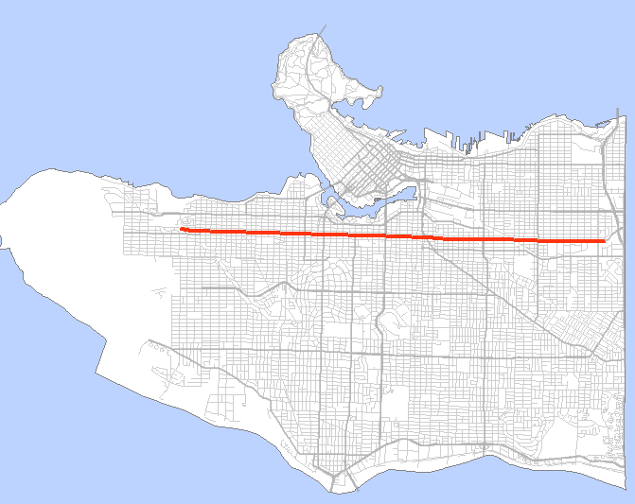
VPD Data – Spatial Trends
V. Spicer (PhD) – J. Song (MSc.)
A
B
A
B
Notes:
Val Spicer- spatial trends along major street.

