Slide 1

A Brief Review of Solar Energy: Technology and Applications
Siavash Vojdani PhD
Unity Integration Corporation
www.Unityintegration.com
Presentation at SFU Mechatronics Department
March 24,2011
March 24 2011

Slide 2
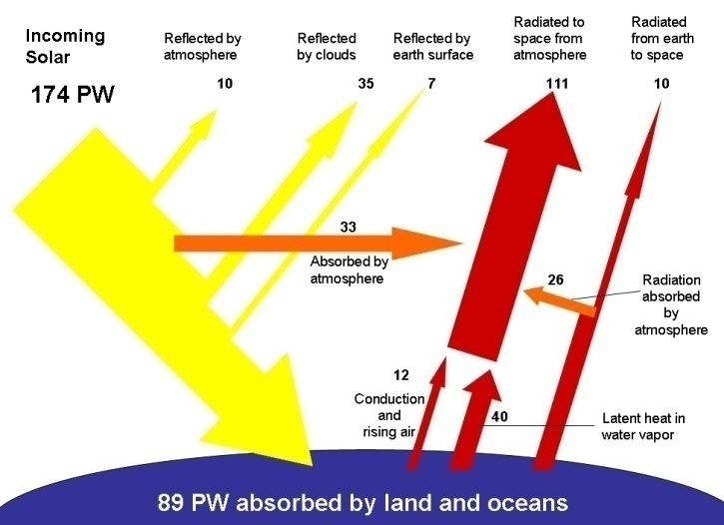
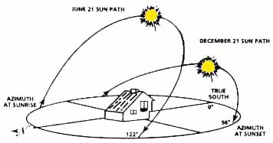
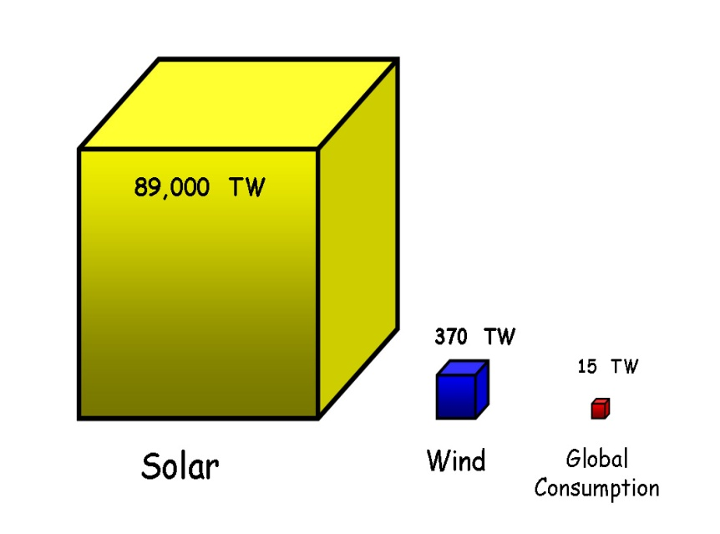
Available Solar energy on Earth
At under 0.5%, the Solar technology is massively under penetrated in the existing electricity domain.
Credite Swisse
Dec 13, 2007
March 24 2011

Slide 3
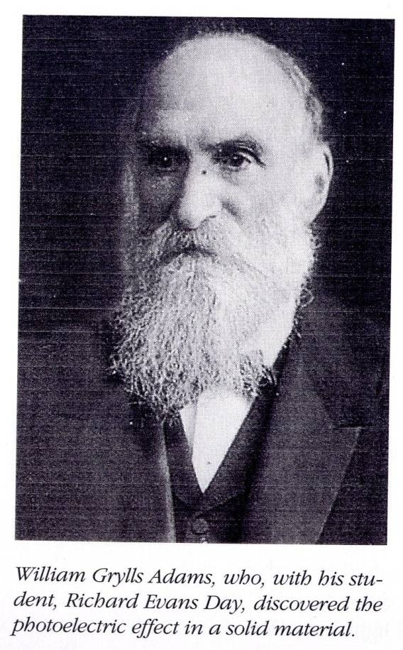
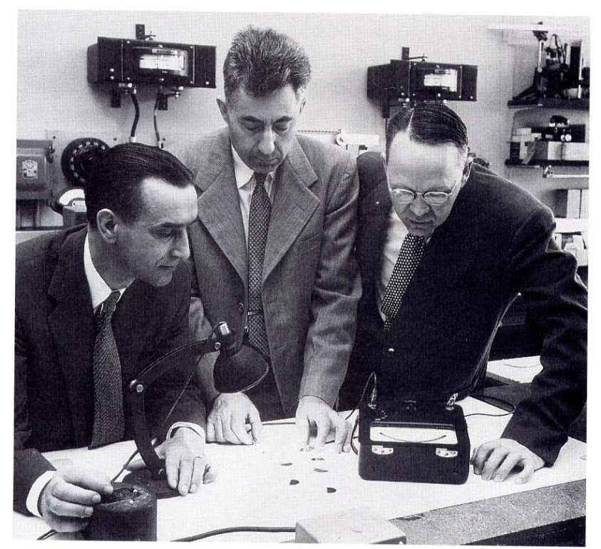
Converting solar energy into electricity:
A Brief Look at History
Photoelectric Effect discovered
by this guy in 1875
Modern silicon PV cell invented by
these guys at Bell Labs in the 50’s
March 24 2011

Slide 4
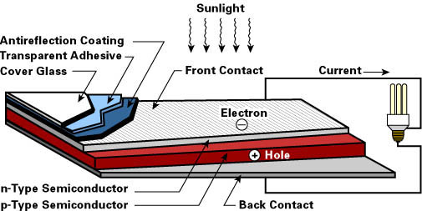
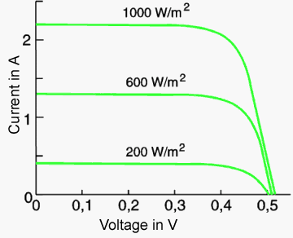
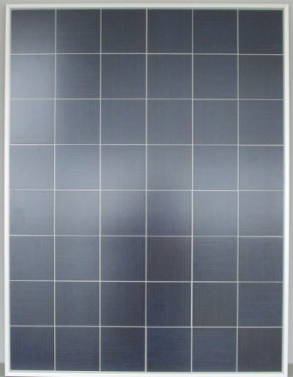
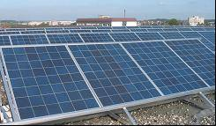
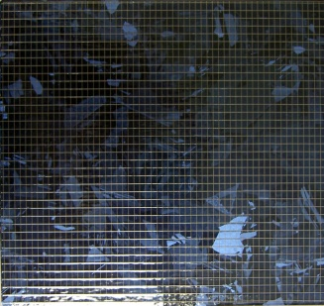
How does it work?
Cell MC48
( 3.85 W )
Module Day4 48 185 W
Panels : 100 KW = 540 Panel
March 24 2011

Slide 5
PV TECHNOLOGIES FOR POWER APPLICATIONS
In the Lab :
Disruptive Technologies
Commercialized
Pilot & Emerging
Thin Film (TF) and Concentrator Systems
C- Silicon
Nano Scale
solar cells:
printable on different objects
Mono Crystalline
Poly Crystalline
Cd-Te Technologies
CIGS Technologies
Organic/polymer
solar cells
Ga- As multi stack cells
Concentrator PV
Dye sensitized solar Cells
Since 1960’s on the market
80-85 % of all Shipments
Efficiency 12 -22 %
TF: Eff. 6-10 %
Stability & uniformity ?
CPV : Eff. (35-40%)
Tracking issue & Heat
Potential in cost reduction
High Potential in Cost Reduction
Need Further Dev.
March 24 2011

Slide 6
From Lab to Market
  The goal of all new TF technologies is to increase the light absorption
  and conversion efficiencies of the PV cell using compound
  semiconductors with stacked multi band gap structures.
  Low amount of material used in TF technologies coupled with continuous
  high throughput production techniques has a potential of lowering
  module costs substantially.
  Uniform performance and high yield in large area TF modules is
a challenging technological problem.
  Historically it has taken much longer time for new PV technologies to
  move from lab to commercialization. TF companies are highly capitalized
  and companies are promising reaching cost parity within the next 3 years.
  Disruptive Technologies like fabricating solar cells on Nano scale, making
  them printable on any object have huge consequences but they are still
  quite a way before becoming commercialized.
March 24 2011

Slide 7
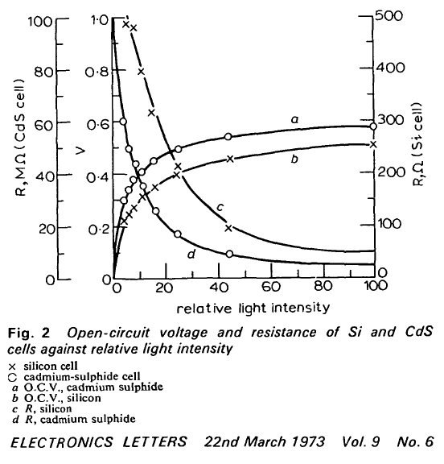

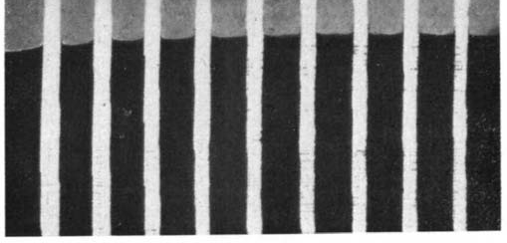

Photovoltaic Junctions formed on Silk-screened Cadmium – Sulphide layers
Flash back 38 years ago
Fig. 1B 9 CdS-printed cells
I -6 X actual size
“In summary, a photovoltaic junction can be made, based
on a CdS layer which is applied to a substrate of almost any
size by simple techniques such as silk-screening or spraying” .
March 24 2011

Slide 8
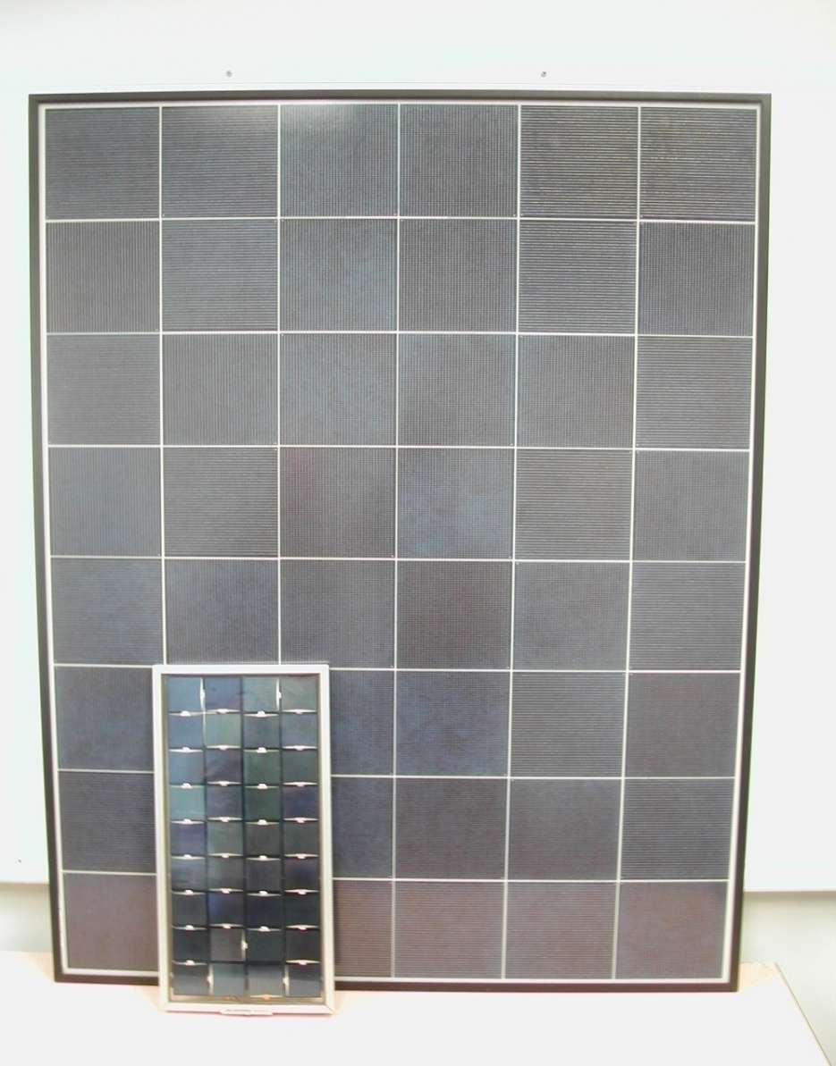
Same material, same technology
35 years time difference
Material Mono Silicon
Module Size : 1000 Sq Cm
Cell size : 5 x 5 cm
Max power : 9.5 W
Efficiency : 9.5 %
Measured on may 2. 2007
2008
Material : Poly Crystalline Silicon
Module Size : 13000 Sq Cm
Cell size : 15.6 x 15.6 Cm
Max power : 180 Watts
Efficiency : 14 %
March 24 2011

Slide 9
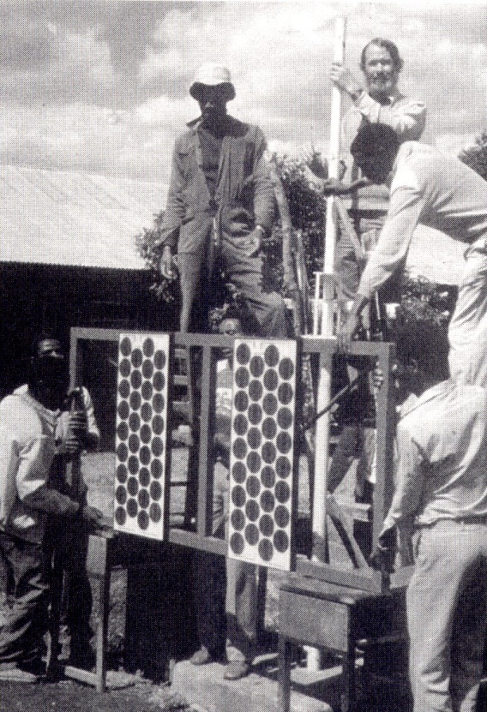
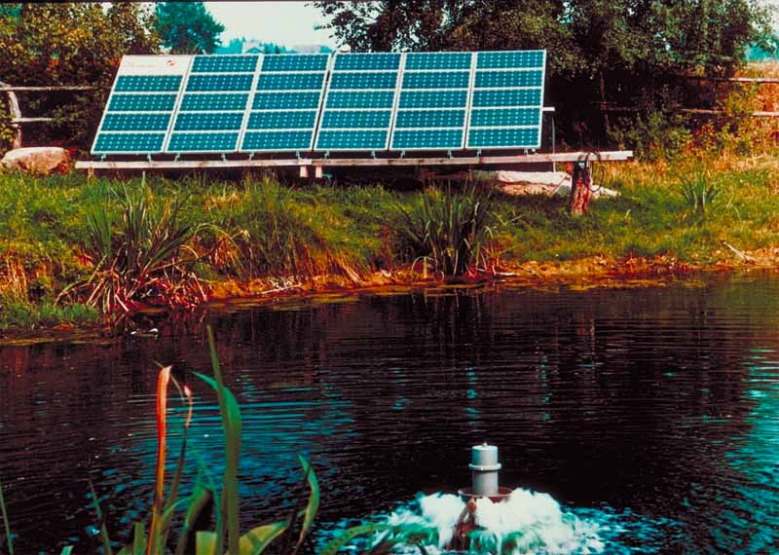
The first major terrestrial PV market was
off – grid in developing countries
March 24 2011

Slide 10

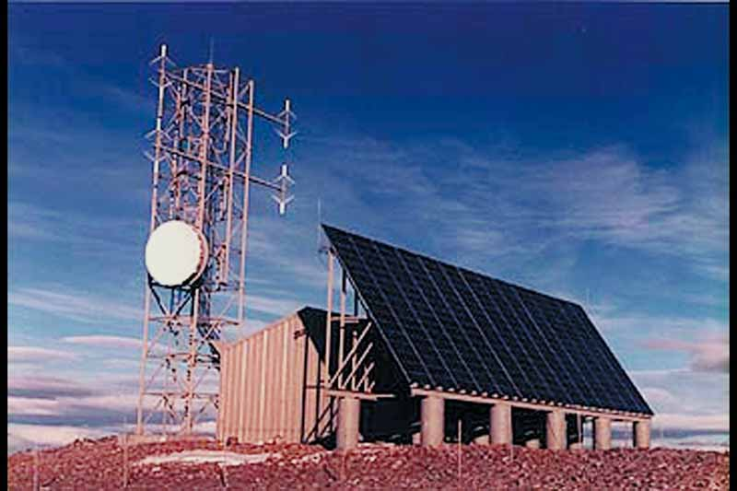
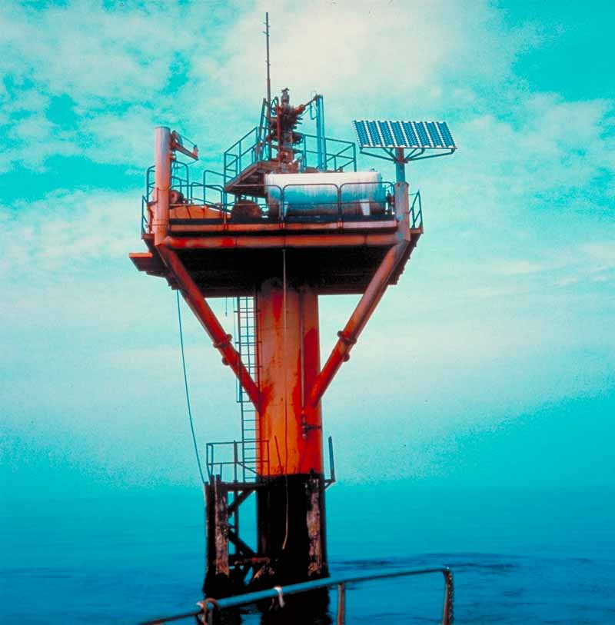
Then came off-grid in the developed world
March 24 2011

Slide 11
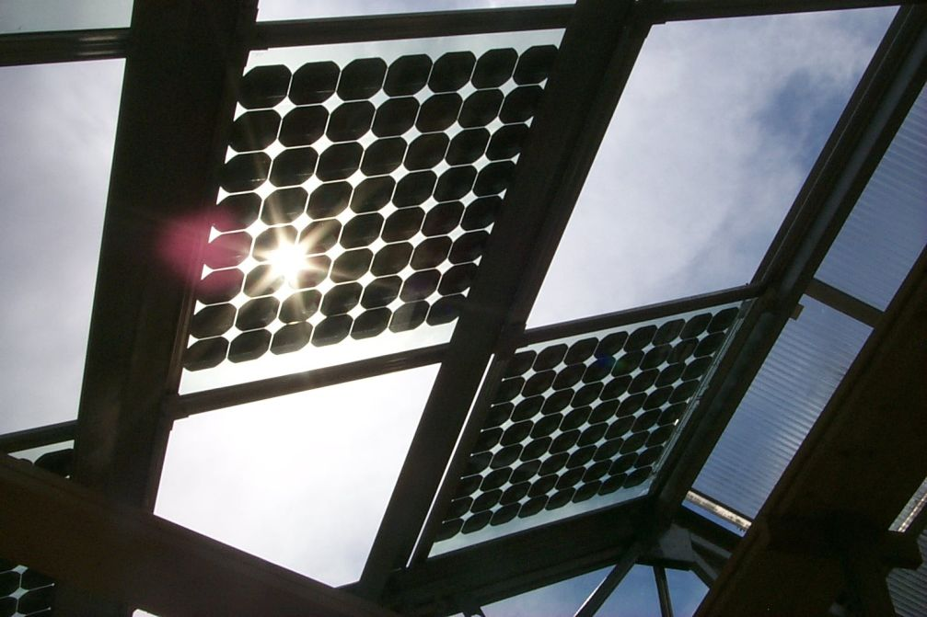
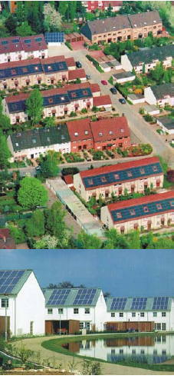
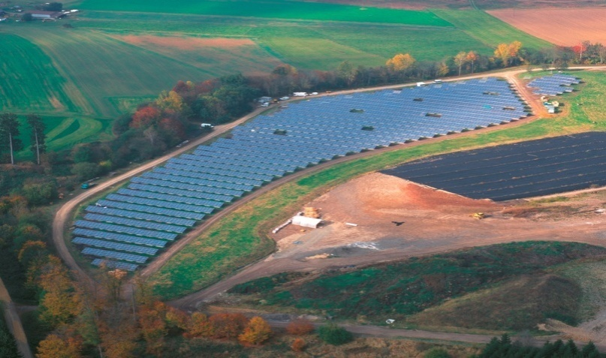
Then sometimes in the 90’s, the developed world began to catch on, and the modern era of grid-tie PV was born
BIPV
Re s
i
de
n
t
i
a
l
Power plant
March 24 2011

Slide 12
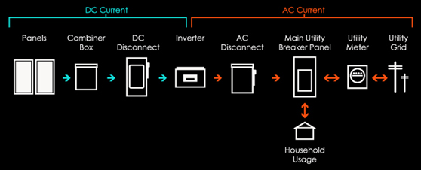
GRID TIE COMPONENTS
March 24 2011

Slide 13
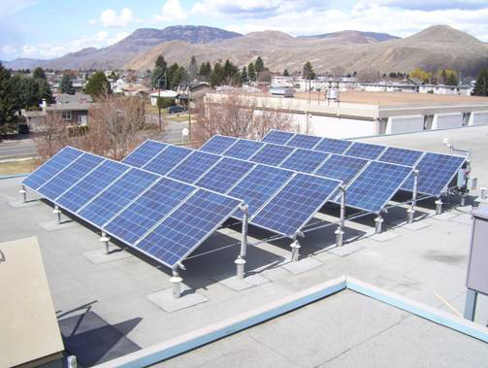
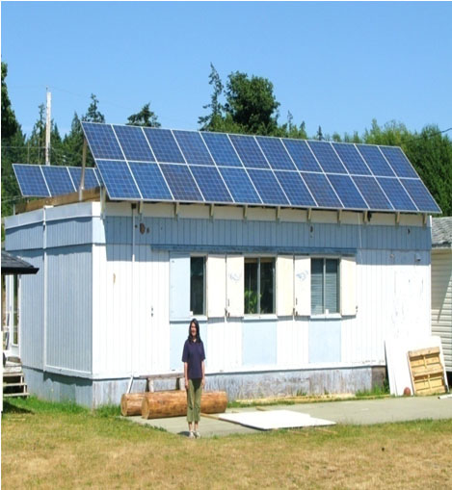
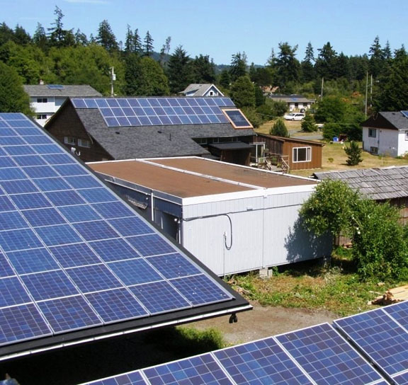
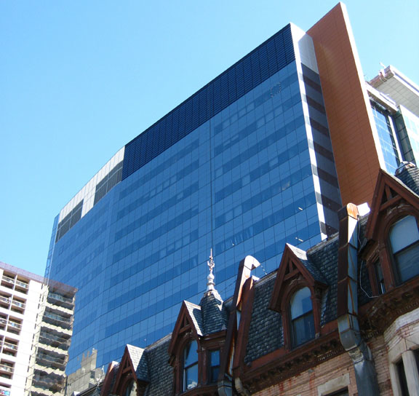
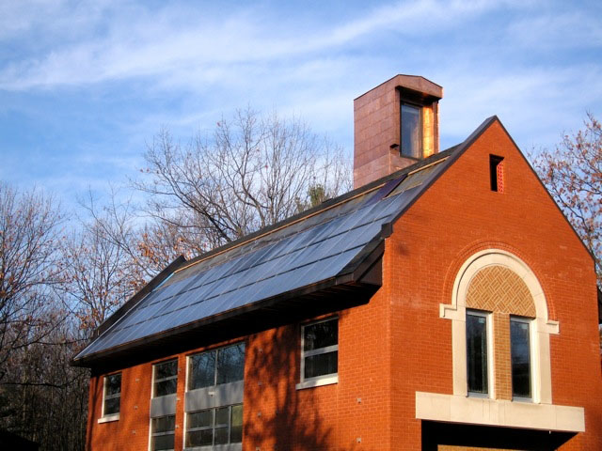
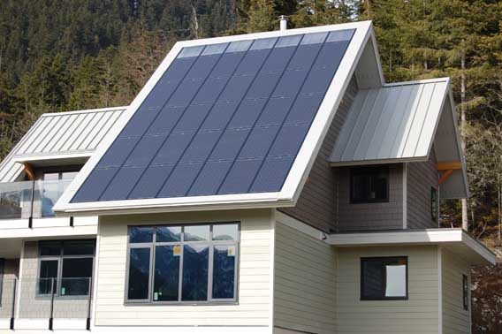
Examples of PV systems in buildings
March 24 2011

Slide 14
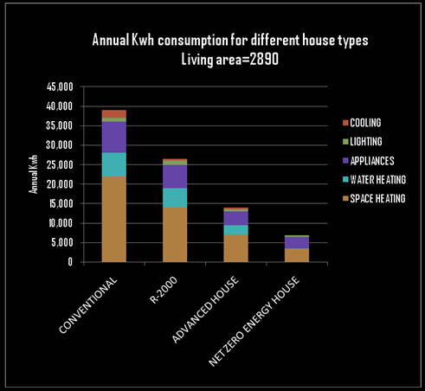
NET ZERO ENERGY CONCEPT
Net Zero Energy Buildings are highly energy efficient buildings that use renewable energy to produce at least as much energy as they consume over the course of a year. The strategy to achieving net zero energy is to begin with a highly-insulated, well-sealed building envelope. Highly energy efficient heating and cooling systems, lighting and appliances are then incorporated creating a net zero energy ready building with over 80% reduction in annual energy consumption compared to conventional buildings.
March 24 2011

Slide 15
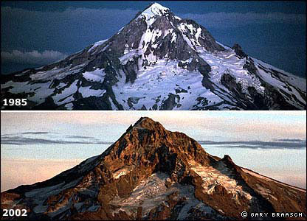
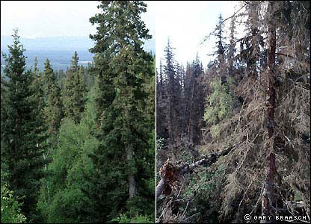
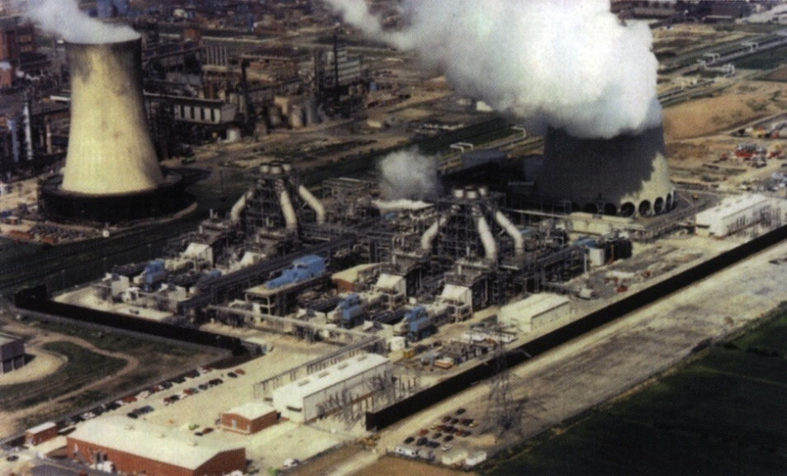
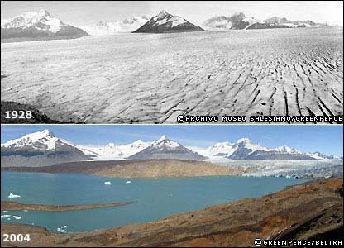
New challenge in 21st Century
No more snow
More pest invading due to warmer temperatures
More pollution
More pollution
Glaciers disappearing
March 24 2011
Glaciers disappearing

Slide 16
The Rise of the Phoenix
Item Last Rise Current Rise
Period 70s & 80s 2000
Poly Supply Semi Supply Chain Own Supply Chain
Projects Pilot, off grid Commercial Grid Tie
Technology C – Si C-Si / TF
Project size 10s of KW Multiples of MW
Module price $30 -15 /W $ 1.6-2.30/W
Market Place Developing countries Industrial world
Financing Government PPA/Gov
Mandates None Utilities, Federal
Manufacturing base Limited, Wide Spread
Leading countries US/Japan/Eu China/Japan/Eu/US
Production Capacity 100s of KW GW
Oil price Over $10/Barrel Over $100 /Barrel
Environment Awareness Serious Concern
March 24 2011

Slide 17
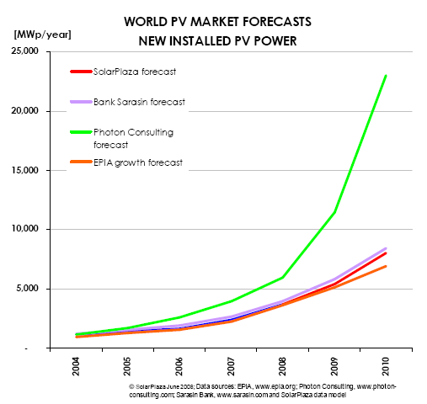
March 24 2011

Slide 18
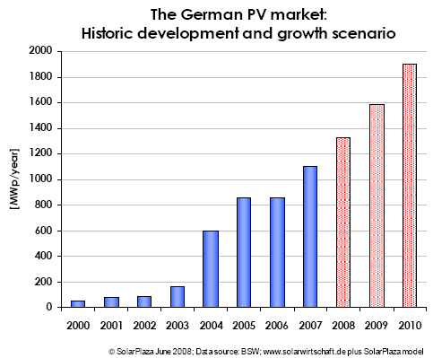
Europe leads the Market
The Magic of Feed-in-Tariff (FIT)
For every kilowatt hour produced by a solar power system, the
energy company pays a cost-covering fee. The fee is fixed over a
long period and is reduced every year by a certain percentage for
the new comers.
: 0.64 – 0.79 $/KWh
2008: 0.60 – 0.74 $/KWh
(Contract period : 20 Years)
Europe leads the Market
The Magic of Feed-in-Tariff (F)
March 24 2011

Slide 19
Ontario’s FIT and MicroFit program
March 24 2011

Slide 20

Thank you
March 24 2011

Slide 21
March 24 2011

Slide 22
March 24 2011

Slide 23
March 24 2011

