Slide 1
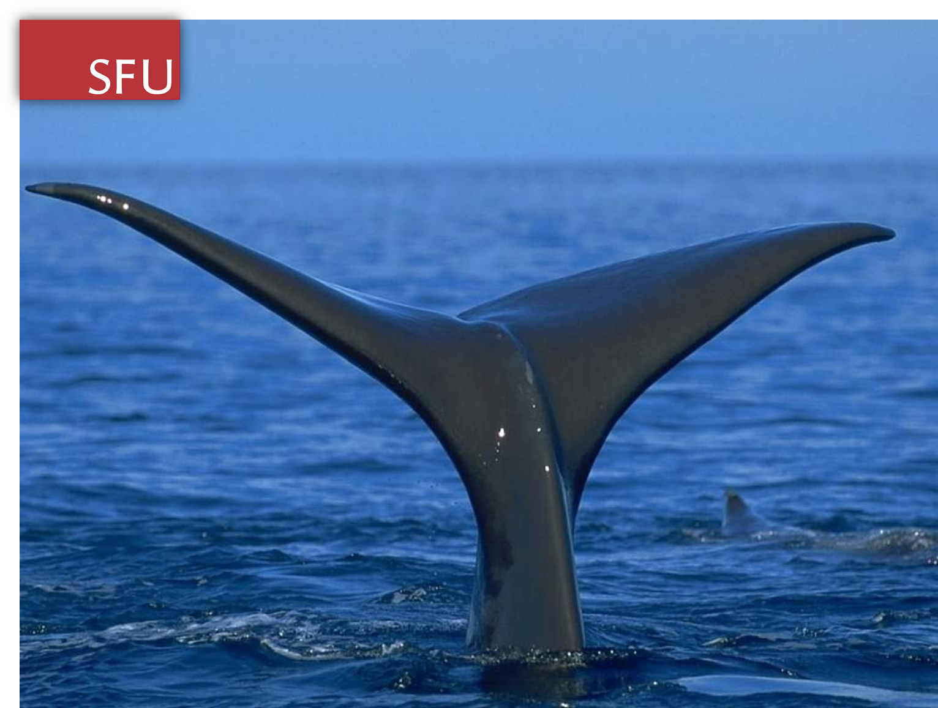

Slide 2
Functional properties of myoglobins from five whale species with different diving capacities
Signe Helbo and Angela Fago Department of Bioscience, Aarhus University, 8000 Aarhus C, Denmark
Sample Presentation
Rodrigo Solis Sosa

Slide 3
INTRODUCTION
Rodrigo Solis Sosa

Slide 4
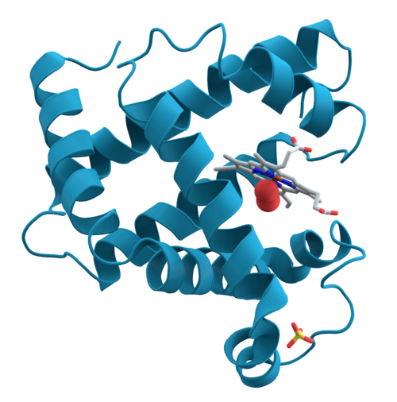
Myoglobin (Mb)
INTRODUCTION
Oxygen binding protein found within striated muscle
↑ concentration of Mb α longer anoxia periods
Has peroxidase and nitrite reductase activities

Slide 5
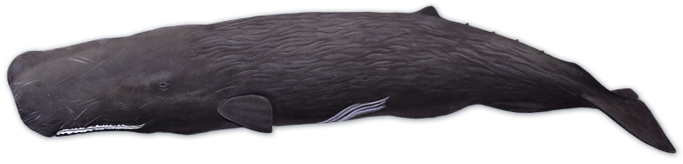
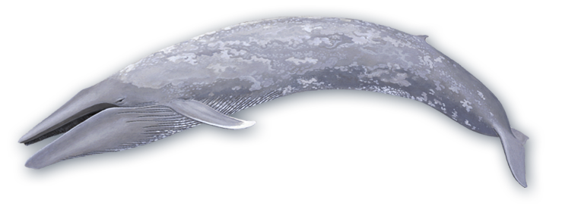
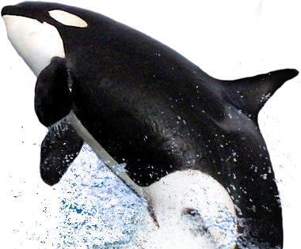
Whales
INTRODUCTION
Kingdom: Animalia
Phylum: Chordata
Class: Mammalia
Subclass: Eutheria
Order: Cetacea
Kingdom: Animalia
Phylum: Chordata
Class: Mammalia
Subclass: Eutheria
Order: Cetacea

Slide 6
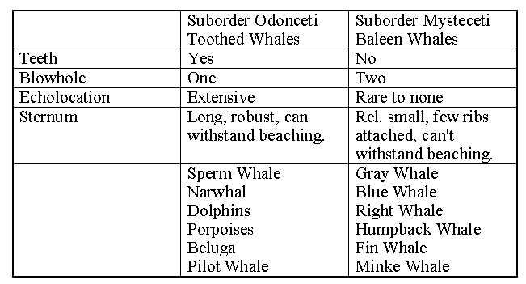
Whales
INTRODUCTION
Modified from Washington State University, BIOL331 course, 2010

Slide 7
Previous works
INTRODUCTION
Toothed whales are more adapted to long time (up to 2 h) high depth (up to 2,000 m) dives than Baleen whales*
Two main adaptations:
Increased O2 storage capacity in Muscle (Mb) **
defense against Reactive Oxygen Species (e.g. H2O2) at reoxygenation***
*Ponganis, 2010; ** Butler and Jones, 1997 ;***Cantu & Medellin, 2011

Slide 8
Setting the stage
INTRODUCTION
Previous hypothesis:
If the length of aerobic dives on whales depends on the Mb concentration then, the a whale with double Mb Concentration will have last twice as much

Slide 9
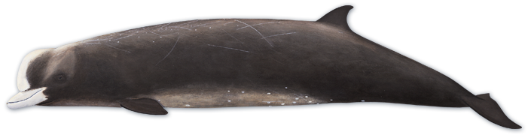
Setting the stage
INTRODUCTION
But:
The beaked whale, among other extreme divers, lasts twice as much would be expected from its Mb Concentration

Slide 10
Setting the stage
INTRODUCTION
So:
Something else must determine the different whales’ diving lengths

Slide 11
Objective
INTRODUCTION
To determine if Mb’s peroxidase and nitrite reductase activities are correlated with the different whale’s diving lengths.

Slide 12
Hypothesis
INTRODUCTION
The nitrate reductase and peroxidase activities of the Mb are correlated with the whales diving length

Slide 13
METHODS
Rodrigo Solis Sosa

Slide 14

Samples
METHODS
Humpback whale HW
(Megaptera novaeangliae)
Arctic minke whale MW
(Balaenoptera acutorostrata)
Mysticetes
(Baleen)
Sperm whale SW
(Physeter macrocephalus)
Harbor porpoise HP
(Phocoena phocoena)
Bottlenose whale BNW
(Hyperoodon ampullatus)
Odontocetes
(Toothed)

Slide 15
METHODS
Purification
Mb Concentration
Muscle from Baleen Whale
MW, HW
Fast protein liquid chromatography gel filtration
Lit review (toothed) and spectrophotometry (baleen)
O2 Equilibria
(Affinity)
O2 Binding curves through diffusion chamber
O2 binding rates analyzed through rapid-scanning stopped-flow spectrophotometer
O2 Dissociation Kinetics
Muscle from Toothed Whale
BNW, HP, SW
Spectrophotometric measurement of anaerobic nitrite reaction
H2O2 added to Mb and decrease in absorbance was measured overtime
Nitrite Reduction
Lit review of diving length and depth of different whales
Peroxidase activity
Dive Duration & Depth

Slide 16
METHODS
Least-square linear regression
Mb Concentration
Mb Concentration
O2 Equilibria
(Affinity)
O2 Equilibria
(Affinity)
O2 Dissociation Kinetics
O2 Dissociation Kinetics
Nitrite Reduction
Nitrite Reduction
Peroxidase activity
Peroxidase activity
Dive Duration & Depth
Dive Duration & Length

Slide 17
Least-square linear regression
METHODS
Mb Concentration
O2 Equilibria
(Affinity)
O2 Dissociation Kinetics
Nitrite Reduction
Peroxidase activity
Dive Duration & Length
Mb Concentration
O2 Dissociation Kinetics
Peroxidase activity
O2 Equilibria
(Affinity)
Nitrite Reduction
Dive Duration & Depth

Slide 18
Least-square linear regression
METHODS
Mb Concentration
O2 Equilibria
(Affinity)
O2 Dissociation Kinetics
Nitrite Reduction
Peroxidase activity
Dive Duration & Length
Mb Concentration
O2 Dissociation Kinetics
Peroxidase activity
O2 Equilibria
(Affinity)
Nitrite Reduction
Dive Duration & Length

Slide 19
Least-square linear regression
METHODS
Mb Concentration
O2 Equilibria
(Affinity)
O2 Dissociation Kinetics
Nitrite Reduction
Peroxidase activity
Dive Duration & Length
Mb Concentration
O2 Dissociation Kinetics
Peroxidase activity
O2 Equilibria
(Affinity)
Nitrite Reduction
Dive Depth

Slide 20
Least-square linear regression
METHODS
Mb Concentration
O2 Equilibria
(Affinity)
O2 Dissociation Kinetics
Nitrite Reduction
Peroxidase activity
Dive Duration & Length
Mb Concentration
O2 Dissociation Kinetics
Peroxidase activity
O2 Equilibria
(Affinity)
Nitrite Reduction
Dive Duration & Depth

Slide 21
RESULTS

Slide 22
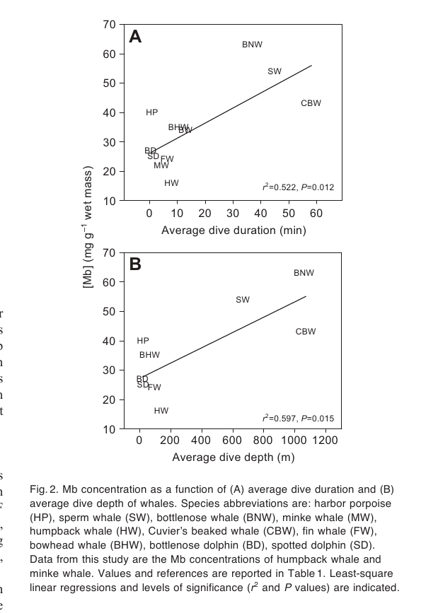
Positive Correlation
RESULTS

Slide 23
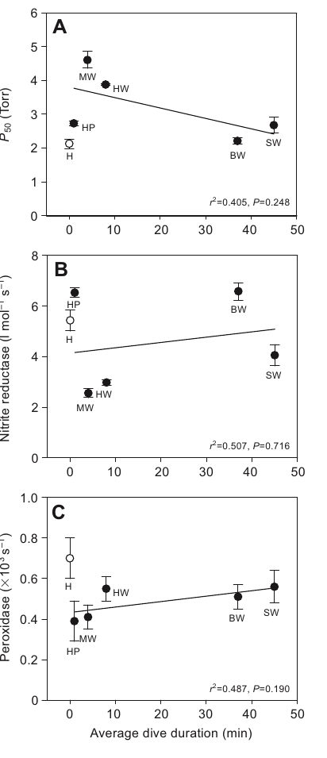
No significance
RESULTS
Peroxidase activity
Nitrite activity
Oxygen affinity

Slide 24
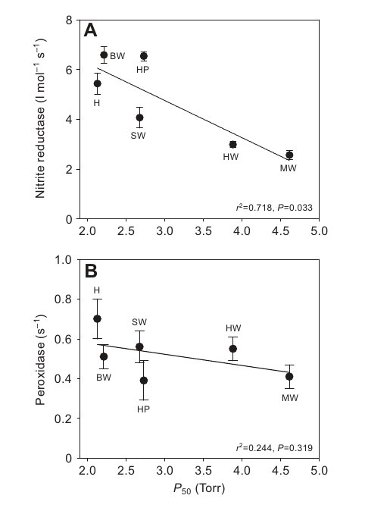
No significance
RESULTS
Positive correlation
Peroxidaseacivity
Nitrite Reductase activity
Notes:
A Mb that works in low O2 environments has a higher nitrate reductase activity of converting nitrite into NO

Slide 25
DISCUSSION

Slide 26
About the findings
DISCUSSION
The minor differences found among different Mb’s reactivities:
Not enough to contribute to the average dive length
Correlation O2 affinity a nitrite reductase activity
Peroxidase activity is not correlated with diving nor with O2 affinity
Other enzymes with a more specific peroxidase and catalase activity than Mb may be of greater importance in the detoxification against H2O2.

Slide 27
Correlation between Mb O2 affinity and nitrite reductase activity
DISCUSSION
Adaptive in Hypoxia-tolerant animals by:
Facilitate O2 diffusion at low PO2
Increase the rate of NO generated from nitrite, slowing down mitochondrial respiration
These differences would not account for a significant difference on different whales….

Slide 28
Other things to take in count:
DISCUSSION
Mb Concentrations
Body size and metabolic rate
Predation Vs Foraging

Slide 29
In a Nut Shell
DISCUSSION
some variation exists among whale Mbs in O2 binding, nitrite reductase activity and rate of reaction with H2O2, but this variation is not correlated with average dive duration.
Average dive duration and depth significantly correlate with Mb muscle concentration in whales
It appears that differences in Mb concentration rather than differences in specific functional reactivities may contribute to dive performance in whales.

Slide 30
Q&A

Slide 31
Regarding the samples, what info is missing that could generate a bias on the data?

Slide 32
A crystallography applied to the different Mbs, would find any explanation for the diving behaviours?, yes?, no?, why?

