Slide 1
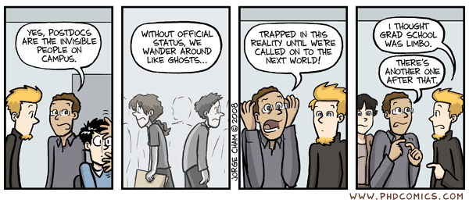
Authorship and Journal Choice
Sandra Gillespie (postdoc)

Slide 2
Authorship Basics
Why is it important?
  Scientific papers are the major currency of academia
  Important for academic grants, scholarships, jobs
  Can show skills and abilities in non-academic context
    Medical school applications
    Industry

Slide 3
What does it mean to be an author?
Authorship means that you contributed to the research presented in a “meaningful way”
PNAS:"authorship should be limited to those who have contributed substantially to the work”
What does “substantially mean????”

Slide 4
What does “substantially mean????”
Could the paper have been done without x’s involvement?
Has x provided intellectual input?
Can x explain the paper if asked to?
Is x willing to take responsibility (as well as credit) for the results?

Slide 5
What does “substantially mean????”
JCU: each author should do ~3-4 of:
  Concept
  Funding
  Experimental design, pilot studies, and equipment development
  Data collection
  Data analysis
  Writing up

Slide 6
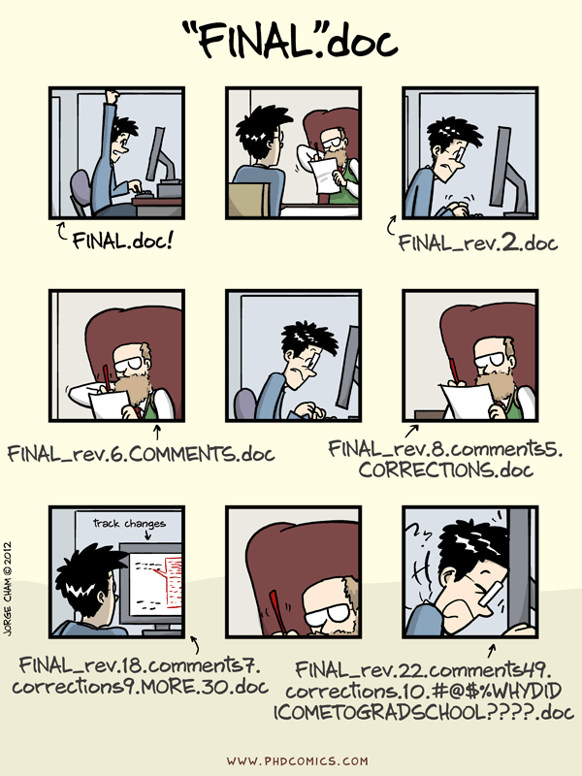
First author provides the greatest contribution and spearheaded the project
- If this paper is part of your thesis, this should be you
Last author – 2 schools:
1. The senior author/lab leader, or
2. The least important author
“Middle” authors
  Level of contribution
  Alphabetical

Slide 7
Conflicts in authorship and publishing
Who to include?
  Lab technician?
  Undergrad assistants?
  Lab PI on all papers?
Authorship order?
Almost all conflicts can be avoided through good communication

Slide 8
Avoiding conflicts: some advice
Ask about authorship early on in project conception – at planning stage ideally
  Make people commit to a plan
  Be prepared to compromise
  Stand up for yourself
Almost all conflicts can be avoided through good communication

Slide 9
Avoiding conflicts: some advice
Ask your PI about their policies
  Some PI’s will let students publish solo papers (great for your career)
  Many assume they will be on all of your papers – with good reason – they contribute to many aspects of your thesis
Almost all conflicts can be avoided through good communication

Slide 10
Some examples – Authorship
Authorship for work exchange
  Statistics help
  Unpaid field/lab work

Slide 11
Some examples – Authorship
Single author paper as PhD student

Slide 12
Some examples – Authorship
Authorship order - alphabetical

Slide 13
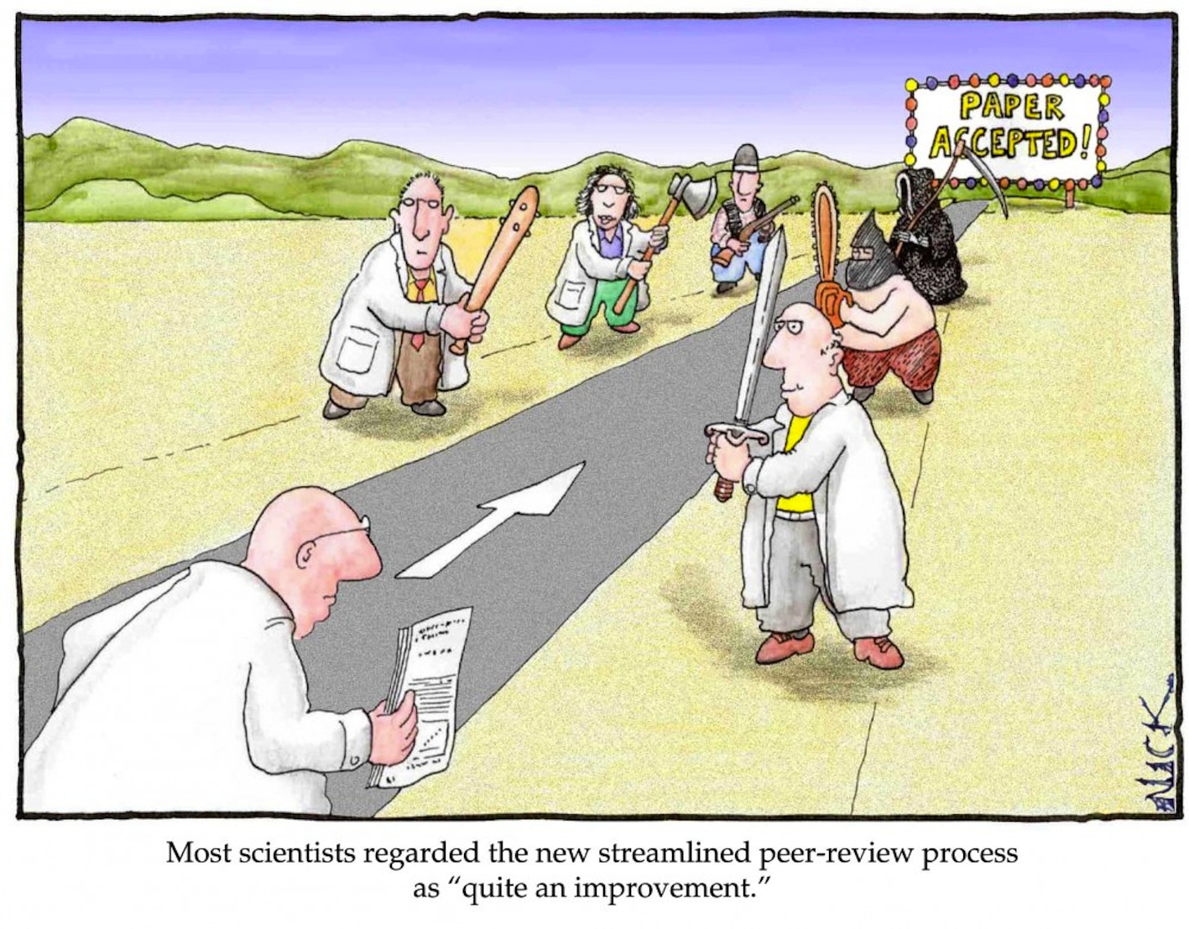
Choosing a Journal
Notes:
supposed to talk about : Which journals to target and why, the pros and cons of open access, online vs. print journal
SFU will *pay* for full page fees for open access journals
Talk about pros/cons of open access

Slide 14
Potential, non-exclusive goals in journal choice:
Maximize exposure to appropriate audience
Maximize impact factor
Get the darn thing published and move on

Slide 15
How can you maximize your research’s exposure?
Publish in open access journals
  SFU will help pay for this!
  But, some open access journals are new, less prestigious
Publish in widely cited, high impact journals
Be aware of ‘within-field’ high impact journals that might technically have a lower IF rating

Slide 16
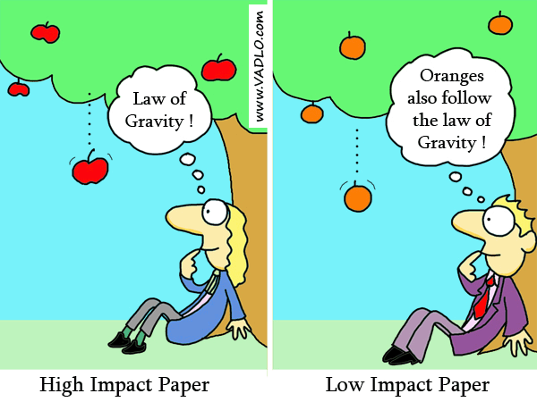
Tips for finding the right journal
Make a short list of 3-5 options – ideally before you do the work!
  What journals are you citing?
  Ask co-authors, colleagues

Slide 17
Tips for finding the right journal
2. Read the journal’s website carefully – does your study match their stated scope and goals?
3. Scan recent issues – does your work match the types of studies published there?
i.e. if your work is observational, do they publish observational work?

Slide 18
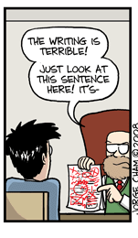
Balance in journal choice:
Consider the different ways you can frame your results
  shift focus to conservation or basic ecology aspects
“Rejection” is often part of the process – don’t fear it!
There are good payoffs to aiming higher than you think your work belongs

Slide 19
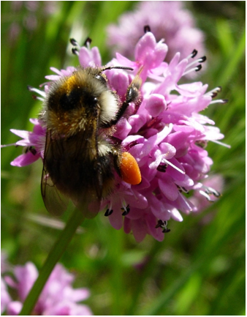
Questions?
Thoughts from other postdocs, senior graduate students?
Cartoons taken from phdcomics.com

