Slide 2
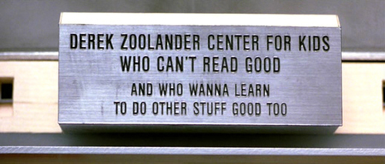
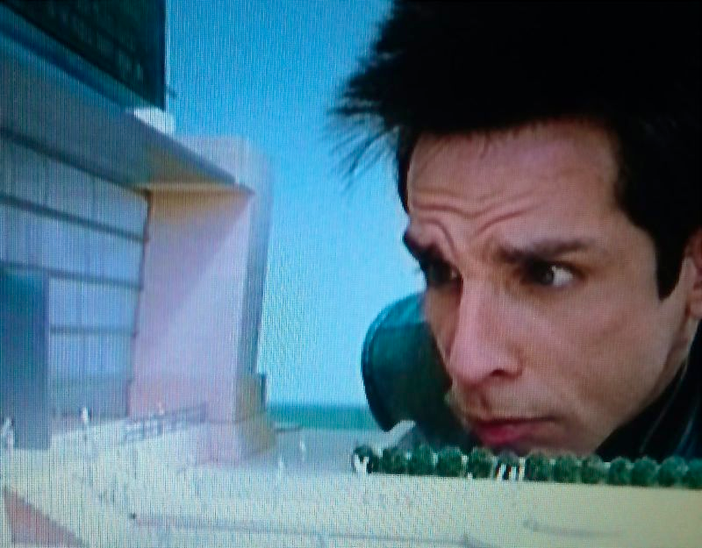
Writing engagingly
@HollyKindsvater
April 11, 2014

Slide 3
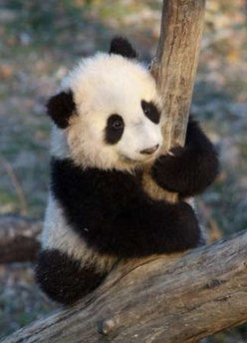
Goals in scientific writing:
  1) Be correct
  2) Be clear
  3) Be engaging
✓
✓
. . .

Slide 4
All scientific writing
Correct
Clearly written
Engaging

Slide 5
Poorly written papers rarely do well in review.
If they are published, they will have a harder time finding an audience – even if the science is GREAT

Slide 6
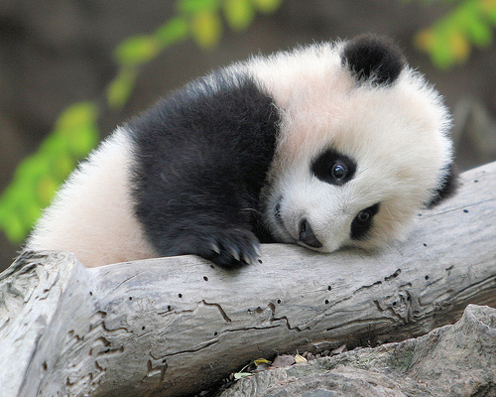
Writing clearly
    READ.
    WRITE. A LOT.
    Notice writing you admire.
    Notice your writing.

Slide 7
Writing myths
  1. Good writers are born
2. Writing non-fiction is easy
3. Good writing is all about grammar (???)
All you have to do is write one true sentence.
Write the truest sentence that you know.
– Earnest Hemingway

Slide 8
But how??
Notes:
THREE STAGES

Slide 9
But how??
Stage I. The first draft
“The first draft of anything is shit”
(Earnest Hemingway)

Slide 10
But how??
Stage I. The shitty first draft

Slide 11
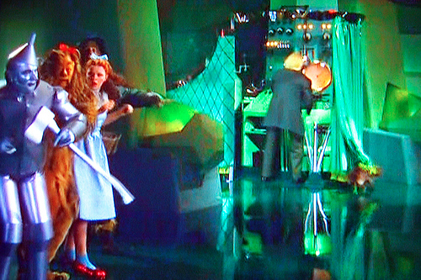
But how??
Stage I. The shitty first draft:
a look behind the curtain

Slide 12
But how??
Stage I. The shitty first draft
Writing as thinking
  Get main ideas/references together
  Figure out the actual reasons for doing the experiment
  Find the thread stitching the story together
Work on the content
  Make a LOT of figures
  Make conceptual figures
  Do this before, during and after data collection/modeling/whatever
Outlining
Synthesis can lead to NOVELTY

Slide 13
Stage II. Improving structure
2-10 revisions of the first draft
  Use “meta-perspective”
  Focus on the paragraphs of the paper. They are the unit of the argument/narrative.
  Intro: review older and recent work, but not exhaustively
  - Clarify motivation, hypotheses
  Discussion: Review the major message of results
  How does it fit (or contradict) hypotheses
  Relate it other recent work – cite others in field, they will be the reviewers

Slide 14
Stage II. Improving structure
2-10 revisions of the first draft
  TIPS:
  Look at topic sentences of every paragraph
  Check transitions (signposts of your argument)
  Use real or hypothetical examples to clarify –
  they build on reader intuition (even in intro)
  Keep your message thread in mind

Slide 15
Stage II. Improving structure
  PLACEHOLDERS:
  “A major problem in evolutionary biology is ….”
  “A central problem in ecology is …”
  Last paragraph of introduction:
  “In this paper our objective was to: 1) X; 2) Y;
  and 3) Z ….”
Write this, then delete the first sentence later
Write this, then cut it out/streamline it later (keeping the structure!)

Slide 16
Stage III. Polishing
My last paper had > 20 drafts
The one before that had 18
  Writing partner (non-specialist is good)
  Lab meeting – pre-review feedback!
  “Micro-perspective” (NOW check grammar)

Slide 17
Stage III. Polishing
  Use active verbs, cite carefully
  “Two studies found X is affected by Y (Cite 1, Cite 2)”

Slide 18
Stage III. Polishing
  Use active verbs, cite carefully
  “Y increases X (Cite 1, Cite 2)”
  Minimize “is”, “may”, “should” or any
  other form of “to be”
    Avoid hollow generalities:
  “is interesting”
  “is a new avenue”
    Sub-clauses rarely improve clarity
    - Nor do commas, nor semi-colons
  Grammar guidelines are made to be [intentionally] broken

Slide 19
November 2013 (Kindsvater & Otto manuscript draft #9):
Intra-specific variation in maternal investment in offspring size is widespread, yet life-history theory does not clearly predict how maternal traits like female age and size, and ecological processes like competition among juveniles, affect maternal investment by older or larger females.
We investigated these processes in a model of a stage-structured life history in order to ask how changing reproductive value, survival costs of offspring effort, and density-dependent fitness of juveniles affect the evolution of maternal investment in each life stage.

Slide 20
February 2014 (Kindsvater and Otto in review):
Females vary in the size of offspring that they produce, often in a manner that depends on maternal age or stage.
This is puzzling given the view that offspring size should be maximized at a single optimal value where the gain in fitness from being larger exactly offsets fitness lost by producing fewer offspring.
We used a stage-structured life-history model to determine the optimal offspring size for females in different stages.

Slide 21
Robustness seems to be the opposite of evolvability. If phenotypes are robust against mutation, we might expect that a population will have difficulty adapting to an environmental change, as several studies have suggested¹⁻⁴. However, other studies contend that robust organisms are more adaptable⁵⁻⁸. A quantitative understanding of the relationship between robustness and evolvability will help resolve these conflicting reports and will clarify outstanding problems in molecular and experimental evolution, evolutionary developmental biology and protein engineering.
- Draghi et al. (2010) Nature 463, 353-355

Slide 22
Robustness seems to be the opposite of evolvability. If phenotypes are robust against mutation, we might expect that a population will have difficulty adapting to an environmental change, as several studies have suggested¹⁻⁴. However, other studies contend that robust organisms are more adaptable⁵⁻⁸. A quantitative understanding of the relationship between robustness and evolvability will help resolve these conflicting reports and will clarify outstanding problems in molecular and experimental evolution, evolutionary developmental biology and protein engineering.
- Draghi et al. (2010) Nature 463, 353-355

Slide 23
It has not escaped our notice that the specific pairing we have postulated immediately suggests a possible copying mechanism for the genetic material.
- Watson and Crick (1953) Nature 171, 737-738
Second-to-last sentence (and paragraph!)

Slide 24
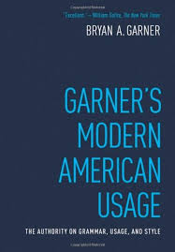
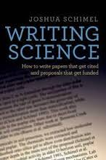

What’s the bottom line?
Writing clearly and with intention takes time,
but it makes life easier in review
(& improves the science).
Notes:
Tip: don’t do it at the last minute!

Slide 25
Publicizing your paper / your work
Academic / Professional
audience
Science
media
Social media

Slide 26
Scientific audience:
your (silent) academic network
Includes:
Reviewers & future reviewers (grants too)
Journal editors
People working in the same field (readers)
  - citers and citees
  (citation is great publicity)

Slide 27
How do you cultivate your scientific network if you don’t know who they are?
Talks/posters at conferences
Workshops
Meet seminar speakers
Tell people what you’re working on – eventually they will remember your name
Professional website (online CV)
Google Scholar profile
Notes:
Also these are reciprocal relationships – WHAT GOES AROUND COMES AROUND – SO TRY TO TAKE THE HIGH ROAD
IT SHOULD GO WITHOUT SAYING BUT – BE PROFESSIONAL – AND YOU DON’T NEED THE BIG NAMES NECESSARILY – YOUR PEERS AND THOSE SLIGHTLY AHEAD OF YOU WILL BE YOUR EVENTUAL NETWORK -

Slide 28
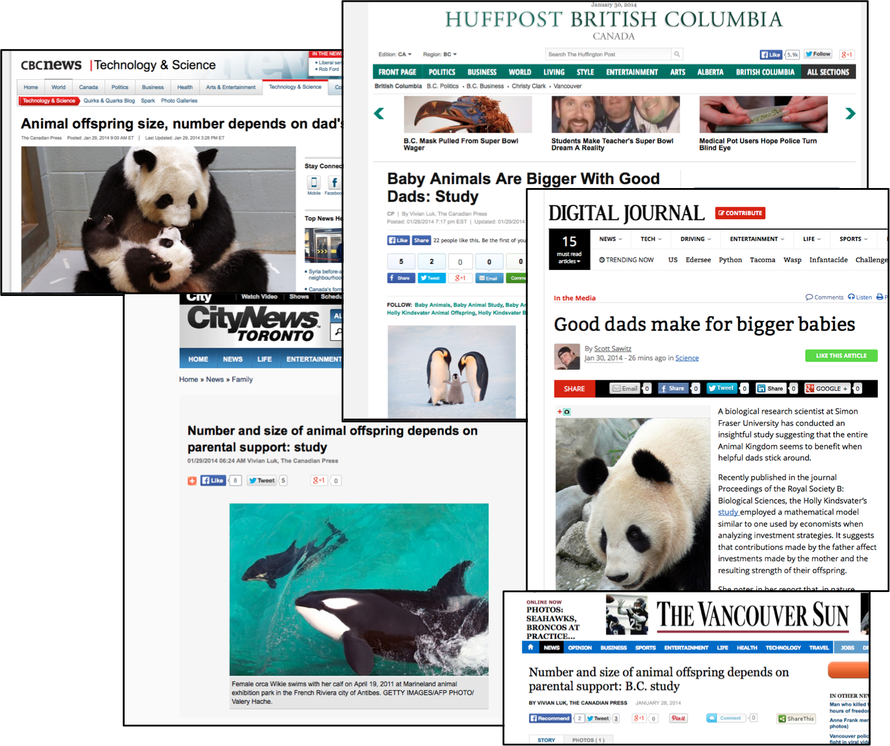
Science media
How does a paper get mainstream media publicity ?

Slide 29
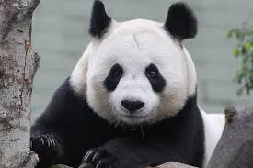
Science media
100 word “media summary” for Proc B
Science Media Centre of Canada
½ hour interview w me + email followup
Van. Sun
article + others (cbc.ca)
SMCC newsletter writeup
Interview with Canadian Press
wire service
=

Slide 30
Science media
100 word “media summary” for Proc B
Science Media Centre of Canada
½ hour interview w me + email followup
Van. Sun
article + others (cbc.ca)
SMCC newsletter writeup
Interview with Canadian Press
wire service
=

Slide 31
Science media

Slide 32
Science media
Science Media Centre of Canada
    lis.ostiguy@sciencemedia.ca
2. University Press Office (press releases)
- Carol Thorbes (SFU) cthorbes@sfu.ca
3. Local Science Writers
@AnneCasselman
@VivianLuk
4. ScienceOnline/NatGeo/Discover #scioX #scicomm, @carlzimmer, @edyong209

Slide 33
Social media
An ever-increasing amount of scientific discourse takes place online
Blogs, tweets, reddit, data repositories, git, and pre-print archives/open access options
are the future
Twitter is great for #meetings, news, & promoting the work of friends

Slide 34
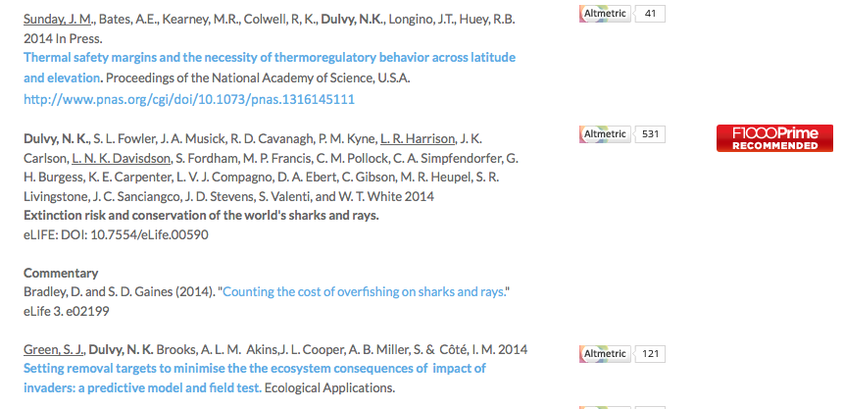
Social media
Altmetrics – measure your impact beyond citations
Dulvy.com:

Slide 35
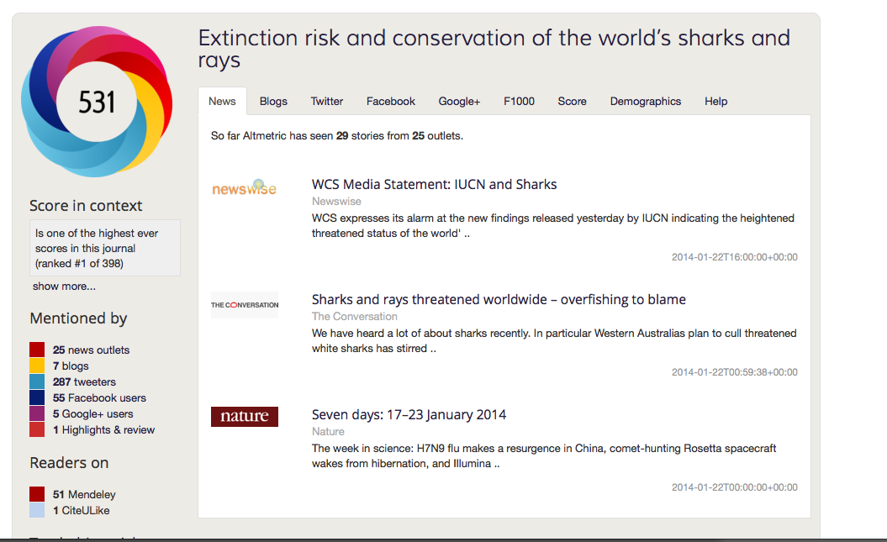
Social media
Altmetrics – measure your impact beyond citations
Dulvy.com:

Slide 36
Social media: growing daily
Altmetrics – measures your impact beyond citations
- ImpactStory – like Altmetrics, but for researchers
- ORCID – “Scholar” for researchers with common names (or name changes)
- DRYAD – open access data repository – now mandatory for many journals (PLOSOne, Evolution)

Slide 37
Github
arXive, PeerJ

