Slide 1
Games in Education and Health
IAT 842: The Theory and Design of Games

Slide 2
Serious Play
What is it?
Raph Koster: play is pattern recognition
James Gee: games can reflect good principles of learning
Gee: Semiotic Domains…any set of practices which recruit one or more modalities to convey meaning
Lloyd Rieber: Microworlds
Learning by doing: de Castell & Jenson

Slide 3
Contextual Learning
Learning IS the play
Rieber, Malone et al: Endogenous vs. Exogenous design
De Castell and Jenson:
Encouraged to develop skills quickly
Not held back
Not pedantic or evaluative
Permit trial and error progression

Slide 4
Fostering Engagement
New media literacies and attentional economies
Rieber/Kafai: Children are as good at playing games and being engaged with them as they are at designing them.
E.g. Workshop with kids: Learning through game design

Slide 5
Design Workshop (WWKD)

Slide 6
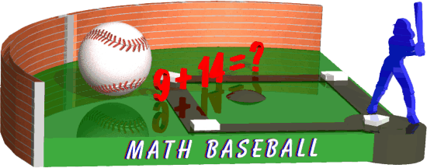
So What’s Out There? The Bad…
Get the question correct and you hit the ball—wow!

Slide 7
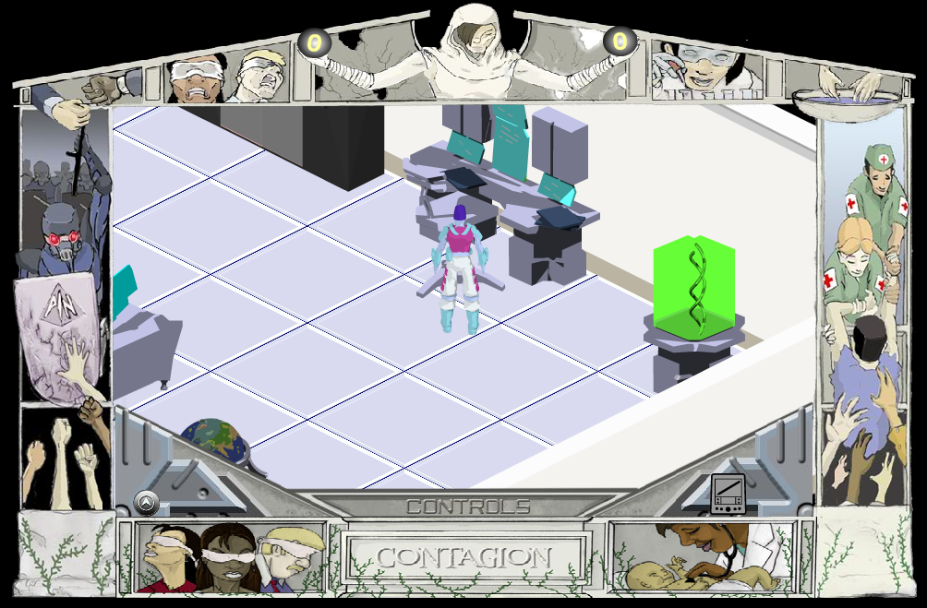
So What’s Out There? The Not So Bad?

Slide 8
So What’s the Difference?
Dissolution of the notion of ‘learning outcomes’
‘outcomes’ per se are embodied in the play process
Play design which STEMS from content rather than MAPPING content.
What is it that already makes content ‘playable’ and how do we take advantage of that as designers?

Slide 9
fin

