Slide 1
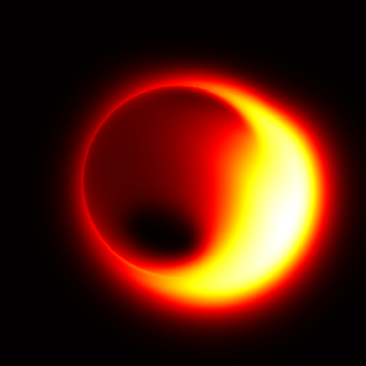

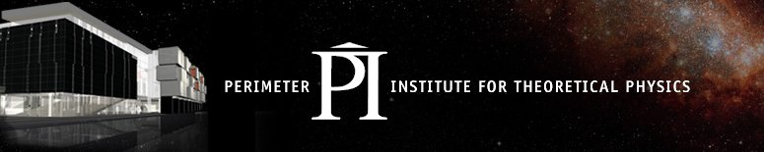
Near Horizon Effects
Avery E. Broderick
EHT Collaboration
Sheperd Doeleman (MIT Haystack)
Vincent Fish (MIT Haystack)
Alan Rogers (MIT Haystack)
Ru-Sen Lu (MPIfR)
Michael D Johnson (CfA)
Dimitrios Psaltis (Arizona)
Tim Johannsen (UW-PI-CITA)
Avi Loeb (Harvard)
Carlos Wang (UW)
Elizabeth Griffin (UW)

Slide 2
Near Horizon Effects:
How the Event Horizon Telescope is accessing Gravity via direct imaging
Avery E. Broderick
EHT Collaboration
Sheperd Doeleman (MIT Haystack)
Vincent Fish (MIT Haystack)
Alan Rogers (MIT Haystack)
Ru-Sen Lu (MPIfR)
Michael D Johnson (CfA)
Dimitrios Psaltis (Arizona)
Tim Johannsen (UW-PI-CITA)
Avi Loeb (Harvard)
Carlos Wang (UW)
Elizabeth Griffin (UW)

Slide 3
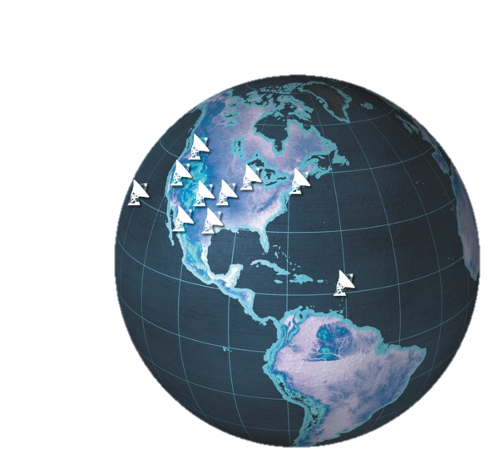
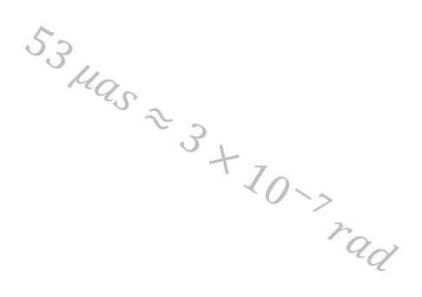
Direct Imaging is
Easier Said than done …
$$53 μas≈3×{10}^{−7} rad$$
Galactic
Center
(Sgr A*)
Very Long Baseline Array

Slide 4

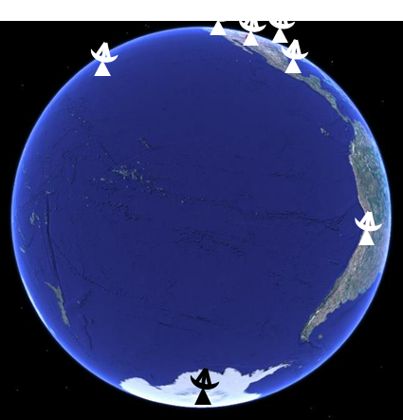
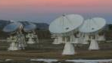
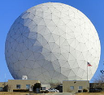
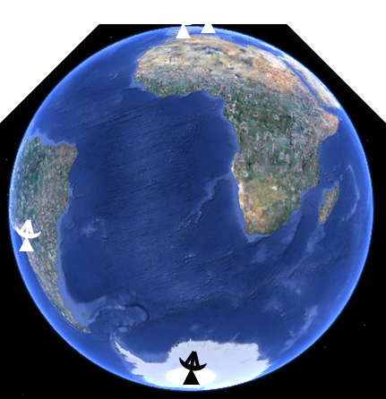
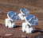
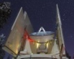
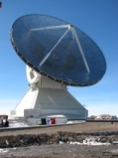



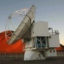
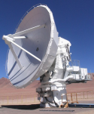
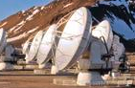
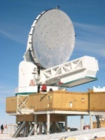



Earth-sized mm VLBI array
Existing telescopes.
Resolutions of $\sim 10 μas$
http://www.eventhorizontelescope.org/
CARMA
Haystack
SMA,
JCMT
ARO-SMT
IRAM 30m
Plateau de Bure
LMT
APEX,
ASTE,
ALMA
APEX,
ASTE,
ALMA
SPT
SPT

Slide 5
Earth-sized mm VLBI array
Existing telescopes.
Resolutions of $\sim 10 μas$
http://www.eventhorizontelescope.org/
CARMA
Haystack
SMA,
JCMT
ARO-SMT
IRAM 30m
Plateau de Bure
LMT
Baselines 3 → 15
Closure phases 1 → 10
SNRs improve x10
Baseline lengths x2
Long EW and NW baseline!
APEX,
ASTE,
ALMA
APEX,
ASTE,
ALMA
SPT
SPT

Slide 6
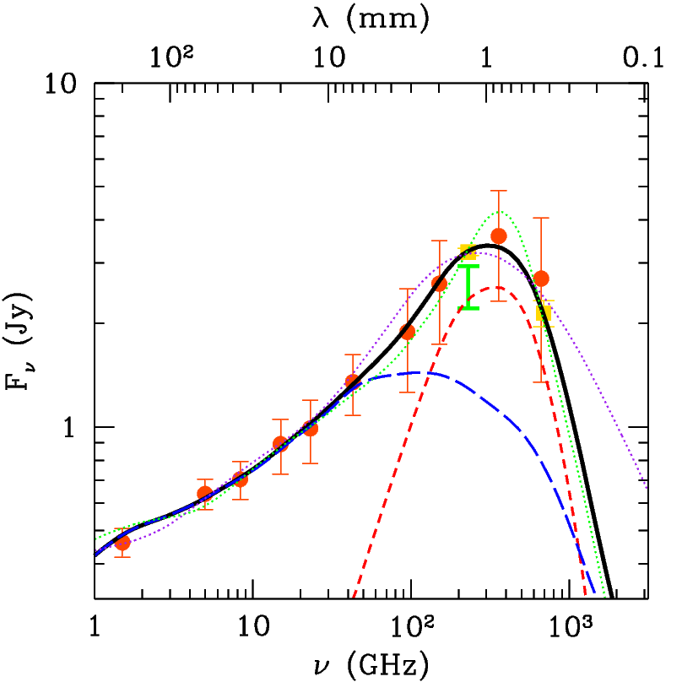
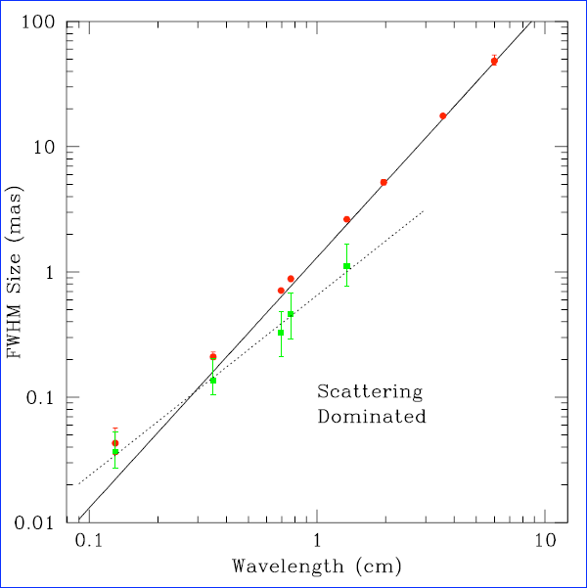
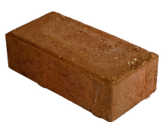

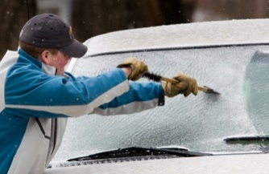
Why millimeter wavelengths?
Absorption in the source!
(Sgr A* & M87)
Scattering in …!
(Only Sgr A*)
Scattering dominated
Optically thick
Optically
thin
Structure dominated
+ applicability of radio techniques!

Slide 7
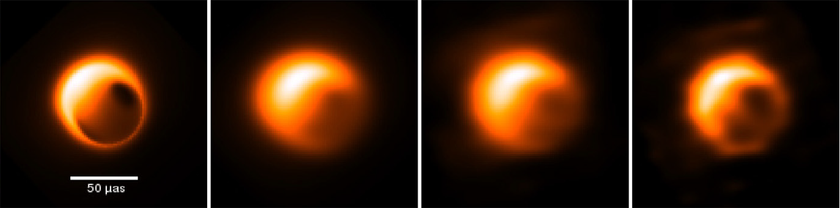
Reconstructing Images of Sgr A* (Disks)
Interstellar electron cattering
BSMEM image reconstruction
Deconvolution of the scattering
Fish et al. (2014)

Slide 8
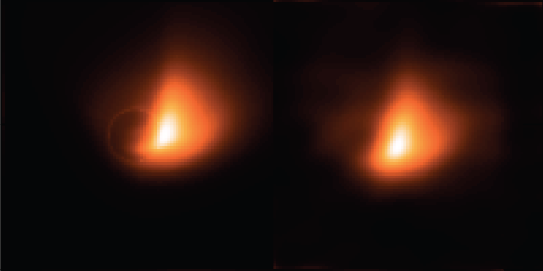
Reconstructing Images of M87 (Jets)
7 stations BSMEM
Lu et al. (2014)

Slide 9
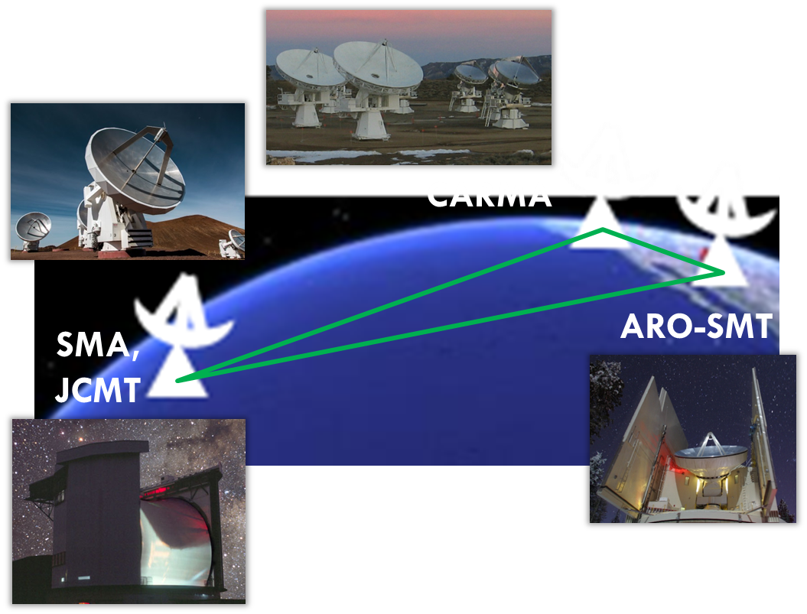
Published: “Proto-EHT”
3 baselines (2 long)
Time ranges from 10s-2yr
Single data type

Slide 10
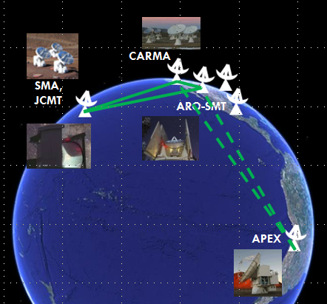
NOW: “Proto-EHT”
5 baselines (4 long)
Time ranges from 10s-7yr
Many data types

Slide 11
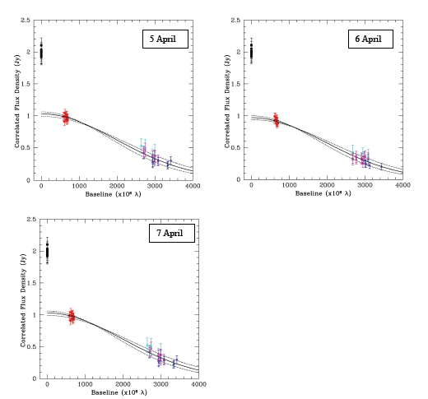
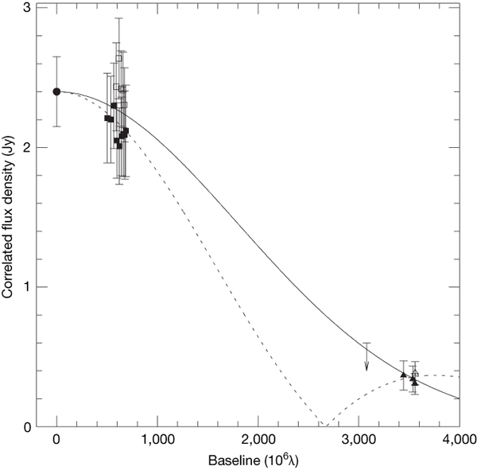
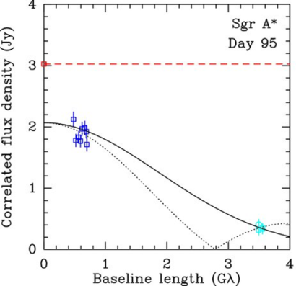
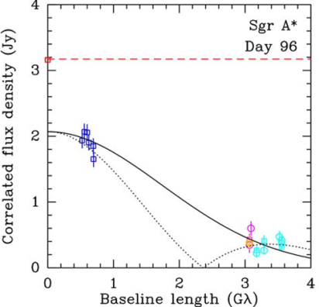
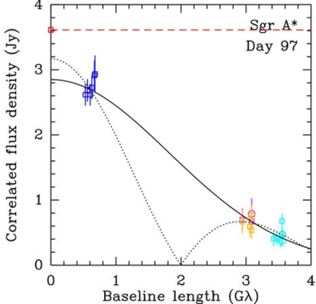





Visibilities
CARMA-SMT
$$1/53μas$$
$$D\sim 37.2±0.5 μas$$
$$P_{ℓ}$$
V (Jy)
CARMA-JCMT
JCMT-SMT
Spatial frequency (${10}^{6}/rad$)
$${10}^{−6}ℓ$$

Slide 12
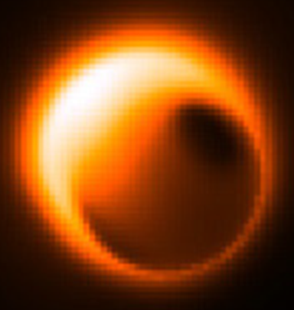
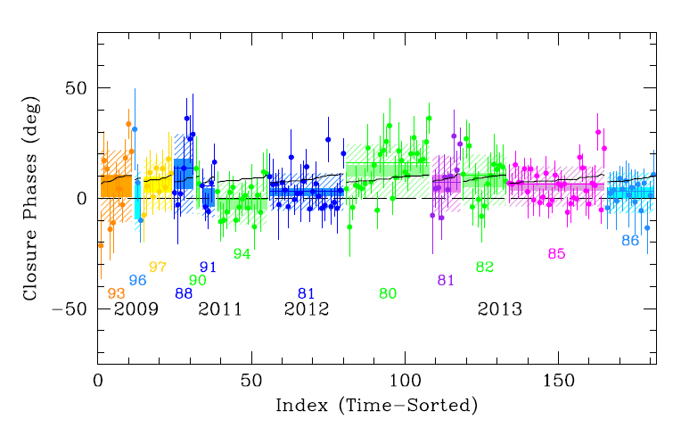
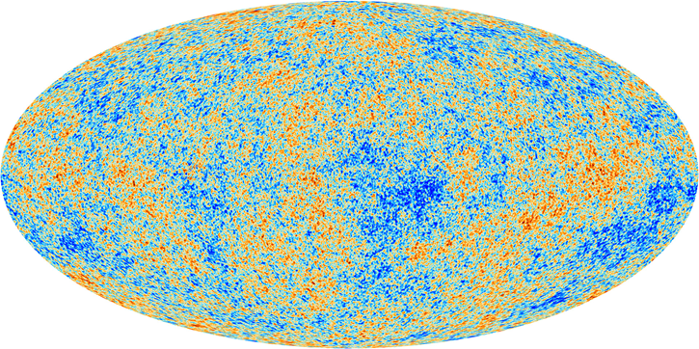
Closure Phases
Overlap with published |V|’s
Statistically significant, net positive CPs!
Ordered Phases
Courtesy of Vincent Fish
& EHT Collaboration
Random Phases

Slide 13
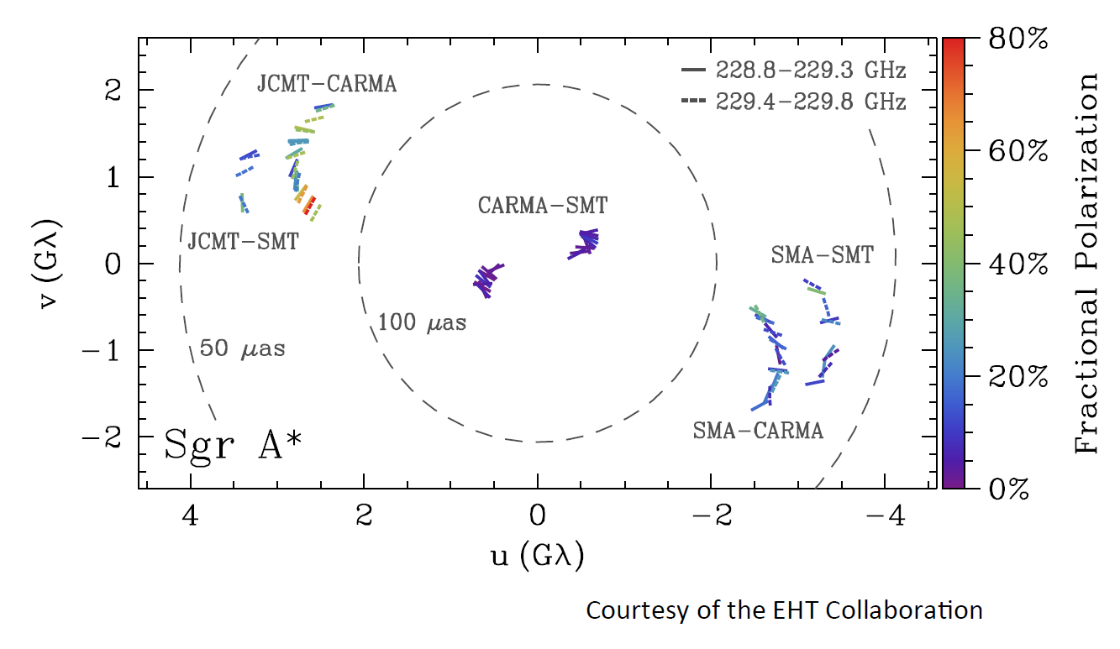

Polarization!
$$\breve{m}=\frac{\tilde{Q}+i\tilde{U}}{\tilde{I}}$$

Slide 14
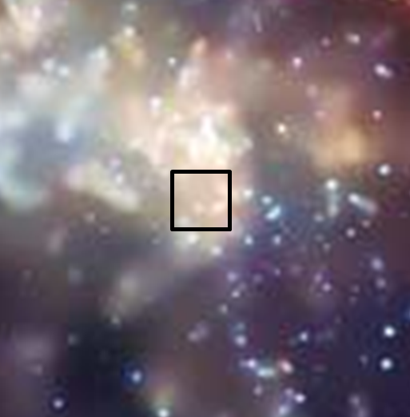
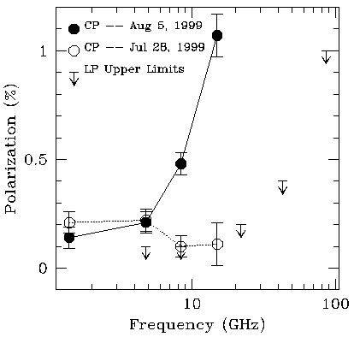
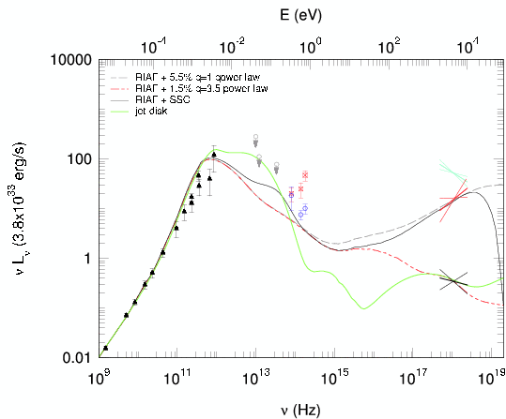
Context

Slide 15
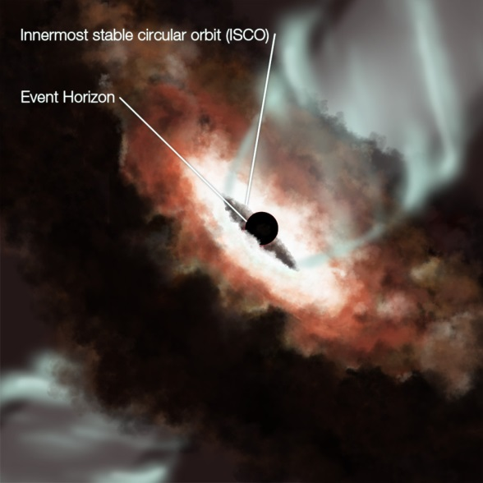
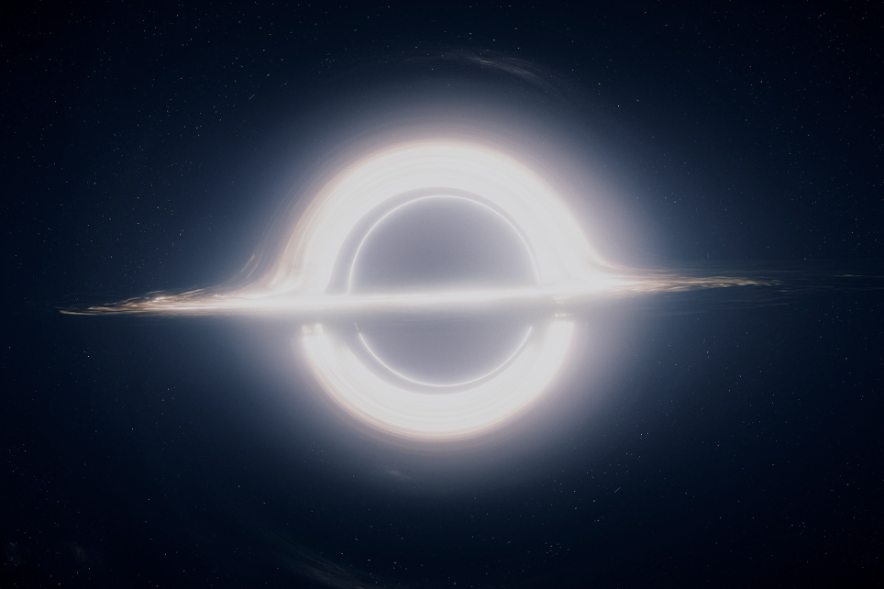
Anatomy of an Image

Slide 16
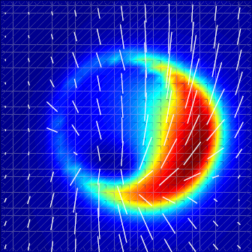
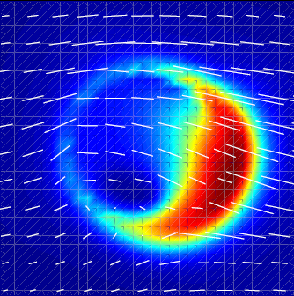
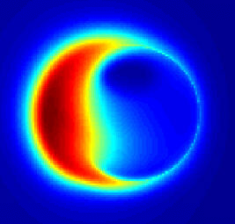
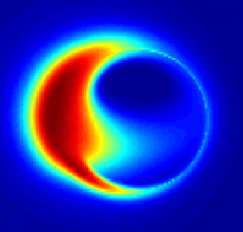
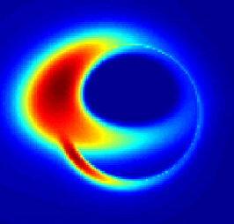
Astrophysical Inputs
Dynamics
Magnetic Fields
Elizabeth Griffin
Thin disk
Thick disk
Carlos Wang
Plasma Distribution

Slide 17
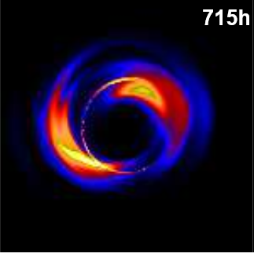
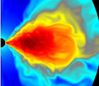
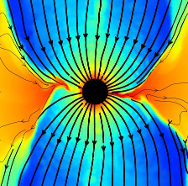
Astrophysical Modeling
Misaligned disk?
J. McKinney
Dexter & Fragile (2013)
Tchekhovskoy et al.
Hot thick disk?
Hot thin disk?

Slide 18
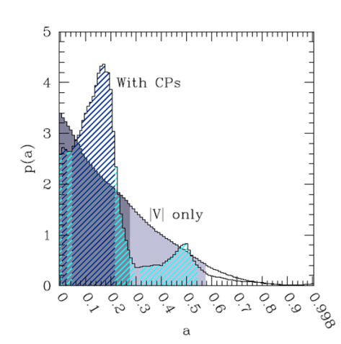
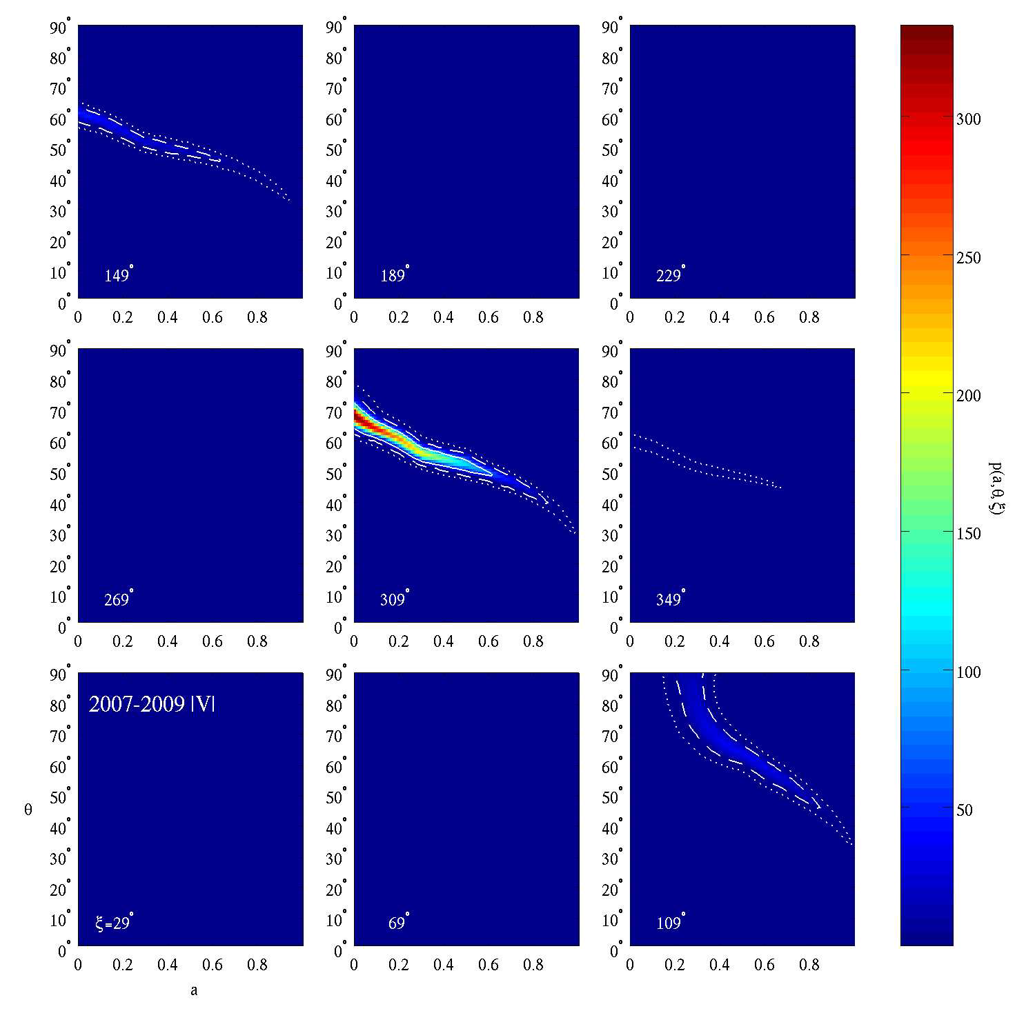
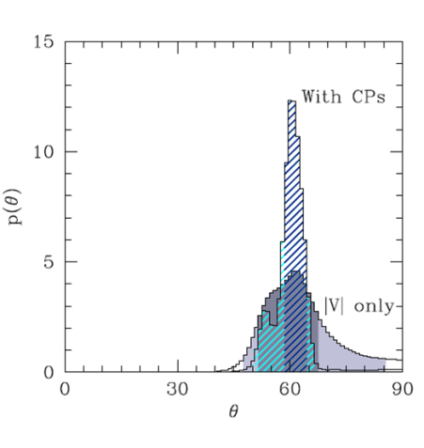
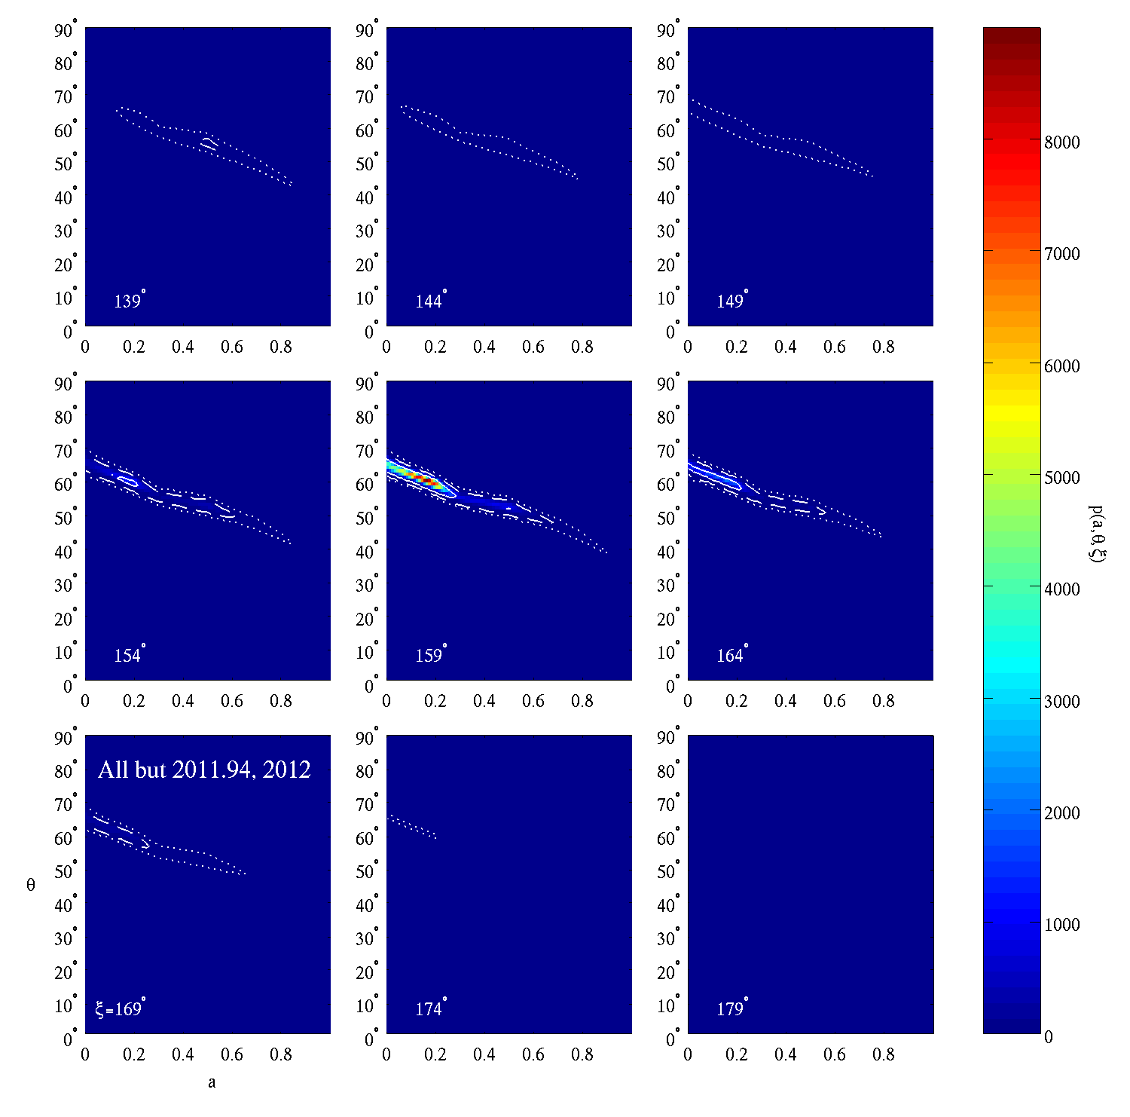
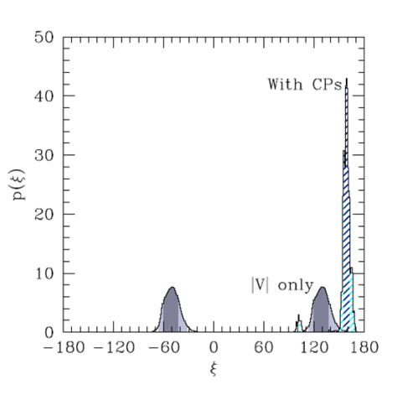
Spin Constraints
Spin Constraints
& Experimental Verification

Slide 19


Building confidence: Testing RIAFs
|V| Data
Closure Phase Data
Broad a priori consistency!
Courtesy of Vincent Fish & EHT Collaboration

Slide 20



Orienting with the Environment: Distribution of Stellar Ang. Mom.
Bartko et al. (2009)
0.3 pc
Young stellar disks in Galactic Center
See Psaltis et al. (2015)
${(90}^{∘}−ξ)$ in radians

Slide 21




Limits on Precession and its causes
Any precession at all
Lense-Thirring precession
Orbiting
S-Stars
Aliasing from 1 yr

Slide 22

Flaring disk features
|V| Data
Closure Phase Data
On Day 94 of 2011
BUT!!
This was expected …
Courtesy of Vincent Fish & EHT Collaboration

Slide 23




Measuring “Mass”
$$M/D^{1.8}$$
$$M/D$$
On horizon scales
On 3000x horizon scales

Slide 24


Measuring “Mass” Now and in the future
+TMT

Slide 25


Constraining monopolE hair
Johannsen (2013)
$$ds^{2}=−\left[1+α_{13}{\left(\frac{M}{r}\right)}^{3}\right]\left(1−\frac{2M}{r}\right)dt^{2}+{\left(1−\frac{2M}{r}\right)}^{−1}dr^{2}+r^{2}dθ^{2}+r^{2}\sin^{2}θ\left[1+α_{13}{\left(\frac{M}{r}\right)}^{3}\right]dφ^{2}$$
+TMT

Slide 26








Quadrupole Hair:
Limits on Quasi-Kerr
$$g_{μν}=g_{μν}^{K}+εh_{μν}$$
$$M=M$$
$$J=aM$$
$$Q=−a^{2}M−εM^{3}$$
Solution to vacuum Einstein equations when $\left|a\right|≪M$
Adds quadrupolar perturbation
(based on Hartle-Thorne metric for slowly spinning neutron stars!)
No-hair theorems → Quasi-Kerr metric must be sick! It is inside $2M$.

Slide 27


Limits on Violations of GR in January ($|V|$ through 2009)
Constant disk inner-edge

Slide 28

Limits on Violations of GR in September (+ CP through 2013)
Constant disk inner-edge

Slide 29

Limits on Violations of GR in single night Next year!
Constant disk inner-edge
1% precision strong-field tests of GR imminent!
ALMA
SPT
LMT

Slide 30
Possibilities for Spacetime Tomography!
|V| Data
Closure Phase Data
On Day 94 of 2011
BUT!!
This was expected …
Courtesy of Vincent Fish & EHT Collaboration

Slide 31





Could this be a hot spot?
YES!
But …

Slide 32



Closure Phase Variability revisited!
φ₁₂
φ₂₃
φ₃₁
Expect ~5x better!
a = 0.9
Hot-spot at ~ 6M
Period = 27 min.
Doeleman, Fish, A.E.B., Loeb & Rogers (2009)

Slide 33






Tracking spots with Polarization
50
25
$$Δy (μas)$$
cf. GRAVITY
0
-25
-50
-50 -25 0 25 50
$$Δx (μas)$$
Johnson et al. (2014)

Slide 34

SummarY
Sub-event horizon structure already detected
in astrophysical black holes
EHT provides a heterogeneous data set, and is part of a
larger constellation of information about EHT sources
While considerable astrophysical uncertainty remains, there are many reasons to believe current accretion models of Sgr A*
Gravity may be tested with the EHT via a number of avenues, sub-percent precision tests of no hair theorems are imminent.

