Slide 1
Gravitational Physics using
Atom Interferometry
Mark Kasevich
Stanford University

Slide 2
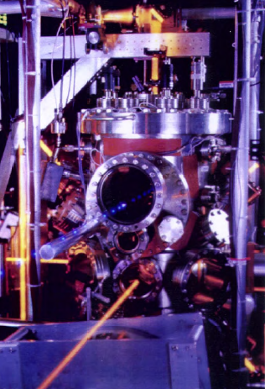
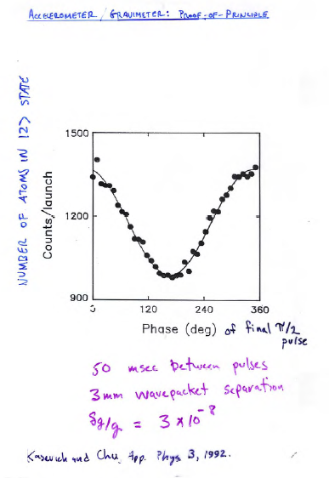
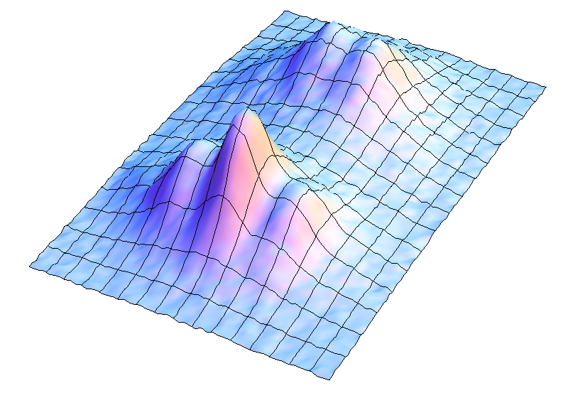
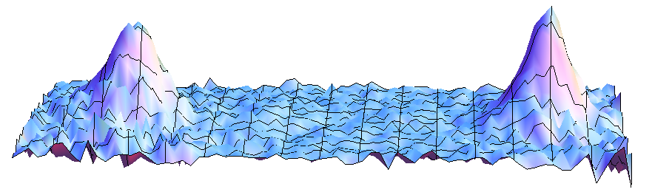
Light-pulse atom interferometers
1991 demonstration of an atom interferometer gravimeter
2015 laboratory sensor, atomic wavepackets separate by 12 cm before interfering, 1e-13 g resolution after 1 hr.
Atoms imaged in middle of interferometer
Interference at output
2

Slide 3
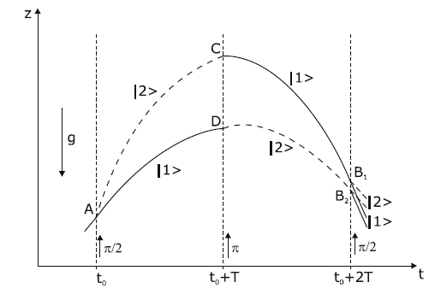
Light-pulse atom interferometry
Three contributions to interferometer phase shift:
Propagation shift:
Laser fields (Raman interaction):
Wavepacket separation at detection:
For example, Bongs, App. Phys. B, 2006; with Gen. Rel., Dimopoulos, PRD, 2008.

Slide 4
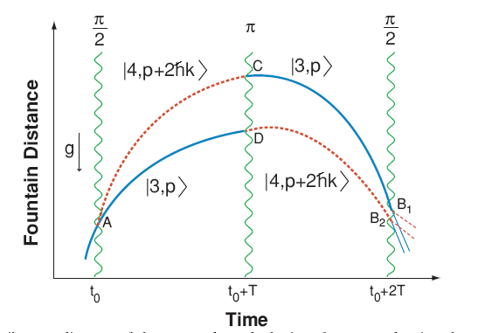
Sensitivity for 10 m wavepacket separation
Quantum limited accelerometer resolution: ~ 7x10⁻²⁰ g
Assumptions:
Wavepackets (Rb) separated by z = 10 m, for T = 1 sec. For 1 g acceleration: Δφ ~ mgzT/h ~ 1.3x10¹¹ rad
Signal-to-noise for read-out: SNR ~ 10⁵:1 per second.
Resolution to changes in g per shot: δg ~ 1/(Δφ SNR) ~ 7x10⁻¹⁷ g
10⁶ seconds data collection

Slide 5
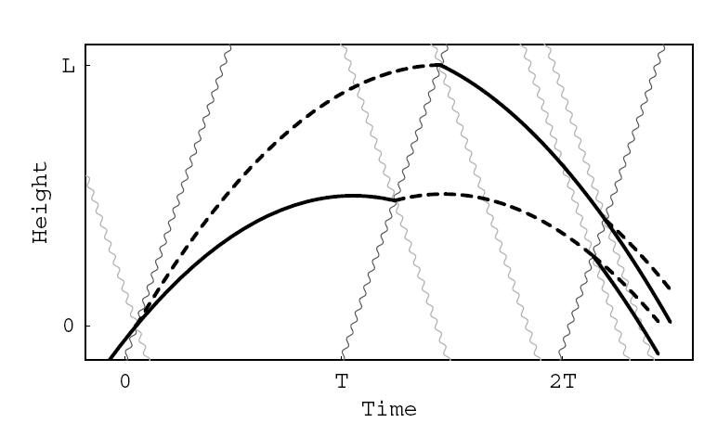
General Relativity/Phase shifts
Light-pulse interferometer phase shifts in GR:
Geodesic propagation for atoms and light.
Path integral formulation to obtain quantum phases.
Atom-field interaction at intersection of laser and atom geodesics.
laser
atom
Atom and photon geodesics
Prior work, de Broglie interferometry: Post-Newtonian effects of gravity on quantum interferometry, Shigeru Wajima, Masumi Kasai, Toshifumi Futamase, Phys. Rev. D, 55, 1997; Bordé, et al.

Slide 6
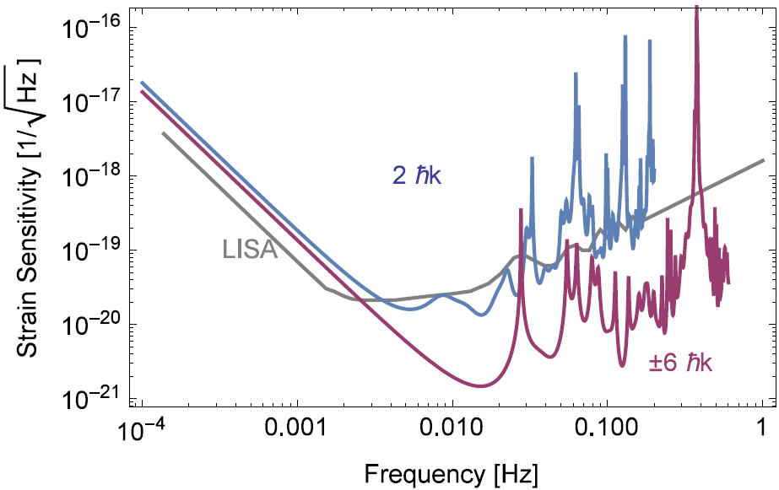
Application to Gravitational Wave Detection
(no angular averaging of antenna orientation)
T = 40 s
4e8 m baseline 2 m separation
P. Graham, et al., arXiv:1206.0818, PRL (2013)
J. Hogan, et al., GRG 43, 7 (2011).

Slide 7
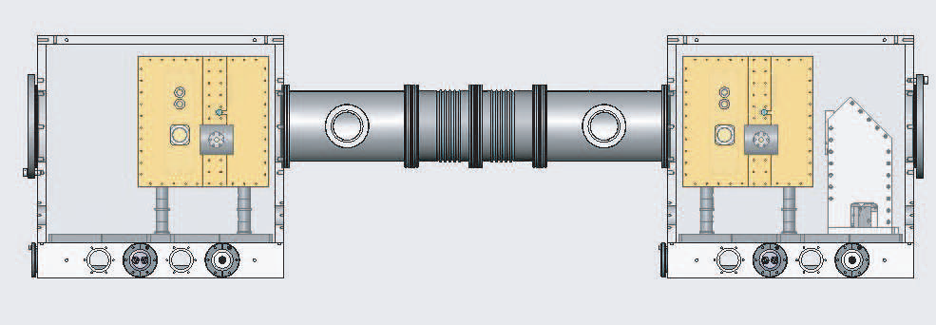
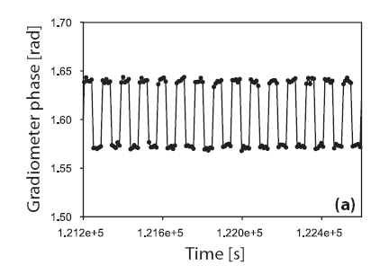
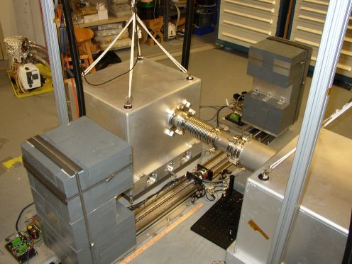
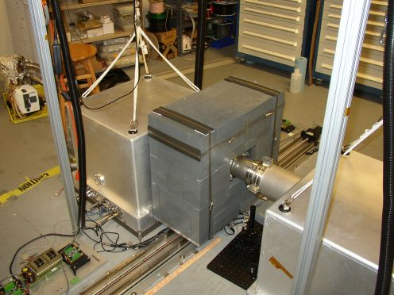
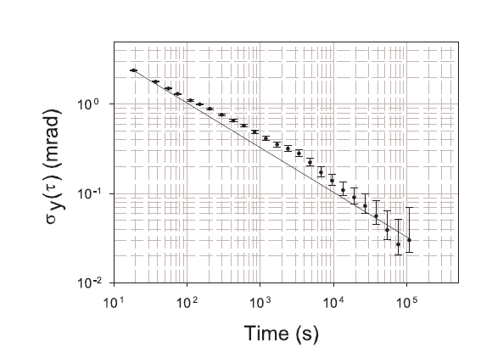
Gravity gradiometer
Gravity gradiometer based on AI.
Used to evaluate system error models (rotation response, laser freq. noise)
Data demonstrating operation of the sensor.
6 generations of instrumentation.

Slide 8
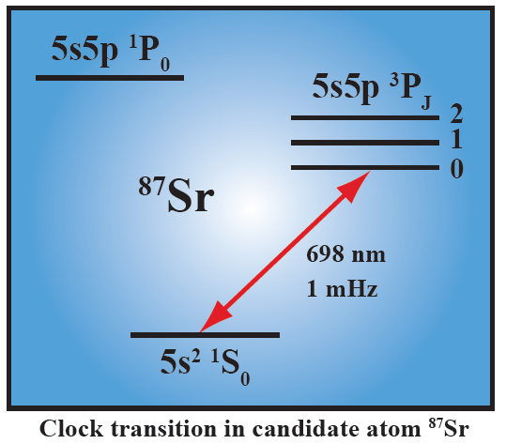
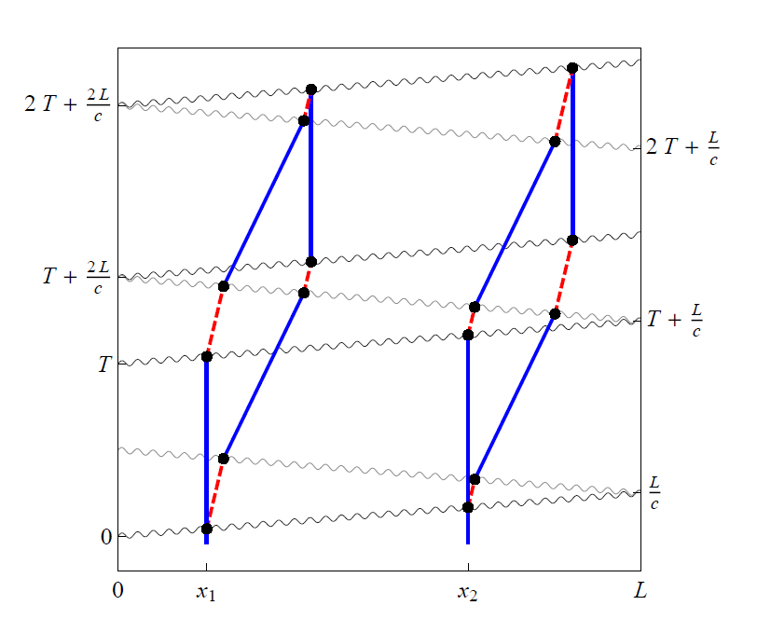
Insensitivity to laser frequency noise
Enables 2 satellite configurations
• Long-lived single photon transitions (e.g. clock transition in Sr, Ca, Yb, Hg, etc.).
• Atoms act as clocks, measuring the light travel time across the baseline.
• GWs modulate the laser ranging distance.
Excited
state
Laser noise is common
Graham, et al., arXiv:1206.0818, PRL (2013)

Slide 9
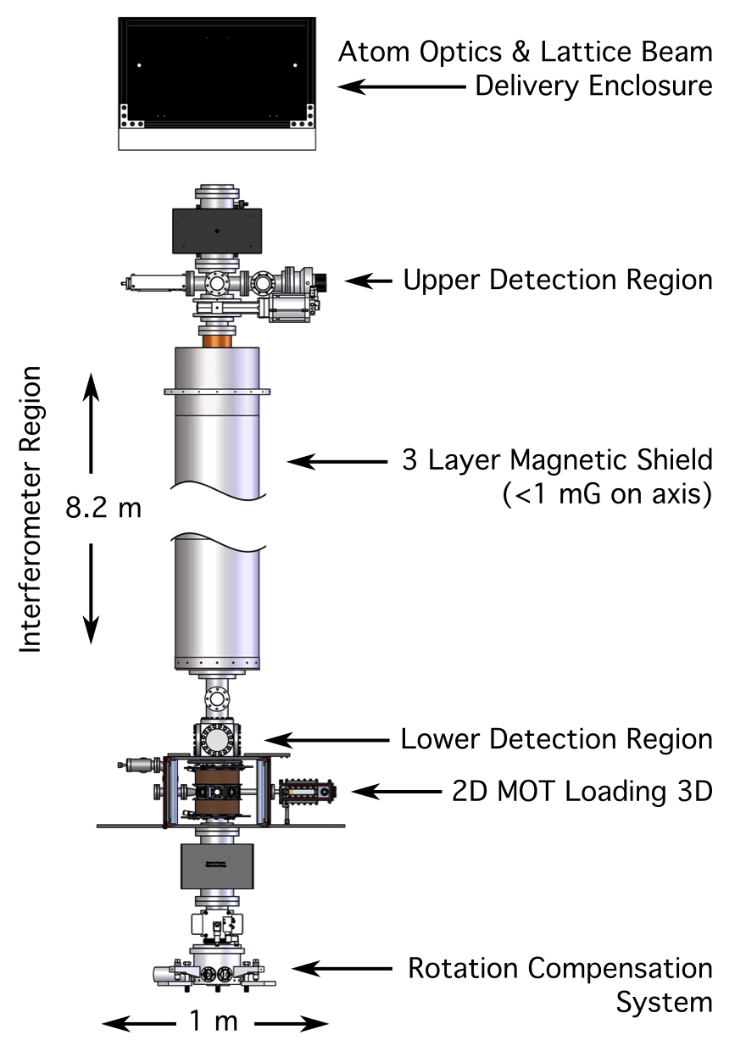
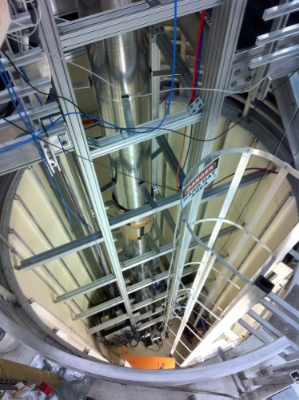
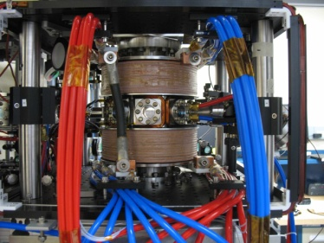
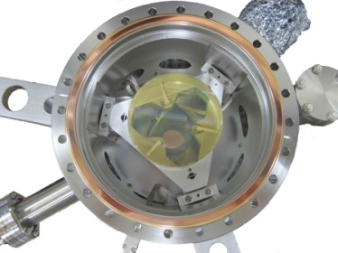
Demonstration apparatus
Ultracold atom source
~ 10⁶ at 1 nK
~ 10⁵ at 50 pK
Optical Lattice Launch
13.1 m/s with 2372 photon recoils to 9 m
Atom Interferometry
2 cm 1/e² radial waist
10 W total power
Dyanamic nrad control of laser angle with precision piezo-actuated stage
Detection
Spatially-resolved fluorescence imaging
Two CCD cameras on perpendicular lines of sight
Working to demonstrate h ~ 3e-19/Hz^{1/2} resolution on ground near 1 Hz.

Slide 10
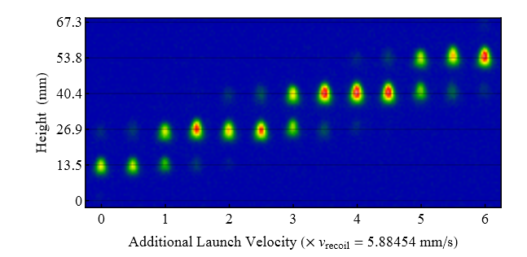
Lattice launch
>2000 photon recoils to launch to top of tower.
Momentum transferred in 2 photon recoil increments.

Slide 11
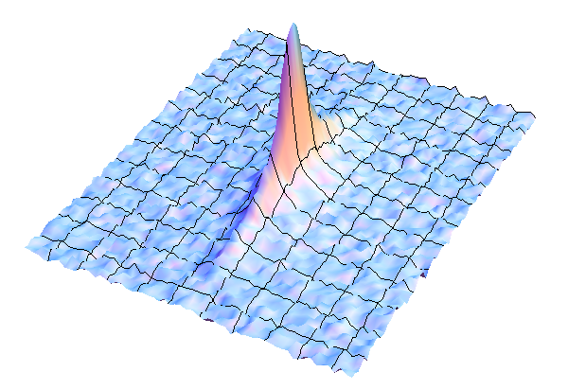
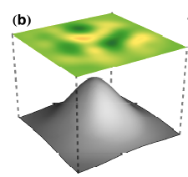
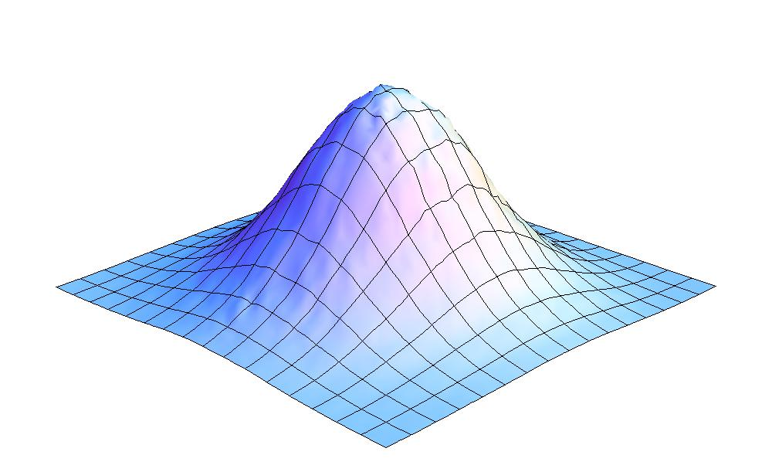
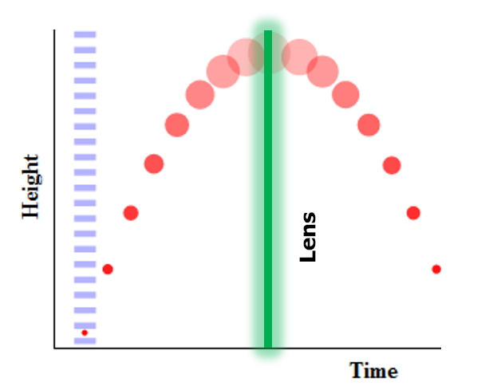
Ultra-ultra cold atoms
Very low temperatures improve the efficiency of atom/laser interactions by controlling inhomogeneous broadening.
A lens for atom clouds is realized using a laser beam:
Atom cloud refocused to <200 microns (resolution limited) after 2.6 seconds drift.
Laser beam profile used in exp’t.
Collimated cloud has inferred effective temperature of <50 picoKelvin
Kovachy, et al., arXiv 1407.6995

Slide 12
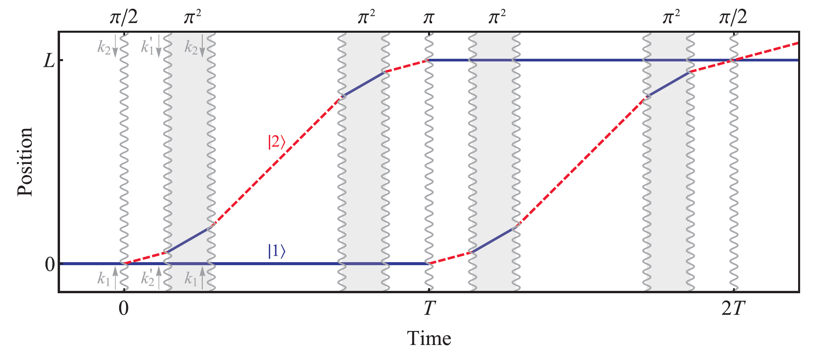
Large momentum transfer atom optics
Sequences of optical pulses are used to realize large separations between interferometer arms.
Position
Time
Example interferometer
pulse sequence

Slide 13
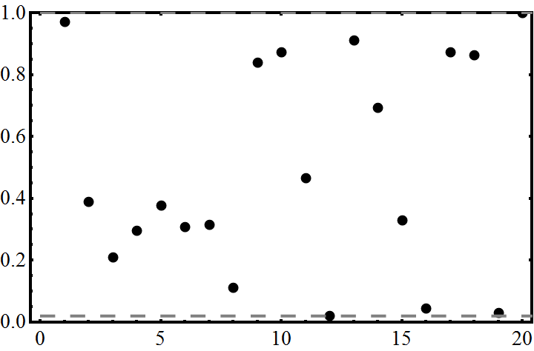
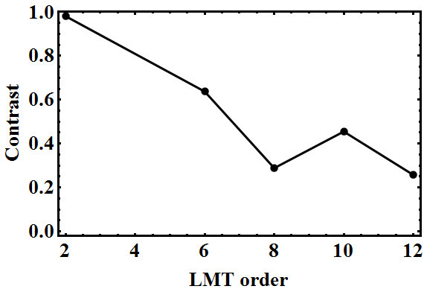
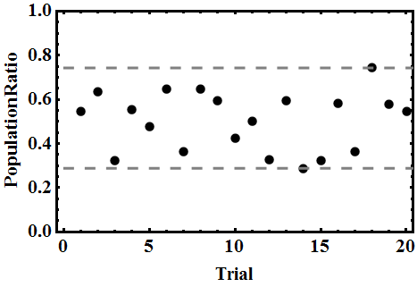
Large wavepacket separation
Sequential Raman transitions with long interrogation time.
4 cm
>98% contrast
8 cm wavepacket separation
LMT demonstration at 2T = 2.3 s

Slide 14
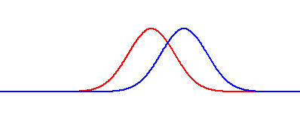
Recent: 12 cm wavepacket separation
Induce offset between interfering wavepackets to observe interference contrast envelope.
Expected contrast from source velocity spread.
20 photon recoil atom optics
Interference Contrast
Offset (microsec)

Slide 15
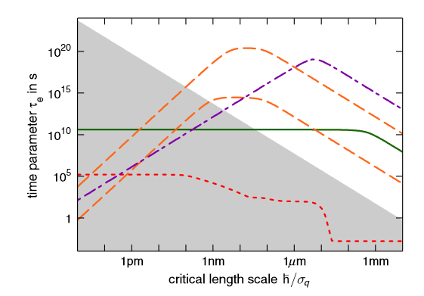
Tests of QM: “Macroscopicity”
We are testing QM at unprecedented energy, length and time scales.
Excluded by present work
Future exp’t with gold clusters/micromirrors
10 cm
Future work to push this to 1 m length scales
Nimrichter, et al., PRL, 2013

Slide 16
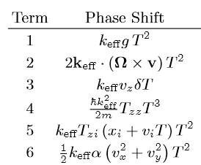
Phase shifts
1e10 rad
Gravity
Coriolis
Timing asymmetry
Curvature, quantum
Gravity gradient
Wavefront
40 rad
T_{ij}, gravity gradient
v_{i}, velocity; x_{i}, initial position
g, acceleration due to gravity
T, interrogation time
k_{eff}, effective propagation vector

Slide 17
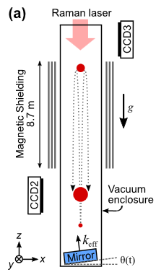
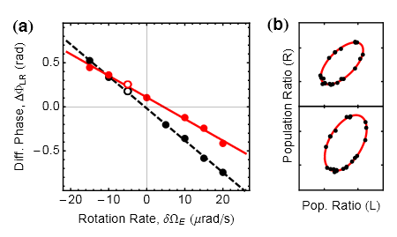
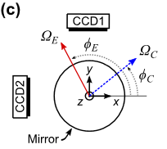
2-axis rotation/1 axis acceleration measurement
Interference patterns for rotating platform:
Side view
2-axis gyroscope
Top view
Measurement of rotation rate near null rotation operating point.
Measurement Geometry
Dickerson, et al., arXiv:1305.1700, PRL (2013)

Slide 18
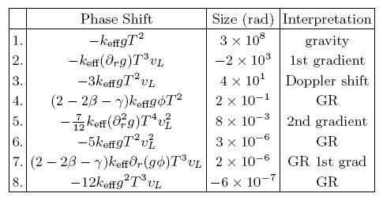
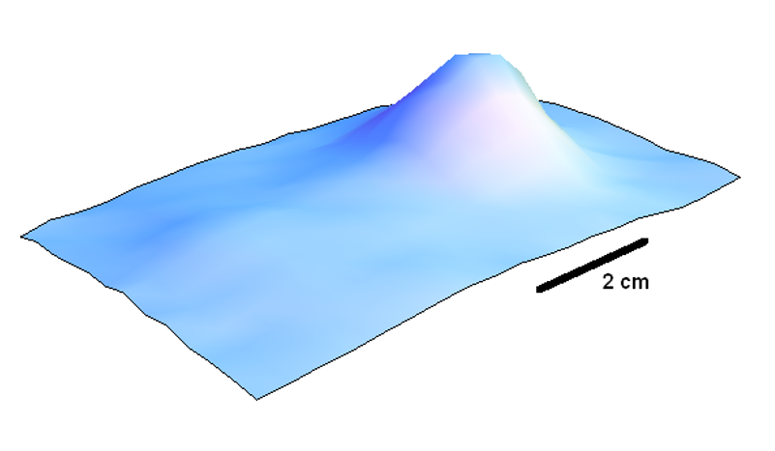
Ground-based Tests of General Relativity
Schwarzschild metric, PPN expansion:
PoE: simultaneously measure phase shifts from 87Rb and 85Rb interferometers.
Corresponding AI phase shifts:
Just launched:
85Rb at 100 nK (sympathetically and delta-kick cooled)
Projected experimental limits:
100K atoms, 100 nK, 2.6 s
Principle of Equivalence
(Dimopoulos, et al., PRL 2007; PRD 2008)

Slide 19
Testing Newton’s Law
Measurement of G
Tests of 1/r² law
Sample 8ћk interferometer simulation with T = 1.2 s
Notes:
Since we can think of the laser phase as simply bein

Slide 20
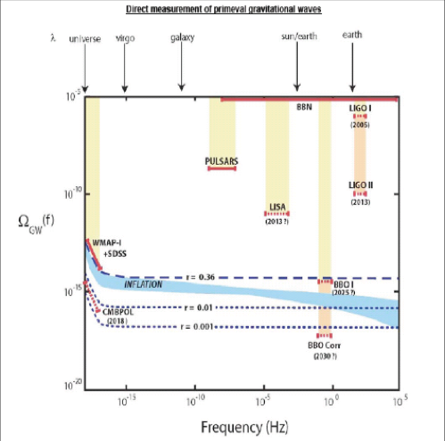
Stochastic Gravitational Waves (?)
Are there atom configurations which can reach these sensitivity levels?
(Maybe.)

Slide 21
Collaborators
Experiment:
Jason Hogan
Susannah Dickerson
Alex Sugarbaker
Tim Kovachy
Christine Donnelly
Chris Overstreet
Peter Asenbaum
Theory:
Peter Graham
Savas Dimopoulos
Surjeet Rajendran
Visitors:
Philippe Bouyer (CNRS)
Jan Rudolf (Hannover)
Stanford Funding:
NASA Fund. Phys.
NASA NIAC
Keck Foundation

