Slide 1


Research Enterprise System (RES) Program:
Research Expenditure Approval Workflow Transition – Compliance Training
November 9, 2022

Slide 2
LEARNING JOURNEY
BACKGROUND
    What is the RES program?
    RES Program Roadmap
    Background and Challenges
    What’s changing?
    Why are we here?
    Training Objectives
    Pilot Period
CHANGES TO RESEARCH EXPENDITURE APPROVAL PROCESS
    Key Roles and Responsibilities
    Process Flows - Overview
    Manual Workflows
    Automated Approval Workflows
    Changes to Faculty & Finance Roles
SPONSOR COMPLIANCE TRAINING
    Background
    Sponsor-specific examples
WALKTHROUGH EXAMPLES
FREQUENTLY ASKED QUESTIONS (FAQS)
RESOURCES AND SUPPORT

Slide 3
RESEARCH ENTERPRISE SYSTEM (RES) PROGRAM
BACKGROUND

Slide 4
What is the RES Program?
    The university requires a solution to effectively manage the approximately $172 million – and growing – research portfolio and reduce the administrative burden for faculty, allowing researchers to focus on research.
    The Research Enterprise System (RES) Program has been established to improve how research projects are supported throughout the research life cycle and to improve service to Researchers while controlling risk to the university.
    Transforming the way we support research at SFU requires a comprehensive review of existing systems and processes. Delivering that transformation will require completion of a suite of projects which together form the RES Program.

Slide 5
RES PROGRAM ROADMAP
5
~2023/2024
Project 4 – Dashboard Viewer
See all projects in a glance through a dashboard view
4
Project 5 – Decommission Grant Track
Grant Track will no longer serve as the university’s awards management system
3
2
Project 3: A/R and Billing
Accounts Receivable and Billing functions streamlined
1
Project 2 - Kuali Research
Common Proposal Repository smart form and workflow for proposal submission
JAN 2022
Compliance & Human Ethics System
Closed in March 2022, positive variance returned to Program
Project 1 - Project Costing
Common Financial Repository
Ability to see multiple project years using FAST
Accurate project resource encumbrances

Slide 6
Background and Challenges
    During the discovery phase, we consulted with stakeholders within SFU and canvassed other universities for input on the existing expenditure approvals process. We reviewed current state roles and responsibilities to identify key pain points in our pre-RES processes:
Principal Investigators (PI) felt that the current process was cumbersome and overly restrictive compared to other post-secondary institutions.
Current process results in duplication of effort in the university due to having to navigate two separate processes for research and non-research expenditure approvals
Required information on project financial status and documentation is not always available

Slide 7
What’s Changing?
Research Accounting will be removed from the approval process for research expenditures to address most of these pain points.

Slide 8
Why are we here?
To identify the key changes in the current and future state Research Expenditure Approval workflow processes
To highlight roles and responsibilities
To provide an overview on how to assess eligibility of expenses based on the principles, directives policies and agreement terms through specific examples
To ensure that the research expenditure approval process across the university is consistent and mitigates the community’s pain points

Slide 9
Training Objectives
By the end of this session, you will be better equipped to make decisions related to research expenditure approvals by:
Understanding additional sponsor requirements specific to your faculty
Using walkthrough examples of compliance review
Providing additional resources for support - such as summary sheets, links to online resources, etc.

Slide 10
What is the Pilot Period?
A trial run of the future state to enable faculties to assess the impact on processes and workloads
Faculties would begin to operate as though RA was not part of the approval process. (pretend it is future state)
  If Faculty Admin have questions about eligibility, they can contact RA for advice
  Once Faculty Admin approves, the claim would still go to RA before it goes to Central Processing for approval
  RA would hold and discuss the claims with Faculty Admin for discussion and training purposes
We can use this period to determine key metrics
  How often do Faculty Admin reach out to RA for advice?
  How often does RA hold back claims that should not have been approved by Faculty Administrators?

Slide 11
CHANGES TO
RESEARCH EXPENDITURE APPROVAL PROCESS

Slide 12

Key Roles and Responsibilities
PI
Responsible for ensuring expenditures meet all requirements for processing
Complies with SFU policies
Complies with sponsor requirements
Funds are available
Faculty Admin
Reviews to ensure that funding is available, and that expenditure complies with SFU policy and sponsor requirement.
Indicates that they have completed those checks before sending to Central Processing
Returns the item to the PI if the compliance checks fail
Central Processing (RPI or Finance Operations)
Verifies that appropriate approvals are in place (PI is authorized via SAM) and that the compliance checks are performed before processing the items
Maintains the central records for paid items
Responds to requests from external auditors

Slide 13

Process Flows - Overview
Current State Submission Process
PI or Delegate
Submits expenditure item for approval
Faculty Admin
Completes review
Budget Approver
Research Accounting
Verifies that funds are available, that expenditure complies with SFU policy and sponsor requirements
Central Processing (Financial Operations/HR)
Verifies Signing Authority, processes expenditures
Future State Submission Process
PI or Delegate
Submits expenditure item for approval
Faculty Admin
Verifies that funds are available, that expenditure complies with SFU policy and sponsor requirements
Budget Approver
Central Processing (Financial Operations/HR)
Verifies Signing Authority, ensures Faculty Admin has verified item, processes expenditures
Research Accounting
Available for Consultation
Performs Spot Audits
SIMON FRASER UNIVERSITY 13
Notes:
Faculty Admin are already reviewing research expenditures
They have systems and processes to confirm compliance
They are familiar with SFU and Tri-Agency policies
The knowledge gap is knowing other sponsor compliance requirements, though this only a partial gap as many Faculty Admin do know other common sponsors already (e.g. MITACS, Michael Smith)
Each faculty will determine how to implement the changes
The processes and procedures will be unique to each faculty

Slide 14
Manual Workflows
Current - Payroll Appointment Form (PAF) Submission
PI
Identifies project resource need
Faculty Admin
Fills out PAF on behalf of PI
Research Accounting
Determines eligibility of funding and forwards
RPI
Enters appointment details in HR
Payroll
Enters funding details in HR, processes payroll bi-weekly
Future - Payroll Appointment Form (PAF) Submission
PI
Identifies project resource need
Faculty Admin
Determines eligibility of funding and fills out PAF on behalf of PI
RPI
Enters appointment details in HR
Payroll
Enters funding details in HR, processes payroll bi-weekly
Research Accounting
Available for consultation
Performs Spot Audits
SIMON FRASER UNIVERSITY 14
Notes:
NOTE: Effective April 1st, RPI handles all PAFs, including Post docs (i.e. assumed this duty from FR).

Slide 15

Manual Workflows
Current – Invoices Submission
PI or Delegate
Add signature for approval and chartfield string
Faculty Admin
Level of review/oversight may vary
Research Accounting
Review, add approval to PDF using Adobe and print for Payment Services
Payment Services
Post
Future – Invoices Submission
Mandatory Fields required for processing by Payment Services
  Accounting String
  Grant compliance verified: (name of Financial Administrator)
  Date:
  Name of Account Holder (printed name of person authorized to sign)
  Signature and stamp
PI or Delegate
Add signature for approval and chartfield string
Faculty Admin
Review, ensure mandatory information is included, add approval to PDF using Adobe and print/send to Payment Services
Payment Services
Post
Research Accounting
Available for Consultation
Performs Spot Audits
SIMON FRASER UNIVERSITY 15

Slide 16
Manual Workflows
JVs may be used for expense reallocation, salary corrections, internal billings, correcting data entry errors, etc.
Current - Journal Voucher (JV) Submission
PI or Delegate
Prepare JV form
Authorized account holder signs JV form
Attach supporting documentation, printing name and signature
Faculty Admin
Level of review/oversight may vary
Research Accounting
Review and approve JV
Check authorization against SAM
Banking
Post JV
Future - Journal Voucher (JV) Submission
PI or Delegate
Prepare JV form
Authorized account holder signs JV form
Attach supporting documentation, printing name and signature
Faculty Admin
Review and approve JV form and supporting documentation
Include “certification” on supporting documentation
Electronic JV: Upload JV form and certified supporting documentation to PeopleSoft
Manual JV: E-mail JV and certified supporting documentation to Banking (E-mail: finshelp@sfu.ca)
Banking
Check authorization against SAM
Review certification is complete
Post JV
Research Accounting
Available for Consultation
Performs Spot Audits
SIMON FRASER UNIVERSITY 16

Slide 17
Manual Workflows
Current - Journal Voucher (JV) Submission – Science/Technical Centres
PI or Delegate
Prepare pre-authorized JV form to create account
Authorized account holder charges purchases to PI’s account in 3rd party system
Science/Technical Centres
Upload JV file from third-party system to PeopleSoft (PS)
Research Accounting
Review for compliance and certify JV
Check authorization against SAM
Banking
Make necessary changes based on RA’s feedback
Post JV
Future - Journal Voucher (JV) Submission – Science/Technical Centres
PI or Delegate
Prepare JV form
Authorized account holder signs JV form
Attach supporting documentation, printing name and signature
Science/Technical Centres
Upload JV file from third-party system to PeopleSoft (PS)
Research Accounting
Distributes JV files to faculties for compliance review
Available for consultation throughout compliance review process
Notify banking if there are any changes to the JV based on faculty admin’s review
Perform spot audits
Faculty Admin
Review and approve JV form and supporting documentation
Include “certification” on supporting documentation
Email JV with certification to Research Accounting who will coordinate the files to send to Banking
Banking
Check authorization against SAM
Review certification is complete
Post JV
SIMON FRASER UNIVERSITY 17

Slide 18
Automated Approval Workflow
Current State
Faculties & Department Reviewers are Responsible for following submissions:
Automated Workflow:
Business and Travel Expense Claims​
Purchase Requisitions– not all faculties perform this today
Manual Workflow:
Payroll Appointment Form (PAF)
Journal Vouchers
Invoices
* Some faculties may use pre-reviewers
* Some faculties perform detailed sponsor compliance review

Slide 19
Automated Approval Workflow
Future State
Faculties & Departments are Responsible for following submissions:
Automated Workflow:
Business and Travel Expense Claims​
Purchase Requisitions– All faculties will be required to perform this in the future state
Manual Workflow:
Payroll Appointment Form
Journal Vouchers
Invoices
Faculties now own and are responsible for compliance review.
They should also ensure that submissions are complete with the required supporting documentation
Recommended best practice:
Verify transaction is properly coded
Validate supporting documentation are accounted for
Validate receipt dates have been inputted correctly
Recommend appointing two people for each box
Notes:
Jennifer/Lesley
Moving forward, we recommend two people per box, so there’s a backup.
We’re sharing these details so that you better understand what the changes mean to your faculty + departments
As you know how your faculty is set up, we look to you to decide how to set this up, Lesley at Payment Services or Jennifer at Procurement will talk through a few gaps and risks from a best practice perspective
Moving forward, each faculty will be responsible for compliance review on Requisitions, as RA will be removed from the workflow
Trina will provide these names of those in the database after today’s meeting as we would like your support to identify who will be in Pre-Reviewer + Department Reviewer roles. for the gradual workflow transition.

Slide 20


Faculty and Finance’s Role
In effect, we will migrate to a common process for approval of expenditures:
Faculties will be responsible for:
Ensuring that funding is available. Consequently, they are responsible for deficits that result from over-spending
Ensuring that expenditures comply with SFU policies
Ensuring that expenditures are eligible for reimbursement from sponsors
Finance will be responsible for:
PST, GST compliance, customs and duties may apply charges if required
Validation that the approver is authorized (e.g. SAM verification)
For PAF’s, RPI or FR will be responsible for confirming appointment
Perform spot audits of processed transactions (e.g. after the expense has been paid) to test for compliance with SFU policy and sponsor requirements

Slide 21



Research Accounting’s Role
Research Accounting’s function at SFU will be adjusted:
RA will stop approving research expenditures
RA will continue to do the following:
Report to sponsors (e.g. Form 300 for Tri-agency)
Be the knowledge centre for understand financial administration of research projects – the place to call if the faculty has questions
RA will take on the following:
Spot audits of processed transactions (e.g. after the expense has been paid) to test for compliance with SFU policy and sponsor requirements
Expand its training for PI’s and Faculty Admin as with the Tri-agency Training (e.g. additional case-based training)
Additional duties within Finance including expanded A/R function, enhancements to revenue recognition, etc.

Slide 22
SPONSOR
COMPLIANCE TRAINING
Notes:
Let’s look at what sponsor compliance mean and how to assess for sponsor compliance.

Slide 23
What Does Compliance Approval mean?
Research expenditures must meet 3 requirements for eligibility:
1) Funding availability:
Confirming availability of funding is based on FAST.
2) Compliance with SFU Policy:
Confirming compliance with SFU policy requires a working knowledge of SFU policies.
3) Compliance with sponsor requirements:
Compliance with additional sponsor requirements is the focus of this presentation.

Slide 24
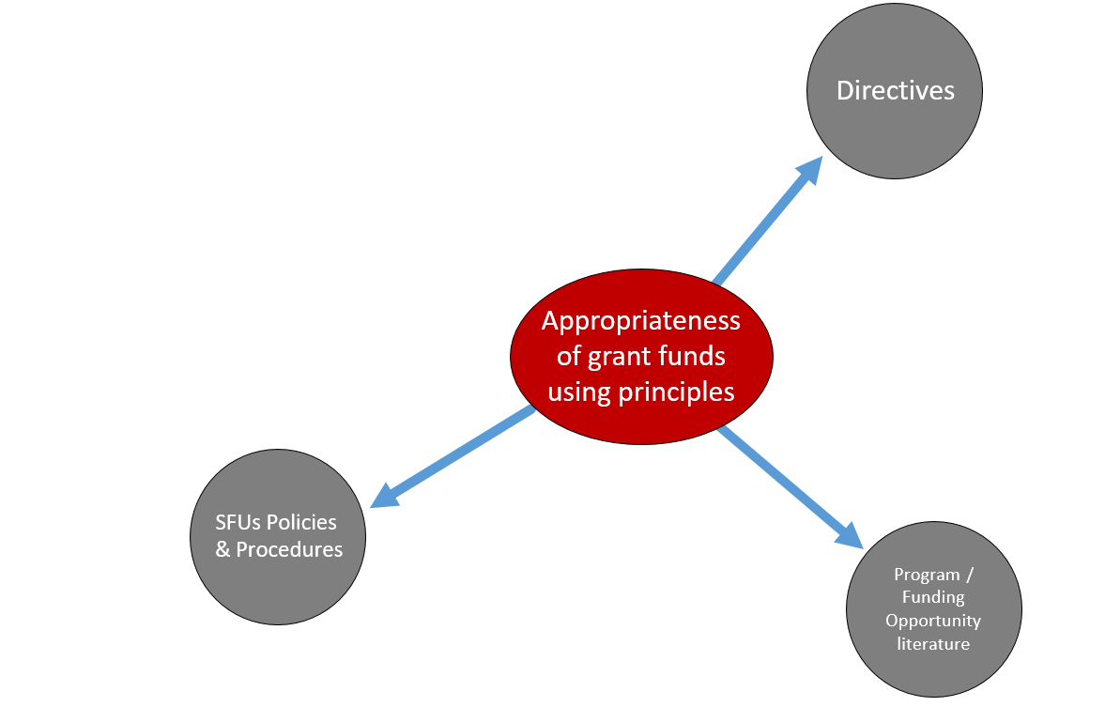
Compliance With Sponsor Requirements
The focus of this presentation is to ensure how compliance has been met with the sponsor requirements
  Once this is completed, the eligible cost can be processed
A major source of funding comes from Tri-Agency projects which will follow the SFU policy framework:
Notes:
Leeann:
As you know Tri-Agencies have to be updated with the general principles. It is a combination of the directives, SFU policies & procedures, and Program/Funding Opportunity literature that determines the eligibility of the expenditures.

Slide 25
Sponsor-Specific Requirements
The purpose of the next few slides is to provide context for sponsors specific to your faculty:
  Identify key considerations on whether sponsor requirements are similar to SFU policy or Tri-Agency guidelines
  Identify current sponsors that have limits on detailed budget line items
Notes:
The purpose of the next few slides is to provide context for sponsors specific to your faculty:
Identify key considerations on whether sponsor requirements are similar to SFU policy or Tri-Agency guidelines
Identify current sponsors that have limits on detailed budget line items; or amounts on detailed budget items as per the sponsors terms and conditions in their agreements.

Slide 26

QUESTIONS?

Slide 27
WALKTHROUGH
PROJECT
EXAMPLES

Slide 28
WALKTHROUGH PROJECT EXAMPLES
Today, we are going to walk you through the following examples:
Project Set-up
Expense Approval: Consideration By Budget Line Item
Expense Approval: Consideration By Amount of Budget Line Item
Expense Approval: Consideration By Specific Budget Cost

Slide 29
EXAMPLE #1
PROJECT
SET-UP NOTES

Slide 30





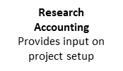

Project Set-up Notes Process
Current State – Project Set-up Notes Process
Do Sponsors have limits on budget line item or amount of budget line item?
Common Sponsor?
e.g. MITACS, MSFHR, CFI
NO
Setup Notes
Notes added to project as an attachment in PS
YES
RS/ISA
Negotiates agreements, sets up project budgets and highlights financial terms
Research Accounting
Uses financial information provided by RS/ISA and knowledge of sponsors to identify points for consideration
YES
NO
Do not setup Notes, refer to Award Letter
Research Accounting
Provides input on project setup
Future State – Project Set-up Notes Process
Do Sponsors have limits on budget line item or amount of budget line item?
Common Sponsor?
e.g. MITACS, MSFHR, CFI
NO
Setup Notes
Notes added to project as an attachment in PS
YES
RS/ISA
Negotiates agreements, sets up project budgets and highlights financial terms
YES
Faculty Admin
Reviews financial information highlighted by RS/ISA and knowledge of sponsors to identify points for consideration
NO
Do not setup Notes, refer to Award Letter
Research Accounting
Available for consultation
SIMON FRASER UNIVERSITY 30
Notes:
Currently, Summary sheets/guidance are being provided.

Slide 31

Key Considerations for Active Projects
  Some sponsors have specific requirements which should be identified when the project is activated.
  Currently, RA reviews these sponsor agreements for key considerations
    Research Accounting works with RS/ISA to identify key financial terms
    RS/ISA highlights points for consideration in the agreements during the project setup phase and makes them available in New FAST Views
    RA reviews the sponsor’s budget and uses that information to prepare notes when there are limits on specific budget line items or amount on budget line for expenditure review and attaches them to the project in PS
    When sponsor agreements do not have restrictions or they align with SFU policy, RA does not make notes - use of funds follows SFU policy
  Please note:
  RA does not review each research agreement in full
  Faculty Admin do not need to review agreement in full either

Slide 32
Key Considerations for Active Projects
Some sponsors may have exceptions for detailed items.
MITACS, Michael Smith (MSFHR), CFI, SFU Endowment-funded are common sponsors that have similar SFU policies:
  MSFHR supports research personnel and other expenditures (and funds should be mostly spent in BC)
  MITACS funds primarily named interns and other research expenditures follow Tri-Agency guidelines which can be easily referred to in the Notice of Award
  CFI supports infrastructure costs and maintenance of the infrastructure
RA does not make notes on these common sponsors as these have become known sponsor requirements and details can be found in their award letters

Slide 33
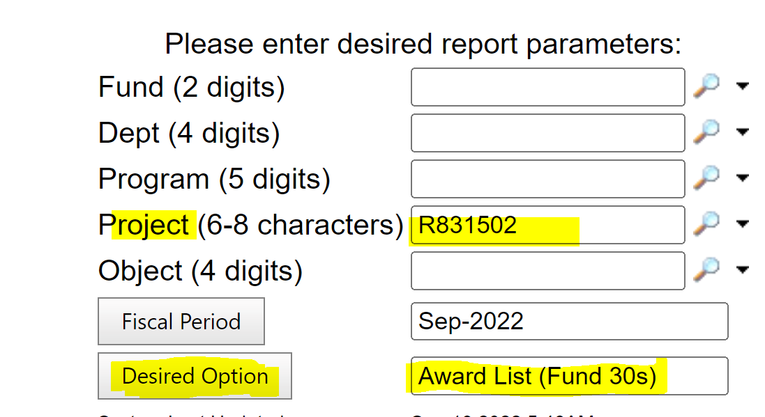
Example #1 - Project Set-up Notes
  Here is an example of how to view an agreement and make notes about limits on specific budget line items; or amount of budget line item
  Faculty Admin will be copied on a PI email notification from Research Accounting that a new project has been activated.
  The next business day, log on to FAST.
  Enter the Project Account number provided in the Project field.
  Select Award List (Fund 30s) for the Desired Option field.

Slide 34
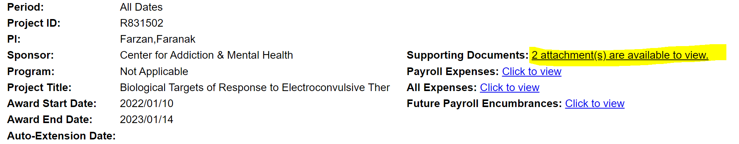
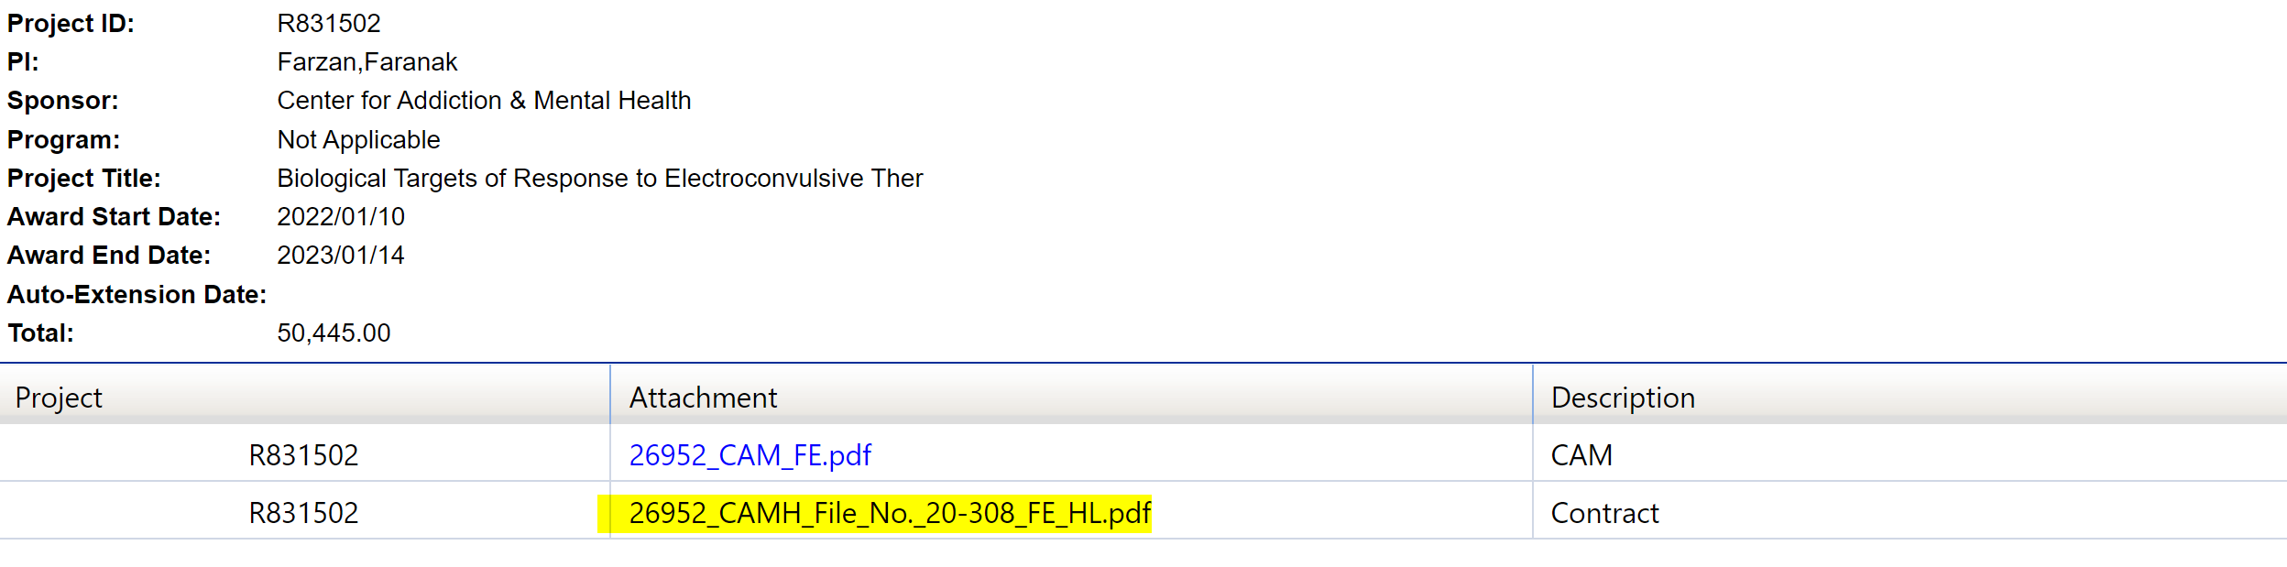
Example #1 - Project Set-up Notes Con’t
  5. Once all of the fields are entered, the project information will be displayed on screen.
  In the Supporting Documents field: Click on ‘attachments are available to view’
  6. In the Supporting Documents viewer, select the Attachment indicating ‘Contract’ or ‘Agreement’ in the Description field.

Slide 35
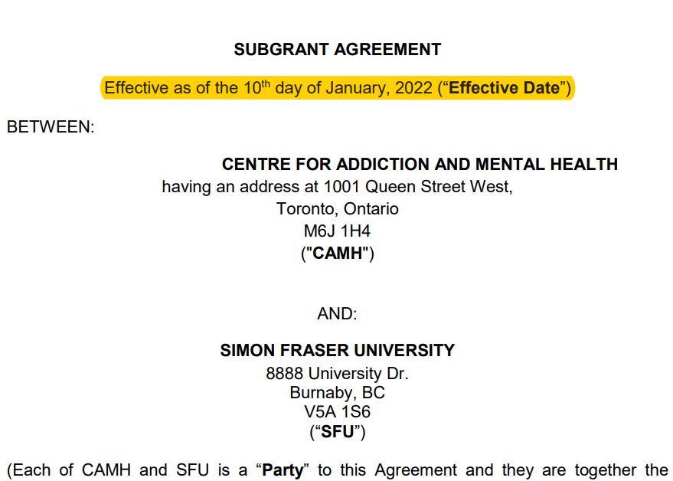
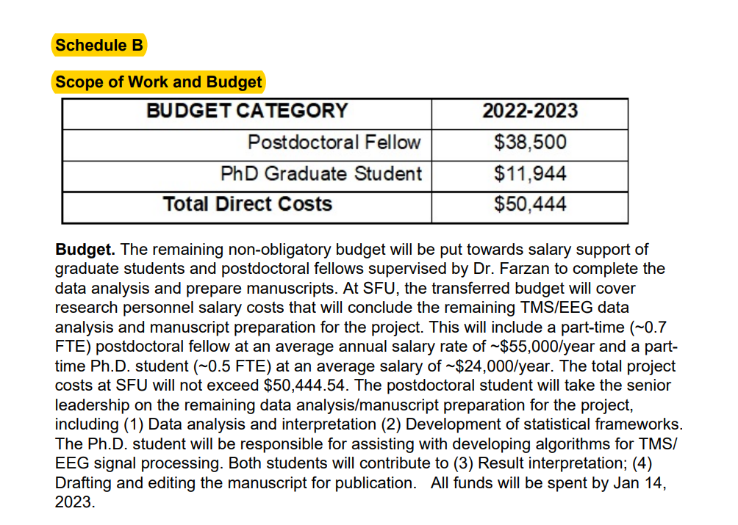
Example #1 - Project Set-up Notes Con’t
  7. Once the attachment is opened, scroll through the agreement to review the highlighted sections. Consider the sections on:
    Limits on specific budget line
    Amount of budget line item
  E.g. In this agreement, the sponsor indicates that the budget is for salary support of a postdoctoral fellow and PhD student.

Slide 36
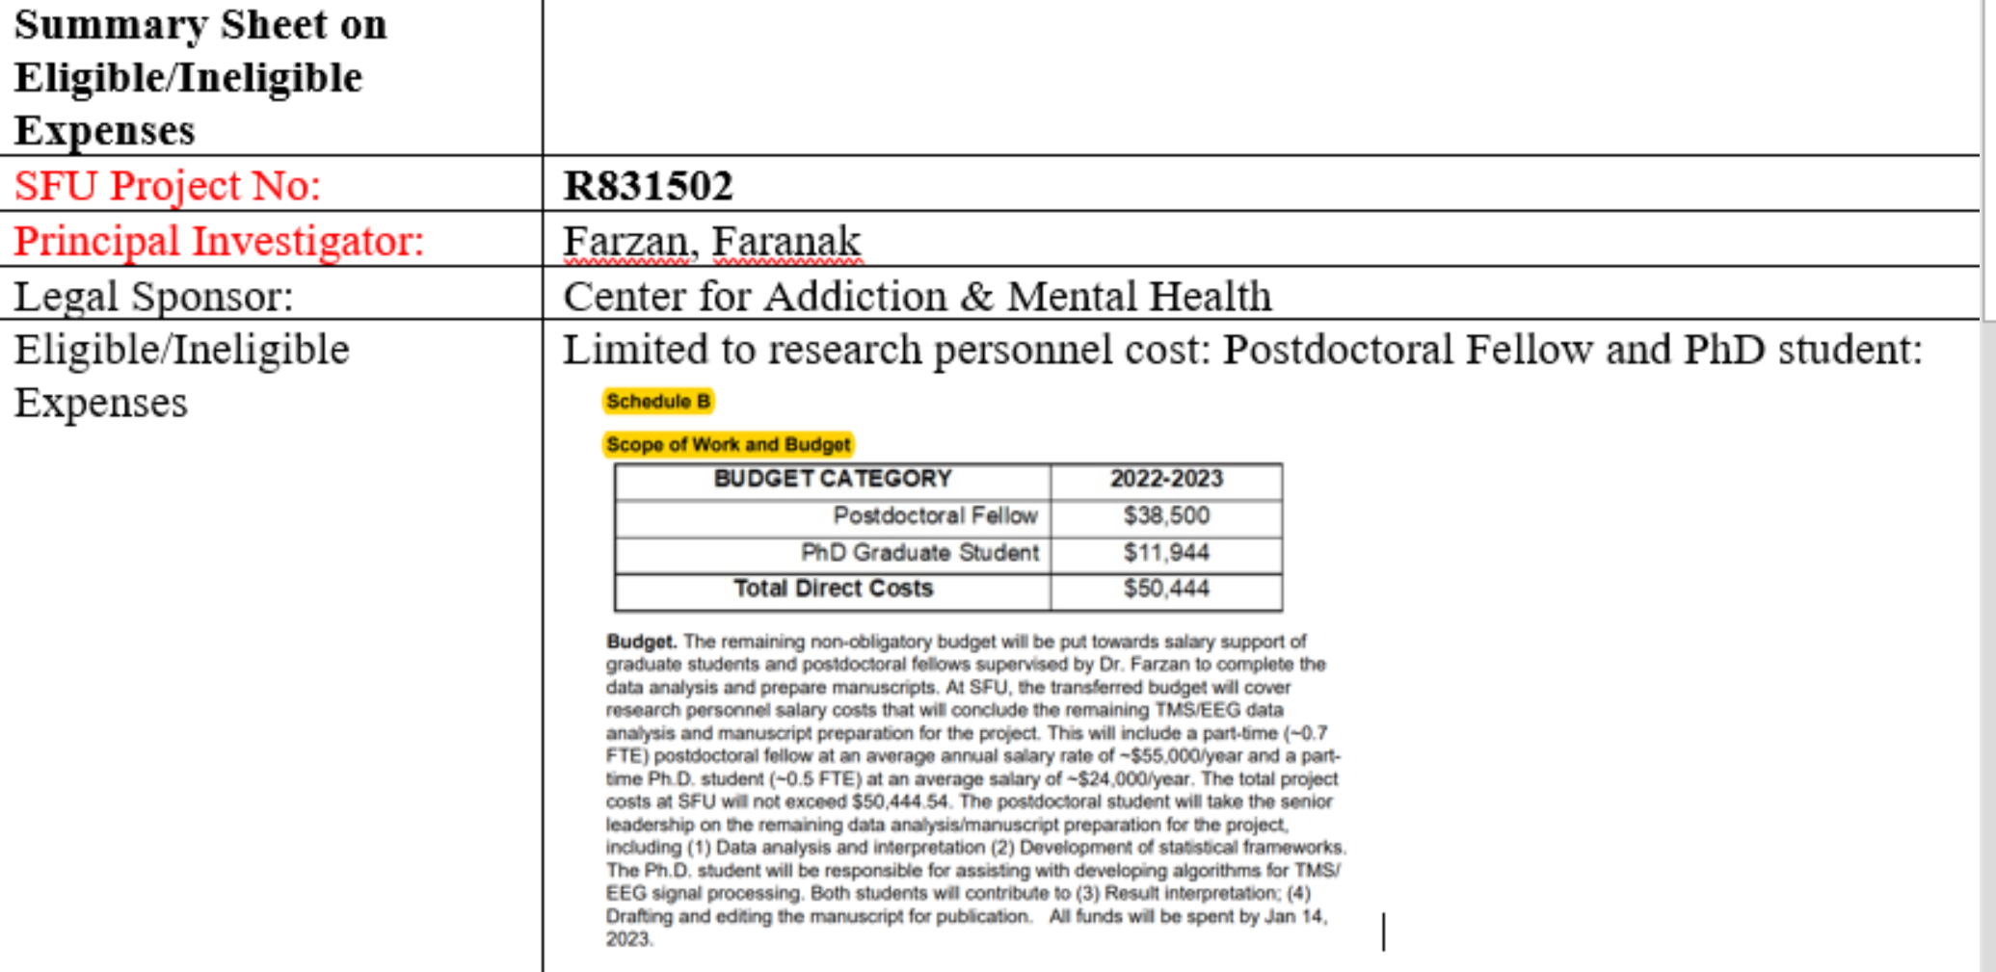
Example #1 - Project Set-up Notes Con’t
  8. Once the limits of budget items are specified, document those items into a Summary Sheet template (Examples can be found in FAST). Record the following:
    SFU project number
    Principal Investor Name
    Legal Sponsor
    Eligible/Ineligible expenses
  9. Once the Summary Sheet has been completed, save the document as a PDF file to your local drive.
Notes:
Please note that this is the summary sheet that Research Accounting generally uses. Your summary sheet may look different depending on your internal process. The method in which you take notes is entirely up to your faculty.

Slide 37
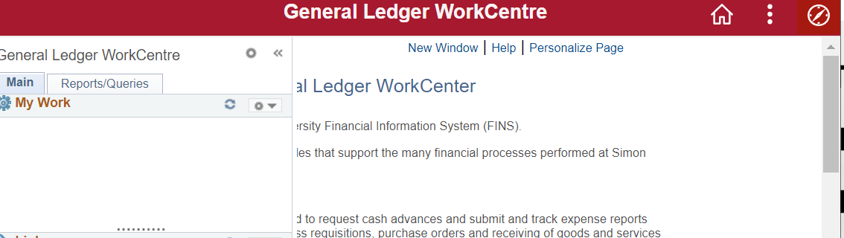
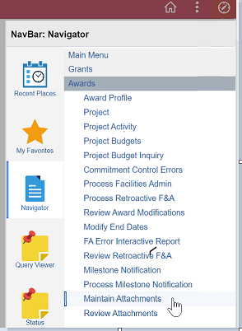
Example #1 - Project Set-up Notes Con’t
  10. The pdf file can be uploaded and saved in PS. As a result, it can viewed in New FAST Views in the project account. Log into FINS.
  11. Click on the navigation pane icon.
  12. Once the navigation pane appears, go to Grants > Awards > Maintain Attachments.

Slide 38
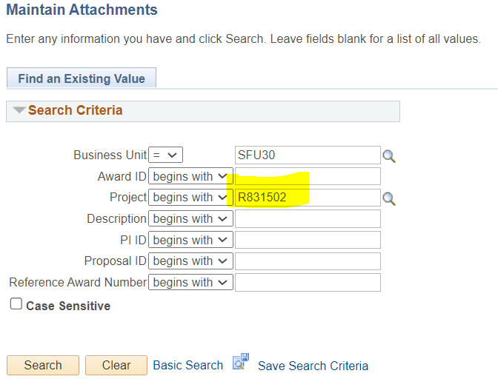
Example #1 - Project Set-up Notes Con’t
  13. Once the Maintain Attachments module opens, go to the Search Criteria section.
  14. Enter “SFU30” within the Business Unit field.
  15. Enter the Project Account number within the Project field.

Slide 39
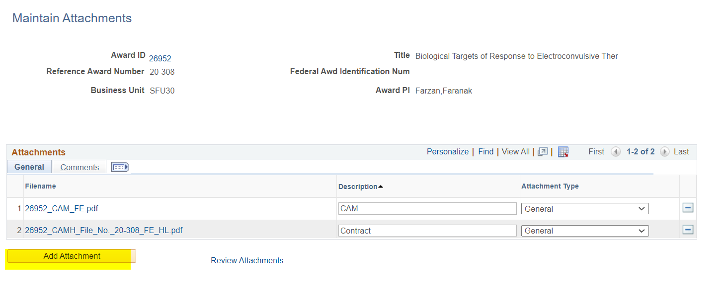
Example #1 - Project Set-up Notes Con’t
  16. Once the Attachment Viewer appears, select the “Add Attachment” button within the General tab.
  Caution:
  Do not select ‘-’ as a document can be deleted.

Slide 40
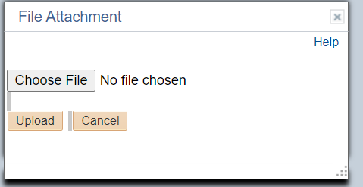
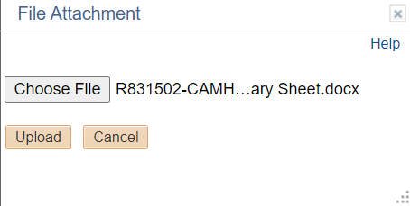
Example #1 - Project Set-up Notes Con’t
  17. When the File Attachment pop-up appears, select the “Choose File” button.
  18. Find the document saved earlier on your local drive and select the “Upload” button.

Slide 41
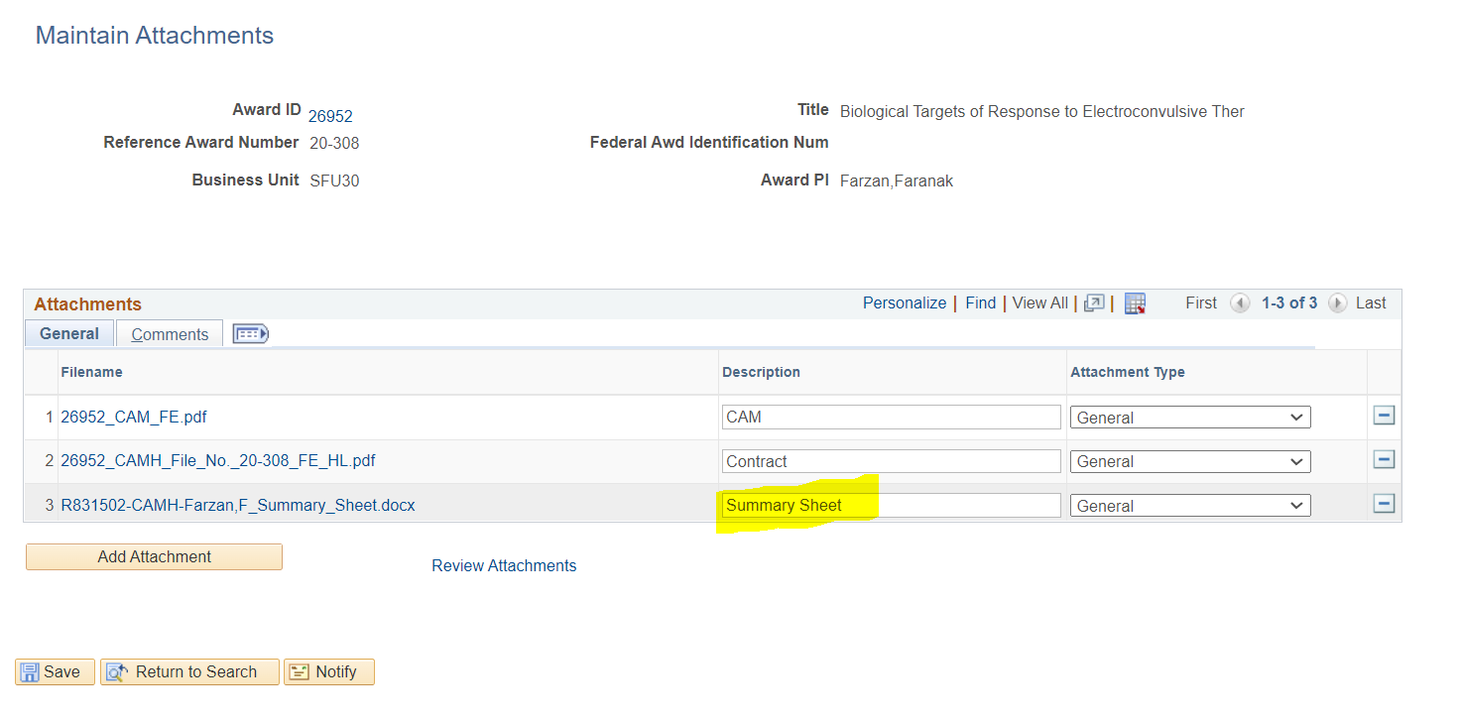
Example #1 - Project Set-up Notes Con’t
  19. Once uploaded, the result will appear in the Attachments Viewer with the new file added.
  20. Enter ‘Summary Sheet’ within the Description field to indicate the type of file added and click Save

Slide 42
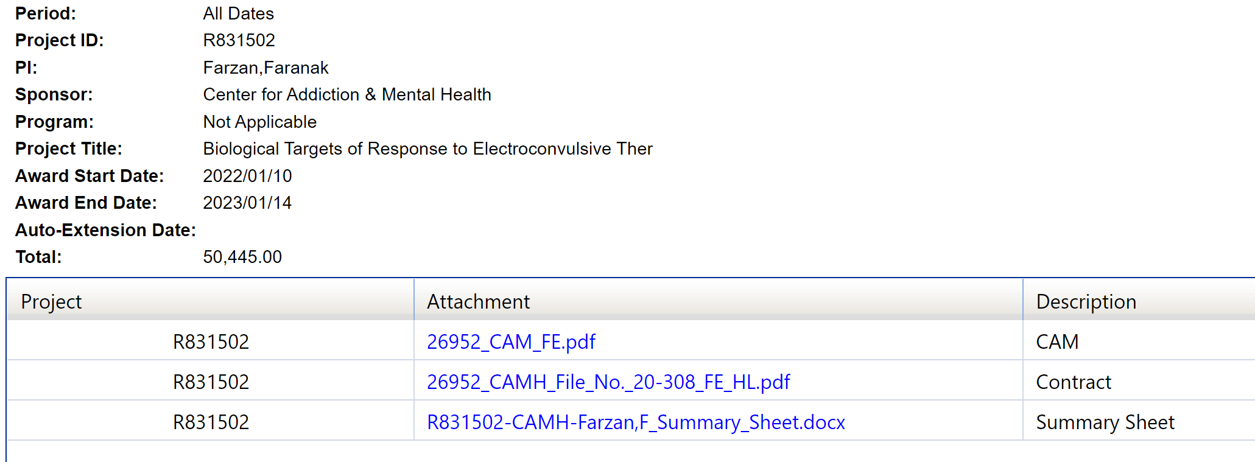
Example #1 - Project Set-up Notes Con’t
  13. The next business day, log into the project account in New FAST Views, and the document will be available to view.

Slide 43
EXAMPLE #2
EXPENSE APPROVAL: Consideration by Budget Line Item

Slide 44
Example #2 – Expense Approval
Consideration by Budget Line Item
  Sometimes, a sponsor’s agreement may not allow an expense to be incurred when the sponsor has not approved a budget item (e.g. equipment)
    The Faculty Admin reviews the sponsor’s approved budget found in the research agreement to consider ineligible costs. The agreement is available as an attachment in New FAST Views
  In New FAST Views, the Approved Total Spending Budget is limited to Direct Cost Expense and Overhead; and does not display by an approved budget line item

Slide 45
Compliance With Sponsor Requirements
  Thus, it is important that the Faculty Admin determines whether an expense is an approved budget line

Slide 46
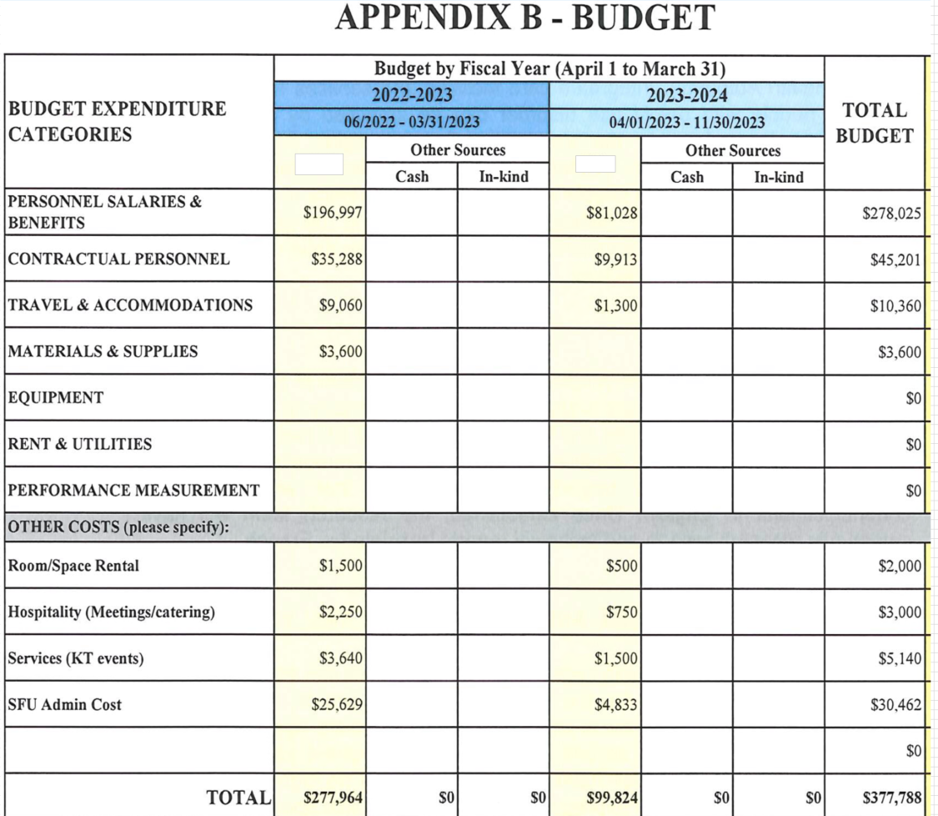
Compliance With Sponsor Requirements
  Here is an example of how a Faculty Admin determines whether an expense is an approved budget line item
  A Faculty Admin receives a $7,000 invoice for equipment (inclusive of PST and net GST) in FY 2022-2023
  The sponsor’s budget line shows that the Equipment budget line is zero.

Slide 47
Compliance With Sponsor Requirements
  The Faculty Admin determines that the expense does not meet compliance
  Thus, the Faculty Admin will discuss with the PI to provide an alternative eligible project to charge the invoice.

Slide 48
EXAMPLE #3
EXPENSE APPROVAL: CONSIDERATION BY AMOUNT OF
BUDGET LINE ITEM

Slide 49
Compliance With Sponsor Requirements
  Sometimes, a sponsor’s agreement may not allow a approved amount for a budget line item to be exceeded - without seeking sponsor’s prior approval
  In New FAST Views, the Approved Total Spending Budget is limited to Direct Cost Expense and Overhead; and does not display by an approved amount for a budget line item

Slide 50
Compliance With Sponsor Requirements
  Thus, it would be important for the Faculty Admin to determine whether an expense will exceed the balance available for a budget line

Slide 51
Compliance With Sponsor Requirements
  Here is an example of how a Faculty Admin determines whether an expense exceeds the balance available for a budget line
  A Faculty Admin receives a $3,000 invoice for materials & supplies (inclusive of PST and net GST) in FY 2022-2023
  The amount of the sponsor’s budget line item for Materials & Supplies is $3,600 for FY 2022-2023

Slide 52
Compliance With Sponsor Requirements
  The Faculty Admin calculates the balance available to spend for Material & Supplies budget line
    The Faculty Admin searches in New FAST Views for prior expenses incurred for material & supplies in Actual Direct Expenditure and determines $2,451.20 has been incurred (Object Code 6199 for Materials and Supplies-Other)
    The balance available is determined to be $1,148.80 (i.e. $3,600 less $2,451.20)
  The Faculty Admin determines that the invoice of $3,000 exceeds the balance available $1,148.80 for Material & Supplies

Slide 53
Compliance With Sponsor Requirements
  The Faculty Admin determines that the expense does not meet compliance
  Thus, the Faculty Admin will discuss with the PI the following options where the PI may choose to
    Seek sponsor approval before incurring the invoice for $3,000 to the project account; or
    Partially allocate an amount of $1,148.80 of the invoice to the project, so not to exceed the budget line; and charge the remainder to another eligible project.

Slide 54
EXAMPLE #4
EXPENSE APPROVAL: CONSIDERATION BY SPECIFIC
BUDGET COST

Slide 55
Compliance With Sponsor Requirements
  On seldom occasion, a sponsor’s agreement may have a specific expense that cannot be incurred, contrary to SFU policy
  For example, a sponsor may allow salary but not benefit costs of research personnel
  The Faculty Admin allows the payroll appointment for a personnel to be charged both salary and benefits to the project; and pre-arranges with the PI an alternate eligible project to absorb the benefit cost
  When the pay is incurred, the Faculty Admin reviews in the New FAST Views and determines the benefit costs incurred (in object code 5911). They prepare a journal, requests the PI to authorize the transfer out the cost to the alternate project. The journal is submitted to Banking to process.

Slide 56
THANK YOU!

Slide 57
FREQUENTLY
ASKED QUESTIONS (FAQS)

Slide 58

Research Funding Cycle
Develop Proposal/
Submit Proposal
Proposal Outcome:
Award Notification
Validation
Project Setup:
Project Activation
Complete Research/ Close Project
Manage Funding
Reporting
Billing and A/R
PI
PI
PI
PI
PI
People
Faculties
Research Services
Research Services
Faculties
Research
Research
Finance
Finance
Finance
SIMON FRASER UNIVERSITY 58
Notes:
Leeann:
1) Research Services - All Proposal and Award/Contract Information in regards to the sponsor’s key requirements and budget
2) Research Services goes through the contracts and highlights items for RA. If RS is not sure about financial terms and conditions, then consult with RA. This pertains to the contracts only.
3) Once project is set-up, Research Accounting will receive alerts from RS to activate the project and the PI will have access to the funding.
Some other sponsors have specific requirements which should be identified when the project is activated
Currently, RA reviews these sponsor agreements for key considerations
Research Accounting works with RS/ISA to identify key financial terms
RS/ISA highlights points for consideration in the agreements during the project setup phase and makes them available in New FAST Views
RA reviews the sponsor’s budget and uses that information to prepare notes when there are limits on specific budget line items or amount on budget line for expenditure review and attaches them to the project in PS
When sponsor agreements do not have restrictions or they align with SFU policy, RA does not make notes. Use of funds follows SFU policy
RA doesn’t review each research agreement in full
Faculty Admin will not review agreement in full either

Slide 59
RESOURCES
AND SUPPORT

Slide 60
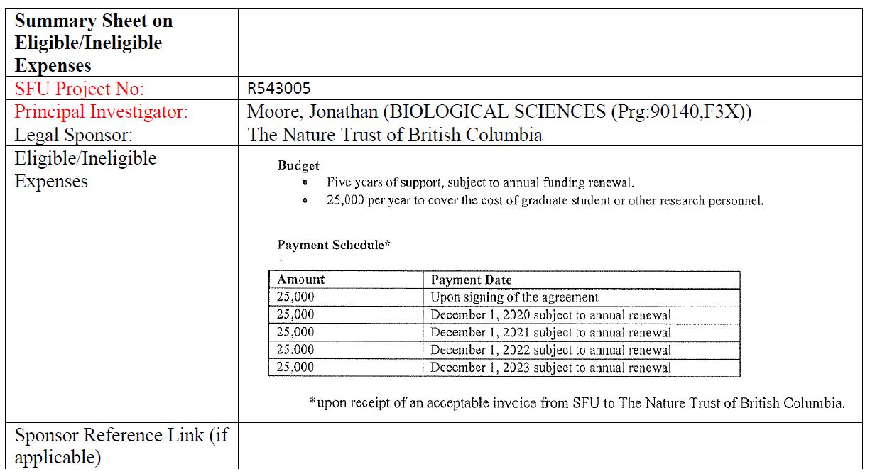
SUMMARY SHEET EXAMPLES
Summary Sheets are in the process of being uploaded into FAST:
Example #1 – Science :

Slide 61
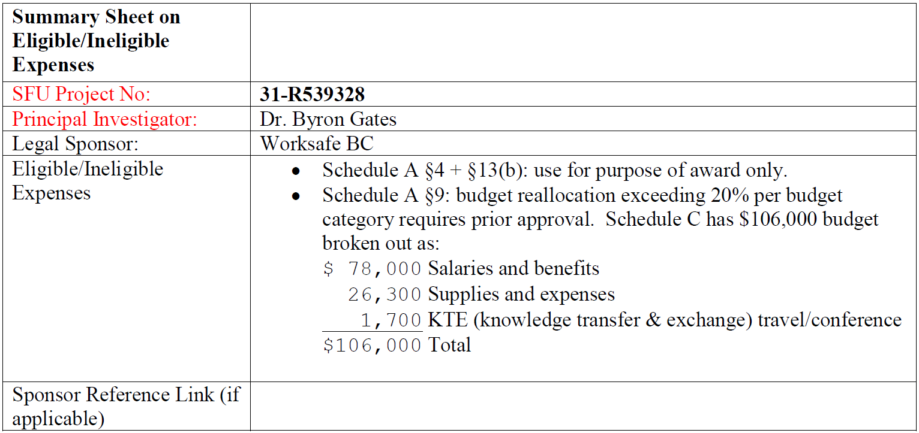
SUMMARY SHEET EXAMPLES
Summary Sheets are in the process of being uploaded into FAST:
Example #2 – WorkSafe BC :

Slide 62
ADDITIONAL RESOURCES
ask_res@sfu.ca for questions relating to compliance approval workflow transition

Slide 63
Next Steps
Research Accounting removed from workflow in January 2023
(dependent on FAST data issues fix)
Training sessions and drop-in sessions will be held once
Pilot Period

Slide 64
QUESTIONS &
FEEDBACK

Slide 65
Appendix

Slide 66
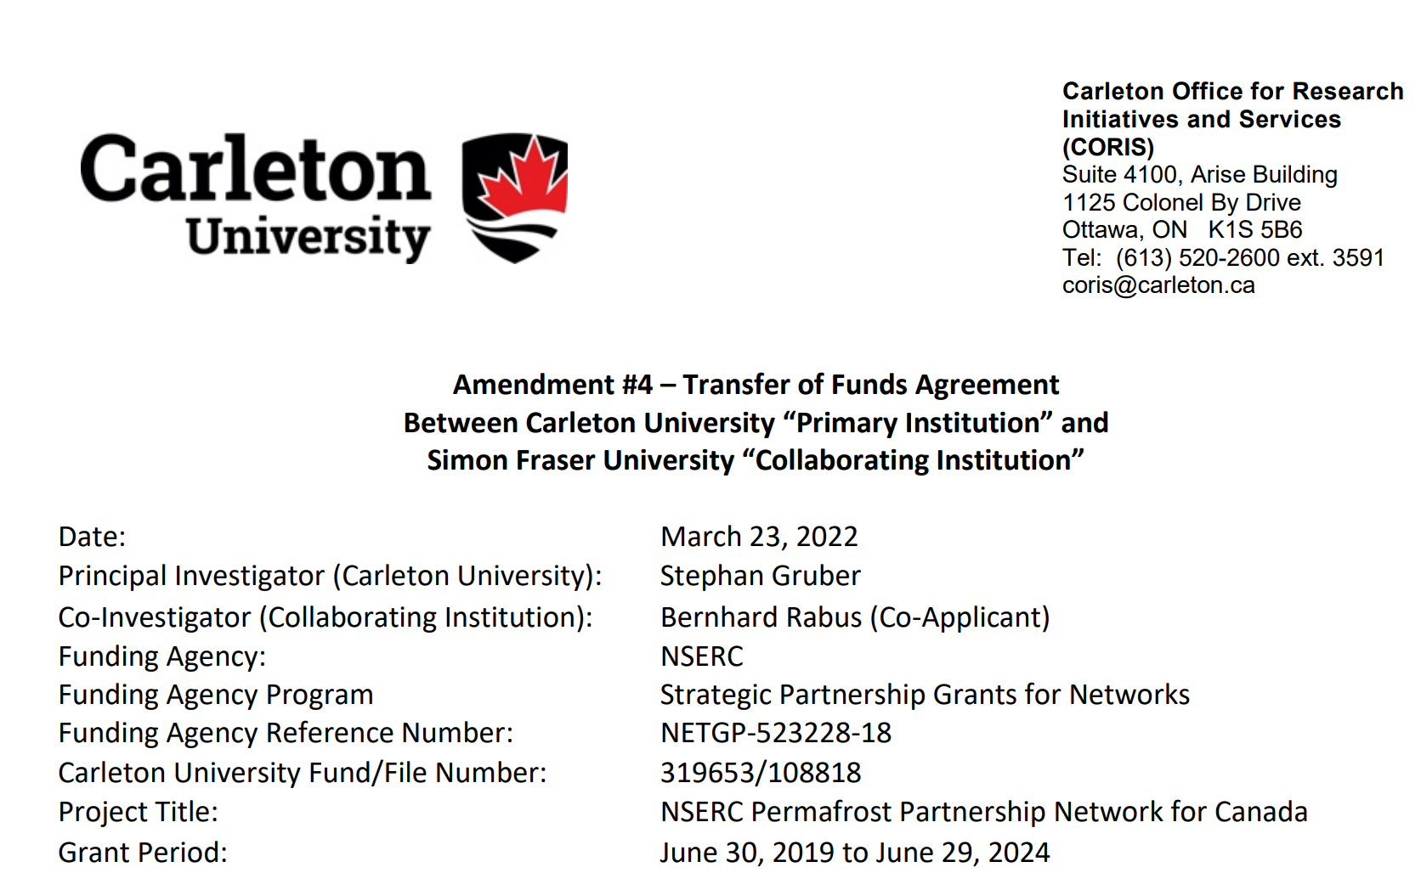
Tri-Agency Awards
Tri-Agency awards are made of
  Direct awards to SFU (e.g. NSERC, SSHRC, CIHR, CRC and NCEs)
  Sub-awards from other eligible Canadian organizations receiving Tri-Agency award
    Here is an example of a subaward from Carleton University to SFU for a NSERC funded project

Slide 67
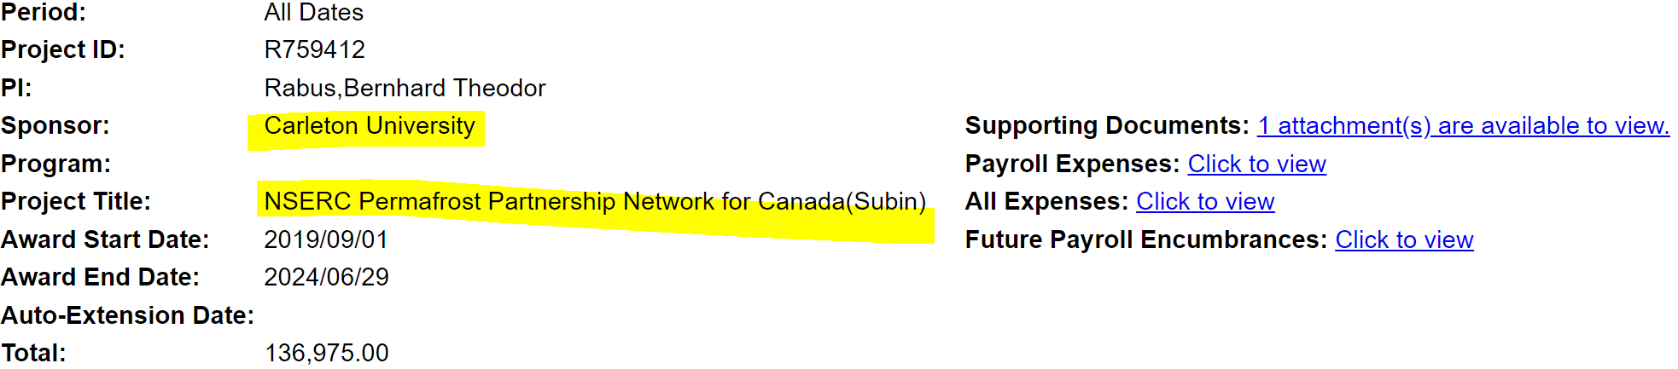
Tri-Agency Awards
In New FAST Views, the Sponsor shows “Carleton University” and the Project Title references “NSERC”
The copy of the agreement is viewable in the Supporting Documents

