Slide 1
Long-Term Financial Planning and Growth

Slide 2
Key Concepts and Skills
Understand the financial planning process and how decisions are interrelated
Be able to develop a financial plan using the step by step percentage of sales approach
The IGR, SGR approach – which provides easy to apply calculations in order to get some insight about the companies’ growth potential.
Understand how capital structure policy and dividend policy affect a firm’s ability to grow

Slide 3
The Bankruptcy of W.T Grant: A Failure in Planning
W.T Grant was the largest and one of the most successful department stores in the US with 1200 stores and 83000 employees, and $1.8 billion of sales. Yet, in 1975, the company filed for bankruptcy. How could this happen?
In the mid 60s the company foresaw a shift in shopping habits from inner city areas to out-of-town centers. The company decided to embark on a rapid expansion policy that involved opening up new stores in suburban areas. In addition to making a substantial investment in new buildings, the company needed to ensure the stores were stocked with merchandise, and it encouraged customers by extending credit more freely. The result was that NWC had to be doubled between 1967-1974.
The expansion plan led to impressive growth: sales doubled, profits increased by 50%, shareholders were happy and the stock price more than tripled. However, the return on capital fell, while management decided to increase dividends. Thus, most money came from debt financing and D/E ratio reached a high of 1.8. By 1974, all of the operating cash flow was used to service the debt. Finally, W.T. Grant could no longer service its mountain of debt.
This is mostly a failure of financial planning – because W.T. Grant sales were certainly not going down.

Slide 4
1.Elements of Financial Planning
Investment in new assets – determined by capital budgeting decisions
Degree of financial leverage – determined by capital structure decisions
Cash paid to shareholders – determined by dividend policy decisions
Liquidity requirements – determined by net working capital decisions

Slide 5
Financial Planning Process
Planning Horizon - divide decisions into short-run decisions (usually next 12 months) and long-run decisions (usually 2 – 5 years)
Aggregation - combine capital budgeting decisions into one big project
Assumptions and Scenarios
  Make realistic assumptions about important variables
  Run several scenarios where you vary the assumptions by reasonable amounts
  Determine at least a worst case, normal case, and best case scenario
Notes:
The time period used in the financial planning process is called the planning horizon.

Slide 6
Role of Financial Planning
Examine interactions – help management see the interactions between decisions
Explore options – give management a systematic framework for exploring its opportunities
Avoid surprises – help management identify possible outcomes and plan accordingly
Ensure feasibility and internal consistency – help management determine if goals can be accomplished and if the various stated (and unstated) goals of the firm are consistent with one another

Slide 7
2. Financial Planning Model Ingredients
Sales Forecast
  Drives the model
Pro Forma Statements
  The output summarizing different projections
Asset Requirements
  Investment needed to support sales growth
Financial Requirements
  Debt and dividend policies
The “Plug”
  Designated source(s) of external financing
Economic Assumptions
  State of the economy, interest rates, inflation

Slide 8
A Simple Financial Planning Model
Recent Financial Statements
Income statement Balance sheet
Sales $100 Assets $50 Debt $20
Costs 90 Equity 30
Net Income $10 Total $50 Total $50
Assume that:
  1. sales are projected to rise by 25%
  2. the debt/equity ratio stays at 2/3
  3. costs and assets grow at the same rate as sales

Slide 9
Example: A Simple Financial Planning Model (concluded)
Pro Forma Financial Statements
Income statement Balance sheet
Sales $ 125 Assets $ 62.5 Debt $ 25
Costs 112.5 ______ Equity 37.5
Net $ 12.5 Total $ 62.5 Total $ 62.5
What’s the plug?
Notice that projected net income is $12.50, but equity only increases by $7.50. The difference, $5.00 paid out in cash dividends, is the plug.

Slide 10
Example 2: Historical Financial Statements
Gourmet Coffee Inc.
Income Statement For Year Ended December 31, 2006
Revenues | 2000
Less: costs | (1600)
Net Income | 400
Gourmet Coffee Inc.
Balance Sheet December 31, 2006
Assets | 1000 | Debt | 400
 |  | Equity | 600
Total | 1000 | Total | 1000

Slide 11
Example 2: Pro Forma Income Statement
Initial Assumptions
  Revenues will grow at 15% (2,000*1.15)
  All items are tied directly to sales and the current relationships are optimal
  Consequently, all other items will also grow at 15%
Gourmet Coffee Inc.
Pro Forma Income Statement For Year Ended 2007
Revenues | 2,300
Less: costs | (1,840)
Net Income | 460

Slide 12
Example 2: Pro Forma Balance Sheet
Gourmet Coffee Inc.
Pro Forma Balance Sheet Case 1
Assets | 1,150 | Debt | 460
 |  | Equity | 690
Total | 1,150 | Total | 1,150
Case I: Dividends are the plug (debt to equity is constant)
Dividends = 460– 90 increase in dividends= 370
Case II: No dividends are paid and debt is the plug
Debt = 1,150 – (600+460) = 90
Repay 400 – 90 = 310 in debt
Gourmet Coffee Inc.
Pro Forma Balance Sheet Case 1
Assets | 1,150 | Debt | 90
 |  | Equity | 1,060
Total | 1,150 | Total | 1,150

Slide 13
Percent of Sales Approach (more realistic)
Some items vary directly with sales, while others do not
Income Statement
  Costs may vary directly with sales - if this is the case, then the profit margin is constant
  Depreciation and interest expense may not vary directly with sales – if this is the case, then the profit margin is not constant
  Dividends are a management decision and generally do not vary directly with sales – this affects additions to retained earnings
Balance Sheet
  Initially assume all assets, including fixed, vary directly with sales
  Accounts payable will also normally vary directly with sales
  Notes payable, long-term debt and equity generally do not vary directly with sales because they depend on management decisions about capital structure
  The change in the retained earnings portion of equity will come from the dividend decision

Slide 14
Example 3: Income Statement
Tasha’s Toy Emporium
Income Statement, 2006
 |  | % of Sales
Sales | 5,000
Less: costs | (3,000) | 60%
EBT | 2,000 | 40%
Less: taxes (40% of EBT) | (800) | 16%
Net Income | 1,200 | 24%
Dividends | 600
Add. To RE | 600
Tasha’s Toy Emporium
Pro Forma Income Statement, 2007
Sales | 5,500
Less: costs | (3,300)
EBT | 2,200
Less: taxes | (880)
Net Income | 1,320
Dividends | 660
Add. To RE | 660
Assume Sales grow at 10%
Dividend Payout Rate = 50%

Slide 15
Example 3: Balance Sheet
Tasha’s Toy Emporium – Balance Sheet
 | Current | % of Sales |  | Pro Forma |  | Current | % of Sales |  | Pro Forma
ASSETS |  |  |  |  | Liabilities & Owners’ Equity
Current Assets |  |  |  |  | Current Liabilities
Cash | $500 | 10% | $550 |  | A/P | $900 |  | 18% | $990
A/R | 2,000 | 40 | 2,200 |  | N/P | 2,500 |  | n/a | 2,500
Inventory | 3,000 | 60 | 3,300 |  | Total | 3,400 |  | n/a | 3,490
Total | 5,500 | 110 | 6,050 |  | LT Debt | 2,000 |  | n/a | 2,000
Fixed Assets |  |  |  |  | Owners’ Equity
Net PP&E | 4,000 | 80 | 4,400 |  | CS & APIC | 2,000 |  | n/a | 2,000
Total Assets | 9,500 | 190 | 10,450 |  | RE | 2,100 |  | n/a | 2,760
 |  |  |  |  | Total | 4,100 |  | n/a | 4,760
 |  |  |  |  | Total L & OE | 9,500 |  |  | 10,250
Notes:
There is not a double-ruled line at the bottom of the pro forma columns because the pro forma balance sheet has not yet been made to balance.

Slide 16
Example 3: External Financing Needed
The firm needs to come up with an additional $200 in debt or equity to make the balance sheet balance
  TA – TL&OE = 10,450 – 10,250 = 200
Choose plug variable ($200 external fin.)
  Borrow more short-term (Notes Payable)
  Borrow more long-term (LT Debt)
  Sell more common stock (CS & APIC)
  Decrease dividend payout, which increases the Additions To Retained Earnings

Slide 17
Example 3: Operating at Less than Full Capacity
Suppose that the company is currently operating at 80% capacity.
  Full Capacity sales = 5000 / .8 = 6,250
  Estimated sales = $5,500, so would still only be operating at 88%
  Therefore, no additional fixed assets would be required.
  Pro forma Total Assets = 6,050 + 4,000 = 10,050
  Total Liabilities and Owners’ Equity = 10,250
Choose plug variable (for $200 EXCESS financing)
  Repay some short-term debt (decrease Notes Payable)
  Repay some long-term debt (decrease LT Debt)
  Buy back stock (decrease CS & APIC)
  Pay more in dividends (reduce Additions To Retained Earnings)
  Increase cash account

Slide 18
Example 4:
All income statement accounts are projected to grow with sales at a rate of 30% (Pro forma). This includes in particular, dividends and retained earnings.
We will assume that some accounts vary with sales. Others, which may not directly vary with sales, we write n/a. We will assume that all asset accounts grow with sales, but only A/P in the liability side grows proportionally to sales (why is this reasonable?)

Slide 19
Example 4
Income Statement
(projected growth = 30%)
Original Pro forma
Sales $2000 $2600 (+30%)
Costs 1700 2210 (= 85% of sales)
EBT 300 390
Taxes (34%) 102 132.6
Net income 198 257.4
Dividends 66 85.8 (= 1/3 of net)
Add. to ret. Earnings 132 171.6 (= 2/3 of net)

Slide 20
Example 4
Preliminary Balance Sheet
Orig. % of sales Orig. % of sales
Cash $100 5% A/P $60 3%
A/R 120 6% N/P 140 n/a
Inv 140 7% Total 200 n/a
Total $360 18% LTD $200 n/a
NFA 640 32% C/S 10 n/a
R/E 590 n/a
$600 n/a
Total $1000 50% Total $1000 n/a
Note that the ratio of total assets to sales is $1000/$2000 = 0.50. This is the capital intensity ratio. It equals 1/(total asset turnover).

Slide 21
Example 4
Now, suppose we are instructed by the CEO to deliver a financing policy, under the following strategy:
Borrow short-term first
If needed, borrow long-term next
Sell equity as a last resort
Constraints:
Current ratio must not fall below 2.0.
Total debt ratio must not rise above 0.40.

Slide 22
Example 4:
The Percentage of Sales Approach, Continued
Proj. (+/-) Proj. (+/-)
Cash $130 $ 30 A/P $ 78 $ 18
A/R 156 36 N/P 140 0
Inv 182 42 Total $ 218 $ 18
Total $468 $108 LTD 200 0
NFA 832 192 C/S 10 0
R/E 761.6 171.6
$771.6 $171.6
Total $1300 $300 Total $1189.6 $189.6
Financing needs are $300, but internally generated sources are only $189.60. The difference is external financing needed:
EFN = $300 - 189.60 = $110.40

Slide 23
Example 4:
So far, we assumed that the firm is operating at 100% capacity. Suppose that, instead, current capacity use is 80%.
What is EFN?

Slide 24
Work the Web
Looking for estimates of company growth rates?
What do the analysts have to say?
Check out Yahoo Finance – click the web surfer, enter a company ticker and follow the “Analyst Estimates” link

Slide 25
3. Growth and External Financing
At low growth levels, internal financing (retained earnings) may exceed the required investment in assets
As the growth rate increases, the internal financing will not be enough and the firm will have to go to the capital markets for money
Examining the relationship between growth and external financing required is a useful tool in long-range planning

Slide 26
The Internal Growth Rate
The internal growth rate tells us how much the firm can grow assets using retained earnings as the only source of financing.
A = ending total assets from the previous period.
Given a sales forecast and an estimated profit margin (note we assume Net income is a percentage of sales), what addition to retained earnings can be expected?
Let:
S = previous period’s sales
g = projected increase in sales
p = profit margin (net income/sales)
b = earnings retention (“plowback”) ratio
The expected addition to retained earnings is:
Notes:
This firm could grow assets at 6.74% without raising additional external capital.
Relying solely on internally generated funds will increase equity (retained earnings are part of equity) and assets without an increase in debt. Consequently, the firm’s leverage will decrease over time. If there is an optimal amount of leverage, as we will discuss in later chapters, then the firm may want to borrow to maintain that optimal level of leverage. This idea leads us to the sustainable growth rate.

Slide 27
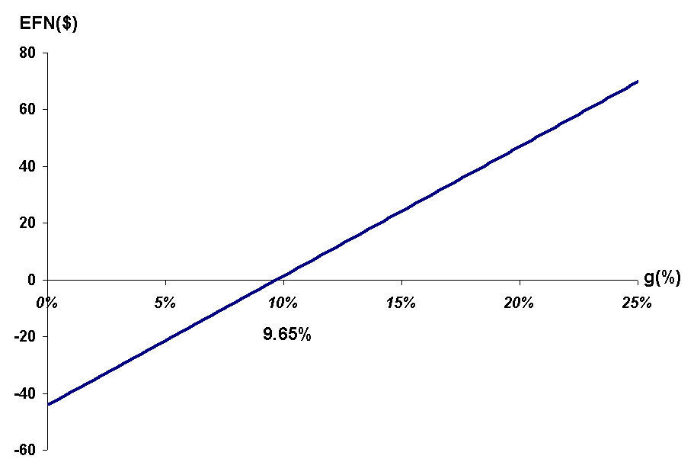
Growth and Financing Needed

Slide 28
The Internal Growth Rate
The internal growth rate tells us how much the firm can grow assets using retained earnings as the only source of financing.
  ROA = 1200 / 9500 = .1263
  B = .5
Notes:
This firm could grow assets at 6.74% without raising additional external capital.
Relying solely on internally generated funds will increase equity (retained earnings are part of equity) and assets without an increase in debt. Consequently, the firm’s leverage will decrease over time. If there is an optimal amount of leverage, as we will discuss in later chapters, then the firm may want to borrow to maintain that optimal level of leverage. This idea leads us to the sustainable growth rate.

Slide 29
The Sustainable Growth Rate
The sustainable growth rate tells us how much the firm can grow by using internally generated funds and issuing debt to maintain a constant debt ratio.
  ROE = 1200 / 4100 = .2927
  b = .5
Notes:
Note that no new equity is issued.
The sustainable growth rate is substantially higher than the internal growth rate. This is because we are allowing the company to issue debt as well as use internal funds.

Slide 30
Determinants of Growth
Profit margin – operating efficiency
Total asset turnover – asset use efficiency
Financial leverage – choice of optimal debt ratio
Dividend policy – choice of how much to pay to shareholders versus reinvesting in the firm
Notes:
The first three components come from the ROE and the Du Pont identity.
It is important to note at this point that growth is not the goal of a firm in and of itself. Growth is only important so long as it continues to maximize shareholder value.

Slide 31
Summary questions:
How does one compute the external financing needed (EFN)? Why is this information important to a financial planner?
What is the percentage of sales approach?
How do you adjust the model when operating at less than full capacity?
What is the internal growth rate?
What is the sustainable growth rate?
What are the major determinants of growth?

Slide 32
Question 1
“Molson” corp. sale is $80,000 and its net income is $5,000. Its dividends are $1,500, its total debt is $40,000, and its total equity is $18,000.
(a) (3 marks) What is the sustainable growth rate for Molson corp?
(b) (3 marks) If it does grow at this rate, how much new borrowing will take place in the coming year?
(c) (4 marks) What growth rate could be supported with no outside financing at all (assume that A/P do not grow with sales)?

Slide 33
Question 2
A firm wishes to maintain a growth rate of 12.94% and a dividend payout ratio of 50%. The ratio of assets to sale is 1.1 and profit margin is 8%. If the firm wishes to maintain a constant debt to equity ratio, what must it be?

Slide 34
Question 3
XYZ has the following financial information for 2006:
Sales = $2M, Net inc. = $.4M, Divs. = .1M
C.A. = $.4M, F.A. = $3.6M
C.L. = $.2M, LTD = $1M, C.S. = $2M, R.E. = $.8M
What is the sustainable growth rate?
If 2007 sales are projected to be $2.4M, what is the amount of external financing needed, assuming XYZ is operating at full capacity, and profit margin and payout ratio remain constant?
Notes:
ROE = net income / shareholders’ equity = $.4M / ($2M = + $.8M) = .1429
Payout ratio = dividends/net income = .1M/.4M = .25
Plowback ratio (b) 1 – payout ratio = 1 - .25 = .75
Sustainable growth rate = ROE X b / 1 – ROE X b = .1429 X .75 / (1 – (.1429 X .75)) = .12
Profit margin = net income/sales = .4M/2M = .2
Projected net income = profit margin X projected sales = .2 X $2.4M = $.48M
Projected addition to retained earnings = projected net income X (1 – payout ratio) = $.48M X (1-.25) = $.48M X .75 = $.36M
% change in sales = ($2.4M - $4M)/$4M = .2
2006 total assets = $.4M + $3.6M = $4M
Projected total assets = $4M X 1.2 = $4.8M
Projected C.L. = $.2M X 1.2 = $.24M
Projected R.E. = 2006 R.E. + projected addition to R.E. = $.8M + $.36M = $1.16M
Projected liabilities and owners’ equity = projected C.L. + LTD + C.S. + projected R.E. = $.24M + $1M + $2M + $1.16M = $4.4M
External Financing Needed = projected assets – projected liabs. and OE = $4.8M - $4.4M = $.4M

