Slide 1
Interest Rates and Bond Valuation

Slide 2
Key Concepts and Skills
Know the important bond features and bond types
Understand bond values and why they fluctuate
Understand bond ratings and what they mean
Understand the impact of inflation on interest rates
Understand the term structure of interest rates and the determinants of bond yields

Slide 3
Bond Definitions
Bond
Par value (face value)
Coupon rate
Coupon payment
Maturity date
Yield or Yield to maturity

Slide 4
YTM versus coupon rate !!
WARNING!
The coupon rate, though a percent, is not the interest rate (or discount rate).
The coupon rate tells us what cash flows a bond will produce.
The coupon rate does not tell us the value of those cash flows.
To determine the value of a cash flow, you must calculate its present value.

Slide 5
What would you be willing to pay right now for a bond which pays a coupon of 6.5% per year for 3 years, has a face value of $1,000. Assume that similar 3 year bonds offer a return of 5.1%.

Slide 6
Bond Prices and Yields
What is a Bond Worth?
To determine the price of the bond, you would calculate the PV of the cash flows using a 5.1% discount rate:
-Price ?
$65
$65
$65 +
1000
BOND PRICE = PV today:
0
1
2
3
$65/ (1.051) = $61.85
$65 / (1.051)² = $58.84
$1065 / (1.051)³ = $917.36
$1,038.05

Slide 7
Present Value of Cash Flows as Rates Change
Bond Value = PV of coupons + PV of par
Bond Value = PV of annuity + PV of lump sum
Remember, as interest rates increase present values decrease
So, as interest rates increase, bond prices decrease and vice versa

Slide 8
The Bond Pricing Equation
Notes:
This formalizes the calculations we have been doing.

Slide 9
Valuing a Bond with Annual Coupons
Consider a bond with a coupon rate of 10% and annual coupons. The par value is $1,000 and the bond has 5 years to maturity. The yield to maturity is 11%. What is the value of the bond?
Notes:
Using the formula:
Using the calculator:
N = 5; I/Y = 11; PMT = 100; FV = 1,000
CPT PV = -963.04
than par

Slide 10
Assume you have the following information.
Seagrams bonds have a $1000 face value
The promised annual coupon is $100
The bonds mature in 20 years.
What is the price of Seagrams bonds if the market’s required return on similar bonds is 12%?
What is the price if the market’s required return on similar bonds is 8%?

Slide 11
Bond Prices: Relationship Between Coupon and Yield
If YTM = coupon rate, then par value = bond price
If YTM > coupon rate, then par value > bond price
Why? The discount provides yield above coupon rate
Price below par value, called a discount bond
If YTM < coupon rate, then par value < bond price
Why? Higher coupon rate causes value above par
Price above par value, called a premium bond
Notes:
There are the purely mechanical reasons for these results.
We know that present values decrease as rates increase. Therefore, if we increase our yield above the coupon, the present value (price) must decrease below par. On the other hand, if we decrease our yield below the coupon, the present value (price) must increase above par.
There are more intuitive ways to explain this relationship. Explain that the yield-to-maturity is the interest rate on newly issued debt of the same risk and that debt would be issued so that the coupon = yield. Then, suppose that the coupon rate is 8% and the yield is 9%. Ask the students which bond they would be willing to pay more for. Most will say that they would pay more for the new bond. Since it is priced to sell at $1,000, the 8% bond must sell for less than $1,000. The same logic works if the new bond has a yield and coupon less than 8%.
Another way to look at it is that return = “dividend yield” + capital gains yield. The “dividend yield” in this case is just the coupon rate. The capital gains yield has to make up the difference to reach the yield to maturity. Therefore, if the coupon rate is 8% and the YTM is 9%, the capital gains yield must equal approximately 1%. The only way to have a capital gains yield of 1% is if the bond is selling for less than par value. (If price = par, there is no capital gain.) Technically, it is the current yield, not the coupon rate + capital gains yield, but from an intuitive standpoint, this helps some students remember the relationship and current yields and coupon rates are normally reasonably close.

Slide 12
Bond Price Sensitivity to YTM
Bond price
$1,800
Coupon = $100 20 years to maturity $1,000 face value
$1,600
$1,400
Key Insight: Bond prices and YTMs are inversely related.
$1,200
$1,000
$ 800
$ 600
Yield to maturity, YTM
4%
6%
8%
10%
12%
14%
16%

Slide 13
Computing Yield-to-maturity
Yield-to-maturity is the rate implied by the current bond price
Finding the YTM requires trial and error if you do not have a financial calculator and is similar to the process for finding r with an annuity
If you have a financial calculator, enter N, PV, PMT, and FV, remembering the sign convention (PMT and FV need to have the same sign, PV the opposite sign)

Slide 14
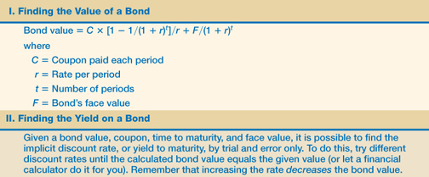
Table 7.1

Slide 15
What is the YTM of a bond with a coupon rate of 8% (paid annually) that matures in 5 years and priced today at 924.18?

Slide 16
YTM and Rate of Return
YTM is also the rate of return that you will receive by holding the bond till maturity. (Important dichotomy, the interest rate that I pay for a loan, is the rate of return the bank earns by lending the money to me).
But what if you wanted to hold this bond for only one year … now how would you calculate your return? Suppose in the previous example, you sell the bond after a year for 920$.

Slide 17
YTM and Rate of Return
Now suppose in the previous example, you sell the bond after a year and the YTM of similar bonds is still 10%. What is your rate of return?

Slide 18
YTM and Rate of Return
The rules with respect to rate of return and YTM are:
If interest rates do not change, the rate of return on the bond is equal to the yield to maturity.
If interest rates increase, then the rate of return will be less than the yield to maturity.
If interest rates decrease, then the rate of return will be more than the yield to maturity

Slide 19
Interest Rate Risk
Price Risk
Change in price due to changes in interest rates
Long-term bonds have more price risk than short-term bonds
Low coupon rate bonds have more price risk than high coupon rate bonds

Slide 20
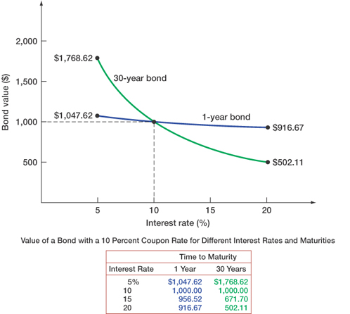
Figure 7.2

Slide 21
Bond Prices and Yields
Interest Rate Risk
Which bond would you rather own, the 30 year or the 3 year, if you expected interest rates to go down?
Why?
Which bond would you rather own, the 30 year or the 3 year, if you expected interest rates to go up?
Why?

Slide 22
YTM with Annual Coupons
Consider a bond with a 10% annual coupon rate, 15 years to maturity and a par value of $1,000. The current price is $928.09.
Will the yield be more or less than 10%?

Slide 23
YTM with Semiannual Coupons
Suppose a bond with a 10% coupon rate and semiannual coupons, has a face value of $1,000 and 20 years to maturity and is selling for $1,197.93.
Is the YTM more or less than 10%?
What is the semiannual coupon payment?
How many periods are there?
Notes:
N = 40; PV = -1,197.93; PMT = 50; FV = 1,000; CPT I/Y = 4% (Is this the YTM?)
YTM = 4%*2 = 8%

Slide 24
Current Yield vs. Yield to Maturity
Current Yield = annual coupon / price
Yield to maturity = current yield + capital gains yield
Example: 10% coupon bond, with semiannual coupons, face value of 1,000, 20 years to maturity, $1,197.93 price.

Slide 25
Bond Pricing Theorems
Bonds of similar risk (and maturity) will be priced to yield about the same return, regardless of the coupon rate
If you know the price of one bond, you can estimate its YTM and use that to find the price of the second bond
This is a useful concept that can be transferred to valuing assets other than bonds

Slide 26
Bond Prices with a Spreadsheet
There is a specific formula for finding bond prices on a spreadsheet
PRICE(Settlement,Maturity,Rate,Yld,Redemption, Frequency,Basis)
YIELD(Settlement,Maturity,Rate,Pr,Redemption, Frequency,Basis)
Settlement and maturity need to be actual dates
The redemption and Pr need to be input as % of par value
Click on the Excel icon for an example
Notes:
Please note that you have to have the analysis tool pack add-ins installed to access the PRICE and YIELD functions. If you do not have these installed on your computer, you can use the PV and the RATE functions to compute price and yield as well. Click on the TVM tab to find these calculations.

Slide 27
Bond Prices and Yields
Default Risk
Both corporations and the Government borrow money by issuing bonds.
There is an important difference between corporate borrowers and government borrowers:
Corporate borrowers can run out of cash and default on their borrowings.
The Government cannot default – it just prints more money to cover its debts.

Slide 28
Bond Prices and Yields
Default Risk
Default risk (or credit risk) is the risk that a bond issuer may default on its bonds.
To compensate investors for this additional risk, corporate borrowers must promise them a higher rate of interest than the US government would pay.
The default premium or credit spread is the difference between the promised yield on a corporate bond and the yield on a Government Bond with the same coupon and maturity.
The safety of a corporate bond can be judged from its bond rating.
Bond ratings are provided by companies such as:
Dominion Bond Rating Service (DBRS).
Moody’s.
Standard and Poor’s.

Slide 29
Bond Ratings – Investment Quality
High Grade
Moody’s Aaa and S&P AAA – capacity to pay is extremely strong
Moody’s Aa and S&P AA – capacity to pay is very strong
Medium Grade
Moody’s A and S&P A – capacity to pay is strong, but more susceptible to changes in circumstances
Moody’s Baa and S&P BBB – capacity to pay is adequate, adverse conditions will have more impact on the firm’s ability to pay

Slide 30
Bond Ratings - Speculative
Low Grade
Moody’s Ba, B, Caa and Ca
S&P BB, B, CCC, CC
Considered speculative with respect to capacity to pay. The “B” ratings are the lowest degree of speculation.
Very Low Grade
Moody’s C and S&P C – income bonds with no interest being paid
Moody’s D and S&P D – in default with principal and interest in arrears

Slide 31
Government Bonds
Treasury Securities
Federal government debt
T-bills – pure discount bonds with original maturity of one year or less
T-notes – coupon debt with original maturity between one and ten years
T-bonds coupon debt with original maturity greater than ten years
Municipal Securities
Debt of state and local governments
Varying degrees of default risk, rated similar to corporate debt
Interest received is tax-exempt at the federal level

Slide 32
The Bond Indenture
Contract between the company and the bondholders that includes
The basic terms of the bonds
The total amount of bonds issued
A description of property used as security, if applicable
Sinking fund provisions
Call provisions
Details of protective covenants

Slide 33
Bond Classifications
Security
Collateral – secured by financial securities
Mortgage – secured by real property, normally land or buildings
Debentures – unsecured
Notes – unsecured debt with original maturity less than 10 years
Seniority

Slide 34
Bond Characteristics and Required Returns
The YTM depends on the risk characteristics of the bond when issued
Which bonds will have the higher YTM, all else equal?
Secured debt versus a debenture
Subordinated debenture versus senior debt
A bond with a sinking fund versus one without
A callable bond versus a non-callable bond
Notes:
Debenture: secured debt is less risky because the income from the security is used to pay it off first
Subordinated debenture: will be paid after the senior debt
Bond without sinking fund: company has to come up with substantial cash at maturity to retire debt and this is riskier than systematic retirement of debt through time
Callable – bondholders bear the risk of the bond being called early, usually when rates are lower. They don’t receive all of the expected coupons and they have to reinvest at lower rates.

Slide 35
Example 7.4
A taxable bond has a yield of 8% and a municipal bond has a yield of 6%
If you are in a 40% tax bracket, which bond do you prefer?
At what tax rate would you be indifferent between the two bonds?
Notes:
You should be willing to accept a lower stated yield on municipals because you do not have to pay taxes on the interest received. You will want to make sure the students understand why you are willing to accept a lower rate of interest. It may be helpful to take the example and illustrate the indifference point using dollars instead of just percentages. The discount you are willing to accept depends on your tax bracket.
Consider a taxable bond with a yield of 8% and a tax-exempt municipal bond with a yield of 6%
Suppose you own one $1,000 bond in each and both bonds are selling at par. You receive $80 per year from the corporate and $60 per year from the municipal. How much do you have after taxes if you are in the 40% tax bracket? Corporate: 80 – 80(.4) = 48; Municipal = 60

Slide 36
Zero Coupon Bonds
Make no periodic interest payments (coupon rate = 0%)
The entire yield-to-maturity comes from the difference between the purchase price and the par value
Cannot sell for more than par value
Sometimes called zeroes, deep discount bonds, or original issue discount bonds (OIDs)
Treasury Bills and principal-only Treasury strips are good examples of zeroes

Slide 37
Floating-Rate Bonds
Coupon rate floats depending on some index value
Examples – adjustable rate mortgages and inflation-linked Treasuries
There is less price risk with floating rate bonds
The coupon floats, so it is less likely to differ substantially from the yield-to-maturity
Coupons may have a “collar” – the rate cannot go above a specified “ceiling” or below a specified “floor”

Slide 38
Other Bond Types
Disaster bonds
Income bonds
Convertible bonds
Put bonds
There are many other types of provisions that can be added to a bond and many bonds have several provisions – it is important to recognize how these provisions affect required returns

Slide 39
Bond Markets
Primarily over-the-counter transactions with dealers connected electronically
Extremely large number of bond issues, but generally low daily volume in single issues
Makes getting up-to-date prices difficult, particularly on small company or municipal issues
Treasury securities are an exception

Slide 40
Work the Web Example
Bond information is available online
One good site is Yahoo Finance
Click on the web surfer to go to the site

Slide 41
Inflation and Interest Rates
Real rate of interest – change in purchasing power
Nominal rate of interest – quoted rate of interest, change in purchasing power, and inflation
The ex ante nominal rate of interest includes our desired real rate of return plus an adjustment for expected inflation

Slide 42
The Fisher Effect
The Fisher Effect defines the relationship between real rates, nominal rates, and inflation
(1 + R) = (1 + r)(1 + h), where
R = nominal rate
r = real rate
h = expected inflation rate
Approximation
R = r + h

Slide 43
Example 7.5
If we require a 10% real return and we expect inflation to be 8%, what is the nominal rate?
R = (1.1)(1.08) – 1 = .188 = 18.8%
Approximation: R = 10% + 8% = 18%
Because the real return and expected inflation are relatively high, there is significant difference between the actual Fisher Effect and the approximation.

Slide 44
Suppose we have $1000, and Diet Coke costs $2.00 per six pack. We can buy 500 six packs. Now suppose the rate of inflation is 5%, so that the price rises to $2.10 in one year. We invest the $1000 and it grows to $1100 in one year. What’s our return in dollars? In six packs?

Slide 45
Term Structure of Interest Rates
Term structure is the relationship between time to maturity and yields, all else equal
It is important to recognize that we pull out the effect of default risk, different coupons, etc.
Yield curve – graphical representation of the term structure
Normal – upward-sloping, long-term yields are higher than short-term yields
Inverted – downward-sloping, long-term yields are lower than short-term yields

Slide 46
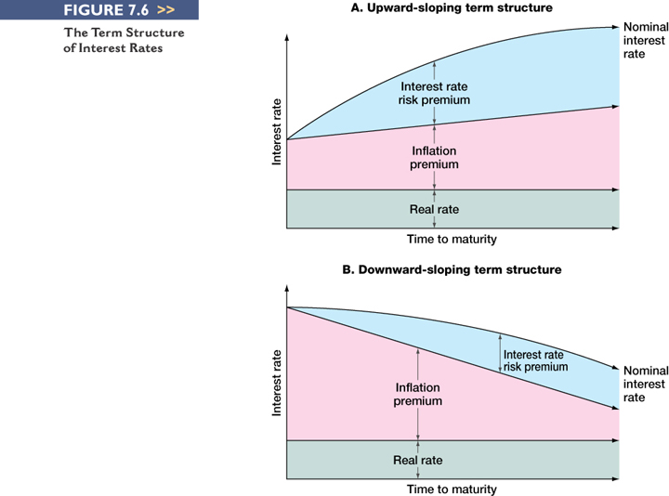
Figure 7.6 – Upward-Sloping Yield Curve

Slide 47
Figure 7.6 – Downward-Sloping Yield Curve

Slide 48
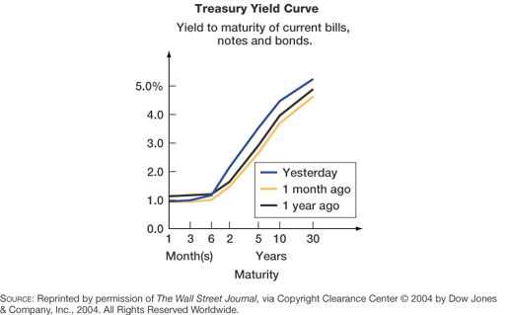
Figure 7.7

Slide 49
Factors Affecting Bond Yields
Default risk premium – remember bond ratings
Taxability premium – remember municipal versus taxable
Liquidity premium – bonds that have more frequent trading will generally have lower required returns
Anything else that affects the risk of the cash flows to the bondholders will affect the required returns

Slide 50
Question 1
Joe Kernan Corporation has bonds on the market with 10.5 years to maturity, a yield-to-maturity of 8 (quoted as APR) percent, and a current price of $850. The bonds make semiannual payments. What must the coupon rate be on the bonds?

Slide 51
Question 2:
Today is Nov 29, 2002 . Calculate the price of the Canada bond 10.25%, Mar 15/14 to prove that it is priced at 141.86 when YTM is 5.28%.
Notes:
The time to maturity at the time of Figure 7.3 is 7 periods plus the period from April 22, 2000 to August 01, 2000 (when the next payment will be made). We calculate the remaining time as
April 22, 2000 - February 1, 2000
--------------------------------------------
August 01, 2000 - February 1, 2000

Slide 52
Question 3
Bond J is a 4% coupon bond. Bond K is a 10% coupon bond. Both bonds have 8 years to maturity, make semiannual payments, and have a YTM of 9%. If interest rates suddenly rise by 2%, what is the percentage price change of these bonds? What if rates suddenly fall by 2% instead? What does this problem tell you about the interest rate risk of lower-coupon bonds?

Slide 53
Solution to Question 3
Percentage Changes in Bond Prices
Bond Prices and Market Rates
7% 9% 11%
_________________________________
Bond J $818.59 $719.15 $633.82
% chg. (+13.83%) (–11.87%)
Bond K $1181.41 $1056.17 $947.69
% chg. (+11.86%) (–10.27%)
_________________________________
All else equal, the price of the lower-coupon bond changes more (in percentage terms) than the price of the higher-coupon bond when market rates change.

Slide 54
Quick Quiz
How do you find the value of a bond and why do bond prices change?
What is a bond indenture and what are some of the important features?
What are bond ratings and why are they important?
How does inflation affect interest rates?
What is the term structure of interest rates?
What factors determine the required return on bonds?

