Slide 1
Internal Rate of Return
This is the most important alternative to NPV
It is often used in practice and is intuitively appealing
It is based entirely on the estimated cash flows and is independent of interest rates found elsewhere

Slide 2
IRR – Definition and Decision Rule
Definition: IRR is the return that makes the NPV = 0
Decision Rule: Accept the project if the IRR is greater than the required return

Slide 3
Internal Rate of Return (IRR)
To go back to our office example, we discovered the following:
Discount Rate NPV of Project
7% $23,382
12% $7,143
At what rate of return will the NPV of this project be equal to zero?

Slide 4
IRR BY GRAPH
NPV Profile for this Project
$60,000
$50,000
IRR = 14.3%
(occurs where NPV = 0)
$40,000
$30,000
NPV ($)
$20,000
$10,000
$0
($10,000)
5%
10%
15%
20%
($20,000)
Discount Rate

Slide 5
Find the IRR for the following cash flow
0 | 1 | 2
-1000 | 500 | 1500

Slide 6
Computing IRR for the Project
If you do not have a financial calculator, then finding the IRR for more than three cash flows becomes a trial and error process
Excel
IRR = 16.13% > 12% required return
Do we accept or reject the project?
Notes:
Many of the financial calculators will compute the IRR as soon as it is pressed; others require that you press compute.

Slide 7
NPV Profile for the Project
IRR = 16.13%

Slide 8
Decision Criteria Test - IRR
Does the IRR rule account for the time value of money?
Does the IRR rule account for the risk of the cash flows?
Does the IRR rule provide an indication about the increase in value?
Should we consider the IRR rule for our primary decision criteria?

Slide 9
Advantages of IRR
Knowing a return is intuitively appealing
It is a simple way to communicate the value of a project to someone who doesn’t know all the estimation details
If the IRR is high enough, you may not need to estimate a required return, which is often a difficult task

Slide 10
Summary of Decisions for the Project
Summary
Net Present Value | Accept
Payback Period | Reject
Discounted Payback Period | Reject
Internal Rate of Return | Accept

Slide 11
NPV vs. IRR
NPV and IRR will generally give us the same decision
Exceptions
Non-conventional cash flows – cash flow signs change more than once
Mutually exclusive projects
Initial investments are substantially different
Timing of cash flows is substantially different

Slide 12
Pitfalls with IRR – Lending vs Borrowing
Calculate the IRR and NPV for the projects below:
Cash Flows in Dollars
Project: C₀ C₁ IRR NPV @ 6%
J -100 +150
K +100 -150
50% + $36.4
50% - $36.4
Both projects have the same IRR … but Project J contributes more to the value of the firm.
Obviously, you should prefer Project J!
.

Slide 13
Pitfalls with IRR – Lending vs Borrowing
Project J involves lending $100 at 50% interest.
Project K involves borrowing $100 at 50% interest.
Which option should you choose?
Remember:
When you lend money, you want a high rate of return.
When you borrow money, you want a low rate of return.
.

Slide 14
Pitfalls with IRR – Lending vs Borrowing
The IRR calculation shows that both projects have a 50% rate of return and are equally desirable.
You should see that this is a trap!
The NPV rule correctly warns you away from a project which involves borrowing money at 50%.
.

Slide 15
Multiple Rates of Return
Assume you are considering a project for which the cash flows are as follows:
Year Cash flows
0 -$252
1 1,431
2 -3,035
3 2,850
4 -1,000

Slide 16
Multiple Rates of Return (continued)
What’s the IRR? Find the rate at which the computed NPV = 0:
at 25.00%: NPV = 0
at 33.33%: NPV = 0
at 42.86%: NPV = 0
at 66.67%: NPV = 0
Two questions:
1. What’s going on here?
2. How many IRRs can there be?

Slide 17
Multiple Rates of Return (concluded)
NPV
$0.06
$0.04
$0.02
IRR = 1/4
$0.00
($0.02)
IRR = 1/3
IRR = 2/3
IRR = 3/7
($0.04)
($0.06)
($0.08)
0.2
0.28
0.36
0.44
0.52
0.6
0.68
Discount rate

Slide 18
IRR and Non-conventional Cash Flows
When the cash flows change sign more than once, there is more than one IRR
When you solve for IRR you are solving for the root of an equation and when you cross the x-axis more than once, there will be more than one return that solves the equation
If you have more than one IRR, which one do you use to make your decision?

Slide 19
Another Example – Non-conventional Cash Flows
Suppose an investment will cost $90,000 initially and will generate the following cash flows:
Year 1: 132,000
Year 2: 100,000
Year 3: -150,000
The required return is 15%.
Should we accept or reject the project?

Slide 20
NPV Profile
IRR = 10.11% and 42.66%

Slide 21
Summary of Decision Rules
The NPV is positive at a required return of 15%, so you should Accept
If you use the financial calculator, you would get an IRR of 10.11% which would tell you to Reject
You need to recognize that there are non-conventional cash flows and look at the NPV profile

Slide 22
IRR and Mutually Exclusive Projects
Mutually exclusive projects
If you choose one, you can’t choose the other
Example: You can choose to attend graduate school at either Harvard or Stanford, but not both
Intuitively you would use the following decision rules:
NPV – choose the project with the higher NPV
IRR – choose the project with the higher IRR

Slide 23
Example With Mutually Exclusive Projects
Period | Project A | Project B
0 | -500 | -400
1 | 325 | 325
2 | 325 | 200
IRR | 19.43% | 22.17%
NPV | 64.05 | 60.74
The required return for both projects is 10%.
Which project should you accept and why?

Slide 24
NPV Profiles
IRR for A = 19.43%
IRR for B = 22.17%
Crossover Point = 11.8%

Slide 25
Conflicts Between NPV and IRR
NPV directly measures the increase in value to the firm
Whenever there is a conflict between NPV and another decision rule, you should always use NPV
IRR is unreliable in the following situations
Non-conventional cash flows
Mutually exclusive projects

Slide 26
Example 2: Mutually Exclusive Projects
Year
0 1 2 3 4
Project A: – $350 50 100 150 200
Project B: – $250 125 100 75 50
IRR(A)= 12.91%
IRR(B)=17.8%
Is B better than A?

Slide 27
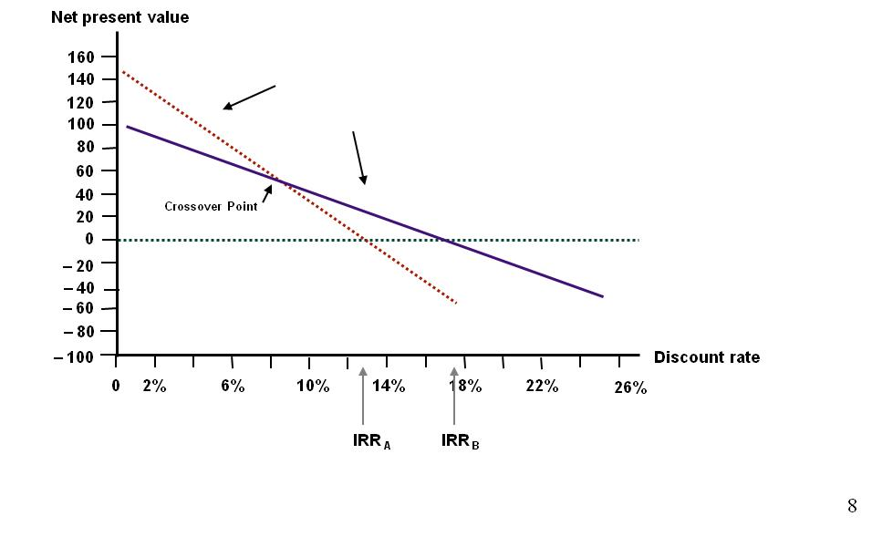
Example 2: Mutually Exclusive Projects

Slide 28
Profitability Index
Measures the benefit per unit cost, based on the time value of money
A profitability index of 1.1 implies that for every $1 of investment, we create an additional $0.10 in value
This measure can be very useful in situations in which we have limited capital

Slide 29
Advantages and Disadvantages of Profitability Index
Advantages
Closely related to NPV, generally leading to identical decisions
Easy to understand and communicate
May be useful when available investment funds are limited
Disadvantages
May lead to incorrect decisions in comparisons of mutually exclusive investments

Slide 30
Summary – Discounted Cash Flow Criteria
Net present value
Difference between market value and cost
Take the project if the NPV is positive
Has no serious problems
Preferred decision criterion
Internal rate of return
Discount rate that makes NPV = 0
Take the project if the IRR is greater than the required return
Same decision as NPV with conventional cash flows
IRR is unreliable with non-conventional cash flows or mutually exclusive projects
Profitability Index
Benefit-cost ratio
Take investment if PI > 1
Cannot be used to rank mutually exclusive projects
May be used to rank projects in the presence of capital rationing

Slide 31
Summary – Payback Criteria
Payback period
Length of time until initial investment is recovered
Take the project if it pays back within some specified period
Doesn’t account for time value of money and there is an arbitrary cutoff period
Discounted payback period
Length of time until initial investment is recovered on a discounted basis
Take the project if it pays back in some specified period
There is an arbitrary cutoff period

Slide 32
Comprehensive Problem
An investment project has the following cash flows: CF0 = -1,000,000; C01 – C08 = 200,000 each
If the required rate of return is 12%, what decision should be made using NPV?
How would the IRR decision rule be used for this project, and what decision would be reached?
How are the above two decisions related?

Slide 33
10
Making Capital Investment Decisions

Slide 34
Key Concepts and Skills
Understand how to determine the relevant cash flows for various types of proposed investments.
Be able to compute depreciation expense for tax purposes.
Understand the various methods for computing operating cash flow.
Be able to do capital budgeting analysis.

Slide 35
Relevant Cash Flows
The cash flows that should be included in a capital budgeting analysis are those that will only occur if the project is accepted
These cash flows are called incremental cash flows
The stand-alone principle allows us to analyze each project in isolation from the firm simply by focusing on incremental cash flows

Slide 36
A. Forget Sunk Cost
You should always ask yourself “Will this cash flow occur ONLY if we accept the project?”
If the answer is “yes”, it should be included in the analysis because it is incremental
If the answer is “no”, it should not be included in the analysis because it will occur anyway
If the answer is “part of it”, then we should include the part that occurs because of the project

Slide 37
Example: Sunk Cost
Your firm paid $100,000 last year for a marketing report for a new widget it is considering to develop.
You are doing a capital budgeting analysis of the new widget project. Should the marketing report cost be considered part of the project’s costs?

Slide 38
B. Include Opportunity Cost
Most resources are not free, even if no money changes hands.
Example: Suppose your firm is considering building a factory on some land. Your firm purchased this land for $50,000 a year ago. Its market value today is $100,000. For analysis purpose, what land value should be used?
Notes:
With each of these types of cash flows, you should ask the class the question on the previous slide so that they can start to determine if the cash flows are relevant.
Sunk costs – our government provides ample examples of inappropriately including sunk costs in their capital allocation decisions.
Opportunity costs – the classic example of an opportunity cost is the use of land or plant that is already owned. It is important to point out that this is not “free.” At the very least we could sell the land; consequently if we choose to use it, we cost ourselves the selling price of the asset.
A good example of a positive side effect is when you will establish a new distribution system with this project that can be used for existing or future projects. The benefit provided to those projects needs to be considered.
The most common negative side effect is erosion or cannibalism, where the introduction of a new product will reduce the sales of existing, similar products. A good real-world example is McDonald’s introduction of the Arch Deluxe sandwich. Instead of generating all new sales, it primarily reduced sales in the Big Mac and the Quarter Pounder.
It is important to consider changes in NWC. We need to remember that operating cash flow derived from the income statement assumes all sales are cash sales and that the COGS was actually paid in cash during that period. By looking at changes in NWC specifically, we can adjust for the difference in cash flow that results from accounting conventions. Most projects will require an increase in NWC initially as we build inventory and receivables. Then we recover NWC at the end of the project.
We do not include financing costs. Students often have difficulty understanding why when it appears that we will only raise capital if we take the project. It is important to point out that because of economies of scale, companies generally do not finance individual projects. Instead, they finance the entire portfolio of projects at one time. The other reason has to do with maintaining a target capital structure over time, but not necessarily each year. Finally, financing cost is included in the required return, thus including the financing-related cash flows would be double counting.
Taxes will change as the firm’s taxable income changes. Consequently, we have to consider cash flows on an after-tax basis.

Slide 39
C. Include Side Effects
Calculate the firm’s cash flows if it goes ahead with the project.
Calculate the cash flows if the firm doesn’t go ahead with the project.
Take the difference, which gives you the extra, or incremental, cash flow of the project.
Incremental cash flow = Cash flow with project – Cash flow without cash flow.
Notes:
With each of these types of cash flows, you should ask the class the question on the previous slide so that they can start to determine if the cash flows are relevant.
Sunk costs – our government provides ample examples of inappropriately including sunk costs in their capital allocation decisions.
Opportunity costs – the classic example of an opportunity cost is the use of land or plant that is already owned. It is important to point out that this is not “free.” At the very least we could sell the land; consequently if we choose to use it, we cost ourselves the selling price of the asset.
A good example of a positive side effect is when you will establish a new distribution system with this project that can be used for existing or future projects. The benefit provided to those projects needs to be considered.
The most common negative side effect is erosion or cannibalism, where the introduction of a new product will reduce the sales of existing, similar products. A good real-world example is McDonald’s introduction of the Arch Deluxe sandwich. Instead of generating all new sales, it primarily reduced sales in the Big Mac and the Quarter Pounder.
It is important to consider changes in NWC. We need to remember that operating cash flow derived from the income statement assumes all sales are cash sales and that the COGS was actually paid in cash during that period. By looking at changes in NWC specifically, we can adjust for the difference in cash flow that results from accounting conventions. Most projects will require an increase in NWC initially as we build inventory and receivables. Then we recover NWC at the end of the project.
We do not include financing costs. Students often have difficulty understanding why when it appears that we will only raise capital if we take the project. It is important to point out that because of economies of scale, companies generally do not finance individual projects. Instead, they finance the entire portfolio of projects at one time. The other reason has to do with maintaining a target capital structure over time, but not necessarily each year. Finally, financing cost is included in the required return, thus including the financing-related cash flows would be double counting.
Taxes will change as the firm’s taxable income changes. Consequently, we have to consider cash flows on an after-tax basis.

Slide 40
Recognize Investment in NWC
Forget Financing Costs
Discount Nominal Cash Flows by the Nominal Cost of Capital
Recognize Government Interventions
Beware of Overhead Costs
Notes:
With each of these types of cash flows, you should ask the class the question on the previous slide so that they can start to determine if the cash flows are relevant.
Sunk costs – our government provides ample examples of inappropriately including sunk costs in their capital allocation decisions.
Opportunity costs – the classic example of an opportunity cost is the use of land or plant that is already owned. It is important to point out that this is not “free.” At the very least we could sell the land; consequently if we choose to use it, we cost ourselves the selling price of the asset.
A good example of a positive side effect is when you will establish a new distribution system with this project that can be used for existing or future projects. The benefit provided to those projects needs to be considered.
The most common negative side effect is erosion or cannibalism, where the introduction of a new product will reduce the sales of existing, similar products. A good real-world example is McDonald’s introduction of the Arch Deluxe sandwich. Instead of generating all new sales, it primarily reduced sales in the Big Mac and the Quarter Pounder.
It is important to consider changes in NWC. We need to remember that operating cash flow derived from the income statement assumes all sales are cash sales and that the COGS was actually paid in cash during that period. By looking at changes in NWC specifically, we can adjust for the difference in cash flow that results from accounting conventions. Most projects will require an increase in NWC initially as we build inventory and receivables. Then we recover NWC at the end of the project.
We do not include financing costs. Students often have difficulty understanding why when it appears that we will only raise capital if we take the project. It is important to point out that because of economies of scale, companies generally do not finance individual projects. Instead, they finance the entire portfolio of projects at one time. The other reason has to do with maintaining a target capital structure over time, but not necessarily each year. Finally, financing cost is included in the required return, thus including the financing-related cash flows would be double counting.
Taxes will change as the firm’s taxable income changes. Consequently, we have to consider cash flows on an after-tax basis.

Slide 41
Example: Incremental Cash Flow
Winnebagel Corp. currently sells 18,500 motor homes per year at $37,500 each, and 5,000 luxury motor coaches per year at $62,000 each. The company wants to introduce a new portable camper to fill out its product line; it hopes to sell 13,500 of these campers per year at $10,000 each. An independent consultant has determined that if Winnebagel introduces the new campers, it should boost the sales of its existing motor homes by 3,500 units per year and reduce the sales of its motor coaches by 1,200 units per year. What is the amount to use as the annual sales figure when evaluating this product?

Slide 42
Pro Forma Statements and Cash Flow
Capital budgeting relies heavily on pro forma accounting statements, particularly income statements
Computing cash flows – refresher
Operating Cash Flow (OCF) = EBIT + depreciation – taxes
CFA = OCF – Capital spending – Changes in NWC
Notes:
Operating cash flow – students often have to go back to the income statement to see that the two definitions of operating cash flow are equivalent when there is no interest expense.

Slide 43
Example: Capital Budgeting of Norma Desmond Enterprises
Suppose Norma Desmond Enterprises is considering a new project with the following information. Should the firm invest in this project? Why or why not?
Sales of 10,000 units/year @ $5/unit.
Variable cost per unit is $3. Fixed costs are $5,000 per year. The project has no salvage value. Project life is 3 years.
Project cost is $21,000. Depreciation is $7,000/year.
Additional net working capital is $10,000.
The firm’s required return is 20%. The tax rate is 34%.

