Slide 1
Week #4: Cold Mountain
Professor Poyner-Del Vento

Slide 2
Kindly turn off
All cell phones
The wireless component of any laptop computers

Slide 3
Overview of lecture
Essay assignment
Connection to land
Spirituality
Portrayal of women
Close Reading and exams

Slide 4
Essay assignment

Slide 5
Components of Essay
Proposal (5% of final grade)
First draft (10% of final grade)
Outline (10% of final grade)
Final draft (35% of final grade)

Slide 6
Assignment Sheet
Front: topics and other important information
Back: grading rubric

Slide 7
Rubric for an A
An “A” is reserved for truly outstanding work. It must have:
a provocative, debatable thesis that advances readers’ understanding of the novel
original, convincing arguments that fully support the thesis
close, detailed analyses of the novel’s passages
a well-organized essay structure
strong language and sentences
successful use of quoted, paraphrased, and summarized material
no spelling, grammar, or sentence-structure errors
correct MLA style

Slide 8
Rubric for a B
A “B” grade means good, not great. It has some qualities of an “A” paper, but also has one or more of the following:
a debatable thesis
some arguments that do not fully support the thesis
analyses of the novel’s passages
a slightly confusing essay structure
some weak use of language
solid use of quoted, paraphrased, and summarized material
some spelling, grammar, or sentence-structure errors
a few MLA style errors

Slide 9
Resources for Ideas
Visit office hours
Tutorial Leaders
Professor P.D.: Monday 4:00 to 6:00 p.m. in SUR 5191, or by appointment
E-mail straightforward questions
Tutorial Leaders
Professor P.D.: k_pd@sfu.ca
ENGL 101’s WebCT page

Slide 10
Resources for Writing Style
Student Learning Commons*
Classmates / friends for proofreading help*
ENGL 101’s WebCT page
OWL website for grammar/syntax help
Folder for MLA Style help
Discussion boards for communicating with classmates*
*Remember to acknowledge outside help with an Acknowledgements page

Slide 11
Essay preparation
During the next few weeks, you should:
Select a novel
Select a topic
Browse through novel for relevant passages
Brainstorm—write down your ideas about your novel/topic combination

Slide 12
Connection to land

Slide 13
Land as source of survival
Both protagonists are struggling just to survive
Inman
Ada
Both protagonists use the land to survive
Inman
Ada

Slide 14
Land as source of survival
“Simply living had never struck Ada as such a tiresome business. . . . When the bleeding headless body staggered about the yard in the time-honored habit of sots, Ruby pointed to it with her ragged sheath knife and said, That’s your sustenance there.” (Frazier 104-105)

Slide 15
Land as physical home
Inman—walking toward home
Ada—trying to build a home

Slide 16
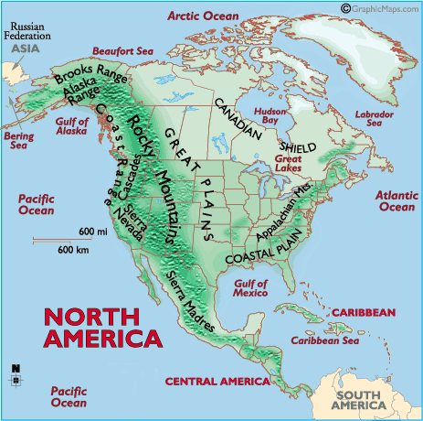
Map of Appalachian Mountains

Slide 17
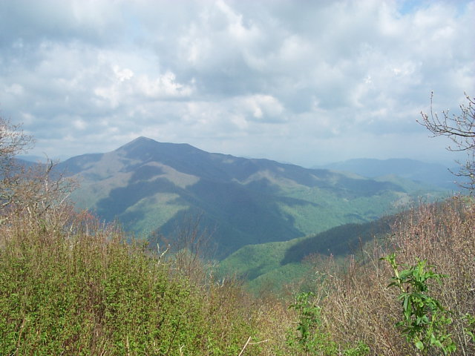
Cold Mountain, North Carolina

Slide 18
Charles Frazier’s Interview with Book Browse
“I’d been wanting to write a book that had the southern Appalachian Mountains as a primary force, almost like a main character, for quite some time, but I didn't know whether I wanted to write a work of fiction, nonfiction, or what.”

Slide 19
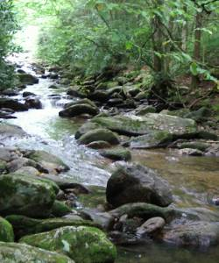
Cold Mountain, North Carolina

Slide 20
Cold Mountain as emotional home
“Inman fared on through this territory, criticizing its every feature. . . . And if Ada would go with him, there might the hope, so far off in the distance he did not even really see it, that in time his despair might be honed off to a point so fine and thin that it would be nearly the same as vanishing.” (Frazier 85)

Slide 21
Spirituality

Slide 22
Omens
“He raised his coffee cup to his lips and found it could and nearly empty, and he put it down. . . . The way Inman saw it, if a thing like Fredericksburg was to be used as a marker of current position, then many years hence, at the rate we’re going, we’ll be eating one another raw.” (Frazier 21-22)

Slide 23
Spiritual sources for Inman
Christianity
Cherokee mythology and religion
Transcendentalism

Slide 24
Cherokee mythology
Cherokee religious beliefs—both a physical and a spiritual world, and it’s essential to maintain harmony between the two
Swimmer—main source of Cherokee knowledge for Inman
Other Cherokee / Native American references

Slide 25
Cherokee beliefs
“His spells portrayed the spirit as a frail thing, constantly under attack and in need of strength, always threatening to die inside you. Inman found this notion dismal indeed, since he had been taught by sermon and hymn to hold as truth that the soul of man never dies.” (Frazier 20)

Slide 26
Cherokee beliefs
“And, too, Inman guessed Swimmer’s spells were right in saying a man’s spirit could be torn apart and cease and yet his body keep on living. . . . It seemed a poor swap to find that the only way one might keep from fearing death was to act numb and set apart as if dead already, with nothing much left of yourself but a hut of bones.” (Frazier 22)

Slide 27
Transcendentalism
Philosophical movement
Monroe—main source of Transcendentalist knowledge for Inman
Bartram’s Travels—not a Transcendentalist text itself, but expresses beliefs closely aligned with the movement

Slide 28
Definition of Transcendentalism
“An American philosophical and religious movement, based in New England from around 1835 until the Civil War. . . . The Transcendentalists stressed the importance of intuition and subjective experience in communication with God. They rejected religious dogma and texts in favor of mysticism and scientific naturalism. They pursued truths that lie beyond the ‘colorless’ realms perceived by reason and the senses and were active social reformers in public education, women's rights, and the abolition of slavery.
“Prominent members of the group include Ralph Waldo Emerson and Henry David Thoreau.”

Slide 29
Intersection of Cherokee and Transcendentalist beliefs
“As Inman walked, he thought of a spell Swimmer had taught him, one of particular potency. . . . Inman thought that had been the best sermon he had ever heard, and Monroe had delivered it on the day Inman first saw Ada.” (Frazier 76-77)

Slide 30
Free write
How are these two passages similar to each other?
How are these two passages different from each other?
Overall, what philosophy toward life and death do they convey?
What significance do these passages have to the novel as a whole?

Slide 31
Intersection of Cherokee and Transcendentalist beliefs
Both beliefs are NOT from Inman’s own white, Southern culture
Cherokees have been forcibly removed from area
Transcendentalism is a philosophy from Northern states
Yet both beliefs honor the natural world and the local landscape
Inman views the land as a source of spiritual strength

Slide 32
Portrayal of Women

Slide 33
Women in U.S. Civil War
Adult men left home to fight in war
Women, children, and old men were left to care for homes and farms
Radically different gender roles during this time of war

Slide 34
Women in Cold Mountain
Many of Inman’s encounters are with women
girl with canoe
Laura (preacher’s lover)
Tildy (African American prostitute)
Lila and her sisters (“house of sluts”)
goatwoman
Sara

Slide 35
Charles Frazier’s Interview with Book Browse
“In many ways [research is] my favorite part of working on a book. . . . The kinds of things I enjoy the most and that were the most helpful in writing the book were things like letters and journals of women of the nineteenth century. And I think they helped me a great deal in developing female characters that maybe are a little different from most people’s stereotypical views of what women were like then. I found journals and letters of women who were very intelligent, headstrong, opinionated, strong women. . . . And I’m not sure that that is our view of nineteenth-century Southern womanhood. I was very interested in reading letters to their husbands from women who’d been left at home to handle the family farm. To follow those letters over the course of the war, to feel those women getting stronger, more confident--they had begun the war asking their husbands’ permission for every decision that needed to be made. By about half way through the war, those same women were informing their husbands that decisions had been made. So it was a kind of process of self-mastery that I think is always a very helpful thing to observe.”

Slide 36
Portrayal of Women in Cold Mountain
This week:
Reflect on the female characters in the novel
Reflect on Ada and Inman’s romance

Slide 37
Close Reading and exams

Slide 38
Close Reading Sheet
Choose short section of text on which to perform “close reading”
Make observations, using these categories:
Genre
Point of View / Narrative Perspective
Tone / Mood
Page Design
Objects
Figures of Speech
Style
Any other observations
Analyze the implications of your observation(s)

Slide 39
A. Choose short section of text on which to perform “close reading”
“But before the dawn of day, feral hogs descended from the woods, drawn by the tang in the air. They plowed at the ground with their snouts and dug out arms and feet and heads, and soon Inman found himself uprooted, staring eye to eye, forlorn and hostile and baffled, into the long face of a great tushed boar.
—Yaah, Inman said.
The boar shied off a few feet and stopped and looked back at him dumbfounded, his little eyes blinking. Inman prised his length out of the ground. To rise and bloom again, that became his wish. When Inman worked his way upright once more, the boar lost interest and went back to grubbing at the ground.
Inman cast back his head to the sky and found it did not look right. There were stars in it, but he could not reason out even one known constellation in the moonless sky. It looked as if someone had taken a stick and stirred it up so that no sense remained, just a smattering of light cast patternless on the general dark.” (Frazier 228-229)

Slide 40
B. Make observations, using these categories:
Genre
Point of View / Narrative Perspective
Tone / Mood
Page Design
Objects
Figures of Speech
Style
Any other observations

Slide 41
Choose which observation(s) to analyze
Genre
Point of View / Narrative Perspective
Tone / Mood
Page Design
Objects
Figures of Speech
Style
Any other observations

Slide 42
C. Analyze the implications of your observation(s)
Complete on your own

Slide 43
To prepare for exam
Practice Close Reading
Choose passages relevant to themes in lecture
Bring examples of Close Reading to office hours

Slide 44
Cold Mountain
Read until end by next lecture

