Slide 1
Week #6:
The Ghost Road
Professor Poyner-Del Vento

Slide 2
Kindly turn off
All cell phones
The wireless component of any laptop computers

Slide 3
Overview of lecture
Introduction to author , novel, and trilogy
Historical background
Proposal—brief reminders

Slide 4
Introduction to author, novel, and trilogy

Slide 5

Introduction to Pat Barker

Slide 6

Introduction to The Ghost Road

Slide 7


Regeneration trilogy

Slide 8
Billy Prior in Regeneration and The Eye in the Door
Served in World War I
  Suffered from “shellshock” and went mute
  Cured at Craiglockhart War Hospital in Scotland
  Worked in for the War Office in England for a while
  Now wants to return to fighting
Bisexual
  Engaged to be married to a woman
  Promiscuous with men and women
Upwardly mobile and class-conscious
  Working class background
  Rose to officer class in military

Slide 9
William Rivers in Regeneration and The Eye in the Door
Military psychologist
  Early pioneer in treating mental illness
  Treated soldiers suffering from “shellshock” (i.e., Post-Traumatic Stress Disorder)
  Worked at Craiglockhart War Hospital in Scotland
  Now working in a hospital in London
Treats several other characters
  Billy Prior
  Wilfred Owen
  Siegfried Sassoon

Slide 10
Other characters in Regeneration and The Eye in the Door
Sarah Lumb—Billy’s fiancée, works in a munitions factory
Wilfred Owen—an officer who serves with Billy, poet, also treated by William Prior

Slide 11
Historical background

Slide 12
World War One
1914-1918
Centered in Europe, but involved countries from around the world
  Allies
  Central Powers
More than 70 million soldiers and other military members were involved
More than 9 million people killed

Slide 13
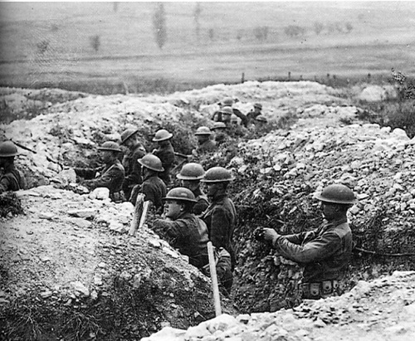
World War One

Slide 14
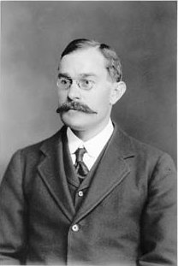
W.H.R. Rivers

Slide 15
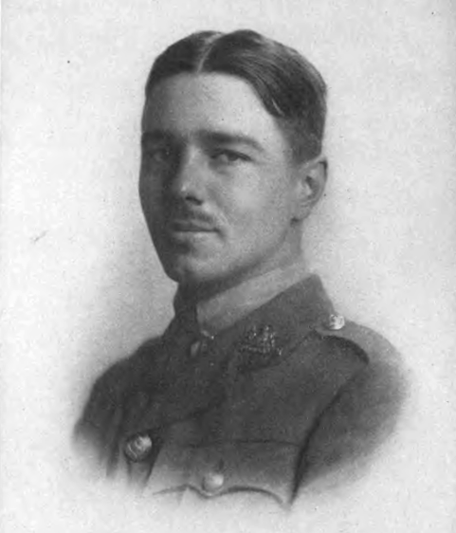
Wilfred Owen

Slide 16
Proposal—brief reminders

Slide 17
Brainstorm first
Choose novel and topic combination
Browse through novel for relevant passages
Perform Close Reading on some relevant passages
Ask yourself questions about your ideas
  How?
  Why?
  What are the implications?

Slide 18
Most important part of proposal:
Thesis statement
Specific, detailed
Reveals your perspective
Must be debatable (not everyone agrees with it)

Slide 19
Format for Proposal
A paragraph
  Possibly format as a formal proposal: “For my essay, I will . . .”
  Possibly format as an introductory paragraph
Summarize main argument, including a thesis statement

Slide 20
Format for Proposal
One paragraph that summarizes the main argument of the essay (approximately 6-8 sentences)
One Works Cited page, using MLA style
Optional: Acknowledgements page
Due dates are based on your tutorial dates
  Mon, June 13
  Tue, June 14
Also turn in via WebCT

Slide 21
The Ghost Road
Read until page 200 by next lecture
Good luck on your proposal!

