Slide 1
Sample Projects

Slide 2
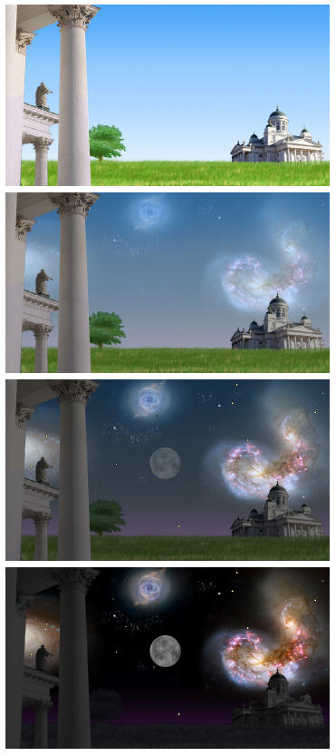
Example of projects: interactive art
Vault of the Sky
Interactive display on screen, with sound and light change
Sensors used: light sensor, slider sensor
Light sensor is adjusting day / night appearance of image on the screen
Slider sensor changes the sound.
Simon Fraser University SIAT
2
Notes:
2

Slide 3
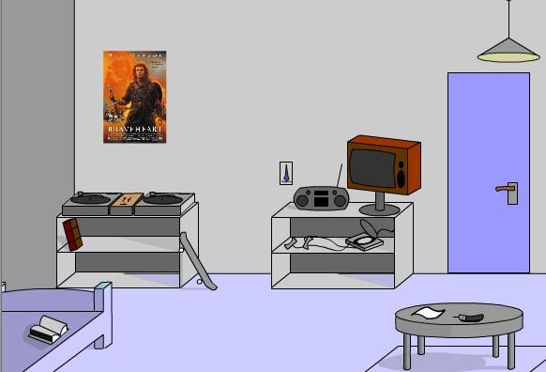
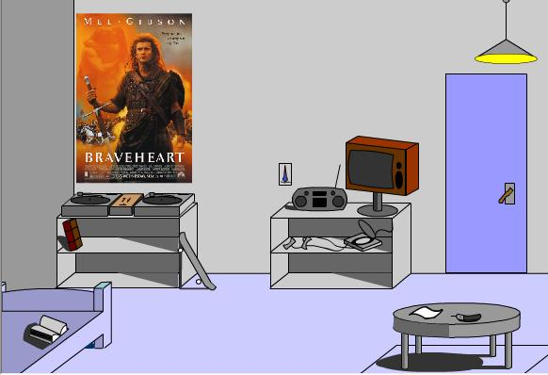
Example of projects: interactive art
Interactive room
Room that can be zoomed in / out.
Light sensor: turn on / off the light
Touch sensor: moves the door handle
Slider sensor: zoom in / out (notice the picture on the wall for this effect)
Simon Fraser University SIAT
3
Notes:
3

Slide 4
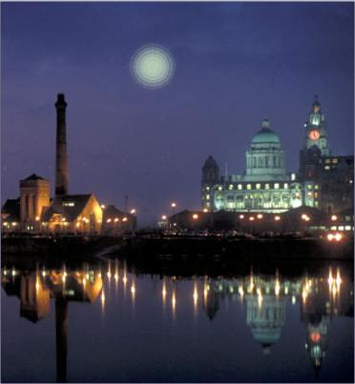
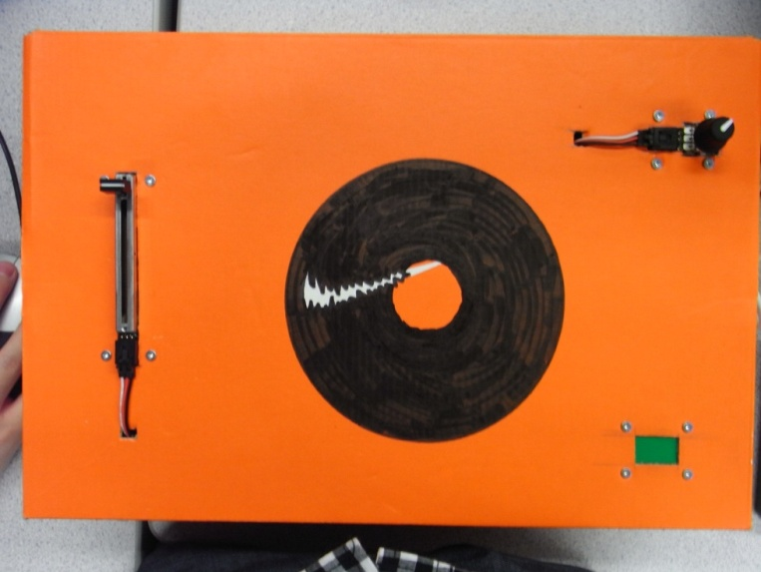
Example of projects: entertainment
Simon Fraser University SIAT
4
Music Synthesizer & Firework generator:
http://www.youtube.com/watch?v=91yn8ksnNcE
Notes:
Fireworks are generated, of different colors and positions on screen
Slider sensor: adjusts position of the firework
rotation sensor: color and sound
4

Slide 5
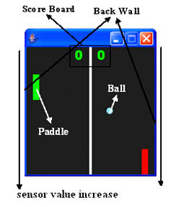
Example of projects: entertainment
Game of pong
Slider sensor for paddles
Touch sensor to start the game
Simon Fraser University SIAT
5
Game of pong
Helmet Man
http://www.youtube.com/watch?v=n_YkGc65P1w
Notes:
Game of pong
Slider sensor for paddles
Touch sensor to start the game
5

Slide 6
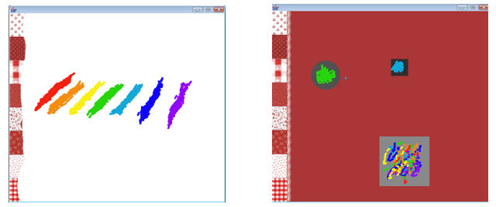
Example of projects: entertainment
Painting board

Slide 7
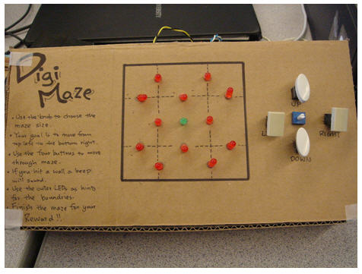
Example of projects: entertainment
Digital maze

Slide 8
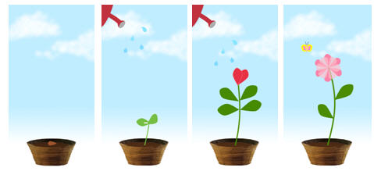
Example of projects
Sensors: light and touch, to simulate sunlight and watering of the plant
Simon Fraser University SIAT
8
Plant growth simulation:
Notes:
8

Slide 9
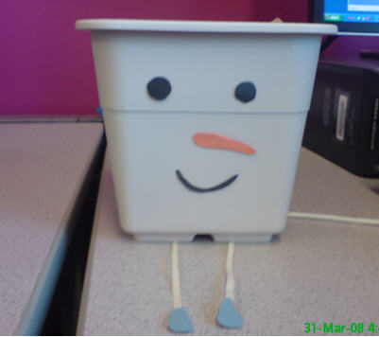
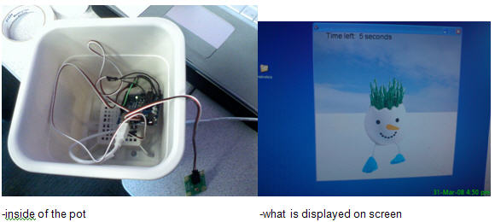
Interactive plant
Simon Fraser University SIAT
9
Notes:
Physical installation with screen output
Game of growing a plant (sufficient water and light)
9

Slide 10
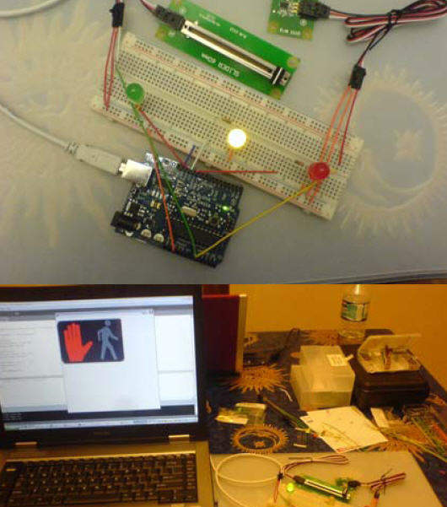
Example of projects: learning apps
Pedestrian signal
Interactive Vault
http://www.youtube.com/watch?v=8s3H08ca13I
Learning application (perhaps for teaching children how to safely cross the street)
-has both on screen and physical component for the crossing signal
Simon Fraser University SIAT
10
Notes:
10

Slide 11
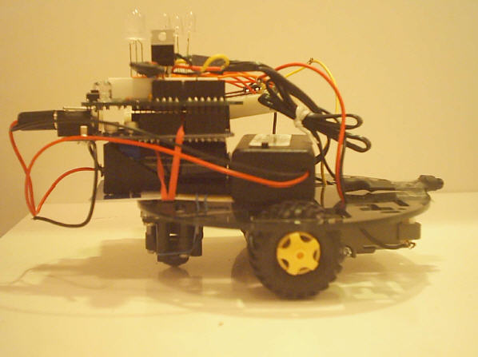
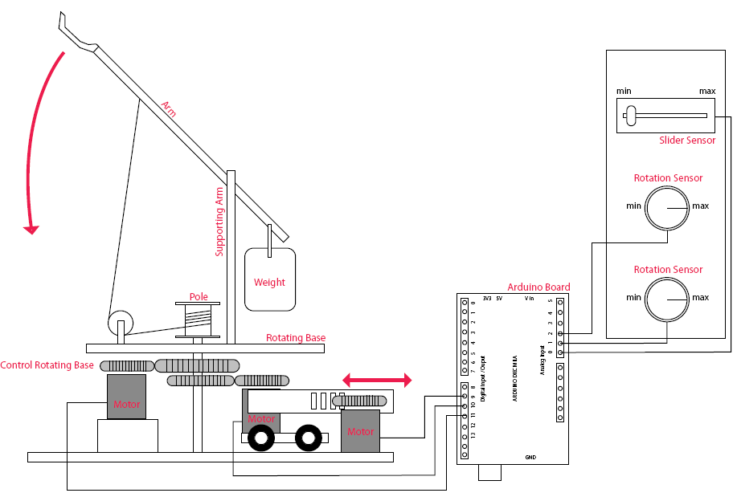
Example of projects
CarBOT & Catapult
Simon Fraser University SIAT
11
Notes:
11

Slide 12
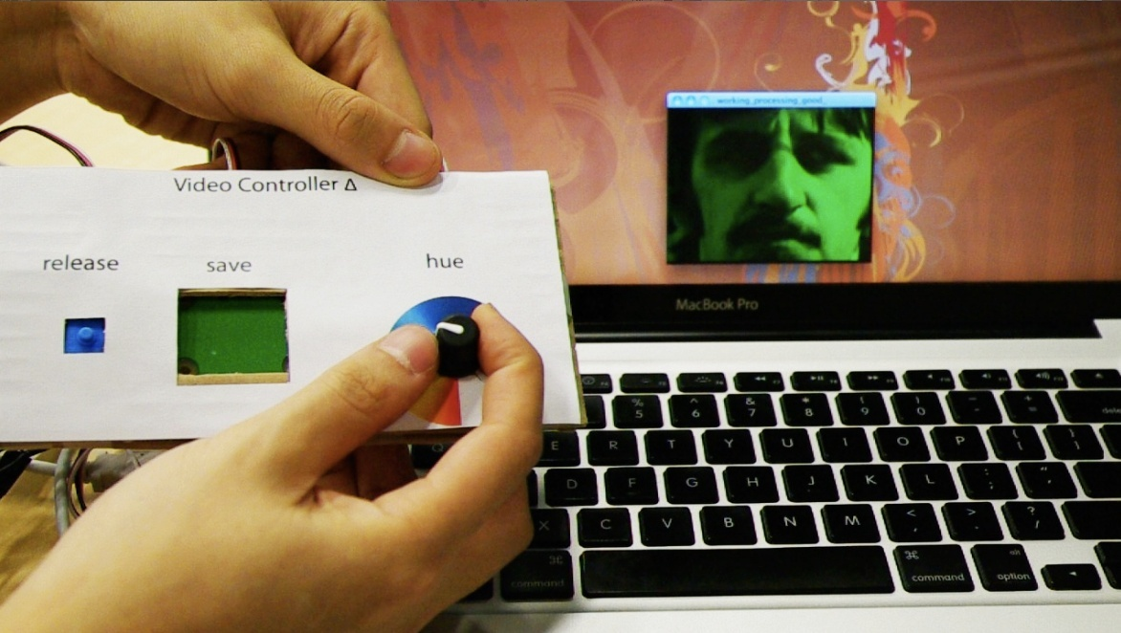
Video Colour Controller
http://www.youtube.com/watch?v=5FV1lRA-zh0
12
Simon Fraser University SIAT
Notes:
12

Slide 13
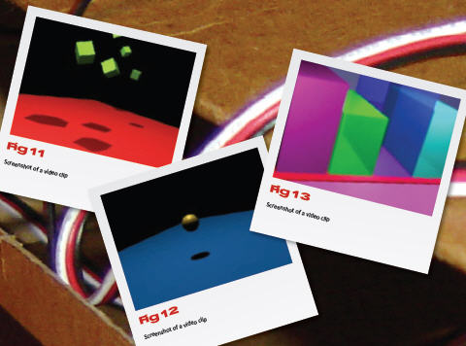
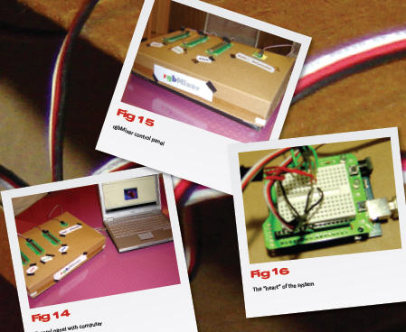
RGB colour channel mixer for video and still images

Slide 14
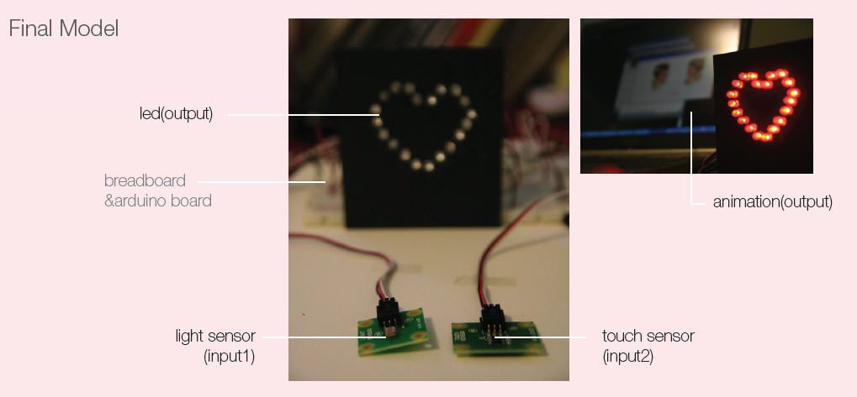
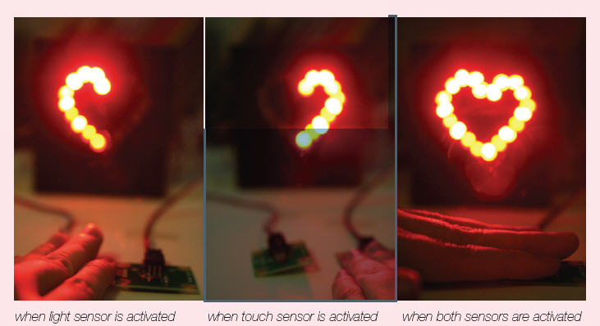
Matching keychain
The two matching keychains are worn by two different persons – if they come in proximity and touch, the heart would light up
Sensors: light and touch
Simon Fraser University SIAT
14
Notes:
14

Slide 15
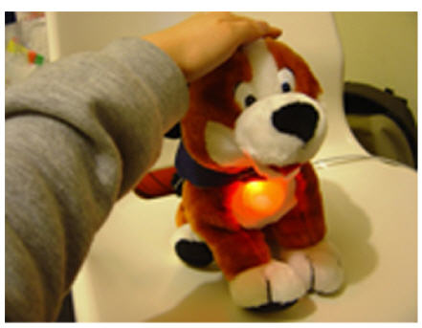
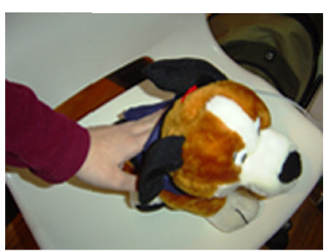
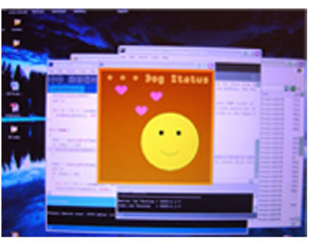
Interactive Gifts
Touch sensor and light sensor
At night the light will be ON, it would also be ON when the dog is touched
Both physical component and on–screen output
Simon Fraser University SIAT
15
Notes:
15

