Slide 1
Week 2 Workshop Basics of Electronic Circuits
IAT 267 Introduction to Technological Systems

Slide 2
Agenda
Introductions
Basic Electronics – review
Circuit components
Circuit relationships and rules
Building circuits

Slide 3
Introductions
Name
Year, Main concentration
What do you hope to learn from this class
Programming background and experience

Slide 4
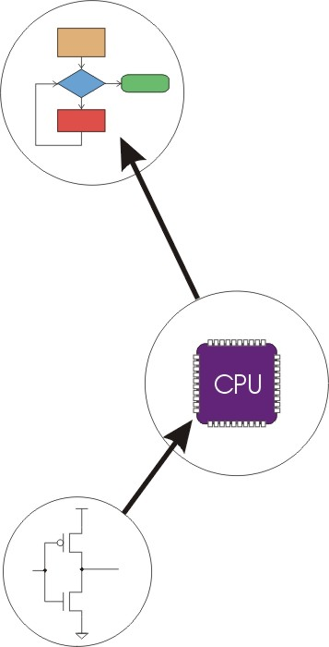
One of the two concepts of technological systems (as discussed in the lecture): Transformations Between the Layers of a Technological System
Algorithms
Language
Instruction Set Architecture
Microarchitecture
Circuits
Devices
Notes:
Transformation between the layers of a technological systems: at the very top layer we have the user who has to solve a problem. Usually, this problem is formulated in the form of a problem statement, in natural language, and thus it may be imprecise, unclear.
Going down at a lower level: algorithm: this is a step-by- step procedure used to solve the problem.
Next, the algorithm can be implemented in the form of a program written in a certain programming language. The programming language is based on a instruction set architecture. The instruction set architecture provides a set of instructions that the computer can perform, it also specifies data types and addressing modes.
Next, going down one more level we have the microarchitecture which specifies the organization of the microprocessor (‘heart of the computer system’) and also the implementation details.
The microarchitecture has a structure given by circuits (logic gates), which are composed of discrete components or devices.

Slide 5
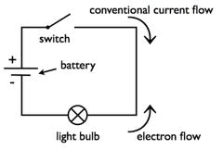
we will start our study at the lowest level: circuit level

Slide 6
Rationale
One goal of this course: to extend the computer system and connect sensors
Sensor → computer system → actuator (small motor)
How to connect the sensor to the computer system? - Build an electric circuit
Goal of this workshop: To get familiar with the basics of electric circuits and electronic components.
Notes:
One goal of this course: to extend the computer system and connect sensors, so that the computer is able to take (read) data from these sensors, process it and based on the result of the processing, perform, a certain action, for example turn on a fan.

Slide 7
Agenda
Introductions
Basic Electronics – review
Circuit components
Circuit relationships and rules
Building circuits

Slide 8
Basic Electrical Definitions
We begin by defining fundamental electrical quantities, and discussing simple circuit elements and models. You need to understand the basic terminology before moving on.
definitions
circuit elements
element laws.
Notes:
We begin by defining fundamental electrical quantities, and discussing simple circuit elements and models. You need to understand the basic terminology before moving on.

Slide 9

Electric Charge and Current
The most basic electrical quantity is that of charge (q) which is measured in coulombs (C) :
Current is a measure of the magnitude of the flow of electrons in a circuit. It is measured in Amperes, or Amps.
Analogy: electrical flow <-> water flow
Notes:
Many people explain electrical flow by using water flow as an analogy. Following that analogy, current would be how much water (or electricity) is flowing past a certain point. The higher the amperage, the more water (or electricity) is flowing.

Slide 10
Voltage
Voltage is a measure of the electrical energy of a circuit. It is measured in Volts.
In the water analogy, voltage would be the water pressure.
high water pressure → high voltage
low water pressure → low voltage
The function of a voltage source is to add energy to the current.

Slide 11
Resistance
Resistance is a measure of a material's ability to oppose the flow of electricity. It is measured in Ohms.
Think of resistance as a property of a material that controls how easy it is for a current to flow.
Analogy: Think of a sponge in the pipe…
Notes:
A sponge in the pipe would act as a resistor, limiting the current (and the voltage) flowing through the pipe.

Slide 12
Resistance (Cont.)
Some materials – isolators – have very high resistance. These include e.g. rubber, paper, porcelain, and air. Because air has a high resistance, it will be difficult for a current to flow through air. We can think of “no connection” as infinite resistance.
Some other materials – mainly metals – are called conductors. They have low resistance. The lower the resistance, the more current will flow. We can think of a metal wire as “zero resistance”.
Some other components will have something in between. There are components called resistors, which have a determined resistance, as in a “220kOhm resistor”.

Slide 13
Electric Circuit
A circuit is a closed loop containing:
a source of electrical energy (like a battery)
and a load (like a light bulb).
Every circuit has to have a load of some sort, All of the electrical energy in a circuit has to get used by the load.
The load will convert the electrical energy to some other form of energy.

Slide 14
Example of a circuit
Notes:
Consider a very basic circuit, consisting of a lamp, a switch, and a battery.
The electrical energy coming from the battery is converted to heat and light energy by the light bulb.

Slide 15
Circuit with no load
Short circuit - A circuit with no load
In a short circuit, the power source feeds all of its power through the wires and back to itself, and either the wires melt (if you're lucky), or the battery blows up, or something else disastrous happens.

Slide 16
Types of circuits
There are two common kinds of circuits:
DC, or Direct Current
AC, or Alternating Current.
In a DC circuit, current always flows one direction.
In an AC circuit, poles of the circuit are reversed in a regular repeating cycle. In one part of the cycle, one pole is at a higher potential (positive) and the other is at a lower (negative). In the next part of the cycle, the second pole is more positive, and the first pole is more negative.
Most of the circuits we'll talk about in this class will be DC circuits.

Slide 17
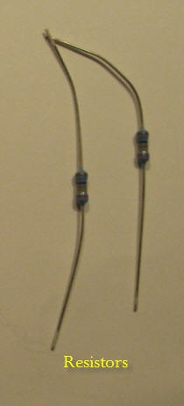

Components of Electric Circuits
Conductors are materials through which electrical current moves freely.
Insulators are materials which prevent the flow of electricity.
Resistors resist, but do not totally block, the flow of electricity. They are used to control the flow of current. Current can move either way through a resistor, so it doesn't matter which way they're connected in a circuit. They are symbolized like this:
Notes:
Used in this lab

Slide 18

Diodes
Diodes permit the flow of electricity in one direction, and block it in the other direction.
Think of a one-way street
Because of this, they can only be placed in a circuit in one direction.
They are symbolized like this:

Slide 19
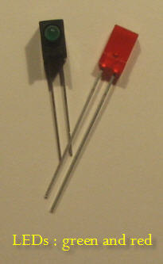

Light – emitting Diodes
Light-Emitting Diodes (LED's) are special types of diodes which emit light when current flows through them.
They are symbolized like this:

Slide 20
Switches
Switches control the flow of current through a junction in a circuit:

Slide 21

Capacitors
Capacitors store up electricity while current is flowing into them, then release the energy when the incoming current is removed.
Polarized or not.
If a capacitor is polarized, it will be marked as such on the diagram.
Notes:
Sometimes they are polarized, meaning current can only flow through them in a specific direction, and sometimes they are not.

Slide 22
Agenda
Introductions
Basic Electronics – review
Circuit components
Circuit relationships and rules
Building circuits

Slide 23
Circuit Relationships
Voltage (V), Current (I), and Resistance are related (R) are all related, by the following formula:
Volts = Amps x Ohms, or
V = I x R
This is Ohm’s Law.
What Ohm’s law means: “the less resistance, the more current”.
What happens when the resistance is zero (no resistance)?
→ infinite current
If you connect a wire directly from plus to ground with no resistance
you create a short circuit. Try not to do this! (Ground has always 0 volts).

Slide 24
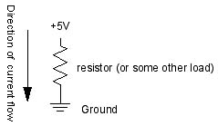
Circuit Relationships (Cont.)
Electrical current flows from places of higher potential energy to places of lower potential energy (i.e. from positive to negative).

Slide 25
Circuit Relationships (Cont.)
Ground is the place in a circuit with where the potential energy of the electrons is zero.
Sometimes this point is connected to the actual ground, either through a grounded electrical circuit, water pipe, or some other method.
Basically, any conductor that goes to the earth will do.

Slide 26
Important Rules
Current follows the path of least resistance to the ground. So if it has a choice of two paths in a circuit, and one has less resistance, that's the path it'll take.
In any given circuit, the total voltage around the path of the circuit is zero. Each component that offers a resistance lowers the voltage, and by the time we reach the end of the circuit loop, there will be no voltage left.
The amount of current going into any point in a circuit is the same as the amount coming out of that point.

Slide 27
Agenda
Introductions
Basic Electronics – review
Circuit components
Circuit relationships and rules
Building circuits

Slide 28
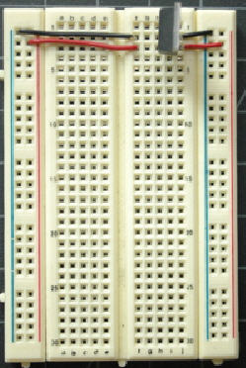
What’s next: buiding circuits
We will use solderless breadboards to built some simple circuits (next week during the workshop):
Notes:
Explain the structure of the solderless breadboard (electrical connections).

Slide 29
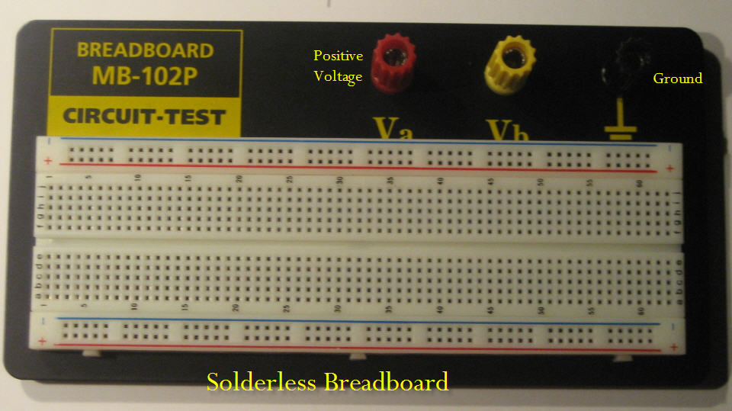
Breadboard
Solderless beadboards are the quickest tools for prototyping a new circuit.

Slide 30
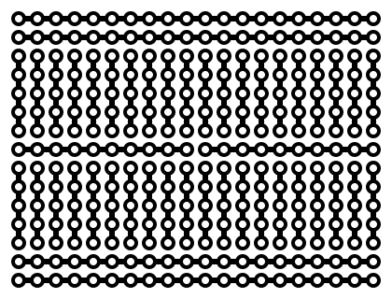
Connections

Slide 31
!!! When you start to put components on your breadboard, avoid adding, removing, or changing components on a breadboard whenever the board is powered. You risk shocking yourself and damaging your components.

Slide 32
LEDs
LEDs, or Light Emitting Diodes, are diodes that emit light when given the correct voltage.
Like all diodes, they are polarized, meaning that they only operate when oriented correctly in the circuit. The anode of the LED connects to voltage, and the cathode connects to ground. The anode in the LEDs in this photo is the longer leg on each LED.
LEDs come in many diferent packages.

Slide 33
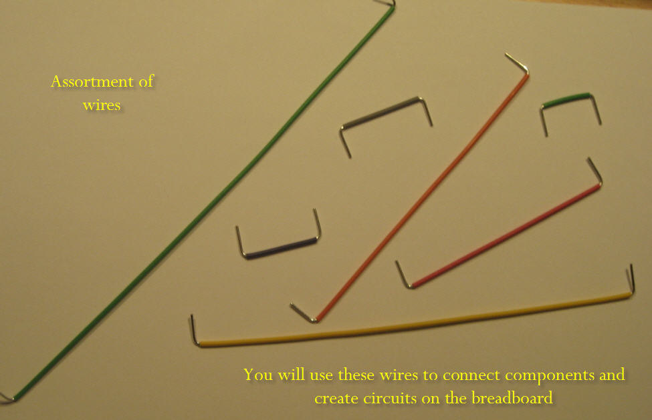
Wires

Slide 34
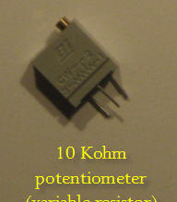
Potentiometer
- A resistor that can change its resistance.
- Three connections. The outer leads are the ends of a fixed value resistor. The center lead connects to a wiper which slides along the fixed resistor.
- The resistance between the center lead and either of the outside leads changes as the pot's knob is moved.

Slide 35
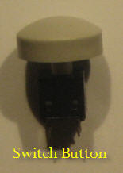
Resistor and switch button
Resistor color coding scheme: http://www.create-california-online.net/Tutorials/Resistor_color_code_2/resistor_colorcode.htm

Slide 36
Resistors: as we have seen in the last workshop, these limit the current in the circuit (the potentiometer is also a resistor, therefore it will also limit the current).
Switch: has two states: on/off, and will control the flow of current through a portion of a circuit.
Notes:
Color code:

Slide 37
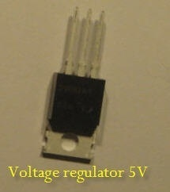
Voltage Regulator
Voltage regulators take a range of DC voltage and convert it to a constant voltage.
For example, this regulator, a 7805 regulator, takes a range of 8 - 15 volts DC input and converts it to a constant 5-volt output.
Notes:
Explain how to connect-

Slide 38
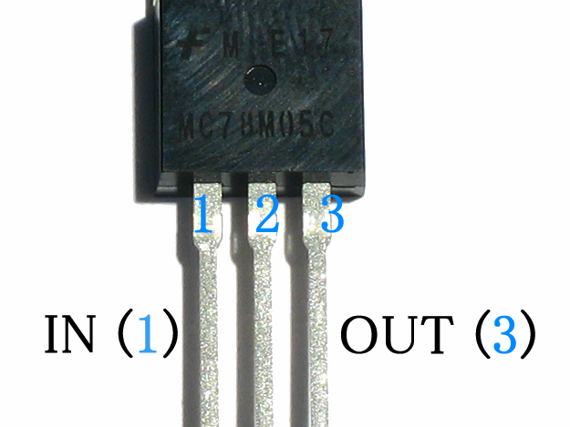
7805 5-Volt Regulator

Slide 39
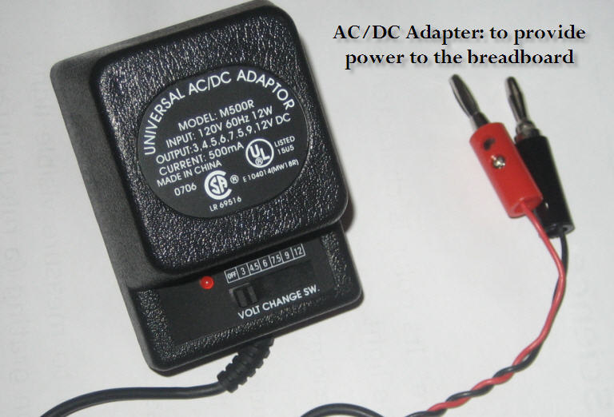

Slide 40
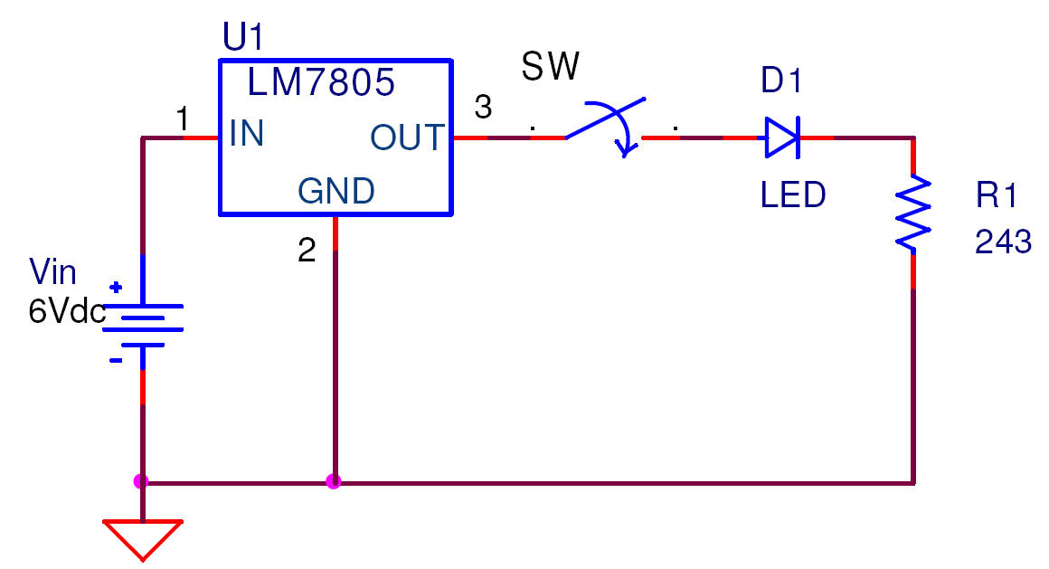
Simple Circuit 1

Slide 41
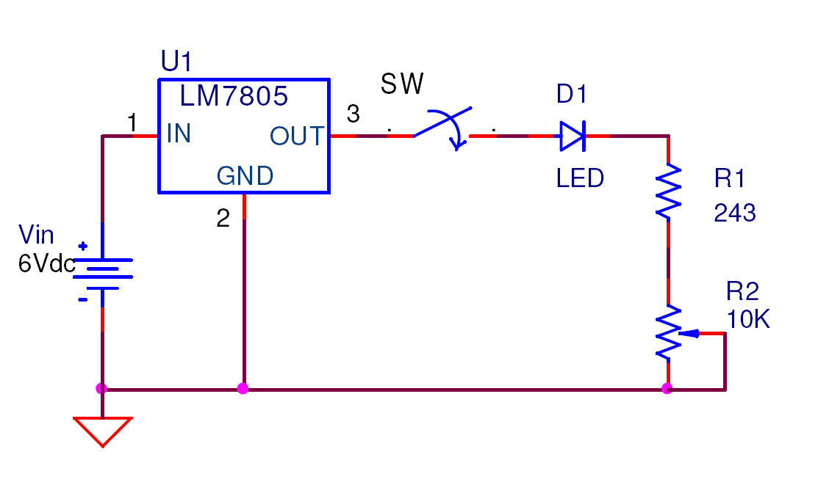
Simple Circuit 2

Slide 42
Summary
Introductions
Basic Electronics – review
Circuit components
Circuit relationships and rules
Building circuits

Slide 43
Thank You! Q & A

