Slide 1
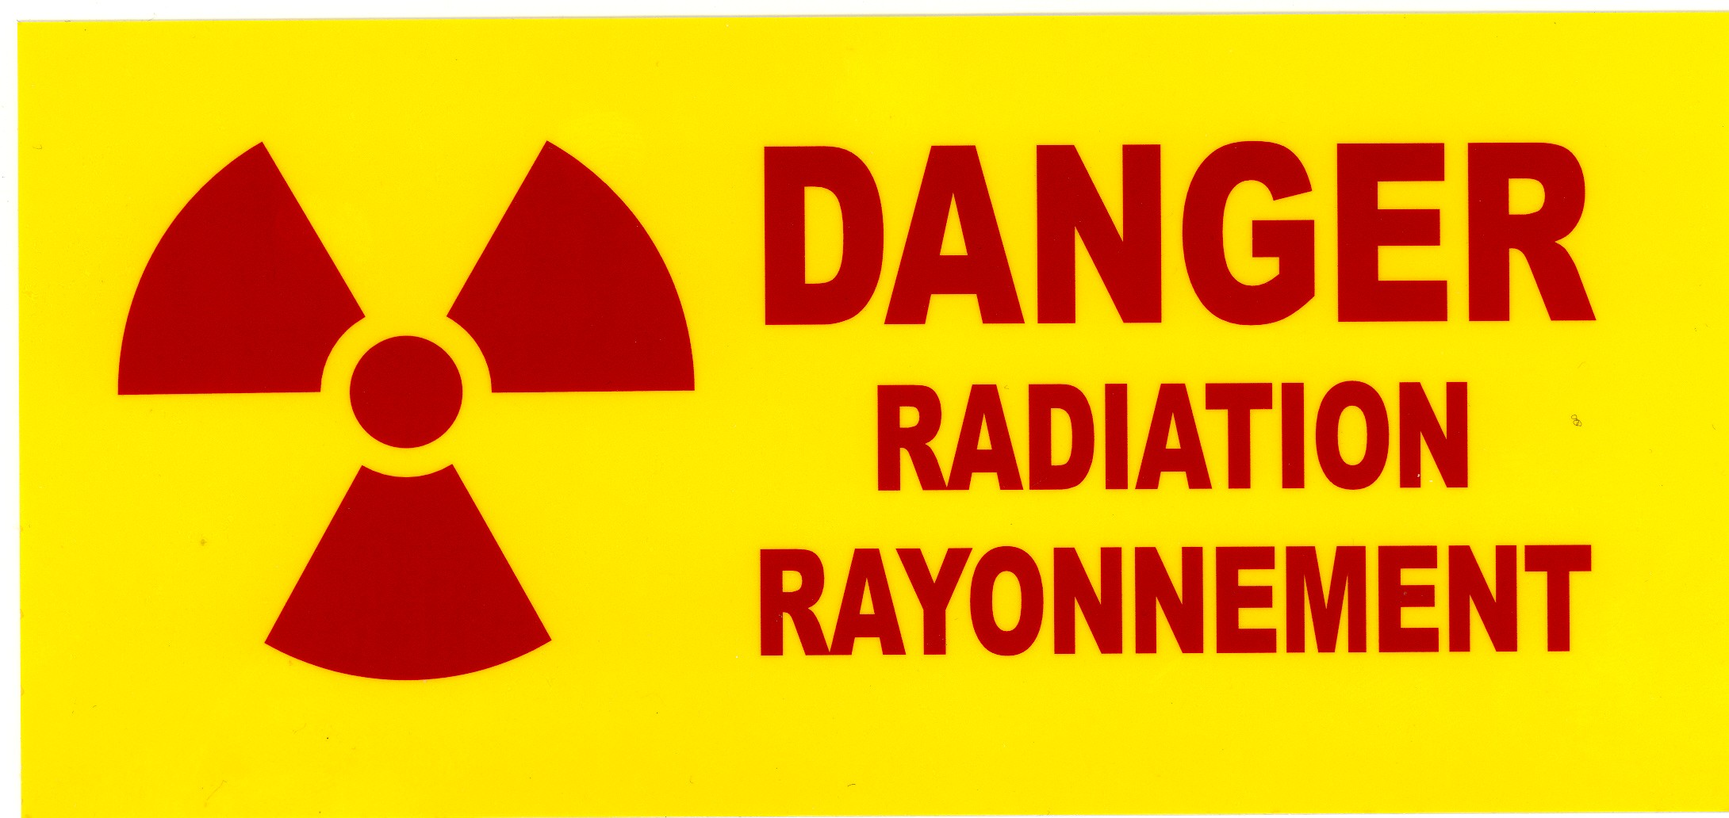
Health Physics and safety chapter 5

Slide 2
Why use radioactive materials in research?
Very convenient labels
Very sensitive markers
Problem with hazardous radiation!!
Fundamental research – TRIUMF, ANL, MSU, etc
Worth considering alternate techniques (e.g. fluorescence labeling)

Slide 3
Ionizing Radiation
Radiation (particulate or electromagnetic) with enough energy to create ions in matter
Interaction With Matter
Radiation going through matter loses energy mostly
by knocking off electrons (ionization), or
by “rattling” electron cloud (electronic excitation)
Specific Ionization
Characterizes efficiency of energy transfer

Slide 4
Ionizing Radiation Properties
Emission |  | Nature | Energy | Range in Water | Energy Spectrum
Alpha | He ions |  | 3-10 MeV | 0.1 mm | Lines
Beta | e⁺ or e⁻ |  | keV-MeV | few mm | Continuum
Gamma X-rays |  | Photon | keV-GeV | Half-value layer:10cm (1 MeV) | Lines
Bremsstrahlung |  |  |  |  | Continuum

Slide 5
Origin of High Energy Photons

Slide 6
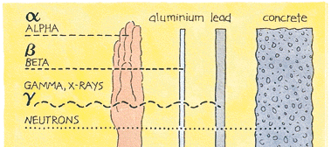
Penetrating Power of Different Types of Ionizing Radiation

Slide 7
Radioisotopes Commonly Used at SFU
Isotope | Radio-toxicity | Half-life | Effect. half-life | Critical organ | Hazard
³H | low | 12 y | 12 d | WB | Low
¹⁴C | med. | 5700 y | 30 d | WB/fat | Low
³²P | med. | 14.3d | 14 d | Bones | High
³³P | med. | 25.3 d | 25 d | Bones | Medium
¹²⁵I | high | 60 d | 42 d | Thyroid | High
²²Na | high | 2.6 y | 11 d | LI | High
³⁵S | med. | 87.2 d | 76 d | WB/testis | Low
⁴⁵Ca | high | 165 d | 165 d | Bone | High
WB: whole body |  | LI: Large intestine

Slide 8
UNITS - 1
Activity (#decay events/unit time)
Curie (Ci) = 3.7x10¹⁰ dps
Becquerel (Bq) = 1 dps
Exposure (electrical charge/volume)
- Rontgen (R) = 2.58 x 10⁻⁴ C/kg
Dose (energy deposited/unit mass)
Rad = 0.01 J/kg = 100 erg/g
SI Gray (Gy) = 1 J/kg (1 Gy = 100 Rad)
Dose equivalent (Dose x Quality Factor)
Rem = Rad x QF
Sievert = Gray x QF (1 Sv = 100 Rem)
Describes source
Relevant to exposed target

Slide 9
UNITS - 2
Radiation energy
Electron volt (eV) = 1.602 x 10⁻¹⁹ J
Regulatory units
Exemption quantity (EQ): indiscriminate use of 1 EQ could result in a dose not exceeding the maximum yearly permissible dose
Annual limit of intake (ALI): intake of 1 ALI is deemed to result in a committed dose equivalent of 20 mSv

Slide 10
Quality Factors
Radiation type | Accepted values for QF (or RBE*)
Gamma | 1
X-Rays | 1
Low energy beta | 2
Alpha | 10 - 20
Neutrons | 3 - 10
*RBE: Relative Biological Efficiency

Slide 11
Quantities commonly used at SFU
Typical experiment uses
kBq (μCi) ← No problem
MBq (mCi) ← Hottish
Exceptionally
GBq (Ci) only for ³H ← can be messy!!!

Slide 12
Legal Possession Limits for Low Level Handling
Toxicity | Permitted Amount (MBq) | Examples
Very High | 0.4 | ²³⁸Pu, ²¹⁰Po
High | 40 | ⁶⁰Co, ²²Na
Moderate | 100 | ¹⁴C, ³²P
Low | 5000 | ³H

Slide 13
Biological Effects of Ionizing Radiation
Deterministic (non-stochastic) effects
Early or prompt effects
Late or delayed effects
Stochastic effects
Somatic
Genetic
Teratogenic

Slide 14
Effects related to a whole body acute dose
Dose/mSv | Effects
0 – 200 | No measurable short-term effects
200 – 500 | - measurable changes in blood composition - some chromosome aberrations - no fatalities (typical cancer therapy dose)
3000 | LD₅₀/60 days without medical care
10000 | LD₁₀₀/15 days

Slide 15
Typical Radiation Doses

Slide 16
Dose-response curve resulting from exposure to ionizing radiation

Slide 17
Health risks associated with low-level exposure
Unambiguous association for measurable doses
For low doses, using linear, no threshold assumption, increased risk can be estimated
Somatic risks: 10 mSv in a life-time increases cancer probability, 20% to 20.04% (or increase risk of 4/100000 per mSv)
Genetic risks: no evidence for increased risk
Teratogenic risks: no evidence for increased risk

Slide 18
Comparative Risks Associated With Various Activities
Source | Average Life Expectancy Lost (days)
20 cigarettes/day | 2370
All accidents | 435
Industry (average) | 74
Natural disasters | 3.5
Natural bkg radiation | 8
Medical X-rays | 6
10 mSv (single dose) | 1
10 mSv y⁻¹ (for 30 years) | 30

Slide 19
Average Yearly Dose Due to Background Radiation (mSv/y/individual)
Natural Background Radiation | 2.0
Medical diagnosis | 0.6
Nuclear power fall out | 0.002
Miscellaneous | 0.02
Total | ≈ 2.62
BC coast natural background is ≈ 1.2 mSv, but ≈ 2.2 mSv in Winnipeg
Background dose rate ≈ doubles for every 1500 m altitude (flight Vancouver-Halifax ≈ 0.03 mSv).
Typical medical X-rays ≈ 0.01 - 3 mSv/shot

Slide 20
Contributions to background exposure

Slide 21
Legal Maximum Permissible Occupational Dose (mSv y⁻¹)ª
Target organ |  | Nuclear Energy Workers | General Public
Whole body |  | 50^{b} | 1
Skin |  | 500 | 50
Lens of eye |  | 150 | 15
Hands or feet |  | 500 | 50
a) Dose must always be kept ALARA (As Low As Reasonably Achievable)
b) No more than 100 mSv over 5 consecutive years

Slide 22
Precautions in the Laboratory
Minimize exposure
Prevent contamination
Containment in case of spill
Maintain inventory
Perform contamination checks
Maintain documentation showing that all above actions were performed successfully

Slide 23
Minimize Exposure Time, Distance, Shielding
Precaution in the laboratory

Slide 24
Prevent Contamination
Precaution in the laboratory
Warning signs
Protective gear (lab coats, disp. gloves, goggles)
Work in authorized locations only
Organize work space, perform blank runs
No personal effects in work area
Minimize movement of source
Wastes to proper container
Monitor frequently, yourself and work area
Wash only “clean” equipment in regular sink
Remove protective gear when leaving working area
DO NOT CONTAMINATE MONITORING EQUIPMENT

Slide 25
2 mSv/year | Typical background radiation experienced by everyone (av 1.5 mSv in Australia, 3 mSv in North America).
1.5 to 2.0 mSv/year | Average dose to Australian uranium miners, above background and medical.
2.4 mSv/year | Average dose to US nuclear industry employees.
up to 5 mSv/year | Typical incremental dose for aircrew in middle latitudes.
9 mSv/year | Exposure by airline crew flying the New York - Tokyo polar route.
10 mSv/year | Maximum actual dose to Australian uranium miners.
20 mSv/year | Current limit (averaged) for nuclear industry employees and uranium miners.
50 mSv/yea | Former routine limit for nuclear industry employees. It is also the dose rate which arises from natural background levels in several places in Iran, India and Europe.
100 mSv/year | Lowest level at which any increase in cancer is clearly evident. Above this, the probability of cancer occurrence (rather than the severity) increases with dose.
350 mSv/lifetime | Criterion for relocating people after Chernobyl accident.
1,000 mSv/cumulative | Would probably cause a fatal cancer many years later in 5 of every 100 persons exposed to it (ie. if the normal incidence of fatal cancer were 25%, this dose would increase it to 30%).
1,000 mSv/single dose | Causes (temporary) radiation sickness such as nausea and decreased white blood cell count, but not death. Above this, severity of illness increases with dose.
5,000 mSv/single dose | Would kill about half of those receiving it within a month.
10,000 mSv/single dose | Fatal within a few weeks.

