Slide 1
Email Replacement Project
BCnet Conference April 18, 2008
Frances Atkinson, IT Services Director
Steve Hillman, IT Services Architect
Annay Slabikowska, User Experience Coordinator, Email Project

Slide 2
Topics
Why Replace the Current System?
In Scope – Out of Scope
Structure of Project
Technical Infrastructure
Automated Data Migration
User Perspective: Who, what, when, how
What we Learned
Future Possibilities

Slide 3
High-level overview
SFU’s implementation of new email/calendaring technology

Slide 4
Why we replaced the current system

Slide 5
How we selected Zimbra

Slide 6
Why we selected Zimbra

Slide 7
Scope – Replaced coloured components

Slide 8

Scope – Details
Moved 50,000 email accounts to new system
Moved 1300 Corporate Time calendar accounts
Trained the support staff & end users
Branded the new system
Scaled the infrastructure & support to handle fully loaded conditions
Retired the old Calendaring system
Still to do - Retire the old Email system

Slide 9
Out of Scope - What we did not do

Slide 10
Structure of Project

Slide 12
Technical perspective
SFU’s implementation of new email/calendaring technology

Slide 13
Legacy Architecture
Amaint
LDAP Directory
Barracuda
MTA
MailLists
IMAP
POP
Webmail Store
Webmail
Barracuda
Mail Store
Desktop
Home Directories
Notes:
Simple, straightforward design
Webmail data is separate
Mailstore is on the server, hard to upgrade
13

Slide 14
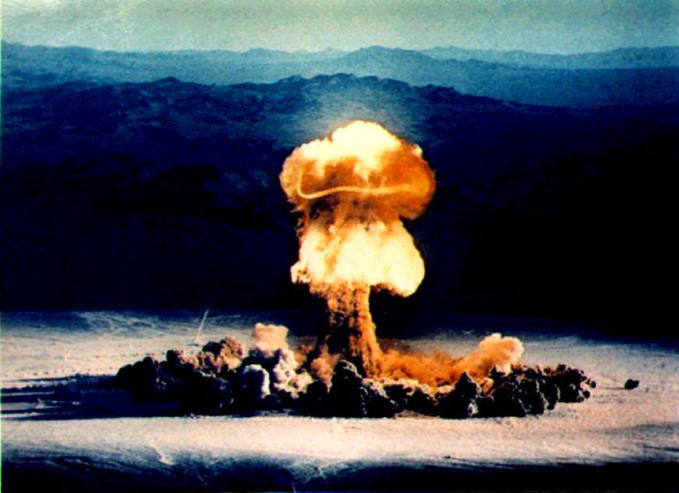
Single server - vulnerable to system failure – expensive to replace
Notes:
14

Slide 15

Several dated components
Notes:
15

Slide 16
Our Email infrastructure was fully understood by one person – me
Notes:
16

Slide 17
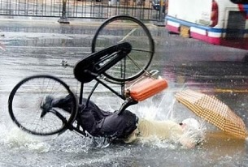
Notes:
17

Slide 18
Technical Objectives
Notes:
18

Slide 19
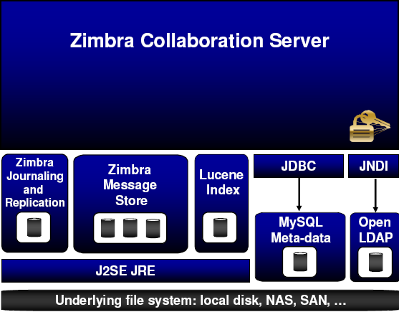
Zimbra Server Architecture
HTTP/SOAP
IMAP/POP
Postfix
Notes:
19

Slide 20
Smtpserver
MTA
MailLists
IMAP
POP
Mail Store
Notes:
20

Slide 21
Zimbra Multi-Server Architecture
LDAP
LDAP
Proxy
Proxy
MTA
MTA
Amaint
LDAP
Zimbra
Mailbox
Server
Zimbra
Mailbox
Server
Zimbra
Mailbox
Server
Zimbra
Mailbox
Server
iSCSI
NFS
Index DB
Primary
Mail Store
Index DB
Primary
Mail Store
Secondary
Mail Store
Notes:
-First we’ll duplicate the MTA
-Then we’ll add some dedicated client-access servers
-And a separate mailstore
-Then we’ll store our indexes in a database, for the best performance. This way, the mailstore can be slower, cheaper disks
-While we’re at it, let’s add a second store for redundancy, and replicate them
-Next, we’ll add a web server directly to the client access machines, to communicate directly between the mailstore and the web client written in Javascript
-Draw a line down the middle, locate each half on a different campus, and we have fault-tolerance
-Now what if we pencil in calendar support on the client access nodes
21

Slide 22
Developed
Automated Migration Scripts
Notes:
22

Slide 23
End-user perspective
SFU’s implementation of new email/calendaring technology

Slide 24
Who: Stakeholders

Slide 25
What: New technology

Slide 26
When?
1 year implementation timeline

Slide 27
How: Obtaining buy-in

Slide 28
How: Voluntary student signup

Slide 29
How: Engaging departmental computer support staff

Slide 30
How: Voluntary staff / faculty signup

Slide 31
How/When: Moving calendaring users

Slide 32
Lessons Learned

Slide 33
Future Possibilities

