Slide 1
Mining Social Ties Beyond Homophily
Hongwei Liang*
Ke Wang*
Feida Zhu #
* Simon Fraser University, Canada
# Singapore Management University, Singapore
Notes:
Focus: beyond

Slide 2
Outline
Introduction & Motivation
Problem Formulation
Solution
Evaluation
Conclusion & Future Work

Slide 3
Integrating graphs and demographic data
ID | SEX | RACE | LOCATOIN
1 | F | Asian | US
2 | F | Latino | US
… | … | … | …
14
5
(a) Graph topology
(b) User profile
integration
Graph data and demographic data are everywhere
But the two aspects of data maybe incomplete within single social network
More comprehensive analysis can be done by integrating them
Notes:
Bank: only have user profile

Slide 4
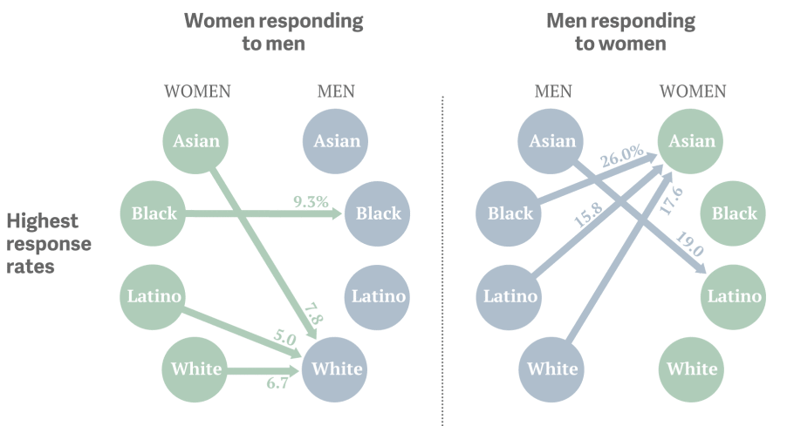

Facebook Dating App Example
All except black women preferred white men,
while all men except Asians preferred Asian women.
Notes:
A resent survey from the Facebook dating app, Are you interested, have shown some surprising results
http://www.huffingtonpost.com/jenny-davis/race-online-dating_b_4449946.html
http://qz.com/149342/the-uncomfortable-racial-preferences-revealed-by-online-dating/

Slide 5


Social Ties (Group Relationships)
Form:
1
2
3
4
5
6
7
F
Asian
Latino
White
US
Canada
Finland
8
9
10
11
12
13
14
M
R₁ : (Sex: M) (Sex: F, Race: Asian)
conf =
7
/14;
supp = 7/15
R₂ : (Sex: M, Race: Asian) (Sex: F, Race: Asian)
conf = 0; supp = 0
Notes:
LHS, RHS, edges. Both sides and the edge can have multiple attribute values
If using the standard supp-conf framework ..

Slide 6
Homophily in Social Network
Homophily principle: love of the same
Homophily effect is well-known and is often “dominant”
  R₃ : (Sex: F, Location: US) (Sex: M, Location: US)
  conf = 4/6; supp = 4/15
Homophily captures “primary” bond
Literature largely focuses on applications based on homophily
  e.g.: community detection, link prediction, friend/product recommendation
Notes:
Homophily: contacts between similar people occur at higher rate.
Similarity is measured by common characteristics such as beliefs/religion, value, race, age, etc.

Slide 7
Beyond Homophily
Unearth the treasures beyond homophily?
  Assume “Location” is homophilic in a dating network
  R₄: (Sex: F, Location: US) (Sex: M, Location: Canada)
standard confidence?
conf = 2/6, not interesting
  new metric that remove homophily?
nhp = 2/ (6 – 4) = 100%, interesting !
VS
support of the homophily effect is 4/15
(Sex: F, Location: US) (Sex: M, Location: US)
US
Canada
Finland
1
2
3
4
5
6
7
F
  Reads as: if a female from US does NOT want her partner to be from US, there is a high chance that she prefers a partner from Canada.
8
9
10
11
12
13
14
M
Notes:
A claim: Recommending popular items is unlikely to result in more gain than discovering insignificant yet liked items, because the popular ones might be already known to the user

Slide 8
Potential Applications
Target advertising
  Homophily pattern: (JOB : Lawyer, PRODUCT : Stocks) → (PRODUCT : Stocks)
  Non-Homphily pattern: (JOB : Lawyer, PRODUCT : Stocks) → (PRODUCT : Bond)
Helpful in link predicting, beyond homphily
  Friend/dating Recommendation
User behaviors/habits analysis
Profile completion
Criminal investigation
Notes:
Financial institute
Among the friends who do not buy Stocks, many buy Bonds. This GR can be used to promote Bonds to a friend if he/she has not bought Bonds.

Slide 9
Non-homophily Preference
Non-homophily preference: a probability of links going to a node described by , given and exclude the homophily effect
  Example: (Sex: F, Location: US) (Sex: M, Location: Canada)
  (Sex: F, Location: US) (Sex: M, Location: US)
Captures “secondary bonds” beyond “primary bonds”
nhp does not have the regular anti-monotonicity
  Adding an attribute on the RHS may increase supp(homophily effect)
Notes:
Adding an attribute on the RHS may cause both the numerator and the denominator to decrease, since the support for the homophily effect may change from 0 to non-zero. In this case, nhp can either increase or decrease, therefore, lose the anti-monotonicity

Slide 10
Outline
Introduction & Motivation
Problem Formulation
Solution
Evaluation
Conclusion & Future Work

Slide 11
Problem - Mining Top-k GRs
Given
  an multi-dimensional information network
  the setting of homophily for attributes
  a supp threshold, a nhp threshold and an integer k
Goal
  discover the top-k GRs, ranked by nph followed by supp, and each of them satisfies the supp and nhp thresholds

Slide 12
Challenges
Storage
  Space = , if single table
Computation
  Exponential order of attributes value combination
  nhp does not have anti-monotonicity
  If only supp pruning: small threshold, and post-processing is needed
How to deal with?
  Storage: favourable data modeling
  Computation: ingenious enumeration with efficient pruning strategies
Notes:
Standard method that collect all data in one table is a disaster for memory, when data is huge and attributes information is rich

Slide 13
Outline
Introduction & Motivation
Problem Formulation
Solution
Evaluation
Conclusion & Future Work

Slide 14
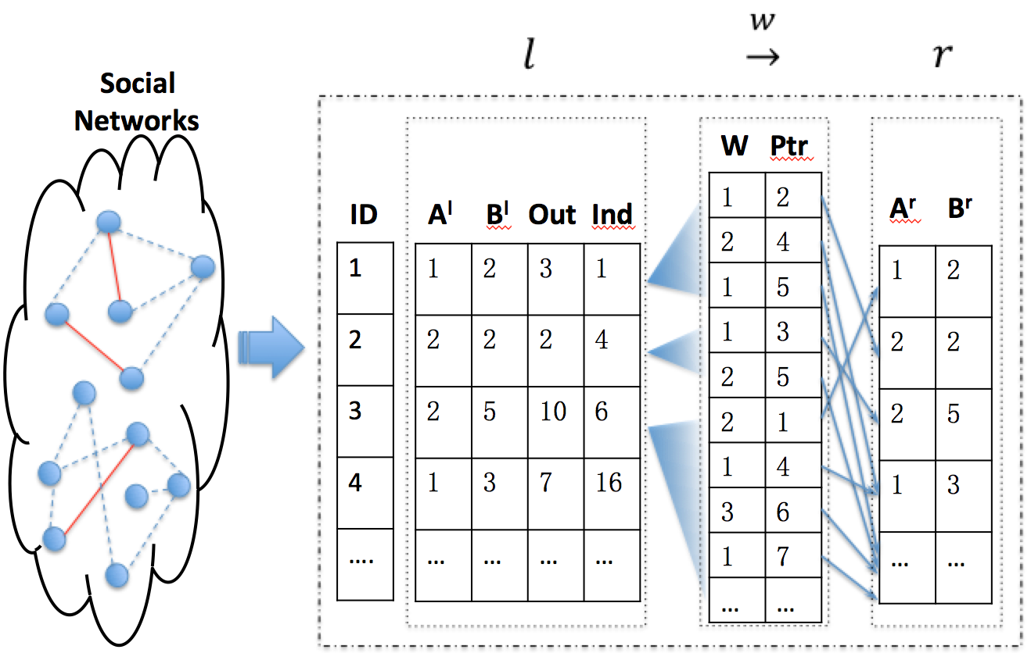
Data Model
Compact 3-table data presentation: combines profile data and graph topology together
No redundant records, data are linked by pointers
Space complexity
Notes:
A^{l}, B^{l} denotes attributes on LHS of GRs, A^{r}, B^{r} denotes those on RHS, W denotes those on edge

Slide 15
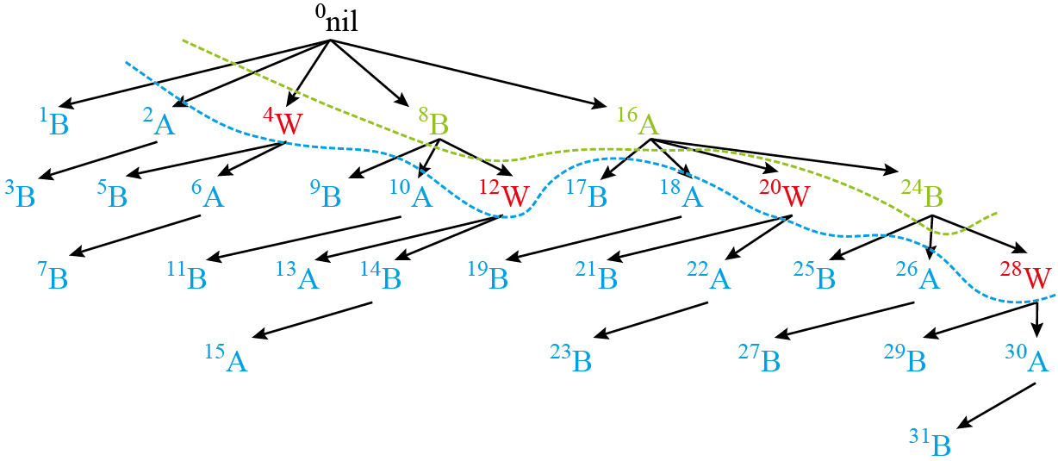
SFDF Enumeration
Subset-First Depth-First (SFDF) Enumeration
  Subset-First: some kind of reverse order, all parts of supp, including that for homophily effect, are available when computing nhp
  Depth-First: only materialize the current branch
Notes:
This enumeration order also ensure the compute the more general GRs first.
If difference metric is used and supp(r) is needed when computing the metric, this metric also makes the supp(r) available before computing the support of the whole GR

Slide 16
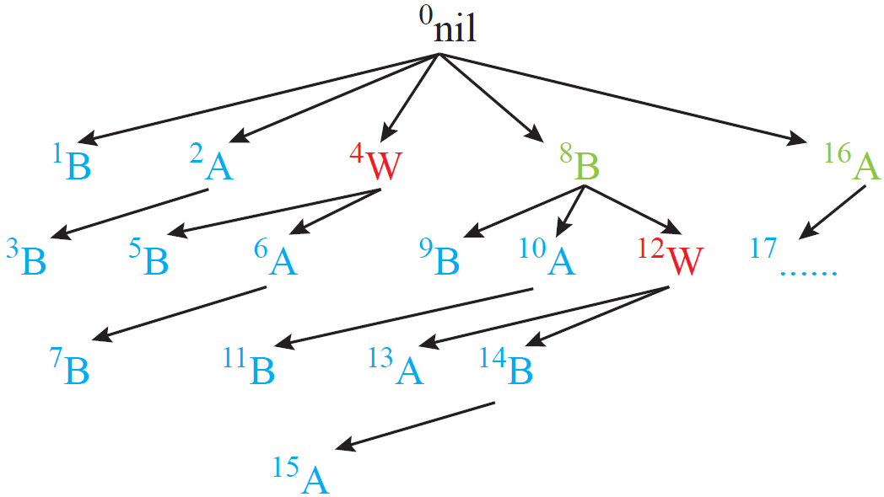
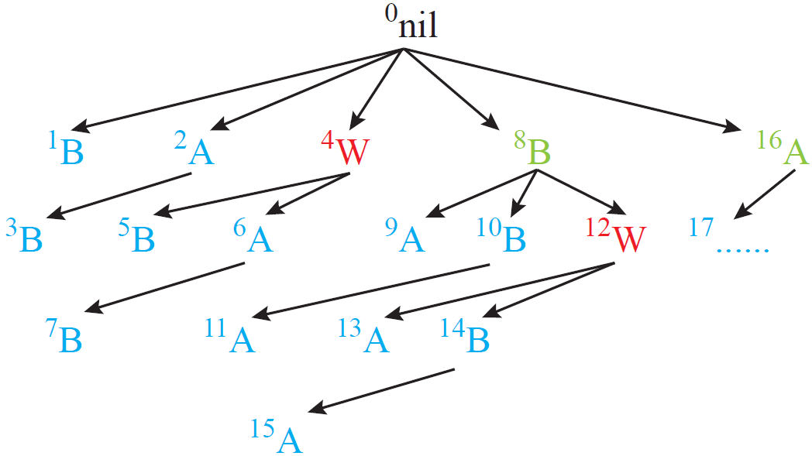
Dynamic Ordering
How to make nhp anti-monotone?
  Dynamically order the homophily attributes, on the basis of whether the same homophily attributes were enumerated in the LHS
dynamic ordering
assume both A and B are homophily attributes
for the GRs with same is anti-monotone, with the help of dynamic ordering

Slide 17
Multiple Pruning Strategies
supp based pruning
nhp based pruning
  enabled with the help of dynamic ordering
Top-k pruning tights up the nph threshold
The mining task finishes in one phase

Slide 18
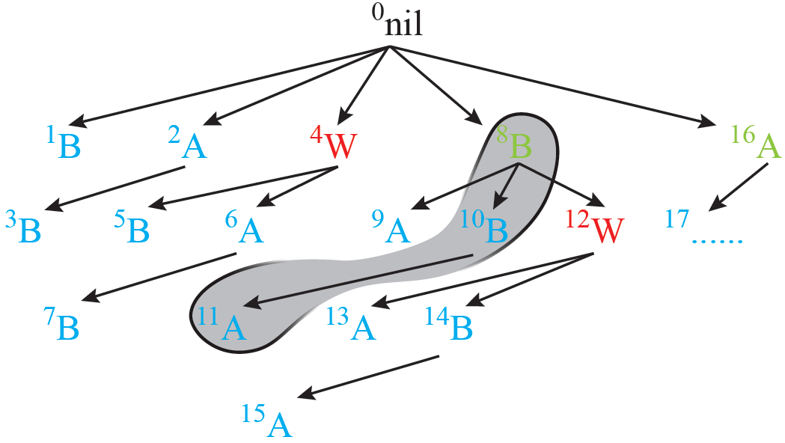
Data partition and Pruning
Partition attributes while computing supp and nhp?
  Recursive partition with linear CountingSort
  At each node, GR representing the homophily effect is generated first, e.g. is generated earlier than
⁸B
b₁
b₂
b₃
¹⁰b₂B
¹⁰b₁B
b₂b₂
b₂b₃
b₂b₁
b₁b₁
b₁b₂
b₁b₃
…...
¹¹b₁b₁A
¹¹b₁b₂A
b₁b₂a₁
b₁b₂a₃
b₁b₁a₂
b₁b₁a₃

Slide 19
Outline
Introduction & Motivation
Problem Formulation
Solution
Evaluation
Conclusion & Future Work

Slide 20
Experimental Evaluation
Implementation: C++
Platform: CentOS 6.4 with Intel 8-core processors 2.53GHz and 12G of RAM
Real Datasets
  Pokec Social Network data¹
    1,436,515 users and 21,078,140 edges, 6 node attributes
  DBLP co-authorship data²
    28,702 authors and 66,832 directed edges, 2 node and 1 edge attributes
Evaluation Measures
  Interestingness
  Efficiency (runtime)
  ¹http://snap.stanford.edu/data/soc-pokec.html
  ²[Zhao et al. SIGMOD 11]

Slide 21
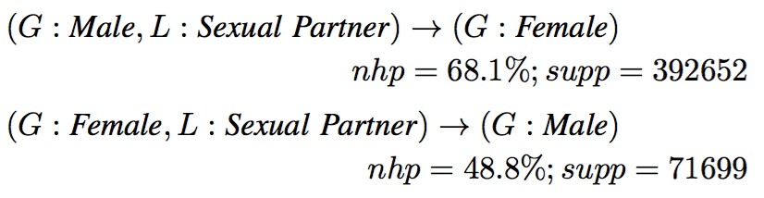

Interestingness: Case Study
Case study
  A top GR
  from Pockec data derives:
  This pair suggests a big difference in the preference of opposite sex partners by males and females when looking for sexual partners
  A top GR from DBLP data
  Authors in the DB area often collaborate with those in the DM area when collaborating with those not in their own area
Notes:
Drill down to do the related queries, interesting findings

Slide 22
Efficiency Study: Pokec Data
A+B+C+D A+B+C A+B A
A: supp based pruning
B: compact 3-table data storage
C: nhp based pruning
D: top-k pruning
Default Parameters Setting
minSupp = 50 (absolute value)
minNhp = 50%
k = 100
Notes:
Several properties/abilities that the algorithm can equip.

Slide 23
Outline
Introduction & Motivation
Problem Formulation
Solution
Evaluation
Conclusion & Future Work

Slide 24
Conclusion, Extensions and Future Work
Conclusion
  Mining social ties beyond homophily, many potential applications
  Compact data presentation
  Novel enumeration with multiple pruning strategies
  Interestingness and efficiency study on real data
Extensions and future work
  Alternative metrics other than nhp, such as lift, laplace, gain, etc
  Deal with unstructured data
  Predictive model

Slide 25
Q & A ?
Thanks !

