Slide 1

Top-k Route Search through Submodularity Modeling of Recurrent POI Features
Hongwei Liang, Ke Wang
Simon Fraser University, Canada

Slide 2

Trip Route Recommendation/Planning
Traveling Apps: usually only suggest isolated popular POIs
Travelers
  Personalized interests
  No idea about which places to visit and in which order to visit

Slide 3
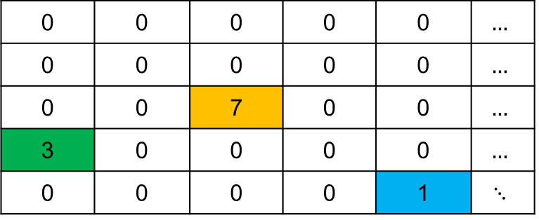

Realistic Considerations
Learn Personalized Ratings?
  Sparse historical rating data on POIs
Users’ Preferences
  Dynamically change over time
  Desire specific features for different trips
Traveling time between POIs
  Impossible to pre-compute the least traveling time for every pair

Slide 4
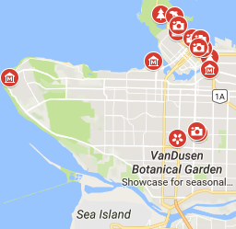



Scenarios: Route Planning with
Explicit Features
Traveling Scenario
  A trip consisting of parks, shopping malls and Japanese restaurants (different degree of preference) before taking the flight
Park
Sushi
Shopping
Eric
Home Seeking Scenario
  Spend a half day to see open houses that have these features: 3 bdrs, close to schools, big yard.
Other Scenarios in Urban Planning, Intelligent transportation, etc
3 bdrs
Close to schools
Big yard

Slide 5
Common Structures and Requirements
POI Map
  Features with rating on nodes
  Costs on edges and nodes
User’s Requirements
  Source and destination, a travel cost budget
  Preferred features and corresponding weights, e.g., park = 0.6, food = 0.4
  More? How user’s satisfaction changes when visiting more POIs with recurrent feature?

Slide 6







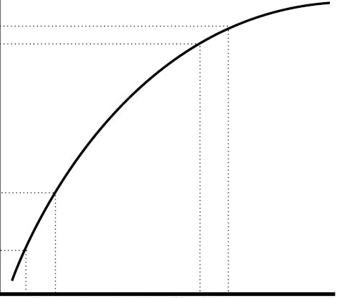


Quantity vs. Variety
First Park
Second Park
Another Park
Don’t want to see
parks any more …
Total accumulated utility
Go shopping ?
Go go go ! Let’s go!
Diminishing Marginal Utility for Recurrent Features
  Different users have various quantity-variety trade-off (personalized diversity requirement)

Slide 7
Problem: Route Search with Personalized Diversity Requirements on POIs
Given
  A POI map
  User query Q
    Source, destination, budget, preferred features and weights
    Feature aggregation functions indicating a route diversity requirement
Goal: top-k routes that maximize a user satisfaction Gain
while meeting the requirements in user query Q
POIs in
a route
weights for
each feature h
aggregate functions
for each feature h

Slide 8

Challenges
Modeling Personalized Diversity Requirements
  General feature aggregation functions for different diversity requirements
Generality and Efficiency of Search Algorithm
  Work nicely for any feature aggregation functions
  Deal with huge search space and generate high-quality routes in a timely manner

Slide 9




Modeling Personalized Diversity Requirements
A
B
C
How to aggregate the ratings
for recurrent features?
Park:3
Park:5
Park:4
SUM = 3 + 5 + 4 ?
Neither models diminishing
marginal utility well
Or MAX = 5 ?
Model Diminishing Marginal Utility by Submodular Set Functions
  If and , :

Slide 10
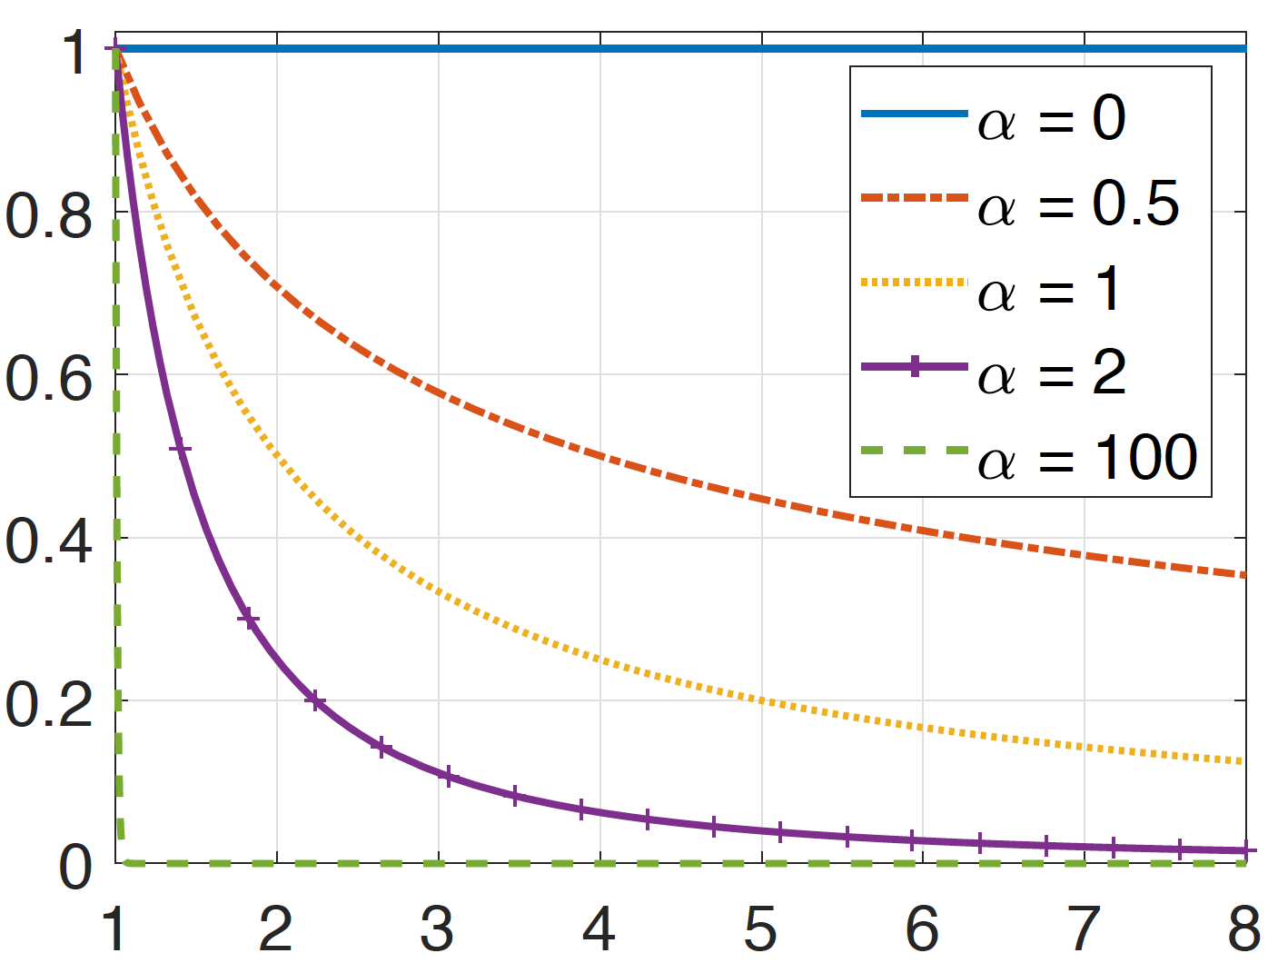


Submodular Aggregation Function Instances
Power-law based submodular aggregation function
the rank of POI i on the rating of
feature h among the POIs on P
power-law
exponent
Rating of POI i
on feature h
= 1
$$rank{\left(i\right)}^{−α}$$
Other Submodular Aggregation Functions
  Log utility function
  Coverage function
$$rank(i)$$

Slide 11

Framework Overview
User Query
Offline
Online
Indexing
(FI and HI)
POI Candidates Retrieval
Routes Finding
Select final POI candidates
Top-k routes
POI
Map
Retrieve sub-indices
According to Query
Search promising routes
Offline
  Index both feature and traveling cost dimensions
Online
  Select the POI candidates and search for the top-k routes

Slide 12
Indexing The POI Map
Offline Index Building
  Feature index
  2-Hop index for least travel cost computation
Feature Index
park: { (v₃,1) (v₂,0.8) }
2-Hop Index
v₂: { (v₂,0) (v₆,4) (v₃,5) }
v₅: { (v₅,0) (v₃,1) (v₄,3) (v₆,5) }
The least cost from v₂ to v₅?
v₃ is the common pivot node u of v₂ and v₅ that
minimize distance(v₂, u) + distance(u, v₅)
Jiang et al., VLDB 2014

Slide 13
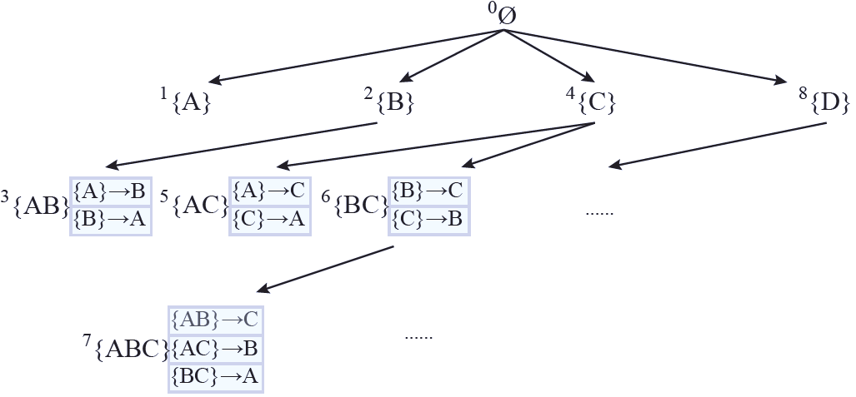
Searching for Optimal Top-k Routes: PACER
Prefix Based Depth-First Compact States Growth
  Compact state : group the routes with same set of POIs
  Enable Dominance-based Pruning: keep one route for each ending POI
  Incorporate the idea of DP: all sub-routes are enumerated earlier than super-routes
Only 3 routes are kept on node 7
{AB} → C represents the dominating feasible route among x → A → B → C and
x → B → A → C,
while the sub-routes
x → A → B and x → B → A are
computed earlier on node 3

Slide 14
Additional Marginal Gain Upper Bound Pruning
upper bound
A partial route can be extended to many feasible complete routes using the remaining 4 hours budget
upper bound of
marginal gain
C
Total accumulated
Gain
B
A
x
Added POIs
Utilize the submodularity of Gain to estimate the upper bound (UP) of the following marginal gain
Prune if

Slide 15
More Details of Gain Upper Bound Pruning
Directly estimate UP = finding the best subject to a route constraint
  Hard to get the cost of without knowing the order of the POIs in it
x
y
Approximate “route cost” by “set cost” and convert the problem to finding the best “set of POIs” subject to a set constraint
  Count half in-edge and half out-edge cost for each POI
  Use a fast approximation algorithm with a tight online bound
x
y
UP is estimated!

Slide 16
Highlights of PACER
General
  Work efficiently for any submodular Gain functions
  Support pruning for any additional anti-monotone constraints
Fast
  Even faster than a state-of-art quasi-polynomial time approximation algorithm for the Orienteering Problem
Extensible
  Can naturally derive a much faster heuristic algorithm to deal with queries with loose constraints

Slide 17
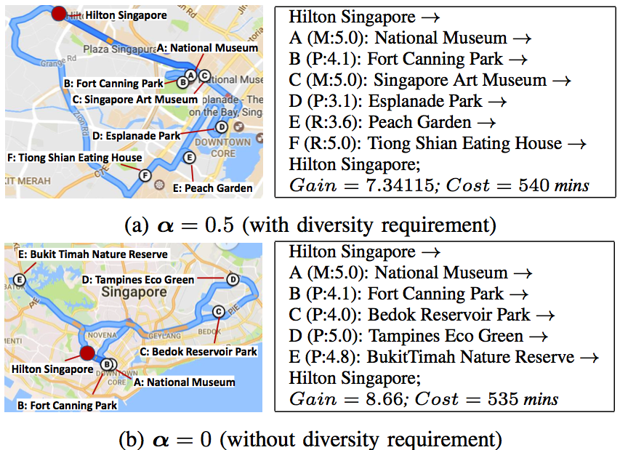
Experiments: A Case Study for Diversity Requirement
Park Museum Restaurant
User query:
hours
is the diversity
parameter of the
power-law based
submodular function
Singapore dataset: 1625 POIs, 24969 edges, 202 features

Slide 18
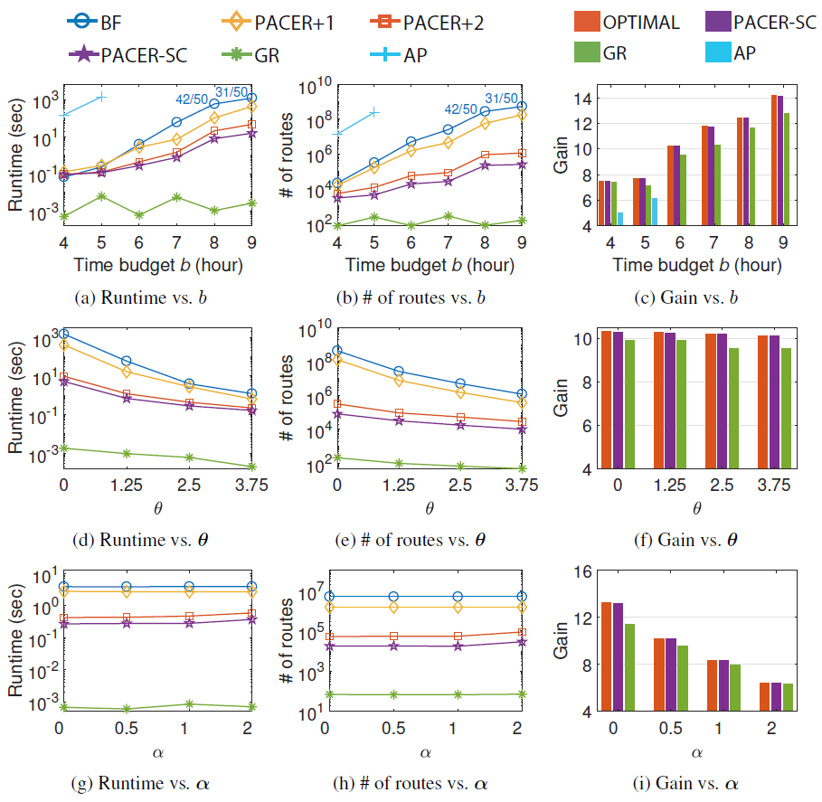
Experiments: Efficiency
Algorithm | Description
BF | optimal, brute-force
PACER+1 | optimal, compact state + dominance pruning
PACER+2 | PACER+1 + gain based upper bound pruning
PACER-SC | PACER+2 with heuristics
GR | greedy, polynomial
AP | baseline approximation
: budget
: threshold on
feature ratings
: parameter for
the power-law based
submodular function
Singapore dataset

Slide 19
Q & A ?
Thanks all audience and the financial support from SIGIR Travel Award !

