Slide 1

Trip Recommendation Meets Real-World Constraints: POI Availability, Diversity, and Traveling Time Uncertainty
Chenyi Zhang*, Hongwei Liang*, Ke Wang
Simon Fraser University, Canada

Slide 2
Motivation: Traveling
The Travel and Tourism Industry
  Contributed US$7.6 trillion to the global economy and supported 292 million jobs in 2016.
How People Travel Nowadays?
  Travel Agent DIY trips
  DIY: flexible, interests-driven and economical

Slide 3

Trip Recommendation for DIY
Traveling Apps: usually only suggest isolated popular POIs
Travelers
  Personalized interests
  No idea about which places to visit and in which order to visit
Personalized
Trip Recommendation

Slide 4



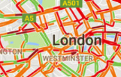
Requirements and Constraints
Personalized ratings on POIs
Realistic Constraints
  Internal (from user)
    Source, destination
    Time budget
    Desire of diverse types of POI in a trip
  External (from environment)
    POIs availability: opening hours
    Uncertain traveling time: various traffic conditions

Slide 5
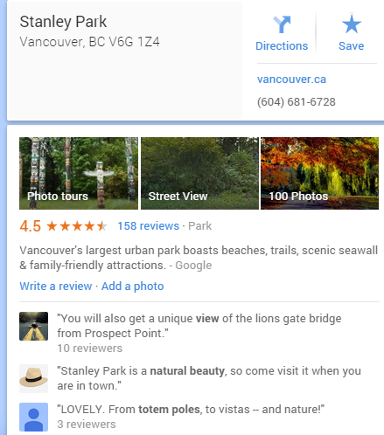
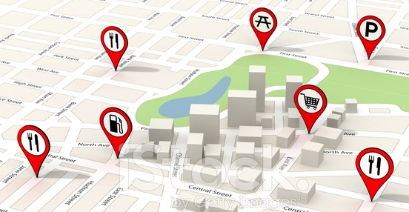
Resources From LBSN and Location Services
POIs
  Geographic information
  Touring time/costs
  Ratings and feature tags
  Users’ reviews with check-ins
Road Networks
  Traveling cost between two POIs that changes over time (indeterministic)

Slide 6
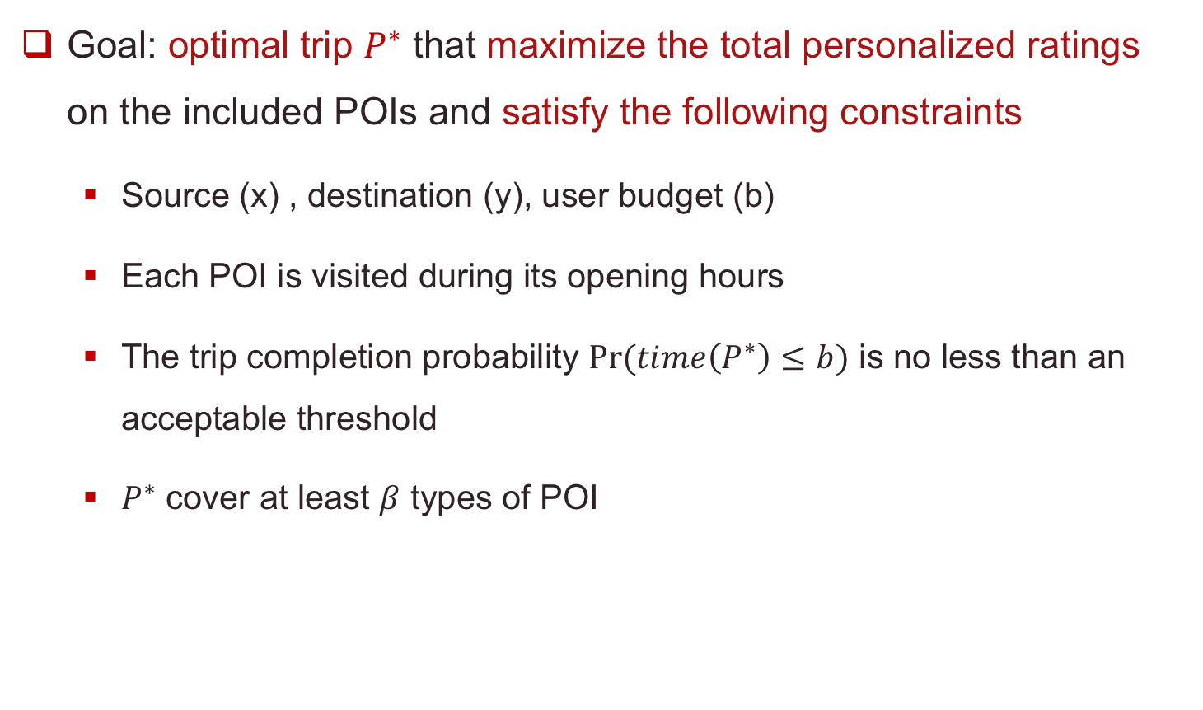
Problem Definition
Goal: optimal trip $P^{∗}$ that maximize the total personalized ratings on the included POIs and satisfy the following constraints
  Source (x) , destination (y), user budget (b)
  Each POI is visited during its opening hours
  The trip completion probability $Pr⁡(time\left(P^{∗}\right)≤b)$ is no less than an acceptable threshold
  $P^{∗}$ cover at least $β$ types of POI
best route
rating aggregate function
constraints

Slide 7

Working Flow
Offline: Recommending POIs
Personalized POI Rating Prediction
Online: Recommending A Best Trip
Search for an optimal trip visiting a subset of preferred POIs while satisfying the constraints
Large Search Space
A brute-force algorithm
NP-hard: For a POI map with 150 POIs to choose from, the number of
routes consisting of only 5 POIs can reach 150!/(150 - 5)! = 70 billions !!

Slide 8


A Sample Trip Recommendation
User’s Input
  Time budget: 6.5 hours
  Start/end: Central Park, New York City
  Completion probability threshold = 0.7
0.93
0.91
0.98
Recommended trip:
with happiness (total ratings) 3.78
0.96
F
B
C
D
E
F
Notes:
Not necessarily be a cycle

Slide 9
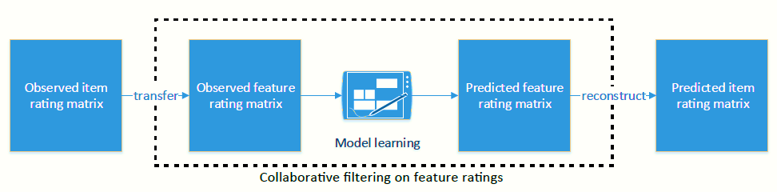
Estimating Personalized POI Ratings
Assumption: a user likes a POI because of its certain features
Method
  Leverage both historical ratings and features extracted from reviews
  Feature-centric collaborative filtering: transfer user-POI rating matrix to user-feature matrix
Zhang et al., AAAI 2015

Slide 10
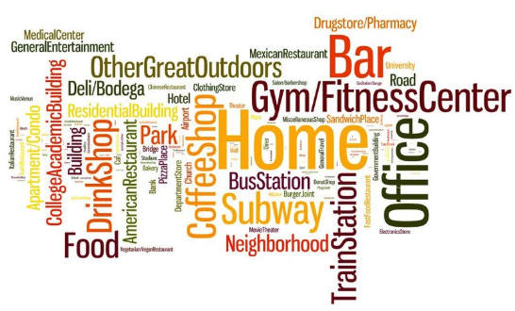

Modeling POI Diversity Constraint
Modeling POI Category
Check Diversity
  The trip finally recommended has to cover at least $β$ types of POI
use the most popular one
Explicit categories or tags
available
infer from the description of POI or
reviews by Latent Dirichlet Allocation (LDA)
unavailable

Slide 11

Time Constraints (Fixed Traveling Time Model)
Time Budget and POI Availability Constraints
starting
time of i
opening
hours
Just
visited i
i
j
destination (y)
source (x)
Visit j ?
staying
time
traveling
time

Slide 12
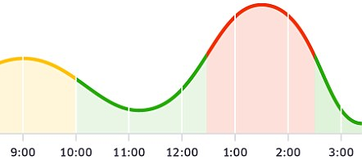
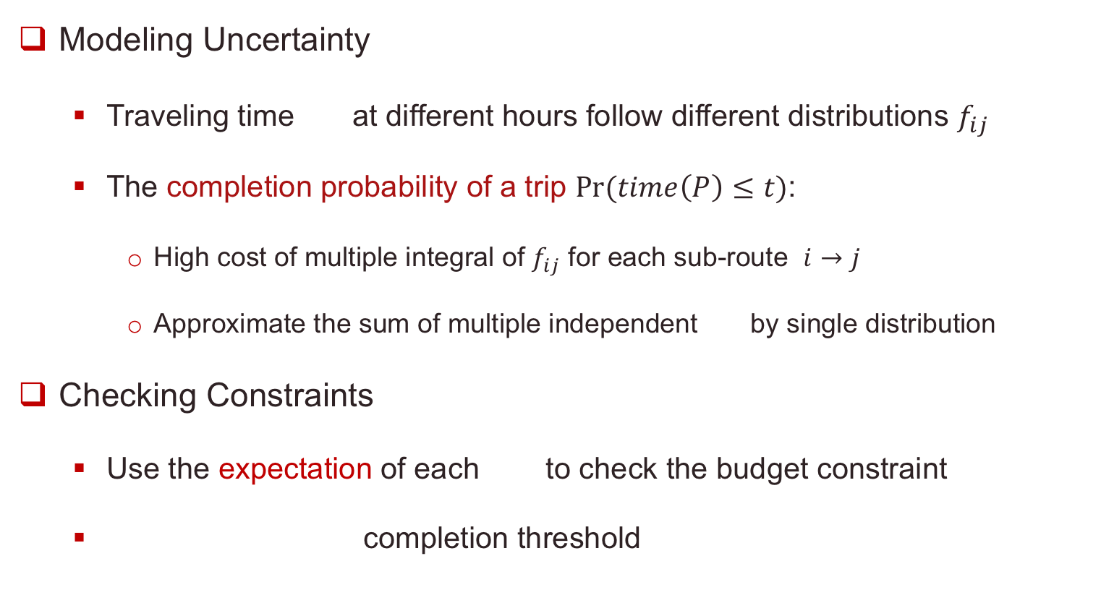

Uncertain Traveling Time Model
Modeling Uncertainty
  Traveling time at different hours follow different distributions $f_{ij}$
  The completion probability of a trip $Pr⁡(time\left(P\right)≤t)$:
    High cost of multiple integral of $f_{ij}$ for each sub-route $i→j$
    Approximate the sum of multiple independent by single distribution
Checking Constraints
  Use the expectation of each to check the budget constraint
  completion threshold
$\operatorname{Pr}\left(time\left(P^{∗}\right)≤b\right)≥$

Slide 13
Optimal Trip Search: State Expansion
State: partial trip route
State Expansion
  Appending reachable POIs incrementally while checking constraints
  The idea of Dynamic Programming
    Always expand “shorter trips” before “long trips”
    Each sub-trip is computed only once and reuse the intermediate results
a set of included POIs
State
collected total ratings
# covered categories
A
…
i
the ending POI i
the starting time of visiting at i

Slide 14


Dominance-based Pruning
Dominance Rule
  All feasible trips with the same set of POIs and the same ending POI Only keep a small number of dominating ones!
  Trip 1 (P1):
  Trip 2 (P2):
A
B
C
dominates
B
A
C
P2 and all its
extensions
are pruned
Used budget: P1 $≤$P2
  P1 dominates P2 iff
Completion probability: P1 $≥$ P2

Slide 15
Heuristics
  Dominance with State Relaxing Method
    No requirement on the same ending POI more aggressive pruning
    Sacrifice optimality for efficiency
  Heuristic Insertion Method
    Select a POI that maximize a marginal utility per unit of time
    Insert it to the current path that minimize the total travel time
C
insert?
B
A
x
y

Slide 16
Experiments Evaluation
Data Sets
  3 real POI data sets: PX in Yelp, LA and NY in Foursquare
  Extract 150 top rated and unvisited POIs for each user
Compared Algorithms
 | Algorithm | Description | Optimal | Heuristic
Our Proposed Methods | SE | State expansion + dominance pruning | √
 | PDFS | Optimized SE with advanced enumeration | √
 | SE-SR | SE with state relaxing heuristic |  | √
 | HA | A linear time heuristic insertion algorithm |  | √
Baselines | DP | A optimal algorithm in a WSDM’14 paper | √*
 | Greedy | A greedy in an operation research paper |  | √
*: can not deal with the POI availability constraint

Slide 17
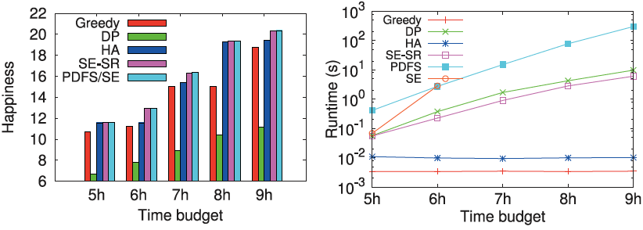
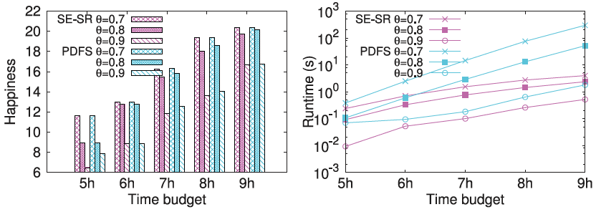
Experiments Evaluation: PX Data
Fixed Traveling Time Model
Uncertain Traveling Time Model
Budget b | Pruning Ratio
5 h | 99.30%
6 h | 99.23%
7 h | 99.20%
8 h | 99.18%
9 h | 99.16%
Pruned search space of SE/PDFS owing
to the dominance based pruning
Larger completion
probability threshold
results in:
Stronger pruning
Lower trip quality

Slide 18
Q & A ?
Thanks !

