Slide 1

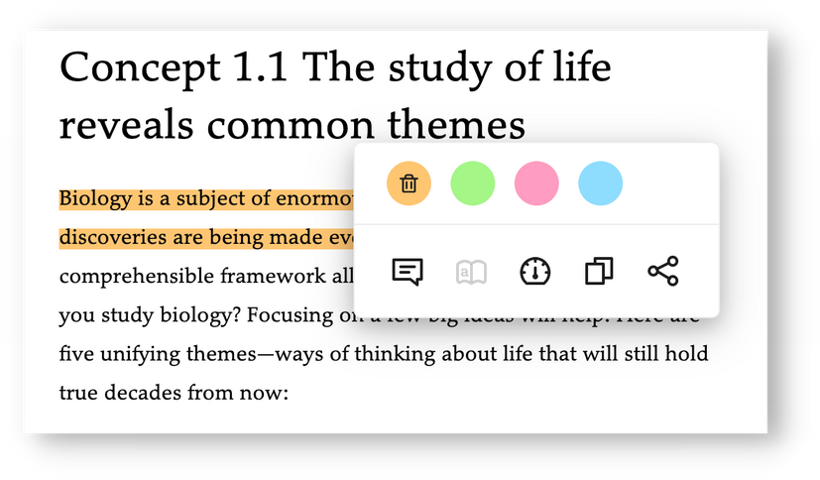
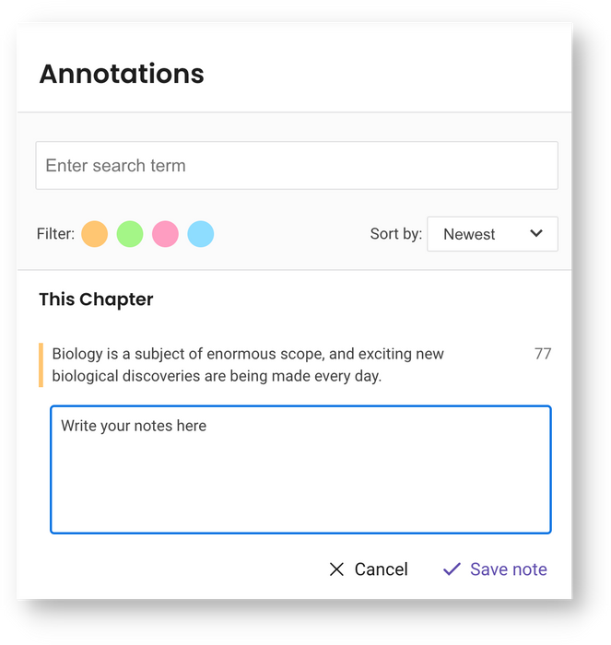
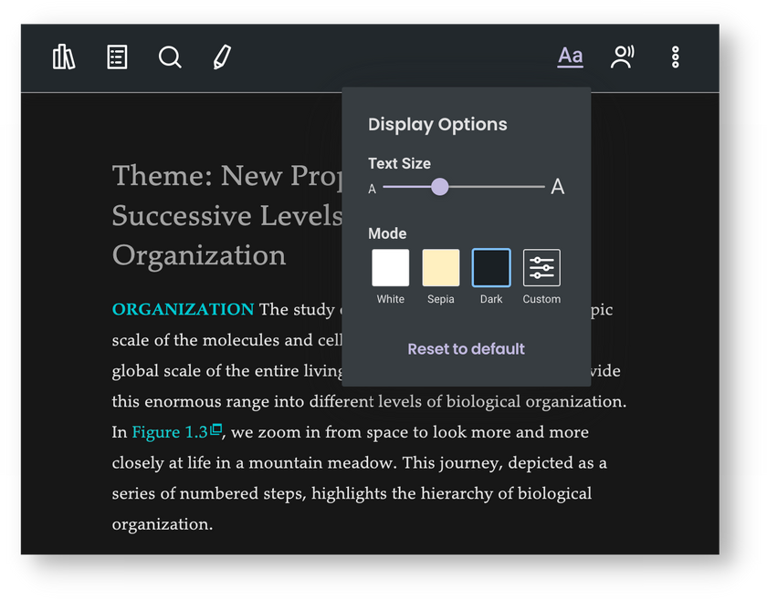
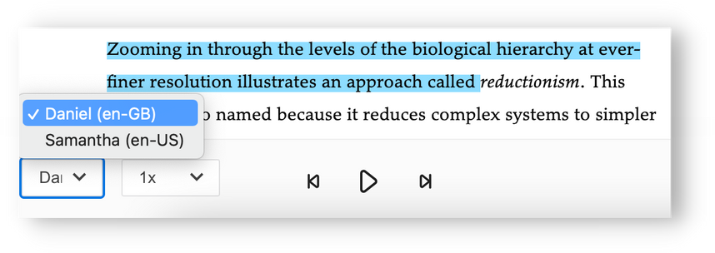

Benefits of
your eText
Your required class resource is an eText - you can purchase it directly below!
https://shop.sfu.ca/CourseSearch/?course[]=BUR,1237,ECON,ECON345,D100&
Here's what you get with your eText:
  Read aloud function
  Highlight and take notes
  Dark mode and Custom display settings
  Search for text and images
  Download and read offline*
It's easy to start - you can purchase it through your campus store.
*with the BibliU mobile app
Visit: https://shop.sfu.ca/CourseSearch/?course[]=BUR,1237,ECON,ECON345,D100&

