Slide 1

Hot enough for you yet?

Slide 2
The UN Arms Trade Treaty: Update and Prognosis
Canada’s National Firearms Association
Richmond BC
2014

Slide 3
Gary Mauser
Professor emeritus, Simon Fraser University
Member, Firearms Advisory Committee,
Public Safety Minister Steven Blaney
Testified before Canadian Parliament and Supreme Court of Canada on criminal justice issues

Slide 4
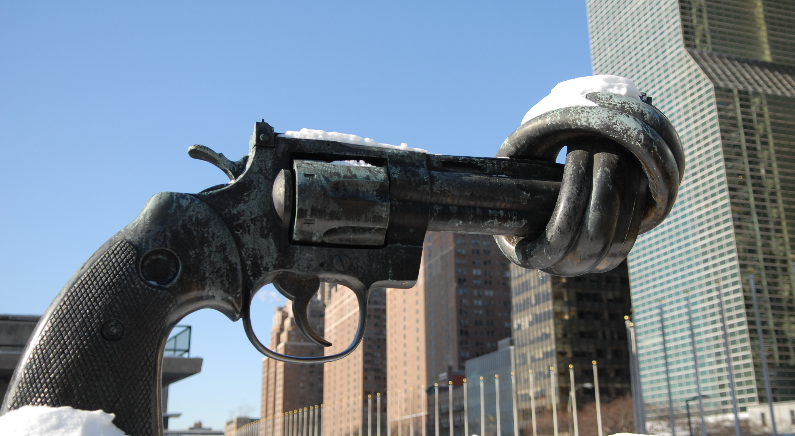
United Nations
Notes:
The UN’s goal is to disarm civilians, not nations.

Slide 5
THE ARMS TRADE TREATY
On 2 April 2013, the General Assembly adopted the landmark Arms Trade Treaty (ATT), regulating the international trade in conventional arms, from small arms to battle tanks, combat aircraft and warships. The treaty will foster peace and security by putting a stop to destabilizing arms flows to conflict regions. It will prevent human rights abusers and violators of the law of war from being supplied with arms. And it will help keep warlords, pirates, and gangs from acquiring these deadly tools.

Slide 6
Arms Trade Treaty
The UN General Assembly violated consensus, broke protocol to act like a world parliament
The ATT is a treaty –- only legally binding between consenting nations
Ostensive goal is to regulate the international trade in conventional arms,
Key provisions focus on “non-state actors”
To be ratified by each member state individually
This treaty will be amended, it will expand

Slide 7
How can the UN affect me?
The UN is far away
There is no direct link
The UN can not pass laws over Canadians

Slide 8

The UN seems as distant as the moon

Slide 9
… but the moon is powerful
Canadians know the moon (though further away than the UN) still has powerful effects
On the tide if not werewolves
Moon’s gravity shaped by other factors
The shoreline
The shape of the sea bottom

Slide 10
The UN can affect you
Canada bound by ATT as it trades with countries that have ratified the ATT
UN resolutions reflect elite opinion
Governments are run by elites
The UN resolutions stimulate national regulations
Shop for ammo in the US recently?
Politicians can use the UN’s decisions to justify their actions
Notes:
Chretien, Clinton, Obama have used UN resolutions as excuses to implement regulations that restrict civilian gun rights

Slide 11
Moving towards entry into force
States have signed the Treaty? 118
States have ratified the Treaty? 32
50 ratifications needed –
This will be reached by September
General Assembly vote to adopt
the Treaty: 154-3-23
Notes:
How many states are needed?

Slide 12
Countries Opposing or Abstaining
Armenia, Belarus, Bolivia (Plurinational State of), Cuba, Democratic People's Republic of Korea, Ecuador, Egypt, Eritrea, Fiji, India, Indonesia, Iran (Islamic Republic of), Kuwait, Lao People's Democratic Republic, Mauritania, Morocco, Myanmar, Nicaragua, Oman, Qatar, Russian Federation, Saudi Arabia, Sri Lanka, Syrian Arab Republic, Uganda, Uzbekistan, Venezuela (Bolivarian Republic of), Yemen, Zimbabwe

Slide 13
UN 101
Security Council
General Assembly
International Court of Justice
UN Secretariat
UN Specialized agencies

Slide 14
Security Council
Veto
Only permanent members
Decisions can be implemented with force, and have been:
Korea
Serbia
Afghanistan

Slide 15
Security Council
Permanent members - The victors of WW II
USA
UK
France
Russian Federation
China

Slide 16
Security Council, Rotating members (2-year terms)
Argentina | Australia
Chad | Chile
Jordan | Lithuania
Luxembourg | Nigeria
Republic of Korea | Rwanda

Slide 17
UN Secretariat
A variety of anti-gun bodies reporting directly to the Secretary General
ISACS – watch out for this one!
UNIDIR
UNODA
DESA
Notes:
International Small Arms Control Standards
UN Institute for Disarmament Research
UN Office for Disarmament Affairs
Department of Economic and Social Affairs (DESA)

Slide 18
UN Specialized Agencies
World Health Organization
International Labour Organization
International Monetary Fund

Slide 19
General Assembly
It simulates a parliament, but delegates are not elected
Decisions have little more than moral force
Sensitive decisions are typically made by consensus rather than by majority vote

Slide 20
General Assembly
The General Assembly has 193 member states
The biggest voting blocs is the “group of 77”
or “developing nations” or former colonies
The group of 77 is dominated by the Arab bloc
Next largest voting block is the “progressives,” mostly Europe and Commonwealth countries

Slide 21
Baptists and Bootleggers
States in US South allow counties
to decide to prohibit booze sales
The predominant religion is Southern Baptist
Result: States are checkerboarded with “wet” and “dry” counties

Slide 22
An “unholy” coalition
Southern Baptists support prohibition because they believe drinking is immoral
Bootleggers support prohibition because it drives up prices … and their profits

Slide 23
Progressives and Arms Dealers
The Progressives support arms controls because they believe civilian arms promote violence
A few arms dealers -- the EU and the UK --support the ATT because it cripples the US
Tyrants support arms controls in order to control their people

Slide 24
Hypocrisy
France ratified the ATT on April 2
In March, France agreed to sell advanced helicopter carriers to Russia for $1.7 billion USD
French Defence Minister described these carriers as unarmed “civilian hulls”
No pro-treaty NGO has condemned this transfer

Slide 25
Major NGOs Advocating Disarmament
Amnesty International
Oxfam
International Action Network on Small Arms (IANSA)
Control Arms
Swiss Small Arms Survey
Stockholm International Peace Research Institute
Notes:
Oxfam - Oxford Committee for Famine Relief by a group of Quakers,

Slide 26
Major NGOs Supporting Gun Rights
World Forum on Shooting Activities (WFSA)
National Rifle Association ILA (NRA)
SAAMI
SAFARI CLUB INTERNATIONAL
Others: SSAA, COLFO, Canada’s NFA

Slide 27
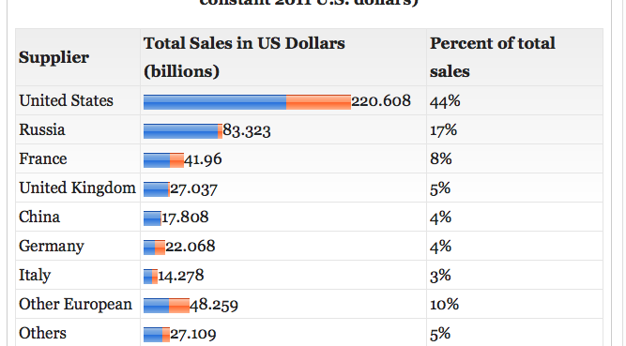
Arms sales by exporter 2004-2011 (billions US $)
Notes:
Source: http://www.globalissues.org/article/74/the-arms-trade-is-big-business#GlobalArmsSalesBySupplierNations
Source: Richard F. Grimmett, CRS Report for Congress; Conventional Arms Transfers to Developing Nations, 2004-2011 , August 24, 2012

Slide 28
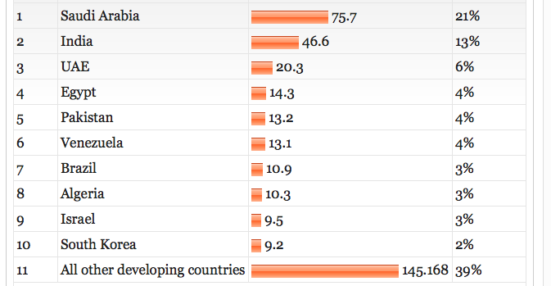
Who are the arms importers? (2004-2011 - billions US $)

Slide 29
Firearms and civilians
No international correlation between civilian access to firearms and national murder rates
Countries with more civilian firearms tend to be those with higher national income, greater economic freedom – and political stability

Slide 33
Canada and the UN
The UN PoA stimulated the passage of strict gun laws in the United Kingdom, Australia, New Zealand, the European Union, and South Africa
Only New Zealand and Canada have ever rolled back any gun law

Slide 34
Canadian Gun Laws Instigated by PoA UN’s Programme of Action
Kim Campbell’s Bill C-17
Jean Chrétien’s Bill C-68

Slide 35
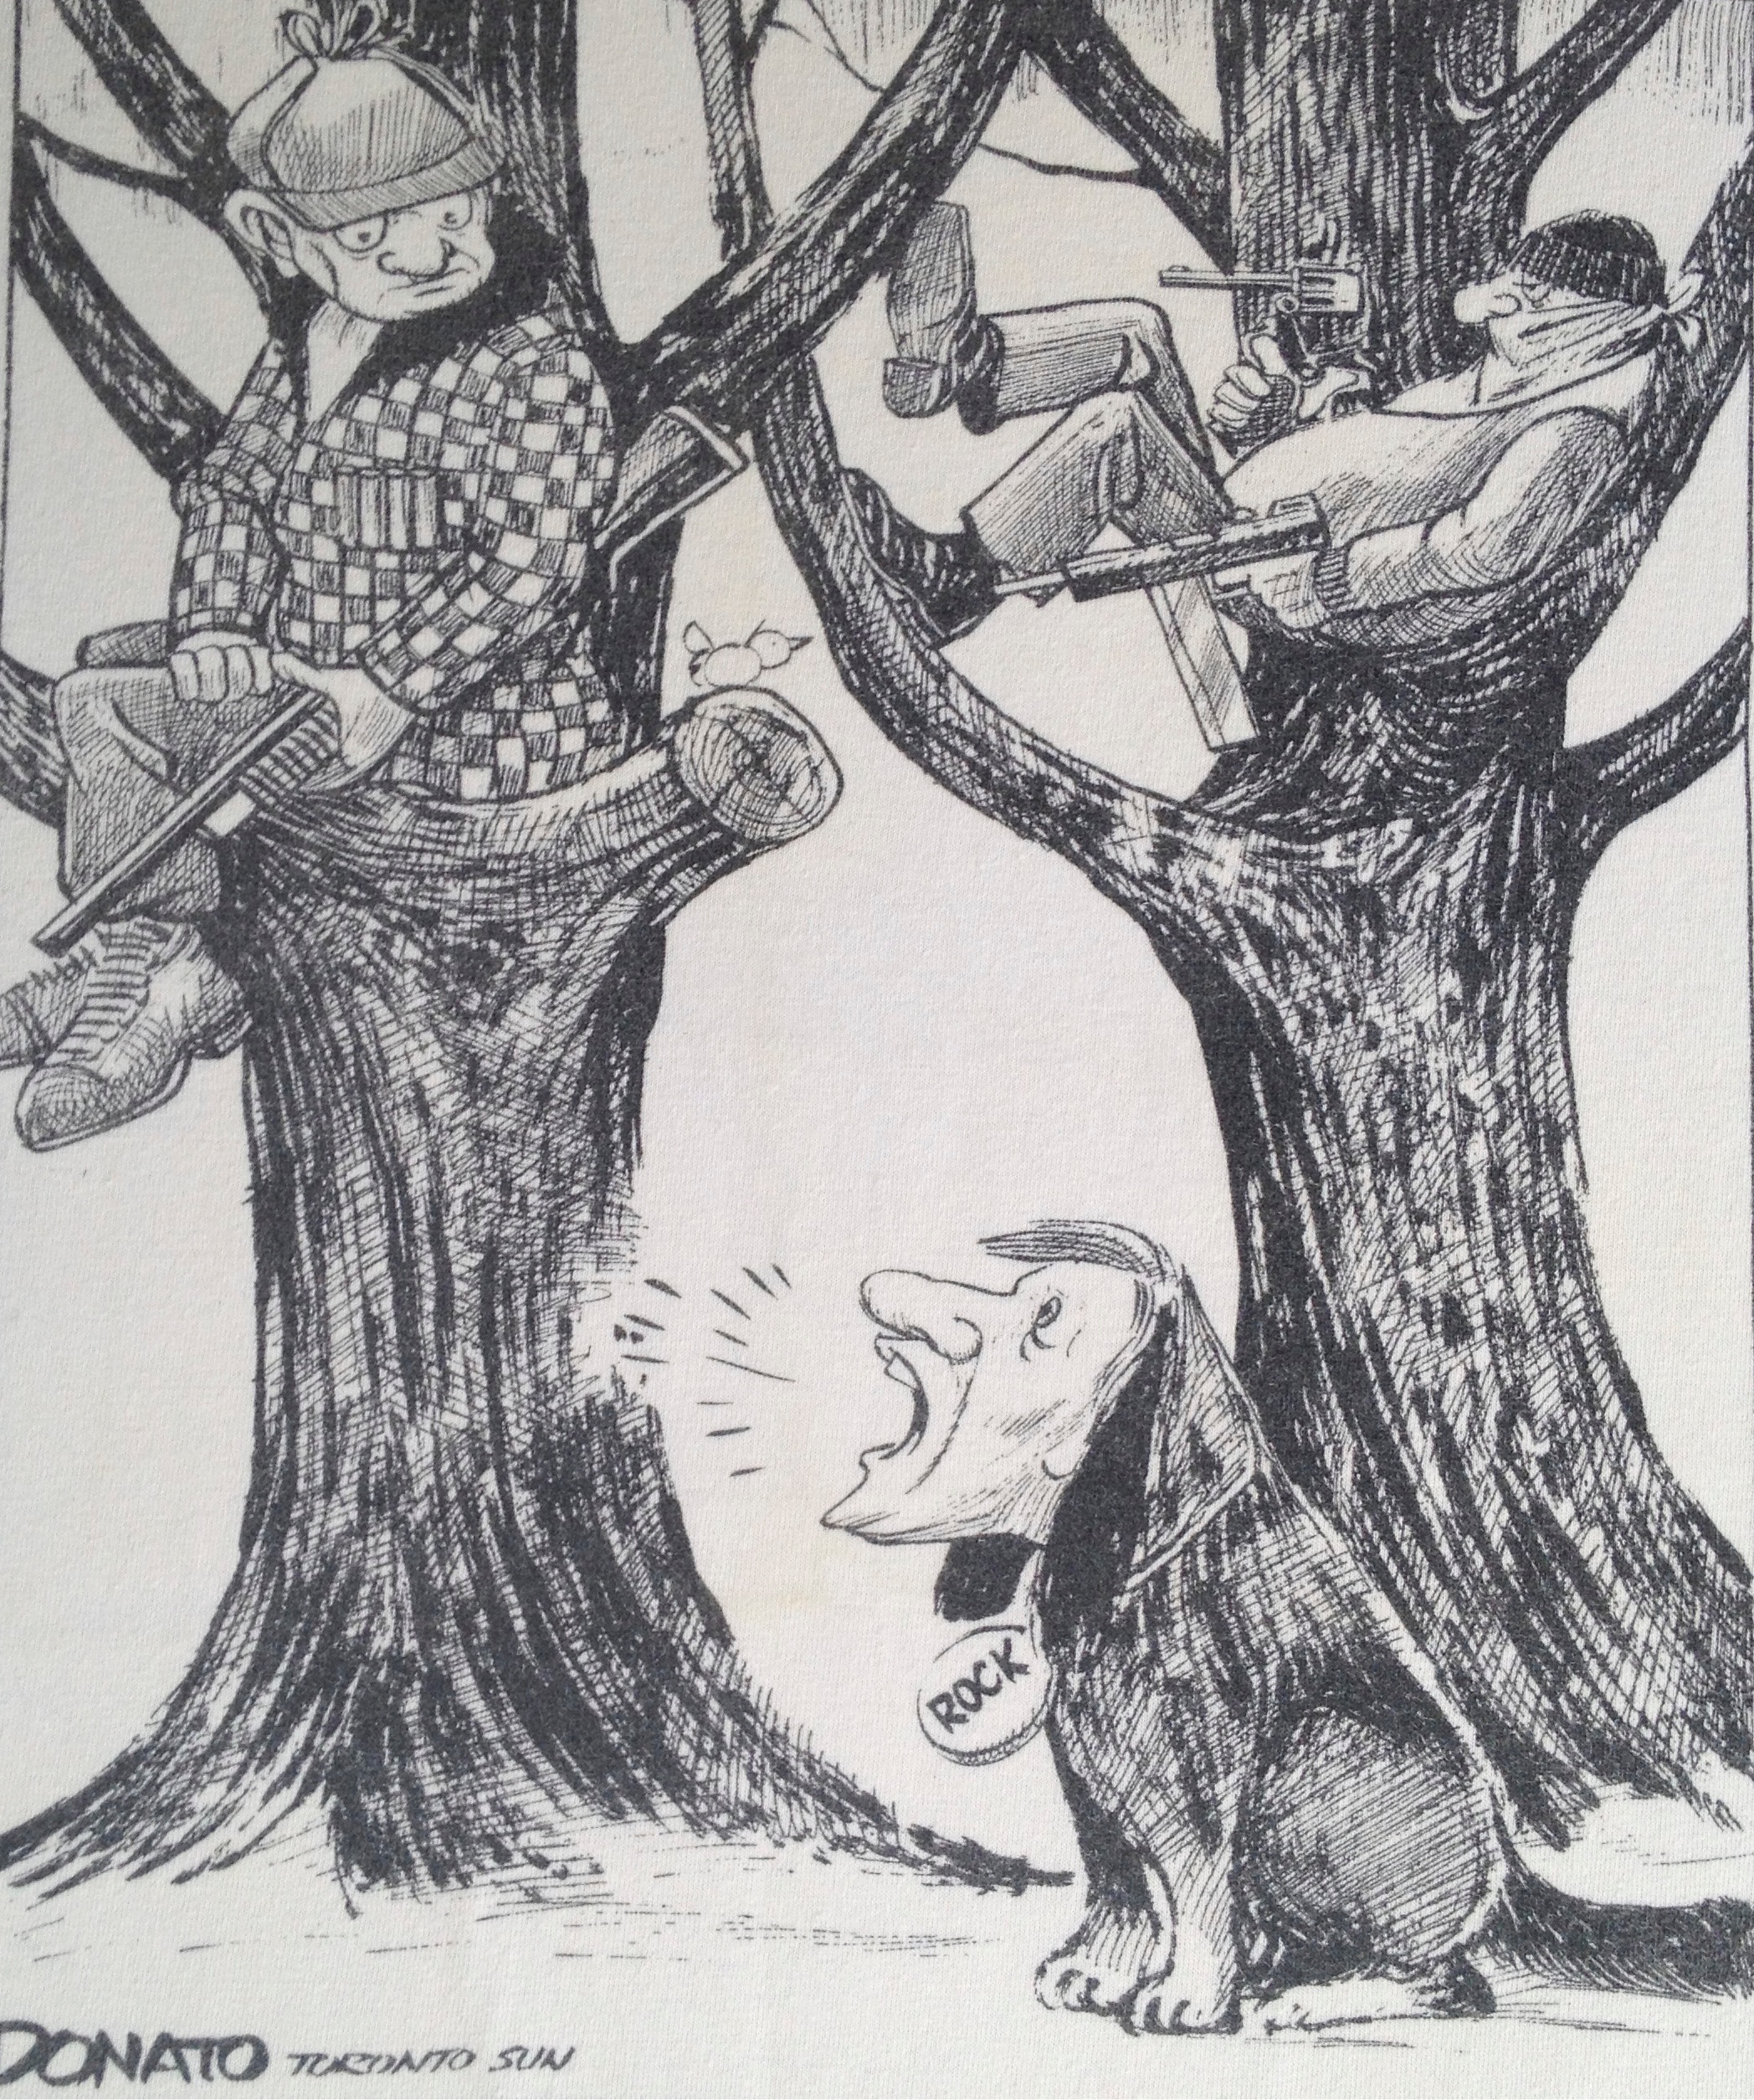

Slide 36
What have the Conservatives done for you?
Eliminated the long-gun registry
Cancelled the proposed gun-show regulations
Postponed marking /tracing regulations
until 2015 (for 11 consecutive years)
Amnesty for licensing (expires 2015)
Extend POLs
Free PAL renewals (expired)

Slide 37
Is this enough?
NO!

Slide 38
Changes under consideration
Roll back RCMP reclassification of Swiss rifles
Restrict RCMP powers to reclassify firearms
Extend duration of PALs (10-year)
Grace period for PAL renewal (1 year proposed)

Slide 39
Further Proposed Changes
Merge POLs and PALs
Attach ATT to PAL
Rein in CFOs – rewrite Section 58.1
Mandatory firearms training for first-time users

Slide 40
Still more proposed changes
Permit police to sell agency/protected firearms (Repeal section 15.1)
Get PALs off CPIC
Create “violent offenders” list
Technical Committee to classify firearms
Repudiate proposed UN marking system

Slide 41
Is this enough?
NO!

Slide 42
The opposition supports UN proposed gun laws
Liberals
Support long-gun registry
Proposed banning semi-automatic firearms
NDP
Support long-gun registry
Wants additional gun controls

Slide 43
What to do now?
Fight or give up?
Fighting means
making difficult choices
working hard despite doubts
Not just angry ranting
Giving up is easy – just be cynical

Slide 44
How to fight
Work from inside a political party
Support favorable candidates, policies
Work from the outside
Protest, demonstrate, partisan action
Both needed

Slide 45
Strategic obstacles
Firearms community diverse and divided
Little coordination, many egos, much competition
Little agreement about what issues or priorities

Slide 46
Three-pronged approach
Grass roots involvement
Partisan action
Organizational advocacy
Notes:
Comments on joining a political party:
At the least, you’ll get an education,
At best you’ll have a say in the party platform

Slide 47
Some Strategies
Barbarian horde vs Roman Army
Pack of wolves vs herd of herbivores
Uncle Tom vs Mau Mau

Slide 48
Uncle Tom vs Mau Mau
In the ’60s, a black radical was called
a “Mau Mau”
The radicals advocated drastic change
An “Uncle Tom” was a black moderate who preferred negotiation
Result: the Uncle Toms profited from the Mau Mau protests and demonstrations
Notes:
Uncle Toms eventually took over the Democratic Party
The Radicals were killed or jailed, some became university professors

Slide 49


