Slide 1
Phys102 Lecture 21/22
Light: Reflection and Refraction
Key Points
The Ray Model of Light
Reflection and Mirrors
Refraction, Snell’s Law
Total internal Reflection
References
23-1,2,3,4,5,6.

Slide 2
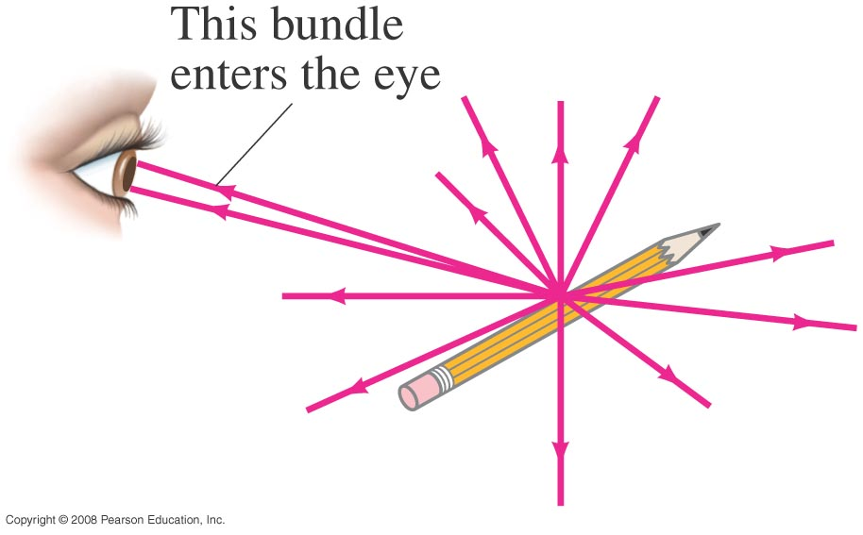
The Ray Model of Light
Light very often travels in straight lines. We represent light using rays, which are straight lines emanating from an object. This is an idealization, but is very useful for geometric optics.
Notes:
Figure 32-1. Light rays come from each single point on an object. A small bundle of rays leaving one point is shown entering a person’s eye.

Slide 3
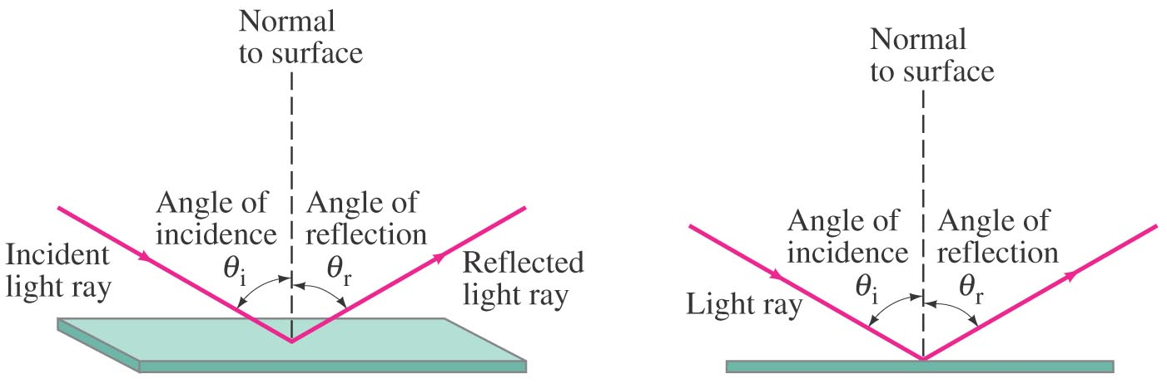
Reflection
Law of reflection: the angle of reflection (that the ray makes with the normal to a surface) equals the angle of incidence.
Notes:
Figure 32-2. Law of reflection: (a) Shows a 3-D view of an incident ray being reflected at the top of a flat surface; (b) shows a side or “end-on” view, which we will usually use because of its clarity.

Slide 4
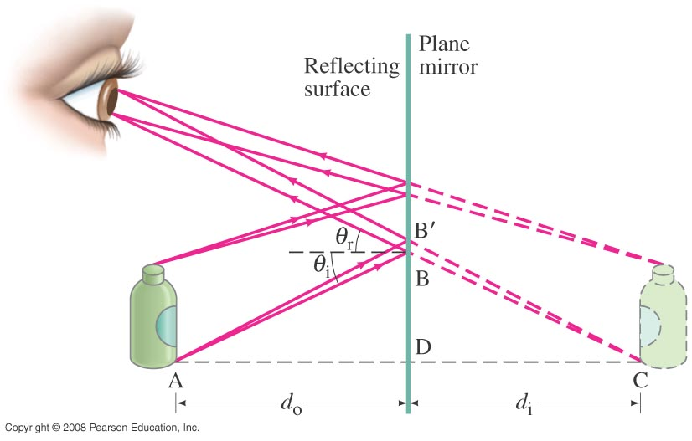
Image Formation by a Plane Mirror
What you see when you look into a plane (flat) mirror is an image, which appears to be behind the mirror.
Notes:
Figure 32-7. Formation of a virtual image by a plane mirror.

Slide 5
Image Formation by a Plane Mirror
This is called a virtual image, as the light does not go through it. The distance of the image from the mirror is equal to the distance of the object from the mirror.

Slide 6
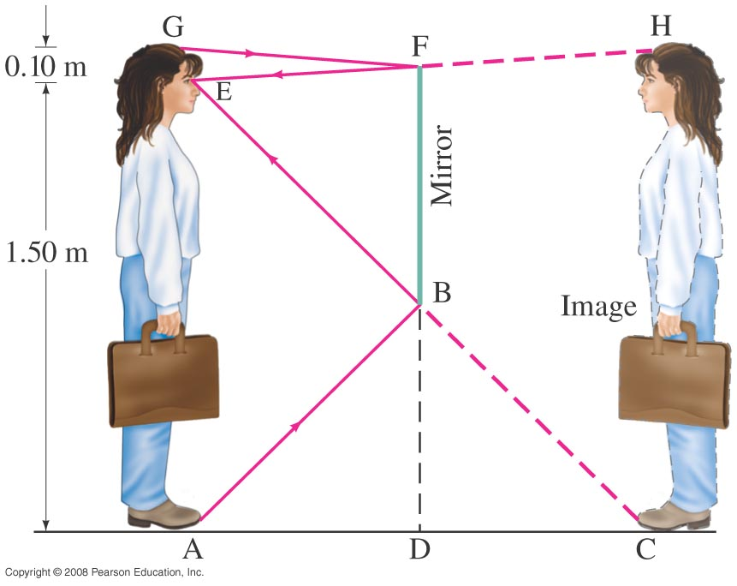
Reflection; Image Formation by a Plane Mirror
Example: How tall must a full-length mirror be?
A woman 1.60 m tall stands in front of a vertical plane mirror. What is the minimum height of the mirror, and how close must its lower edge be to the floor, if she is to be able to see her whole body? Assume her eyes are 10 cm below the top of her head.
N
M
Notes:
Solution: At the minimum height, light from her feet strikes the bottom edge of the mirror and reflects into her eyes; light from the top of her head strikes the top edge of the mirror and reflects into her eyes. Geometry then shows that the mirror must be 80 cm high, with its bottom 75 cm off the floor.

Slide 7
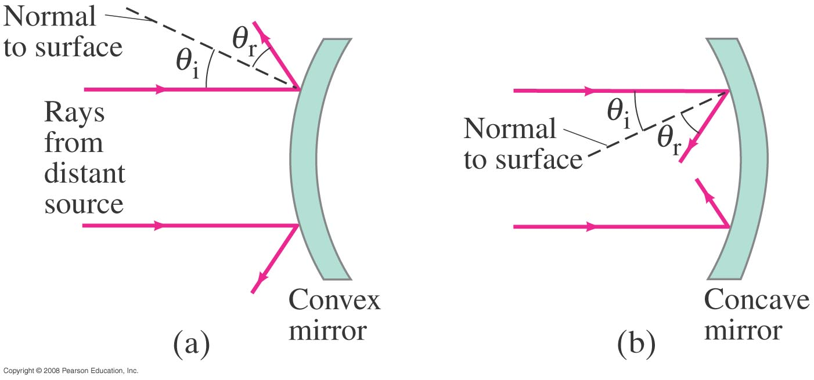
Formation of Images by Spherical Mirrors
Spherical mirrors are shaped like sections of a sphere, and may be reflective on either the inside (concave) or outside (convex).
Notes:
Figure 32-10. Mirrors with convex and concave spherical surfaces. Note that θ_{r} = θ_{i} for each ray.

Slide 8
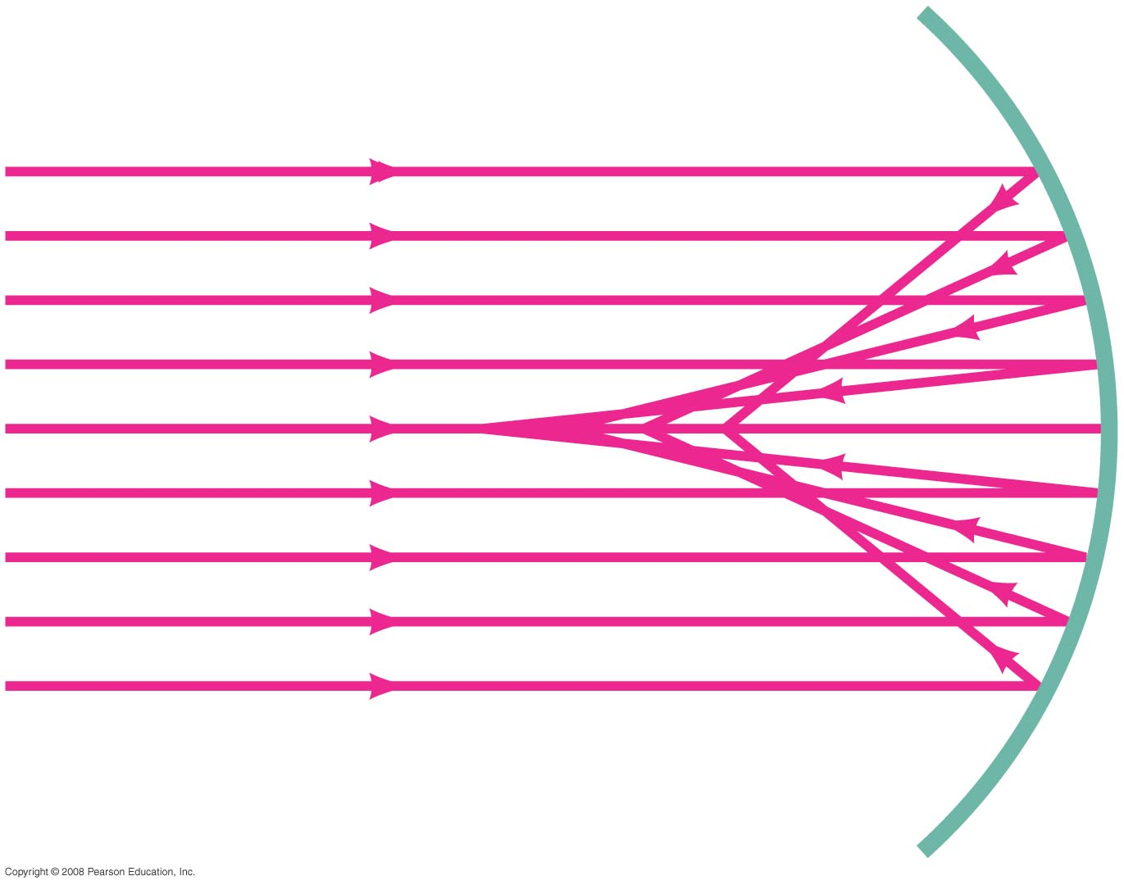
Formation of Images by Spherical Mirrors
Parallel rays striking a spherical mirror do not all converge at exactly the same place if the curvature of the mirror is large; this is called spherical aberration.
Notes:
Figure 32-13. Parallel rays striking a concave spherical mirror do not intersect (or focus) at precisely a single point. (This “defect” is referred to as “spherical aberration.”)

Slide 9
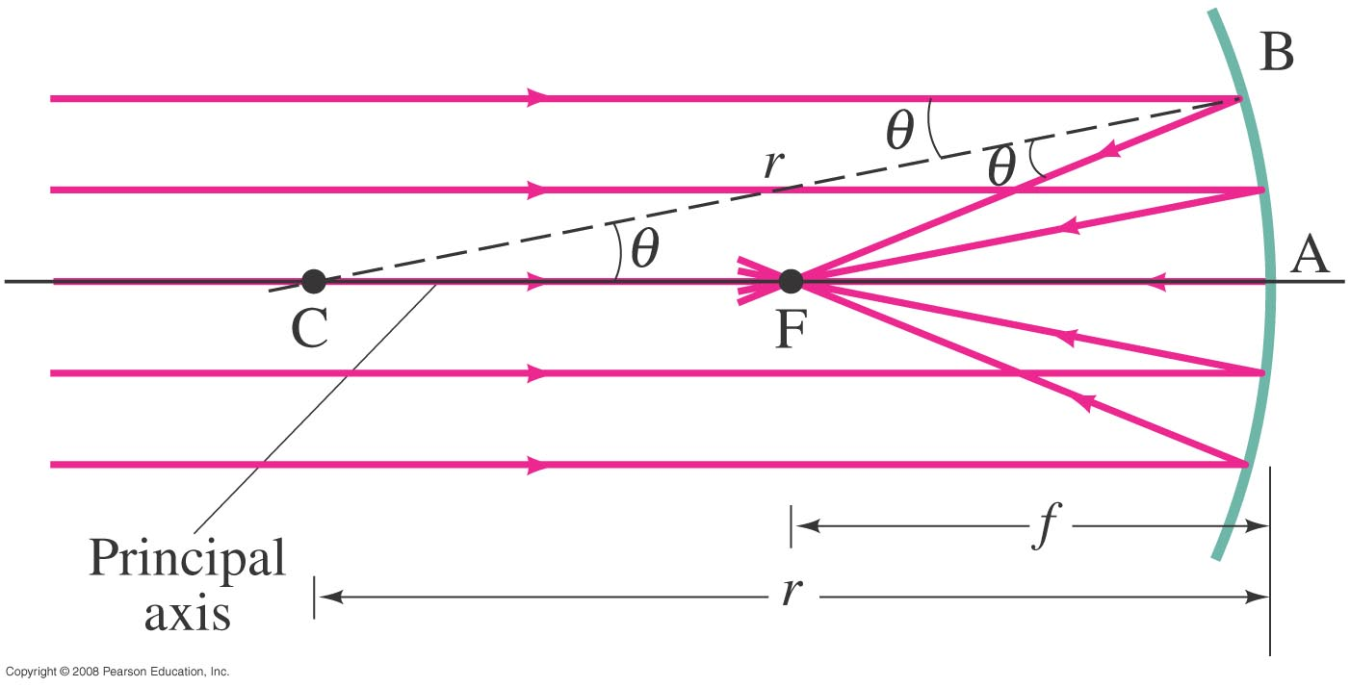
Formation of Images by Spherical Mirrors
If the curvature is small (small θ), the focus is much more precise; the focal point is where the rays converge.
Notes:
Figure 32-14. Rays parallel to the principal axis of a concave spherical mirror come to a focus at F, the focal point, as long as the mirror is small in width as compared to its radius of curvature, r, so that the rays are “paraxial”—that is, make only small angles with the horizontal axis.

Slide 10
Formation of Images by Spherical Mirrors
Using geometry, we find that the focal length is half the radius of curvature:
Spherical aberration can be avoided by using a parabolic reflector; these are more difficult and expensive to make, and so are used only when necessary, such as in research telescopes.

Slide 11
Formation of Images by Spherical Mirrors
We use ray diagrams to determine where an image will be. For mirrors, we use three key rays, all of which begin on the object:
A ray parallel to the axis; after reflection it passes through the focal point.
A ray through the focal point; after reflection it is parallel to the axis.
A ray perpendicular to the mirror; it reflects back on itself.

Slide 12
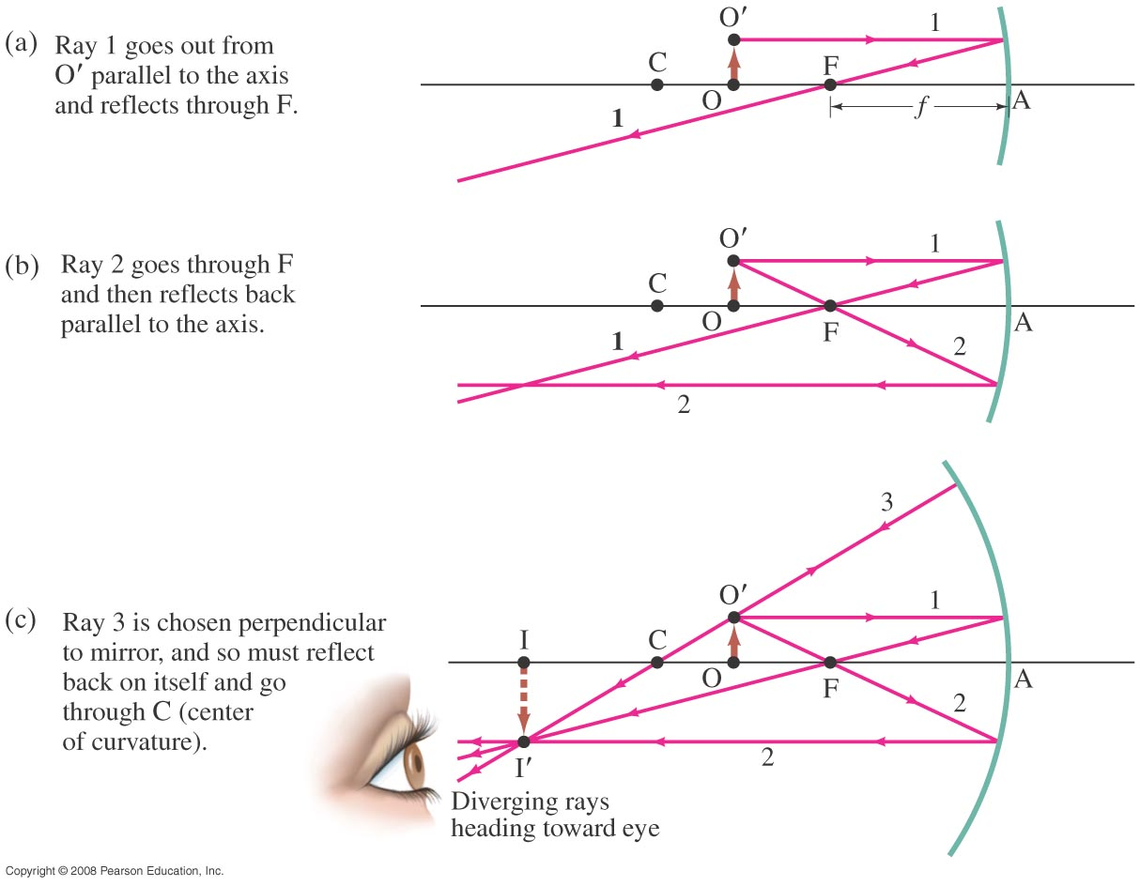
Formation of Images by Spherical Mirrors
Notes:
Figure 32-15. Rays leave point O’ on the object (an arrow). Shown are the three most useful rays for determining where the image I’ is formed. [Note that our mirror is not small compared to f, so our diagram will not give the precise position of the image.]

Slide 13
Formation of Images by Spherical Mirrors
The intersection of these three rays gives the position of the image of that point on the object.
Usually only two of these three rays are needed, the third can be used as a check.

Slide 14
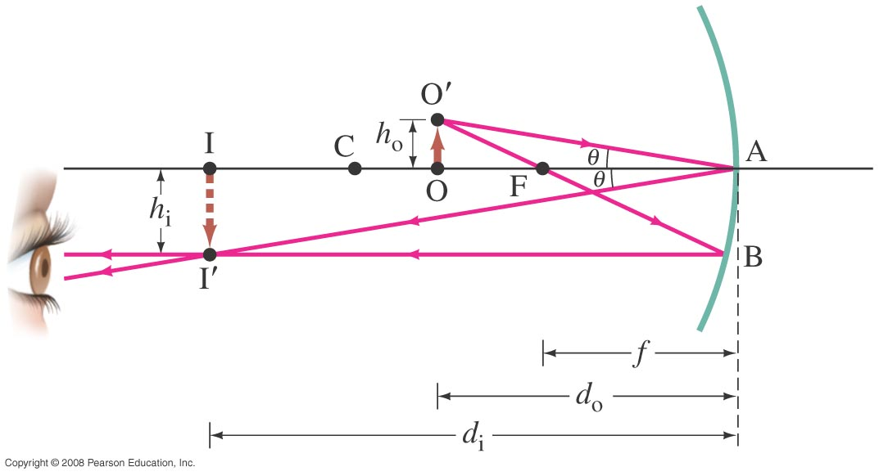
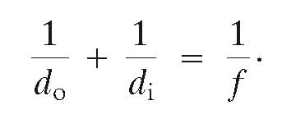
Formation of Images by
Spherical Mirrors
Geometrically, we can derive an equation that relates the object distance, image distance, and focal length of the mirror:
Sign conventions: if the object, image, or focal point is on the reflective side of the mirror, its distance is positive, and negative otherwise.
Notes:
Figure 32-16. Diagram for deriving the mirror equation. For the derivation, we assume the mirror size is small compared to its radius of curvature.

Slide 15
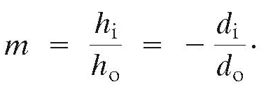
Formation of Images by Spherical Mirrors
We can also find the magnification (ratio of image height to object height):
When the image is inverted, m will be negative.
In this case, the object is between the center of curvature and the focal point, and its image is larger, inverted, and real.

Slide 16
Formation of Images by Spherical Mirrors
Example: Image in a concave mirror.
A 1.50-cm-high diamond ring is placed 20.0 cm from a concave mirror with radius of curvature 30.0 cm. Determine (a) the position of the image, and (b) its size.
Notes:
Solution: a. Using the mirror equation, we find d_{i} = 60.0 cm.
b. Using the magnification equation, we find M = -3.00 and h_{i} = -4.5 cm.

Slide 17
Conceptual Example: Reversible rays.
If the object in this figure is placed where the image is, where will the new image be?
Are light rays reversible?
Yes.
No.
Notes:
Solution: The equations, and the physical setup, are symmetric between the image and the object. The new image will be where the old object was.

Slide 18
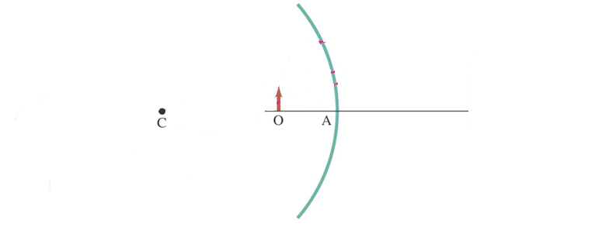
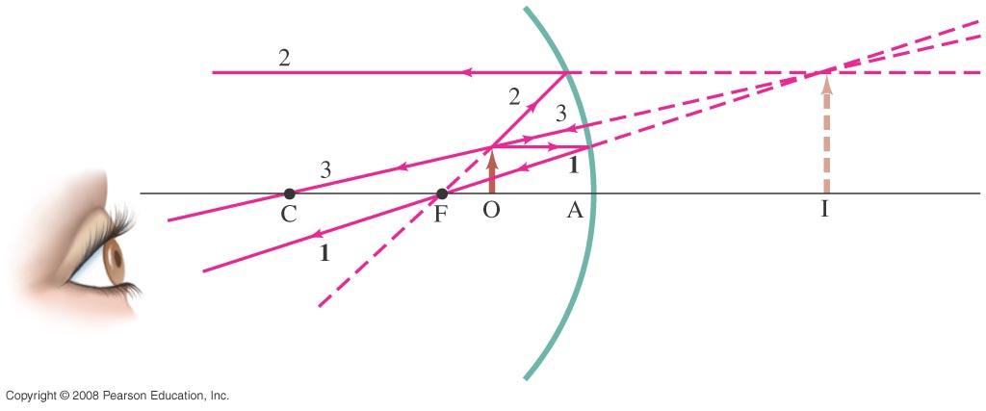
Formation of Images by Spherical Mirrors
Example: Object closer to concave mirror.
A 1.00-cm-high object is placed 10.0 cm from a concave mirror whose radius of curvature is 30.0 cm. (a) Draw a ray diagram to locate (approximately) the position of the image. (b) Determine the position of the image and the magnification analytically.
Notes:
Figure 32-17. Object placed within the focal point F. The image is behind the mirror and is virtual, [Note that the vertical scale (height of object = 1.0 cm) is different from the horizontal (OA = 10.0 cm) for ease of drawing, and reduces the precision of the drawing.]
Example 32–6. Solution: a. The figure shows the ray diagram and the image; the image is upright, larger in size than the object, and virtual.
b. Using the mirror equation gives d_{i} = -30.0 cm. Using the magnification equation gives M = +3.00.

Slide 19
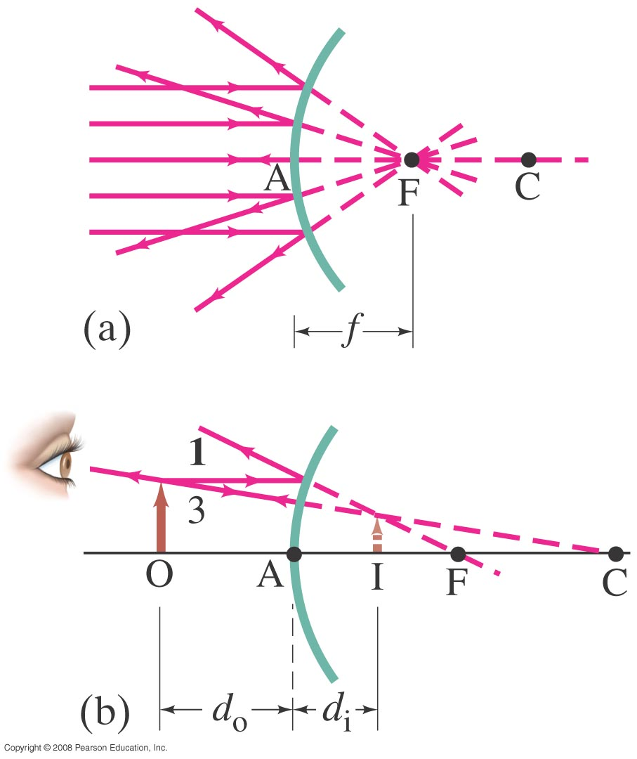
Formation of Images by Spherical Mirrors
For a convex mirror, the image is always virtual, upright, and smaller.
Notes:
Figure 32-19. Convex mirror: (a) the focal point is at F, behind the mirror; (b) the image I of the object at O is virtual, upright, and smaller than the object.

Slide 20
Formation of Images by
Spherical Mirrors
Problem Solving: Spherical Mirrors
Draw a ray diagram; the image is where the rays intersect.
Apply the mirror and magnification equations.
Sign conventions: if the object, image, or focal point is on the reflective side of the mirror, its distance is positive, and negative otherwise. Magnification is positive if image is upright, negative otherwise.
Check that your solution agrees with the ray diagram.

Slide 21
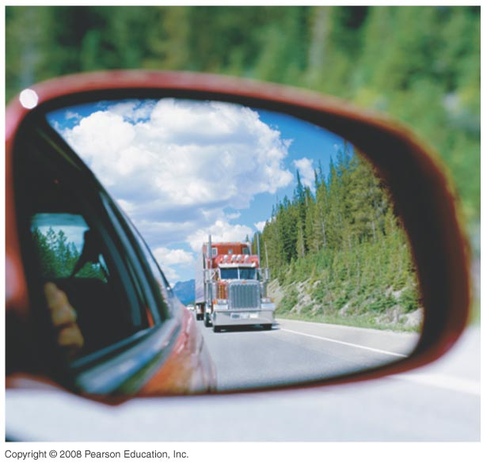
Formation of Images by Spherical Mirrors
Example: Convex rearview mirror.
An external rearview car mirror is convex with a radius of curvature of 16.0 m. Determine the location of the image and its magnification for an object 10.0 m from the mirror.
Notes:
Solution: The ray diagram for a convex lens appears in Figure 32-19b. A convex mirror has a negative focal length, giving d_{i} = -4.4 m and M = +0.44. The image is virtual, upright, and smaller than the object.

Slide 22
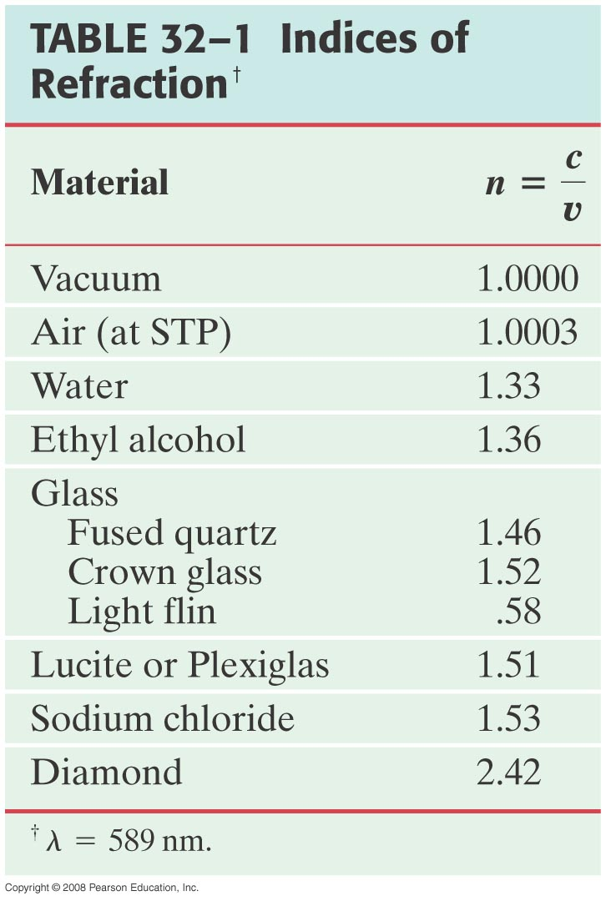

Index of Refraction
In general, light slows somewhat when traveling through a medium. The index of refraction of the medium is the ratio of the speed of light in vacuum to the speed of light in the medium:

Slide 23
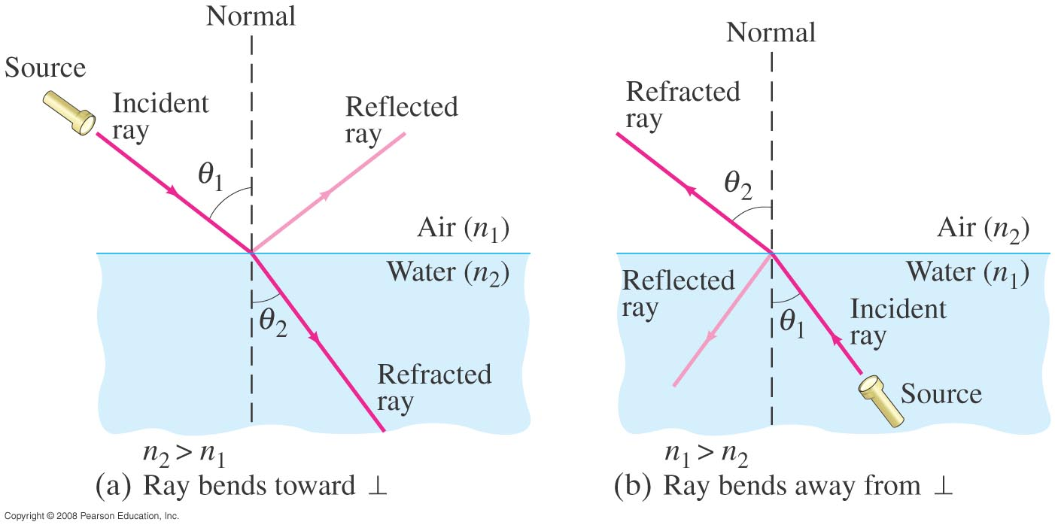
Refraction: Snell’s Law
Light changes direction when crossing a boundary from one medium to another. This is called refraction, and the angle the outgoing ray makes with the normal is called the angle of refraction.
Notes:
Figure 32-21. Refraction. (a) Light refracted when passing from air (n₁) into water (n₂): n₂ > n₁. (b) Light refracted when passing from water (n₁) into air (n₂): n₂ < n₁.

Slide 24
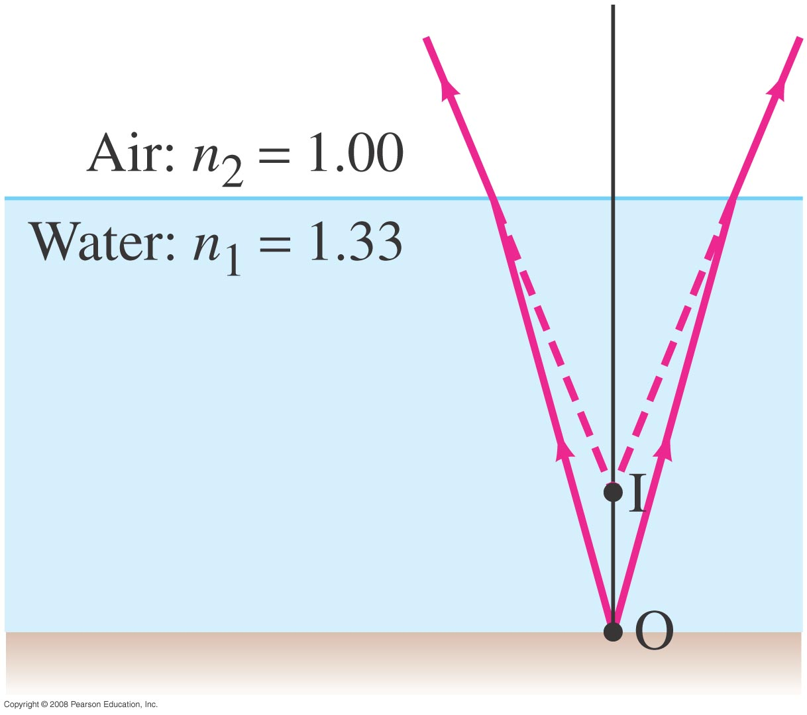
Example 32-9: Apparent depth of a pool.
A swimmer has dropped her goggles to the bottom of a pool at the shallow end, marked as 1.0 m deep. But the goggles don’t look that deep. Why? How deep do the goggles appear to be when you look straight down into the water?
Notes:
Solution: The ray diagram appears in Figure 32-25. Refraction causes the goggles to appear to be less deep than they actually are. Snell’s law plus a small-angle approximation (sin θ ≈ tan θ ≈ θ) gives d’ ≈ d/n₁ = 0.75 m.

Slide 25
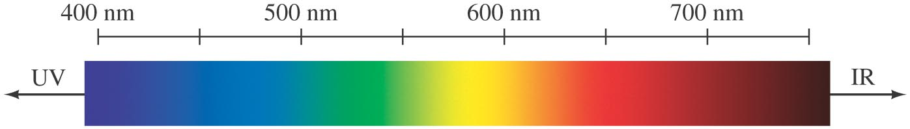
Visible Spectrum and Dispersion
The visible spectrum contains the full range of wavelengths of light that are visible to the human eye.
Notes:
Figure 32-26. The spectrum of visible light, showing the range of wavelengths for the various colors as seen in air. Many colors, such as brown, do not appear in the spectrum; they are made from a mixture of wavelengths.

Slide 26
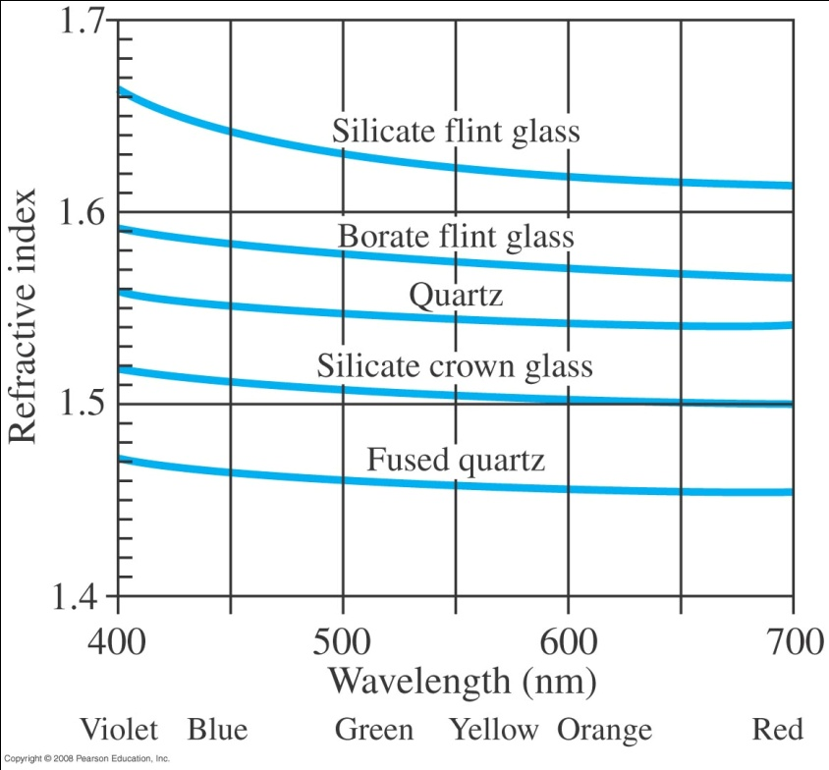
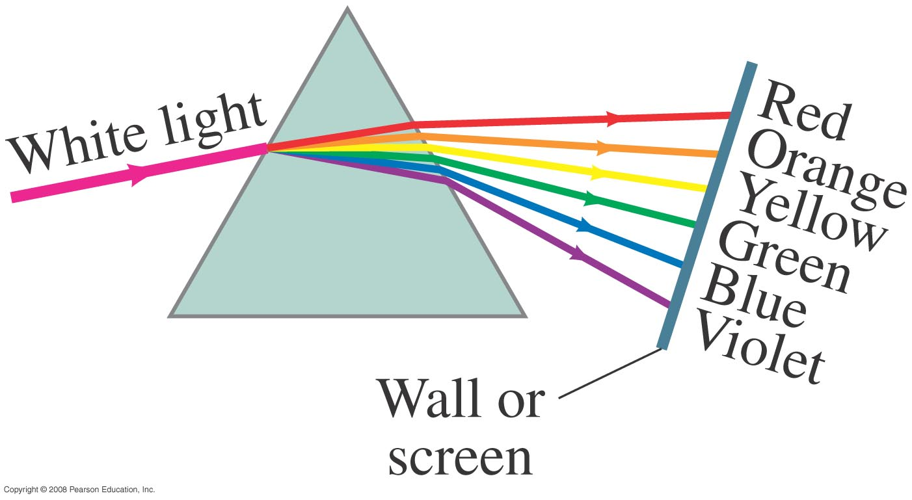
Visible Spectrum and Dispersion
The index of refraction of many transparent materials, such as glass and water, varies slightly with wavelength. This is how prisms and water droplets create rainbows from sunlight.
Notes:
Figure 32-28. Index of refraction as a function of wavelength for various transparent solids.
Figure 32-29. White light dispersed by a prism into the visible spectrum.

Slide 27
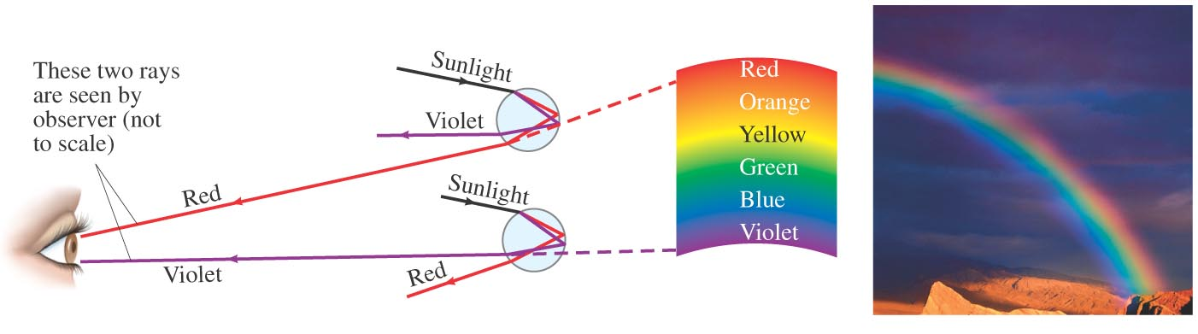
Visible Spectrum and Dispersion
This spreading of light into the full spectrum is called dispersion.
Notes:
Figure 32-20. (a) Ray diagram explaining how a rainbow (b) is formed.

Slide 28

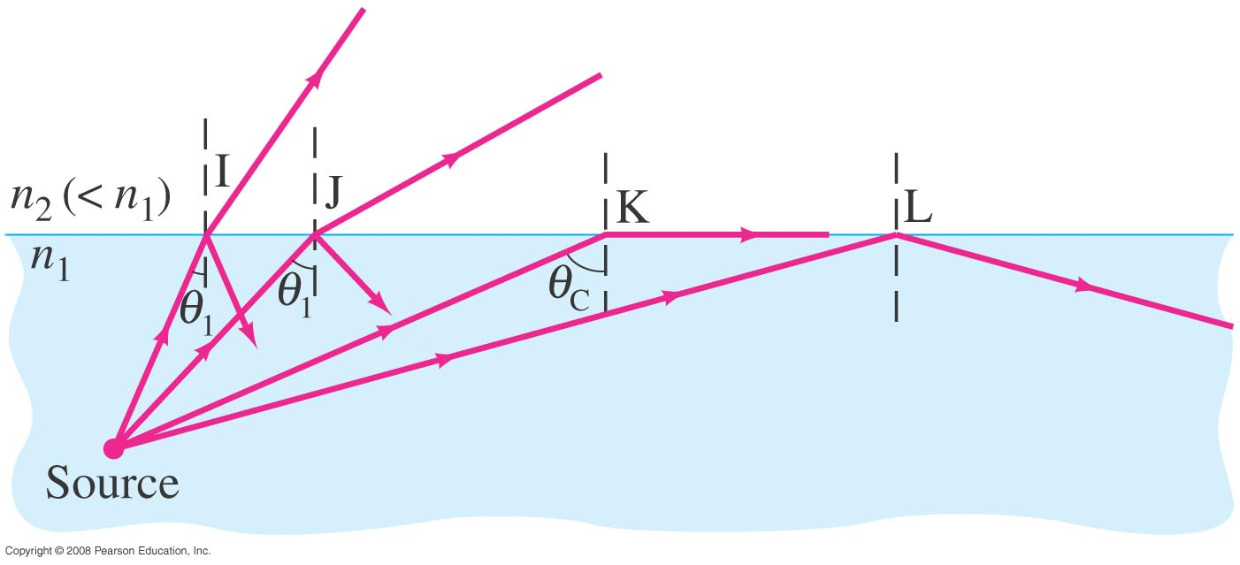
Total Internal Reflection
If light passes into a medium with a smaller index of refraction, the angle of refraction is larger. There is an angle of incidence for which the angle of refraction will be 90°; this is called the critical angle:
If the angle of incidence is larger than this, no transmission occurs. This is called total internal reflection.

Slide 29
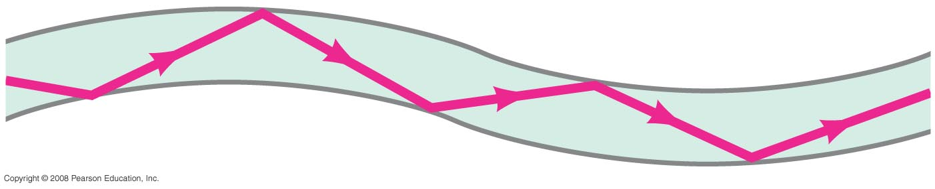
Total Internal Reflection;
Fiber Optics
Optical fibers also depend on total internal reflection; they are therefore able to transmit light signals with very small losses.
Notes:
Figure 32-34. Light reflected totally at the interior surface of a glass or transparent plastic fiber.

