Slide 1
LIBS 7023: Religious Studies
Dr. Stephen A. Ogden

Slide 2
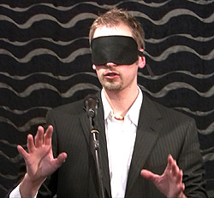
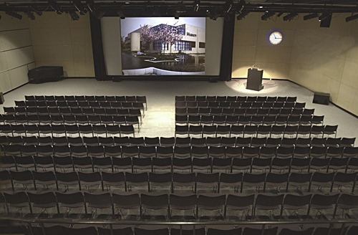
WHAT DOES ‘TAKING NOTES’ MEAN?
POWERPOINT: VISUAL
LECTURE: AUDITORY
[BLANK]

Slide 3
WHAT DOES ‘TAKING NOTES’ MEAN?
PowerPoint is visual, and lecture is auditory.
Lack of exercise of any faculty—here, auditory—results in atrophy of that faculty.
Unfortunately, professional and community life is predominantly—and often exclusively—auditory.
  Meetings
  Discussions
  Exchanges
  Conversations
    participant
    overhearer

Slide 4
WHAT DOES ‘TAKING NOTES’ MEAN?
TAKING NOTES DOES NOT MEAN
  Hearing
  Copying
  Passively receiving
  Passive acceptance
  Collecting details
  Recording
  Stenography

Slide 5
WHAT DOES ‘TAKING NOTES’ MEAN?
TAKING NOTES DOES MEAN
Listening
  active critical mental engagement
Observing:
  body language
  facial cues
  emphases
    pauses
    repetitions
    changes in volume
Recognising:
  main points
  major themes
  subtext
  Illustration & examples
Organising:
  primary ideas
  secondary ideas
  tertiary ideas
  connections & pathways

Slide 6
“RELIGION”:
NON-POLEMICAL DEFINITION
We learned last week that not all Religions have any essential reference to the concept of “God”.
This week, we learn that strong intellectual disagreement exists over the categorisation of some systems—such as Buddhism—as “Religion”.
It is necessary for proper scholarship that we begin from a workable but non-prejudiced definition of “Religion”.

Slide 7
RELIGION: PROVISIONAL DEFINITION
For our present purposes, let us work from a definition of ‘religion’ that is broad enough to be free of bias and assumption yet specific enough to be academically productive.
    this honours Cicero’s derivation ‘to treat carefully.’
Applying Lactantius’s OED derivation, ‘to bind’, to the general OED etymology, we can use this for a working definition of ‘religion’:
  A set of beliefs and practices, referencing some larger & all-encompassing power, system, or idea revered as the Good, that has force of prohibition and affirmation, and binds together a self-identified group.

Slide 8
COMPARATIVE RELIGION:
CHARACTERISTIC BIAS IN WESTERN STUDIES
Academic studies of religion in Western civilisation (usually titled ‘Comparative Religion’) have had a dogmatic bias from their 18th C. Enlightenment beginnings through their modern practice.
However, recent academic moves toward ‘post-colonial’ understanding have exposed and sharply rejected these biases.
The assumptions in Religious Studies among Western intellectuals matched the assumptions, preferences, and biases of Western civilisation—specifically, academic atheism.
  the “Secularist” bias: asserting that a neutral position exists independent of religion and with privilege of judgement.
  a priori relegates religion to an inferior position and aggrandises rationalist world-views: hence ‘comparative religion’
  devalues non-Western civilisations with different histories and concepts of religion

Slide 9
COMPARATIVE RELIGION:
CHARACTERISTIC BIAS IN WESTERN STUDIES
Assumptions of modernist Western science and biases of Religious Studies (‘Comparative Religion’):
  Developmental
  Progession
  Evolutionary
Value-judgements of modernist Western science and of Religious Studies (‘Comparative Religion’):
  ‘Lower’ to “Higher’
  ‘Primitive’ to ‘Advanced’
  ‘Savage’ to ‘Civilised’
  ‘Intuitive’ to ‘Rationalised’
  ‘Superstitious’ to ‘Positive’
  (originally) Magic —> (replaced by) Religion —> (replaced by) Science

Slide 10
THE BIASED ‘COMPARATIVE RELIGION’ VIEW
People were originally ignorant, fearful, and stupid.
  These ‘primitives’ or ‘savages’ still exist in places
These original peoples were afraid, so they invented ‘gods’ inside nature and in the sky and then begged, flattered, and bribed these ‘gods’ not to harm them.
These people next made images of these inventions and prayed to (i.e. begged, flattered, and bribed) them
After a while, a priesthood developed to look after and manage these images
This priesthood made themselves an institution and this becomes Religion.
Fortunately, Science was discovered by nice, smart, advanced people (i.e. the science people themselves) and now we know what’s best.

Slide 11
EXAMPLE OF COMPARATIVE RELIGION:
J.G. FRAZER (1854-1941)
At the turn of the 19th C., J.G. Frazer was one of the three great pillars of secular studies: Darwin, Freud and Frazer co-equally were said to have made secular science intellectually respectable.
The Golden Bough: a large anthropological accumulation of practices across history and around the world, that used a comparative and model.
  “this is an example of ‘the dying god’.”
  “this is an example of the ‘sacred grove’.”
  ‘this is an example of a ‘fertility rite’.”
Sat in his study in Cambridge and wrote from books and reports.
Encoded the progression of Magic → Religion→ Science

Slide 12
MAGIC & RELIGION: COMPARATTIVE RELIGION VIEW
MAGIC
RELIGION
Two Principles:
Law of Similarity
  Like produces Like
  Effect resembles Cause
  The Magician can produce the effect of something by imitating it.
Law of Contagion
  What was once in contact continues to influence.
  Charms, Amulets
  The Magician operates on an object and so acts on the person it had original contact with,
A propitiation or conciliation of Powers Superior to man which are believed to direct and control the course of nature and of human life.
1.] Belief (theology)
2.] Practice (prayer, worship)

Slide 13
PROBLEMS OF THE COMPARATIVE APPROACH
Assumes non-Western cultures are primitive, lesser, ignorant.
Makes an arbitrary valuation of science:
  Magic, Religion, and Science are all theories about the world
  Magic, Religion, and Science are all causal explanations
    Magic and Science both assume mechanical laws; both apply technique to nature.
      E.g. the magician compels the spirit to appear, and the elements to obey
      Religion talks, asks, requests: the world is a world of persons
Animistic (‘Folk’) Religions do not believe that there is no difference between inanimate and animate objects & forces: rather, a UNITY of all things: the animate-inanimate binary is null.
Assumes that abstraction is necessarily an advance:
  “Spirit” and “Breath” were originally the same word; same understanding of ‘living-ness’

