Slide 1
Lecture 1
Introduction to Fixed Income Securities
Class Organization: Overview of Syllabus
Discussion of Evaluation; Group Creation?
Groups projects only if class wants (score weights adjusted)
What is Fixed Income Security?
Overview of Global Fixed Income Markets
Fixed Income Pretest Review
Basic Fixed Income Calculations

Slide 2
Class Organization
Review of Course Syllabus
Discussion of Course Objectives
Course Text and Reading Materials (see webpage)
Most Useful Text is “Security Analysis and Investment Strategy” (SAIS);
Also: Various Readings in Supplementary Material
Evaluation of Grade
Formation of Groups

Slide 3
What is a Fixed Income Security?
Reading: SAIS, Sec. 1.1
  Legal Definitions,
    In the US, Securities Act (1933) and Trust Indenture Act (1939) apply to ‘bonds’ and other securities that make a fixed periodic ‘coupon’ payment
      Omits various types of securities, e.g., governments
    Graham and Dodd (1934) definition
      Only covers corporate debt securities
    Functionality approach (Poitras 2004)
      Any legally specified arrangement promising a regular income, coupon, implied interest or dividend payment
        Includes publicly traded preferred stocks, and govt. and corp. bonds and bills, defined benefit pensions, life annuities, perpetuities, GICs and CDs

Slide 4
Basics of Corporate Debt Securities
The Bond Indenture
  The bond indenture is a legal document, monitored and enforced by a trustee, that contains the terms and conditions governing that issue.
  Where applicable, the indenture contains
    coupon payment schedules,
    protective provisions and covenants,
    priority of claim relative to other bond issues,
    conversion conditions, sinking fund payment schedules and the like.
(US) Trust Indenture Act (1939)
  prohibits bond issues valued over $50 million (initially $10 million) from being offered for sale without a written indenture contract between the bond issuer and an independent trustee responsible for protecting the interests of bondholders.

Slide 5
Canadian Approach: Fixed Income as Securities
See Mcmillan reading on webpage

Slide 6
Prospectus for Canadian non-exempt (not private placement) fixed income securities are available on SEDAR

Slide 7
Types of Corporate Debt Securities
Debt issues can be secured by specific property, such as mortgage bonds
Debentures are unsecured issues that do not have a lien against a specific asset identified in the indenture.
When a number of debentures are issued by a corporation, the issues are usually further classified as senior, senior subordinated and subordinated debentures to reflect the associated priority of claim.
(See Boeing Financials, Tables 1.2 and 1.3)

Slide 8
Overview of Global Fixed Income Markets
Type of Issuer
  Government vs. Corporate
    Government Securities are debt
    Domestic vs. Foreign
Priority of Claim
  Debt vs. Equity
    Relevant for Corporate Securities
  Examine Boeing Financials

Slide 9
Boeing, Form 10-Q, Quarterly filing for 2018-2Q
For most companies the quarterly filing is a brief, unaudited report of the four essential financial statements. Detailed discussion of MD&A is provided in the 10-K filing which is typically provided in the annual report.
In Canada, the filing process differs somewhat from the tight scheduling in the US
IN ALL CASES in both Canada and the US, the required regulatory filings can be obtained from the Investors link on the company website.

Slide 11
Boeing Form 10-K 2017 Note: 13

Slide 13
Types of US and Other Debt Securities
US Treasury and Govt. of Canada securities
  Table 1.9 in SAIS and Bloomberg/GI websites
Corporate Bonds
  Investment Grade vs. High Yield
  Table 1.10 in SAIS + websites
Tax-Exempt (State and Local)
  Table 1.11 in SAIS
Mortgage-Backed Securities
  Table 1.12 in SAIS + issuer websites
Foreign Bonds

Slide 14
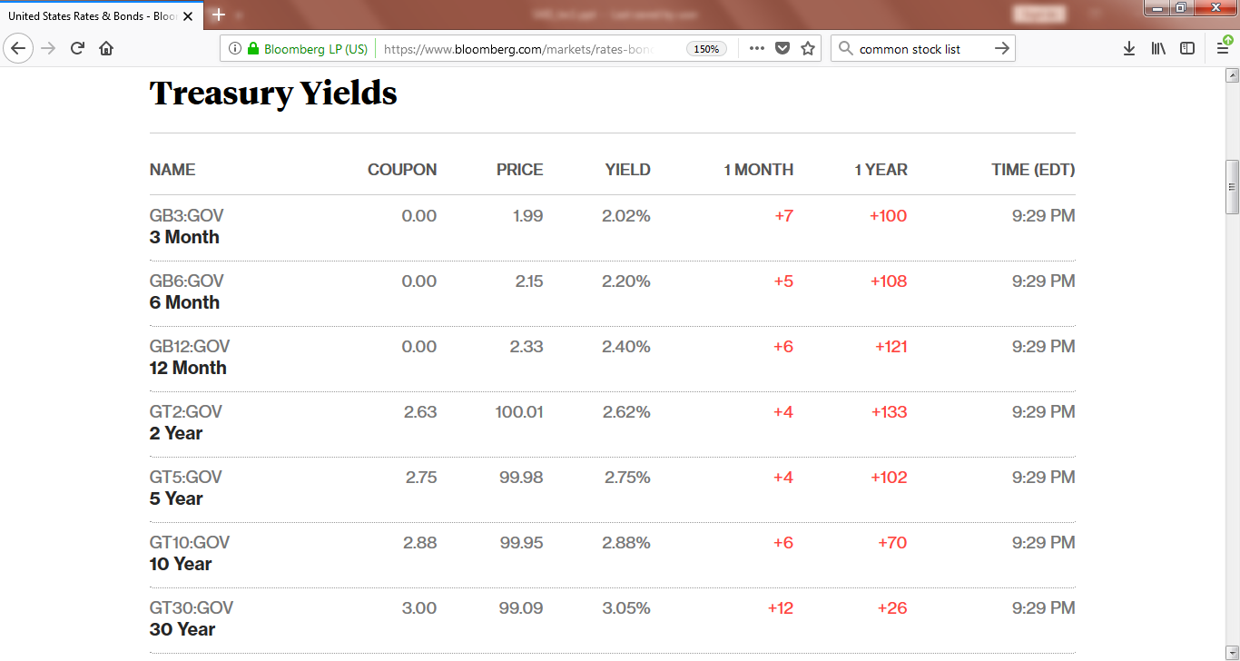

Slide 15
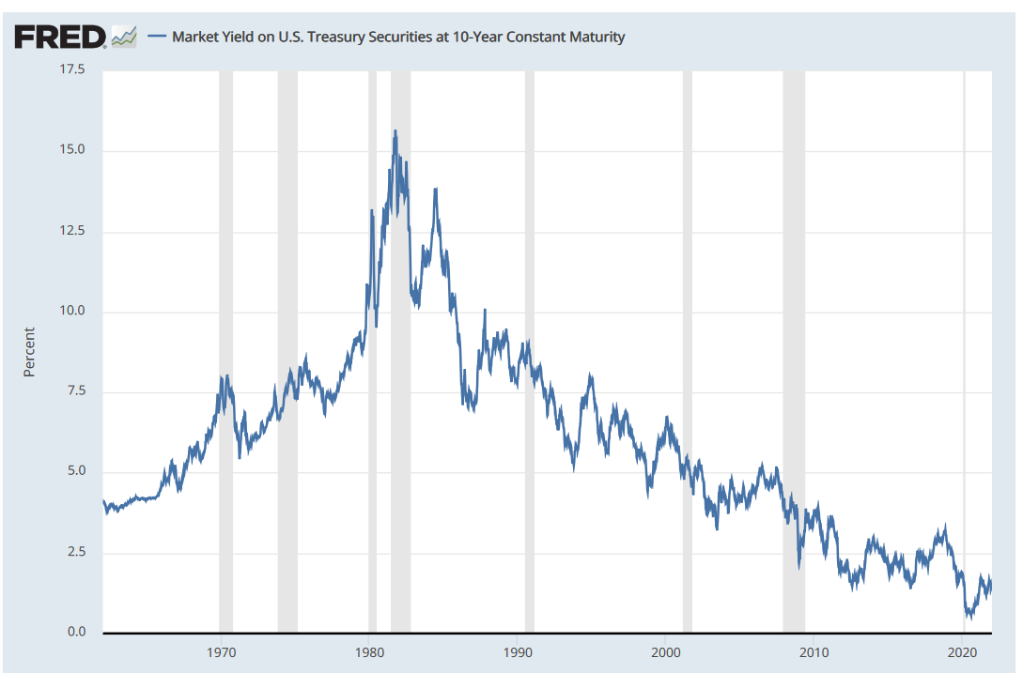

Slide 16
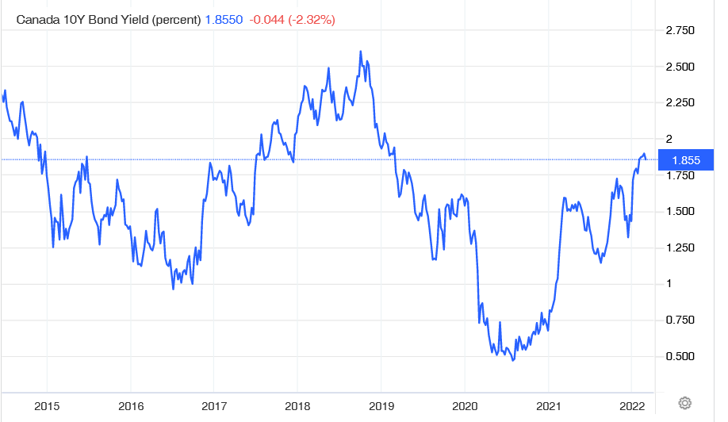

Slide 17
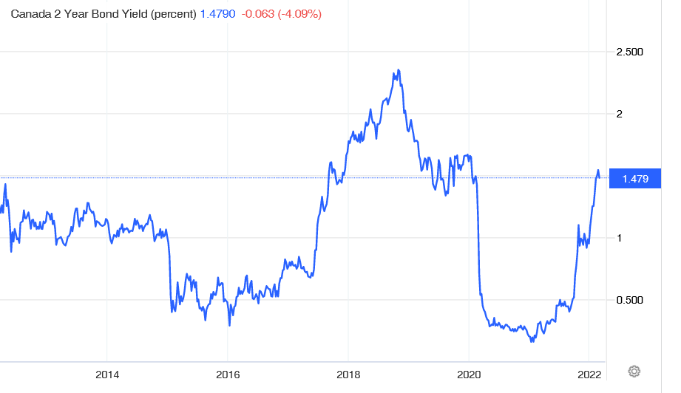

Slide 18
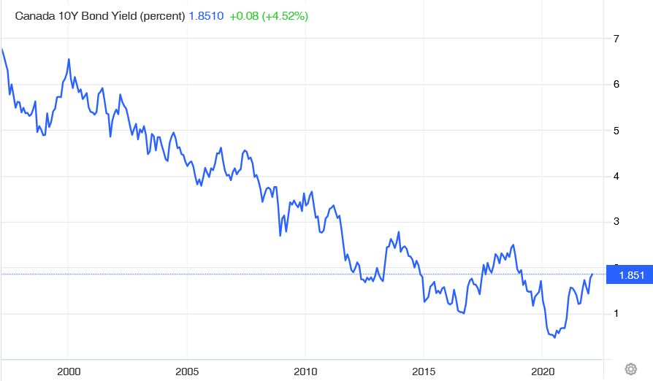

Slide 19
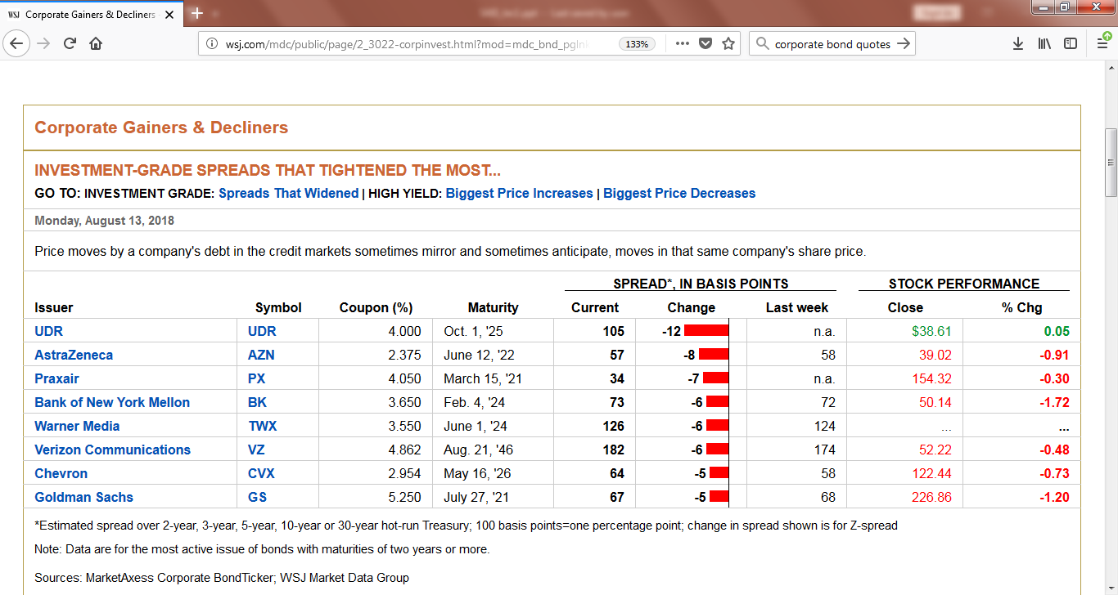

Slide 20
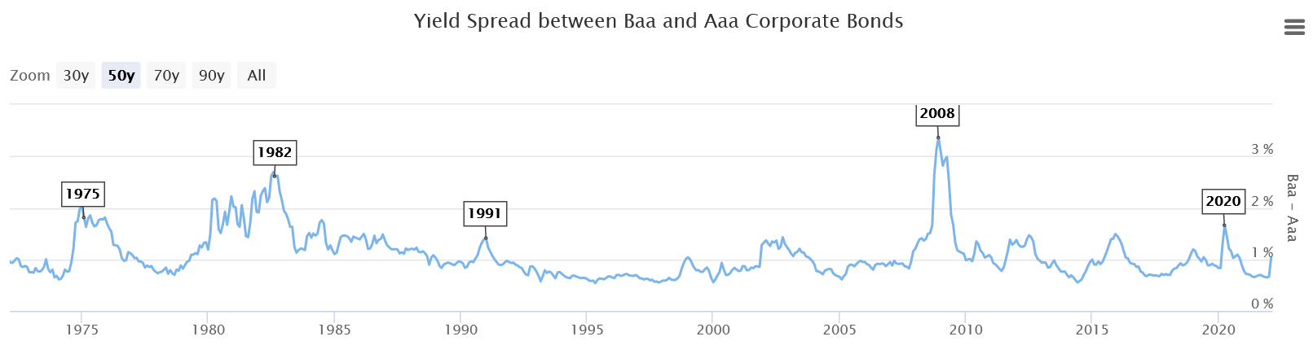
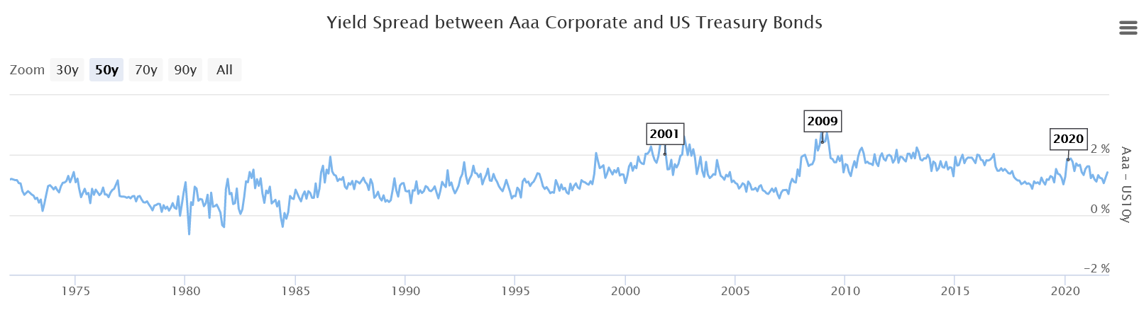

Slide 21
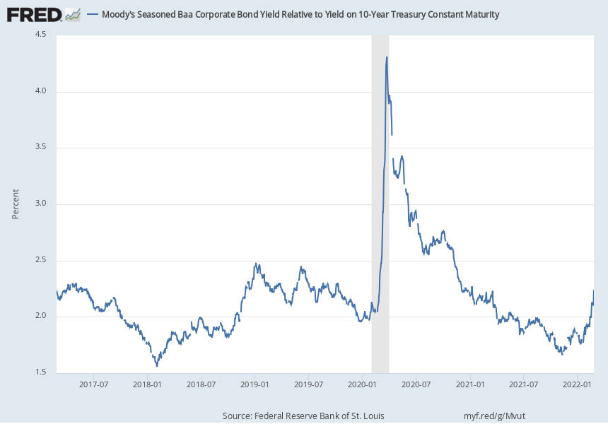
Notes:
Source:
Federal Reserve Bank of St. Louis
Release:
Interest Rate Spreads
Units:
Percent, Not Seasonally Adjusted
Frequency:
Daily
Series is calculated as the spread between Moody's Seasoned Baa Corporate Bond© (https://fred.stlouisfed.org/series/DBAA) and 10-Year Treasury Constant Maturity (BC_10YEAR).©2017, Moody's Corporation, Moody's Investors Service, Inc., Moody's Analytics, Inc. and/or their licensors and affiliates (collectively, "Moody's"). All rights reserved. Moody's ratings and other information ("Moody's Information") are proprietary to Moody's and/or its licensors and are protected by copyright and other intellectual property laws. Moody's Information is licensed to Client by Moody's. MOODY'S INFORMATION MAY NOT BE COPIED OR OTHERWISE REPRODUCED, REPACKAGED, FURTHER TRANSMITTED, TRANSFERRED, DISSEMINATED, REDISTRIBUTED OR RESOLD, OR STORED FOR SUBSEQUENT USE FOR ANY SUCH PURPOSE, IN WHOLE OR IN PART, IN ANY FORM OR MANNER OR BY ANY MEANS WHATSOEVER, BY ANY PERSON WITHOUT MOODY'S PRIOR WRITTEN CONSENT.Starting with the update on June 21, 2019, the Treasury bond data used in calculating interest rate spreads is obtained directly from the U.S. Treasury Department.
Federal Reserve Bank of St. Louis,
Moody's Seasoned Baa Corporate Bond Yield Relative to Yield on 10-Year Treasury Constant Maturity [BAA10Y],
retrieved from FRED,
Federal Reserve Bank of St. Louis;
https://fred.stlouisfed.org/series/BAA10Y,
February 27, 2022.

Slide 22
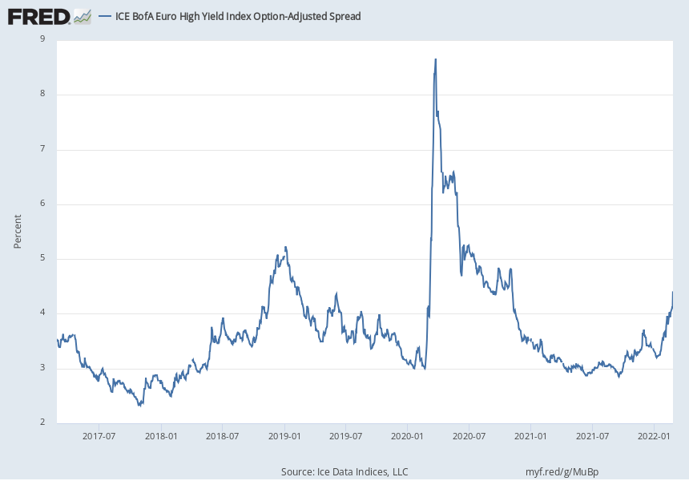
Notes:
Source:
Ice Data Indices, LLC
Release:
ICE BofA Indices
Units:
Percent, Not Seasonally Adjusted
Frequency:
Daily, Close
This data represents the Option-Adjusted Spread (OAS) of the ICE BofA Euro High Yield Index tracks the performance of Euro denominated below investment grade corporate debt publicly issued in the euro domestic or eurobond markets. Qualifying securities must have a below investment grade rating (based on an average of Moody's, S&P, and Fitch). Qualifying securities must have at least one year remaining term to maturity, a fixed coupon schedule, and a minimum amount outstanding of Euro 100 million. Original issue zero coupon bonds, "global" securities (debt issued simultaneously in the eurobond and euro domestic markets), 144a securities and pay-in-kind securities, including toggle notes, qualify for inclusion in the Index. Callable perpetual securities qualify provided they are at least one year from the first call date. Fixed-to-floating rate securities also qualify provided they are callable within the fixed rate period and are at least one year from the last call prior to the date the bond transitions from a fixed to a floating rate security. Defaulted, warrant-bearing and euro legacy currency securities are excluded from the Index.ICE BofA Explains the Construction Methodology of this series as:Index constituents are capitalization-weighted based on their current amount outstanding. With the exception of U.S. mortgage pass-throughs and U.S. structured products (ABS, CMBS and CMOs), accrued interest is calculated assuming next-day settlement. Accrued interest for U.S. mortgage pass-through and U.S. structured products is calculated assuming same-day settlement. Cash flows from bond payments that are received during the month are retained in the index untilthe end of the month and then are removed as part of the rebalancing. Cash does not earn any reinvestment income while it is held in the Index. The Index is rebalanced on the last calendar day of the month, based on information available up to and including the third business day before the last business day of the month. Issues that meet the qualifying criteria are included in the Index for the following month. Issues that no longer meet the criteria during the course of the month remain in the Index until the next month-end rebalancing at which point they are removed from the Index.The ICE BofA OASs are the calculated spreads between a computed OAS index of all bonds in a given rating category and a spot Treasury curve. An OAS index is constructed using each constituent bond's OAS, weighted by market capitalization. When the last calendar day of the month takes place on the weekend, weekend observations will occur as a result of month ending accrued interest adjustments.The index data referenced herein is the property of ICE Data Indices, LLC, its affiliates, ("ICE") and/or its Third Party Suppliers and has been licensed for use by the Federal Reserve Bank of St. Louis. ICE, its affiliates and Third Party Suppliers accept no liability in connection with its use.Copyright, 2017, ICE Benchmark Administration. Reprinted with permission.
Ice Data Indices, LLC,
ICE BofA Euro High Yield Index Option-Adjusted Spread [BAMLHE00EHYIOAS],
retrieved from FRED,
Federal Reserve Bank of St. Louis;
https://fred.stlouisfed.org/series/BAMLHE00EHYIOAS,
February 27, 2022.

Slide 23
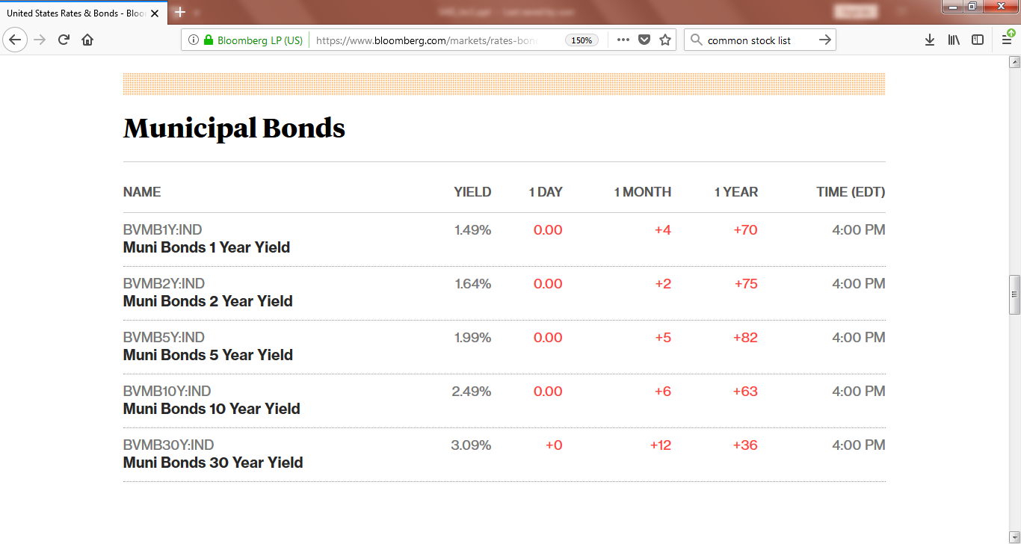

Slide 24
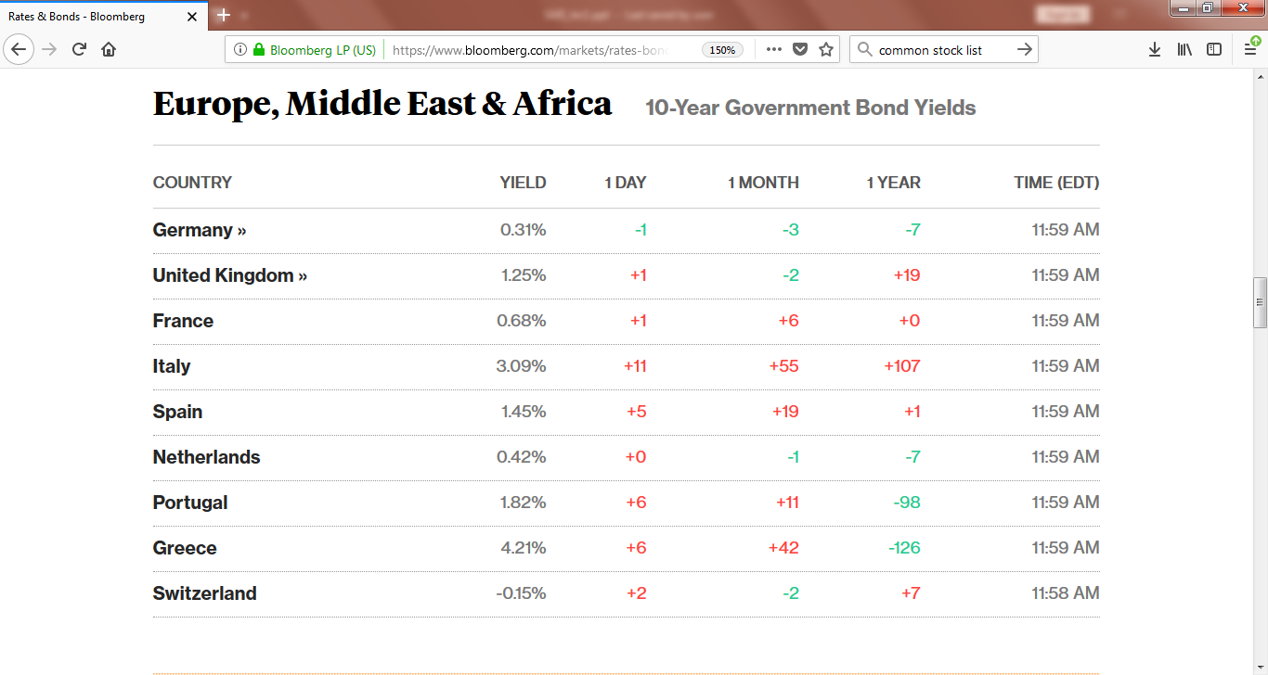

Slide 25
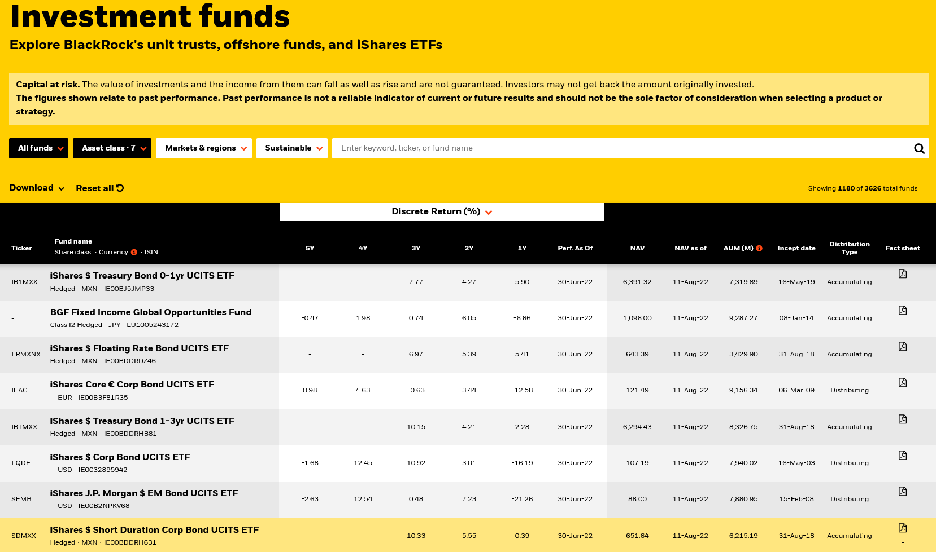
Bond Funds and Fixed Income ETFs: Blackrock

Slide 26
The US Regulators
Securities Laws require regular filing of information about publicly traded securities
  In the US: (Available on company sites)
    Annual Filing 10-K
    Quarterly Filing 10-Q
Information is filed with the US Securities and Exchange Commission (www.sec.gov)
  Securities Act (1933)
  Securities Exchange Act (1934)
  Other laws see SEC website About link
FINRA – US exchanges, NYSE and NASDAQ also have self-regulatory oversight, Financial Industry Regulatory Authority was the result of a 2003 merger of the exchanges’ oversight functions

Slide 27

SEC website, for FINRA and other websites see Links page

Slide 28
Canadian Regulators
Canada does not have a national regulator, works by agreement between provincial security regulators
  Ongoing attempts by federal government to get agreement by provinces to launch a national regulator; Alberta and Quebec usually opposed
Most important Canadian regulator is the Ontario Securities Commission as this is the jurisdiction with the TSX
  See Links page for link to OSC website
  Canada has similar requirement that publicly traded securities be subject to regular filings
    Filings are less structured than in US

Slide 29
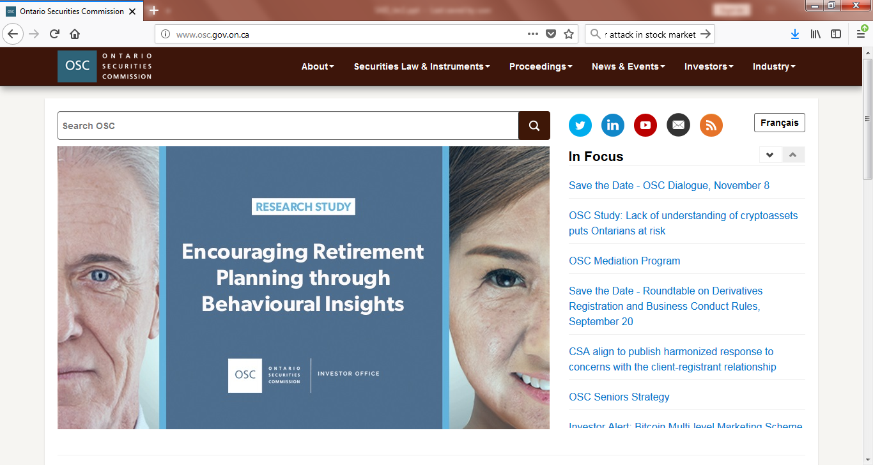
Ontario Securities Commission website

Slide 30
Equity Securities vs. Fixed Income
Key feature of equity securities is limited liability
  In the event of bankruptcy shareholders are only liable to the extent of the amount that was paid for the shares.
Equity securities are composed of common stock, preferred stock and claims against equity such as warrants
  Preferred stock is typically classified as fixed income
  Some common stocks have cash flow characteristics of fixed income

Slide 31
Legal Character of Equity
At the time of incorporation, a corporate charter has to be filed which contains the articles of incorporation.
The corporate charter provides information about:
  the methods by which the articles of incorporation can be amended;
  the classes of stock and the par values;
  features protecting the preferred stock;
  voting rights for the stock;
  powers of the board of directors;
  rules for retiring common stock;
  dividend payment provisions;
  rights of prior security holders in the event of new issues;
  merger and reorganization procedures.

Slide 32
Fixed Income Equity Securities
Preferred Stock
  See link on class webpage to available Canadian preferreds
    Different types of preferreds
  Table 1.4 in SAIS + GI website
    Observe that the yields on preferred stock are comparable to bond yields

Slide 33
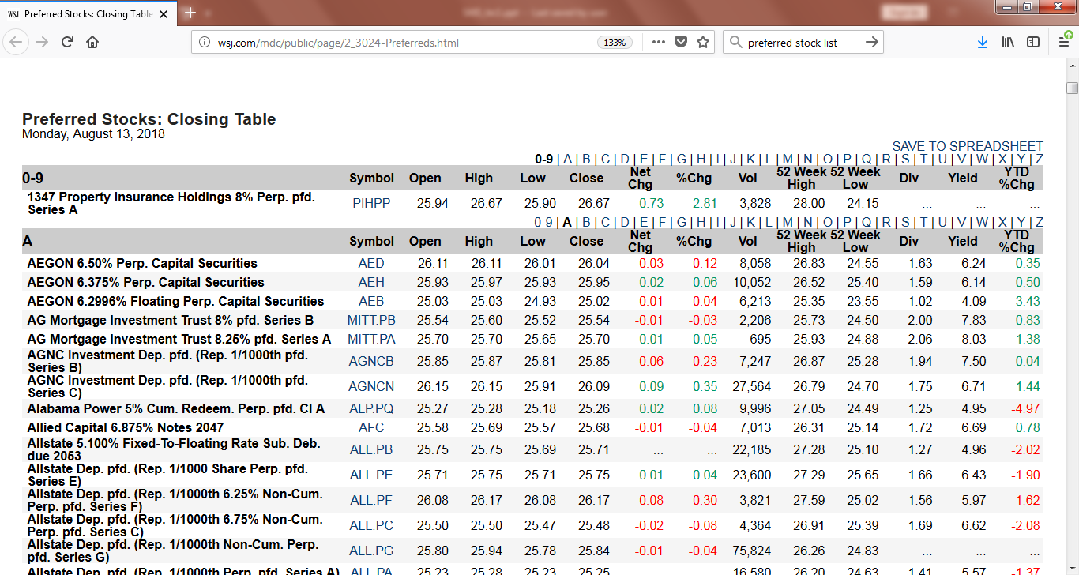
Source: WSJ US Data

Slide 34
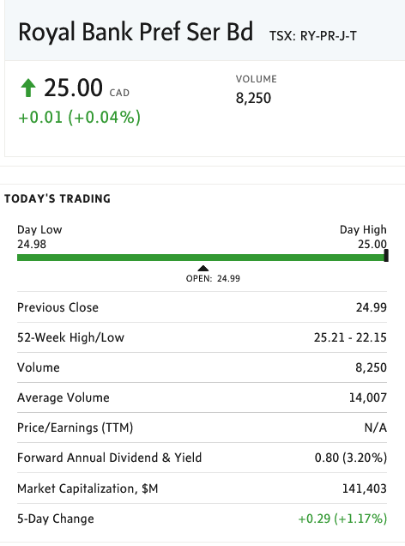
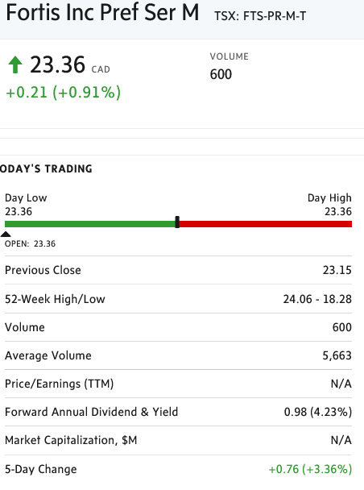

Slide 35
Fixed Income and Security Analysis?
Reading: SAIS, sec. 2.3
Graham and Dodd (1934) define security analysis to mean ‘the use of fundamental analysis to value securities issued by publicly traded corporations.’
  This has led to the mantra: “All security analysis involves the use of financial statements”
  This ignores government securities
“It should always be kept in mind that corporate managements generally do not have bondholders’ interests at heart; they are elected by, and beholden to, the owners of the business, namely the common shareholders. Their duty is to increase shareholder wealth, not that of bondholders. They do not owe any fiduciary duty to bondholders, their only responsibility is contractual.”
Wilson and Fabozzi (1996, p.114)

Slide 36
Graham and Dodd (1934) on the selection of corporate bonds.
“Since the chief emphasis must be placed on the avoidance of loss, bond selection is primarily a negative art. It is a process of exclusion and rejection, rather than of search and acceptance. In this respect the contrast with common stock
selection is fundamental in character. The prospective buyer of a given common stock is influenced more or less equally by the desire to avoid loss and the desire to make profit. The penalty for mistakenly rejecting the issue may conceivably
be as great as that for mistakenly accepting it. But an investor may reject any number of good bonds with virtually no penalty at all, provided he does not eventually accept an unsound issue”

Slide 37
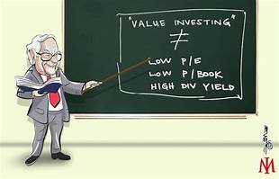
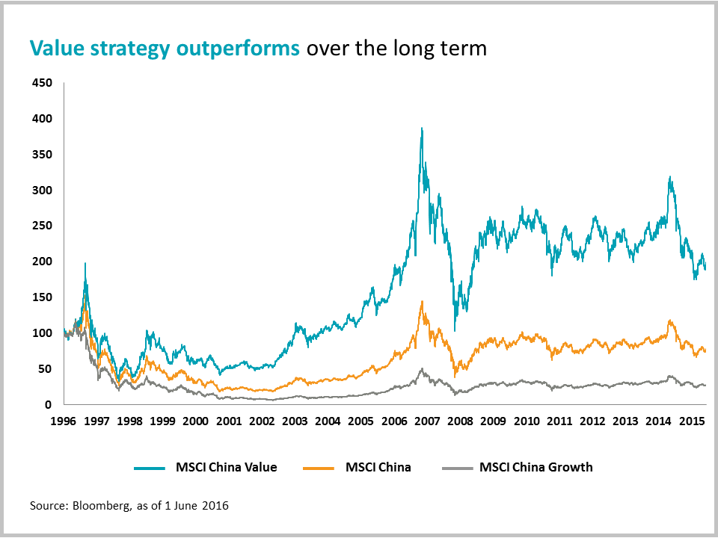
Do the methods of equity security analysis apply to the valuation of fixed income securities?

Slide 38
Themes of Fixed Income Security Analysis
Constant themes in the realm of equity security analysis applied to fixed income securities
  The relevance of the distinction between investment and speculation
    Credit Agencies provide ratings for many fixed income securities to assist in this task
  The emphasis on the use of financial statements to form opinions
    Valuation metrics dependent on ability to pay not on future common stock valuation increases
  The problems raised by the vagaries of market pricing
    Much of the vagaries for fixed income securities depend on changes in interest rates, credit risk and default risk

Slide 39





Slide 40
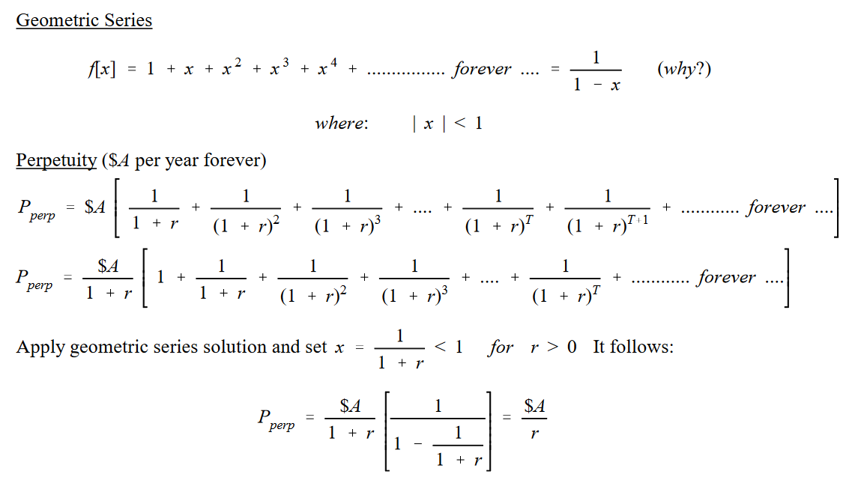
Some Fixed Income Basics

Slide 41
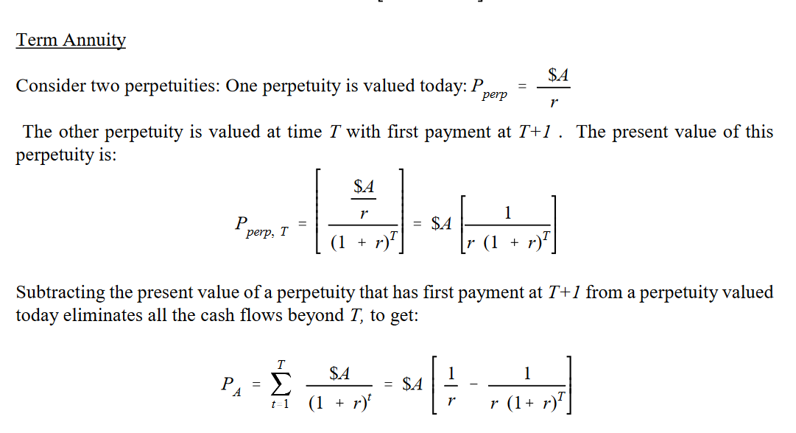
More Fixed Income Basics

Slide 42
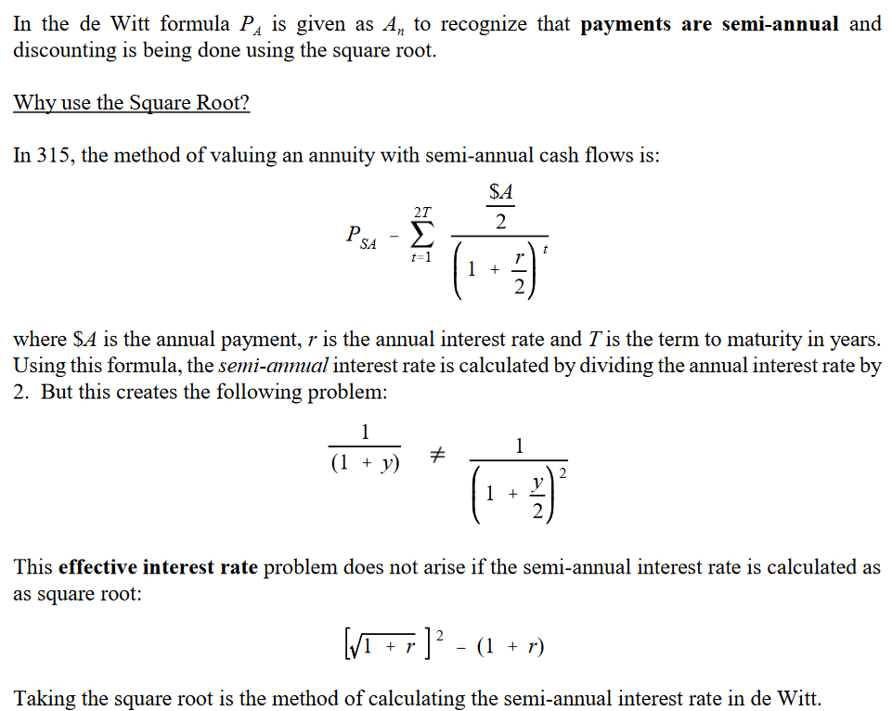
Some results for Lecture 3

Slide 43
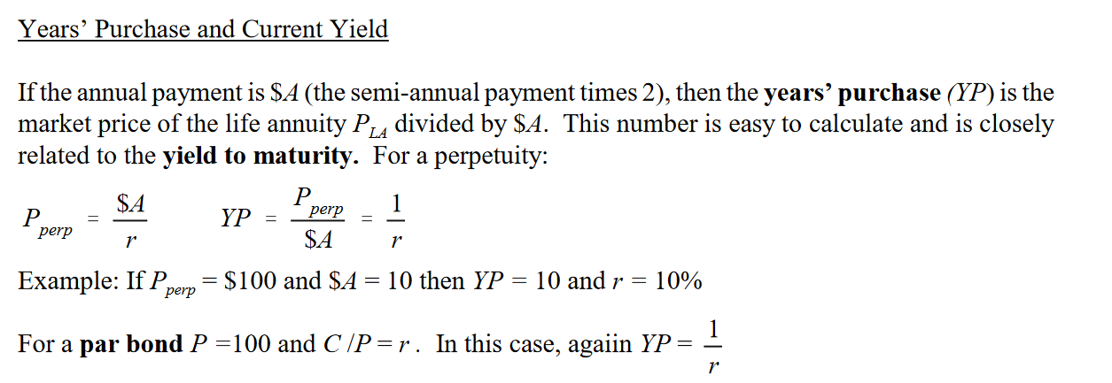
Modern fixed income calculations have been revolutionized by calculator and computer aided functions starting in the 1960’s. Investment textbooks up to the mid-1990’s continued to include interest rate tables used to manually calculate the yield to maturity and other fixed income valuation measures. Prior to this time, a commonly used method of approximating the yield to maturity was the current yield. (This measure was reported in the WSJ and NYT together with bond prices.) The current yield is connected to ‘years purchase’) a valuation method that was used in early fixed income security markets (see Lecture 3).

