Slide 1
Lecture 5
Review of Fixed Income Concepts
Types of Fixed Income Securities
Basic Fixed Income Calculations, How to Price Perpetuities, Mortgages and Bonds
Review of Fixed Income Concepts: How to calculate spot and implied forward interest rates
Introduction to Duration and Convexity
Basics of Credit and Default Risk

Slide 2
Types of Securities and Markets
Reading: SAIS, sec. 4.1, 4.2 and 4.3
Various classification schemes are available:
  by types of issuer, e.g., corporate vs. government;
  by country of issue, e.g., national vs. international;
  by credit rating, e.g., investment grade vs. speculative;
  classification by features, e.g., callable, putable, convertible, and tax status;
  by term to maturity, e.g., bond market vs. money market.

Slide 3
Notes to the .zip files
The BUS417 webpage has links to a number of .zip files with data on fixed income (Lecture 4). The size of many files makes it difficult to load into the slides
Bond Info: Information about bonds that are available for trading at an on-line brokerage. CIBC-Fixed_Income is the index file.
More Bond Info: Has two publications on Canadian housing finance and Trust bonds; Trade info for IPO’s and a few example pages from Moody’s bond book.
Bond Market Info: Has statistics for the US and Canadian bond markets.
Mortgage Info: Has three publications (2 US and 1 Canada) on the housing market and an info sheet on mortgage insurance,
Notes:
CI

Slide 5
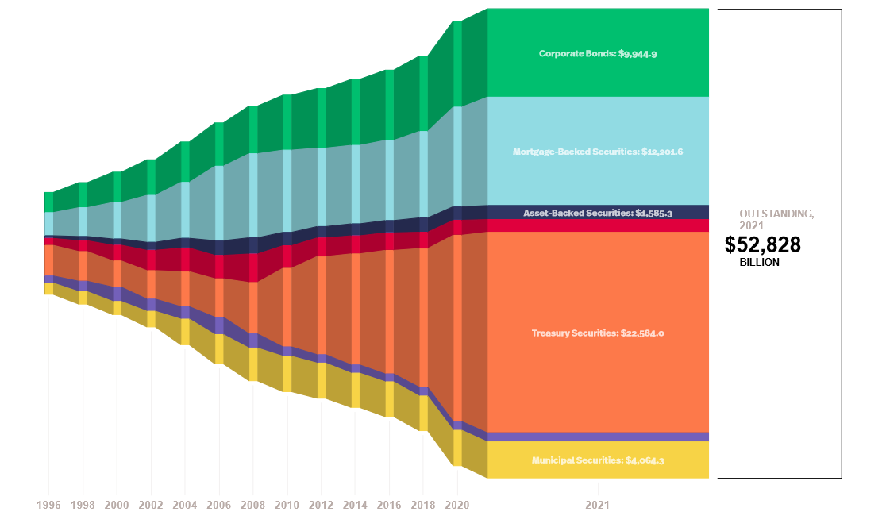
US Fixed Income Outstanding, 1996- 2021-Q4, 2 Year Intervals (SIFMA)

Slide 6
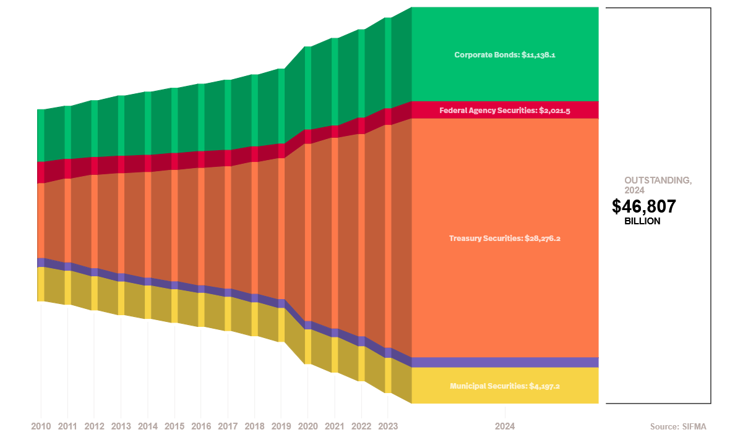
US Fixed Income Outstanding, 2010-24, Annual (SIFMA)

Slide 7
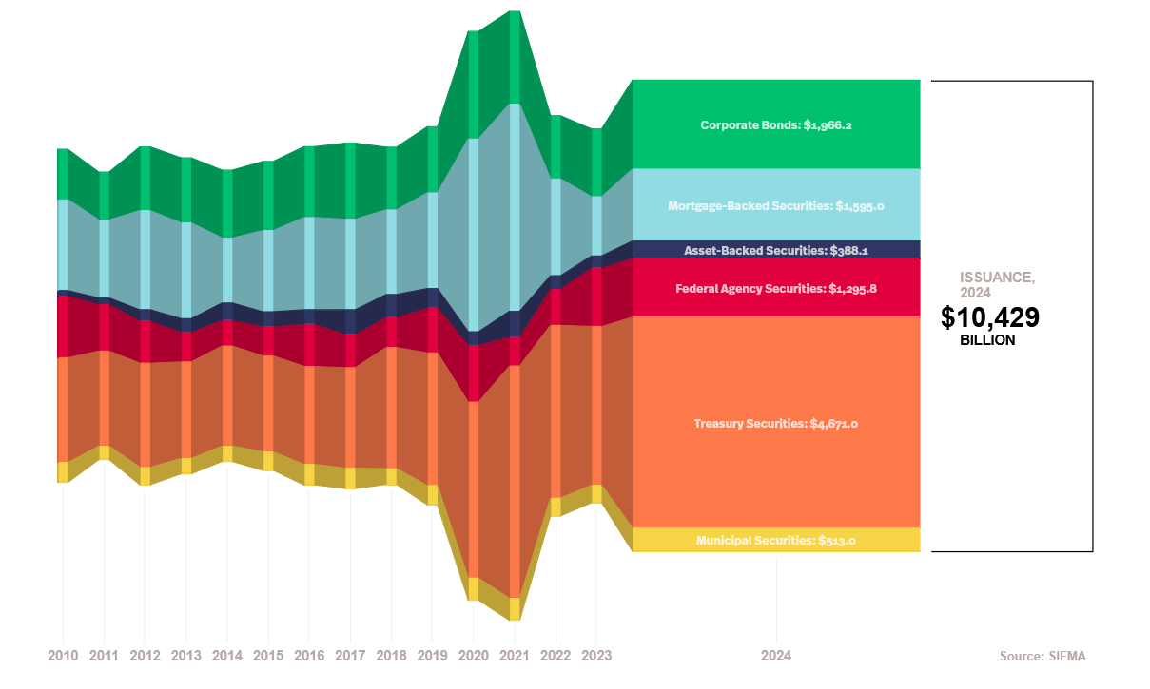
US Fixed Income Issuance, annual up to 2024

Slide 8
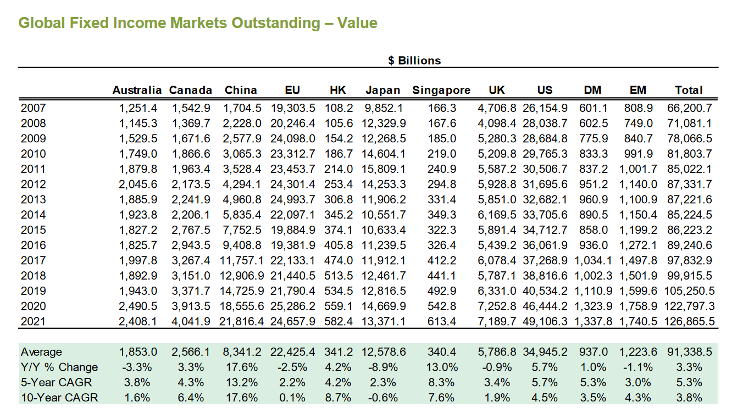

Slide 10
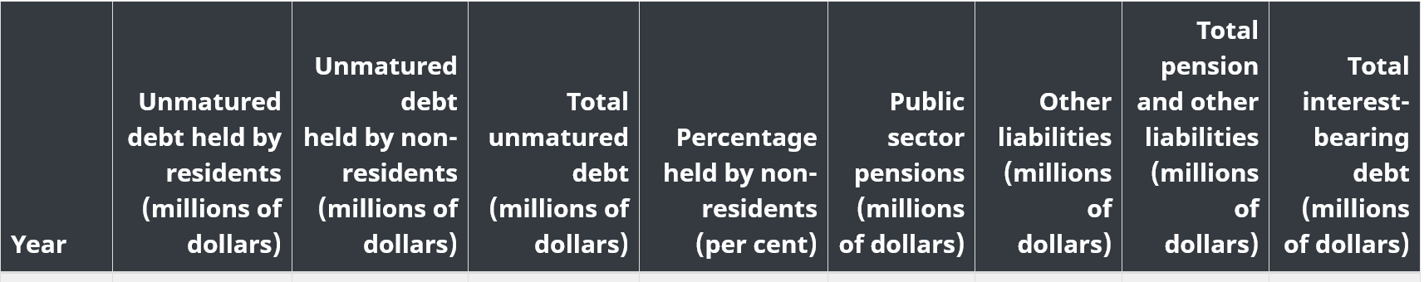
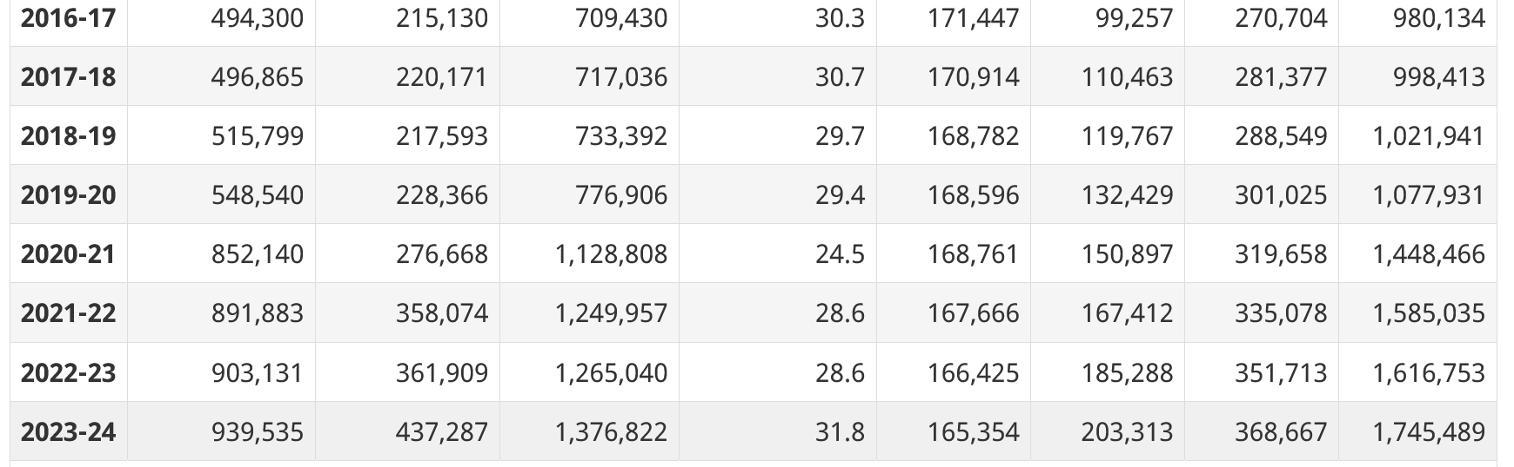
Canadian Federal Debt 2016-2024
Table 14; Fiscal Reference Table – Department of Finance (Bank of Canada series discontinued)

Slide 11
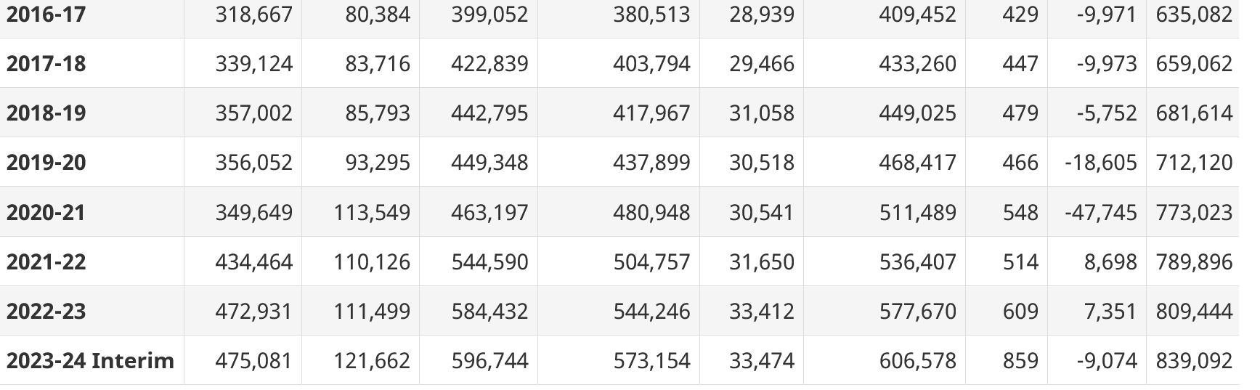
Canadian Provincial Debt 2016-2024
Table 32; Fiscal Reference Table – Department of Finance (Bank of Canada series discontinued)

Slide 12
Types and Amounts of Fixed Income
Outstanding Level of US Public and Private Debt
  A breakdown by type of issuer reveals the relative importance of mortgage related issues. This category and the corporate debt category are the two largest and are the two categories most characterized by issues with embedded options.
  See ‘bond market info’ file on webpage
    Data is from SIFMA (link on Fixed Income on links page)
  Canadian data from Bank of Canada in bfs.pdf in this .zip file
    Table K8 is only published occasionallyt
Summary of Treasury Securities, Maturity Distribution and Average Length ...
  See ‘SIFMA factbook’ file on webpage (from SIFMA)
    Data also available on Bureau of Public Debt (see links page)
  The STRIPS program and pricing of zeroes

Slide 13
Trading and Researching Bonds
Bond prices and information on specific issues is not as readily accessible as common stocks
  There are specialized fee-service firms that provide detailed information
  Liquidity in the bond market concentrates on primary issues (unlike the stock market that is mostly concerned with secondary issues)
    Easiest to get quotes and trade for investment grade issues
    Possible to gather information about the bond issues of specific Canadian companies – using SEDAR prospectus info + Annual Reports

Slide 14
Types of Special Contingency Features
Call feature
Sinking fund provision
Put feature
Extendible feature
Convertibility
Warrant bond structure
Floating rate provision
Cap, floor and collar features

Slide 15
Canadian versus US Mortgage (1)
Basic Mortgage Characteristics
  Term to Maturity and Amortization Period
    Amortization Period refers to the time required to fully pay the mortgage
      In US 30 year amortization conventional
      In Canada 25 year amortization (this changes depending on Dept. of Finance, OSFI and CMHC)
    The Term to Maturity (Term) determines the time for which the mortgage contract applies
      In US possible to have a 30 year mortgage term = amortization period – mortgage payment fixed over the of the mortgage contract
      In Canada, term < amortization period, mortgage payment resets at end of term

Slide 16
Basic Overview of US vs. Canadian Mortgages

Slide 18
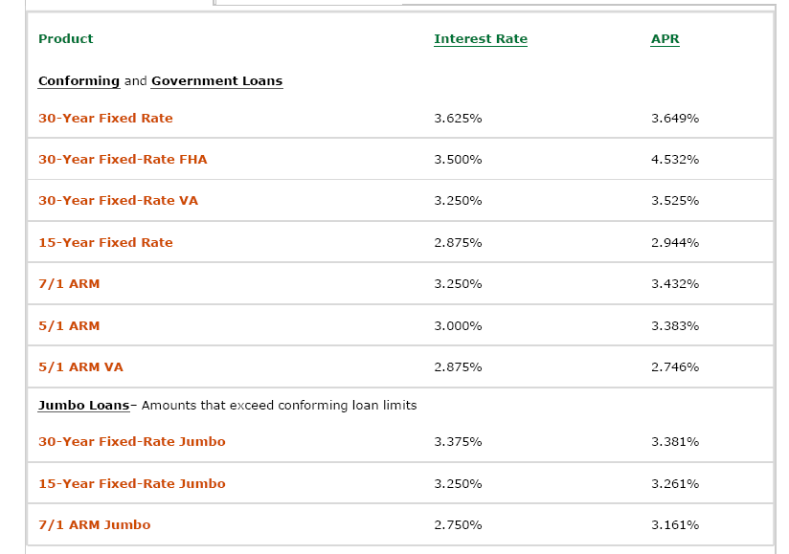

Slide 19
Canadian versus US Mortgage (2)
Prepayment penalties
  US Mortgages have no mortgage prepayment penalties (still legal/origination fees for re-issuing mortgage)
    Prepayment penalty is often barred by state law
    If interest rates fall this allows mortgage holders to ‘refi’ (refinance)
  In Canada prepayment penalty equal to 3 months payment or loss of interest (whichever is greater)
    Most mortgages permits an annual prepayment of up to 10% of initial principal value without penalty
    At end of mortgage term, mortgage balance can be paid without penalty by refinancing balance at another financial institution or mortgage can be renewed with the same financial institution
    Possible to change term and amortization period when the mortgage is reissued (will be legal/origination fees for reissuing that can be negotiated)

Slide 20
Canadian versus US Mortgage (3)
Mortgage Funder (Mortgagee) Recourse for Default by Borrower (Mortgagor)
  High Loan-to-Value (LTV) > 80% require mortgage insurance
    Insurance premium can be charged as a fixed payment at origination or as ‘points’ which increase the monthly payment; premium increases with LTV; 95% maximum in Canada
    Both public (FHA and the GSE’s in US; CMHC in Canada) and private insurance (e.g., Genworth, Canada Guarantee in Canada)
Lender Recourse depends on mortgage contract terms
  In Canada, typically full recourse
  In US depends on state, usually no recourse
    Mortgage insurance does not guarantee that value of (foreclosed) property will be sufficient to avoid loss, i.e., V < LV
    Average Default Loss more likely on non-insured (LTV < 80%) mortgages

Slide 21
Valuation Formula and Examples
Perpetuities, SAIS, p.207-8, e.g., British consol.
  Application of geometric series
  Fixed and variable coupon
Semi-annual and Quarterly coupons
  SAIS, p.209
  Effective Yield
Mortgage Valuation, SAIS, p.243.
  See midterm mortgage question and solution on class webpage
  See Mortgage Info on class webpage for background

Slide 22
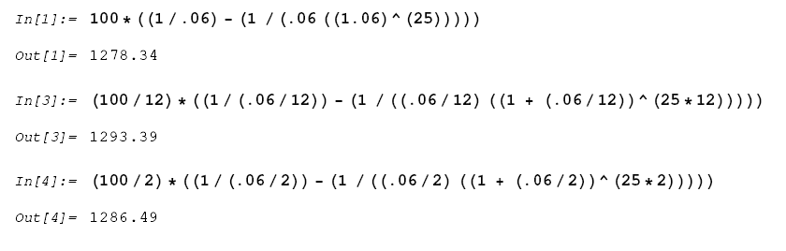

Slide 23
How to Price Bonds
Simplifications required to use the basic formulas to determine the bond price/yield:
  Bond is valued on the issue date or coupon payment date
    No need to take account of accrued interest.
    It is possible to specify more complicated, exact formulas for price between payment dates.
  The bond has no embedded options.
  ‘Straight bonds’ with a bullet maturity are used.

Slide 24
Bond Price and Yield to Maturity
Yield to Maturity
  Key method of comparing values, see Table 4.5
  Basis of traditional yield spread analysis
For an annual coupon bond valued on the issue date, the yield to maturity is determined by solving:

Slide 25
Interpretations of Yield to Maturity
Because the calculation assumes that future coupon cash flows can be reinvested at the stated y, it follows that y is only a promised yield to maturity.
Reinvestment of coupons at the promised yield is required in order for the bond to actually earn the stated yield if the bond is held to maturity. As such, the yield to maturity is an ex ante forecast of the ex post realized yield.
When C = 0, the bond is referred to as a pure discount or zero coupon bond. If held to maturity, a default and option free zero coupon bond will have the promised yield to maturity equal to the realized yield.

Slide 26
Spot Interest Rate
(Implied Zero Coupon Interest Rate)
The spot interest rate address a conceptual problem that arises with the yield to maturity
  applying the same interest rate to discount cash flows occurring at different points in time
The spot interest rate z_{t} used to discount cash flows at time t is specified by:

Slide 27
Use of Implied Zeroes
Calculation of implied forward rates
  Used to empirically model term structure behavior
  Used in Monte Carlo estimation procedures for OAS (see sec. 6.3)
To calculate the value of bonds with contingencies
To provide riskfree discount rates for cash flows occurring at a particular time t or over a horizon [0,T]

Slide 28
Calculation of Implied Zeroes
Implied zeroes are calculated from the US Treasury yield curve (Government of Canada curve for Canada)
  Introduction of contingencies and default risk modeled as an add-on to the implied zero
Calculated implied zeroes typically differ from rates in the STRIPS market (SAIS, p.201-2)

Slide 29
This spot rate calculation example makes the simplifying assumption that the quoted yields are annual, which the actual yields are semi-annual. This will result in a small deviation from the ‘true spot rate’

Slide 30
Bootstrapping Implied Zeros
(An ‘Exact’ Semi-annual Coupon Bond Example from Stigum – 1980’s interest rates)
Assume:
  Bonds are sold at par and pay coupons semi-annually.
  The observed six month Tbill yield is 8.87%, where the six month Treasury bill discount rate is converted to a true yield.
  The observed one year Tbond yield is 9.04%

Slide 31
Next Step in the Bootstrap
Solving for z₁ -- the implied one year zero coupon rate -- gives 0.090438.
This solution can now be used to solve the next step in the bootstrap where the observed 1.5 year Treasury yield is 9.155:

Slide 32
Finishing the Bootstrap
Solving for z_{1.5} -- the implied one and a half year zero coupon rate -- gives 0.091629.
This solution can now be used to solve the next step in the bootstrap where the observed 2 year Treasury yield is 9.2:
solve for z₂ and ETC ETC ETC to T.

Slide 33
The yield curve and the term structure
Basic definitions:
  The yield curve is the relationship between term to maturity and yield to maturity
    See Bloomberg and other sites for a plot of the yield curve
  The term structure of interest rates is the relationship between spot interest rates and term to maturity
    Demonstrate that is the yield curve slopes up then the term structure of interest rates will lie above the yield curve
Note that the ‘continuous’ yield curve is a ‘best fit’ to a discrete sample of available bonds, there is a considerable literature on the appropriate methodology to do this.

Slide 34
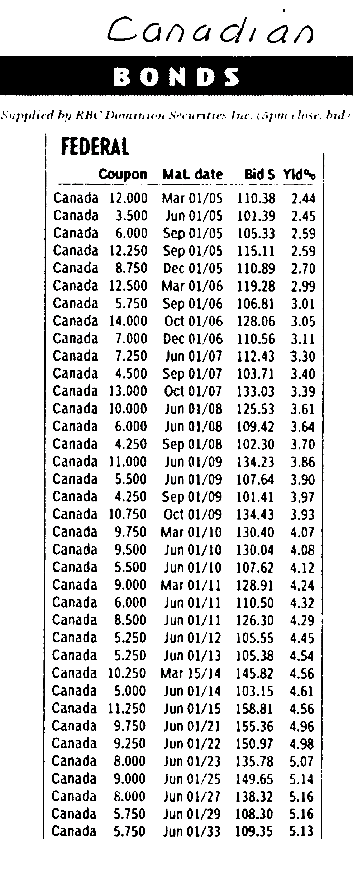
Yield curve for Government of Canada bonds observed in Jan. 2004
Notice that the yield curve specifies the relationship between the maturity date column and the yield column
Observe that two bonds with the same maturity date, e.g., June 01/09, don’t have the same yield due to differences in the coupon → the bond with the higher coupon is actually a ‘shorter’ bond as more of the cash flow will be received sooner. Put differently, the return of principal at maturity is a larger fraction of the total cash flow for a lower coupon bond.
When the yield curve is plotted, the sequence of individual points are connected with a ‘best fit’ line

Slide 35
US Yield Curve (from Financial Times, UK) 17-8-18

Slide 36
Specifying implied forward interest rates
An important application of implied zero coupon interest rates is to calculate implied forward interest rates
A useful interpretation of the implied forward interest rate is as a breakeven interest rate in comparing a 2 period rollover portfolio with a 2 period buy and hold portfolio.
These two types of portfolios are defined as:

Slide 37

Calculation of one period implied forward interest rates

Slide 38
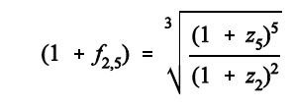
A variety of implied forward rates:
The following can be used to specify: i) a one year implied forward rate starting at time t ii) a five year implied period forward rate starting at time 5 maturing at time 10 iii) a three year implied forward rate starting at time 2 and maturing at time 5 iv) a k period implied forward rate starting at time t and maturing at time t + k

Slide 39
Interpreting yield curve shape with implied forward rates
Three basic interpretations of the term structure
  The unbiased expectations hypothesis
    This theory predicts that implied forward rates are unbiased expectations of future interest rates
      An upward sloping yield curve implies that the market expects higher future interest rate levels
  The liquidity premium hypothesis
    Interprets the implied forward rate as a biased predictor by the amount of a liquidity premium
      Liquidity premia are montonically increasing with the term to maturity
  Market segmentation/Preferred Habitat hypothesis
    Implied forward rates are biased and it is not possible to state that liquidity premia are monotonically increasing

Slide 40
Introduction to Duration
Duration is a fundamental concept in the analysis of fixed income securities, both for individual securities and for portfolios.
Duration has at lease three distinct interpretations:
  Adjusted (weighted average) term to maturity
  Elasticity of bond price with respect to interest rate changes
  A tool for bond portfolio management

Slide 41
20th Century Contributions
Frederick Macaulay (1882-1970)
  Early member of NBER, Canadian, son of Sun Life pioneers, founder of Macaulay-Bernstein
  The Movements of Interest Rates. Bond Yields and Stock Prices in the United States since 1856, (1938) seminal contribution of Macaulay Duration
John Hicks (1904-1989)
  Value and Capital (1939) contains duration as an elasticity
  Nobel Prize in Economics winner, IS-LM model
Frank Redington (1906-1984)
  Duration and Convexity as tools in bond portfolio management
  Seminal development of classical immunization theory

Slide 42
Duration as an Elasticity Measure
Macaulay duration is the elasticity of the bond's price with respect to a change in interest rates.
  Elasticity is usually dimensionless (dollars divided by dollars) but, due to the presence of compound interest it is acceptable to express duration in years
  For those unfamiliar with ‘point elasticity’ see the link ‘Point Elasticity Note’ on class webpage

Slide 43
Macaulay Duration as Adjusted Maturity
The Macaulay duration (D) of a zero coupon bond equals the term to maturity (T). To see this, set C = 0 in the duration formula and use the price of zero coupon bond for P_{B}
For C > 0, D < T.
  Macaulay duration adjusts the term to maturity of a fixed income security to be equal to the duration of a zero coupon bond with term to maturity equal to D.
  Macaulay duration is sometimes referred to as the weighted average term to maturity.

Slide 44
Duration for Semi-annual Coupon Bonds
As an elasticity measure, the “length” of duration is equal to the frequency of the cash flows, i.e., when coupons are paid semi-annually, the duration is measured in ½ years (need to divide by 2 to get duration as an annualized number):

Slide 45
Some special Macaulay durations: Term Annuity and Par Bond (see Macaulay Duration and Term Annuity file on class webpage) and the Convexity of a Par Bond (in Par-Bond-Convexity file contained in 16-1 midterm answer .zip file) → notice that the ANNUAL COUPON Par Bond assumption allows the use of simple results to program formulas
Term Annuity Par Bond Duration

Slide 46
Macaulay Duration versus Modified Duration
Recall the three different uses of Duration: An Elasticity Measure; Weighted Average Term to Maturity; and, Tool in Fixed Income Portfolio Management → these three applications apply to Macaulay Duration
In theoretical applications in fixed income P.M., it is useful to use the simplified Modified Duration (D) where (annualized form):
D = (D* / (1 + y))
Note: Modified duration is not an exact measure of either the elasticity or weighted average term to maturity but eliminates the theoretically unnecessary (1 + y)

Slide 47
Basics of Credit Risk and Default Risk
Note: The following section will only be covered if time permits
The Legal Aspects of Default
  ABA Model Indenture
  Absolute Priority Rule
Credit risk can be decomposed into three parts:
  default risk (bond default)
  credit spread risk (no change in rating)
  downgrade risk (change down in rating)

Slide 48
Assessment of Credit and Default Risk
Ratings Services
  Standard and Poor's Corporation,
  Moody's Investors Services Inc.
  Fitch Ratings (created by the merger of Fitch IBCA with Duff and Phelps Credit Rating Co.)
    See next slide
There are also firms that specialize in ratings for specific industries such as Demotech, Inc. that assesses insurance companies and HMO’s
  See links in Fixed Income on links page.

Slide 50
Evidence on Defaults
How to measure default rates?
  Figures + Tables – altman.pdf
  S&P Global Default Study (on class webpage)
Loss depends on probability of default and the recovery rate
  Tables --altman.pdf
Ratings Drift
  S&P Global Default Study

Slide 55
More Evidence of Credit Risk
Default and Original Rating
  Figures 28-9 – altman.pdf
  See also Table 4.10 (webpage Copies of Tables)
Years to Default
  Table 4.11 (webpage Copies of Tables)
Credit Spreads
  Figure 4,1 and Table 4.12 (see next slides or Copies of Tables)

Slide 59
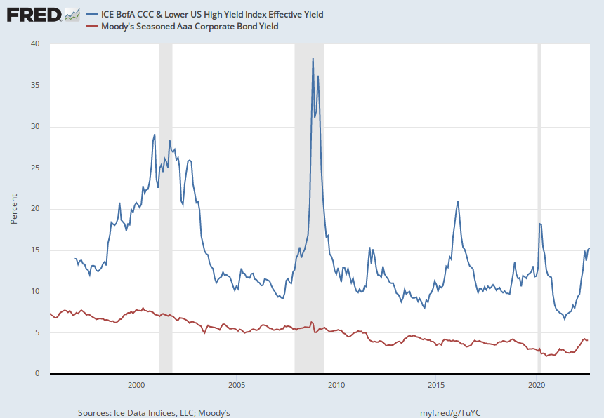
Notes:
Source:
Ice Data Indices, LLC
Release:
ICE BofA Indices
Units:
Percent, Not Seasonally Adjusted
Frequency:
Daily, Close
This data represents the effective yield of the ICE BofA US Corporate C Index, a subset of the ICE BofA US High Yield Master II Index tracking the performance of US dollar denominated below investment grade rated corporate debt publicly issued in the US domestic market. This subset includes all securities with a given investment grade rating CCC or below. When the last calendar day of the month takes place on the weekend, weekend observations will occur as a result of month ending accrued interest adjustments.The index data referenced herein is the property of ICE Data Indices, LLC, its affiliates, ("ICE") and/or its Third Party Suppliers and has been licensed for use by the Federal Reserve Bank of St. Louis. ICE, its affiliates and Third Party Suppliers accept no liability in connection with its use.Copyright, 2017, ICE Benchmark Administration. Reprinted with permission.
Ice Data Indices, LLC,
ICE BofA CCC & Lower US High Yield Index Effective Yield [BAMLH0A3HYCEY],
retrieved from FRED,
Federal Reserve Bank of St. Louis;
https://fred.stlouisfed.org/series/BAMLH0A3HYCEY,
September 7, 2022.
Source:
Moody’s
Release:
Moody's Daily Corporate Bond Yield Averages
Units:
Percent, Not Seasonally Adjusted
Frequency:
Monthly
These instruments are based on bonds with maturities 20 years and above. © 2017, Moody’s Corporation, Moody’s Investors Service, Inc., Moody’s Analytics, Inc. and/or their licensors and affiliates (collectively, “Moody’s”). All rights reserved. Moody’s ratings and other information (“Moody’s Information”) are proprietary to Moody’s and/or its licensors and are protected by copyright and other intellectual property laws. Moody’s Information is licensed to Client by Moody’s. MOODY’S INFORMATION MAY NOT BE COPIED OR OTHERWISE REPRODUCED, REPACKAGED, FURTHER TRANSMITTED, TRANSFERRED, DISSEMINATED, REDISTRIBUTED OR RESOLD, OR STORED FOR SUBSEQUENT USE FOR ANY SUCH PURPOSE, IN WHOLE OR IN PART, IN ANY FORM OR MANNER OR BY ANY MEANS WHATSOEVER, BY ANY PERSON WITHOUT MOODY’S PRIOR WRITTEN CONSENT.
Moody’s,
Moody's Seasoned Aaa Corporate Bond Yield [AAA],
retrieved from FRED,
Federal Reserve Bank of St. Louis;
https://fred.stlouisfed.org/series/AAA,
September 7, 2022.

Slide 60
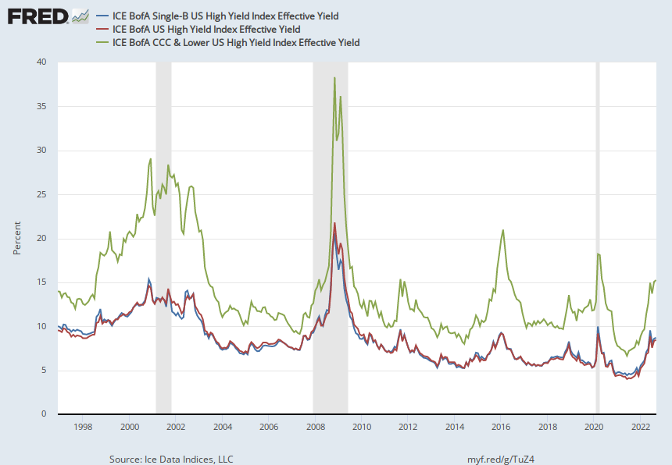
Notes:
Source:
Ice Data Indices, LLC
Release:
ICE BofA Indices
Units:
Percent, Not Seasonally Adjusted
Frequency:
Daily, Close
This data represents the effective yield of the ICE BofA US Corporate B Index, a subset of the ICE BofA US High Yield Master II Index tracking the performance of US dollar denominated below investment grade rated corporate debt publicly issued in the US domestic market. This subset includes all securities with a given investment grade rating B. When the last calendar day of the month takes place on the weekend, weekend observations will occur as a result of month ending accrued interest adjustments.The index data referenced herein is the property of ICE Data Indices, LLC, its affiliates, ("ICE") and/or its Third Party Suppliers and has been licensed for use by the Federal Reserve Bank of St. Louis. ICE, its affiliates and Third Party Suppliers accept no liability in connection with its use.Copyright, 2017, ICE Benchmark Administration. Reprinted with permission.
Ice Data Indices, LLC,
ICE BofA Single-B US High Yield Index Effective Yield [BAMLH0A2HYBEY],
retrieved from FRED,
Federal Reserve Bank of St. Louis;
https://fred.stlouisfed.org/series/BAMLH0A2HYBEY,
September 7, 2022.
Source:
Ice Data Indices, LLC
Release:
ICE BofA Indices
Units:
Percent, Not Seasonally Adjusted
Frequency:
Daily, Close
This data represents the effective yield of the ICE BofA US High Yield Index, which tracks the performance of US dollar denominated below investment grade rated corporate debt publicly issued in the US domestic market. To qualify for inclusion in the index, securities must have a below investment grade rating (based on an average of Moody's, S&P, and Fitch) and an investment grade rated country of risk (based on an average of Moody's, S&P, and Fitch foreign currency long term sovereign debt ratings). Each security must have greater than 1 year of remaining maturity, a fixed coupon schedule, and a minimum amount outstanding of $100 million. Original issue zero coupon bonds, "global" securities (debt issued simultaneously in the eurobond and US domestic bond markets), 144a securities and pay-in-kind securities, including toggle notes, qualify for inclusion in the Index. Callable perpetual securities qualify provided they are at least one year from the first call date. Fixed-to-floating rate securities also qualify provided they are callable within the fixed rate period and are at least one year from the last call prior to the date the bond transitions from a fixed to a floating rate security. DRD-eligible and defaulted securities are excluded from the Index.ICE BofA Explains the Construction Methodology of this series as:Index constituents are capitalization-weighted based on their current amount outstanding. With the exception of U.S. mortgage pass-throughs and U.S. structured products (ABS, CMBS and CMOs), accrued interest is calculated assuming next-day settlement. Accrued interest for U.S. mortgage pass-through and U.S. structured products is calculated assuming same-day settlement. Cash flows from bond payments that are received during the month are retained in the index until the end of the month and then are removed as part of the rebalancing. Cash does not earn any reinvestment income while it is held in the Index. The Index is rebalanced on the last calendar day of the month, based on information available up to and including the third business day before the last business day of the month. Issues that meet the qualifying criteria are included in the Index for the following month. Issues that no longer meet the criteria during the course of the month remain in the Index until the next month-end rebalancing at which point they are removed from the Index.When the last calendar day of the month takes place on the weekend, weekend observations will occur as a result of month ending accrued interest adjustments.The index data referenced herein is the property of ICE Data Indices, LLC, its affiliates, ("ICE") and/or its Third Party Suppliers and has been licensed for use by the Federal Reserve Bank of St. Louis. ICE, its affiliates and Third Party Suppliers accept no liability in connection with its use.Copyright, 2017, ICE Benchmark Administration. Reprinted with permission.
Ice Data Indices, LLC,
ICE BofA US High Yield Index Effective Yield [BAMLH0A0HYM2EY],
retrieved from FRED,
Federal Reserve Bank of St. Louis;
https://fred.stlouisfed.org/series/BAMLH0A0HYM2EY,
September 7, 2022.
Source:
Ice Data Indices, LLC
Release:
ICE BofA Indices
Units:
Percent, Not Seasonally Adjusted
Frequency:
Daily, Close
This data represents the effective yield of the ICE BofA US Corporate C Index, a subset of the ICE BofA US High Yield Master II Index tracking the performance of US dollar denominated below investment grade rated corporate debt publicly issued in the US domestic market. This subset includes all securities with a given investment grade rating CCC or below. When the last calendar day of the month takes place on the weekend, weekend observations will occur as a result of month ending accrued interest adjustments.The index data referenced herein is the property of ICE Data Indices, LLC, its affiliates, ("ICE") and/or its Third Party Suppliers and has been licensed for use by the Federal Reserve Bank of St. Louis. ICE, its affiliates and Third Party Suppliers accept no liability in connection with its use.Copyright, 2017, ICE Benchmark Administration. Reprinted with permission.
Ice Data Indices, LLC,
ICE BofA CCC & Lower US High Yield Index Effective Yield [BAMLH0A3HYCEY],
retrieved from FRED,
Federal Reserve Bank of St. Louis;
https://fred.stlouisfed.org/series/BAMLH0A3HYCEY,
September 7, 2022.

