Slide 1
Global Airlines
Presented by:
Jenny Kuan
Gabriel Li
Morris Tang

Slide 2
Agenda
Industry Overview
Southwest Airlines
British Airways
Singapore Airlines

Slide 3
Terminology
ATK: Available Tonne Kilometer (Capacity)
= Passenger and cargo capacity
ASK: Available Seat Kilometer (Capacity)
= [Number of seats] * [kilometers flown]
RPK: Revenue Passenger Kilometer (Traffic)
= [Number of paying passengers] * [kilometers flown]
FTK: Freight Tonne Kilometer (Traffic)
= [Freight tonnes carried] * [kilometers flown]
YIELD
  = [Revenue] / [RPK]
LF: Load Factor (Capacity Utilization)
= [RPK] / [ASK]
= [number of passengers]/[number of seats]
Break Even LF: Unit cost / Yield
i.e. Operating cost = Operating Revenue

Slide 4
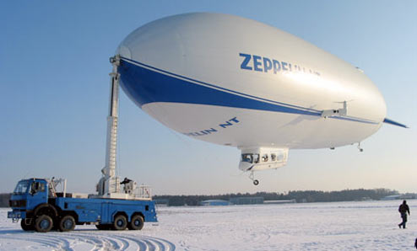
History/Regulations
1900
First Zeppelin (Deutsche Luftschiffahrts-AG, DELAG)
1910
First jet-propelled aircraft (Coanda1910)
1919
First non-stop transatlantic flight (Alcock and Brown)
1925
Airmail Act– transferring operations to private companies
1926
Air Commerce Act—safer flying routes needed
Notes:
DELAG—means German Airship Travel Corporation, first airline
Alcock and Brown—spent more than 15 hrs to fly >3000km, from Newfoundland to Ireland
Air Commmerce Act:
The Act created an Aeronautic Branch assigned to the United States Department of Commerce, and vested that entity with the fundamental regulatory powers needed to ensure civil air safety. Among these functions were: testing and licensing pilots, issuing certificates to guarantee the airworthiness of aircraft, making and enforcing safety rules, certificating aircraft, establishing airways, operating and maintaining aids to air navigation, and investigating accidents and incidents in aviation.

Slide 5
History/Regulations (2)
1934
Federal Aviation Administration was formed due to another Airmail Act
1940
Civil Aeronautics Administration (CAA)
Civil Aeronautics Board (CAB)
Air traffic control
Adequate air service
Regulate fees/schedules
1949
First commercial aircraft (de Havilland DH 106)
1957
Boeing 707 was created
1938
Civil Aeronautics Act: delegating federal responsibilities to Civil Aeronautics Authority
Notes:
Mission statement FAA--Our continuing mission is to provide the safest, most efficient aerospace system in the world.
CAB– monitoring the entry/exit of carriers
Delegation of federal responsibility (1938):
The Civil Aeronautics Act transferred federal responsibilities for non-military aviation from the Bureau of Air Commerce to a new, independent agency, the Civil Aeronautics Authority. The legislation also gave the authority the power to regulate airline fares and to determine the routes that air carriers would serve.

Slide 6
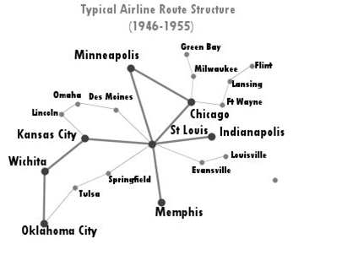
After World War II
Open skies competition for international routes
Open skies refers to the Air Transport Agreement which
  Liberalizes the rules for international aviation markets and minimizes government intervention
  Military and other state-based flights may be permitted
Notes:
The graph shows the flying paths opened after WWII.

Slide 7
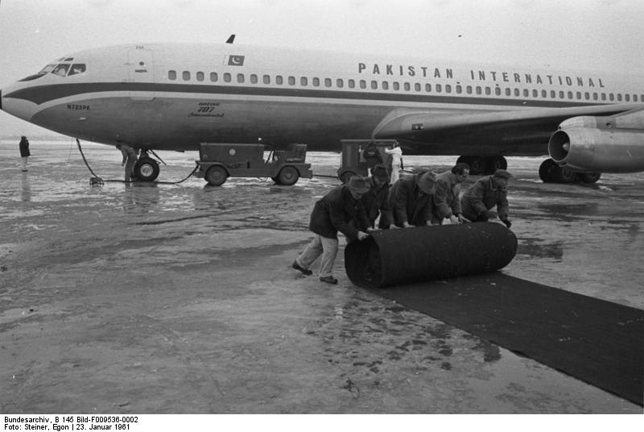
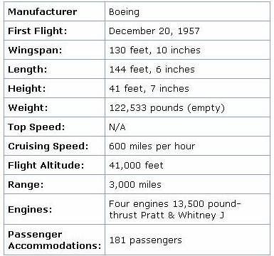
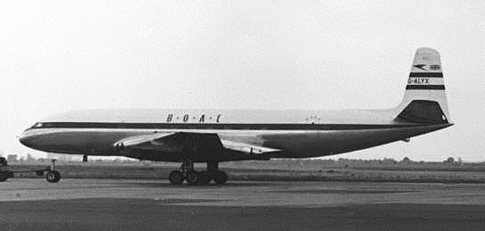
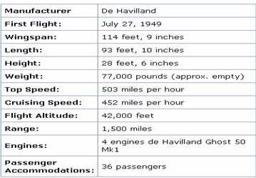
Jet: 1950’s - 1960’s
Boeing 707
DH 106 Comet
Notes:
Boeing 707 => 181 passengers
DH 106 => 36 passengers

Slide 8
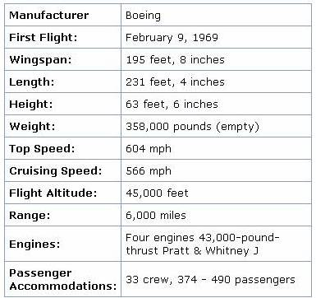
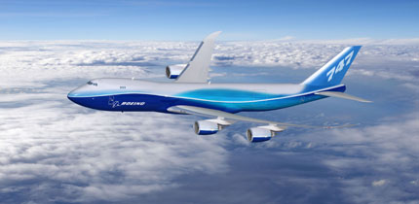
Jumbo Jet: 1960’s – 1970’s
Boeing 747-8
Notes:
Boeing 747 => 490 passengers

Slide 9
Airline Deregulation Act (1978)
To remove government control over fares, routes, and market entry => CAB eliminated
Underserved airports opened to major carriers
Mergers between local carriers were allowed
Implementation of “Hub and Spoke” system
CAB
Notes:
Again, CAB = Civil Aeronautics Board

Slide 10
Global Airlines
Key factors affecting the business:
  Airport capacity
  Route structure
  Technology
  Costs to lease/buy the aircrafts
  Weather
  Cost of fuel
  Cost of labour
Notes:
Because airline industry requires large amount of fixed cost for aircrafts—capital intensive, highly leveraged
- so the cost of borrowing becomes very important
Cost of fuel/labour is important. Will talk about that later

Slide 11
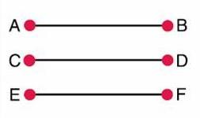

Types of Airlines & Models
Low-Cost Airlines
  Point to Point as main system
    → Fly directly to destination
  Shorter routes, usually regional/domestic
  ↓wait time, ↑utilization
    → Lower unit cost
  e.g. Southwest
Network-Legacy Airlines
  Hub and Spoke as main system
  Long routes, international flights, main airports
  Max. passenger load factor
  ↑wait time, ↓utilization time
  e.g. British Airways, Singapore Airlines

Slide 12
Types of Airlines & Models (2)
Network-Legacy Airlines
  More Luxury aircrafts
  Economic/Business/First Class
  Price discrimination
    Yield management system
    Different prices for same class
  Higher fares
  Frequent-flyer program
  Airlines alliances
  Frills
Low Cost Airlines
  Fewer types of aircrafts
    Lower maintenance expenses
  Economic class
  Fly early/late
    Lower landing fees
  High proportion of sales from the Internet
  Lower fares
  No alliance
  No frills

Slide 13
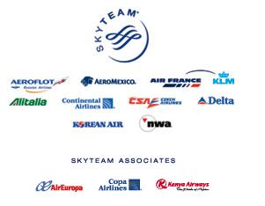
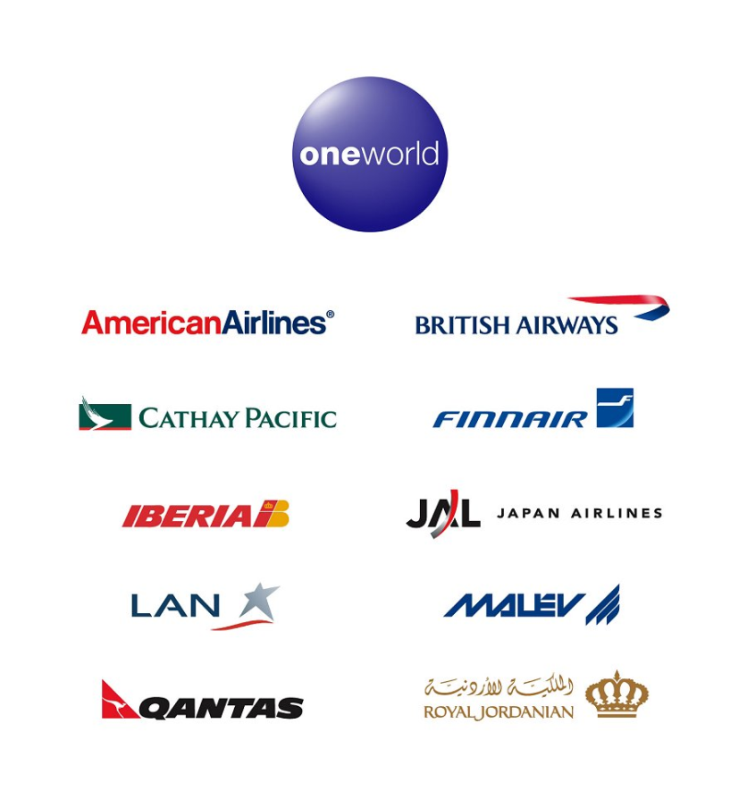
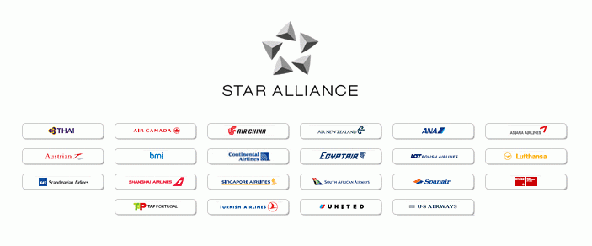
Airline Alliances
Notes:
Alliances are for Network-Legacy Type.
An airline alliance is an agreement between two or more airlines to cooperate on a substantial level. The three largest passenger alliances are the Star Alliance, SkyTeam and Oneworld.
Note that:
British Airways is in One World
Singapore is in Star Alliance
Southwest isn’t in any alliance (low cost airlines)

Slide 14
Benefits of Alliances
An extended and optimized network
Cost reduction from sharing of
  Sales offices
  Maintenance/operational facilities
  Operational staff
  Investment and purchases
Benefits Traveler
  Lower Price
  More choice of departure and destination
  Faster mileage reward

Slide 15
Industry Overview

Slide 16
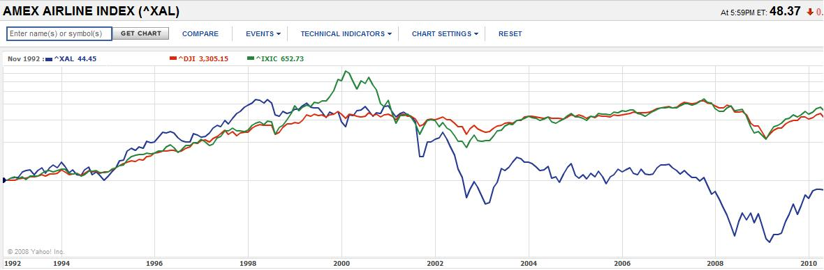
Airline Index (AMEX)
Notes:
The index was lowest between 2008 and 2009
Mainly due to the market didn’t do so well
And more importantly, the jet fuel price was sky high in 2008.
RED: Dow Jones
GREEN: NASDAQ

Slide 17
Notes:
Source: ATA

Slide 18
Fuel Costs – Impact on Operating Costs
Year | % of Operating Cost | Avg Price/ Barrel of Crude (USD) | Break-even Price/ Barrel (USD) | Total Fuel Cost (USD)
2003 | 14% | 28.8 | 23.3 | 44 billion
2004 | 17% | 38.3 | 34.5 | 65 billion
2005 | 22% | 54.5 | 51.8 | 91 billion
2006 | 24% | 65.1 | 67.4 | 107 billion
2007 | 27% | 73 | 81.1 | 134 billion
2008 | 33% | 99 | 88.9 | 189 billion
2009 | 23% | 62 | 55.3 | 113 billion
2010 | 26% | 79 | 80.6 | 140 billion

Slide 19
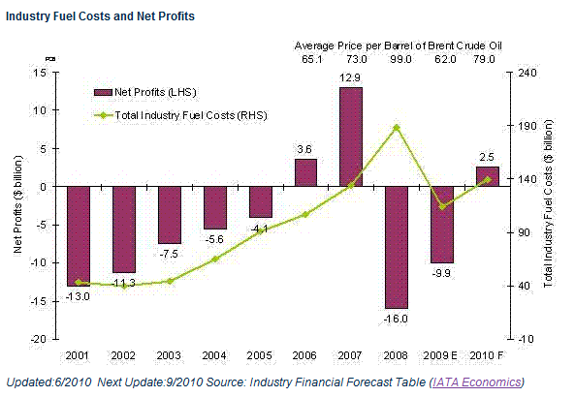
Fuel Costs – Impact on Net Profits

Slide 20
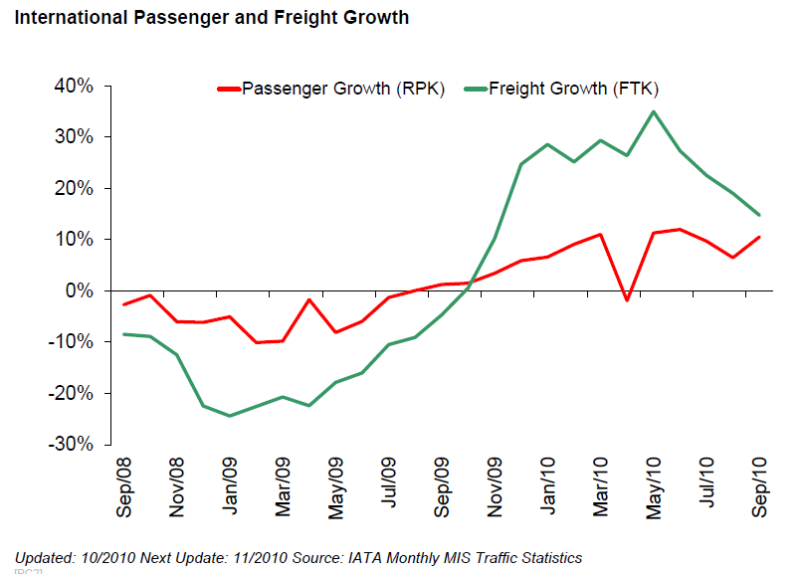
Industry Statistics – International Traffic

Slide 21
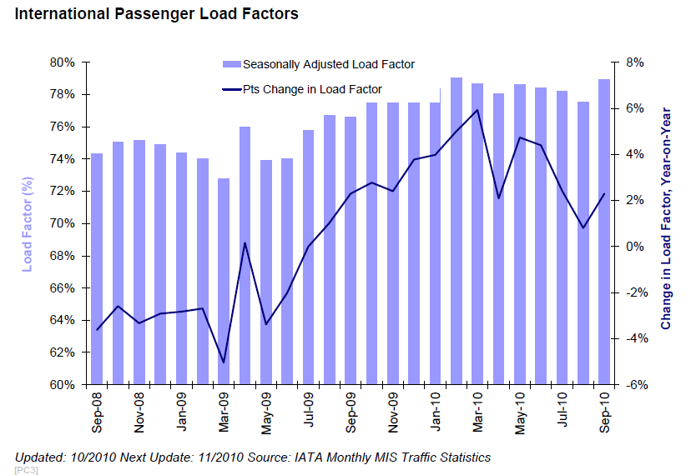
Industry Statistics – International Traffic

Slide 22
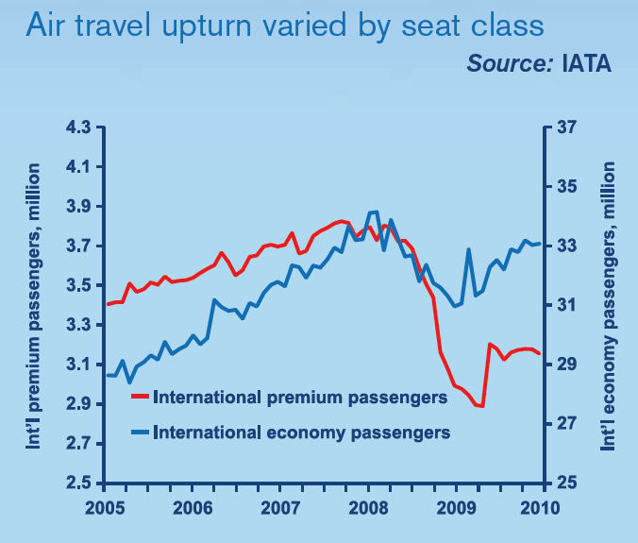
State of the Industry – Passenger Market
Notes:
From mid-2009, air travel markets began
to turn upward, boosted by the massive
fiscal and monetary stimulus measures
taken by governments. By the end of
2009, premium travel had risen 11%
and economy 7%. But while the number
of passengers traveling on economy
seats was within 3% of the 2008 peak,
premium travel lagged 17% below its
previous high point.

Slide 23
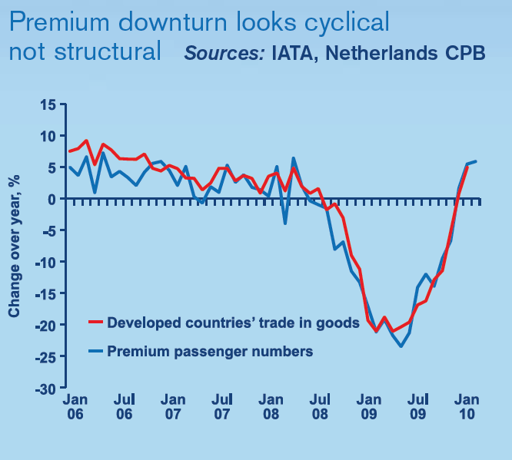
State of the Industry – Passenger Market
Notes:
Drop in premium passenger number in 2009 was mainly driven by trades and financial activities downturn.
An important question was whether the
decline in premium travel was a structural
shift or simply a cyclical downturn, to
be followed by an upturn. This market
segment generates a disproportionate
amount of profit for network airlines,
particularly in long-haul markets.
Many passengers traveling on premium
seats are on business, which is driven by
international trade and financial activity.
Growth in premium travel fits closely with
world trade trends. This is consistent
with the view that the loss of premium
passengers early in 2009 was due to
the unprecedented downturn in
economic activity and world trade
and not to a structural loss.

Slide 24
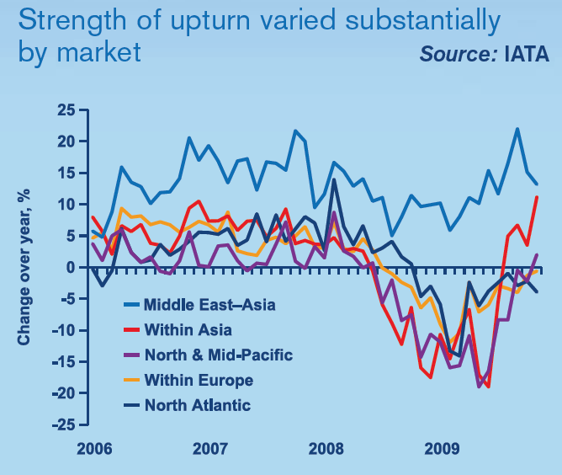
Demand in Passenger Market
Notes:
Overall, passenger demand dropped
2.1% in 2009. By December, though,
traffic was up 8.4% on the February
low and was rising at an annualized rate
of 9% in the first quarter of 2010. The
travel upturn during late 2009 and early
2010 was not even across markets.
Weak economic activity in Europe, and
to a lesser extent in North America, led
to travel remaining fragile within and
between these important markets. By
contrast, strong economic recoveries
in Asia and South America generated
robust upturns in travel in those markets.
Middle Eastern travel markets benefited
from regional economic growth and
continued market share gains in long-haul
markets connecting over Middle
Eastern hubs.

Slide 25
Growth of International Schedule Passenger Demand (2009-2010)
Source: IATA
Notes:
This shows only the growth, not the market share.

Slide 26
International Scheduled Freight Market Volume (2009-2010)
Source: IATA
Notes:
This is the actually market share.
And from the pie chart, we can see that Asia-Pacific becomes the largest market in the world.

Slide 27
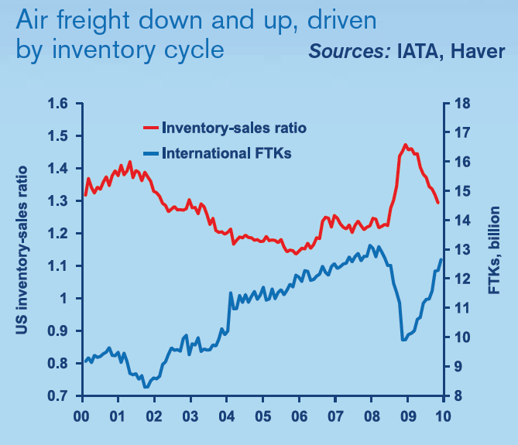
State of Industry – Cargo Markets
FTKs: Freight Tonnes Kilometres
Notes:
In late 2008, business stopped shipping components and goods due to recessions, and air freight slumped as a result.
As that overhang diminished through 2009 shipments began to rise to the benefit of air freight.

Slide 28
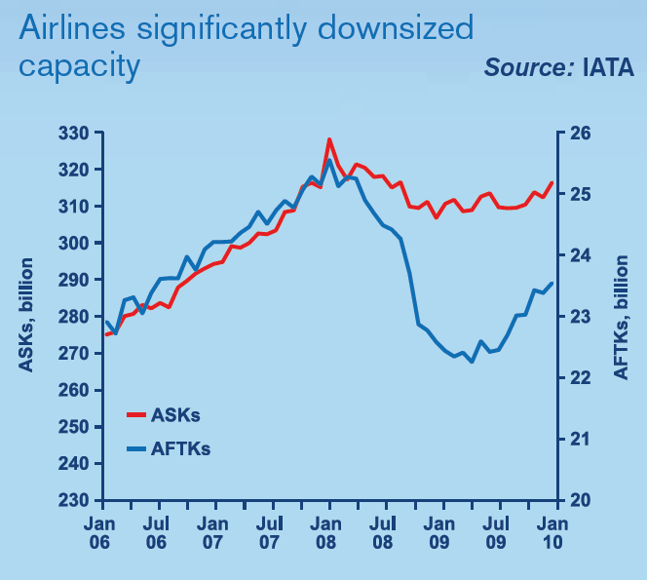
State of the Industry – Capacity
ASKs:
Available Seats Kilometres
AFTKs:
Available Freight Tonnes Kilometres
Notes:
Airlines responded to the severity of
the recession with an unprecedented
reduction in both passenger and freight
capacity. By the end of 2009, passenger
capacity in international markets had
shrunk 5%. Freight capacity was down
10%, and even more at its lowest point
in mid-2009.
These capacity cuts, combined with
the upturns in demand, led to load
factors rising very sharply from their
early 2009 lows. By the end of the year,
load factors had reached record highs.
During the first quarter of 2010, capacity
was being added at an annualized pace
of 6%, but this remains less than the 9%
expansion in demand, and so supplydemand
conditions were still tightening.

Slide 29
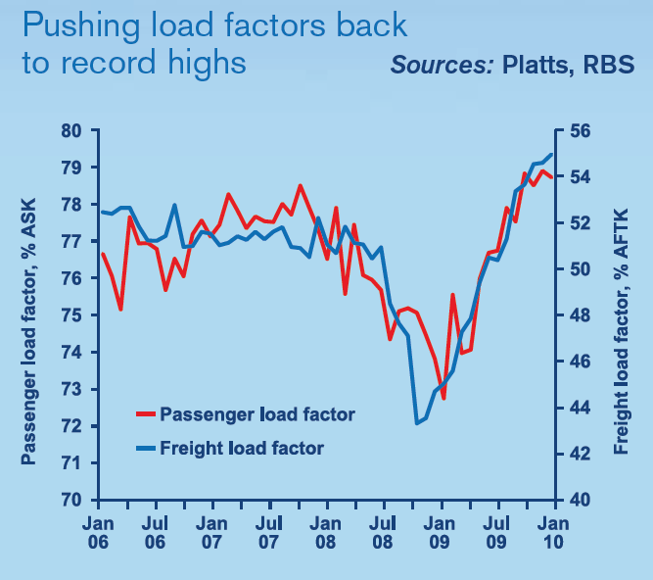
State of the Industry – Capacity
Notes:
Load factor rises were also driven by
aircraft underutilization. Aircraft were on
the ground longer, largely due to reduced
flight frequencies. Around 160 freighters
were taken out of the in-service fleet in
2009, but the passenger fleet expanded.
Narrow-body aircraft utilization, mostly
in short-haul markets, has recovered
to prerecession levels. This mainly
reflects capacity cuts in US domestic
markets and strong demand in intra-
Asian markets. However, wide-body and
freighter utilization—largely in long-haul
markets—was 7–10% lower at the end
of 2009 than in early 2008.
In a capital-intensive industry such as
aviation, high asset utilization is vital to
profitability. With such a large proportion
of costs fixed over the short term, low
aircraft use means higher unit costs. It
also represents redundant capacity that
could very easily return to the market
and put downward pressure on yields.

Slide 30
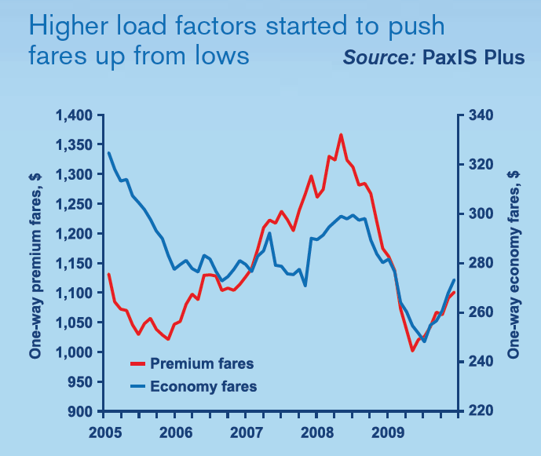
State of the Industry – Yields
Notes:
Intense competition continues to exert
downward pressure on yields. When
fuel prices were rising steeply in 2008,
airlines managed to recover their costs
through raising premium fares, their least
price-sensitive market segment. But the
collapse of business travel led to fire
sales of premium seats. From peak to
trough, average premium fares fell 26%,
and economy fares saw a 17% decline.
This was a measure of the financial
distress network airlines were under
during the first half of 2009.
From their low points, premium and
economy fares (which exclude fuel
surcharges and taxes) were up 10% by
the end of the year. But it was still 9%
cheaper to travel economy than in early
2008 and 20% cheaper to use premium.
On average, passenger and cargo yields
fell 14% in 2009.

Slide 31
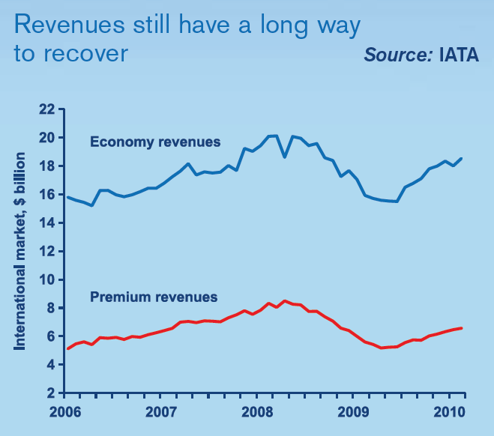
State of the Industry – Revenues
Notes:
IATA estimates that global airline
revenues fell to $479 billion in 2009,
an unprecedented fall of $85 billion, or
15%. This represents a two- to threeyear
backward step for the industry.
Network airlines with significant longhaul
services were hard hit during 2009
because of the larger proportion of
their revenues made up by premium
passengers and cargo. Despite a
second-half upturn in demand, revenues
from premium passengers were down
an estimated 30% in 2009, and cargo
revenues fell 24%. Although the industry
has seen volumes and yields rising since
the middle of 2009, there is still a long
way to go before the revenue levels seen
in early 2008 are recovered. For example,
year-end 2009 revenues from premium
passengers were still almost 30% below
the previous peak. They were still over
20% below peak at the end of the
first quarter of 2010.

Slide 32
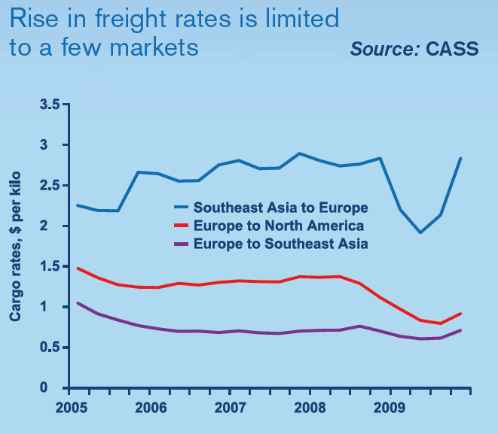
State of the Industry – Yields
Notes:
Freight rates are rising and on average
were higher in the fourth quarter of 2009
than at the same time the previous year.
However, the upturn has been highly
concentrated in a few markets, especially
in Asia, where the economic recovery
has been strong. Trade with Asia is
highly unbalanced, with flows out of Asia
stronger than inward flows. Together with
a shortage of cargo capacity in Asia, this
has helped freight rates from Southeast
Asia to Europe recover to prerecession
levels. By contrast, rates in the opposite
direction have barely moved from their
depressed levels. This is also true of
rates across the North Atlantic between
the relatively weak economies of Europe
and North America.

Slide 33
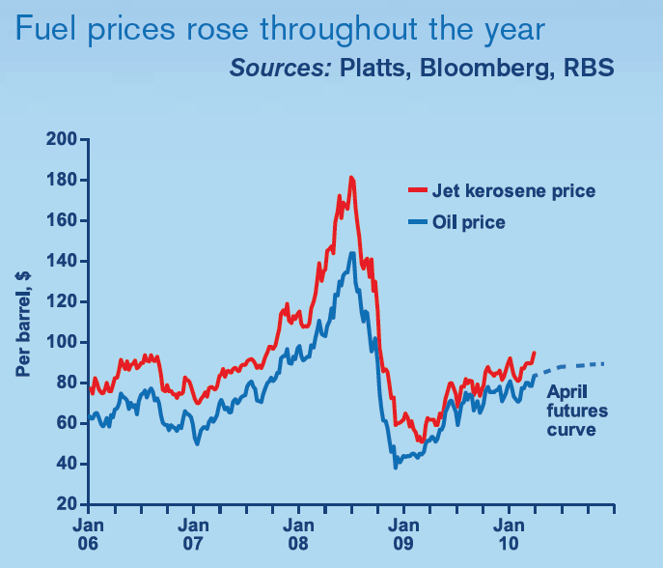
State of the Industry – Fuel Costs
Notes:
For the past decade, increases in jet
kerosene prices have been the major
driver of costs. Air transport is an energy intensive
industry, so when oil prices
spiked in 2008 fuel made up 33% of
operating costs on average. By the start
of 2009, oil prices had fallen back to
around $40 a barrel as the so-called
Great Recession caused energy
demand to slump.
However, from that low point the industry
has faced continuously rising fuel prices.
By year-end 2009, crude oil prices had
risen 85%, to $74 a barrel, as economic
recovery began to raise demand and as
futures markets, anticipating strengthening
economic recovery, added to upward
pressures.
Jet kerosene prices did not rise quite
as far, since the “crack spread” (the
difference between jet kerosene and
crude oil prices) narrowed from a very
high 50% at the start of the year to
an unusually low 15% by year-end,
reflecting the emergence of significant
excess capacity in the refining industry.
By the end of 2009, jet kerosene prices
were $85 a barrel. This was well down
on the 2008 spike of $180 a barrel
but back to 2006–2007 levels when
economic growth and the ability to offset
higher costs with higher revenues was
much stronger. The volatility in fuel prices
has meant airline hedging strategies have
met only moderate success.
13
As of mid-May 2010, oil futures markets
are anticipating a rise in spot oil prices
above $88 a barrel by the end of 2010,
which would be consistent with a further
rise in the price of jet kerosene to over
$100 a barrel.

Slide 34
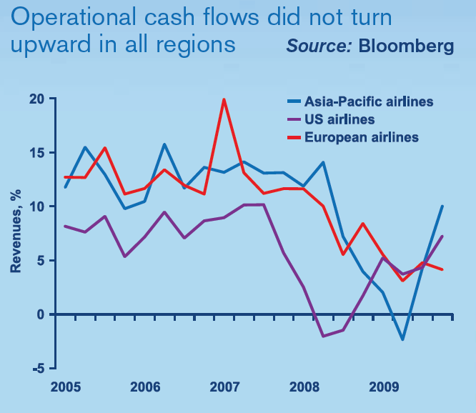
State of the Industry – Cash Flow
Notes:
The cash that airlines are able to
generate from operations gives a clear
picture of the impact of revenue and cost
fluctuations on the bottom line. Earnings
before interest, tax, and depreciation and
amortization (EBITDA) as a percentage
of revenues give a close approximation of
airline cash flows in a metric that allows
comparison across regions. Airlines in
North America, Europe, and Asia-Pacific
experienced very different trends in cash
flows during 2009.
The weakest point for the US airlines
was in mid-2008, as record fuel prices
hit them at a time when their hedging
levels were low and the US economy
was weak. Early and sharp capacity
cuts meant they were able to improve
their operational cash flows, albeit from
an exceptionally weak level, throughout
2009 and in spite of the recession. By
the end of 2009, their cash flows were
almost back to 2005–2007 levels.
However, debt levels and interest rate
spreads are high for US airlines, so
once debt interest and capital spending
are taken into account these positive
operating cash flows turn into further
net losses.
Asia-Pacific airlines found their cash
flows hit dramatically by the recession.
In addition, fuel hedges locking in prices
that looked low in mid-2008 went wrong
as oil prices slumped. In the second half
of 2009, many airlines in this region saw
an equally dramatic upturn. Cash flows in
this region are back to a healthier 10%
of revenues.
European airlines suffered a gentler
decline in cash flows, partly because
their hedging strategies offered
better protection against the oil price
fluctuations early on. However, that is
offering less of an advantage now, and
cash flows did not pick up at all during
2009 because of the weak economic
recovery. In fact, a number of European
economies weakened in the fourth
quarter of 2009, and this has been
reflected in disappointing revenues
for the European airlines.
In April 2010, European airlines were
hit hardest by the airspace closure in
Europe resulting from the eruption of
the Icelandic volcano Eyjafjallajökull. At
its peak, the disruption affected 29% of
global traffic. The industry is estimated
to have lost $1.7 billion in revenues over
a six-day period. The greatest share of
this revenue loss was borne by European
carriers, whose operations accounted for
70% of the disruptions.

Slide 35
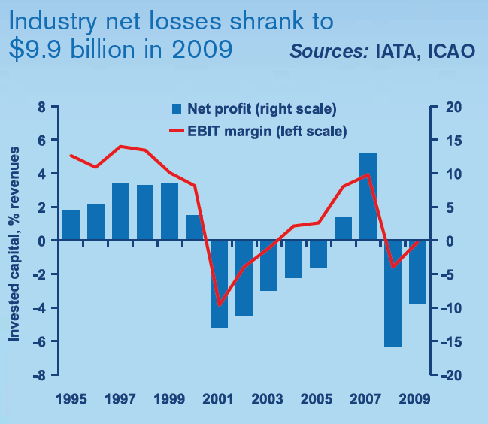
State of the Industry – Profits
Notes:
IATA estimates that capacity cuts
and lower average fuel prices cut
industry operating costs by more than
the $85 billion fall in revenues in 2009.
At the operating or earnings before
income tax (EBIT) level, the industry was
almost back to breakeven, with losses of
a few hundred million dollars, or 0.1%
of revenues. However, the increase in
debt as airlines raised cash and the
widening of credit spreads increased
debt interest payments. As a result, the
reduction in losses was limited, and
the global industry ended 2009 with
estimated net losses of $9.9 billion.
That total obscures some very different
financial performances. Europe, from
having been one of the best-performing
regions in 2008, reported the largest
losses in 2009. US airlines managed to
substantially reduce their losses from
2008, thanks to large capacity cuts, but
were coming from the weakest position.
North America thus generated the
second-largest net losses in 2009.
Asia-Pacific has seen the largest
rebound in economic growth and air
transport demand, but the region was
mired in the deepest recession at the
start of 2009. That impact caused
net losses there to be large.
There were small losses for African
and Middle Eastern airlines. But in Latin
America, a number of airlines continued
to produce results that were exceptional
given the economic environment. This
was the one region that managed to be
profitable in 2009, partly as a result of
economies in the south of the continent
that proved relatively resilient to the
recession.

Slide 36
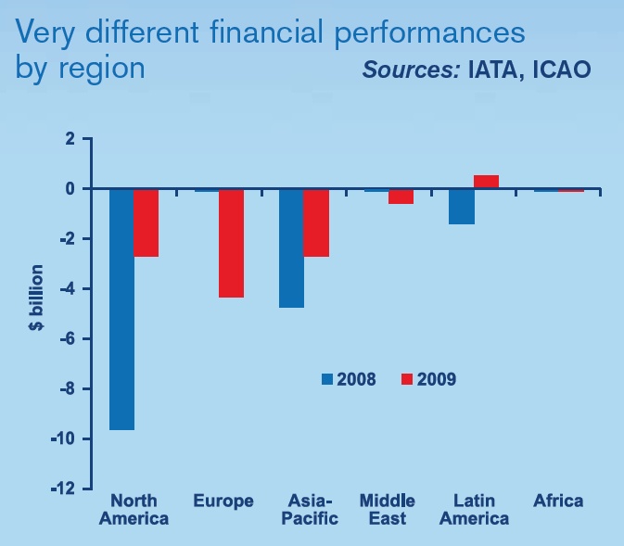
State of the Industry – Profits
Notes:
Stronger financial markets in 2009
allowed major airlines to raise a
$30 billion cash cushion by issuing debt
and some equity on capital markets.
This allowed major airlines in North
America and Europe, and some in Asia-
Pacific, to raise their cash or near-cash
balances to 20–25% of revenues. That,
in turn, offered them a secure cushion
against adverse economic conditions
and reduced the risk of major airline
bankruptcy during 2009.
The capital markets, however, were
only open to the major airlines. Banks in
Europe and North America are still not
lending easily. As a result, many small
and medium-sized airlines are finding
accessing credit and establishing secure
cash balances difficult. Consequently,
the industry remains vulnerable to
adverse shocks.

Slide 37
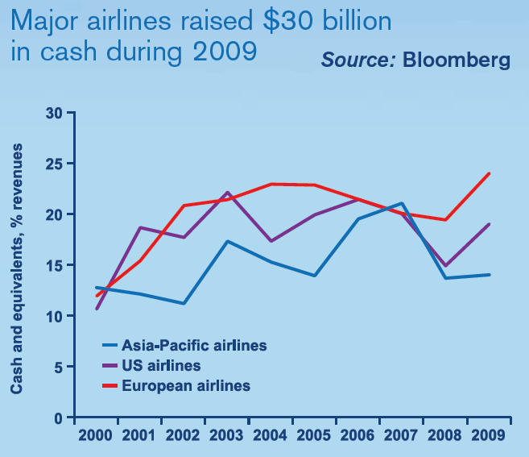
State of the Industry – Cash and Balance Sheets
Notes:
Major airlines raised $25 billion of
the $30 billion in cash by issuing new
debt. There was only $5 billion in new
equity. In addition, around $13 billion
of aircraft assets were sold and leased
back. This weakened balance sheets,
with leverage rising sharply in all regions.
For US airlines in particular, where
leverage is now around 100%, there
are few unencumbered assets against
which to raise future debt. Without new
equity, balance sheets may be close to
exhaustion, which may make significant
capital spending on re-fleeting more
difficult.
For many airlines, particularly in small
countries with poorly developed capital
markets, national ownership and control
rules continue to restrict access to
necessary equity.

Slide 38
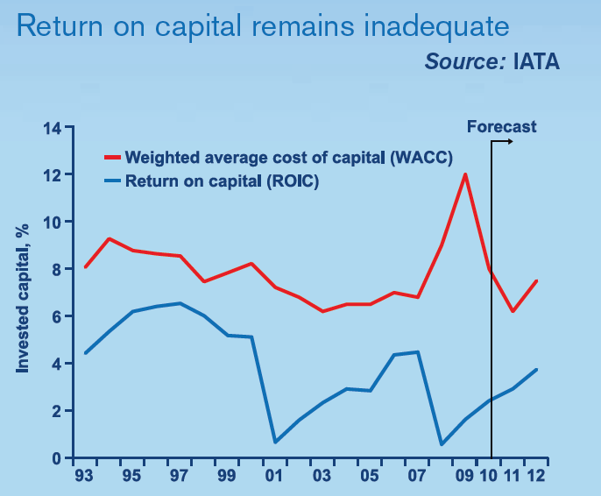
State of the Industry – Financial Sustainability
Notes:
Financial sustainability for the industry
means not just generating profit but
also paying investors a “normal” return.
Such a return is generally benchmarked
as the average cost of equity and debt
(the WACC, or weighted average cost
of capital). In 2009, the industry was
as far from achieving this as it has ever
been, partly because the financial crisis
caused non-investment grade debt
costs to rise dramatically. This raised the
airlines’ average cost of capital to 12%,
well above its normal 7–8%. But weak
cash flows meant that in 2009 the return
on capital (which is before debt interest
or dividend payments) was only a little
above the 2008 all-time low, at 1.6%.
The return on capital rose throughout
2009 and is expected to be higher in
2010. There is, though, a long way to go
before it approaches the cost of capital,
which is now falling back to more normal
levels. The industry has not managed to
produce adequate returns even in peak
years.
Overall, there was evidence of a
strong cyclical upturn by the end of
2009. The trend continued in the first
quarter of 2010. However, the structural
problems remain and must be addressed.

Slide 39
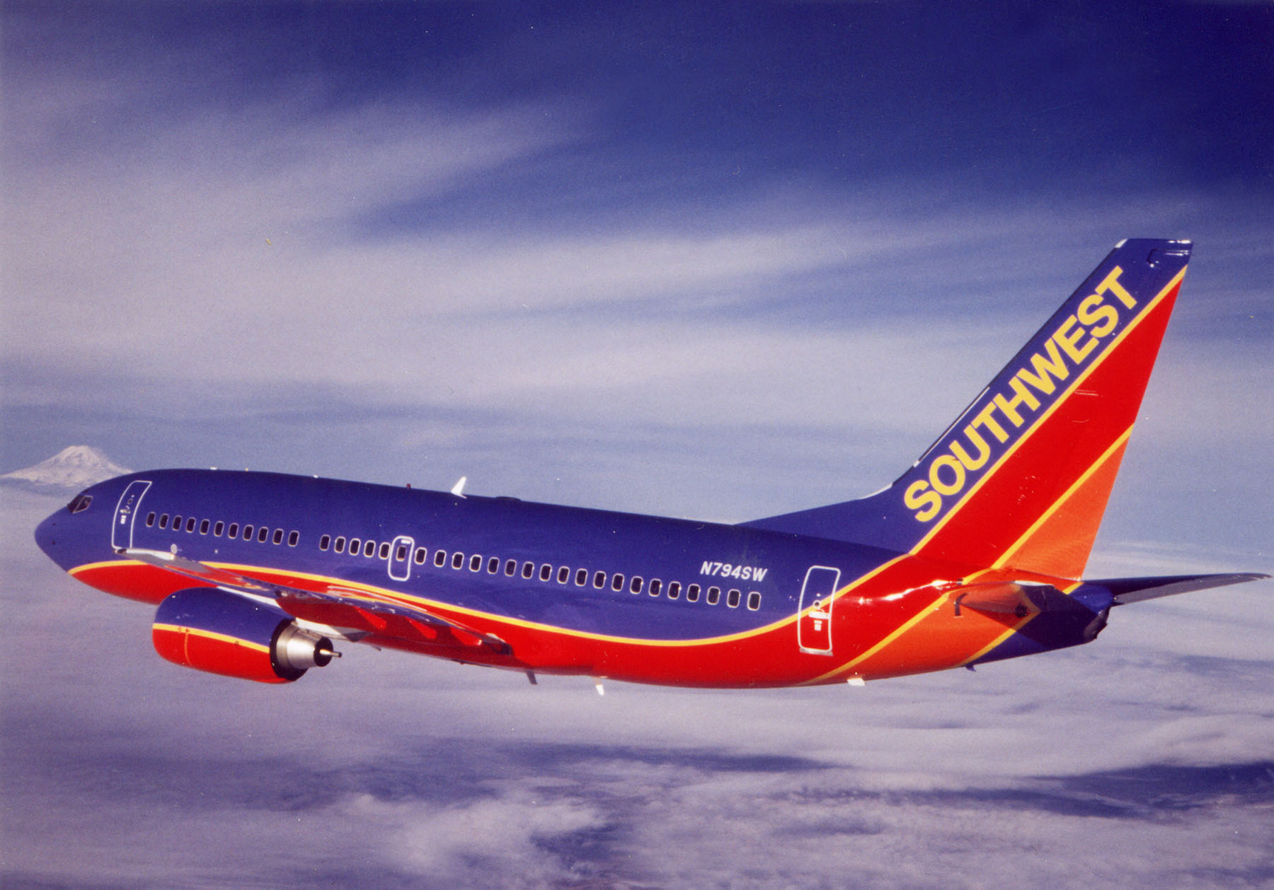
Southwest Airlines
SOUTHWEST AIRLINES

Slide 40
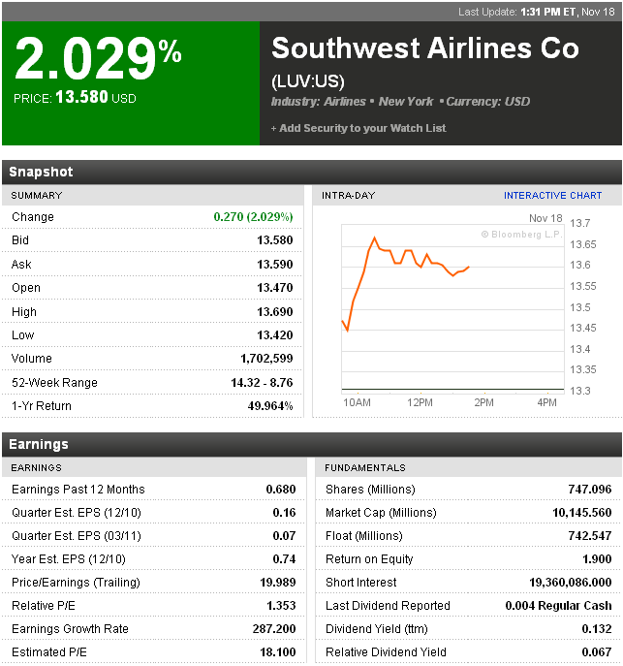
Stock Quote (NYSE:LUV)

Slide 41
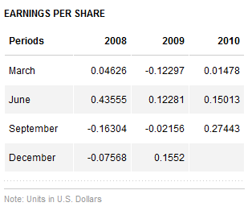
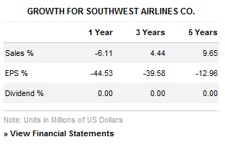
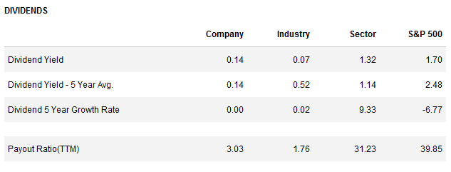
Southwest Stock (NYSE:LUV)

Slide 42
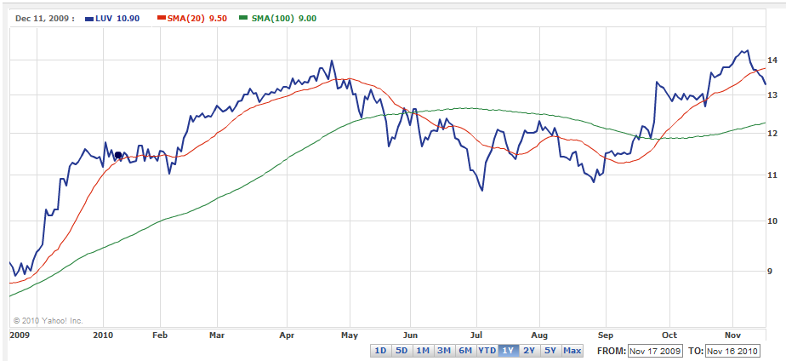
Moving Average (One-year)

Slide 43
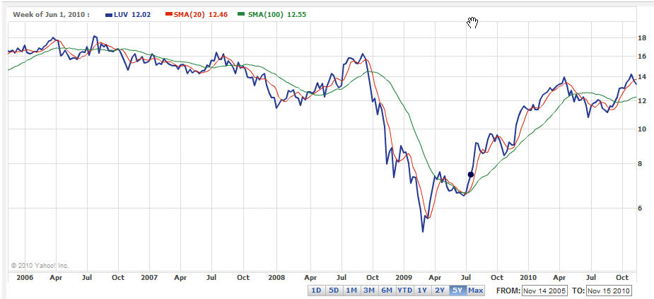
Moving Average (Five-year)

Slide 44
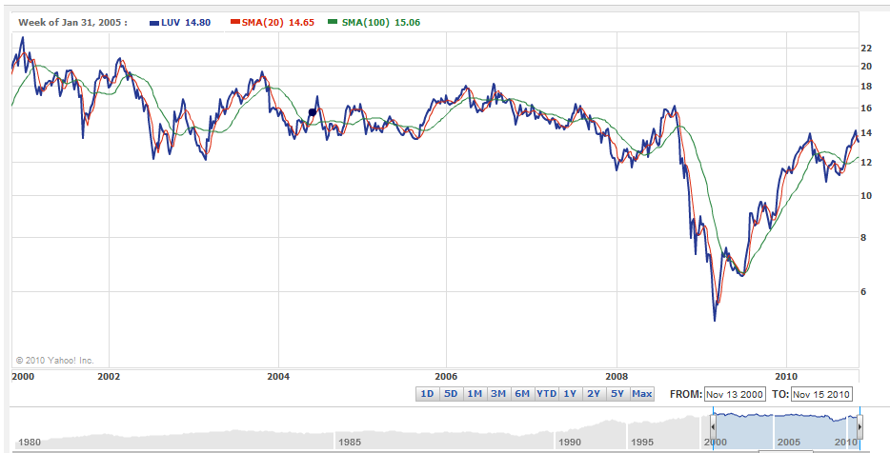
Moving Average (Ten-year)

Slide 45
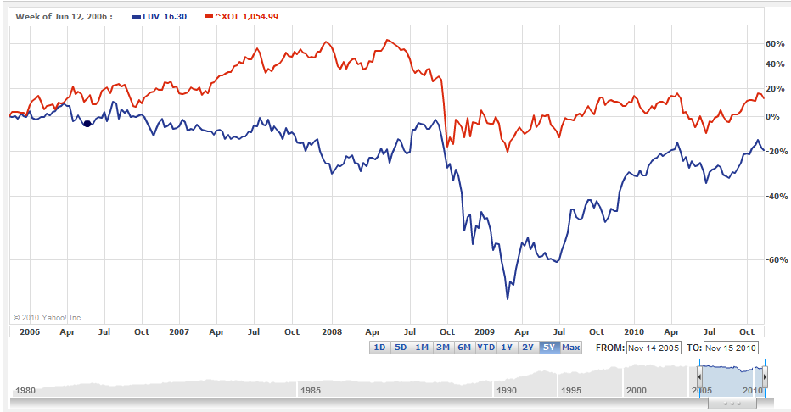
Southwest VS. Oil Price (AMEX) - 5 Year

Slide 46
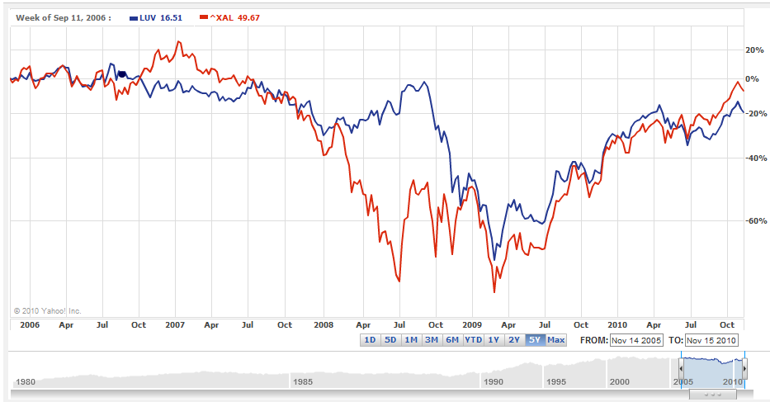
Southwest VS. Airline Index (AMEX) - 5 Year

Slide 47
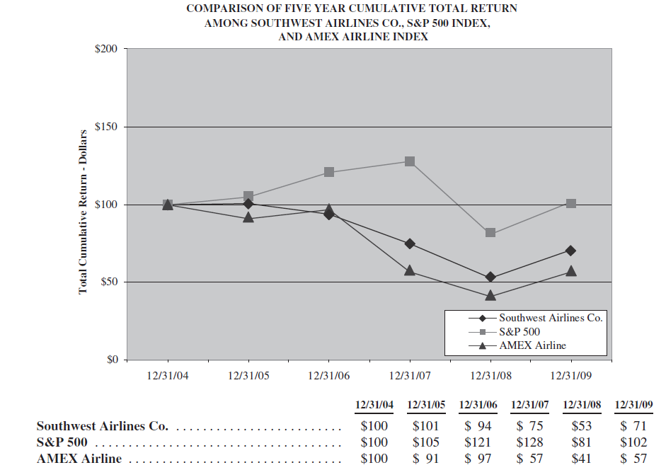
5 Year Cumulative Return
(reinvestment of dividends)

Slide 48
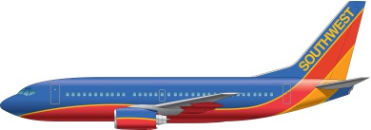
Company Profile
Southwest is a major domestic airline that provides primarily short-haul, high-frequency, point-to-point, low-fare service
Headquarters in Dallas, Texas
Operates over 500 Boeing 737
aircrafts in 69 cities
Has among the lowest cost structures in domestic airline industry and consistently offers the lowest and simplest fares
Average passenger airfare for a one-way ticket is $131.82
Adopted the first profit-sharing plan in U.S. airline industry in 1973 where employees own about 8% of the company stock

Slide 49
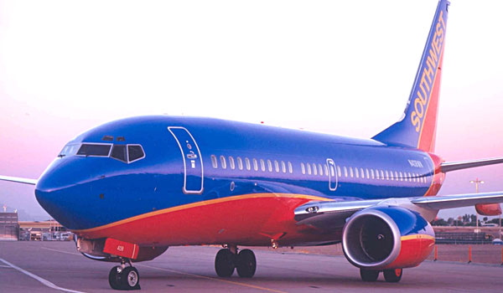
History of Southwest
1967
Air Southwest Co. was incorporated
1971
Air Southwest Co. changes its name to Southwest Airlines Co.
Begins service to Dallas, San Antonio and Houston with three Boeing 737s
1973
Ends the year with first yearly profit
1974
Carries one-millionth customer
1975
Common stock listed on
American Stock Exchange under
the ticker “LUV”
1978
Flies to New Orleans, first flight
destination outside of Texas
1990
Revenue exceeded $1 Billion

Slide 50
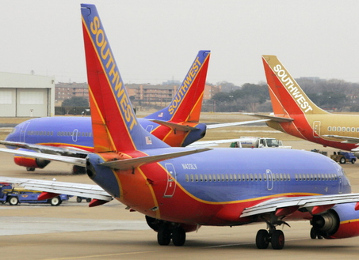
History of Southwest (2)
1994
Acquires 2 airline companies: Morris Air and Arizona One
1996
Online booking site launched
2005
Enters first code-share agreement with American Trans Air
2009
Becomes largest carrier in the US with 545 Boeing 737 aircrafts servicing 68 airports in 35 states and able to offer more than 3,300 flights a day

Slide 51
Southwest Airlines Today
World’s largest low cost carrier
Maintains the 4th largest passenger fleet of aircraft among all airlines
One of the most profitable airlines (37th consecutive profitable year in 2010)
Has nearly 35,000 employees and makes more than 3,200 flights a day

Slide 52
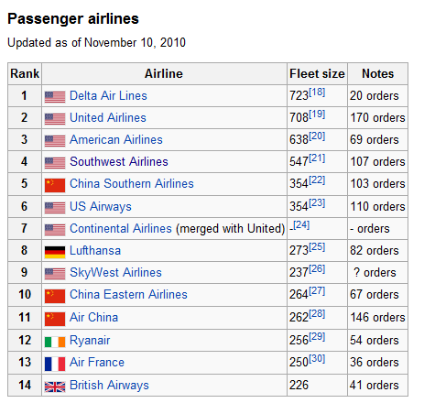
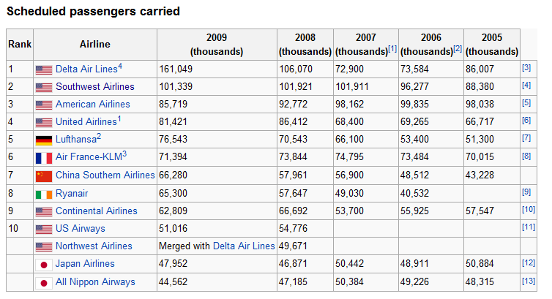
Size of Southwest Airlines
By Scheduled Passengers:
By Fleet Size:

Slide 53
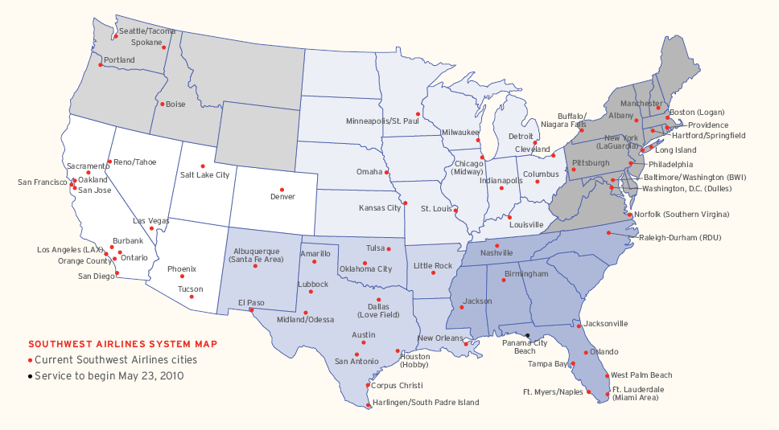
Southwest Servicing Map
69 cities in 35 states

Slide 54
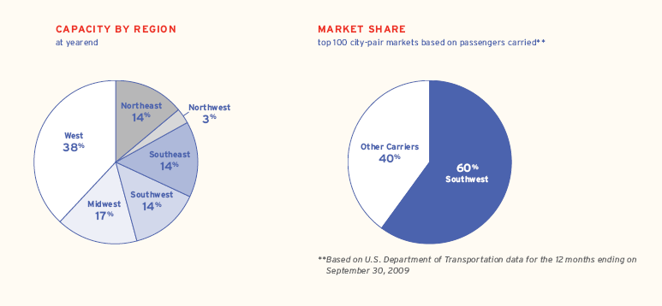
Region Break-down & Market Share

Slide 55
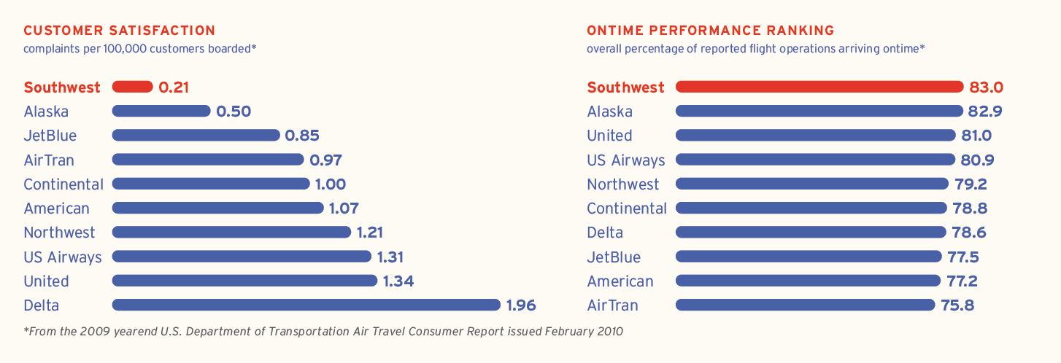
Customer Service
In June 2010, the American Customer Satisfaction Index ranked Southwest Airlines number one among all airlines for the 17th year in a row.

Slide 56


Innovation
“One of the most innovative companies in the world” – BusinessWeek, 2009
EarlyBird Check-In
  By paying $10 (one-way), customers can be checked in
  automatically up to 6 hrs before general boarding positions
  become available and have a confirmed boarding position
  Allows customers to have earlier access to seats and luggage compartments
  Generated $15 million in revenue in 2009
P.A.W.S. (Pets Are Welcome on Southwest)
  Customers can bring a small dog or cat on board by
  paying $75
  In the first 7 months (june to dec 2009), it generated more
  than $5 million in revenue

Slide 57
Southwest Operations
[Number of revenue passengers]
*
[Number of miles flown by those passengers]
[Number of seats available]
*
[Number of miles flown]

Slide 58
Southwest Operations (2)
The amount of operating cost incurred per ASM; also referred to as “unit cost”.
The amount of passenger revenue earned per ASM; also referred to as “unit revenue.”

Slide 59
Southwest Airlines
Management

Slide 60

Management
Herbert D. Kelleher - Founder and
Chairman Emeritus
Incorporated Southwest in 1967
1976 to 2008: Executive Chairman
1981 to 2001: President and CEO
May 2008: Stepped down from the role of Chairman and resigned from the Board of Directors
Graduated with honors from Wesleyan University, where he was an Olin Scholar
  Major in English and Minor in Philosophy
Graduated from NYU Law School, where he was a Root-Tilden Scholar

Slide 61

Management
Gary C. Kelly – Chairman, President
(since 1994), CEO
Age: 55
1986: Joined the company as Controller
1989: CFO and VP of Finance
1991: Executive Vice President
1994: CEO
2008: Chairman of the Board of Directors
Education:
  Earned B.B.A. in Accounting from University of Texas
  Certified Public Accountant

Slide 62

Management
Laura Wright - CFO, VP of Finance
(Since 2004)
Age: 49
1988: Joined the company as Director of Corporate Taxation
1990: Director of Corporate Finance
1995: Assistant Treasurer
1998: Treasurer
2001: VP of Finance and Treasurer
2004: VP Finance and CFO
Education:
  Earned B.S.A and an M.S.A. (emphasis in taxation) from the University of North Texas
  Certified Public Accountant

Slide 63

Management
Michael Van de Ven – COO,
Executive Vice President
Age: 48
Joined the company in April 1993
Experience in the Company:
  Executive Vice President of Aircraft Operations
  Senior Vice President of Planning
  Vice President Financial Planning & Analysis
  Senior Director of Financial Planning & Analysis
  Director of Financial Planning
  Director of Internal Audit
Education:
  B.B.A. from University of Texas at Austin
  Certified Public Accountant

Slide 64
Southwest Airlines
Financial Analysis

Slide 65

Annual Income Statements
(in millions, except per share amounts)

Slide 66

Quarterly Income Statement
(in millions, except per share amounts)
4th Q 2009
1st Q 2010
2nd Q 2010
3rd Q 2010

Slide 67
Income & Expense Figures

Slide 68

Balance Sheet - Annual
Notes:
southwest lost a lot of their cash and cash equivalents since 2007

Slide 69

Balance Sheet - Annual
Notes:
Current liabilities have decreased a lot since 2007

Slide 70

The company`s cash collateral deposits related to derivates that have been provided to a counterpart have been adjusted to show a ``net`` presentation against the fair value of the company`s fuel derivative instruments

Slide 71

Notes:
both the Passenger revenue yield per PRM and RASM (revenue per available seat mile) has increased which is a good sign of improvement in operations
the RASM has increased over 16% in both the 3rd quarter and 9 months ended while costs have only increased 10.2% for the 9 months ended this year

Slide 72
Recommendation
HOLD

Slide 73


British Airwys

Slide 74




Stock Performance

Slide 75

Moving Average (One-year)
Notes:
The fall from May to Jul was mainly due to the strike.
Investors were worried that it would affect the company.
The increase in price in Sept was mainly based on the strategic deal that will be discussed soon.

Slide 76

Moving Average (Five-year)
Notes:
The price drop in Oct 09 was resulted by another strike.

Slide 77

Moving Average (Ten-year)
Notes:
Dividend paid out in 2000, 2001, and 2008 throughout the past 10 years.

Slide 78

Comparing with Indices (One-year)

Slide 79

Comparing with Indices (Five-year)

Slide 80

Comparing with Indices (Ten-year)

Slide 81
Overview
UK’s largest international scheduled airline
One of the largest Network-Legacy Airlines
Member of Oneworld Alliance
Flying to more than 300 destinations
HQ in London: Heathrow, Gatwick

Slide 82

Overview (2)
Carried more than 32 million passengers last year
Earned £8 billion in revenue
Carried 760,000 tones of cargo
Have 238 aircrafts in service

Slide 83
Key Business Priorities
Upgraded customer experience
  More first cabin for long-haul fleet
Capacity and fleet
  More aircraft and more destinations
Competitive cost base
  More competitive cost by introducing structural change
Corporate responsibility
  Working with “Flying Start,” and planning to raise £8 million by 2013

Slide 84
Timeline of the Company
1919
Forerunner company, Aircraft Transport and Travel Limited, scheduled the first air service
1939
Aircraft Transport and Travel and Imperial Airways were nationalized and form British Overseas Airways Corp. (BOAC)
1946
The first fight to New York
1958
Dissolved to form two additional Corporations: BEA and BSAA
First transatlantic jet passenger service
1974
BOAC and BEA merged to form British Airways (BA)
1987
British Airways was privatized and merged with British Caledonian. Valuing at over £900 million GBP
2008
1993
Lord King stepped down as chairman
2002
British Airways merged with four regional airlines and became one single regional subsidiary airline
British Airways bought L'Avion, a French airline
Notes:
BEA: British European Airways—European and domestic routes
BSAA: British South American Airways—South American and Caribbean routes

Slide 85

Current News
November 09
May 10
September 10
The union, Unite, announced the strike
British Airways merged with Iberi Airlines
Will become the world third largest airline in terms of annual income
Passenger traffic at BAA airports dropped by 1.7% in June
BA reaches agreement with unions in August
AA-BA-Iberi signed strategic alliance
The deal is worth approximately £4.4 billion
Lower cost for flights to Europe, South and North American
Notes:
Nov 09—after Delta Air Lines and American Airlines.
BAA—One of the world's leading airport operators, BAA owns and manages six airports in the UK
AA—American Airlines

Slide 86

Flight Routes (Europe)

Slide 87


Flight Routes (Other Destinations)
Far East
North America
Source: BA

Slide 88
Management

Slide 89


Non-executive director since May 2000
Became Chairman in July 2004
Chairman of the Nominations Committee
MBA from University of Hull
Compensation: £351k + award
Executive board member since May 2005
MBA from Trinity College, Dublin
Former CEO of Aer Lingus (an Irish airline)
Compensation: £1,024k + award
Martin Broughton
Chairman
Willie Walsh
CEO
Notes:
Interesting fact: Broughton is also the chairman of Liverpool Football Club, and he helped John Henry to become the new boss of the club a month ago.

Slide 90



Executive Board Member since January 2006
Degree in History, Chartered Accountant
Compensation: £582k
Senior independent non-executive director since 2002
Audit, Nominations and Remuneration Committees
Compensation: £46k
Non-executive director since November 2006
Unilever’s CFO (2007-2009)
Degree in Economics from Yale, MBA from Harvard Business School
Compensation: £47k
Keith Williams
CFO
Maarten van den Bergh
Jim Lawrence

Slide 91
Financial Analysis

Slide 92

Quick Overview
(I/S)

Slide 93

Quick Overview (B/S)

Slide 94

Quick Overview (B/S) (2)

Slide 95

Quick Overview (Ratios)

Slide 96

Annual Report (I/S)

Slide 97

Annual Report (B/S)

Slide 98

Annual Report (B/S) (2)
Notes:
Leasing

Slide 99

Annual Report
(C/F)

Slide 100

Current Performance
Notes:
Q1:
Cargo business has seen strong performance, with revenue increasing by 36.7 per cent. Cargo
yields increased by 33.9 per cent
6-month:
Revenue from passengers and cargo go up by 7.9% and 39.4% respectively. This result the strong performance of Q2 in 2010.
The overall revenue is up by 8.4%.

Slide 101

6-month (I/S)

Slide 102

6-month (Other comprehensive income)

Slide 103

6-month (B/S)

Slide 104

6-month (B/S) (2)

Slide 105

6-month (C/F)

Slide 106
Recommendation
HOLD

Slide 107


Slide 108


Singapore Airline
Last update Nov 18th
1 US dollar =1.2975 SGD

Slide 109
Shares Outstanding
May 27 2008
No. of issue shares: 1,186,547,791
No. excluding treasury shares: 1,183,686,752
May 6 2009
No. of issue shares: 1,186,547,791
No. excluding treasury shares: 1,182,649,308
June 7 2010
No. of issue shares: 1,192,105,292
No. excluding treasury shares: 1,192,038,808

Slide 110

One Year Stock Price (moving average)
Source: Reuters (In Singapore Dollars)

Slide 111

Five Year Stock Price (moving average)
Source: Reuters (In Singapore Dollars)

Slide 112

Ten Year Stock Price (moving average)
Source: Reuters (In Singapore Dollars)

Slide 113

One Year Stock Price Comparison
Source: Reuters (Comparison with
Nasdaq and Dow)

Slide 114

Five Year Stock Price Comparison
Source: Reuters (Comparison with
Nasdaq and Dow)

Slide 115

Ten Year Stock Price Comparison
Source: Reuters (Comparison with
Nasdaq and Dow)

Slide 116

Current Events
The Australian newspaper reported Qantas operated its A380 engines at higher maximum thrust levels than rivals, which could result in resonating vibrations that cause oil lines to crack
Rolls says progress made in Qantas A380 engine probe
safety regulator orders A380 engine inspection
Quantas keeps A380 grounded, exam 3 suspect engines

Slide 117

Singapore Airline
Listed and traded on Singapore Stock Exchange
Share price as of Nov 18th
  15.90 SGD
Currency exchange rate as of Nov 18th
  1 US = 1.2975 SGD

Slide 118
Singapore Airline Brief History
Begin as an incorporation of Malayan Airlines (MAL) in 1937.
First flight from British Straits Settlement of Singapore to Kuala Lumpur in 1947 using Airspeed Consul twin Engine airplane
In 1963, the Federation of Malaysia was born and the Airline became known as Malaysian Airways.

Slide 119

Singapore Airline Brief History
In May 1966, it became Malaysia-Singapore Airlines.
In 1972, Malaysia-Singapore Airlines split up to become two entities - Singapore Airlines and Malaysian Airline System

Slide 120

Stated Objectives
Provide innovative promotions to attract new customers and maintain competitive advantage
Maximize return for shareholder and employees
Continuously maintain profitable position in times of economy downturn, and recover loss as the economy starts to pick up.

Slide 121
Strategy
Enhance customer experience by providing service such as free beverage (with or without alcohol) and hot towels…etc free of charge
Maintain cost efficiency by using latest aircraft (four A330-2010) and at the same time as marketing purpose. SIA also decommissioned 6 B777s (four for lease and two for sale)
Adding capacity to designations such as Hong Kong, New Delhi, and Seoul. Also Expanding the Singapore and Munich-Manchester service

Slide 122

Global Route Map

Slide 123

West Asia and Africa Route Map
Here SIA uses “hub and spoke” method

Slide 124

Type of Aircrafts
Notes:
The Boeing 777 is a long-range, wide-body twin-engine jet airliner manufactured by Boeing Commercial Airplanes. It is the world's largest twinjet and is commonly referred to as the "Triple Seven".[3][4] The aircraft has seating for over 300 passengers and has a range from 5,235 to 9,380 nautical miles (9,695 to 17,370 km) depending on model

Slide 125
SIA Subsidiaries
SilkAir
Tradewinds Tour and Travel
SIA Engineering Company
SIA Cargo
NO MORE Singapore Airport Terminal Service (SATS) → diversified from SIA in 2009
Notes:
According to Chew Choon Seng, the CEO of SIA “The move will unlock shareholder value, give shareholders a direct interest in SATS without them having to put their hands in their pockets, and allow the airline to concentrate on its core business”

Slide 126



Main Competitors
Cathay Pacific Airways Limited
Japan Airline Corporation
Malaysian Airline System Berhad

Slide 127

Main Controller
Notes:
Temasek Holdings is an investment company owned by the government of Singapore.
It is an active shareholder and investor in - financial services, telecommunications & media, technology, transportation, industrials, lifesciences, consumer, real estate, energy & resources.

Slide 128

Key Financial Highlight

Slide 129

Dividend
Notes:
March 2010 year end the board recommend dividend of 12 cents per share
A drop from 40 cent share in 2008

Slide 130

Group Liquid Asset
Net liquid asset increase from 2,802 to 3,274 (million) over a year due to deconsolidation of SATS Group, including 200(m) notes payable issued by SATS Group
Total debt to equity ratio lower by 0.02

Slide 131

Cost Structure
Notes:
Fuel cost went down a lot, likely due to reduce in flight frequency in economy downturn
Staff costs were $151 million lower, mainly attributable to wage cuts and voluntary no-pay leave, lower crew allowances
and provision for profit-sharing bonus
Handling charges was $40 million lower, attributable to decrease in number of handlings, partially offset by increase in
rates from new aircraft type joining the fleet.
Inflight meals and other passenger costs fell $38 million due mainly to decrease in number of passengers uplifted.
Airport and overflying charges was $47 million lower, largely due to decrease in number of trips.
Sales cost decreased $125 million, as commissions and incentives reduced.
Rentals on leased aircraft increased $69 million, primarily attributable to lease of additional 7 A330-300 aircraft, partially
offset by the return of 3 B747-400 aircraft on expiry of lease.
Other costs were $91 million higher, due mainly to foreign exchange revaluation and hedging loss this year (against gain
last year).

Slide 132
Cost Structure

Slide 133

Fuel Cost

Slide 134

Revenue Composition by Product

Slide 135
Revenue Composition by Product

Slide 136

Revenue by Business Segment

Slide 137

Revenue Composition by Region

Slide 138


Capital Expenditure
The decrease in internally generated cash flow is driven by lower proceeds from disposal of aircrafts and other assets
93% of capital spending was on aircraft and spare engines

Slide 139

Operating Performance
Passenger carriage (in revenue passenger-km) was 8.0 per cent lower year-on-year, at a slower pace than the reduction in capacity (in available seat-km) of 10.3 per cent. As a result, passenger load factor increased 1.9 percentage points to 78.4%
Passenger yield fell due to intense competition and aggressive promotional fare activities
Notes:
Number of passenger carried by the company fell 9.9%
Passenger carriage (in revenue passenger-km) was 8.0 per cent lower year-on-year, at a slower pace than the reduction in capacity (in available seat-km) of 10.3 per cent. As a result, passenger load factor increased 1.9 percentage points to 78.4%

Slide 140

Earnings Breakdown
Notes:
The profit turning point is at dividends from long-term investments

Slide 141
Singapore Airlines
Management

Slide 142

CEO: Chew Choon Seng
Joined SIA in 1972 and held senior assignments and headed the planning and marketing division at corporate headquarters.
Become CEO in 2003
Director of Singapore Exchange Ltd and Government of Singapore Investment Corporation
Member of board of governors of IATA
Bachelor degree (honors) in mechanical engineering from university of Singapore
Master degree in Operations Research and Management Studies from Imperial College, University of London
Notes:
IATA→ International Air Transport Association
Mr. Chew joined Singapore Airlines in 1972. He held senior assignments in Tokyo, Rome, Sydney, Los Angeles and London, and headed the Planning and the Marketing divisions at corporate headquarters. Before becoming CEO in 2003, he was Senior Executive Vice-President for Administration, covering finance, treasury, corporate planning, human resources, legal and corporate affairs

Slide 143

BOD Chairman: Stephen Lee Ching Yen
Became chairman of BOD in 2006
Managing Director of Shanghai Commercial & Savings Bank (Taiwan) and Great Malaysia Textile Investments Pte Ltd
President of the Singapore National Employers’ Federation since 1988 and is a Council Member of the Singapore National Wages Council
Nominated Member of Parliament from 1994-1997 and was awarded the Distinguished Service Order Award in 2006 and the Public Service Star Award in 1998
graduated from Northwestern University, Illinois, USA in 1973 with a Masters in Business Administration

Slide 144

Senior Executive VP: Bey Soo Khiang
Become senior Executive Vice President of Marketing & Corporate Services at Singapore Airlines Ltd. on March 1, 2010
Chief of Air Force from 1992 to 1995 and Chief of Defence Force in the Ministry of Defence from 1995 to 2000
graduated with a Bachelor of Arts in Engineering and has a Master of Arts degree in Engineering from the University of Cambridge
Master of Public Administration Degree from Harvard University in 1988
attended the Advanced Management Program at the Harvard Business School in 2000
Notes:
Singapore Airlines announced on Tuesday that Mr Bey Soo Khiang, Senior Executive Vice President for Marketing & Corporate Services, will leave the company with effect from 28 February 2011. r Bey said he has decided to move on 'to explore new opportunities and challenges'.

Slide 145
Singapore Airlines
Financial Analysis

Slide 146

Income Statement (Consolidated)

Slide 147

Comprehensive Income Statement

Slide 148

Balance Sheet
Notes:
Increase in share capital (some expansion), Fair value reserve went up a lot
Slight increase on long term debt, decrease in deposit and other debtors, and sold lots of short term investments
PPE → some expansion on aircraft and engines but a decrease on land and buildings and others PPE

Slide 149

Balance Sheet
Notes:
Increase in sales in advance of carriage
Decrease in trade and other creditors

Slide 150

Cash Flow Statement
Notes:
Surplus on disposal decrease; Depreciation increase;
decrease in trade and other creditors → paying down A/P by the amount less than 2008 (2008 paid more A/P down)
decrease in deposit and other debtors
Increase in sales in advance of carriage;

Slide 151

Cash Flow Statement
Notes:
Decrease in capital expenditure; disposal of short term investments; proceed from sale of non-equity investments
Decrease in dividend paid; Increase from proceeds of exercise of share options

Slide 152
 | 2nd Q 2010-2011 | 2nd Q 2010-2011 | 1st Q 2010-2011 | 1st Q 2009-2010
Total Revenue | 3,631.2 | 3,082.1 | 3,465.8 | 2,871.4
Total Expenditure | 3,285.5 | 3,263.5 | 3,215.3 | 3,190.7
Operating profit/(loss) | 345.7 | (181.4) | 250.5 | (319.3)
Non-operating Items | 134.7 | 59.3 | 67 | 49.4
Profit/(loss) before tax | 480.4 | (122.1) | 317.5 | (269.9)
Profit/(loss) attributable to owners of the parent | 380.2 | (158.8) | 252.5 | (307.1)
Per share data
Earning/(loss) before tax (cents) | 40.2 | (10.3) | 26.6 | (22.8)
Earning after tax-basic | 31.8 | (13.4) | 21.2 | (26)
Earning after tax- diluted | 31.4 | (13.4) | 20.9 | (26)
Quarterly Financial Result

Slide 153
Quarterly Result
 | 2nd Q 2010-2011 | 2nd Q 2009-2010 | 1st Q 2010-2011 | 1st Q 2009-2010
Passenger carried (thousand) | 4,165 | 4,194 | 4,018 | 3,809
Revenue Passenger-km | 21,564.3 | 21,252.7 | 20,303.4 | 18,655.0
Available seat-km | 26,856.2 | 26,693.1 | 25,903.2 | 26,072.6
Passenger Load Factor (%) | 80.3 | 79.6 | 78.4 | 71.6
Passenger yield (cent/pkm) | 11.8 | 9.8 | 11.7 | 10.2
Passenger unit cost (cent/ctk) | 8.8 | 8.7 | 9 | 8.6
Passenger Load B.E. factor (%) | 74.6 | 88.8 | 76.9 | 84.3
Notes:
Revenue passenger-km = Number of passengers carried x distance flown (in km)
Available seat-km = Number of available seats x distance flown (in km)
Passenger load factor = Revenue passenger-km expressed as a percentage of available seat-km
Passenger yield = Passenger revenue from scheduled services divided by revenue passenger-km
Passenger unit cost = Operating expenditure (less bellyhold revenue from SIA Cargo) divided by available seat-km
Passenger breakeven
load factor
= Passenger unit cost expressed as a percentage of passenger yield. This is the theoretical load factor at
which passenger revenue equates to the operating expenditure (less bellyhold revenue from SIA Cargo)

Slide 154
Recommendation
BUY

