Slide 1
Lecture 6 Basics of Financial Statement Analysis
Interpreting Financial Statements
Management Discussion and Analysis (MD&A)
Balance Sheet and Income Statement
Understanding the Cash Flow Statement
Importance of the Notes
Relevance of Ratio Analysis
Reading: SAIS, sec. 8.1, 8.2 and 8.3 and Case Downloads from the Class Webpage (see last slides in this lecture)

Slide 2
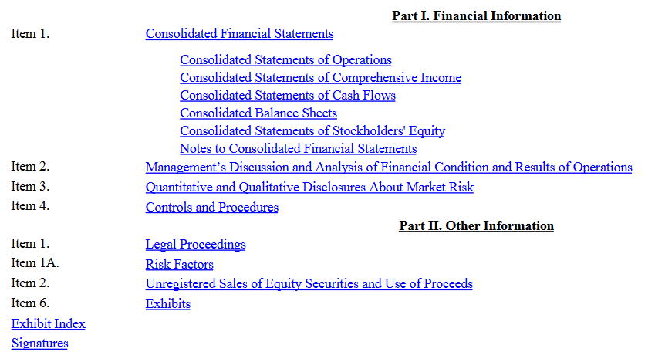
SEC filings: 10-K format vs. 10-Q format Canadian companies are not subject to strict formatting though content is similar as most Canadian companies have American investors – stmt. release procedure also different

Slide 3
What is Financial Statement Analysis (FSA)?
FSA has applications beyond equity security valuation to include general aspects of decision making involving financial decisions, such as: managing a commercial venture or corporate entity; assessing credit for lending; or auditing
In the context of equity security analysis, FSA involves the application of analytical tools and techniques to financial statements and the related data in order to derive measurements and relationships that are useful for determining the value of an equity security.

Slide 4
The Financial Statements
Recall the observation of GDC:
“All security analysis involves the analysis of financial statements”
Under US GAAP and IFRS, the accounting statements that are available for analysis are:
the balance sheet
the income (earnings) statement
the cash flow statement
the statement of stockholders’ equity.
In addition to these statements, there is also the management discussion and analysis, risk factors, notes to financial statements and other supplementary information.

Slide 5
The Great FSA Debate: Cash vs. Accruals
Accountants dedicate consider effort to specify accruals in order to provide a more accurate representation of company operations
Most important accruals include depreciation; deferred equity compensation; deferred tax; goodwill and goodwill impairment; estimated value of inventory, accounts receivable and payable
This leads to focus on earnings and forecasts of earnings as the key variable in equity security valuation
In opposition is the focus on cash generation which leads to focus the cash flow statement instead of the income statement and balance sheet (and equity statement) that are dependent on accruals

Slide 6
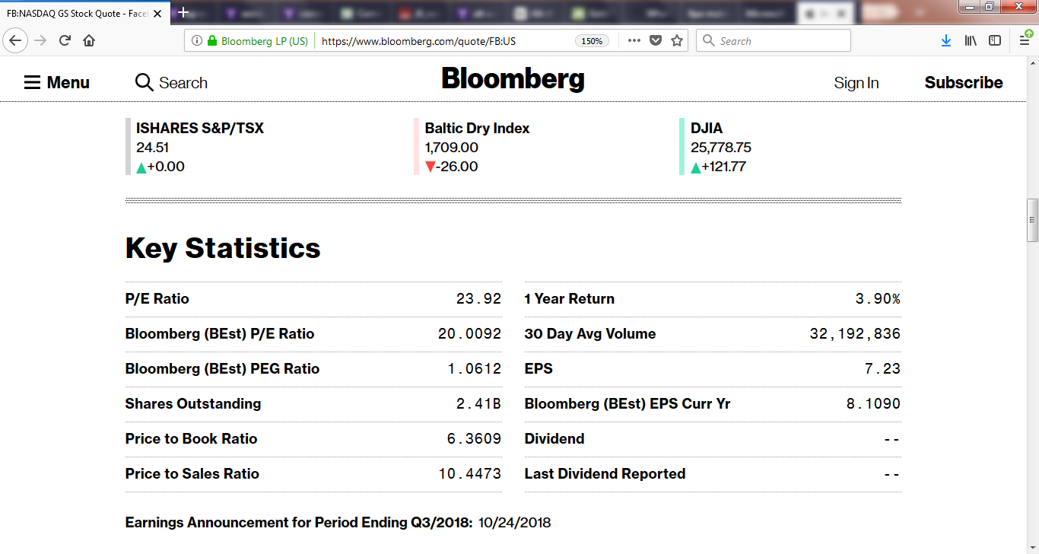
Illustration of influence of Accruals on Equity Valuation: Key Statistics from Bloomberg for Facebook (24/8/18)

Slide 7
Key to FSA: Reconciling Accruals with Cash
Failures of Accrual Statements and Cash Statements to accurately represent the status of firm operations are well known
Paying employees with deferred equity compensation will inflate cash from operations by lowering employee cash expenses
Depreciation can differ from the actual usage of assets
IFRS marking to market of asset value changes requires imprecise estimate
Book value of equity is impacted by share repurchases
Timing of revenue and expenses can impact cash flows
These shortcomings can be overcome by examining initially 1) the balance sheet, then 2) the income statement and finally using 3) the cash flow statement to interpret the relevance of the accruals in 1) and 2)

Slide 8
Financial Statement Analysis and the Presentation
The ‘Description of the Presentations Model’ on the class webpage has brief discussion of how to use the Balance Sheet, Income Statement and, especially, the Cash Flow Statement (other Financial statements) in the valuation of common stocks
The financial statements provide essential information about whether the ‘story’ of a company has validity → the ‘story’ is constructed from various qualitative and quantitative sources
The regulatory files, especially the Annual Report / 10-K, are essential sources of information

Slide 9
Accruals, Cash Flows and Financial Statements
The Financial Statements are an inter-connected picture of the company, all three statements need to be considered → the BALANCE SHEET AND EARNINGS STATEMENT HAVE MANY IMPORTANT ACCURAL ITEMS THAT COULD POSSIBLY DISTORT THE ACCURACY OF THE INFORMATION CONTAINED IN THE FINANCIAL STATEMENTS
There is an OVER-EMPHASIS in the financial press on EARNINGS which has many ACCRUALS (e.g., Depreciation) → essential to also consult the CASH FLOW STATEMENT to provide an accurate assessment of the impact of accruals on the other financial statements
The NOTES to the financial statements need to be investigated when there are large items that impact a financial statement

Slide 10
ESSENTIAL INFO FOR FSA (see also Lecture 10)
Academic Finance is concerned with the search for homogeneity – factors that are common across firms (e.g., CAPM) → diversification reduces firm specific risk
In seeking securities that will outperform, equity security analysis aims to identify sources of heterogeneity – factors related to firm specific risk → each firm (even those in the same sector) is distinct from others
The best that can be expected are rules of thumb to identify what FSA features to consider for a given firm

Slide 11
Essential Information in the MD&A (Items 7 in 10-K)
Financial Statements provide an overview of company performance → detailed insights into the interpretation of the statements by management is provided in MD&A
If the story and financial statements support further investigation, examination of the MD&A is an essential next step
Examples of overview inferences from MD&A
Goldman-Sachs merging Item 7 and 7A
Southwest Airlines highlighting risk management of jet fuel risk
Apple providing breakdown by geography and product group
Microsoft providing breakdown by product group
REITs providing information on tenant exposures and cost and location of projects under development
Pipelines providing breakdown of projects under development
Mining companies providing breakdown by mine type and location

Slide 12
Making Sense of the Balance Sheet
Balance Sheet captures the essence of double entry bookkeeping → provides the accounting definition of equity
Assets = Liabilities + Equity (Net Worth)
Problem: Balance Sheet Equity is an accrual number → it usually is difficult to have a ‘market value’ balance sheet estimate → NAV valuation for REITs; Airline valuations (discounts/premiums)

Slide 13
Home Depot 10-K: Riddled with accruals. Items to notice in Assets: 1) cash / per share (# from equity account); 2) amount of goodwill – indicator of acquisitions role in business growth; 3) ratio of payables to receivables as indicator of retailing model strength; 4) inventory accumulation or reduction; 5) amount of PPE relative to income generation as measure of ‘economic goodwill’; 6) method of valuing inventories and AR (usually in notes

Slide 14
Liabilities + Equity: Liability items are less impacted by accrual assumptions → Key takeaway from Home Depot Negative Equity (2020) due to share repurchase; switching back to leveraging up (2021) and building up of cash

Slide 15
A few rules of thumb for the Balance Sheet
Cash (+ near cash + possibly long term portfolio) per share relative to share price
Ratio of accounts payable to receivables
Quick look at the Cash Conversion Cyce
Equity and share repurchase or RE
Amount of PPE and depreciation accrual
Goodwill + Intangibles (as a measure of acquisitions to fund growth) → impairments
Compositions and evolution of debt and other liabilities

Slide 16
A Few Balance Sheet Items to Ponder
Are leases relevant?
Amazon, Free Cash Flow and Leases
Amazon emphasizes FCF which will be increased using leases vs. direct purchase of assets
Operating Leases vs. Financial Leases
Lack of 10K transparency on what these leases are and how the leases are sourced
IFRS vs. FASB lease accounting rules
The relevance of off-balance sheet liabilities
The Importance of Deferred Revenue (Liability)
Zoom Video Communications
Revenue arising from payment for services that will be delivered in the future

Slide 17
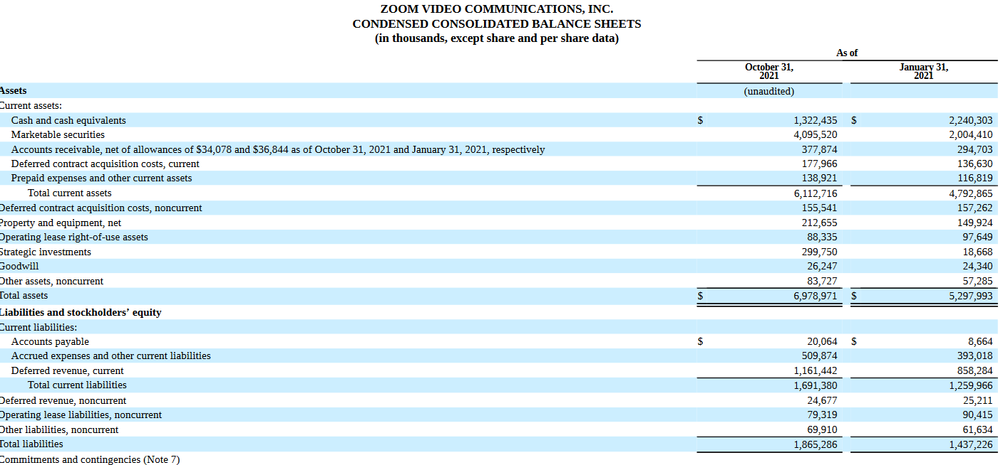

Slide 18
Income Statement: The Top Lines for Tesla in 21-Q2 Rapid acceleration of Auto Revenues; Slight increase in gross margin

Slide 19
Income Statement: The Top Lines for Shopify in 21-Q2 Rapid acceleration of Revenues; Slight increase in gross margin + Other Income

Slide 20
Income Statement: Before the Bottom Line Mark to Market Accounting, IASB, REITs

Slide 21
Making Sense of Earnings: REITs
Previous slide for Boardwalk REIT, Canadian REITs file financial statements using IASB where fair value gains and losses (changes in market value of properties) are recorded on the income statement
The treatment of fair value gains and losses differ from the treatment under FASB where assets are carried at book value and gains (losses) are realized only when the asset is sold (the realization principle that is applicable to personal income taxation)

Slide 22
Gains (losses) realized on sale of asset under FASB

Slide 23
Relevance of the Cash Flow Statement
The cash flow statement is based on the following identity:
Change in Cash = Cash from Operations +
Cash from Investing Activities +
Cash from Financing Activities
Though it might seem that the change in cash (a balance sheet item) is only an incidental item for most valuations, it is the process of arriving at the change (knocking out accruals) that is important. By collecting items according to function, the activities of the firm reflected in the accounting statements containing accruals (Balance Sheet and Income Statement) becomes more transparent.

Slide 24
Basics of the cash flow statement
The cash flow statement has essential information about how the cash generated by operations net of cash used in investing activities (capital expenditures, purchases and sales of investment assets, acquisitions and dispositions) is distributed to shareholders as dividends, share buybacks and issuance both to the market and from executive and employee option exercise, repayment and issuance of debt
Companies are heterogeneous → the financial statements for each need to be examined and interpreted relative to the story in order to determine a heuristic valuation

Slide 25
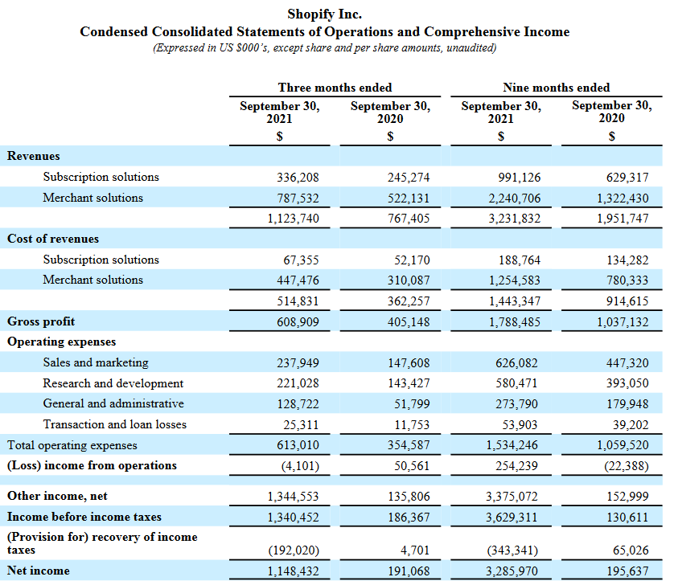
Income and Cash from Operations: Shopify

Slide 26
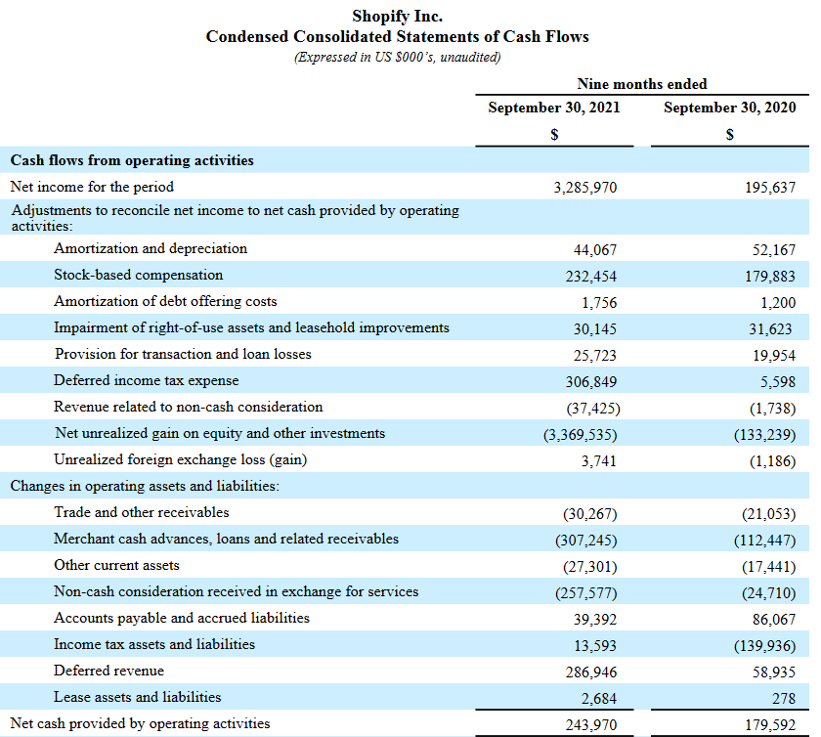
Accrual from Affirm and Global-e

Slide 27
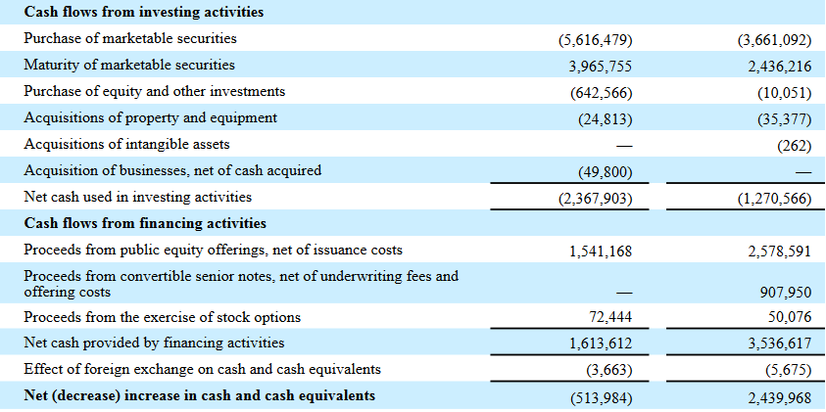
Shopify: Investing and Financing Activities – active issuance of additional equity

Slide 28
Detailing the Shopify unrealized gains at Q3-21
In July 2020, Shopify entered a partnership with on-line lender Affirm Holdings Inc. making Affirm the exclusive provider of ‘buy now, pay later’ point-of-sale Shop Pay Installments. In exchange for allowing Affirm “to significantly expand the number of merchants and consumers on their platform’, Affirm granted Shopify warrants to purchase up to 20.3 Affirm shares at a penny each.
Affirm IPO in Jan 2021 (at $49) quickly trading over $100 making over a $2B gain for Shopify
Shopify also participated in the May 2021 IPO for Global-e a cross border e-commerce platform
Shopify purchase 7.75 million IPO shares about $24 plus warrants for another 11.4 million shares (12/27/21 trading above $60)

Slide 29
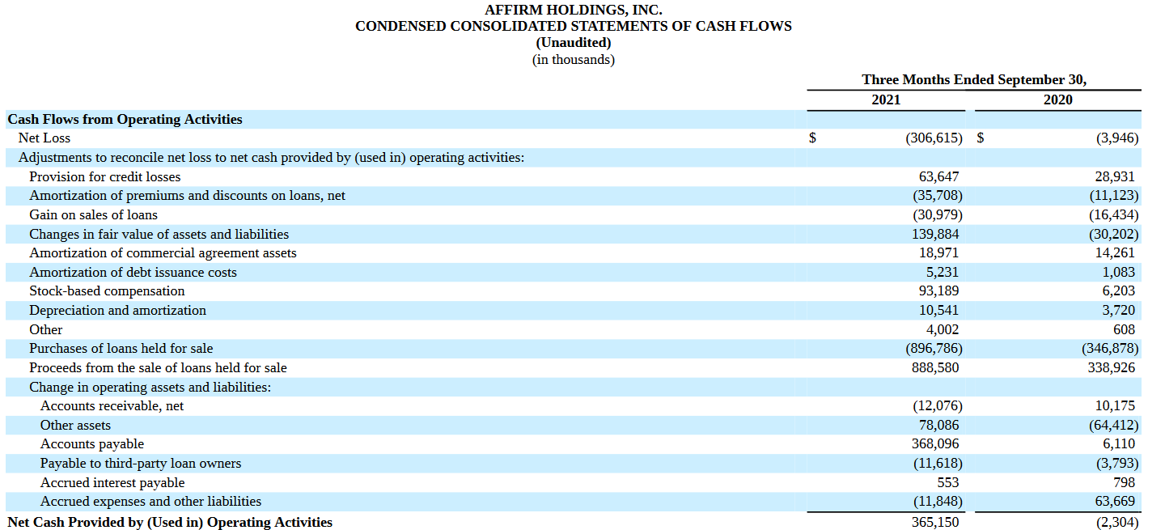
Despite the large negative reported loss for Affirm, cash from operations is positive → this change is driven largely by two accruals: accounts payable and fair value change. Are these accruals materially impactful?

Slide 30
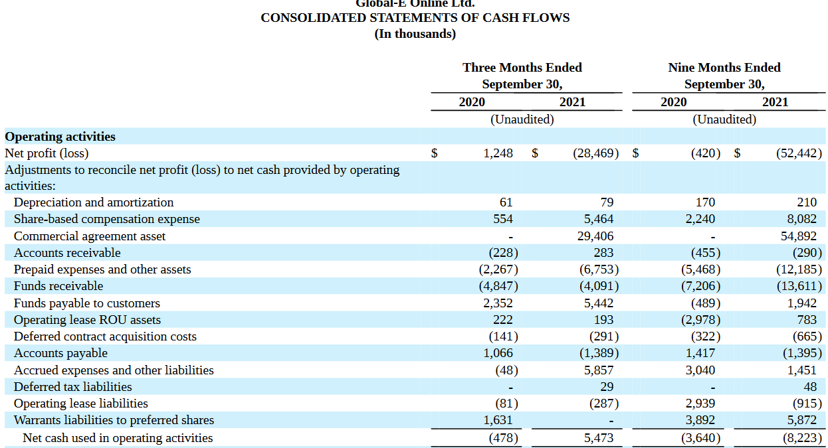
Global-e (UK company) is not much better: (Financial info below from the 6K SEC filing for fgn. Issuers)

Slide 31
Complicated Accounting: Cost of Netflix Revenue
The primary source of Netflix revenue is monthly membership fees (reported net of tax)
Netflix earns more revenue outside North America
Europe generates almost as much revenue as NA
Complications in determining net income arise in calculating the cost of revenue
Netflix acquires, licenses and produces content → what is the value of such assets? Once the title is received and available for viewing, cost is recorded as an asset and available for amortization (see link of class webpage)
Production of content requires agreements involving future obligations to make payments → these obligations are recorded as liabilities.

Slide 32
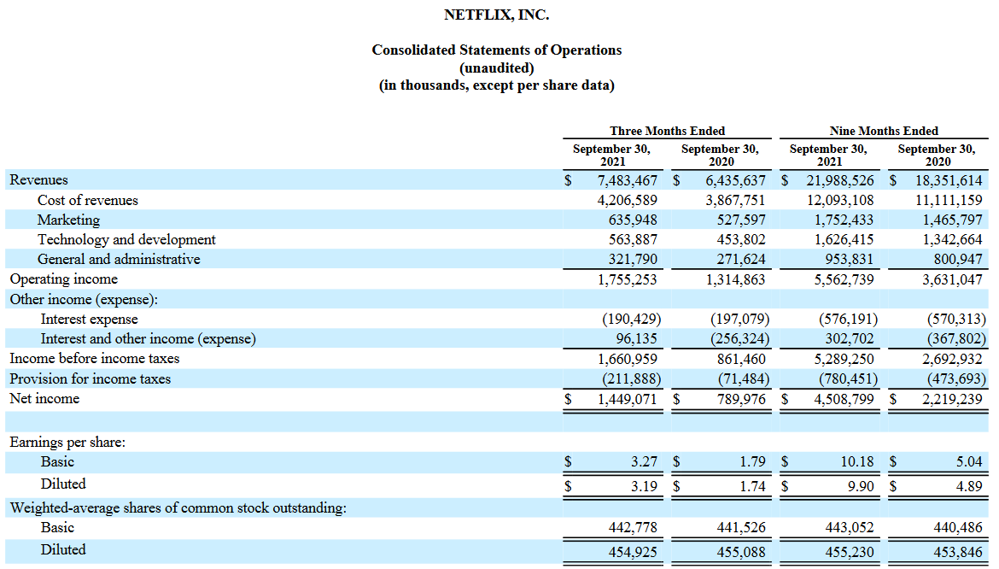
Income and Cash from Operations: Netflix

Slide 33
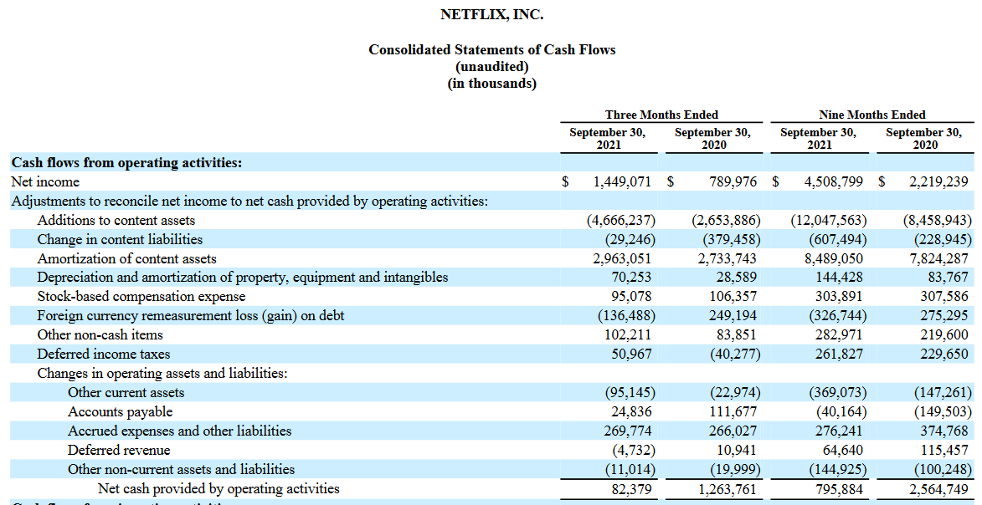
Cash and Accrual Accounting for Netflix (Note: drop in CFO partially due to cost of production having to be made despite delay in production due to COVID

Slide 34
Information in Cash from Investing Activities
Key Items in Cash from Investing Activities
Purchase of Property, Plant and Equipment (PPE)
Capital Expenditure can be roughly divided into two types: Sustaining Cap-Ex and Growth Cap-Ex
Sustaining is expenditure required to maintain (possibly improve?) the capital stock that is in place
Growth Cap-Ex is new additions to PPE (sometimes reported as acquisitions of plant and equipment)
Acquisitions and Dispositions of Assets
Other businesses (usually reported net of cash)
Intangible assets
Transactions in marketable securities
Maturity and Purchase of marketable securities
Difference can be an important source of financing
Purchase of equity and other investments

Slide 35
Cash from Financing Activities: Raising or Distributing?
Key Items in Cash from Financing Activities
Proceeds from equity offerings
May combine both equity award exercise and new issues
Repurchases of Common
An important theme for many profitable companies → what fraction of cash from operations is being allocated to repurchases
Dividend payments and equivalents
Proceeds from Debt Issues
Repayments of Debt
Items related to exercise of equity awards
Often identifiable via ‘Tax payments for equity awards item’
May need to examine the relevant item in the Notes to determine the amount of exercises

Slide 36

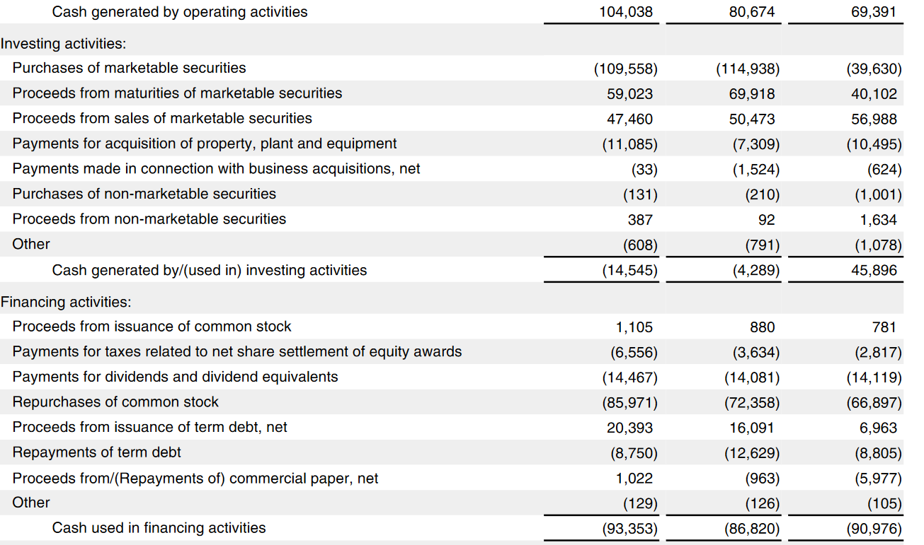
Apple 2021 10K : Distributing Cash to Shareholders

Slide 37
Accounting Implications of Share Repurchases
The immediate implication of the cost method for share repurchases is the reduction in the equity account
The par method for share purchase accounting that impacts paid in capital is not used as often as the cost method
The offsetting balance sheet reduction in the equity account is a reduction in cash → this feeds into the ‘share repurchase’ item in cash flow statement financing activities
There is an indirect implication for E = Div + RE that follows because the decision to repurchase shares instead of paying dividends will increase RE that provides the cash to finance the share repurchase
What are the accounting implications of other methods for returning profits to shareholders???

Slide 38

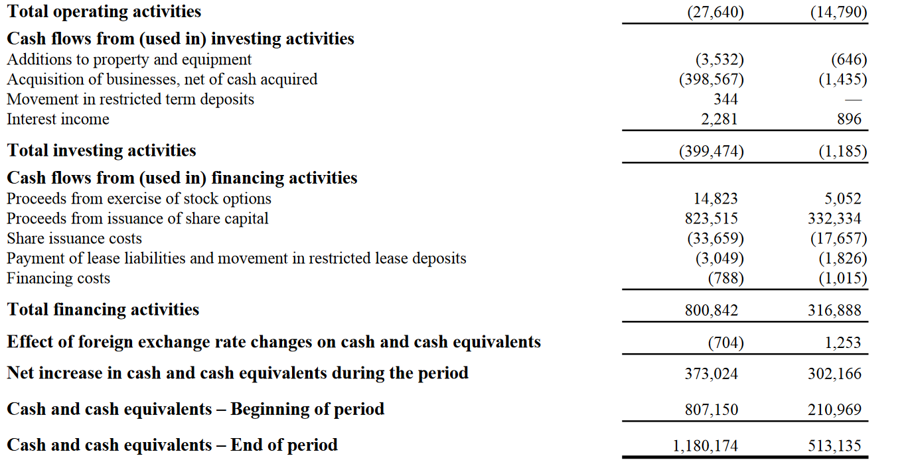
Lightspeed Commerce Inc. – “one-stop commerce platform” acquired cloud-based retailer Vend

Slide 39
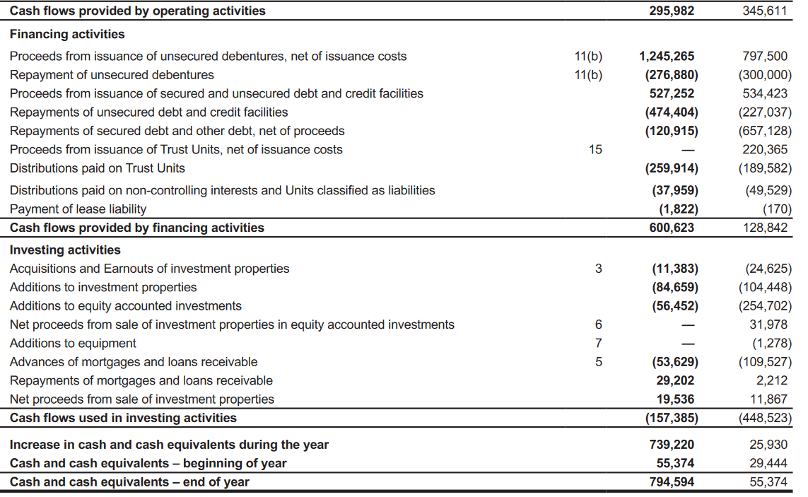
Smart REIT: Relationship between CFO and Distributions

Slide 40
Exploring the Notes
Notes are an integral part of the financial statements
Importance of specific notes depends on company
Unlike the structured ‘Item’ format of the 10-K, there is some flexibility in the ordering of the Notes
Key items
Statement of significant accounting principles and policies
Accounting presentations depend on ‘classificatory decisions’ and recent changes to accounting principles
Goodwill and Intangibles
Fair Value calculations
Stock based compensation and equity awards
Derivative Securities and Risk Management
Details of debt issues and Leases
PPE details

Slide 41
Some Example Companies: Toll Bros. + Methanex
On class webpage see MX-TOL_12-3.zip files
Others .zip files have information for earlier selected years
TOLL Bros. Is a luxury home builder in the US (www.tollbros.com)
Home builders were a central feature of the US housing market collapse/financial crisis in 2008-9
In the 26 year .pdf in 2012 file examine the acceleration and collapse of various important numbers → examine the cash flow statement in 2005-6 .zip file to identify the impact of the inventory accrual
Methanex (locally headquartered) is the world’s largest producer and supplier of methanol (www.methanex.com)
Annual report is in the 11-10 .zip file
Examine the impact on Methanex of changes in the price of methanol (obtainable for company webpage) and commissioning / decommissioning of plants around the world
The 2012 file illustrates how quarterly earnings announcements are made in Canada vs. 10-Q release in US.

Slide 42
Toll Bros. is an illustration of the divergence between accruals and cash numbers associated with inventory valuation in real estate construction (US GAAP) – inventory value is an estimate for what properties available for sale are worth – if the real estate market collapses, the value of inventory is written down with associated implications for income (and indirectly revenue generation)

Slide 43
The cash flow implications of accruals: luxury builder

Slide 44
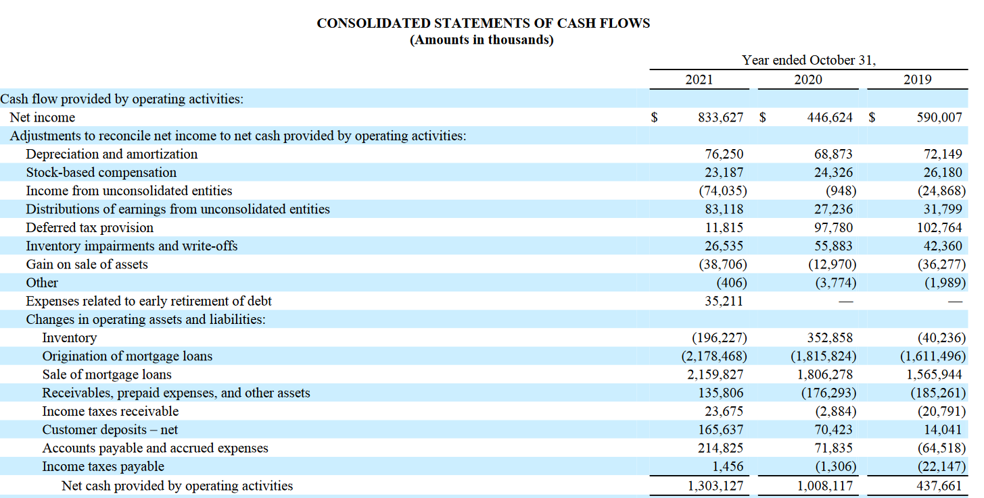
Toll Bros. CFO from 2021 10K (27/12/21 P/E = 10.6)

Slide 45
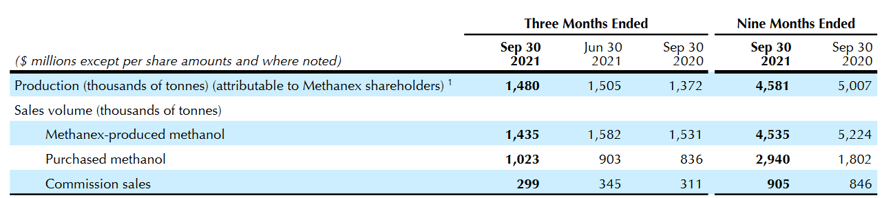
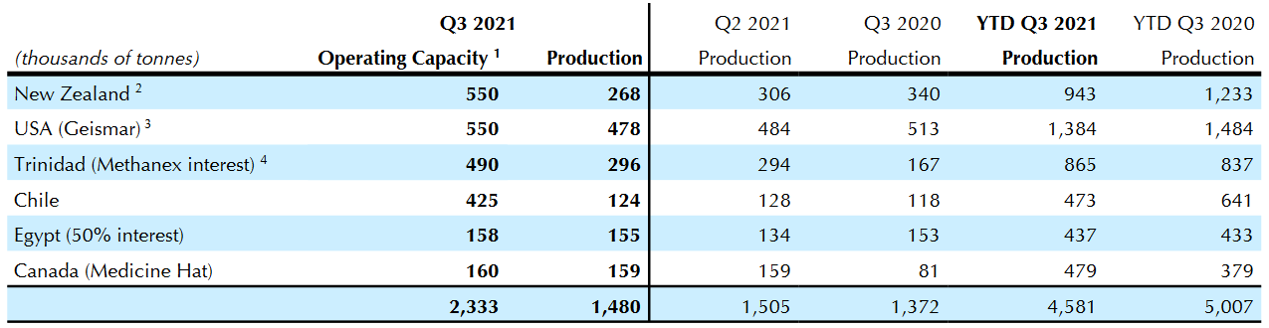
Methanex: Commodity Pricing and Processing Profits (27/12/21 P/E = 12.9
Methanex is the world’s largest producer and supplier of methanol

Slide 47
Methanex strategy is based around liquifying natural gas in locales where the gas is stranded, e.g., Chile, Trinidad, or there is a large excess supply. Methanol is used in anti-freeze, as a solvent, component of formaldehyde and as a fuel component

Slide 48
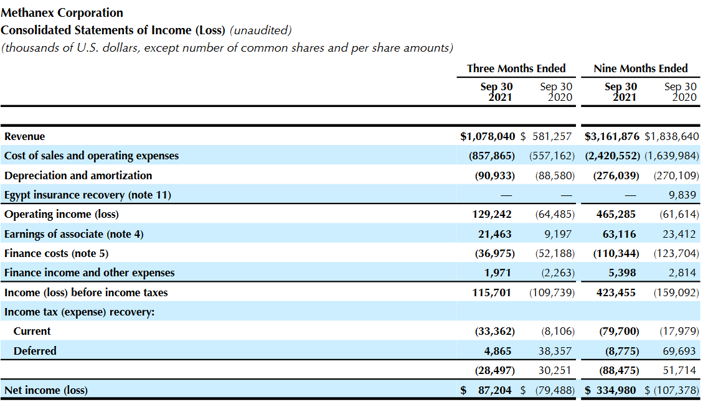
Methanex Income Statement Q3-21

