Slide 1
Lecture 8 Valuation Models for Stock Prices
Cash Flow Models of Equity Valuation.
Dividend Discount Models
Accrual Discount Models
Determining the Value Drivers
Cases in Valuation Model Analysis
Reading: SAIS, sec. 8.1, 8.2 and 8.3 and Case Downloads from the Class Webpage (see last slides in this lecture)

Slide 2
Connection to Final Exam Question
ii) “The search for the 'correct' way to value common stocks, or even one that works, has occupied a huge amount of effort over a long period of time....the implementation of a system to selectively value or select common stocks is a difficult task. This is a task that a valuation model purports to accomplish.”
Describe the discounted dividend cash flow valuation models conventionally used to analyse common stocks. How do these models differ from valuation models that discount cash flows other than dividends? What are some important limitations of using accounting data to implement discounted cash flow valuation?
It is commonplace to hear that discounted cash flow (DCF) models are the appropriate way to value common stocks – in the context of value investing, DCF has been proposed as the way to estimate ‘intrinsic value’. This lecture covers these models and the connection to using accounting data for stock valuation.
It is doubtful that such models can do any more than provide some structure to a stock valuation. As the quote recognizes, stock valuation is ‘a difficult task’ – too difficult in many cases for a formula to capture.

Slide 3
Basics of Discounted Cash Flow Valuation
The basic models can be specified as:
Key issues:
What is the relevant cash flow variable?
What is the terminal cash flow?
How to get the discount rate?
NOTE: For an equity security all of the rhs variables are unknown on the valuation date t = 0.

Slide 4
History of Discounted Cash Flow (DCF) Models
Origins of DCF models for security valuation can be found in John Burr Williams The Theory of Investment Value (1938).
The present value for a business or a security, such as a stock or bond, can be determined by discounting the future stream of expected cash inflows minus expected cash outflows at the appropriate rate of interest.
The basic DCF model was adapted and expanded in the DDM of Gordon (1962)
valuation of companies in regulated industries was a central concern.
the constant growth version of the discounted dividend model is often referred to as the ‘Gordon growth model’

Slide 5
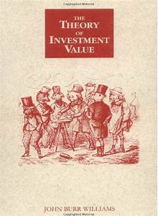
Who was John Burr Williams (1900-1989)?
Williams is credited with being an early proponent of using discounted cash flow to estimate the ‘intrinsic value’ of a stock.
This represented a more theoretical and mathematical approach to ‘intrinsic value’ than the relatively heuristic notions previously available.
Williams was a long time student at Harvard and the Theory of Investment Value was his Harvard PhD thesis in Economics
Williams worked as a securities analyst and sometime professor.

Slide 6
J.B. Williams DCF model was not new. Previous writers such as Macaulay (1938) questioned the application of DCF to value common stocks
The ‘assumption of payment’, which must be made before the promised or ‘hypothetical’ yield of a bond can be calculated ... may, as we have seen, be a mere mathematical fiction for all except the highest grade of bonds. But, for common stocks it is not only a mathematical fiction but also an economic absurdity. Even if the chance that the promises contained in a bond will be kept is negligibly small that the promises are little more than mere words, they are at least definite words and, as such, can stand the strain of mathematical manipulation.

Slide 7
Macaulay (1938) The Movement of Interest Rates, Bonds, Yields and Stock Prices in the United States since 1865 was a monumental NBER study. On k = g in the Gordon DDM model, Macaulay observed:
If … the dividend payments were to increase in geometric progression … One of the strangest rationalizations of unending price rise that appeared in the months immediately preceding the stock market culmination of 1929 was evolved by a Wall Street economist. He presented to the directors of the investment trust … statistical evidence that the wealth of the country increased in the long run about 3 per cent per annum. He then argued that corporations as a class should be expected to share in this growth at this rate and hence that their dividends should be expected, over the long run, to increase at least 3 per cent per annum; that is to say in such a series as $4.12, $4.24, $4.37, etc., or $4(1.03), $4(1.03)², $4(1.03)³, etc. He then suggested that … these future dividends would eventually be discounted at a rate that would not exceed 3 per cent per annum. But, he continued, if distant enough payments were assumed, discounting them at this rate would give very high prices for the stocks. The suggestion was even made that, as there seemed to be no necessary time limit to the 3 per cent rate of growth in wealth, there should logically be no ‘ceiling’ whatever for stock prices. The phantasy was strangely reminiscent of the Petersburg Paradox in the mathematical theory of probability.

Slide 8
Narrow vs. Broad Dividends
Initial conception of the dividend DCF models were developed for high cash payout securities
Gordon focused on US utility stocks where the cash payout was determined by state/federal rate setting bodies that set utility rates for private companies
More recently, share buyback programs have been replacing high cash payout
narrow dividends are just cash dividend payout while broad dividends include both buybacks and cash dividends
See three files in 417_lecture8.zip on growth of share repurchases

Slide 9
Narrow and Broad Dividends for Pfizer (from 10-K)

Slide 13
Basic DCF model: The DDM
Dividend Discount Model (DDM): Assume that the future is known with certainty and that perfect market assumptions apply.
No taxes and the term structure of discount rates is flat.
Assumes dividends are source of security cash flow
Assume that the stock to be valued is purchased at price P(0) and held for one period and then sold, the dividend to be received in the next period is Div(1)) and the price received from selling the stock is P(1)

Slide 14
Solving for the Infinite Horizon DDM
Notice the essential role of a simplified firm with ‘clean surplus’ – no share repurchases, only dividends
Accounting for randomness in the future cash flows by taking expectations conditional on information available at t=0, the infinite horizon DDM is derived by making a progressive substitution for prices:

Slide 15
Applying the DDM: Preferred Stock Valuation
Preferred Stocks
Rationales for preferred stock issuance
Role of Basel III for banks
Debt surrogates for corporations
Low credits and non-bank financials
Assume that Div(t) is fixed at Div* ( g = 0 )
Apply the perpetual pricing model
P(t) = Div* / k
Valuation for preferred shares involves comparison of the dividend yield (similar to traditional yield spread analysis)

Slide 16
Preferred Share Features
Fixed rate vs. Rate Reset
The reset rate can vary according to the length of time between reset dates and the reference rate used for the reset
See Enbridge Examples → see CIBC ‘Canadian preferred shares’ report in link to CIBC report on class webpage
www.prefinfo.com (Hymas Investments) also has details of Cdn. Pref. shares
Retractable vs. Redeemable
Redeemable preferred shares, also known as callable preferred shares, allows the issuer to buy back the (perpetual) preferred stock at a fixed (call) price
Terms and conditions depend on the prospectus
Retractable preferred shares are issued with a maturity date when the company can force the shareholders to redeem shares for a fixed payment
Terms and conditions depend on the prospectus, the retraction may be an exchange for common shares (not necessarily a cash price).

Slide 17
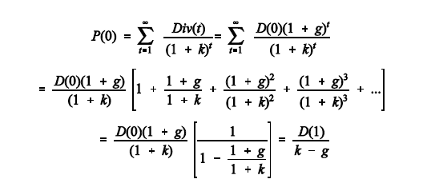
The Gordon Growth Model
The Gordon growth model (growing perpetuity)
Assume the dividend changes over time according to the assumption: D(t+1) = D(t)(1 + g), where g is the assumed constant growth rate in dividends.

Slide 18
Examples of Applying the Formula
SAIS, p.428-33, examines examples from Damodaran (1994)
How is k estimated?
How is g estimated?
How is D(1) estimated?
What types of companies are examined?
Exercise: use Gordon model to value BUD, GE and BCE

Slide 19
From Dividends to Earnings
Dividends are problematic as a model for determining stock prices as the limited variation in dividend payout does not correspond to the substantial variation in stock prices → transition to an earnings model
Assume constant dividend payout b E(t) = Div(t)
It follows that the constant dividend payout of the Gordon model translates to earnings
b E(t+1) = Div(t+1) = Div(t) (1+g) = b E(t) (1+g)
Constant dividend growth with constant dividend payout translates the substitution of earnings (which has more substantial variation than dividends) in the Gordon Growth model → P(0) = (b E(1)) / (k - g)
Damodaran estimates k using CAPM and g from past growth rates

Slide 20
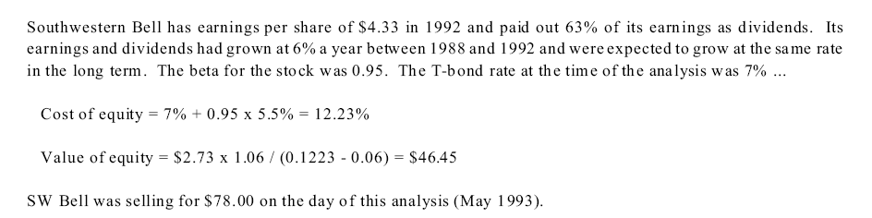
Damodaran on Simplified DDM Valuation: Substituting Earnings g for Dividends g

Slide 21
Calculating the g and k
Estimating g by converting the problematic dividend growth assumption to earnings growth requires assuming a constant dividend payout ratio (b)
Damodaran estimates the g from the previous 5 years of earnings → more realistic to take use the observed stock price and use the formula to provide an implied growth rate estimate → this can be used to interpret P/E
Earnings are an accrual measure that might not represent the underlying cash flows → possible to interpret b as a broad dividend
How to interpret g?
Estimating k using the CAPM requires R_{F} as the long term bond rate, Damodaran estimates β (somehow?) with geometric equity risk premium (E[R_{M}] – R_{F} ) estimated from 1925 to 1992
Is this the best way to get k?

Slide 22
Two more Damodaran Examples: Exxon, Dresdner

Slide 23
Using Accruals for the Cash Flow: The Residual Income Model
This model exploits the clean surplus relationship:
BV(t) = BV(t-1) + E(t) - D(t) = BV(t-1) + RE(t)
D(t) = E(t) – ΔBV → E(t) = D(t) + RE(t)
Clean surplus does not apply with share repurchases or other manipulations of the equity account
The clean surplus equation is substituted into the general DCF model to obtain (AE is ‘abnormal earnings’, i.e., return on equity in excess of cost of capital):

Slide 24
Some Basic Residual Income Calculations
ROE(t) = E(t) / BV(t-1)
ROE (return on equity) is an accrual measure
This is not a cash measure
k = ΔBV / BV(t-1)
This is an interpretation for k that differs from the CAPM interpretation of the Gordon DDM
‘Return on equity in excess of cost of capital’ interpretation of the residual income model needs to be in an accounting, not economic, sense

Slide 25
Interpreting Return on Equity
Examine the numerator of the residual income model
(ROE(t) – k) BV(t-1)
This variable depends on the accrual relationship between earnings and the change in book value → importance of clean surplus
The ROE can be expressed in value driver format (Table 8.10, p.467):

Slide 26
P / BV, ROE and P / E
Conventional measures of relative valuation are Price to Book Value (P/BV), Price to Earnings (P/E) and Return on Equity (ROE)
Given any two the other is given
Assume Net Income and Earnings are the same:
ROE = E / BV
P/E = (P / BV) ÷ (E / BV)
This holds for aggregate and per share values

Slide 27
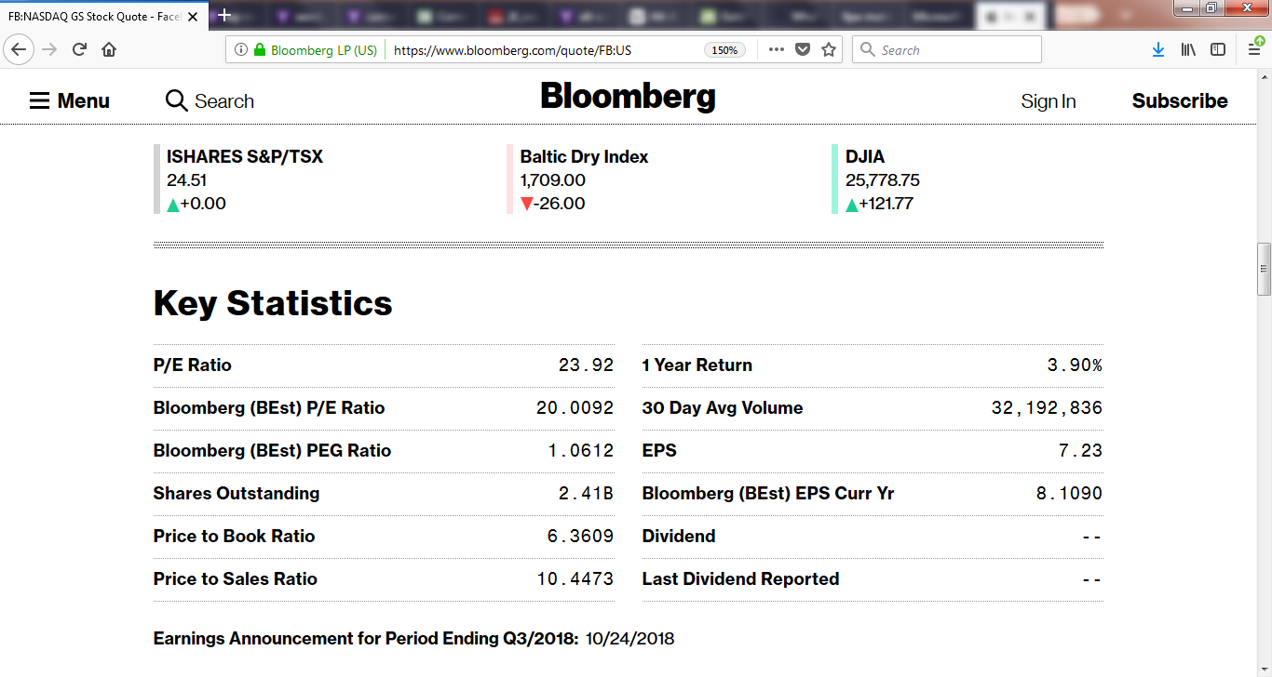
Key Statistics from Bloomberg for Facebook (24/8/18)

Slide 28
Different Forms of the P/E Ratio
The P/E ratio is a key valuation measure for practicing security analysts
Letting b represent the dividend payout ratio (Div(t) / E(t)), i.e., b E(t) = Div(t), in the Gordon model the P/E ratio can be solved as:
Observe what the P/E is when g = 0 (no growth) and b = 1 (full earnings payout to dividends)

Slide 29
Interpreting the P/E ratio
For a preferred stock E = Div., b = 1, g = 0
It follows that P/E = 1/k* → this k* provides a low bound for the k associated with common stock
Consider a stock that may or may not pay narrow dividends (ND) and needs to allocate a constant fraction of cash flow to sustain the growth of earnings (or alternatively, cash from operations) at g and returns the remainder (BD) to shareholders (as share buybacks, dividends, debt paydown, increased asset purchases to fund increased future g)
To make sense of this BDDM version, i.e., k > g, the observed P/E implies k from the CAPM imposes an implied estimate about the E[R_{i} ] and β for that stock
E.g., b = .8 P/E = 35 g = 10% → k = 12.5%
Increasing g = 25% k = 27.5%

Slide 30
Scenarios for k in BDDM given g & b & P/E *
P/E 5 20 50
b .8 g = .25 k = 45% k = 30% k = 27%
g = .05 k = 22% k = 9.2% k = 6.7%
g = -.05 k = 10% k = -1.2% k = -3.5%
b .5 g = .25 k = 37.5% k = 28% k = 26%
g = .05 k = 15.5% k = 7.6% k = 6.1%
g = -.05 k = 4.5% k = -2.6% k = -4%
b .2 g = .25 k = 30% k = 26.3% k = 25.5%
g = .05 k = 9.2% k = 6.1% k = 5.4%
g = -.05 k = -1.2% k = -4% k = -4.6%
b -.05 g = .25 k = 23.8% k = 24.7% k = 24.9%
g = .05 k = 4% k = 4.7% k = 4.9%
g = -.05 k = -5.9% k = -5.2% k = -5.1%
* What happens as b → 0? (k → g why?)

Slide 31
P/E Ratio for the AE Model
The Residual Income Model can also be solved for a P/E ratio (after some manipulation)
Recalling that the definition for AE(t) requires, k BV(t-1) = E(t) - AE(t):

Slide 32

The PEG Ratio
The “PEG” ratio, or P/E to growth rate ratio:
sometimes used as a crude rule of thumb to determine under/over valuation for a common stock.
For example, if the PEG ratio is less than one then the stock is undervalued because the ‘cost of growth’ as measured by the P/E is less than the actual growth.
Problems with the PEG → based on accrual # (earnings) and does not investigate sources of and future prospects for growth
In terms of the AE model:

Slide 34
Earnings, Free Cash Flow and EVA
What is the appropriate ‘cash flow’ to discount in the DCF model?
‘economic free cash flow’ (Buffett)
net cash flow
free cash flow
EVA
Higgins (1998, p.19) observes:
“So many conflicting definitions of cash flow exist today that the term has almost lost meaning”

Slide 35
Free Cash Flow to Equity Model
The free cash flow to equity model (FCFE) aims to measure the return to equity above the amount required to: maintain existing production levels; or, alternatively, to keep the firm on a particular growth path.
Adjustments for payment to debt can create conceptual problems
As with PEG, FCFE is an accrual number; Difficult to estimate future values of FCFE
Much the same manipulations as for the models using dividends can be applied to this model (see sec. 8.3):

Slide 36
Free Cash Flow (FCF), A Non-GAAP measure
Various methods are suggested for FCF
Free Cash Flow to the Firm (FCFF)
Free Cash Flow to Equity (FCFE)
Could be calculated from Income Statement or Cash Flow Statement
Basic Idea is to provide a measure of Economic ‘Profit’
‘Simple FCFF’, determined from the Cash Flow Statement: FCFF = CFO – Cap. Ex.
‘Adjusted Simple FCFF’: Simple FCFF – Div.

Slide 37
Inter Pipeline, Annual Report 2017

Slide 38
Other Suggestions for FCF
FCFF = EBIT(1 - Tax rate) + Depreciation - Capital Expenditures ± Δ Net Working Capital
Mix of Income Statement and Cash Flow Statement and Balance Sheet
FCFE = Net Income + Depreciation - Capital expenditures - Δ Net Working Capital - Debt principal repayments + Proceeds of New Debt Issues
Calculations from Cash Flow Statement
Note the potentially important impact of adjustments to Debt on FCFE

Slide 39
What is working capital?
Working Capital (WC) is a Balance Sheet Item
Working Capital = Current Assets – Current Liabilities
WC is often interpreted as a liquidity measure
Key Current Assets usually are Cash and Marketable Securities
Inventories
Accounts Receivable
Key Current Liabilities usually are
Accounts payable
Short Term Borrowing
Accrued Liabilities

Slide 42
What is a Value Driver?
For equity securities, the key part of the DCF valuation is the determining the numerator
A value driver is a factor that has a significant impact on the level and change of the cash flow that drives equity security value.
Value drivers are essential items that need to be identified in constructing the ‘story’ about a company, e.g., Apple and iPhone demand
Two key dimensions to value drivers:
profitability
growth

Slide 43
The Story: COS Syncrude Valuation
Canadian Oil Sands (COS.UN) was a unit trust with ownership in Syncrude as the sole income producing asset. The company was formed in 2001 by the merger of two previous entities resulting in a non-operating entity with 21.7% ownership of the Syncrude oil sands project.
The Syncrude oil sands project involves surface mining of oil with an alternative technology
In Feb. 2003 COS announced the intention to buy 10% of Syncrude from Encana
Problem to assess whether fair value was paid for the purchase
COS was purchased by Suncor in 2016
Suncor was one of the partners in the Syncrude project

Slide 44
What is a ‘unit trust’?
Common stocks arising from limited liability corporations (LLC) are one of a number of different methods of creating tradeable equity claims
Other methods include limited liability partnerships (LLP) and limited corporations (LC)
Key point: Different forms of organization have different tax implications
In the LLC taxes on profits are paid the firm level with dividend payments receiving favorable personal income tax treatment
A unit trust has a ‘flow through’ tax structure where the payment to unit holders are treated like debt payments, deductible at the firm level, with tax implications passing to unit holders at full personal income tax rates
Unit trusts have theoretical unlimited liability
Tax treatment is similar to limited partners in LLP

Slide 45
Problems? A DCF for Canadian Oil Sands
The DCF was conducted by a professional engineering firm to value the initial COS unit trust issue. A number were required: SSB prices off WTI (US$), gas is used to heat the slurry

Slide 46
Result of the DCF with escalating costs and prices

Slide 47
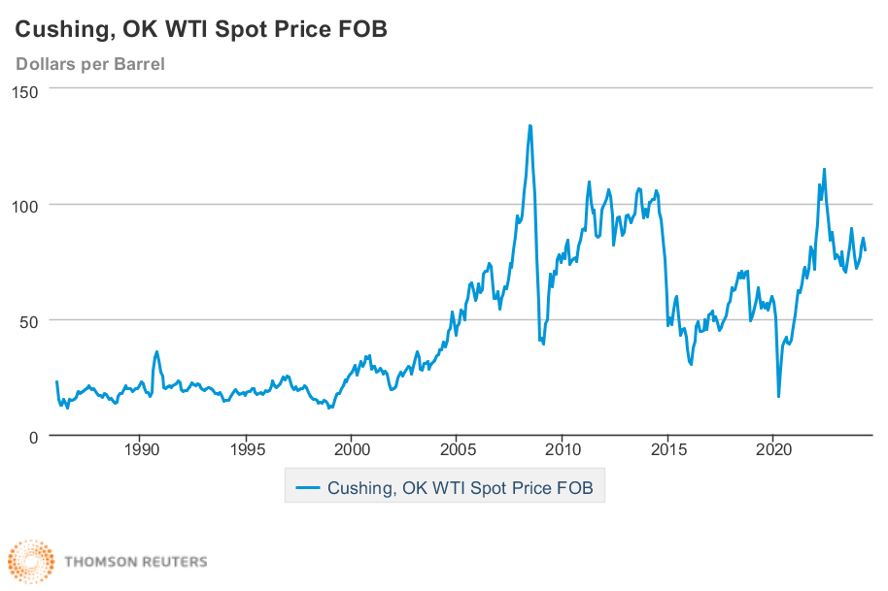
Compare the predictions with actual future price performance
Oil price prediction here

Slide 48
Calculating the DCF for the Combined entities
Even a relatively simple valuation scenario associated with the non-operating COS, the validity of the results is problematic, e.g., in 2012 the Canadian dollar was near par and the WTI price was close to $100 → breakeven market value of COS based on this DCF was consistent with a 12% discount rate

Slide 49
Possible DDM: Anheuser-Busch (BUD)
GDC (p.437) observe: “in practice, we find that the more a company’s results are subject to fluctuation, the less predictable becomes the future average. Thus the best industries for valuation are those which do not show large profit declines in periods of recession.”
Beer industry provides an excellent of a company with stable cash flows
Not all brewers have this characteristic
Important breweries are owned by companies that produce many beers in different countries, AB InBev + SABMiller
The key element in any security valuation is the price.

Slide 50
Story of the Beer Industry
Beer Industry has changed dramatically since the Belgian brewery Interbrew acquired Labatts in 1995
What followed was a global acquisition of breweries in many countries
Key Acquisitions
Beck’s (German) 2001
2004 major Latin American brewer Ambev merges with Interbrew to form Inbev
2008 InBev acquires the largest US brewer Anheuser-Busch (Budweiser) to form AB Inbev
2015 acquires second largest global brewer SABMiller
Going back to Ambev, AB Inbev has dedicated considerable effort to non-brew liquids expansion

Slide 51
Problems? Delta Airlines (DAL)
Airlines are a favorite example used by Buffett to describe ‘growth without profits’
After years of critiquing airlines, B-H did invest in Delta and Southwest
Valuation of major US airlines after 9/11 are an excellent example of companies on the fast track to bankruptcy → American vs. United price history
Prior to 9/11Delta was the strongest of the hub-airline majors.
Need to assess the competition with Southwest in conjunction with the 9/11 shock

