Slide 1
By Vincent Chen
Hong Zhou (Bibby) Tang
Shabnam Antikchi

Slide 2
Overview
Citi Overview
Financial Statement
Risk Mgmt
Market Risks
Credit risks
Agenda
Industry Overview
Citi Overview
Financial Statements Analysis
Risk Management
Market Risks
Credit Risks

Slide 3
Overview
Citi Overview
Financial Statements
Risk Mgmt
Market Risks
Credit risks
Citi has lowest domestic assets

Slide 4
Overview
Citi Overview
Financial Statements
Risk Mgmt
Market Risks
Credit risks
Financial Performance

Slide 5
Overview
Citi Overview
Financial Statements
Risk Mgmt
Market Risks
Credit risks
Stock Performance

Slide 6
Overview
Citi Overview
Financial Statement
Risk Mgmt
Market Risks
Credit risks
Citi Overview

Slide 7
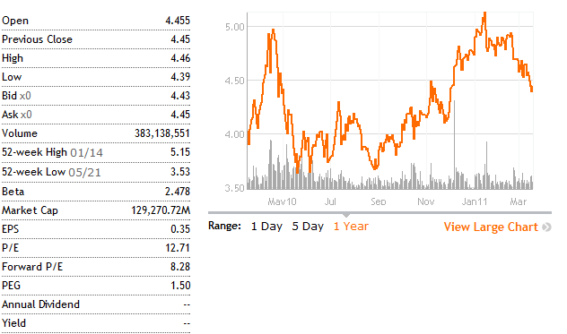
Overview
Citi Overview
Financial Statement
Risk Mgmt
Market Risks
Credit risks
Stock Information as of March 17, 2011

Slide 8
Overview
Citi Overview
Financial Statement
Risk Mgmt
Market Risks
Credit risks
Common Shares and Preferred Shares

Slide 9
Troubled Asset Relief Program (TARP)
Overview
Citi Overview
Financial Statement
Risk Mgmt
Market Risks
Credit risks
U.S government purchases assets and equity from financial institutions to help them to overcome financial crisis and strengthen its financial sector
Signed in Oct 2008
Purchase or insure up to 700 billion “troubled assets”

Slide 10
Overview
Citi Overview
Financial Statement
Risk Mgmt
Market Risks
Credit risks
Entering the TARP
Oct & Dec 2008:
Citi raised $25 billion, and $20 billion through sales or preferred stock and warrants to the U.S. Treasury
Jan 2009:
Citi issued $7.1 billion of preferred stock to the U.S. Treasury and FDIC
July 2009:
$25 billion preferred stock was exchanged to 7.7 billion shares of Citi’s common stock
July 2009:
$20 billion preferred stock issued to U.S. Treasury and $7.1 billion preferred stock issued to U.S. Treasury and FDIC were exchanged to trust preferred securities.

Slide 11
Overview
Citi Overview
Financial Statement
Risk Mgmt
Market Risks
Credit risks
Results
Paid U.S government approximately $2.2 billion dividends for preferred stock
Paid $800 million interest for trust preferred securities

Slide 12
Overview
Citi Overview
Financial Statement
Risk Mgmt
Market Risks
Credit risks
Repayment of the TARP
Dec 2009:
Repaid $20 billion of trust preferred securities to U.S. Treasury
Raised about $20.3 billion through issuance of common equity
Made $439.8 billion credit available to U.S. borrowers
After exiting TARP:
U.S. Treasury holds 27% of common stock
U.S. Treasury and FDIC continue to hold $5.3 billion of trust preferred securities

Slide 13
Overview
Citi Overview
Financial Statement
Risk Mgmt
Market Risks
Credit risks
TARP in 2010
Warrants issued to the U.S. Treasury as part of TARP and the loss-sharing agreement, with exercise prices of $17.85 and $10.61 for approximately 210 million and 255 million shares of common stock
Were not included in the computation of earnings per common share in 2010 and 2009, because they were anti-dilutive
Dec 2010 :
The Treasury sold the last of its 27% equity stake in the bank for $10.5 billion
Locking in at least $12 billion in profits from the government’s $45 billion rescue package.

Slide 14
Overview
Citi Overview
Financial Statement
Risk Mgmt
Market Risks
Credit risks
TARP in 2010
Revenues increased primarily due to the absence of
the loss on debt extinguishment related to the repayment of the $20 billion of TARP trust preferred securities and the exit from the loss-sharing agreement with the U.S. government, each in the fourth quarter of 2009.

Slide 15
Overview
Citi Overview
Financial Statement
Risk Mgmt
Market Risks
Credit risks
Joint Venture with Morgan Stanley
On June 1, 2009, Citi and Morgan Stanley established a joint venture (JV) that combines the Global Wealth Management platform of Morgan Stanley with Citigroup’s Smith Barney, Quilter and Australia private client networks.
The Brokerage and Asset Management business recorded a pretax gain of approximately $11.1 billion ($6.7 billion after-tax) on this sale.

Slide 16
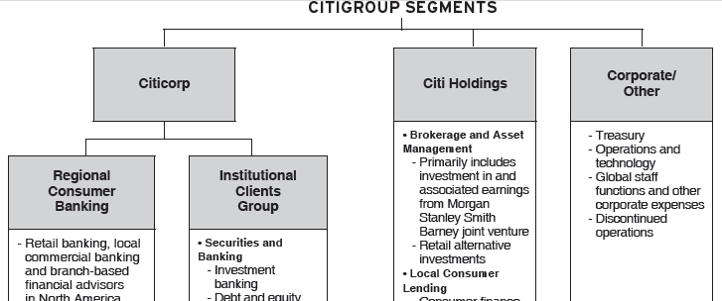
Overview
Citi Overview
Financial Statement
Risk Mgmt
Market Risks
Credit risks
Joint Venture with Morgan Stanley

Slide 17
Overview
Citi Overview
Financial Statement
Risk Mgmt
Market Risks
Credit risks
5 Year Key Statistic

Slide 18
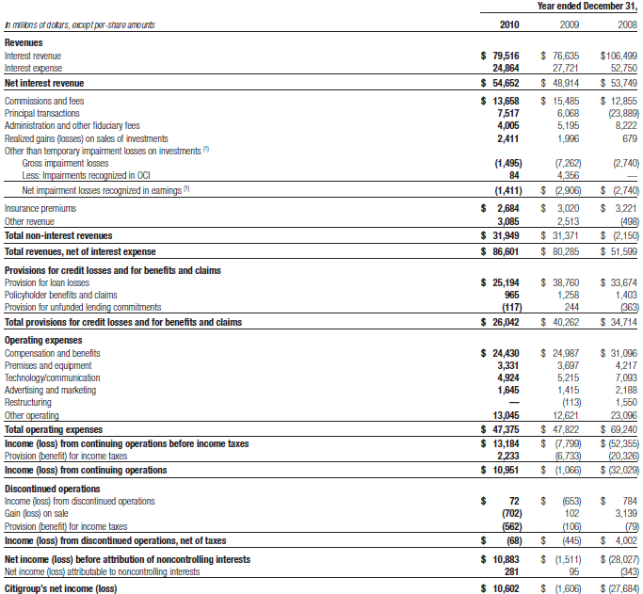
Overview
Citi Overview
Financial Statement
Risk Mgmt
Market Risks
Credit risks

Slide 19
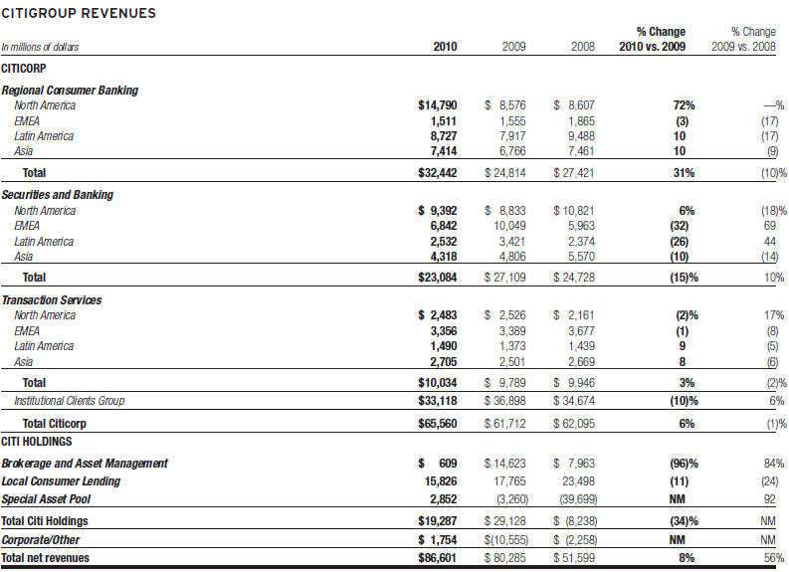
Overview
Citi Overview
Financial Statement
Risk Mgmt
Market Risks
Credit risks

Slide 20
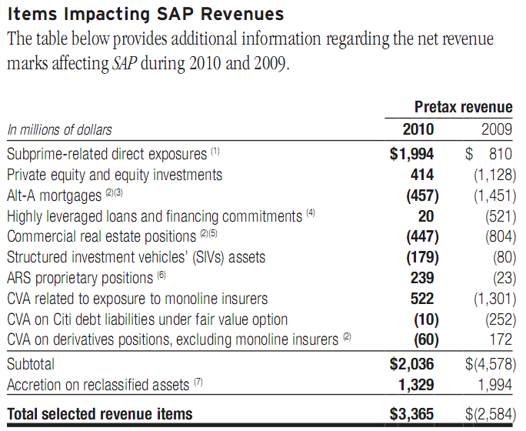
Overview
Citi Overview
Financial Statement
Risk Mgmt
Market Risks
Credit risks
SAP

Slide 21
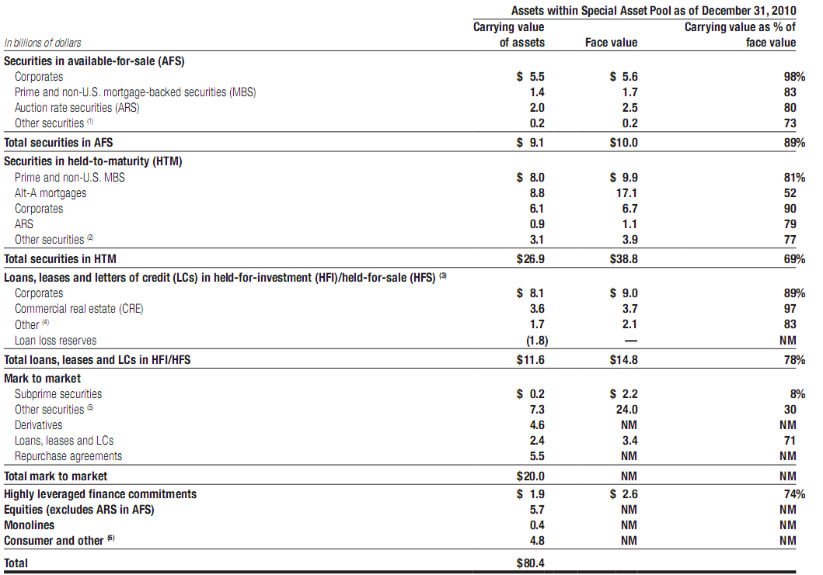
Overview
Citi Overview
Financial Statement
Risk Mgmt
Market Risks
Credit risks
SAP(book value VS Face value)

Slide 22
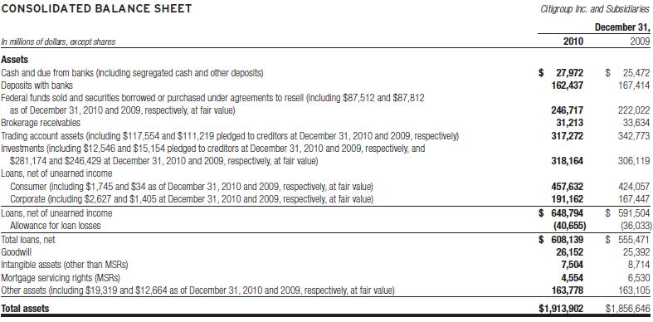
Overview
Citi Overview
Financial Statement
Risk Mgmt
Market Risks
Credit risks
Balance Sheet I

Slide 23
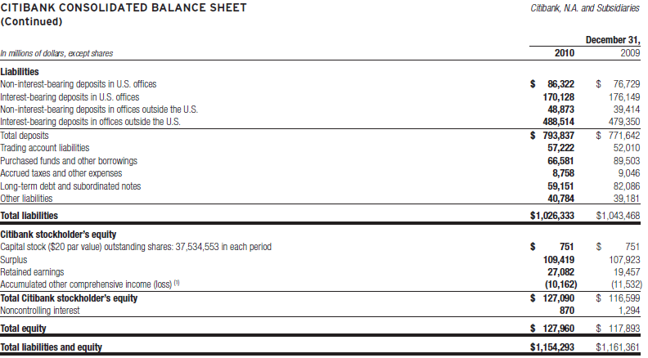
Overview
Citi Overview
Financial Statement
Risk Mgmt
Market Risks
Credit risks
Balance Sheet II

Slide 24
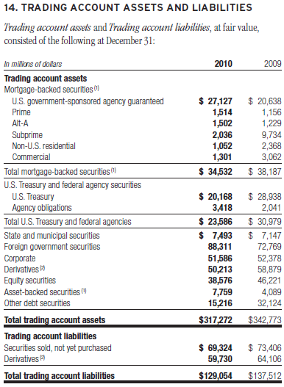
Overview
Citi Overview
Financial Statement
Risk Mgmt
Market Risks
Credit risks
Trading Account Assets from B/S

Slide 25
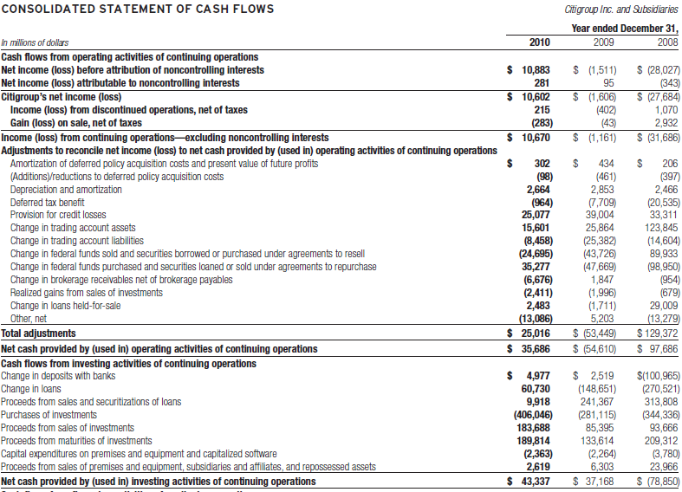
Overview
Citi Overview
Financial Statement
Risk Mgmt
Market Risks
Credit risks
Cash Flow Statement I

Slide 26
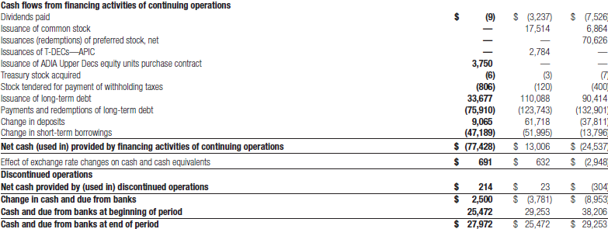
Overview
Citi Overview
Financial Statement
Risk Mgmt
Market Risks
Credit risks
Cash Flow Statement II

Slide 27
Overview
Citi Overview
Financial Statement
Risk Mgmt
Market Risks
Credit risks
Capital Resources
Basel I: Banks that operate internationally are required to maintain capital (Tier 1 and Tier 2) equal to at least 8% of its risk-weighted assets
Basel II: Banks holding riskier assets should be required to have more capital on hand than those maintaining safer portfolios. Basel II also requires companies to publish both the details of risky investments and risk management practices.
Basel III and more…

Slide 28
Overview
Citi Overview
Financial Statement
Risk Mgmt
Market Risks
Credit risks
Citi Capital Resources
At Year End (in %) | 2010 | 2009 | 2008 | Well-capitalized | Require Min
Tier 1 Common | 10.75 | 9.6 | 2.3
Tier 1 Capital | 12.91 | 11.7 | 12 | 6 | 4
Total Capital (Tier1+Tier2) | 16.59 | 15.3 | 16 | 10 | 8
Leverage | 6.60 | 6.89 | 6.1 | 3 | 3

Slide 29
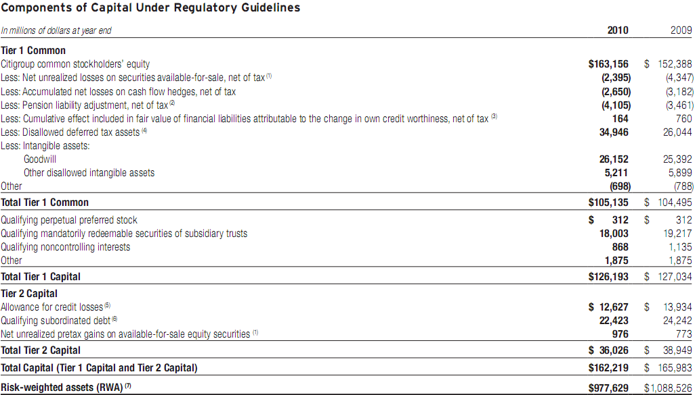
Overview
Citi Overview
Financial Statement
Risk Mgmt
Market Risks
Credit risks
Citi Tier 1 Capital
Notes:
Common shares owned by the fed

Slide 30
Overview
Citi Overview
Financial Statement
Risk Mgmt
Market Risks
Credit risks
Citi Risk Management
Risk Factors
Risk Management team
Market Risk
Credit Risk

Slide 31
Overview
Citi Overview
Financial Statement
Risk Mgmt
Market Risks
Credit risks
Risk Factors
Price Risk
Value at Risk (VAR)
Foreign Exchange Risk
Interest Rate Risk
Credit Risk

Slide 32
Overview
Citi Overview
Financial Statement
Risk Mgmt
Market Risks
Credit risks
Risk Factors
Market disruptions continues?
Is “Well capitalized” enough?
Is the write down of financial instrument possible?
Are the estimations of fair value accurate (i.e. CVA on derivatives)?
Reduction of citi and subsidiaries’ credit rating?
Notes:
Market disruptions may increase the risk of customer or counterparty delinquency or default.
Although Citigroup currently believes it is “well capitalized,” its capitalization may not prove to be sufficiently consistent with its risk profile or sufficiently robust relative to future capital requirements.
Citigroup may experience further write-downs of its financial instruments and other losses related to volatile and illiquid market conditions.
- Citigroup’s financial statements are based in part on assumptions and estimates, which, if wrong, could cause
unexpected losses in the future.

Slide 33
Overview
Citi Overview
Financial Statement
Risk Mgmt
Market Risks
Credit risks
Risk Management Team
Board of Directors
Chief Risk Officer
Business Chief Risk Officer
Regional Chief Risk Officers
Product Chief Risk Officers

Slide 34
Overview
Citi Overview
Financial Statement
Risk Mgmt
Market Risks
Credit risks
Chief Risk Officer
Brian Leach:
B.A in economics from Brown University and M.B.A from Harvard Business School.
Founder (in 2005) and Co-Coo of Old Lane.
Finished as Risk Manager of the Institutional Securities Business at Morgan Stanley where he worked for most of his financial career.
Oversaw capital allocation, strategic revenue-enhancement opportunities, and all aspects of credit, market, and operational risk management.

Slide 35
Overview
Citi Overview
Financial Statement
Risk Mgmt
Market Risks
Credit risks
Chief Risk Officer
Establishing core standards for management, measurement and reporting of risk
Identify, assessing, communicating and monitoring risk on company-wide basis
Engaging with senior management and on a frequent basis on material matters with respect to risk-taking activities in businesses and related risk management processes
Ensuring that risk function has adequate independence, authority, expertise, staffing, technology and resources

Slide 36
Overview
Citi Overview
Financial Statement
Risk Mgmt
Market Risks
Credit risks
Risk Management Team
Business Chief Risk Officer: focal point for risk decisions in company’s major business groups
Regional Chief Risk Officers: Accountable for risks in their geographic areas
Product Chief Risk Officers: Accountable for risks within their speciality (real estate, structured products, etc)

Slide 37
Overview
Citi Overview
Financial Statement
Risk Mgmt
Market Risks
Credit risks
Risk Management Guidelines
a common risk capital model to evaluate risks;
a defined risk appetite, aligned with business strategy;
accountability through a common framework to manage risks;
risk decisions based on transparent, accurate and rigorous analytics;
expertise, stature, authority and independence of risk managers; and
empowering risk managers to make decisions and escalate issues.

Slide 38
Overview
Citi Overview
Financial Statement
Risk Mgmt
Market Risks
Credit risks
Citi Risk Culture
“ Taking Intelligent Risk with Shared Responsibility, Without Forsaking Individual Accountability ”

Slide 39
Overview
Citi Overview
Financial Statement
Risk Mgmt
Market Risks
Credit risks
Market Risks
Notes:
Market Risk
Market risk includes Liquidity risk and price risk
Liquidity risk: is risk that an entity may be unable to meet a financial commitment to a customer, creditor, or investor when due.
Price risk: is the earnings risk form changes in interest rates, foreign exchange rates, and equity and commodity prices, and in their implied volatilities.
Price risk arise from both non-trading portfolios and trading portfolios

Slide 40
Overview
Citi Overview
Financial Statement
Risk Mgmt
Market Risks
Credit risks
Liquidity risk:
Risk that an entity may be unable to meet a financial commitment to a customer, creditor, or investor when due.
Price risk:
Earnings risk from changes in interest rates, foreign exchange rates, equity and commodity prices, and in their implied volatilities.
Arises in non-trading portfolios, as well as in trading portfolios.
Focus on Interest rate risk & Foreign exchange rate risk
Notes:
Market Risk
Market risk includes Liquidity risk and price risk
Liquidity risk: is risk that an entity may be unable to meet a financial commitment to a customer, creditor, or investor when due.
Price risk: is the earnings risk form changes in interest rates, foreign exchange rates, and equity and commodity prices, and in their implied volatilities.
Price risk arise from both non-trading portfolios and trading portfolios

Slide 41
Overview
Citi Overview
Financial Statement
Risk Mgmt
Market Risks
Credit risks
Trading Portfolios - Price Risk
Measured by:
Factor Sensitivities
Stress Testing
Value-at-risk (VAR).

Slide 42
Overview
Citi Overview
Financial Statement
Risk Mgmt
Market Risks
Credit risks
Price Risk Management
Factor sensitivities
Expressed as the change in the value of a position for a defined change in a market risk factor, such as a change in the value of a Treasury bill for a one-basis-point change in interest rates.
Stress testing
Is regularly performed on trading portfolios on a regular basis to estimate the impact of extreme market movements.
VAR
Estimates the potential decline in the value of a position or a portfolio under normal market conditions.
Notes:
Factor sensitivities are calculated, monitored and, in most cases, limited, for all relevant risks taken in a trading portfolio.
Information from the stress test is then used to make judgments as to the ongoing appropriateness of exposure levels and limits.
Citigroup’s VAR is based on the volatilities of and correlations among a multitude of market risk factors as well as factors that track the specific issuer risk in debt and equity securities.

Slide 43
Overview
Citi Overview
Financial Statement
Risk Mgmt
Market Risks
Credit risks
Citigroup & VAR
VAR method incorporates the factor sensitivities of the trading portfolio with the volatilities and correlations of those factors and is expressed as the risk to Citigroup over a one-day holding period, at a 99% confidence level.
Citigroup’s VAR is based on the volatilities of and correlations among a multitude of market risk factors as well as factors that track the specific issuer risk in debt and equity securities.

Slide 44
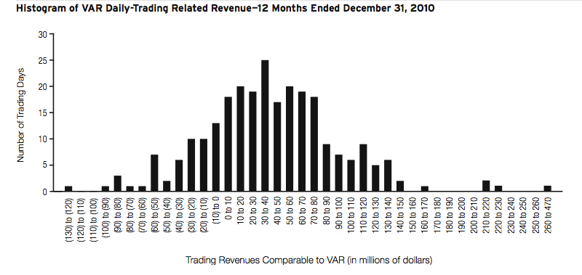
Overview
Citi Overview
Financial Statement
Risk Mgmt
Market Risks
Credit risks
Trading Revenue
Total revenues consist of:
• Customer revenue, which includes spreads from customer flow and positions taken to facilitate customer orders;
• Proprietary trading activities in both cash and derivative transactions; and
• Net interest revenue.
Notes:
The Following histogram of total daily revenue or loss captures trading volatility and shown the number of days in which Citigroup’s VaR trading-related revenues fell within particular ranges.
All trading positions are marked-to-market, with the results reflected in earnings.
In 2010, negative trading-related revenue (net losses) was recorded for 55 of 260 trading days.
Of the 55 days on which negative revenue (net losses) was recorded, one day was greater than $100 million

Slide 45
Overview
Citi Overview
Financial Statement
Risk Mgmt
Market Risks
Credit risks
Accuracy of VAR
Checked using Back-testing:
Process in which the daily VAR of a portfolio is compared to the actual daily change in the market value of its transactions
Confirms daily market value losses in excess of a 99% confidence level occur, on average, only 1% of the time.

Slide 46
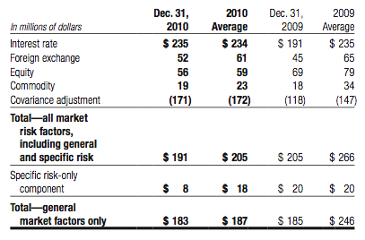
Overview
Citi Overview
Financial Statement
Risk Mgmt
Market Risks
Credit risks
Value at Risk
Following table summarizes VAR of Citigroup in the trading portfolios as of December 31,2010 and 2009.
Notes:
For Citigroup’s major trading centers, the aggregate pretax VAR in the trading portfolio was $191 million at December 31,2010 and $205 million at December 31,2009.
Daily exposures averaged $205 million in 2010 and ranged from $145 million to $289 million

Slide 47
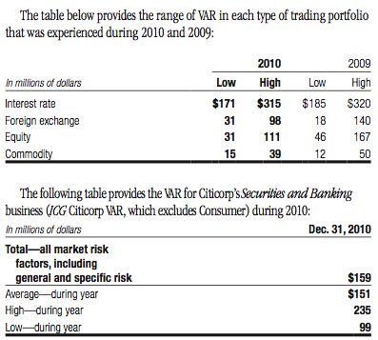
Overview
Citi Overview
Financial Statement
Risk Mgmt
Market Risks
Credit risks
Value at Risk

Slide 48
Overview
Citi Overview
Financial Statement
Risk Mgmt
Market Risks
Credit risks
Interest Rate Risk
Citigroup measure of risk to Net Interest Revenue (NIR) is Interest Rate Exposure (IRE)
IRE measures the change in expected NIR in each currency resulting from unanticipated changes in forward interest rates
Mitigation and Hedging of Risk
“Citigroup may modify pricing on new customer loans and deposits, enter into transactions with other institutions or enter into off-balance-sheet derivative transactions that have the opposite risk exposures”
Regularly assesses the viability of strategies to reduce unacceptable risks to earnings
Stress testing the impact of non-linear interest rate movements on the value of the balance sheet; analysis of portfolio duration and volatility; particularly as they relate to mortgage loans and mortgage-baked securities; and the potential impact of the change in the spread between different market indices.
Notes:
Net Interest Revenue (NIR) is the difference between the yield earned on the non-trading portfolio assets (including customer loans) and the rate paid on the liabilities (including customer deposits or company borrowing). NIR is affected by changes in the level of interest rates.

Slide 49
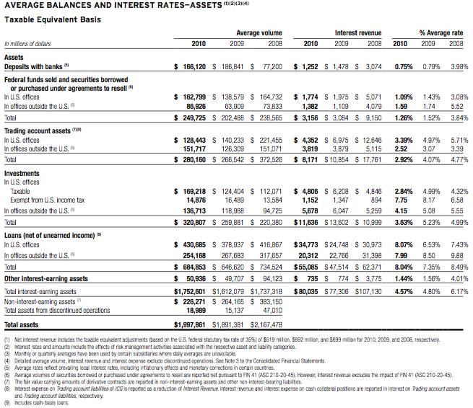
Overview
Citi Overview
Financial Statement
Risk Mgmt
Market Risks
Credit risks
Interest Rate Risk

Slide 50
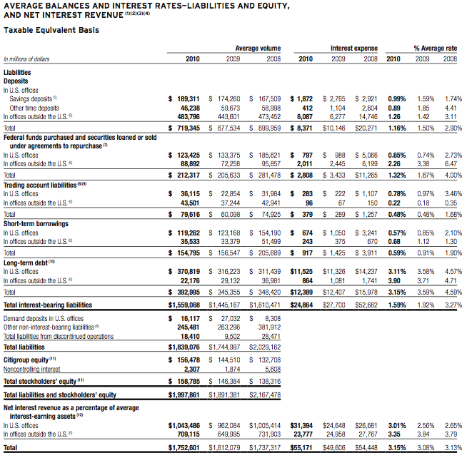
Overview
Citi Overview
Financial Statement
Risk Mgmt
Market Risks
Credit risks
Interest Rate Risk

Slide 51
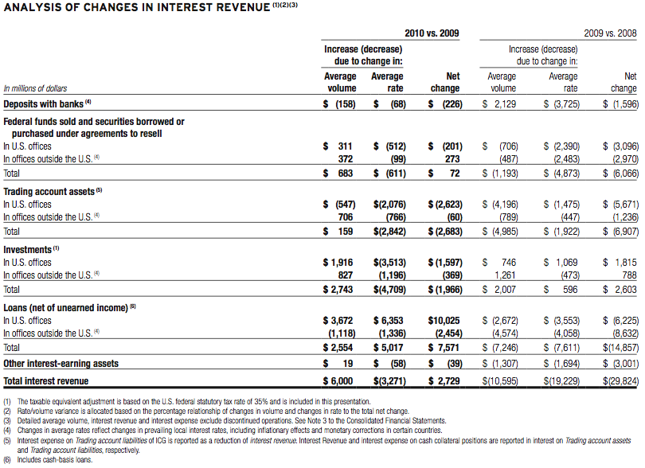
Overview
Citi Overview
Financial Statement
Risk Mgmt
Market Risks
Credit risks
Interest Rate Risk

Slide 52
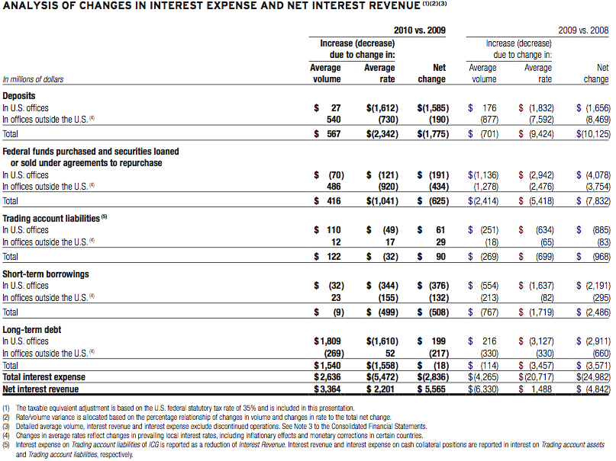
Overview
Citi Overview
Financial Statement
Risk Mgmt
Market Risks
Credit risks
Interest Rate Risk

Slide 53
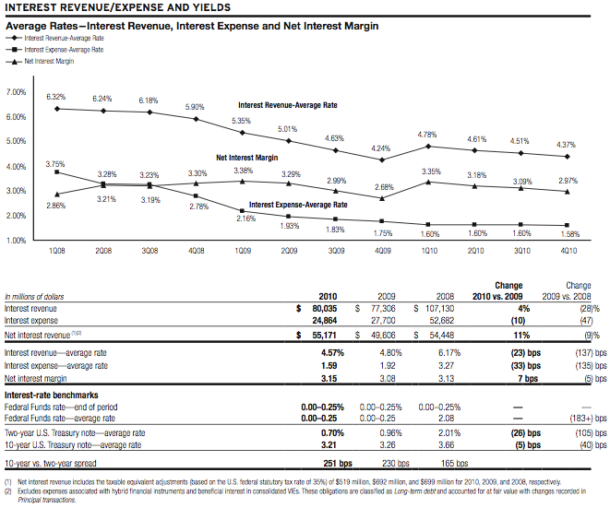
Overview
Citi Overview
Financial Statement
Risk Mgmt
Market Risks
Credit risks
Interest Rate Risk

Slide 54
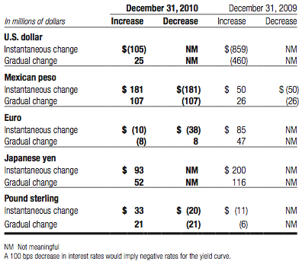
Overview
Citi Overview
Financial Statement
Risk Mgmt
Market Risks
Credit risks
Non-Trading Portfolios – Interest Rate Risk
The exposures below represent the approximate annualized risk to NIR assuming an unanticipated parallel instantaneous 100 bps change, as well as a more gradual 100 bps (25 bps per quarter) parallel change in rates compared with the market forward interest rates in selected currencies.

Slide 55
Overview
Citi Overview
Financial Statement
Risk Mgmt
Market Risks
Credit risks
Interest Rate Risk
The following table shows the risk to NIR from 6 different changes in the implied-forward rates.
Each scenario assumes that the rate change will occur on a gradual basis every three months over the course of one year.

Slide 56
Overview
Citi Overview
Financial Statement
Risk Mgmt
Market Risks
Credit risks
Country & Cross-Boarder Risk
Country Risk
Risk that an event in a country will impair the value of Citi’s franchise or will adversely affect the ability of obligors within that country to honor their obligations to Citi
Includes: sovereign defaults, banking crises, currency crises, currency convertibility and/or transferability restrictions, or political events.
Risk management framework includes country risk rating models, scenario planning and stress testing, internal watch lists
Cross-Boarder Risk
Risk that actions taken by non-U.S. Government may prevent the conversion of local currency into non-local currency and/or the transfer of funds outside the country
Impacts the ability of Citigroup and its customers to transact business across borders.
Notes:
Is the risk that actions taken by a non-U.S. Government may prevent the conversion of local currency into non-local currency and/or the transfer of funds outside the country
Impacts the ability of Citigroup and its customers to transact business across borders

Slide 57
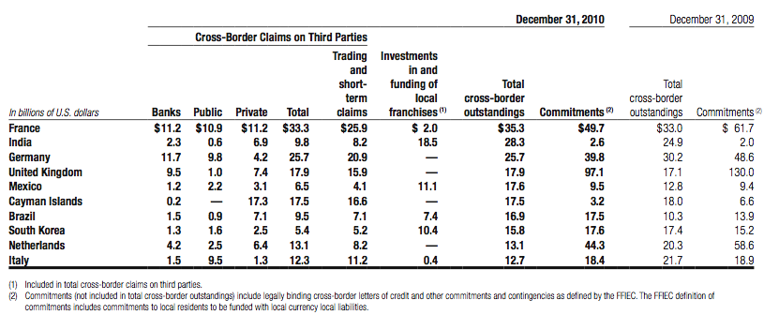
Overview
Citi Overview
Financial Statement
Risk Mgmt
Market Risks
Credit risks
Country & Cross-Boarder Risk
The table below shows all countries where total Federal Financial Institutions Examination Council (FFIEC) cross-boarder outstandings exceed 0.75% of total Citigroup assets:

Slide 58
Overview
Citi Overview
Financial Statement
Risk Mgmt
Market risks
Credit risks
Credit Risks

Slide 59
Overview
Citi Overview
Financial Statement
Risk Mgmt
Market risks
Credit risks
Citi Credit Risks
Credit risk: Losses result from borrower’s or counterparty’s inability to meet its obligation
Citi’s business activities that could arise credit risk:
Lending
Sales and trading
Derivatives
Securities transactions
Settlement
Act as an intermediary

Slide 60
Overview
Citi Overview
Financial Statement
Risk Mgmt
Market risks
Credit risks
Citi Credit Risk Overview
During 2010, Citigroup’s aggregate loan portfolio increased by $57.3 billion to $648.8 billion
Citi’s total allowance for loan losses totaled $40.7 billion at December 31, 2010, a coverage ratio of 6.31% of total loans, up from 6.09%.
Net credit losses of $30.9 billion during 2010 decreased $11.4 billion from year-ago levels (on a managed basis)
Consumer non-accrual loans totaled $10.8 billion at December 31, 2010, compared to $18.3 billion

Slide 61
Overview
Citi Overview
Financial Statement
Risk Mgmt
Market risks
Credit risks
Loan Mix - Consumer

Slide 62
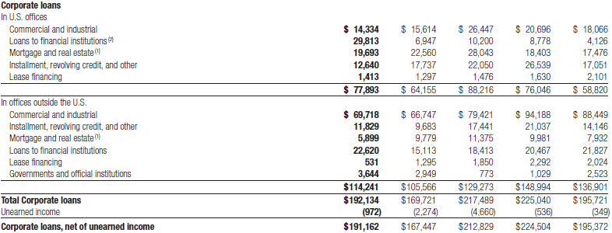
Overview
Citi Overview
Financial Statement
Risk Mgmt
Market risks
Credit risks
Loan Mix - Corporate

Slide 63
Overview
Citi Overview
Financial Statement
Risk Mgmt
Market risks
Credit risks
Loan Mix

Slide 64
Overview
Citi Overview
Financial Statement
Risk Mgmt
Market risks
Credit risks
Allowance for Loan Losses

Slide 65
Overview
Citi Overview
Financial Statement
Risk Mgmt
Market risks
Credit risks
Allowance for Loan Losses

Slide 66
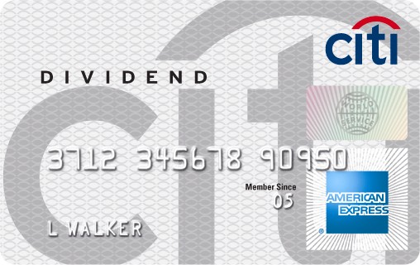
Overview
Citi Overview
Financial Statement
Risk Mgmt
Market risks
Credit risks
Consumer Loans – Details
US Consumer Lending:
- Mortgage Lending
1st lien mortgage: $102 billion
2nd lien mortgage: $49 billion
North America Cards
- Citi-branded cards: $78 billion
Retail partner cards $46 billion
Open account down 8% and 11% relatively

Slide 67
Overview
Citi Overview
Financial Statement
Risk Mgmt
Market risks
Credit risks
Delinquencies and Net Credit Losses of First Mortgage

Slide 68
Overview
Citi Overview
Financial Statement
Risk Mgmt
Market risks
Credit risks
Consumer Loans Modification Program
Programs to assist borrower with financial difficulties
Involves:
- modifying the original loan terms
- reducing interest rates
- extending the remaining loan duration
- waiving a portion of the remaining principal balance

Slide 69
Overview
Citi Overview
Financial Statement
Risk Mgmt
Market risks
Credit risks
U.S. Treasury’s Home Affordable Modification Program
(HAMP)
Reduce monthly mortgage payments to a 31% housing debt ratio by lowering the interest rate and extending the term of the loan and remove some principal of certain eligible borrowers
From inception through December 31, 2010, approximately $9.5 billion of first mortgages were enrolled in the HAMP trial period, while $3.8 billion have successfully completed the trial period.

Slide 70
Overview
Citi Overview
Financial Statement
Risk Mgmt
Market risks
Credit risks
Hedge Risks Associate with Consumer Mortgage
Credit risks and liquidity risk
Sells most of mortgage loans it originates, retains servicing rights
Mortgage servicing rights (MSR) (intangible assets)
Still affected by changes in interest rate
Interest rate risks
Hedge MSR with:
Interest rate derivative contracts
Forward purchase commitments
Primarily mortgage-backed securities
Non-perfect hedge → basis risk
Reviewing mix of hedging instruments daily

Slide 71
North America Card - Loss Mitigation Efforts
Overview
Citi Overview
Financial Statement
Risk Mgmt
Market risks
Credit risks
Eliminate riskier accounts and sales to mitigate losses:
Removed higher-risk customers from portfolio:
Reducing available line of credit
Closing accounts
Improve tools used to identify and manage exposure in each of portfolios by targeting unique customer attributes
Tighten credit standards:
Stricter underwriting standards for new accounts
Decreasing higher-risk credit lines
Closing high-risk accounts
Re-pricing
Improvements in collections effectiveness
Various forbearance programs

Slide 72
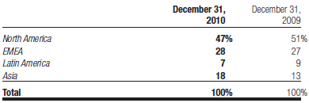
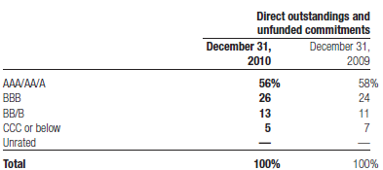
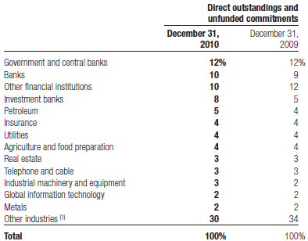
Corporate Loans – Details
Overview
Citi Overview
Financial Statement
Risk Mgmt
Market risks
Credit risks
Citigroup uses credit derivatives and other risk mitigants to hedge portions of the credit risk in its portfolio, in addition to outright asset sales.

Slide 73
Overview
Citi Overview
Financial Statement
Risk Mgmt
Market risks
Credit risks
Derivatives

Slide 74
Overview
Citi Overview
Financial Statement
Risk Mgmt
Market risks
Credit risks
Derivative Overview
Various Types of Derivative Transactions:
- Futures and Forward Contracts
- Swap Contracts
- Option Contracts

Slide 75
Overview
Citi Overview
Financial Statement
Risk Mgmt
Market risks
Credit risks
Derivative Overview
Reason of Entering Derivatives Contracts:
- Trading Purposes
- Hedging

Slide 76
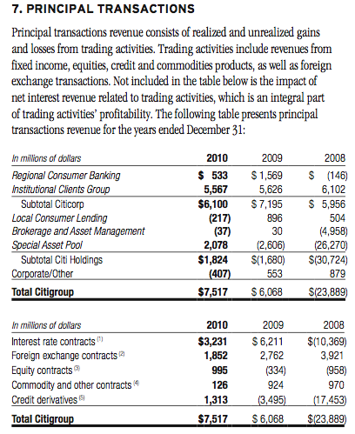
Overview
Citi Overview
Financial Statement
Risk Mgmt
Market risks
Credit risks
Trading Purposes

Slide 77
Hedging
Overview
Citi Overview
Financial Statement
Risk Mgmt
Market risks
Credit risks
Risk management activities to hedge certain risks
Manage risks inherent in specific group of on-balance-sheet assets and liabilities
Market Risks
Credit Risks
Liquidity Risks

Slide 78
Overview
Citi Overview
Financial Statement
Risk Mgmt
Market risks
Credit risks
Derivatives
Interest Rate Contracts
- Swaps
- Futures and Forwards
- Purchased Options
- Written Options
Foreign Exchange Contracts

Slide 79
Overview
Citi Overview
Financial Statement
Risk Mgmt
Market risks
Credit risks

Slide 80
Overview
Citi Overview
Financial Statement
Risk Mgmt
Market risks
Credit risks

Slide 81
Overview
Citi Overview
Financial Statement
Risk Mgmt
Market risks
Credit risks
3 types of hedge:
Fair Value Hedge
Cash Flow Hedge
Net Investment Hedge

Slide 82
Fair Value Hedges
Overview
Citi Overview
Financial Statement
Risk Mgmt
Market risks
Credit risks

Slide 83
Cash Flow Hedges
Overview
Citi Overview
Financial Statement
Risk Mgmt
Market risks
Credit risks

Slide 84
Net Investment Hedges
Overview
Citi Overview
Financial Statement
Risk Mgmt
Market risks
Credit risks
Citigroup uses foreign currency forwards, options, swaps and foreign currency denominated debt instruments to manage the foreign exchange risk associated with Citigroup’s equity investments in several non-U.S. dollar functional currency foreign subsidiaries.

Slide 85
Credit Derivatives
Overview
Citi Overview
Financial Statement
Risk Mgmt
Market risks
Credit risks
Citi actively participates in trading variety of credit derivatives as
Two-way market-maker for clients
To manage credit risk
Majority was transacted with other financial intermediaries:
Banks
Broker-dealers
Generally mismatch between total notional amounts of protection purchased and sold

Slide 86
Credit Derivatives
Overview
Citi Overview
Financial Statement
Risk Mgmt
Market risks
Credit risks
Open risk exposures from credit derivative are matched after
Certain cash positions in reference assets are considered
Notional amounts are adjusted to a
Duration-based equivalent basis or
Reflect the level of subordination in tranched structures
Citi actively monitors its counterparty credit risk in credit derivative contracts

Slide 87
Credit Derivatives
Overview
Citi Overview
Financial Statement
Risk Mgmt
Market risks
Credit risks
Settlement triggers
Market standard of failure to pay on indebtedness
Bankruptcy of reference credit
Debt restructuring

Slide 88
Overview
Citi Overview
Financial Statement
Risk Mgmt
Market risks
Credit risks
Derivatives: Obligor Credit Rating

Slide 89
Overview
Citi Overview
Financial Statement
Risk Mgmt
Market risks
Credit risks
Derivatives: Obligor Industry

Slide 90
Credit Derivatives
Overview
Citi Overview
Financial Statement
Risk Mgmt
Market risks
Credit risks
Four Types of Creditors
Bank
Broker Dealer
Non-financial
Insurance

Slide 91
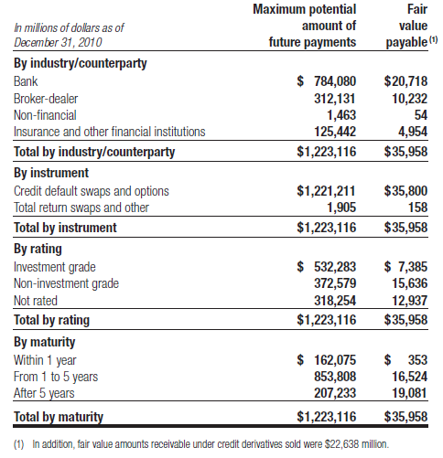
Credit Derivatives
Overview
Citi Overview
Financial Statement
Risk Mgmt
Market risks
Credit risks

Slide 92
Securitization
Overview
Citi Overview
Financial Statement
Risk Mgmt
Market risks
Credit risks
Securitizes different asset classes to:
Strengthen balance sheet
Obtain more favourable credit rating
Accessing competitive financing rates in market
Assets transferred into a trust and used as collateral by trust to obtain financing
Cash flows from assets in trust service the corresponding trust securities

Slide 93
Securitization
Overview
Citi Overview
Financial Statement
Risk Mgmt
Market risks
Credit risks
Structure of trust meets accounting guidelines?
Yes: no longer reflected as assets
No: Assets continue recorded as assets, financing activity as liabilities
Special Purpose Entities (SPEs):
Entity designed to fulfill specific limited need of company that organized it
Organized as trusts, partnerships or corporations

Slide 94
Securitization
Overview
Citi Overview
Financial Statement
Risk Mgmt
Market risks
Credit risks
SPEs used to:
Obtain liquidity and favourable capital treatment by securitizing certain Citi’s assets
Assist clients in securitizing their assets
Create investment products for clients
Entity designed to fulfill specific limited need of company that organized it

Slide 95
Overview
Citi Overview
Financial Statement
Risk Mgmt
Market risks
Credit risks
Securitization
2 types of SPEs:
Qualifying SPEs (QSPEs):
Significant limitations on:
Types of assets or derivatives instruments may own or enter into
Types and extent of activities and decision-making may engage in
Passive entities designed to
Purchase assets
Pass through cash flows from those assets to investors in QSPE
Generally exempt from consolidation

Slide 96
Overview
Citi Overview
Financial Statement
Risk Mgmt
Market risks
Credit risks
Securitization
2 types of SPEs:
Variable Interest Entities (VIEs):
Entities that have either:
Total equity investment that is insufficient to permit entity to finance its activities without additional subordinated financial support
Equity investors lack characteristics of controlling financial interest
Consolidation of VIE based on variability generated in scenarios that are considered most likely to occur

Slide 97
Overview
Citi Overview
Financial Statement
Risk Mgmt
Market Risks
Credit risks
Thank you!

