Slide 1
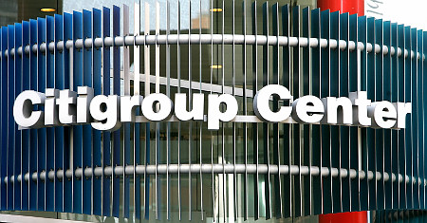
Present by: Yongrui Cheng, Rickie Wang,
Megan Yao, Andy Ho

Slide 2
Agenda
Company Overview
Risk Management Environment
  Market risk
  Liquidity risk
  Credit risk
  Operational risk
  Regulatory risk
  Country and Cross-Border risk
Derivative Activities
Securitizations

Slide 3
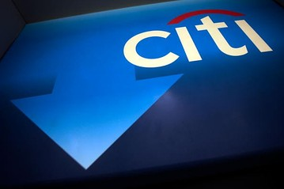
Company Overview
Notes:
Basel, var

Slide 4
Citigroup’s History
Citibank founded in 1812
Became Citigroup is 1998 after merger of Citicorp and Traveler’s Group
Diversified financial services holding company
Approx. 200 million customer accounts

Slide 5
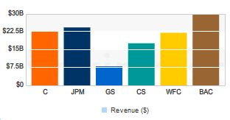
2011 INDUSTRY COMPETITORS
JPMORGAN CHASE & CO (JPM) Goldman Sachs Group (GS)
Credit Suisse Group (CS) Wells Fargo (WFC) Bank of America (BAC)
Notes:
he major players in Citi's league are Bank of America (BAC), Deutsche Bank AG (DB) and J P Morgan Chase (JPM). These firms typically operate on a business model that gradually introduces clients to complex financial services and solutions as the client matures. In this way, these banking firms try to cater to the client's entire life span by offering as many products as possible. For this reason some have identified this strategy as building "banking supermarkets." This mode of thinking has changed recently, as Citigroup increasingly focuses on its most profitable products, continues to cut costs and personnel, and relocates offices to regions that are experiencing robust growth.

Slide 6
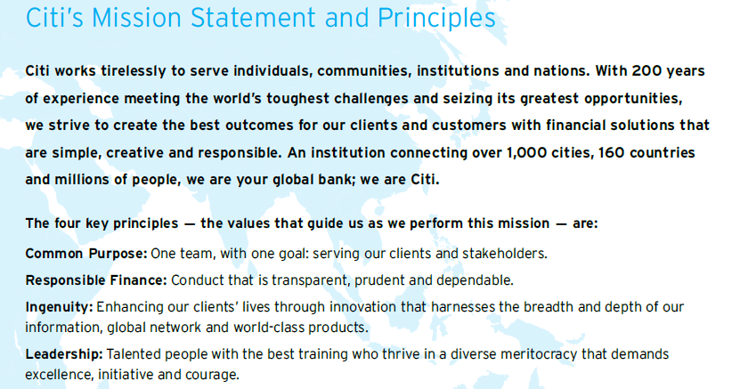

Slide 7
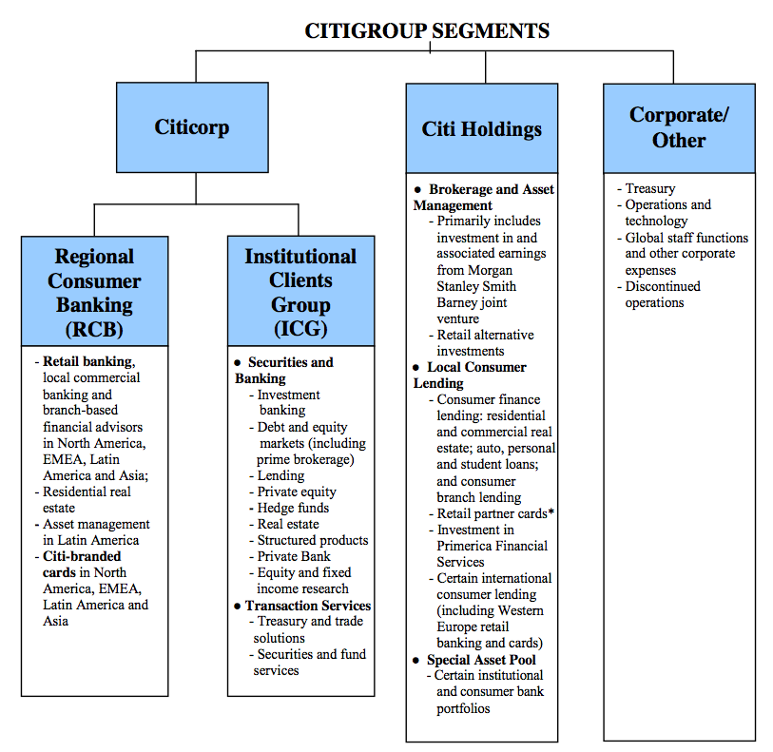
Notes:
The company operates through two segments, Citicorp and Citi Holdings. The Citicorp segment operates as a global bank for businesses and consumers with two primary businesses, Regional Consumer Banking and Institutional Clients Group. The Regional Consumer Banking business provides traditional banking services, including retail banking, and branded cards in North America, Asia, Latin America, Europe, the Middle East, and Africa. The Institutional Clients Group business provides securities and banking services comprising investment banking and advisory services, lending, debt and equity sales and trading, institutional brokerage, foreign exchange, structured products, cash instruments and related derivatives, and private banking; and transaction services consisting of treasury and trade solutions, and securities and fund services. The Citi Holdings segment operates Brokerage and Asset Management, Local Consumer Lending, and Special Asset Pool businesses.

Slide 8
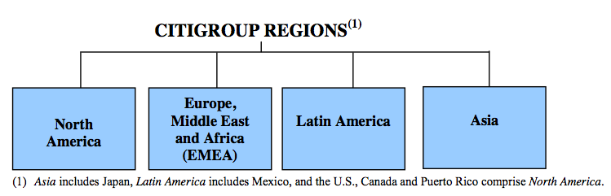
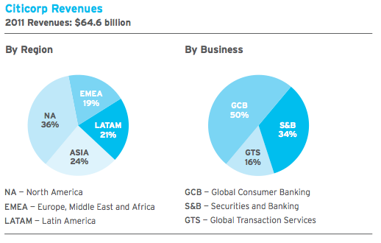
Notes:
Citigroup reported net income of $11.1 billion and diluted EPS of $3.63 per share in 2011, compared to $10.6 billion and $3.54 per share, respectively, in 2010

Slide 9
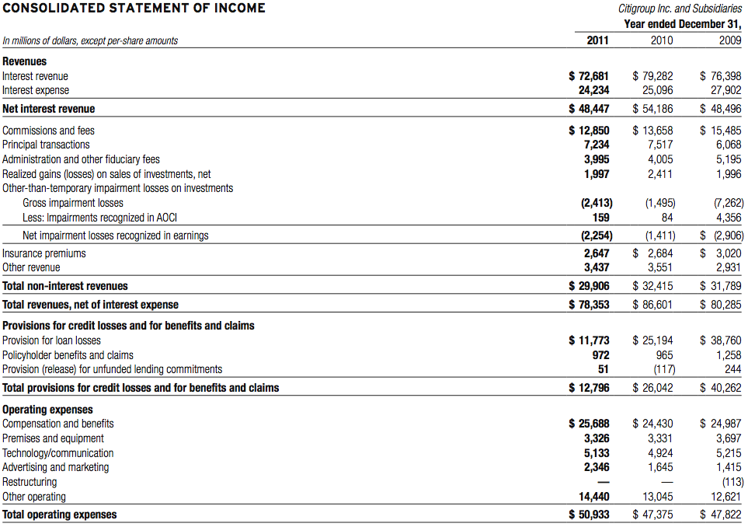
Consolidated Statement of Income

Slide 10
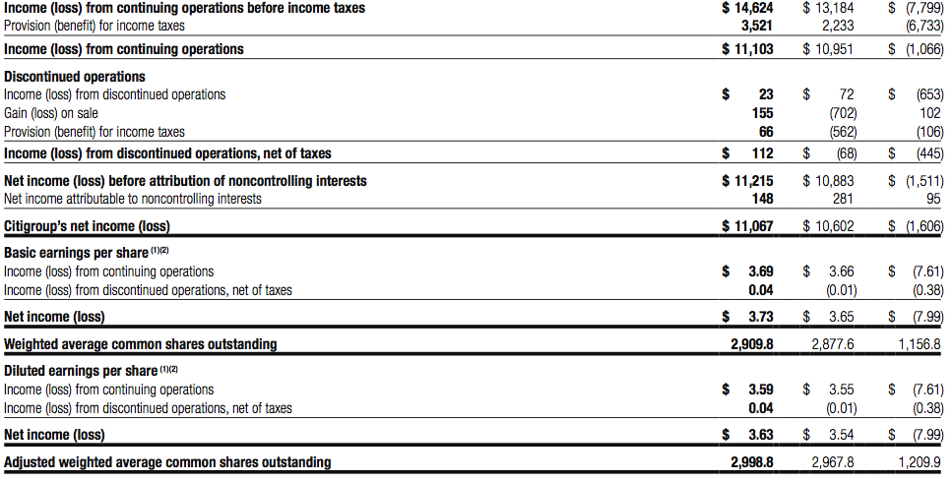
Income Statement Cont.

Slide 11
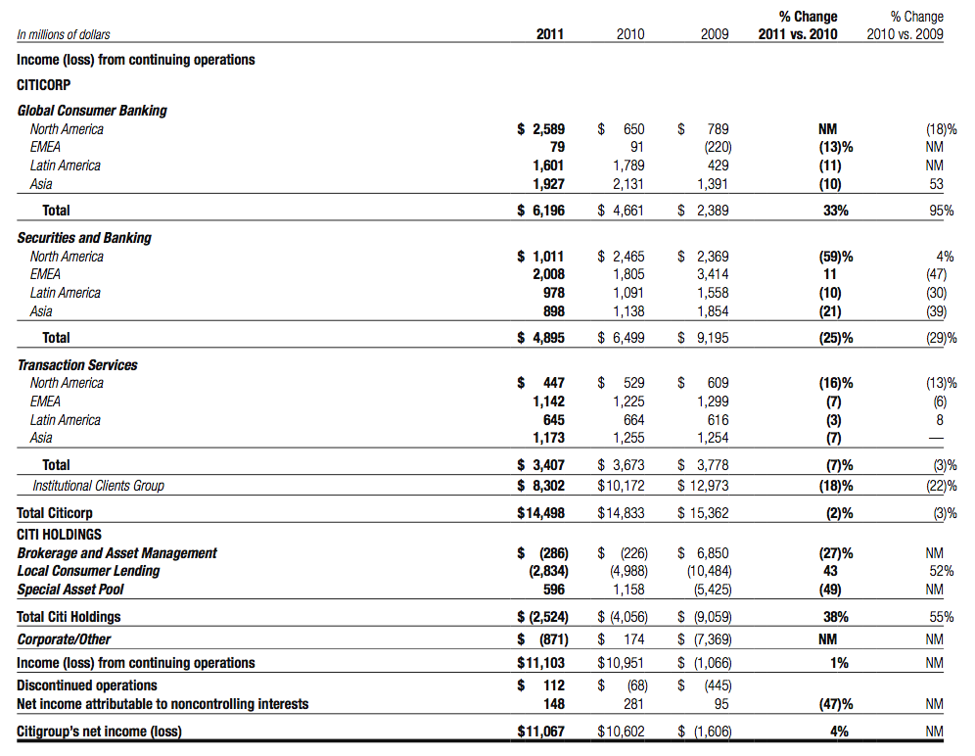
Citigroup Segmented Income Statement
Notes:
Citicorp is Citigroup’s global bank for consumers and businesses and represents Citi’s core franchises.
At December 31, 2011, Citicorp had approximately $1.3 trillion of assets and $797 billion of deposits, representing approximately 70% of Citi’s total assets and approximately 92% of its deposits.
Global Consumer Banking (GCB) consists of Citigroup’s four geographical Regional Consumer Banking (RCB) businesses that provide traditional banking services to retail customers.
At December 31, 2011, GCB had $340 billion of assets and $313 billion of deposits.
North America Regional Consumer Banking (NA RCB) provides traditional banking and Citi-branded card services to retail customers and small to mid-size businesses in the U.S.
At December 31, 2011, NA RCB had $38.9 billion of retail banking loans and $148.8 billion of deposits. In addition, NA RCB had 22.0 million Citi-branded credit card accounts, with $75.9 billion in outstanding card loan balances.
EMEA Regional Consumer Banking (EMEA RCB) provides traditional banking and Citi-branded card services to retail customers and small to mid-size businesses, primarily in Central and Eastern Europe, the Middle East and Africa
At December 31, 2011, EMEA RCB had 292 retail bank branches with 3.7 million customer accounts, $4.2 billion in retail banking loans and $9.5 billion in deposits. In addition, the business had 2.6 million Citi-branded card accounts with $2.7 billion in outstanding card loan balances.

Slide 12
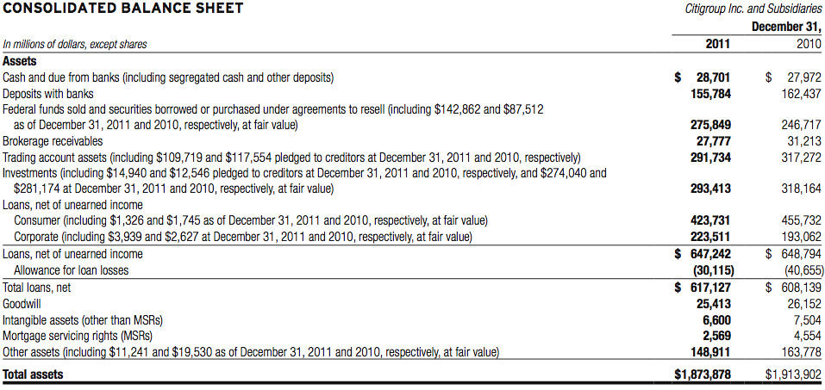
Consolidated Balance Sheet

Slide 13
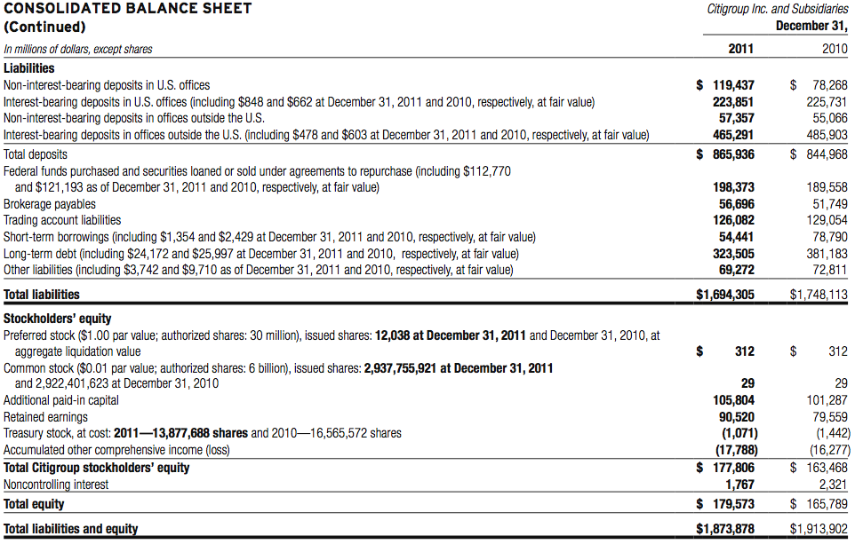
Balance Sheet Cont.

Slide 14
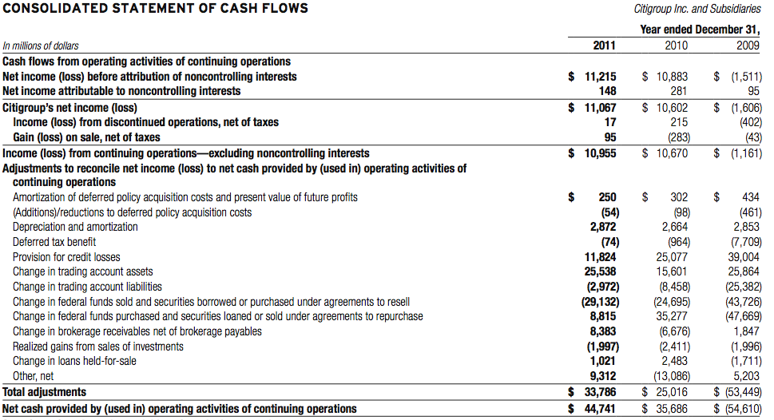
Consolidated Statement of CF

Slide 15
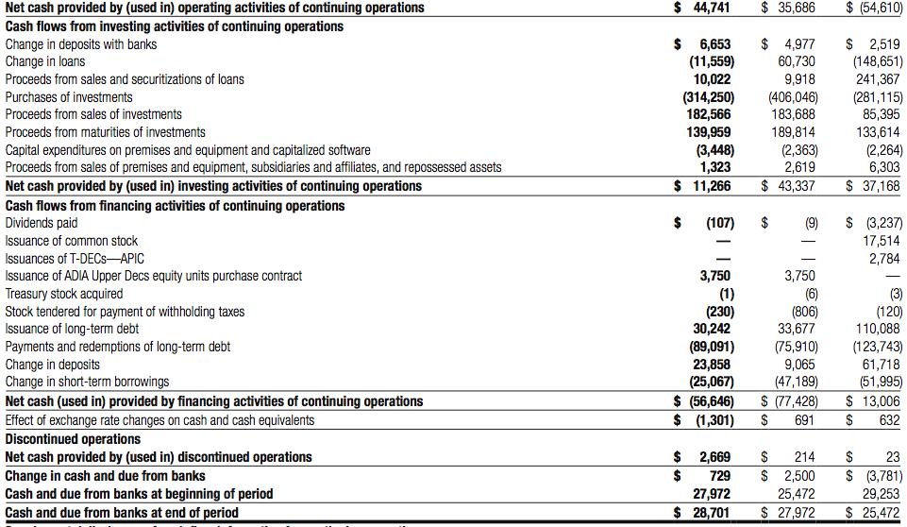
CF Cont.

Slide 16
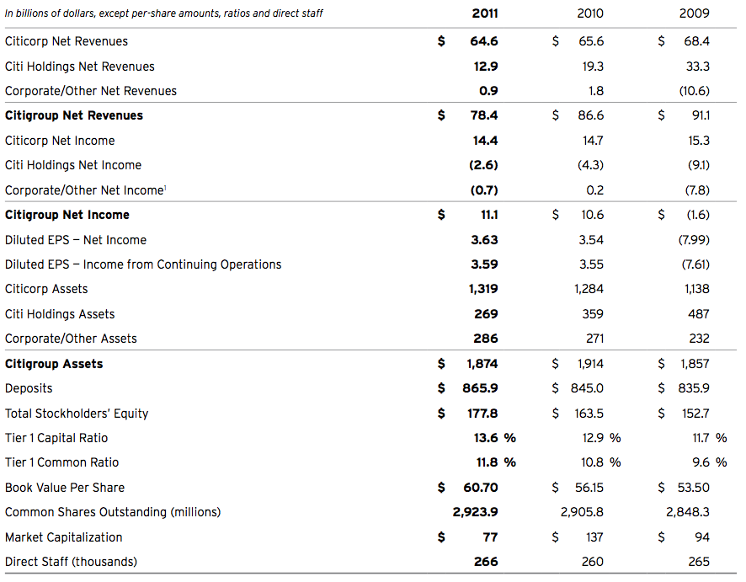
Financial Summary

Slide 17
Basel II
An international standard for banking regulators
Protect the international financial system from the types of problems that might arise should a major bank or a series of banks collapse
Sets up risk and capital management requirements designed to ensure that a bank has adequate capital for the risk the bank exposes itself to through its lending and investment practices

Slide 18
Basel III
Will be slowly implemented in the near future
Key differences between Basel ii and Basel iii:
  Increase bank capital requirements
  New regulatory requirements on bank leverage and bank liquidity

Slide 19
Regulatory Requirements
Citigroup is subject to the risk-based capital guidelines issued by the Federal Reserve Board
Capital levels must meet specific requirements as calculated under regulatory reporting practices
Capital levels are subject to qualitative judgments by regulators regarding components, risk weightings and other factors

Slide 20
Capital Requirements
To be “well capitalized” under current federal bank regulatory agency definitions, a bank holding company must have:
    Tier 1 Capital ratio > 6%
    Total Capital ratio > 10%
    Leverage ratio of > 3%

Slide 21
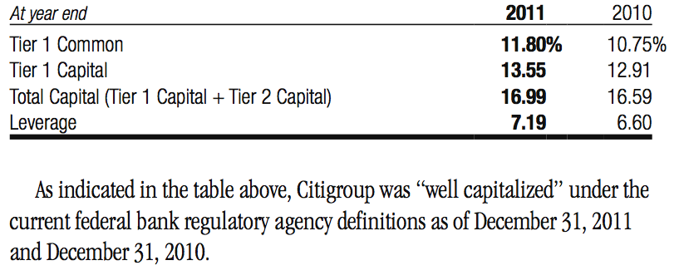
Citigroup Capital Ratios

Slide 22
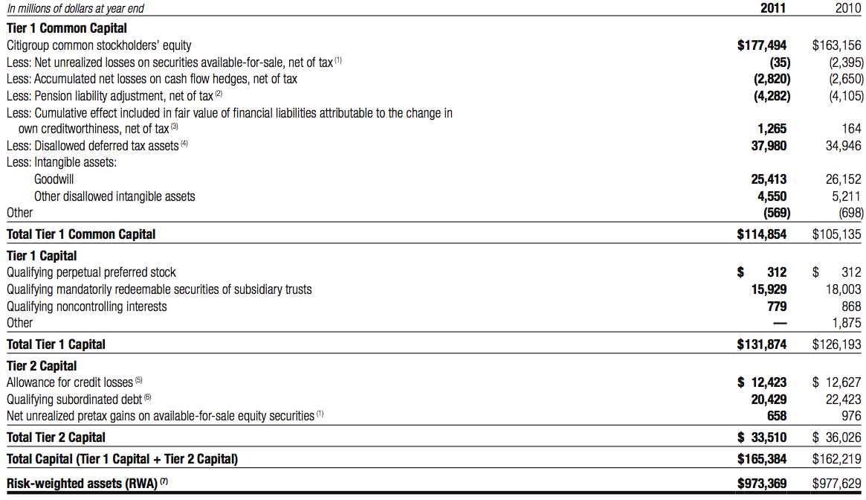
Components of Capital Under Regulatory Guidelines

Slide 23
Subsidiary Capital Requirements
Citigroup‘s U.S. subsidiary depository institutions are also subject to risk-based capital guidelines issued by their respective primary federal bank regulatory agencies, which are similar to the guidelines of the Federal Reserve Board

Slide 24
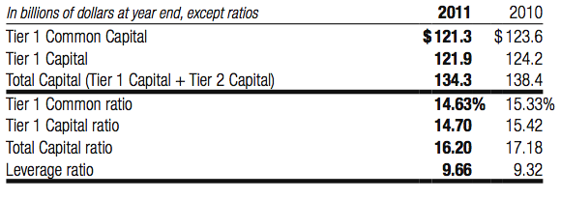
Citibank, N.A. Capital Tiers and Capital Ratios Under Regulatory Guidelines

Slide 25
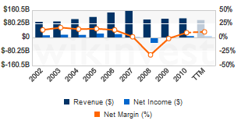
Citi’s revenue and net income

Slide 26
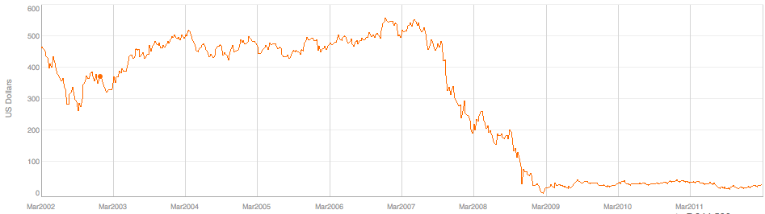
10 Year Stock Price of Citi

Slide 27
Troubled Asset Relief Program (TARP)
U.S government purchases assets and equity from financial institutions to help them to overcome financial crisis and strengthen its financial sector
Signed in Oct 2008
Purchase or insure up to 700 billion “troubled assets”
Notes:
By February 2009, the government had given Citi $45 billion in Troubled Assets Relief Program (TARP) funds, giving government a 35% stake in Citi. As part of its agreement with Citi, the government had opted to take on more risk and convert $25 billion of its preferred stock to common shares. The government beared more risk by converting its shares because it became subject to the volatility of Citi's stock prices. By converting its shares, Citi gained more tangible equity available to improve its balance sheet. Its equity-to-asset ratio improved from 1.5% to approximately 4%.^{[15]} The Federal Deposit Insurance Corporation (FDIC) defines a bank as being critically under-capitalized with a ratio under 2%.^{[15]}
This move negatively effected stockholders because the huge conversion to common stock will lead to a dilution of shares, and Citi has agreed to stop paying dividends for at least the next 3 years. In addition, the government has the right to convert its remaining $20 billion in shares to common stock in the future. This would further dilute the stock and give the public even less of a stake in Citi.^{[15]}
On December 14, 2009, Citi announced that it reached an agreement with the U.S. government and its regulators to repay U.S. taxpayers for the $20 billion in TARP trust preferred securities held by the government. Citi also decided to cancel its loss-sharing agreement with the government, which will increase its risk-weighted assets by approximately $144 billion. As a result of the repayment of TARP trust preferred securities and the termination of the loss-sharing agreement, Citi expects a net reduction in annual interest expense of approximately $1.7 billion as well as $0.5 billion in lower amortization expense associated with the loss-sharing agreement. Once the repayment and agreement cancellation are official, Citi will no longer be deemed a beneficiary of "exceptional financial assistance" under Tarp beginning in 2010, restoring some credibility and stability to the company. ^{[6]}
On March 10, 2010, agreed to sell its real estate unit, Citi Property Investors, to private equity investor Apollo Management LP, giving Apollo 65 real estate investments that span across 26 countries with a total net asset value of just under $3.5 billion. The sale was another effort by Citi to raise capital to repay the remaining $25 billion which it still owes the government. Such efforts to repay government debt ultimately shrink Citi's net assets and overall business, which may not be beneficial to the bank in the long run.^{[16]}

Slide 28
Troubled Asset Relief Program (TARP)
Oct/Dec 2008: raised $25 billion, and $20 billion through sales or pref. stock and warrants to the US Treasury
Jan 2009: issued $7.1 billion of pref. Stock to the US Treasury and FDIC; issued warrants to the US Treasury
July 2009: exchanges $25b pref. for $7.7b of common
July 2009: exchanges $20b pref. And $7.1b pref. for trust preferred securities
Citigroup has paid $2.2 billion in dividends to the US gov’t on the preferred stock held
Citigroup has paid $800 million in interest on the trust preferred securities

Slide 29
Risk Management—Overview
Citigroup believes that effective risk management is of primary importance to its overall operations. Accordingly, Citigroup has a comprehensive risk management process to monitor, evaluate and manage the principal risks it assumes in conducting its activities. These include credit, market and operational risks.

Slide 30
Risk Factors
Market risk
Liquidity risk
Credit risk
Operational risk
Regulatory risk
Country and Cross-Border risk
Notes:
Page 67 K11

Slide 31
Market Risk

Slide 32
Market and Economic Risk
Eurozone debt crisis have significant adverse effects on Citi’s business, particularly if it leads to any sovereign debt defaults, bank failures or defaults and/or the exit of one or more countries from the European Monetary Union.
Continued economic uncertainty in the U.S., high levels of unemployment and depressed values of residential real estate negatively impact Citi’s U.S. Consumer mortgage business.
Downgrade of the U.S. government credit ratings negatively impacted Citi’s liquidity and sources of funding

Slide 33
Market Risk
Encompasses liquidity risk and price risk
Price risk is the earnings risk from changes in interest rates, foreign exchange rates, and equity and commodity prices, and in their implied volatilities
Price risk arises in non-trading portfolios, and in trading portfolios.

Slide 34
Non-Trading Portfolios Interest Rate Risk
Citigroup's primary focus is providing financial products for its customers. Loans and deposits are tailored to the customer's requirements in terms of maturity and whether the rate is fixed or floating
Net interest revenue (NIR): the difference between the yield earned on the non-trading portfolio assets (including customer loans) and the rate paid on the liabilities (including customer deposits or company borrowings)

Slide 35
NIM
Net interest margin:
(interest revenue - gross interest expense)/ average interest earning assets.
During 2011, Citi’s NIM declined by approximately 26 basis points, primarily driven by continued run-off and sales of higher-yielding assets in Citi Holdings and lower investment yields driven by the continued low interest rate. This effect is partially offset by the growth of lower-yielding loans in Citicorp and lower borrowing costs.

Slide 36
NIR & NIM

Slide 37
Interest Rate-Assets

Slide 38
Interest Rate-Liability, Equity & NIR

Slide 39
Changes in Interest Revenue

Slide 40
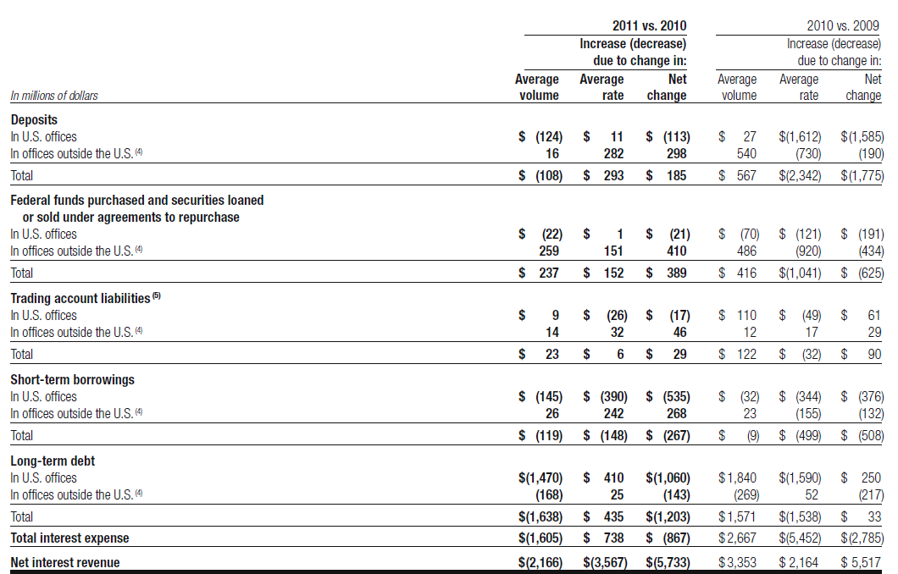
Changes in Interest Expense & NIR

Slide 41
Interest Rate Risk Measurement
Interest rate exposure (IRE) is Citigroup’s principal measure of risk to NIR
IRE measures the change in expected NIR in each currency resulting from unanticipated changes in forward interest rates.
Does not capture factors such as changes in volumes, spreads, margins and the impact of prior-period pricing decisions

Slide 42
IRE for Non-trading portfolios
approximate annualized risk to net interest revenue (NIR), assuming an unanticipated parallel instantaneous 100 basis points change, as well as a more gradual 100 basis points (25 basis points per quarter) parallel change in rates

Slide 43
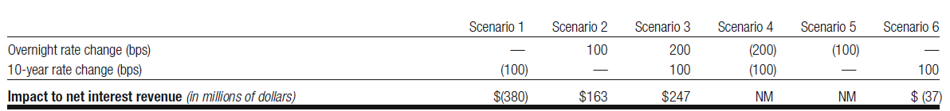
IRE--Risk to NIR
The table shows the risk to NIR from six different changes in the implied-forward rates. Each scenario assumes that the rate change will occur on a gradual basis every three months over the course of one year.

Slide 44
Mitigation and Hedging of Risk
Citigroup may modify pricing on new customer loans and deposits, enter into transactions with other institutions or enter into off-balance-sheet derivative transactions that have the opposite risk exposures

Slide 45
Trading Portfolio
Total revenues of the trading business consist of:
• customer revenue, which includes spreads from customer flow and positions taken to facilitate customer orders;
• proprietary trading activities in both cash and derivative transactions
• net interest revenue
• Credit Valuation Adjustments (CVA) incurred due to changes in the credit quality of counterparties as well as any associated hedges to that CVA. (CVA-market value of counterparty credit risk)
Price risk in trading portfolios is monitored using a series of measures including:
• factor sensitivities
• stress testing
• value-at-risk (VAR)

Slide 46
Price Risk Measurement
Factor sensitivities are expressed as the change in the value of a position for a defined change in a market risk factor, such as a change in the value of a Treasury bill for a one-basis-point change in interest rates.
Stress testing is performed on trading portfolios on a regular basis to estimate the impact of extreme market movements. The Monte Carlo is used by Citi.
VAR estimates the potential decline in the value of a position or a portfolio under normal market conditions. Citigroup’s VAR is based on the volatilities of and correlations among a multitude of market risk factors as well as factors that track the specific issuer risk in debt and equity securities.

Slide 47
VAR
Value at Risk (VaR): widely used as a risk measure of pontential decline in the value of a portfolio under normal market conditions
Common parameters for VaR are 1% and 5% probabilities and one day and two week horizons
VaR is conventionally reported as a positive number. A negative VaR would imply the portfolio has a high probability of making a profit

Slide 48
Total Daily Trading Revenue(Loss)
A substantial portion of the volatility relating to Citi’s total daily revenue VAR is driven by changes in CVA on Citi’s derivative assets, net of CVA hedges.

Slide 49
Citi’s total trading and CVA VAR as of December 31, 2011 and 2010
The change in total trading and CVA VAR was driven by a reduction in Citi’s trading exposures across Security & Banking, offset by an increase in market volatility and an increase in CVA exposure and associated hedges.

Slide 50
VaR
The table below provides the range of market factors VARs, inclusive of specific risk, during 2011 and 2010.
The following table provides the VAR for S & B during 2011 excluding the CVA relating to derivative counterparties CVA and hedges of CVA

Slide 51
Liquidity Risk

Slide 52
Liquidity Risk
Inability to raise funds in the long/short-term debt/equity capital markets or inability to access secured lending markets
  Caused by:
    Disruption of the financial markets
    Negative views about the financial services industry
    Negative perception of long or short term financial prospects
      Large trading losses, downgraded or negative watch by rating agencies, decline in business activity, action by regulators, employee misconduct or illegal activity, and other reasons
  Would have to liquidate assets to meet maturing liabilities and may have to sell at a discount
Notes:
52

Slide 53
Funding and Liquidity
Citigroup’s Funding and Liquidity Objective:
to fund its existing asset base and grow its core business in Citicorp
to maintain sufficient excess liquidity so that it can operate under a wide variety of market conditions.
Notes:
To maintain liquidity to fund its existing asset base and grow its core businesses in Citicorp,
At the same time, To maintain sufficient excess liquidity, structured appropriately, so that it can operate under a wide variety of market conditions, including market disruptions for both short- and long-term periods
An extensive range of liquidity scenarios is considered based on both historical industry experience and hypothetical
situations. The approach is to ensure Citi has sufficient funding that is structural in nature so as to accommodate market disruptions for both
short- and long-term periods.
53

Slide 54
Funding and Liquidity
Citigroup’s primary liquidity objectives are established by entity, and in aggregate, across:
(i) The non-bank, which is largely comprised of the parent holding company (Citigroup) and Citi’s broker-dealer subsidiaries
(ii) Citi’s significant bank entities, such as Citibank, N.A.
(iii) Other entities
At an aggregate level, Citigroup’s goal is to ensure that there is sufficient funding in amount and tenor to ensure that aggregate liquidity resources are available for these entities.
Notes:
Due to various constraints that limit the free transfer of liquidity or capital between Citi-affiliated entities, Citigroup’s primary liquidity objectives are established by entity, and in aggregate, across:
(collectively referred to in this section as “nonbank”);
At an aggregate level, Citigroup‘s goal is to ensure that there is sufficient funding in amount and tenor to ensure that aggregate liquidity resources are available for these entities. The liquidity framework requires that entities be self-sufficient or net providers of liquidity in their designated stress tests and have excess cash capital.
54

Slide 55
Sources of Funding
(i) Deposits via Citi‘s bank subsidiaries,
(ii) Long-term debt issued at the non-bank level and certain bank subsidiaries,
(iii) Stockholders‘ equity, and
(iv) Short-term borrowings, primarily in the form of commercial paper and secured financing transactions at the non-bank level.
Notes:
Deposits : which continue to be Citi‘s most stable and lowest-cost source of long-term funding,
Long-term Debt: including trust preferred securities and other long-term collateralized financings
Stockholder’s equity:
Short-term borrowing: Secured financings: securities loaned or sold under agreements to repurchase
55

Slide 56
Aggregate Liquidity Resources
liquidity at Citi’s significant bank entites was down at Dec 31, 2011, as compared to 2010, as Citi deployed some of its excess bank liquidiy into loan growth within Citicorp and paid down long-term bank debt.
Citi’s additional potential liquidity resources can be in the form of borrowing capacity at the U.S. Federal Reserve Bank discount window and from the various Federal Home Loan Banks.

Slide 57
Deposits
Citi‘s most stable and lowest-cost source of long-term funding
Citi had $866 billion of depositss at Dec 31, 2011; of those, $177 billion were non-interest-bearing, and $689 was interest-bearing
Increased $21 billion as compared with $845 at Dec 31, 2010, due to higher deposit volumes in Global Consumer Banking and Transaction Services. The increase was partially offset by a decrease in deposits in Citi Holdings.

Slide 58
Long-term Debt
an important funding source, primarily for the non-bank, because of its multi-year maturity structure.
Overall long-term debt decreased by approximately $58 billion
Decrease in the non-bank was primarily due to TLGP run-off
Decrease in the bank entities was due to TLGP run-off, FHLB reductions, and the maturing of credit card securitization debt.
Notes:
Citi currently expects a continued decline in its overall long-term debt over the remainder of 2011, particularly within its significant bank entities. Given its significant liquidity resources as of September 30, 2011, Citi may consider opportunities to repurchase its long-term debt, pursuant to open market purchases, tender offers or other means.
58

Slide 59
Short-term Borrowings
Short-term borrowings include:
(i) secured financing (securities loaned or sold under agreements to repurchase, or repos)
(ii) commercial paper and borrowings from the FHLB and other market participants.
Notes:
Citi supplements its primary sources of funding with short-term borrowings.
Secured financing appears as a liability on Citi‘s Consolidated Balance Sheet (―Federal Funds Purchased and Securities Loaned or Sold Under Agreements to Repurchase‖).
Original maturities of less than one year.
Interest rates include the effects of risk management activities.
59

Slide 60
Liquidity Risk Management
Liquidity management is the responsibility of senior management through Citigroup’s Finance and Asset and Liability Committee (FinALCO)
Liquidity management is overseen by the Board of Directors through its Risk Management and Finance Committee.
Notes:
60
http://www.citibank.com/transactionservices/home/about_us/online_academy/docs/holistic_liquidity_mgmt.pdf

Slide 61
Measures of Liquidity
Liquidity Ratio:
  Defined as the sum of deposits, long-term debt and stockholders’ equity as a percentage of total assets
  measures whether Citi‘s asset base is funded by sufficiently long-dated liabilities
  Citi’s structural liquidity ratio was 73% at Dec 31, 2011 and 73% at Dec 31, 2010.
Capital Ratio:
measures the amount of long-term funding—core deposits, long-term debt and equity—available to fund illiquid assets (generally include loans, securities haircut and other assets i.e. goodwill, intangibles and fixed assets).

Slide 62
Liquidity Measurements
Basel III proposed two new liquidity measurements:
Liquidity Coverage Ratio (LCR):
  to ensure banks maintain an adequate level of unencumbered cash and high quality unencumbered assets that can be converted into cash to meet liquidity needs.
  Must be at least 100%, and is proposed to be effective beginning Jan 1, 2015.
Net Stable Funding Ratio (NSFR):
  to promote the medium-and long-term funding of assets and activities over a one-year time horizon.

Slide 63
Stress Testing
Stress testing and scenario analyses are intended to quantify the potential impact of a liquidity event on the balance sheet and liquidity position, and to identify viable funding alternatives that can be utilized.
Notes:
These scenarios include assumptions about significant changes in key funding sources, market triggers (such as credit ratings), potential
uses of funding and political and economic conditions in certain countries.
These conditions include standard and stressed market conditions as well as firm-specific events.
The potential liquidity events are useful to ascertain potential mis-matches between liquidity sources and uses over a variety of horizons, and liquidity limits are set accordingly
To monitor the liquidity of a unit, those stress tests and potential mismatches may be calculated with varying
frequencies, with several important tests performed daily.
63

Slide 64
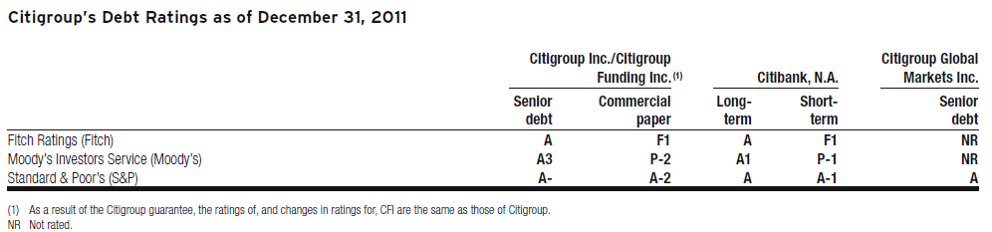
Credit Ratings
Citigroup’s ability to access the capital markets and other sources of funds, as well as the cost of these funds and its ability to maintain certain deposits, is partially dependent on its credit ratings.
Notes:
The table below indicates the current ratings for Citigroup and Citibank, N.A
Just being downgraded a notch by a rating agency can have significant effects on the cost of borrowing
Ratings downgrades by rating agency could have material impacts on funding and liquidity through cash obligations, reduced funding capacity, and due to collateral triggers.
64

Slide 65
Ratings Downgrades
On September 21, 2011, Moody’s changed the short-term rating of Citigroup to ‘P-2’ from ‘P-1’.
On November 29, 2011, S&P downgraded the issuer credit rating for Citigroup Inc. to ‘A-/A-2’ from ‘A/A-1’, and Citibank, N.A. to ‘A/A-1’ from ‘A+/A-1’.
On December 15, 2011, Fitch announced a revision to the issuer credit ratings of Citigroup and Citibank, N.A. from ‘A+’ to ‘A’ and the short-term issuer rating from ‘F1+’ to ‘F1’.

Slide 66
Impact of Downgrading
As of December 31, 2011, Citi estimates that a one-notch downgrade of the senior debt/long-term rating of Citigroup could result in loss of funding due to derivative triggers and additional margin requirements of $1.3 billion
a one-notch downgrade by Fitch of Citigroup’s commercial paper/short-term rating could result in the assumed loss of unsecured commercial paper of $6.4 billion. Other funding sources, such as secured financing transactions and other margin requirements, for which there are no explicit triggers, could also be adversely affected.
as of December 31, 2011, a one-notch downgrade of the seniordebt/long-term ratings of Citibank, N.A. could result in an approximate $2.4 billion funding requirement in the form of collateral and cash obligations

Slide 67
Contingency Funding Plans & Mitigation
Citi maintains a series of Contingency Funding Plans on a consolidated basis as well as for individual entities.
These plans specify a wide range of readily available actions that are available in a variety of adverse market conditions or disruptions.
To reduce the funding and liquidity risk of such a downgrade, Citi’s mitigating actions include, but are not limited to:
  selling or financing highly liquid government securities
  Tailoring levels of secured lending
  repricing or reducing certain commitments to commercial paper conduits, exercising reimbursement agreements for the municipal programs
  adjusting the size of select trading books
  reducing loan originations and renewals
  raising additional deposits
  borrowing from the FHLB or other central banks
Notes:
67

Slide 68
Credit Risk

Slide 69
Credit risk: Financial losses result from borrower’s or counterparty’s inability to meet its obligation
Citigroup’s business activities that could arise credit risk:
  Lending
  Sales and trading
  Derivatives
  Securities transactions
  Settlement
  Act as an intermediary

Slide 70
Loan and Credit Overview
During 2011, Citigroup’s aggregate loan portfolio was $647.2 billion, which is similar amount as in 2010.
Citi’s total allowance for loan losses totaled $30.1 billion in 2011, a coverage ratio of 4.69% of total loans, down from 6.31%.
Net credit losses of $20 billion during 2011, compared to $30.9 billion during 2010.
Consumer non-accrual loans totaled $8.0 billion during 2011, compared to $10.8 billion during 2010.
Corporate non-accrual loans were $3.2 billion during 2011, compared to $8.6 billion during 2010.

Slide 71
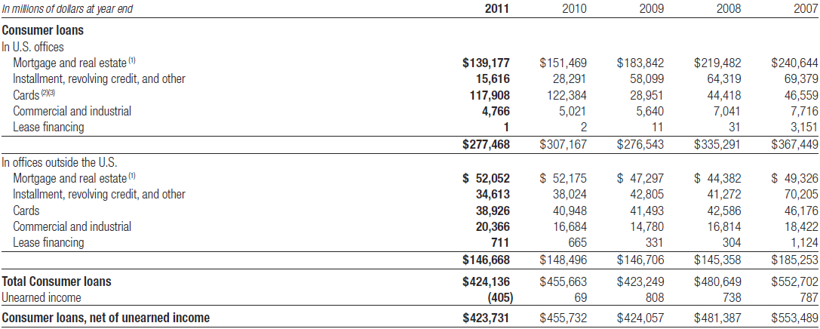
Loan Outstanding- Consumer Loans

Slide 72
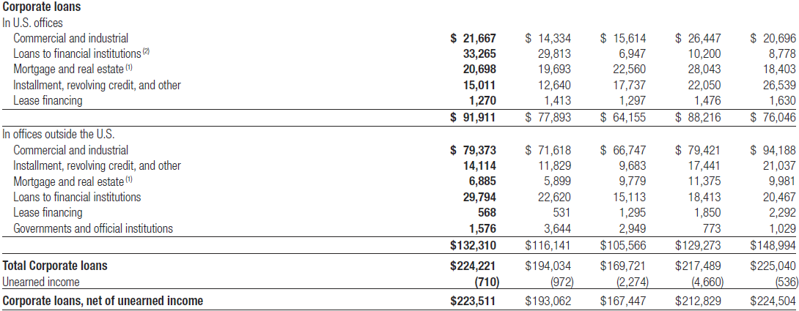
Loan Outstanding – Corporate Loans

Slide 73
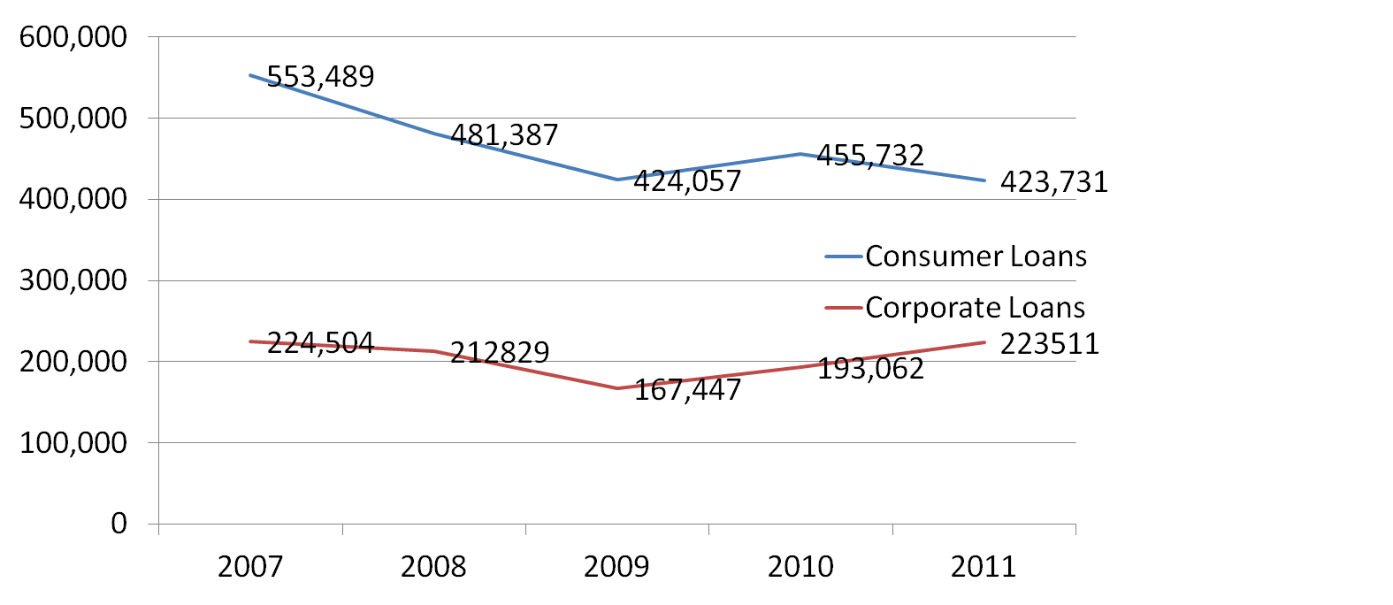
Loan Outstanding
Comparing consumer loans and corporate loans

Slide 74
Allowance of losses as a % of total loans
Allowance for Loan Losses

Slide 75
Non-Accrual Loans
Non-accrual status is based on the determination that payment of interest or principal is doubtful.
Consumer non-accrual loans: the borrower has fallen behind in payments.
Corporate non-accrual loans: the future payment of interest is doubtful.
The non-accrual loan do not include North America credit card loans.

Slide 76
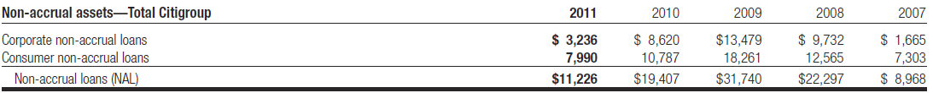
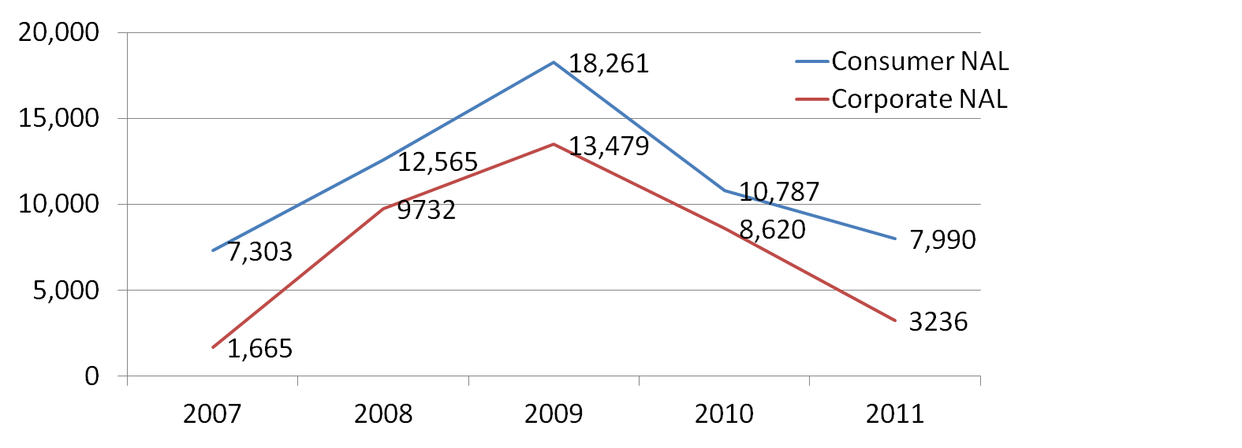
Non-Accrual Loans

Slide 77
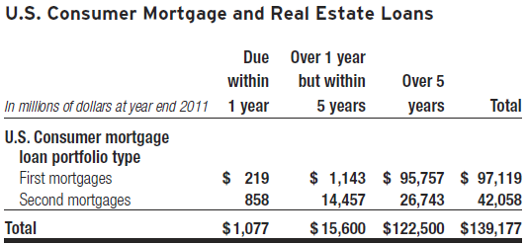
U.S. Consumer Mortgage Loans
Mortgage Lending at December 31, 2011
  First mortgages: $97 billion
  Second mortgages: $42 billion
  Total mortgages: $139 billion

Slide 78
U.S. Consumer Mortgage Loans
Consumer Loans Modification Programs
assist borrower with financial difficulties
Involves:
- modifying the original loan terms
- reducing interest rates
- extending the remaining loan duration
- waiving a portion of the remaining principal balance
For example: HAMP (the U.S. Treasury’s Home Affordable Modification Program) and CSM (Citi supplemental Program)

Slide 79
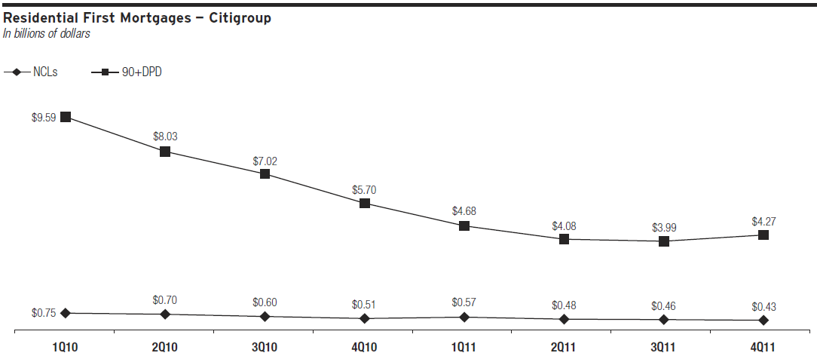
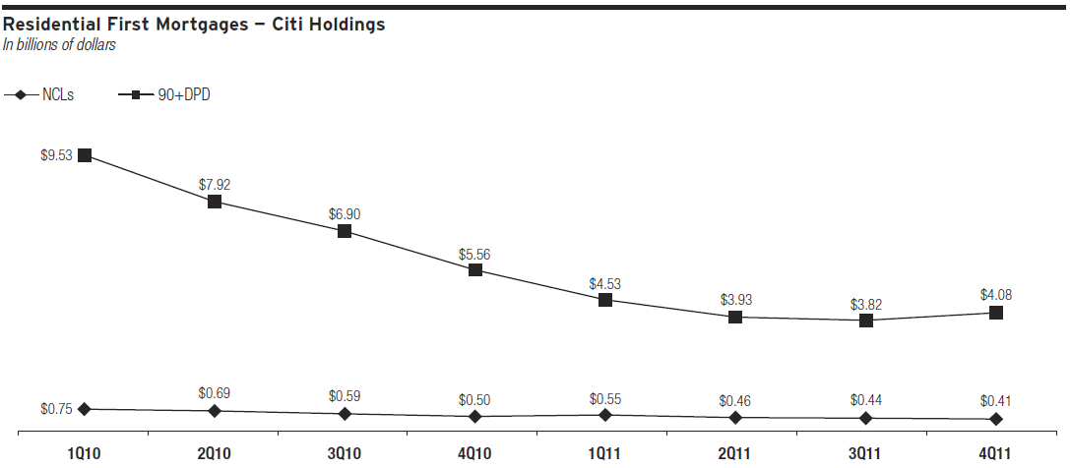
U.S. Consumer Mortgage Loans
90+DPD: 90 days past due delinquencies
NCLs: Net credit losses
Notes:
Net credit loss
90 days past due dulinquencies

Slide 80
U.S. Consumer Mortgage Loans
Citi has permanently modified $6.1 billion of residential first mortgage loan under HAMP and CSM programs since 2009.
Citi has sold $7.6 billion of delinquent first mortgages since the beginning of 2010.
As a result, delinquencies continue to decline, while net credit losses decreased during 2011.

Slide 81
North America Cards
North America cards portfolio consists of its Citi-branded portfolio in Citicorp and its retail partner card portfolio in Citi Holdings
North America Cards at December 31, 2011
  Citi-branded cards: $76 billion
  Retail partner cards $43 billion

Slide 82
North America Cards
Loss Mitigation Efforts since the beginning of 2008
Eliminate riskier accounts and sales to mitigate losses:
  Stricter underwriting standards for new accounts
  Decreasing higher-risk credit lines
  Closing high-risk accounts
  Re-pricing

Slide 83
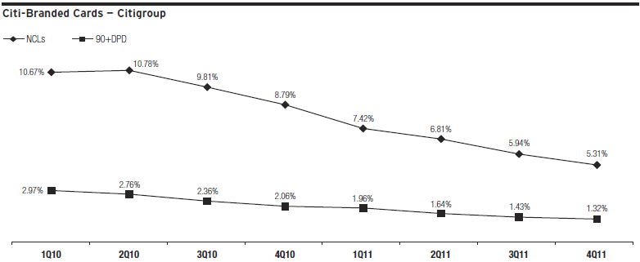
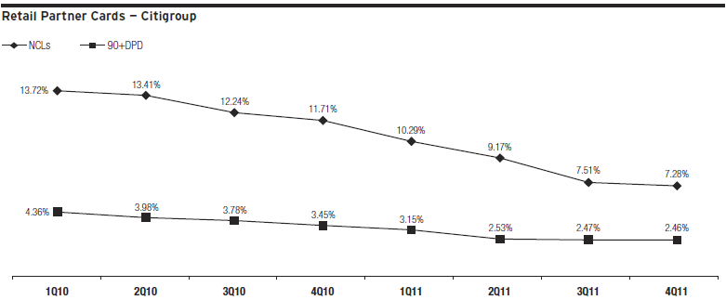
North America Cards
90+DPD: 90 days past due delinquencies
NCLs: Net credit losses

Slide 84
Operational Risk

Slide 85
Operational Risk
Operational risk: The risk of loss resulting from inadequate or failed internal processes, systems or human factors, or from external events
Operation risk in Citigroup’s global business activities is managed through an overall frameworks.
  Recognized ownership of the risk by the businesses;
  Oversight by Citi’s independent risk management;
  Independent review by Citi’s Audit and Risk Review (ARR).

Slide 86
Framework
Each major business segment must implement an operational risk process consistent with the requirements of this framework in the following steps:
identify and assess key operational risks;
establish key risk indicators;
produce a comprehensive operational risk report; and
assure adequate resources to actively improve the operational risk environment and mitigate emerging risks.

Slide 87
Measurements and Basel II
To support advanced capital modeling and management, the businesses are required to capture relevant operational risk capital information.
A risk capital model for operational risk has been developed and implemented across the major business segments as a step toward readiness for Basel II capital calculations.

Slide 88
Measurements and Basel II
The risk capital calculation under Basel II uses a combination of internal and external loss data to support statistical modeling of capital requirement estimates.
Then adjusted to reflect qualitative data regarding the operational risk and control environment.

Slide 89
Information Security
Information security and the protection of confidential and sensitive customer data
Citi has implemented an Information Security Program in accordance with the Gramm-Leach-Bliley Act and regulatory guidance.
The Information Security Program is reviewed and enhanced periodically to address emerging threats to customers’ information.

Slide 90
Regulatory Risk

Slide 91
Regulatory Risk
Citi faces significant regulatory changes around the world which could negatively impact its businesses.
The ongoing implementation of the Dodd-Frank Act, as well as international regulatory reforms, continues to create much uncertainty for Citi.
Citi’s prospective regulatory capital requirements remain uncertain. Citi will be unable to meet these new standards in the timeframe expected by the market or regulators.

Slide 92
Regulatory Risk
Under the Dodd-Frank Act, changes in regulation of derivatives will require significant and costly restructuring of Citi’s derivatives businesses in order to meet the new market structures.
The establishment of the new Consumer Financial Protection Bureau could affect Citi’s operations with respect to a number of its U.S. Consumer businesses and increase its costs.
Citi could be harmed competitively if it is unable to hire or retain highly qualified employees.

Slide 93
Country and Cross-Border Risk

Slide 94
Country Risk
Country Risk: an event in a country will impair the value of Citi’s franchise or will adversely affect the ability of obligors within that country to honor their obligations to Citi, including
    sovereign defaults, banking crises, currency crises or political events
Country risk management framework includes country risk rating models, scenario planning and stress testing, internal watch lists, country risk capital limits, and the Country Risk Committee process.

Slide 95
GIIPS and France
Several European countries, including Greece, Ireland, Italy, Portugal, Spain (GIIPS) and France, have been the subject of credit deterioration due to weaknesses in their economic and fiscal situations.
  As of December 31, 2011, Citi’s net current funded exposure to the GIIPS sovereigns, financial institutions and corporations was $7.7 billion.
  Citi’s net current funded exposure to the French sovereign, financial institutions and corporations was $1.9 billion.

Slide 96
Cross-Border Risk
Cross-Border Risk: risk that actions taken by a non-U.S. government may prevent the conversion of local currency into non-local currency and/or the transfer of funds outside the country, among other risks, thereby impacting the ability of Citigroup and its customers to transact business across borders
  Examples: actions taken by foreign governments such as exchange controls and restrictions on the remittance of funds
These actions might restrict the transfer of funds or the ability of Citigroup to obtain payment from customers on their contractual obligations

Slide 97
Cross-Border Risk
Management oversight of cross-border risk is performed through a formal review process that includes annual setting of cross-border limits and ongoing monitoring of cross-border exposures, as well as monitoring of economic conditions globally.
Under Federal Financial Institutions Examination Council (FFIEC) regulatory guidelines, total reported cross-border outstandings include cross- border claims on third parties, as well as investments in and funding of local franchises.

Slide 98
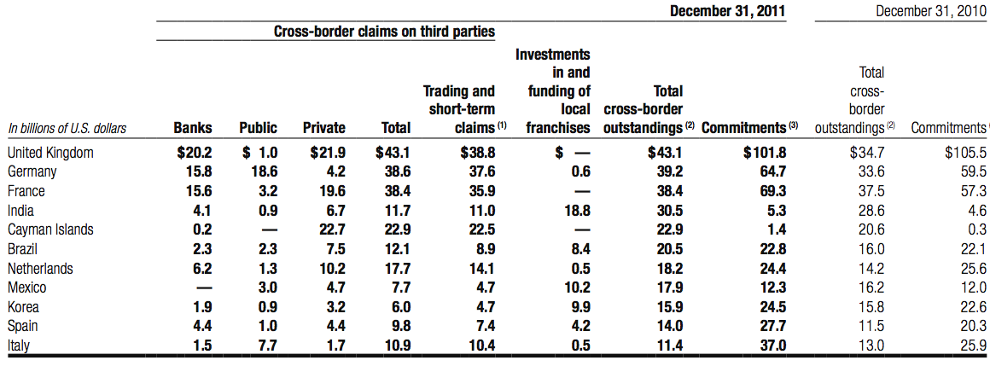
Cross-Border Risk
Citigroup‘s total cross-border outstandings, as defined by FFIEC guidelines, exceeded 0.75% of total Citigroup assets :

Slide 99
Derivative Activities

Slide 100
Derivative Activities
Reasons of entering derivatives contracts :
Trading Purposes (Customer Needs)
Trading Purposes (Own Account)
- Hedging
Notes:
Citigroup manages its exposures to market rate movements outside its trading activities by modifying the asset and liability mix, either directly or through the use of derivative financial products

Slide 101
Hedging
Risk management activities to hedge certain risks
Manage risks inherent in specific group of on-balance-sheet assets and liabilities
Expose Citigroup to market, credit or liquidity risks
Notes:
Credit Risks: the exposure to loss in the event of nonperformance by the other party to the transaction

Slide 102
Derivative Activities
Derivative transactions include interest-rate swaps, futures, forwards, and purchased options, as well as foreign-exchange contracts
These end-user derivatives are carried at fair value in Other assets, Other liabilities, Trading account assets and Trading account liabilities

Slide 103
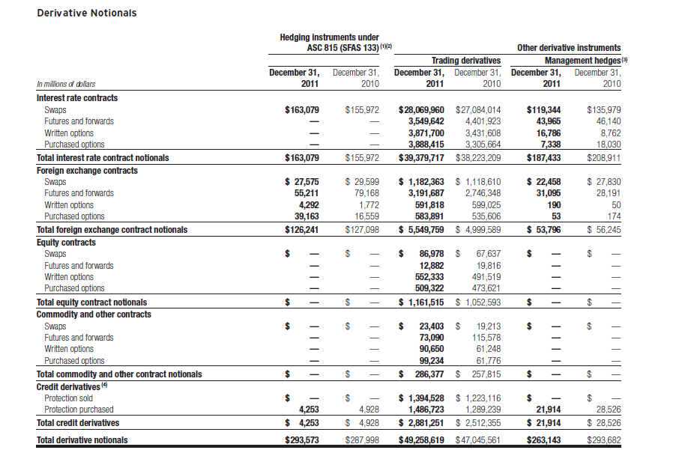

Slide 104
Fair Valuation Adjustments for Derivatives
The fair value adjustments applied by Citigroup to its derivative carrying values consist of :
Liquidity adjustments
-- applied to items in Level 2 or Level 3 of the fair-value hierarchy to ensure that the fair value reflects the price at which the entire position could be liquidated
Credit valuation adjustments (CVA)
-- applied to over-the-counter derivative instruments, in which the base valuation generally discounts expected cash flows using LIBOR interest rate curves
Notes:
Liquidity adjustments are applied to items in Level 2 or Level 3 of the
fair-value hierarchy (see Note 25 to the Consolidated Financial Statements
for more details) to ensure that the fair value reflects the price at which
the entire position could be liquidated. The liquidity reserve is based on the
bid/offer spread for an instrument, adjusted to take into account the size of
the position.
• Credit valuation adjustments (CVA) is applied to over-the-counter
derivative instruments, in which the base valuation generally discounts
expected cash flows using LIBOR interest rate curves. Because not all
counterparties have the same credit risk as that implied by the relevant
LIBOR curve, a CVA is necessary to incorporate the market view of both
counterparty credit risk and Citi’s own credit risk in the valuation.

Slide 105
Fair Value Measurement
Fair Value Measurement, specifies a hierarchy of valuation techniques based on whether the inputs to those valuation techniques are observable or unobservable.
Level 1: Quoted prices for identical instruments in active markets.
Level 2: Quoted prices for similar instruments in active markets; quoted prices for identical or similar instruments in markets that are not active; and model-derived valuations in which all significant inputs and significant value drivers are observable in active markets.
Level 3: Valuations derived from valuation techniques in which one or more significant inputs or significant value drivers are unobservable.
Notes:
Page 241 K11

Slide 106
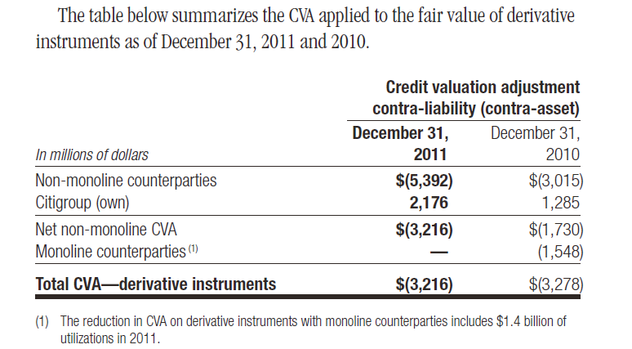
Credit Valuation Adjustments (CVA)
The CVA adjustment is designed to incorporate a market view of the credit risk inherent in the derivative portfolio.

Slide 107
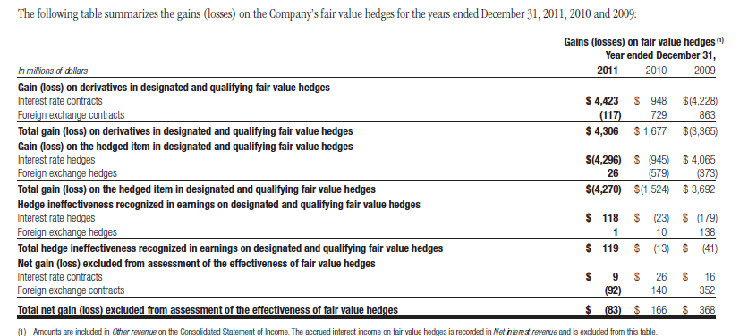
Fair Value Hedges
Hedging of benchmark interest rate risk
Hedging of foreign exchange risk
Notes:
232-241

Slide 108
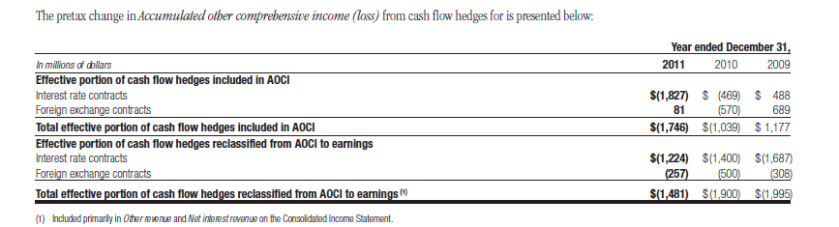
Cash Flow Hedges
Hedging of benchmark interest rate risk
Hedging of foreign exchange risk
Hedging of total return

Slide 109
Credit Derivatives
Citi primarily uses credit derivatives to help mitigate credit risk in its corporate loan portfolio and other cash positions, and to facilitate client transactions
Citigroup makes markets in and trades a range of credit derivatives, both on behalf of clients as well as for its own account
Through these contracts, Citi either purchases or writes protection on either a single-name or portfolio basis

Slide 110
Credit Derivatives
Credit derivatives generally require that the seller of credit protection make payments to the buyer upon the occurrence of predefined events (settlement triggers)
Settlement triggers
  Market standard of failure to pay on indebtedness
  Bankruptcy of reference credit
  Debt restructuring
Notes:
Settlement triggers are defined by the form of the derivative and the referenced credit, are generally limited to the market standard of failure to pay indebtedness and bankruptcy (or comparable events)
Citi actively participates in trading a variety of credit derivatives products as both an active two-way market-maker for clients and to manage credit risk.

Slide 111
Credit Derivative
Citi actively participates in trading variety of credit derivatives as
  Two-way market-maker for clients
  To manage credit risk
Majority was transacted with other financial intermediaries:
  Banks & Financial Institutions
  Broker-dealers
Generally mismatch between total notional amounts of protection purchased and sold

Slide 112
Credit Derivatives
The range of credit derivatives sold includes:
A credit default swap is a contract in which, for a fee, a protection seller agrees to reimburse a protection buyer for any losses that occur due to a credit event on a reference entity.
A total return swap transfers the total economic performance of a reference asset, which includes all associated cash flows, as well as capital appreciation or depreciation
A credit option is a credit derivative that allows investors to trade or hedge changes in the credit quality of the reference asset.

Slide 113
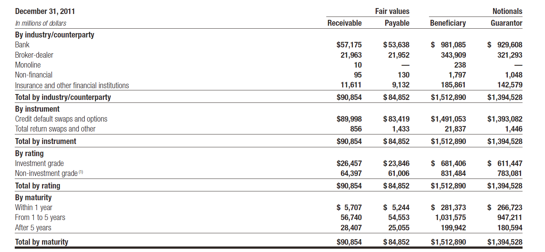
The following tables summarize the key characteristics of Citi’s credit derivatives portfolio by counterparty and derivative form as of December 31, 2011

Slide 114
Securitizations

Slide 115
Securitizations
Securitizes different asset classes to:
  Strengthen balance sheet
  Obtain more favorable credit rating
  Accessing competitive financing rates in market
Assets transferred into a trust and used as collateral by trust to obtain financing
Cash flows from assets in trust service the corresponding trust securities

Slide 116
Securitizations
Structure of trust meets accounting guidelines?
  Yes: treated as sold and no longer reflected as assets of Citi
  No: Assets continue recorded as Citi assets, with financing activity recorded as liabilities
Special Purpose Entities (SPEs):
  Entity designed to fulfill specific limited need of company that organized it
  Organized as trusts, partnerships or corporations

Slide 117
Securitizations
SPEs used to:
  Obtain liquidity and favorable capital treatment by securitizing certain Citi’s assets
  Assist clients in securitizing their assets
  Create investment products for clients
  Entity designed to fulfill specific limited need of company that organized it

Slide 118
Securitizations
2 types of SPEs:
  Qualifying SPEs (QSPEs):
    Significant limitations on:
      Types of assets or derivatives instruments may own or enter into
      Types and extent of activities and decision-making may engage in
    Passive entities designed to
      Purchase assets
      Pass through cash flows from those assets to investors in QSPE
    Generally exempt from consolidation

Slide 119
Securitizations
2 types of SPEs:
  Variable Interest Entities (VIEs):
    Entities that have either:
      Total equity investment that is insufficient to permit entity to finance its activities without additional subordinated financial support
      Equity investors lack characteristics of controlling financial interest
    Consolidation of VIE based on variability generated in scenarios that are considered most likely to occur

Slide 120


