Slide 1
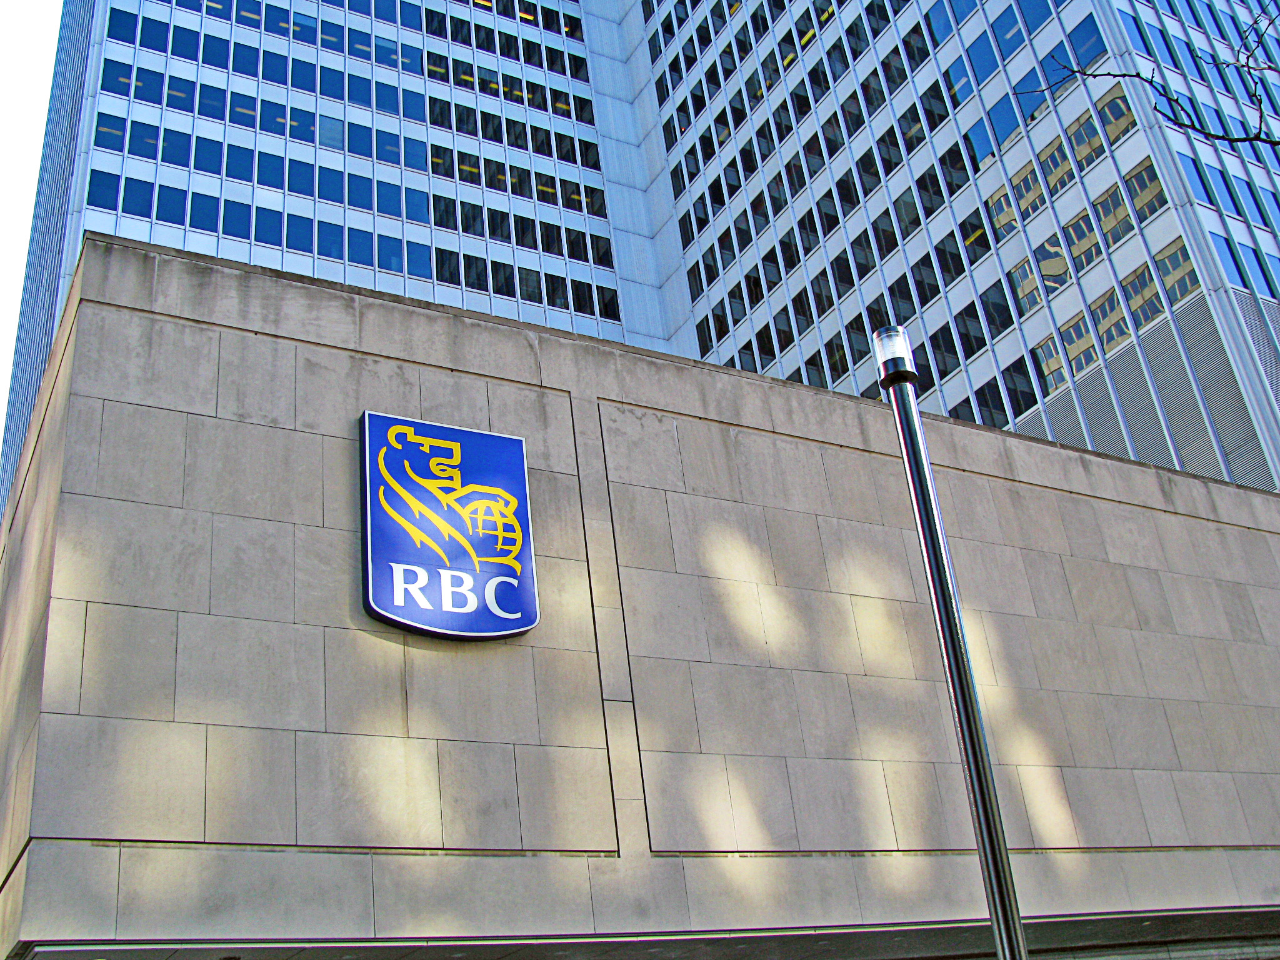
Royal Bank of Canada
BUS 419
Advanced Derivatives Securities
Prepared by
Tina Wu
Paul Yip
Sherry Li
Vivien Ding

Slide 2
Agenda
Industry Overview
Regulations
Overview of RBC
Risk management environment
Risk management structure of RBC
Analysis of financial statements
Major risks of RBC
Hedging and derivative activities

Slide 3
INDUSTRY OVERVIEW
ROYAL BANK OF CANADA

Slide 4
Canadian Banking Industry
22 domestic banks
26 foreign bank subsidiaries
22 full-service foreign bank branches
7 foreign bank lending branches

Slide 5
Schedule
Schedule I banks allowed to accept deposits that are not a subsidiary of a foreign bank.
Schedule II banks are a subsidiary of a foreign bank allowed to accept deposits in Canada.
Schedule III banks are foreign banks which can do banking business in Canada.
Notes:
RBC is schedule I bank

Slide 6
Big Five Canadian banks
RBC- Royal Bank of Canada
TD- Toronto Dominion Bank Financial Group
Scotiabank
CIBC- Canadian Imperial Bank of Commerce
Bank of Montreal
RBC is Canada’s largest bank
Notes:
RBC is schedule I bank

Slide 7
REGULATIONS
Basel Committee

Slide 8
Basel Committee
A forum to promote discussion and policy analysis among central banks and within the international financial community
Objective is to enhance understanding of key supervisory issues and improve the quality of banking supervision worldwide
Created by the central bank Governors of the Group Ten nations in 1974 and meets four times a year at the Bank for International Settlements (BIS) in Basel Switzerland
    Current Basel members from 27 countries and regions
Notes:
RBC is schedule I bank

Slide 9
Main Expert Sub-Committees
The Committee's work is organized under four main sub-committees:
  The Standards Implementation Group (SIG)
  The Policy Development Group (PDG)
  The Accounting Task Force (ATF)
  The Basel Consultative Group (BCG)
Notes:
RBC is schedule I bank

Slide 10
Sub-committee: SIG
Established to share information and promote consistency in implementation of the Basel II Framework.
In January 2009, broadened to concentrate on implementation of Basel Committee guidance and standards
SIG has two subgroups that share information and discuss specific issues related to Basel II implementation.
Notes:
-It is chaired by Mr Jos¨¦ Mar¨ªa Rold¨¢n, Director General of Banking Regulation at the Bank of Spain.

Slide 11
SIG: 2 subgroups
I) The Validation Subgroup
  Explores issues related to the validation of systems used to generate rating and parameters for internal rating-based approaches to credit risk
II) The Operational Risk Subgroup
  Addresses issues related primarily to banks' implementation of advanced measurement approaches for operational risk

Slide 12
Sub-committee: PDG
Review and identify potential supervisory issues
Propose and develop policies that supports a sound banking system and high supervisory standards
Notes:
-the Policy Development Group (PDG) is to support the Committee by identifying and reviewing emerging supervisory issues and proposing and developing policies that promote a sound banking system and high supervisory standards.
-The group is chaired by Mr Stefan Walter, Secretary General of the Basel Committee.

Slide 13
7 working groups reporting to PDG
Risk Management and Modeling Group
Working Group on Liquidity
Research Task Force
Definition of Capital Subgroup
Trading Book Group
Basel II Capital Monitoring Group
the Cross-border Bank Resolution Group

Slide 14
Sub-committee: ATF
Ensure that international accounting and auditing standards and practices promote sound risk management at financial institutions, support market discipline through transparency, and reinforce the safety and soundness of the banking system.
Developed reporting guidance and takes active role in the development of international accounting and auditing standards.

Slide 15
3 working groups report to the ATF:
Conceptual Framework Issues Subgroup
Monitors and responds to the conceptual accounting framework project of the International Accounting Standards Board (IASB) and the Financial Accounting Standards Board in the United States.
Financial Instruments Practices Subgroup
Assesses implementation of international accounting standards related to financial instruments, and the links between accounting practices in this area and prudential supervision.
Audit Subgroup
Promotes reliable financial information by exploring key audit issues from a banking supervision perspective.
Responds to international audit standards-setting proposals, other issuances of the International Auditing and Assurance Standards Board and the International Ethics Standards Board for Accountants, and audit quality issues.

Slide 16
Sub-committee: BCG
Provides a forum for deepening the Committee's engagement with supervisors around the world on banking supervisory issues.
Communicate supervisory matter with non-member countries on new Committee initiatives
Notes:
Facilitates broad supervisory dialogue with non-member countries on new Committee initiatives early in the process by gathering senior representatives from various countries, international institutions and regional groups of banking supervisors that are not members of the Committee.
-The BCG is chaired by Mr Karl Cordewener, Deputy Secretary General of the Basel Committee.
Formal channels for coordinating with supervisors of non-bank financial institutions include the Joint Forum, for which the Basel Committee Secretariat provides the secretariat function, and the Coordination Group. The Joint Forum was established in 1996 to address issues common to the banking, securities and insurance sectors, including the regulation of financial conglomerates. The Coordination Group is a senior group of supervisory standard setters comprising the Chairmen and Secretaries General of the Committee, the International Organization of Securities Commissions (IOSCO) and the International Association of Insurance Supervisors (IAIS), as well as the Joint Forum Chairman and Secretariat. The Coordination Group meets twice annually to exchange views on the priorities and key issues of interest to supervisory standard setters. The position of chairman and the secretariat function for the Coordination Group rotate among the memb-er representatives of the three standard setters every two years.

Slide 17
Basel
Basel I
  A set of minimal capital requirements for banks, as known as 1988 Basel Accord
  risk insensitive and can easily be circumvented by regulatory arbitrage
Basel II
  Replace BASEL I (1988)
  the concept and rationale of the three pillars (minimum capital requirements, supervisory review, and market discipline) approach
Notes:
RBC is schedule I bank

Slide 18
THE FIRST PILLAR: Minimum Capital Requirements
Credit Risk
  Standardized Approach
    Weighted Risk
    External credit assessment institution (ECAI)
  Internal Ratings-based Approach

Slide 19
THE FIRST PILLAR: Minimum Capital Requirements
Operational Risk
  Operational risk is defined as the risk of loss resulting from inadequate or failed internal processes, people and systems or from external events.
  Three approaches:
    the Basic Indicator Approach
    the Standardized Approach
    Advanced Measurement

Slide 20
THE FIRST PILLAR: Minimum Capital Requirements
Market Risk
  Market risk is defined as the risk of losses in on and off-balance-sheet positions arising from movements in market prices.
    The risks pertaining to interest rate related instruments and equities in the trading book;
    Foreign exchange risk and commodities risk throughout the bank.
Market Risk valuation:
  Standardized method
  Internal Model Approach

Slide 21
THE SECOND PILLAR: Supervisory Review
The second pillar deals with regulatory response to the first pillar, giving regulators much improved “tools” over those available to them under Basel I.
It also provides a framework for dealing with all the other risks, such as systemic risk, pension risk, concentration risk, reputational risk, liquidity risk and legal risk.

Slide 22
THE THIRD PILLAR: Market Discipline
It leverages the ability of market discipline to motivate prudent management by enhancing the degree of transparency in banks’ public reporting to shareholders and customers
It presents a set of disclosure requirements that should improve market participants’ ability to assess banks’ capital structures, risk exposures, risk management processes.

Slide 23
BASEL III
Key objectives
dampen any excess cyclicality of the minimum capital requirement
promote more forward looking provisions
conserve capital to build buffers at individual banks and the banking sector that can be used in stress
achieve the broader macro-prudential goal of protecting the banking sector from periods of excess credit growth

Slide 24

OVERVIEW OF RBC
ROYAL BANK OF CANADA

Slide 25
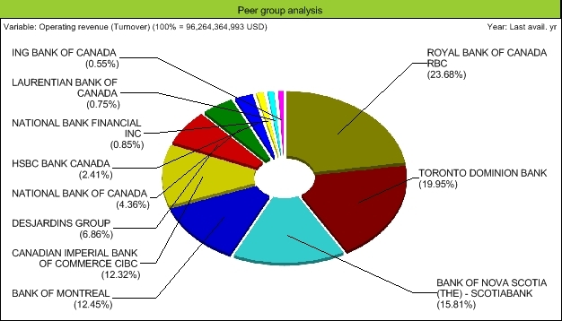
Market Share

Slide 26
Royal Bank of Canada
Operation in Canada, the US, and 50 other countries
Largest bank in Canada
79,000 full-time and part-time employees
Notes:
RBC is schedule I bank

Slide 27
Services
Personal and commercial banking
Wealth management services
Insurance
Corporate and investment banking
Transaction processing services
Notes:
RBC is schedule I bank

Slide 28
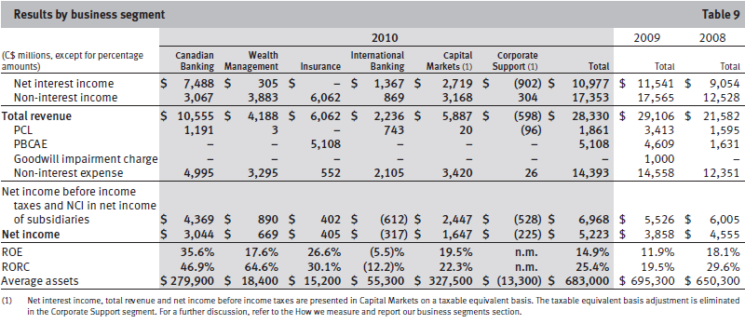
Business Segment Results

Slide 29
Revenue and Cost

Slide 30
Vision and Goals
Vision
  Always earning the right to be clients’ first choice
Strategic goals
  In Canada, to be the undisputed leader in financial services
  Globally, to be a leading provider of capital markets and wealth management solutions
  In targeted markets, to be a leading provider of select financial services complementary to core strengths
Notes:
RBC is schedule I bank

Slide 31
Macro Risk
The major risks faced by firms in the Banking industry

Slide 32
Risk Assessment
Notes:
4 major interconnected source of risk comes from:
{High}sovereign debt concerns in several countries:
{mid-High} Financial fragility associated with the weak global economic recovery
{Higher} Global imbalances has risen in the 4th quarter of 2010
{High}Main domestic risk is the rising financial position of Canadian households, which in turn is weak against adverse events
{Moderate}Potential for risk-taking behavior due to the low interest rates in major advanced economies

Slide 33
High Sovereign Debt Concerns
Canada can be affected by European financial situation due to
financial and economic linkages between Europeans banks and
Canadian banks
Cross-border spill over: peripheral debt problems may affect and weaken borderline European banks
Market concern: sovereign debt in countries with severe fiscal strains rise concerns of default risks thus affecting all banks involved in the debt which may affect the Global bank funding markets as institutional investors become less willing to lend to each other

Slide 34
High Sovereign Debt Concerns
Indications:
Escalation to generalized retrenchment
  affect prices of risky assets (include equity, currencies, commodities)
  increase risk aversion result in increased spread
  narrower options for borrowers and financial institutions
Result:
slower global economic growth, potential risk that fiscal strains can affect others due to general loss of confidence in market
Relative status of Canadian financial banking industry:
Potential risk to the global sovereign debt is high and has risen since June 2010

Slide 35
Financial Fragility Associated With The Weak Global Economic Recovery
Economic recovery is slower than expected
weak macroeconomic environment raises concern of investors
Delay of the improvement in the international Financial sector and the pace of structural adjustment

Slide 36
Global Imbalances
The accumulation of large current account surpluses by some countries and large deficits by others
Major stress lay on financial institutions, particularly those with imperfectly hedged cross-border exposures and funding strategies
Investors with exposures to cross-border carry trades could also experience losses arising from sharp fluctuations in exchange rates
Solution:
Deficit countries need to increase domestic savings and countries with
emerging economies need to adjust internal source of growth to
become less dependent on external demand
Notes:
"Such large imbalances cannot persist indefinitely; the more they grow, the greater the magnitude of the future adjustment required to resolve them.”

Slide 37
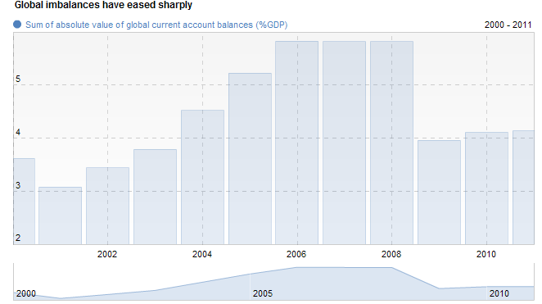
Global Imbalance
Notes:
"Such large imbalances cannot persist indefinitely; the more they grow, the greater the magnitude of the future adjustment required to resolve them.”

Slide 38
Low Interest Rates in Major Advanced Economies
Indications of global investors increasing investment in riskier assets for
higher return:
  The record issuance of high-yield debt securities in US
  Rebound of capital flows into emerging-market economies
  Increase popularity of commodity exchange-traded funds
As Result:
Excessive credit creation and increase risk-taking behaviors as investors
seek higher returns, leading to the underpricing of risk and
unsustainable increases in asset prices
Notes:
Experience suggests that a long period of very low interest rates may be associated with excessive credit creation and undue risk-taking as investors seek higher returns, leading to the underpricing of risk and unsustainable increases in asset prices
The influence of sustained low interest rates in major advanced economies on risk-taking behaviour is a powerful dynamic that bears watching. While the Bank judges that the risk of this environment jeopardizing financial stability in Canada in the near term is moderate, careful monitoring of risk-taking is essential so that any resulting buildup of financial imbalances can be identified early.

Slide 39
Financial Position of Canadian Household
The risk is that a shock to economic conditions could be transmitted to the broader financial system through a deterioration in the credit quality of loans to households
This would prompt a tightening of credit conditions that could trigger a mutually reinforcing deterioration of real activity and financial stability
Notes:
The risk is that a shock to economic conditions could be transmitted to the broader financial system through a deterioration in the credit quality of loans to households. This would prompt a tightening of credit conditions that could trigger a mutually reinforcing deterioration of real activity and financial stability.

Slide 40
Current Condition for Canadian Banking Sector
Capital position strengthened
Profitability remains strong compared to historical standard
Enjoy access to domestic and global capital market for funding
Profitability and capital adequacy
  Average return-on-equity ratio of 13.6 %
  Total loan loss has receded 1% of loans in second quarter of 2010 and 0.5 % in the third quarter of 2010

Slide 41
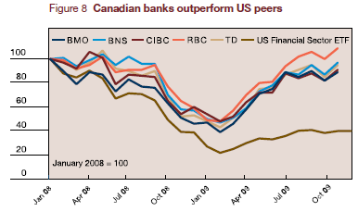
Current Condition for Canadian Banking Sector

Slide 42
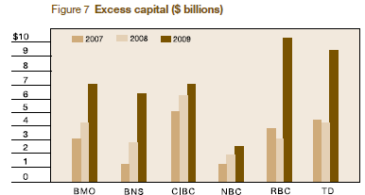
Current Condition for Canadian Banking Sector
Notes:
The continuous growing excess capital shows that canadian banks are keen to provide a cushion to help them through the recovery

Slide 43
Risk Management Structure
Royal bank of canada

Slide 44
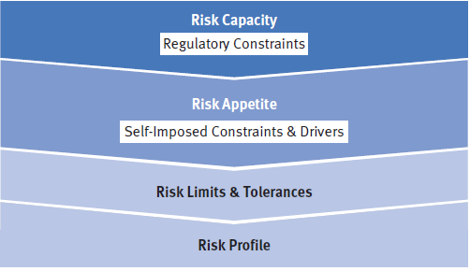
Risk Appetite
Risk Appetite is the amount and type of risk RBC are willing to accept in pursuit of their business objectives

Slide 45
Risk Appetite
The Risk Appetite Framework provides a structured approach to:
Define Risk Capacity by identifying regulatory constraints that restrict their ability to accept risk
Establish and regularly confirm their Risk Appetite, defined by Self-Imposed Constraints and Drivers in which they have chosen to limit or otherwise influence the amount of risk undertaken
Translate Risk Appetite into Risk Limits and Tolerances that guide businesses in risk taking activities
Regularly measure and evaluate Risk Profile against Risk Limits and Tolerances ensuring appropriate action is taken in advance of Risk Profile surpassing Risk Appetite

Slide 46
Risk Management Principles
The following principles guide the management of risk:
Effective balancing of risk and reward
Use of judgment and common sense
Shared responsibility for risk management
Business decisions are based on an understanding of risk
Avoid activities that are not consistent with Values, Code of Conduct or Policies
Proper focus on clients reduces their risks

Slide 47
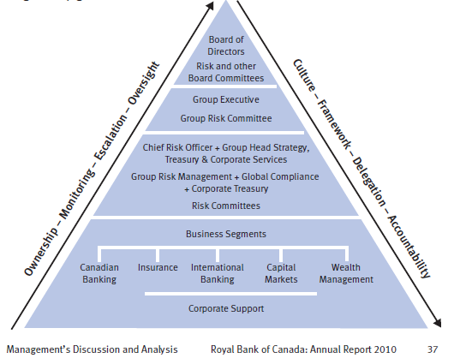
Risk Governance
Notes:
Our overall risk governance structure shown below illustrates the
roles and responsibilities of the various stakeholders in our enterprise
risk management program. Our risk governance structure is
reviewed regularly against best practices as set out in industry and
regulatory guidance.
The Board of Directors provides oversight and carries out its risk
management mandate primarily through its Risk and other Board
Committees, consisting of the Audit Committee, Corporate Governance
and Public Policy Committee (CG&PPC) and Human Resources
Committee. The Group Executive (GE) is responsible for our strategy
and its execution by establishing the “tone at the top”. GE’s risk
oversight role is executed primarily through the mandate of the Group
Risk Committee (GRC). GRC, with the assistance of its supporting Risk
Committees, is the senior management risk committee responsible
for ensuring that our overall risk profile is consistent with strategic
objectives and there are ongoing, appropriate and effective risk
management processes.

Slide 48
Risk Measurement
Expected loss: represents losses that are statistically expected to occur in the normal course of business in a given period of time
Unexpected loss and economic capital: a statistical estimate of the amount by which actual losses can exceed expected loss over a specified time horizon, measured at a specified level of confidence; hold economic capital to offset these unexpected losses
Model validation: to ensure that all underlying model risk factors are identified and successfully mitigated

Slide 49
Risk Measurement
Sensitivity analysis and stress testing: to ensure that risks RBC takes remain within the risk appetite and level of capital remains adequate
    Sensitivity analysis involves varying a single factor (e.g., a model input or specific assumption) to assess the impact on various risk measures
    Stress testing generally involves consideration of the simultaneous movements in a number of risk factors; It plays an important role in supporting overall capital management and adequacy assessment processes

Slide 50
Risk Control
Risk management frameworks and policies are organized into
the following five levels:
Level 1: Enterprise Risk Management Framework provides an overview of the enterprise-wide program for identifying, measuring, controlling and reporting on the significant risks
Level 2: Risk-Specific Frameworks elaborate on each specific risk type and the mechanisms for identifying, measuring, monitoring and reporting of risks, key policies and responsibilities
Level 3: Enterprise Risk Policies articulate minimum requirements within which businesses and employees must operate

Slide 51
Risk Control
Level 4: “Multi-risk” Enterprise Risk Policies govern activities such as product risk review and approval, stress testing, risk limits, risk approval authorities and model risk management
Level 5: Business Segments and Corporate Support Specific Policies & Procedures are established to manage the risks that are unique to their operations

Slide 52
Analysis of Financial Statements
ROYAL BANK OF CANADA

Slide 53
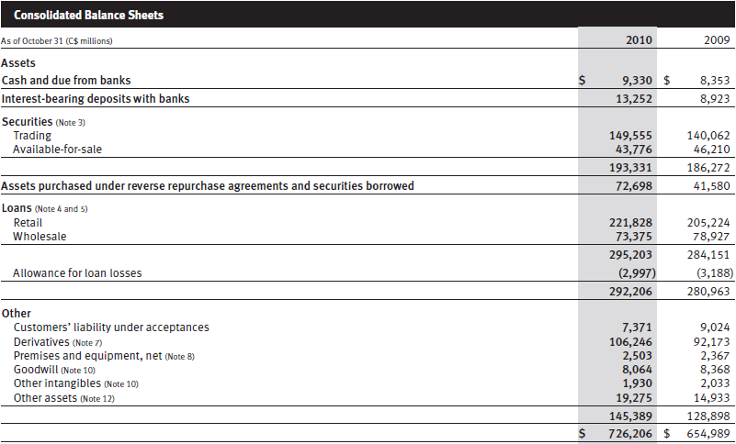
Consolidated Balance Sheets

Slide 54
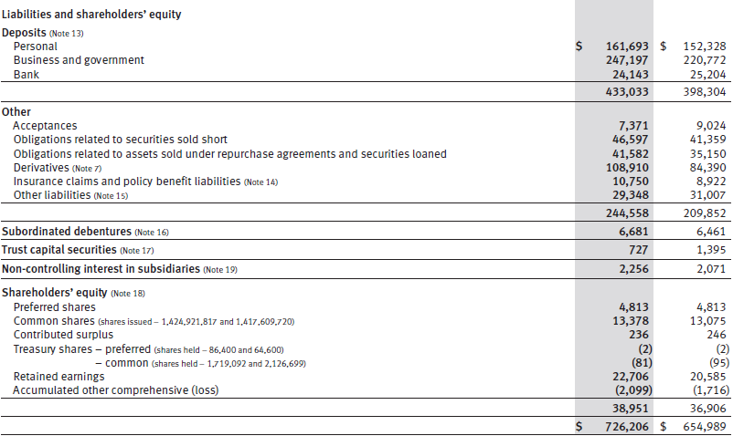
Consolidated Balance Sheets

Slide 55
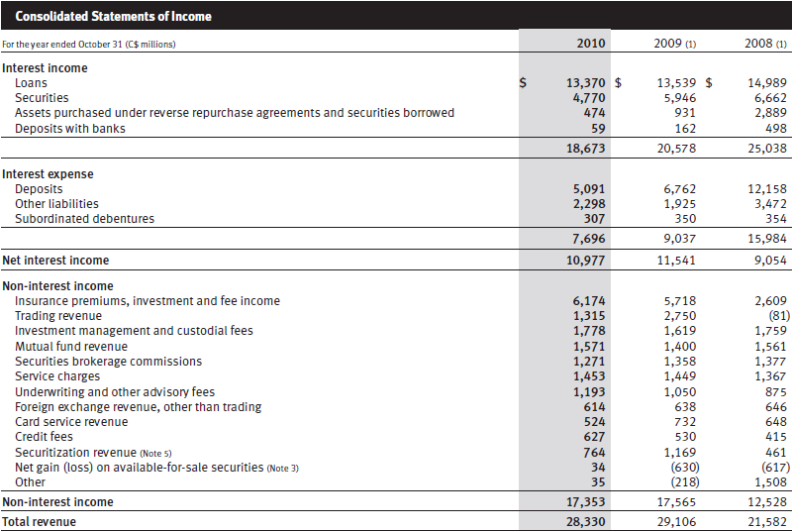
Consolidated Income Statements

Slide 56
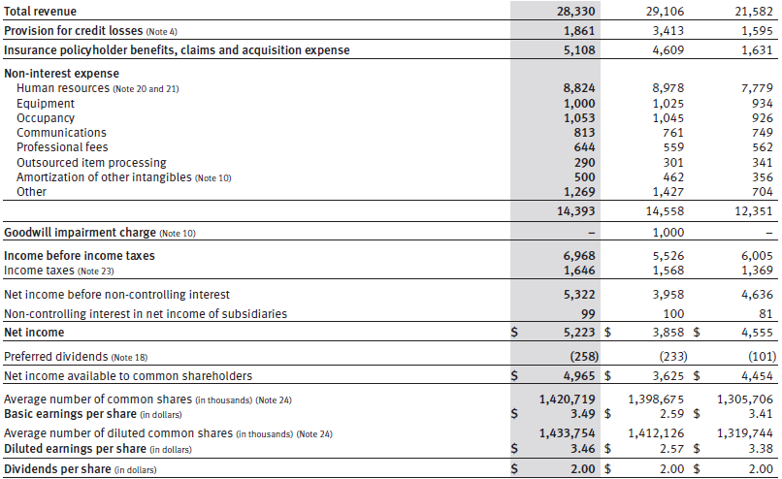
Consolidated Income Statements

Slide 57
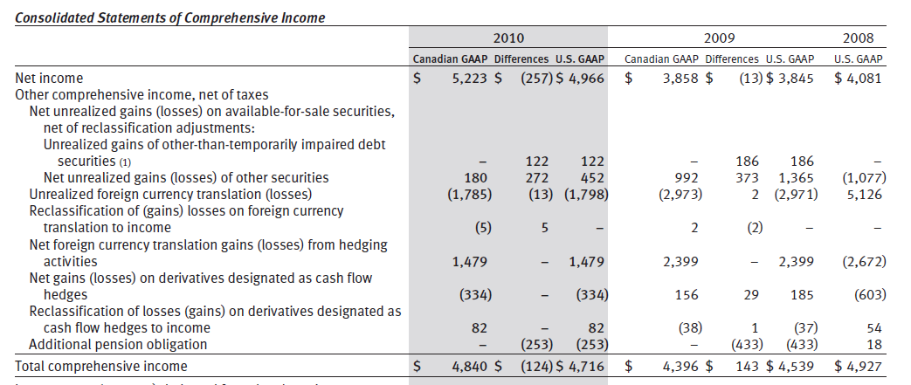
Consolidated Statements of Comprehensive income

Slide 58
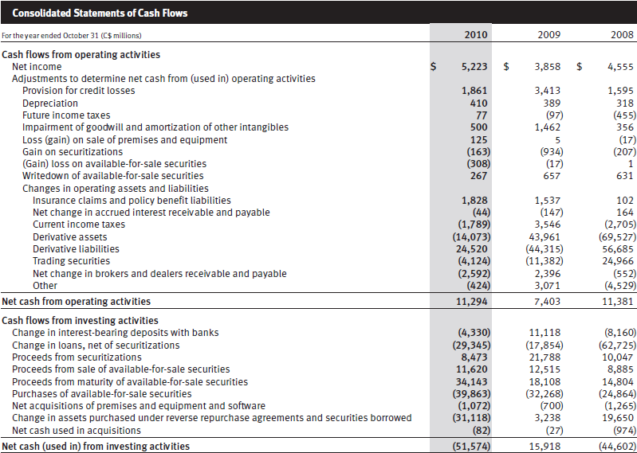
Consolidated CF Statements

Slide 59
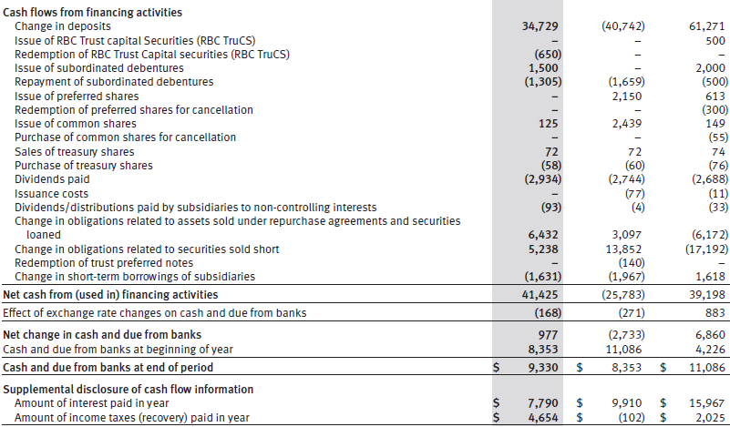
Consolidated CF Statements

Slide 60
Major Risks of RBC
ROYAL BANK OF CANADA

Slide 61
Credit Risk
Credit risk is the risk of loss associated with an obligor’s inability or unwillingness to fulfill its contractual obligations.
Credit risk may arise from the risk of default
Primary obligors
Issuer
Secondary obligors
guarantor
reinsurer
Debtor
Counterparty
Borrower
Policyholder

Slide 62
Key Parameters for Credit Risk
Probability of default (PD)
  An estimated percentage that represents the likelihood of default within a one-year period of an obligor for a specific rating grade or for a particular pool of exposures
Exposure at default (EAD)
  An amount expected to be owed by an obligor at the time of default
Loss given default (LGD)
  An estimated percentage of EAD that is not expected to be recovered during the collections and recoveries process
Notes:
These parameters are determined based on historical experience from internal credit risk rating systems in accordance with supervisory standards, and are independently validated and updated on a regular basis.

Slide 63
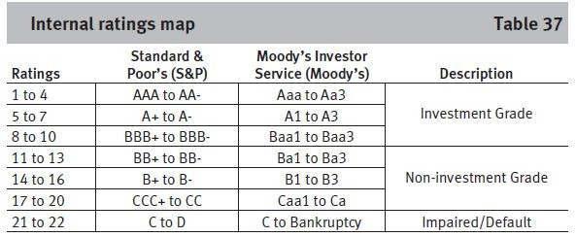
Wholesale Credit Portfolio
The wholesale credit risk rating system is designed to measure the credit risk inherent in wholesale lending activities along two dimensions.
  Assign a borrower risk rating (BRR)
  Each credit facility is assigned an LGD rate
  EAD is estimated based on the current exposure
Notes:
First, each obligor is assigned a borrower risk rating (BRR),
reflecting an assessment of the credit quality of the obligor. Each
BRR has a PD assigned to it. The BRR differentiates the riskiness of
obligors and represents our evaluation of the obligor’s ability and
willingness to meet its contractual obligations despite adverse or
stressed business conditions, troughs in the business cycle,
economic downturns or unexpected events that may occur. The
assignment of BRRs is based on the evaluation of obligors’ business
risk and financial risk based on fundamental credit analysis
supplemented by quantitative models.
Second, each credit facility is assigned an LGD rate. LGD rates are
largely driven by factors such as seniority of debt, collateral security,
product type, and the industry in which the obligor operates and
market environment.
EAD is estimated based on the current exposure to the obligor
and the possible future changes of that exposure driven by factors
such as credit quality of the obligor and type of credit commitment.
Management’s Discussion

Slide 64
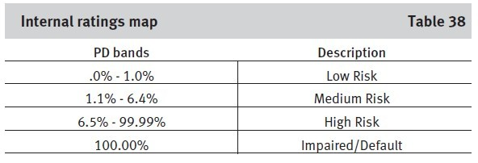
Retail Credit Portfolio
Acquisition scoring for new clients
Behavioural scoring for existing clients
For overall portfolio management, retail exposures are assessed on a pooled basis
Notes:
Acquisition scoring models, which are used for underwriting
purposes, utilize established statistical methods of analyzing new
applicant characteristics and past performance to estimate future
credit performance. In model development, sources of data are used
and include information obtained from the client such as
employment status, data from our internal systems such as loan
information and information from external sources such as credit
bureaus.
Behavioural scoring is used in the ongoing management of retail
clients with whom we have an established relationship. It utilizes
statistical techniques that capture past performance to predict future
behaviour and incorporate information, such as cash flow and
borrowing trends, as well as the extent of our relationship with the
client. The behavioural risk score is dynamic and is generally updated
on a monthly basis to continually re-evaluate the risk. Characteristics
used in behavioural scoring models are based on information from
existing accounts and lending products for each client, and from
information obtained from external sources, such as credit bureaus.
For overall portfolio management, retail exposures are assessed
on a pooled basis, with each pool consisting of exposures with
similar homogeneous characteristics. We believe pooling allows for
more precise, accurate and consistent estimates of default and loss
characteristics at the pool level.

Slide 65
Risk Control
Credit risk assessment
Credit risk mitigation
  Structuring of transactions
  Collateral
  Credit derivatives
Product approval
Credit portfolio management
Notes:
Structuring of transactions
• Includes the use of guarantees, security, seniority and
covenants. Product-specific guidelines set out appropriate
product structuring as well as client and guarantor criteria.
The third-party guarantors that we deal with are primarily
sovereign-sponsored agencies.
Collateral
• We often require obligors to pledge collateral as security
when we advance credit. The extent of risk mitigation
provided by collateral depends on the amount, type and
quality of the collateral taken.
Credit derivatives
• Used as a tool to mitigate industry sector concentration and
single-name exposure. The counterparties that we transact
with are typically investment-grade banks and broker/
dealers. As with other derivatives, we use collateral and
master netting agreements for managing counterparty credit
risk and these contracts are subject to the same credit
approval, limit and monitoring standards used for managing
credit risk. For a more detailed description of the types of
credit derivatives we enter into and how we manage related
credit risk, refer to Note 7 to our 2010 Annual Consolidated
Financial Statements.

Slide 66
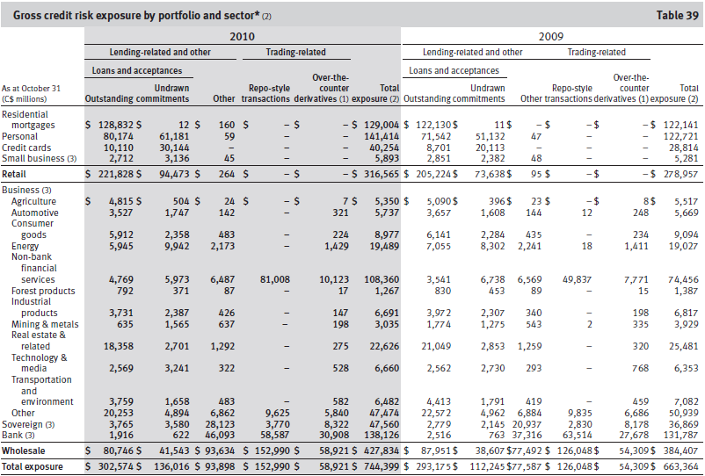
Gross Credit Risk Exposure
Notes:
2010 vs. 2009
Total gross credit risk exposure increased $81 billion, or 12%, from a
year ago, reflecting increases in both retail and wholesale portfolios.
Retail exposure increased $38 billion, or 14%, primarily driven
by the implementation of updated risk parameters for undrawn
commitments and the realignment of the retail risk rating system
reflecting recent credit experience. Retail exposure also increased as
a result of solid volume growth in Canadian home equity and personal
lending products. The use of guarantees and collateral represents an
integral part of our credit risk mitigation in the retail portfolio. Insured
mortgages accounted for 20% of our residential mortgage portfolio in
2010 as compared to 24% in 2009. Secured personal lending
represented 56% of personal loans outstanding in 2010 as compared
to 54% in 2009.
Wholesale exposure increased $43 billion, or 11%, mainly
reflecting increases in most exposure types. Repo-style transactions
increased $27 billion, primarily in non-bank financial services, due to
higher market activity from the European Government Bond business
and increased volume for our primary dealer activities, partially offset
by the impact of the stronger Canadian dollar. Other exposure
increased $16 billion in bank and sovereign, largely due to higher
guarantees and securities exposures. Loans and acceptances
decreased $7 billion, mainly in the business portfolio across most
sectors largely due to a strategic reduction in our U.S. loan portfolio,
maturity and repayments and the impact of the stronger Canadian
dollar. Most of the decrease in business exposure was in real estate
and related, mining and metals, energy and other services within the
other category. The decrease was partially offset by increases in nonbank
financial services and sovereign. The loan utilization rate
remained stable at 42%.

Slide 67
Loans and Acceptances
Notes:
2010 vs. 2009
Loans and acceptances increased by $9 billion, or 3%, from the prior
year, mainly reflecting strong retail growth in Canada, partially offset
by decreases in our wholesale portfolio.
Solid retail growth of $17 billion was driven by volume growth in
Canadian personal lending and residential mortgages.
Wholesale loans and acceptances decreased by $7 billion
mainly due to the same reasons discussed in the gross credit risk
exposure section.

Slide 68
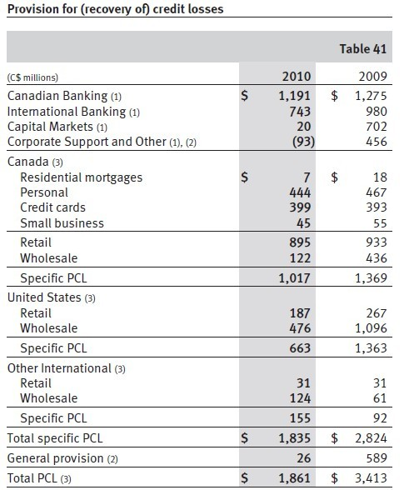
Provision for Credit Losses
Notes:
Total PCL of $1.9 billion decreased $1.6 billion from a year ago,
mainly reflecting decreased specific PCL of $1.0 billion. We incurred a
general provision of $26 million in the current year, as compared to
$589 million in 2009.

Slide 69
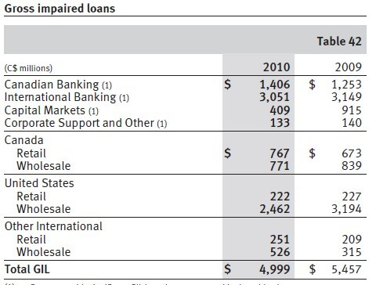
Gross Impaired Loans
Notes:
2010 vs. 2009
Total gross impaired loans (GIL) decreased by $458 million, or 8%
from a year ago.
GIL in Canadian Banking increased $153 million, or 12% mainly
reflecting higher impaired loans in our residential mortgages and
commercial portfolios.
GIL in International Banking decreased $98 million, or 3%,
mainly reflecting reductions in our residential builder finance portfolio
from higher write-offs and foreclosures, and declines in certain
impaired AFS securities reclassified to loans. These factors were
partially offset by higher impaired loans in our U.S. commercial
portfolio. Both our Caribbean wholesale and retail portfolios
remained under pressure from the slow economic recovery and
continued weakness in commercial real estate asset values.
GIL in Capital Markets decreased $506 million, or 55%, mainly
due to lower new impaired loans in our non-bank financial services,
and other portfolios primarily in the U.S.
GIL in Corporate Support and Other decreased slightly by
$7 million.

Slide 70
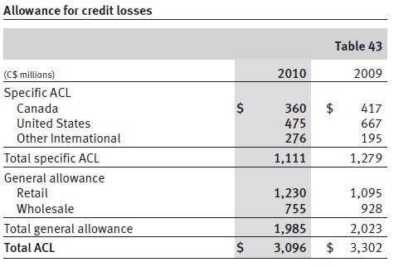
Allowance for credit losses
Notes:
2010 vs. 2009
Total allowance for credit losses (ACL) decreased $206 million, or 6%,
from a year ago, mainly due to a $168 million decrease in the specific
allowance, reflecting the same factors as previously discussed. It also
includes a $38 million decrease in the general allowance largely as a
result of the impact of a stronger Canadian dollar. This was offset by
an increased provision relating to our U.S. banking business. Refer to
the Supplemental information section for further details.

Slide 71
Market Risk
Market risk is the risk of loss that may arise from changes in market factors such as interest rates, foreign exchange rates, equity or commodity prices, and credit spreads
RBC are exposed to market risk in trading activity and asset/liability management activities.

Slide 72
Trading market risk
Interest rate risk
Credit specific risk
Foreign exchange rate risk
Equity risk
Commodities risk
Market liquidity risk
Notes:
Trading market risks associated with securities and related
derivatives trading activities are a result of market-making, proprietary,
and sales and arbitrage activities in the interest rate, credit,
foreign exchange, equity, and commodities markets. Trading market
risk reflects the potential adverse impact on our earnings and
economic value and is comprised of the following components:
• Interest rate risk arises from the changes in interest rates and is
composed of directional risk, yield curve risk, basis risk and
option risk. Interest rate risk also captures credit spread risk
arising from the changes in issuer spreads.
• Credit specific risk arises from the change in the
creditworthiness and default of issuers of our holdings in fixed
income products.
• Foreign exchange rate risk arises from the change in currency
rates and precious metals price movements and volatilities. In
our proprietary positions, we are exposed to the spot, forward
and derivative markets.
• Equity risk arises from the movements in individual equity
prices or movements in the level of stock market indices.
• Commodities risk arises from commodities price movements
and volatilities.
• Market illiquidity risk arises from the inability to liquidate our
positions or acquire hedges to neutralize our trading positions.

Slide 73
Risk measurement
Value at risk (VaR)
  A statistical technique that measures the worst-case loss expected over a one-day period with a 99% confidence level
Sensitivity analysis
  Measure the impact of small changes in individual risk factors such as interest rates and foreign exchange rates
  Is designed to isolate and quantify exposure to the underlying risk
Stress testing
  To address more extreme market events
  Is used to measure and alert senior management to our exposure to potential political, economic or other disruptive events

Slide 74
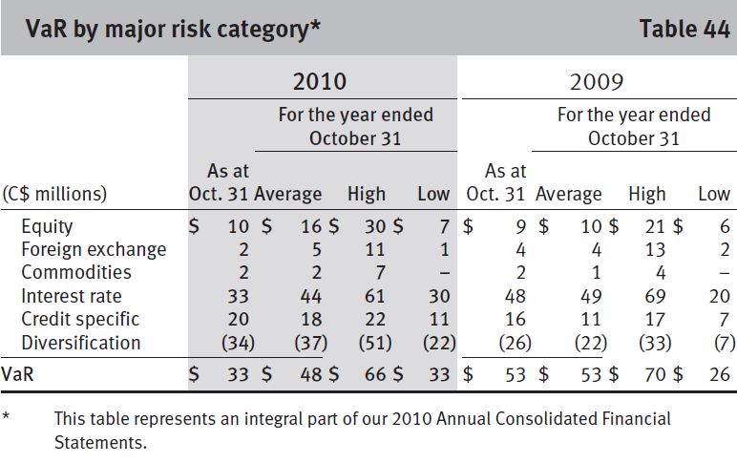
VaR
Notes:
2010 vs. 2009
Average VaR of $48 million for the year was down $5 million
compared to a year ago. This was largely due to the impact of the
stronger Canadian dollar on foreign-denominated portfolios and an
increase in diversification from 29% to 44%. These factors were
partially offset by the increases in Credit Specific and Equity VaR. The
increase in Credit Specific VaR is attributed to the Credit Specific VaR
model incorporating higher probabilities of credit events. The
increase in Equity VaR was largely driven by a combination of
business activity and market volatility.

Slide 75
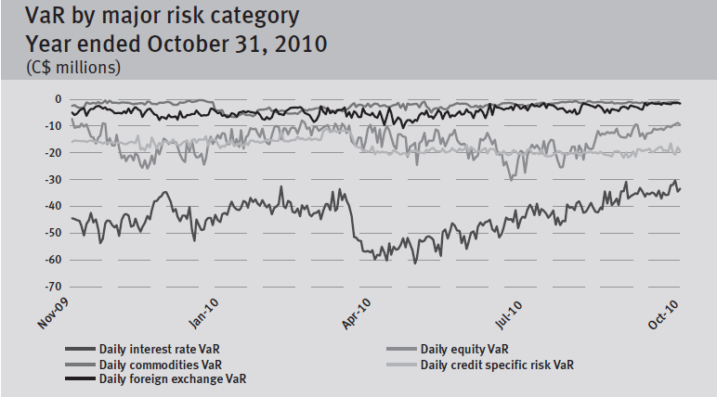
VaR

Slide 76
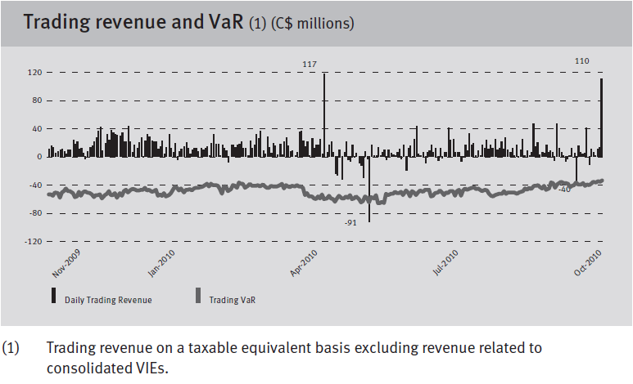
VaR

Slide 77
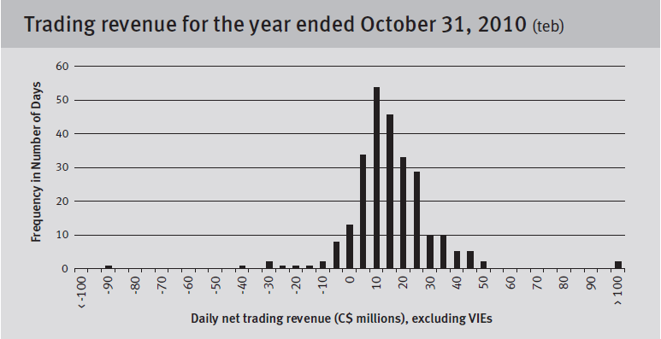
VaR
Notes:
2010 vs. 2009
During the year, we experienced 30 days of net trading losses
compared to 13 days in 2009. Two of the losses in 2010 exceeded
VaR. The volatility in daily trading revenue during the second and
third quarters reflected the increased volatility in the market driven by
the European sovereign debt crisis. The largest loss occurred on
May 31, 2010, totalling $91 million, exceeding the VaR for that day.
This loss as well as two large profit days on April 30, 2010 and
October 29, 2010, were primarily due to a month-end credit valuation
adjustment on a certain MBIA exposure.

Slide 78
Non-trading Market Risk (Asset/Liability Management)
Deposit taking and lending expose to market risk, of which interest rate risk is the largest component
Goal is to manage the interest rate risk of the non-trading balance sheet to a target level

Slide 79
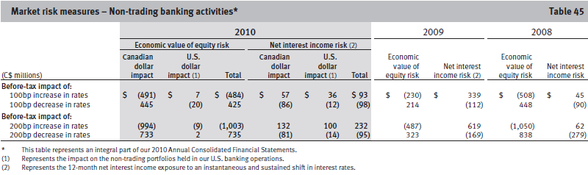
Risk Control
Notes:
Our risk position is measured
daily, weekly or monthly based on the size and complexity of the
portfolio. Measurement of risk is based on rates charged to clients as
well as funds transfer pricing rates. Key rate analysis is one of the
tools utilized for risk management. It provides us with an assessment
of the sensitivity of the exposure of our economic value of equity to
instantaneous changes in individual points on the yield curve. The
economic value of equity is equal to the net present value of our
assets, liabilities and off-balance sheet instruments.
As part of our monitoring process, the effectiveness of our
interest rate risk mitigation activity is assessed on value and earnings
bases, and model assumptions are validated against actual client
behaviour.
The Asset Liability Committee (ALCO) provides oversight over
non-trading market risk policies, limits, and operating standards.
Interest rate risk reports are reviewed regularly by ALCO, GRC and the
Board of Directors. The structural interest rate risk policy defines the
management standards and acceptable limits within which risks to
net interest income over a 12-month horizon, and the economic value
of equity, are to be contained. These ranges are based on immediate
and sustained ±100 basis points (bps) parallel shifts of the yield
curve. The limit for net interest income risk is 3% of projected net
interest income, and for economic value of equity risk, the limit is
3.75% of shareholder’s equity. Interest rate risk limits are reviewed
and approved annually by the Board of Directors.
The following table provides the potential before-tax impact of
an immediate and sustained 100 basis point and 200 basis point
increase or decrease in interest rates on net interest income and
economic value of equity of our non-trading portfolio, assuming that
no further hedging is undertaken. These measures are based upon
assumptions made by senior management and validated by empirical
research. All interest rate risk measures are based upon interest rate
exposures at a specific time and continuously change as a result of
business activities and our risk management actions. Over the course
of 2010, our interest rate risk exposure was well within our target
level.

Slide 80
Non-trading Foreign Exchange Rate Risk
Potential adverse impact on earnings and economic value due to changes in foreign currency rates
Also exposed to foreign exchange rate risk arising from investments in foreign operations
Reduce risks by hedging
Notes:
Foreign exchange rate risk is the potential adverse impact on earnings
and economic value due to changes in foreign currency rates. Our
revenue, expenses and income denominated in currencies other than
the Canadian dollar are subject to fluctuations as a result of changes
in the value of the average Canadian dollar relative to the average
value of those currencies. Our most significant exposure is to the U.S.
dollar due to our level of operations in the U.S., and other activities
conducted in U.S. dollars. We are also exposed to the British pound
and the Euro due to our activities conducted internationally in these
currencies. A strengthening or weakening of the Canadian dollar
compared to the U.S. dollar, British pound and the Euro could reduce
or increase, as applicable, the translated value of our foreign currency
denominated revenue, expenses and earnings and could have a
significant effect on the results of our operations. We are also
exposed to foreign exchange rate risk arising from our investments in
foreign operations. For un-hedged equity investments, when the
Canadian dollar appreciates against other currencies, the unrealized
translation losses on net foreign investments decreases our
shareholders’ equity through the cumulative translation account and
decreases the translated value of the RWA of the foreign currencydenominated
operations. The reverse is true when the Canadian
dollar depreciates against other currencies. Consequently, we
consider these impacts in selecting an appropriate level of our
investments in foreign operations to be hedged.

Slide 81
Liquidity and Funding Risk
The risk that may be unable to generate or obtain sufficient cash or its equivalent in a timely and cost-effective manner to meet RBC’s commitments as they come due.
RBC’s goals:
An balance between the level of risk and cost of its mitigation
Broad funding access through retaining and promoting a reliable base of client deposits, accessing diversified sources of wholesale funding
A comprehensive enterprise-wide liquidity contingency plan supported by unencumbered marketable securities that provide assured access to cash in a crisis
Appropriate and transparent liquidity transfer pricing and cost allocation

Slide 82
Risk Measurement
Structural (longer-term) liquidity risk
  use cash capital and other structural metrics to measure and control balance sheet risk and to assist in the determination of our term funding strategy.
Tactical (shorter-term) liquidity risk
  apply net cash flow limits in Canadian dollar and foreign currencies for key short-term time horizons and assign a risk-adjusted limit to our aggregate pledging exposure and individual limits.
Contingency liquidity risk
  assesses the impact of and intended responses to sudden stressful events

Slide 83
Risk Governance and Control
Delegation and liquidity management framework are approved annually
Liquidity status and position monitored on a regular basis
Shared management and oversight of funding activities and status
Analyze ability to lend or borrow funds between:
  Branches
  Subsidiaries
  convert btw currencies

Slide 84
Funding strategy
Core funding, comprising capital, longer-term liabilities and a diversified pool of personal and, to a lesser extent, commercial and institutional deposits, is the foundation of RBC’s structural liquidity position.
Wholesale funding activities are well diversified by geographic origin, investor segment, instrument, currency, structure and maturity.
Maintaining competitive credit ratings is also critical to cost-effective funding.

Slide 85
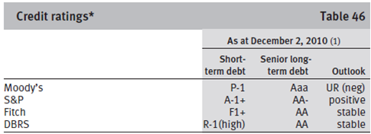
Credit ratings

Slide 86
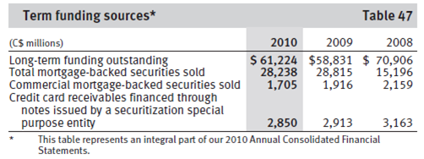
Deposit profile
Notes:
During 2010, we continued to expand our long-term funding base by
selectively issuing, either directly or through our subsidiaries,
$21.5 billion of senior deposit notes in various currencies and
markets. Total long-term funding outstanding increased by
$3.2 billion. Outstanding senior debt containing ratings triggers,
which would accelerate repayment, constitutes a very small
proportion of our overall outstanding debt of $62 billion.

Slide 87
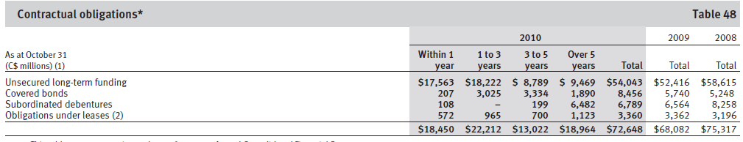
Limitation: Contractual obligations
Notes:
Contractual obligations
In the normal course of business, we enter into contracts that give
rise to commitments of future minimum payments that affect our
liquidity. Depending on the nature of these commitments, the
obligation may be recorded on- or off-balance sheet. The following
table provides a summary of our future contractual funding
commitments.

Slide 88
Other Risk
Operational Risk
Strategic risk
Regulatory and legal risk
Reputation risk
Insurance risk
Environmental risk
Notes:
RBC is schedule I bank

Slide 89
Operational Risk
Risk of loss or harm resulting from inadequate or failed internal processes, people and systems or from external events
Result in direct or indirect financial loss, reputational impact, regulatory censure, or failure in the management of other risks such as credit or market risk
Notes:
RBC is schedule I bank

Slide 90
Management of Operational Risk
Measurement tools and Methodologies:
Standardized Approach
Advanced Measurement Approach (AMA)
  Expect to implement in 2013
Specific programs to support the management of
Operational risk:
Risk and control assessment,
Operational event data collection and analysis
Industry loss analysis
Key risk indicators.
Notes:
The two options available to us under Basel II are the Advanced Measurement Approach (AMA) and the Standardized Approach. RBC continued to adopt the Standardized pproach for operational risk and expect to implement the Advanced Measurement Approach in 2013
Specific programs, policies, standards and
methodologies have been developed to support the management of
Operational risk. These programs are (i) Risk and control assessment,
(ii) Operational event data collection and analysis, (iii) Industry loss
analysis, and (iv) Key risk indicators.

Slide 91
Strategic risk
Risk that the enterprise or particular business areas will make
inappropriate strategic choices, or will be unable to successfully
implement selected strategies or related plans and decisions
Management of Strategic Risk
The heads of the business segments, the Enterprise Strategy Office, Group Executive, and the Board of Directors will take responsibility
Management of strategic risk is supported by the Enterprise Strategy Group through the use of an enterprise strategy framework that synthesizes business portfolio strategies with the enterprise vision
Notes:
For example, failure to successfully integrate and retain
clients and key employees from our strategic acquisitions or joint
ventures may adversely affect our financial performance.

Slide 92
Regulatory and legal risk
Risk of negative impact to
  business activities
  earnings or capital
  regulatory relationships or reputation
Negative impact
  failure to comply or adapt to
    Current and changing regulations
    Law
    industry codes or rules
    Regulatory expectations
    Ethical standards

Slide 93
Management of Regulatory and Legal Risk
Enterprise Compliance Management (ECM) framework that is consistent with -regulatory guidance from OSFI and other regulators
To promote the proactive, risk-based management of compliance and regulatory risk
Notes:
Global Compliance has developed a comprehensive enterprise
compliance management (ECM) framework that is consistent with -
regulatory guidance from OSFI and other regulators.

Slide 94
Management of Regulatory and Legal Risk
Elements driving the management of regulatory risk:
Sets the cycle in motion by defining the nature of business activities and operations
Ensures compliance programs are designed in a manner to most effectively meet regulatory requirements
Relate to the design and implementation of specific controls and the associated monitoring and oversight of the effectiveness of those controls
Ensures the timely escalation and resolution of issues, and clear and transparent reporting (Critical Step)
Notes:
critical step in enabling senior management and the Board of
Directors to effectively perform their management and oversight
responsibilities

Slide 95
Reputation Risk
The risk that an activity undertaken by an organization or its representatives will impair its image in the community or lower public confidence in it, resulting in the loss of business, legal action or increased regulatory oversight
Arise from a number of events and primarily occurs in connection with regulatory, legal and operational risks

Slide 96
Management of Reputation Risk
The following principles guide RBC management of reputation risk:
Operate with integrity at all times in order to sustain a strong and positive reputation.
Protecting our reputation is the responsibility of all employees, including senior management and extends to all members of the Board of Directors

Slide 97
Insurance risk
Insurance risk is the exposure to potential financial loss arising from payments that are different than anticipated (e.g. number, amount or timing) under an insurance policy or reinsurance treaty
Insurance risk is further categorized into the following sub-risks:
Claims Risk
Policyholder Behaviour Risk (Lapse Risk)
Expense Risk

Slide 98
Environmental risk
The risk of loss to financial, operational or reputational value resulting
from the impact of environmental issues
Example:
The environmental issues associated with clients’ purchase and sale
of contaminated property may give rise to credit and reputation risk
To manage environmental risk by maintaining an environmental management system, including policies, management and mitigation strategies, training, communication, and reporting

Slide 99
RISK MANAGEMENT STRATEGIES
ROYAL BANK OF CANADA

Slide 100
Derivative Instruments
Financial derivatives are financial contracts whose value is derived from an underlying interest rate, foreign exchange rate, credit risk, and equity or equity index.
Non-financial derivatives are contracts whose value is derived from a precious metal, commodity instrument or index.
Financial Derivatives
Forwards and Futures
Swaps
Option
Credit Derivatives
Other Derivatives Products

Slide 101
Derivative Instruments
Trading purposes
  Sales
  Trading
Non-trading purposes (hedging)
  Interest rate swaps
  Cross currency swaps
  Foreign exchange forward contracts
  Credit derivatives
Notes:
We also use derivatives for purposes other than trading, primarily for
hedging, in conjunction with the management of interest rate, credit,
equity and foreign exchange risk related to our funding, lending,
investment activities and asset/liability management.
Interest rate swaps are used to manage our exposure to interest
rate risk by modifying the repricing or maturity characteristics of
existing and/or anticipated assets and liabilities, including funding
and investment activities. Purchased interest rate options are used to
hedge redeemable deposits and other options embedded in
consumer products. We manage our exposure to foreign currency risk
with cross currency swaps and foreign exchange forward contracts.
We predominantly use credit derivatives to manage our credit
exposures. We mitigate industry sector concentrations and singlename
exposures related to our credit portfolio by purchasing credit
derivatives to transfer credit risk to third parties.
Certain derivatives and cash instruments are specifically
designated and qualify for hedge accounting. We apply hedge
accounting to minimize volatility in earnings caused by changes in
interest rates or foreign exchange rates. Interest rate and currency
fluctuations will either cause assets and liabilities to appreciate or
depreciate in market value or cause variability in anticipated cash
flows. When a hedging instrument functions effectively, gains, losses,
revenue and expenses of the hedging instrument will offset the gains,
losses, revenue and expenses of the hedged item. We largely assess
and measure the effectiveness of a derivative that is designated as a
hedging instrument based on the change in its fair value. When cash
instruments are designated as hedges of currency risks, only changes
in their value due to currency risk are included in the assessment and
measurement of hedge effectiveness. We applied hedge accounting
to anticipated transactions and firm commitments during the year.

Slide 102
Market Risk Management Strategy
Interest rate Risk
Interest rate swap
Interest rate option
Foreign Exchange risk
Cross currency swap
Foreign currency option
Equity risk
Equity swap
Index option
Credit Spread Risk
Equity option
Credit default swap
Foreign exchange forward and future
Interest rate forward/future

Slide 103
Hedge Accounting
Fair value hedges
  Carrying value → Non-interest income.
Net investment hedges
  Effective portion → Other Comprehensive Income,
  Ineffective portion → Non-interest income.
Cash flow hedges
  Effective portion → Other Comprehensive Income,
  Ineffective portion → Non-interest income.

Slide 104
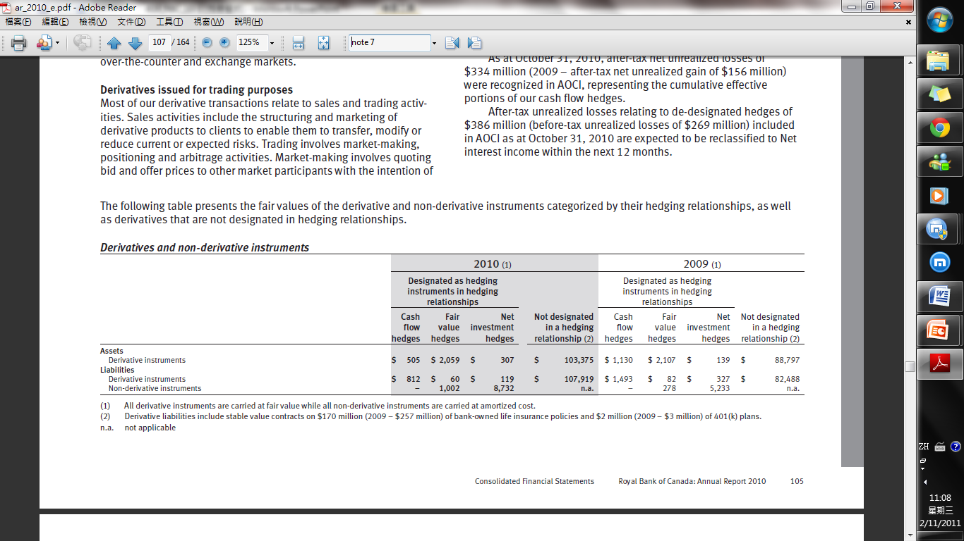
Fair Value of Derivatives

Slide 105
Fair Value
is used as a certainty of the market value of an asset (or liability) for which a market price cannot be determined
is defined as the amount at which a financial instrument could be bought or sold in a current transaction, other than in a forced or liquidation sale, between knowledgeable and willing parties in an arm’s-length transaction under no compulsion to act.
Management’s judgment is required when the observable market prices and parameters do not exist.

Slide 106
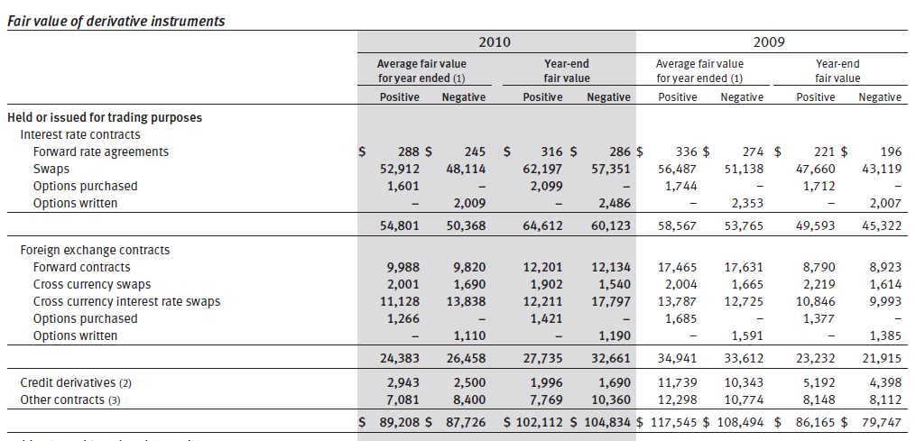
Fair Value of Derivatives

Slide 107
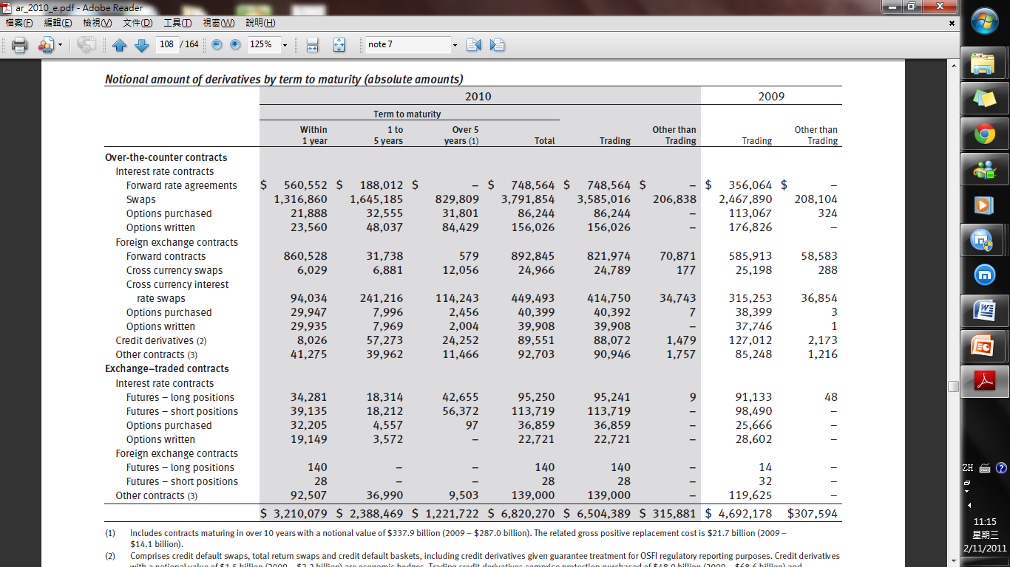
Notional Amount of Derivatives

Slide 108
Derivative Related Credit Risk
Generated by the potential for the counterparty to default on its contractual obligations
Represented by the positive fair value of the instrument
Normally a small fraction of the contract’s notional amount

Slide 109
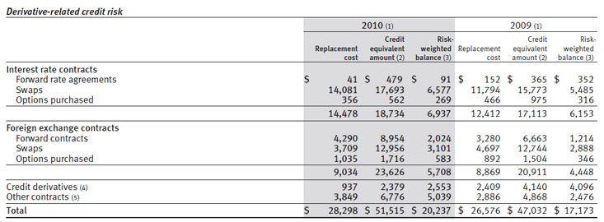
Derivative Related Credit Risk

Slide 110
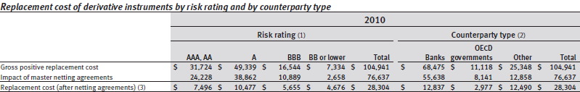
Derivative Related Credit Risk
Reduce derivative-related credit risk
    Master netting agreement
    Collateral
Notes:
Netting is a technique that can reduce credit exposure from
derivatives and is generally facilitated through the use of master
netting agreements. A master netting agreement provides for a single
net settlement of all financial instruments covered by the agreement
in the event of default. However, credit risk is reduced only to the
extent that our financial obligations to the same counterparty can be
set off against obligations of the counterparty to us. We maximize the
use of master netting agreements to reduce derivative-related credit
exposure. Our overall exposure to credit risk that is reduced through
master netting agreements may change substantially following the
reporting date as the exposure is affected by each transaction subject
to the agreement as well as by changes in underlying market rates.
Measurement of our credit exposure arising out of derivative transactions
is reduced to reflect the effects of netting in cases where the
enforceability of that netting is supported by appropriate legal
analysis as documented in our trading credit risk policies.
The use of collateral is another significant credit mitigation
technique for managing derivative-related counterparty credit risk.
Mark-to-market provisions in our agreements with some counterparties,
typically in the form of a Credit Support Annex, provide us
with the right to request that the counterparty pay down or collateralize
the current market value of its derivatives positions when the
value passes a specified threshold amount.

Slide 111
THANK YOU!

