Slide 1

The Shippers
Allen Ngai
Kevin Kim
Greg Edmunds

Slide 2
Global Transportation Services
Includes Rail, Road, Marine, and Air
Diversity of services makes it difficult to generalize about competitive forces.
Barriers to entry range from low (trucking) to very high (rail)
Labor Intensive
Fuel intensive
Highly Influenced by macro economic conditions

Slide 3
General Risks
Macro Economic Conditions
Commodity Prices
Free Trade
Regulation
Weather
Currency
Technology Failure

Slide 4
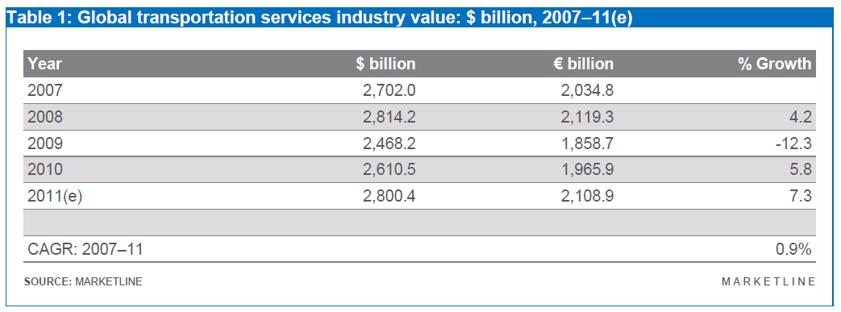
Global Transportation Services Industry
*Includes freight services by air, rail, marine, and ground

Slide 5
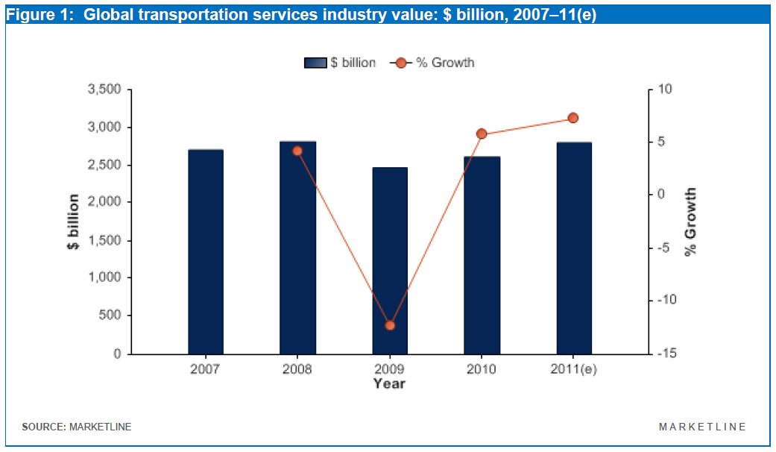

Slide 6
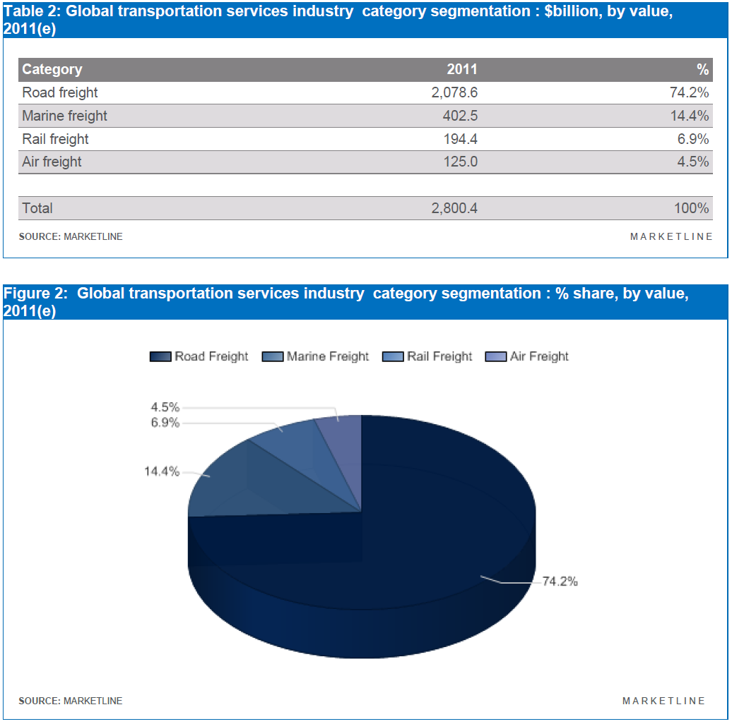
Category Segmentation

Slide 7
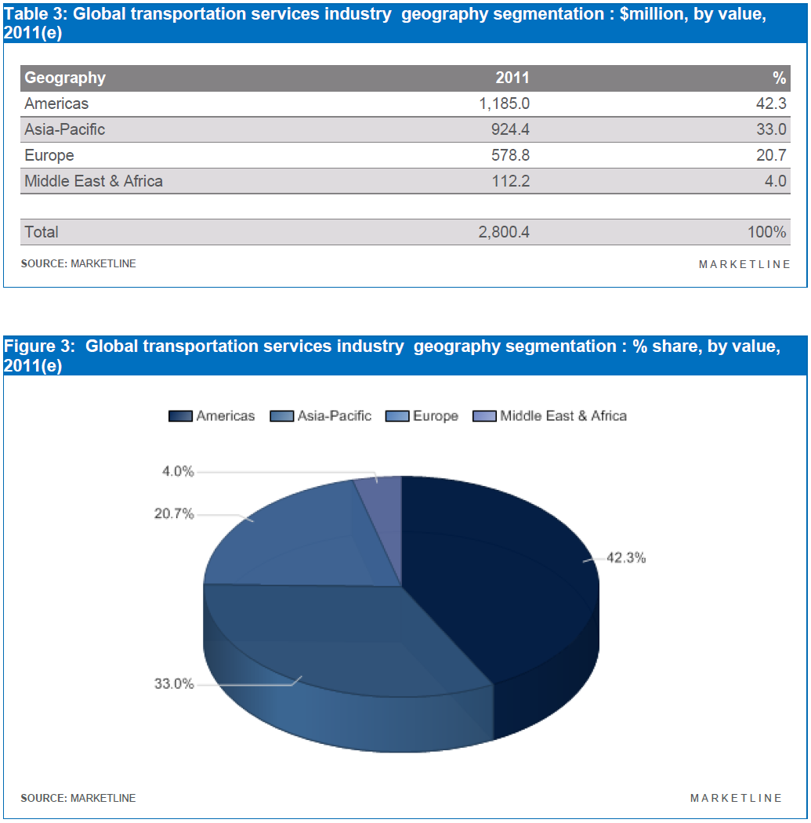
Geographic Breakdown

Slide 8
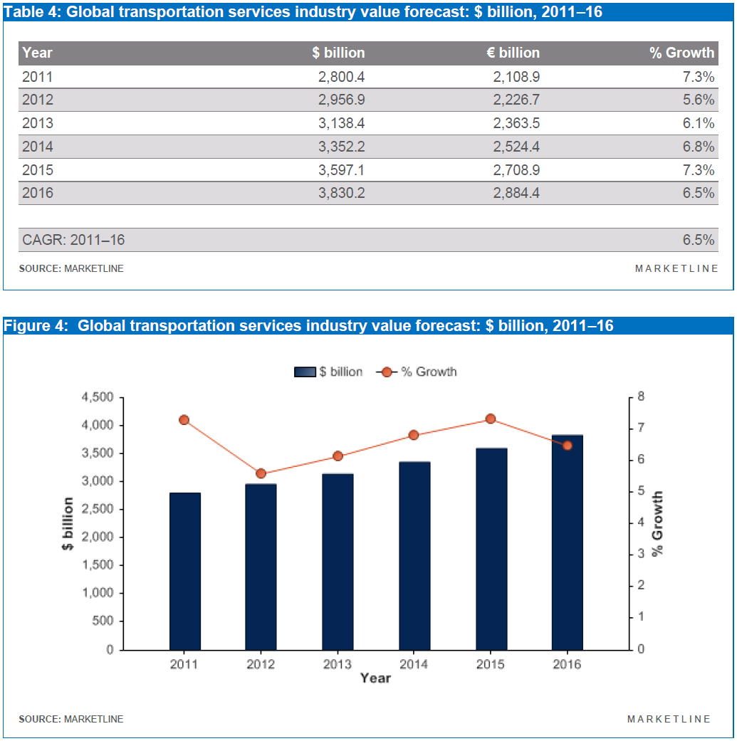
Growth Forecast

Slide 9


Slide 10
FedEx Corporation: History
1971: Federal Express is founded
1973: Begins uninterrupted air courier service
1978: Listed on the NYSE; ticker FDX
1998: Acquires Caliber Systems Inc.
2000: Parent FDX Corporation renamed FedEx Corporation. Services are divided into independently operated companies that compete collectively.

Slide 11
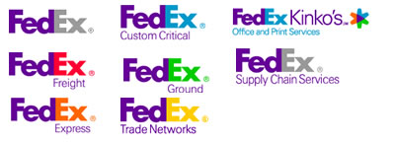
The Companies

Slide 12
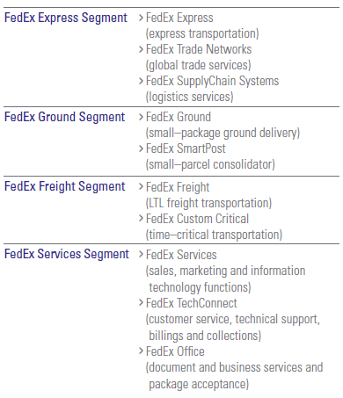
Reporting Units

Slide 13
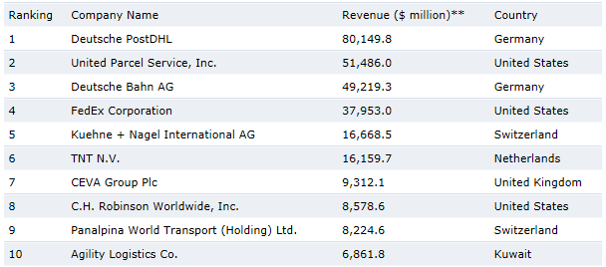
Major Competitors

Slide 14
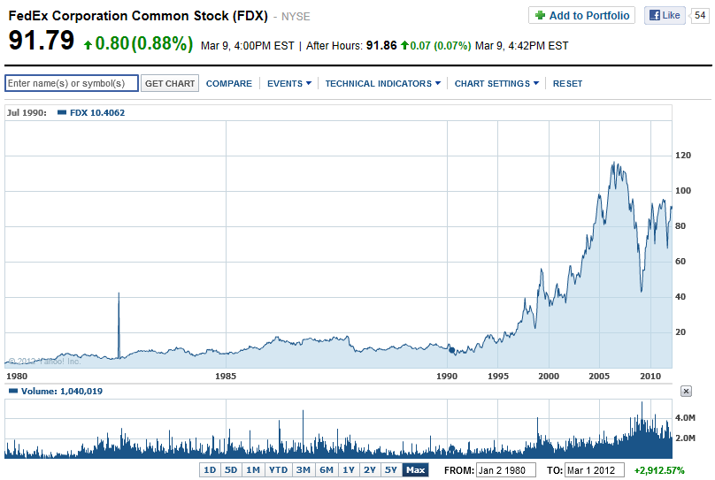
Share Price

Slide 15
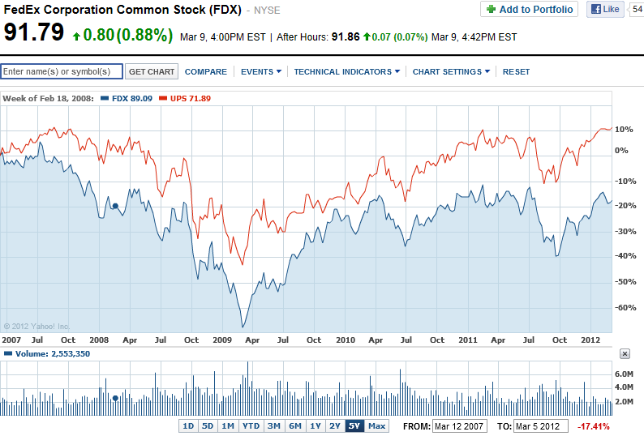

Slide 16
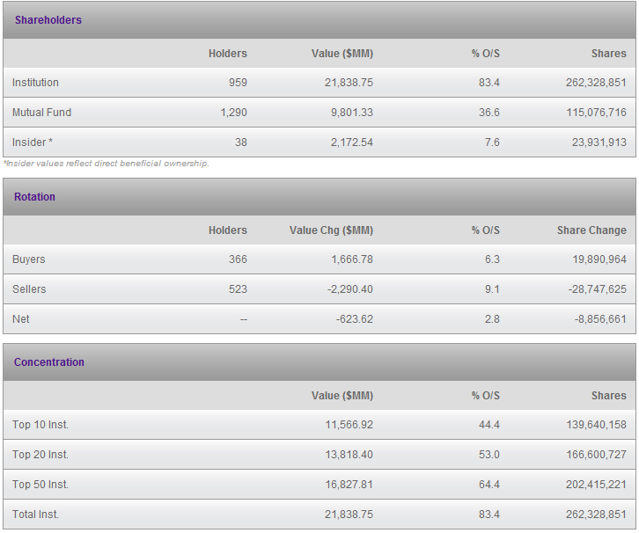
Share Ownership

Slide 17
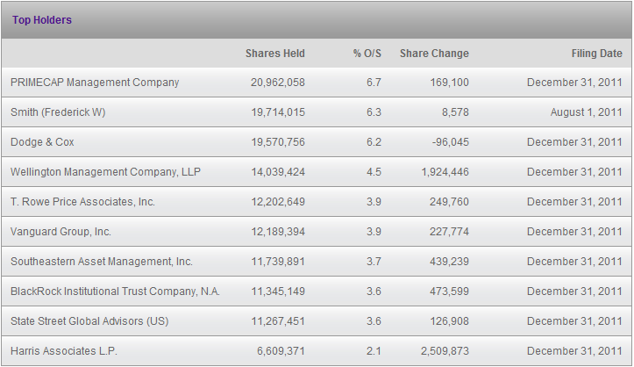

Slide 18
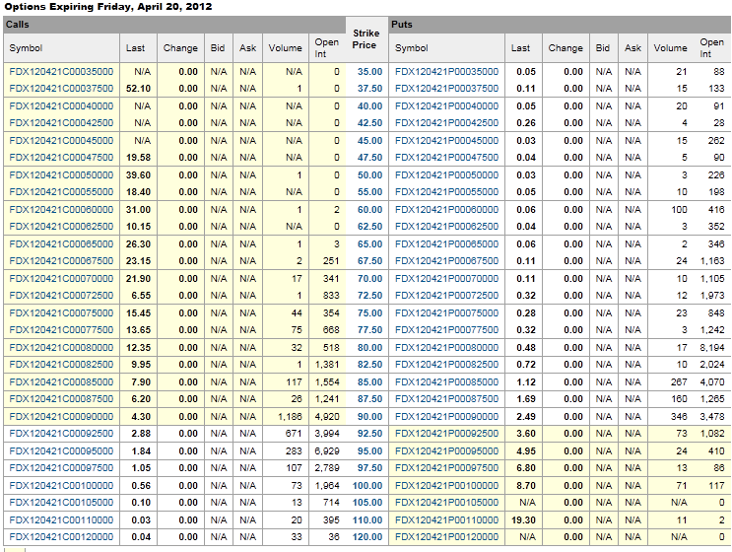

Slide 19
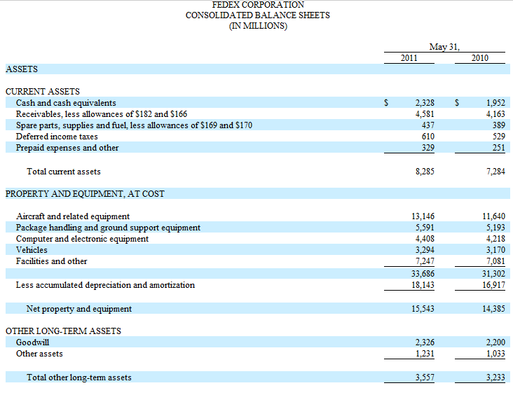

Slide 20
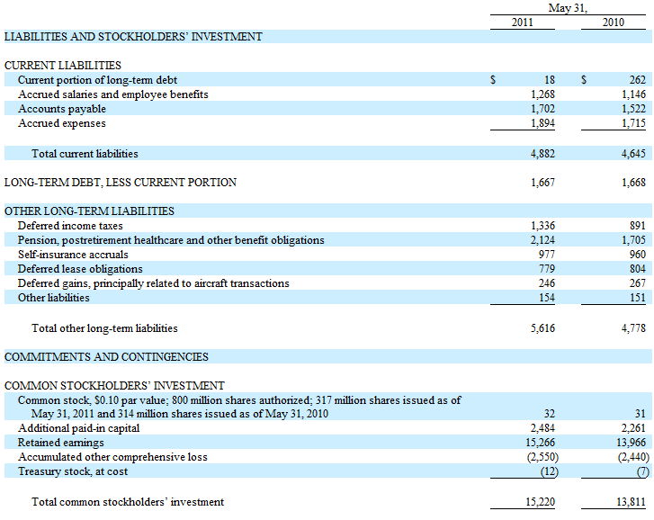

Slide 21
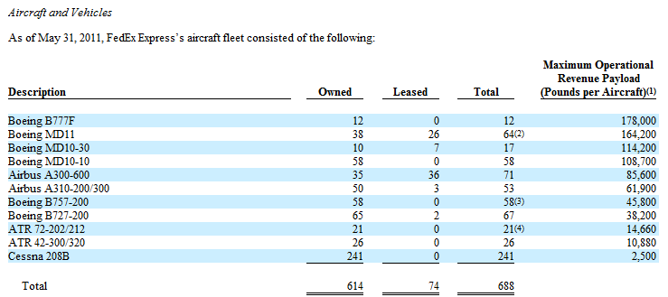
FedEx Express
FedEx Express also operated approximately 50,000 ground transport vehicles
FedEx Ground had approximately 32,600 company-owned trailers. In addition, approximately 28,100 owner-operated vehicles support FedEx Ground’s business.
FedEx Freight operated approximately 58,000 vehicles and trailers
Noteworthy: FedEx currently has 408 hybrid/all-electric service vehicles in its fleet. 4000 are expected to be added by EOY.

Slide 22
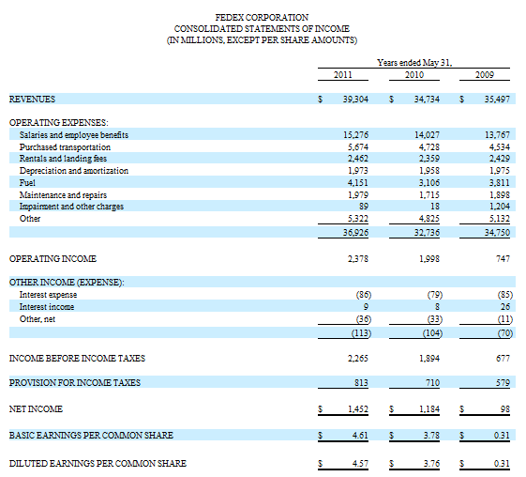


Slide 23
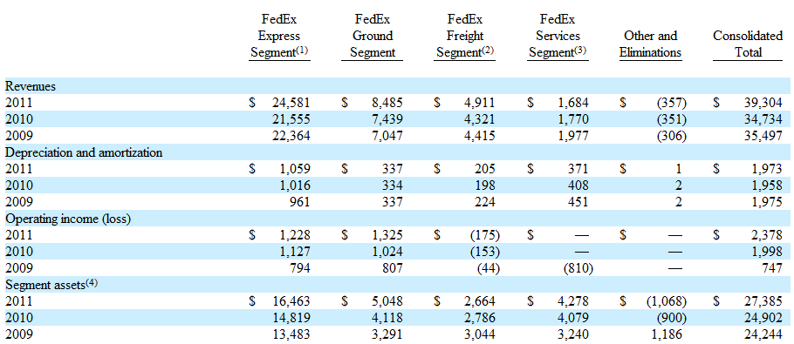

Slide 24
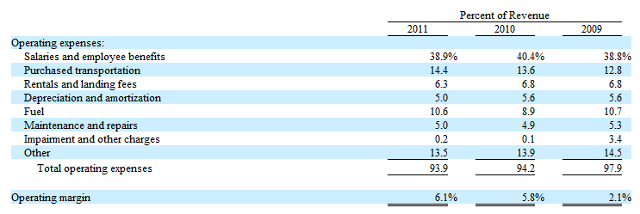
Expenses as Percent of Revenue

Slide 25
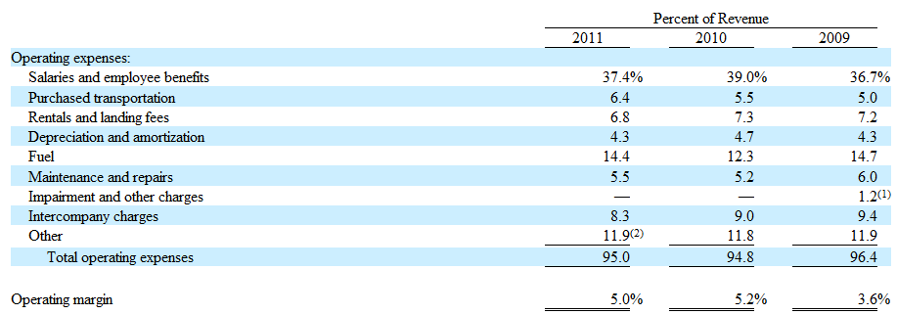
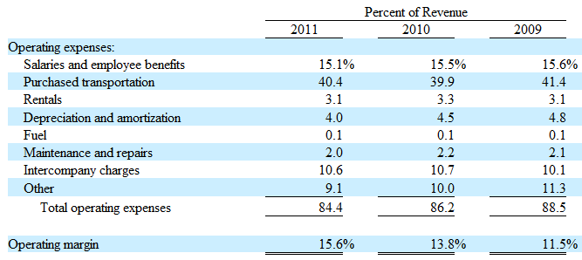
FedEx Express (Air)
FedEx Ground

Slide 26
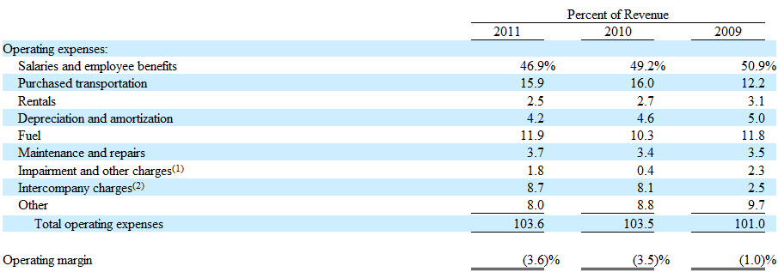
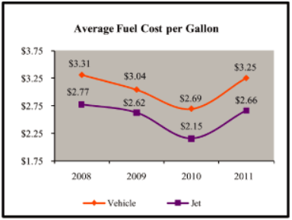
FedEx Freight (LTL Shipping)

Slide 27
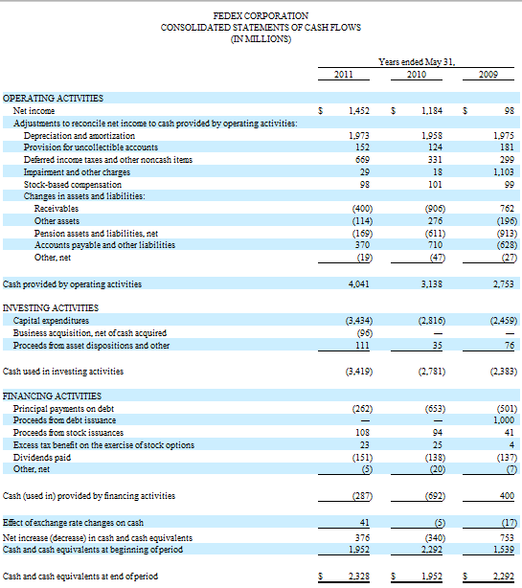

Slide 28
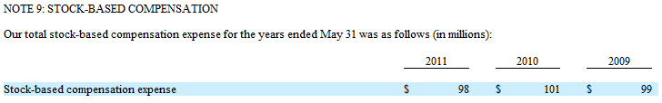
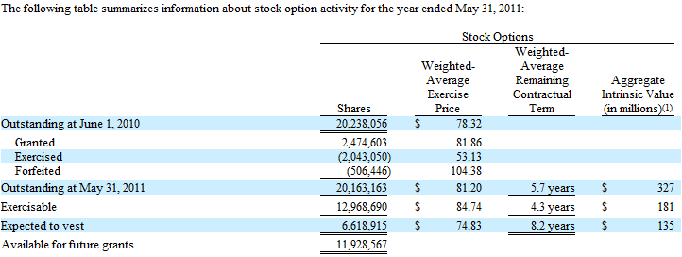
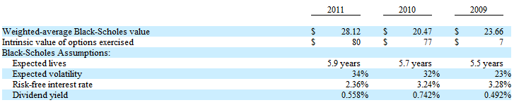
Employee Stock Options

Slide 29
Risk Factors
We are directly affected by the state of the economy.
Our businesses depend on our strong reputation and the value of the FedEx brand.
We rely heavily on information and technology to operate our transportation and business networks, and any disruption to our technology infrastructure or the Internet could harm our operations and our reputation among customers.
Our transportation businesses may be impacted by the price and availability of fuel.
Our businesses are capital intensive, and we must make capital expenditures based upon projected volume levels.
We face intense competition.
Labor organizations attempt to organize groups of our employees from time to time, and potential changes in labor laws could make it easier for them to do so.
If we do not effectively operate, integrate, leverage and grow acquired businesses, our financial results and reputation may suffer.
FedEx Ground relies on owner-operators to conduct its line haul and pickup-and-delivery operations, and the status of these owner-operators as independent contractors, rather than employees, is being challenged.
Increased security or pilot safety requirements could impose substantial costs on us.
The regulatory environment for global aviation or other transportation rights may impact our operations.

Slide 30
QUANTITATIVE AND QUALITATIVE DISCLOSURES ABOUT MARKET RISK
FOREIGN CURRENCY. While we are a global provider of transportation, e-commerce and business services, the substantial majority of our transactions are denominated in U.S. dollars. The principal foreign currency exchange rate risks to which we are exposed are in the euro, Chinese yuan, Canadian dollar, British pound and Japanese yen. Historically, our exposure to foreign currency fluctuations is more significant with respect to our revenues than our expenses, as a significant portion of our expenses are denominated in U.S. dollars, such as aircraft and fuel expenses. During 2011 and 2010, operating income was positively impacted due to foreign currency fluctuations. However, favorable foreign currency fluctuations also may have had an offsetting impact on the price we obtained or the demand for our services, which is not quantifiable. At May 31, 2011, the result of a uniform 10% strengthening in the value of the dollar relative to the currencies in which our transactions are denominated would result in a decrease in operating income of $38 million for 2012. This theoretical calculation assumes that each exchange rate would change in the same direction relative to the U.S. dollar. This calculation is not indicative of our actual experience in foreign currency transactions. In addition to the direct effects of changes in exchange rates, fluctuations in exchange rates also affect the volume of sales or the foreign currency sales price as competitors’ services become more or less attractive. The sensitivity analysis of the effects of changes in foreign currency exchange rates does not factor in a potential change in sales levels or local currency prices.

Slide 31
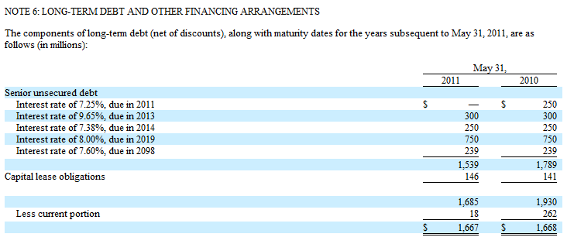
INTEREST RATES. While we currently have market risk sensitive instruments related to interest rates, we have no significant exposure to changing interest rates on our long-term debt because the interest rates are fixed on all of our long-term debt. As disclosed in Note 6 to the accompanying consolidated financial statements, we had outstanding fixed-rate, long-term debt (exclusive of capital leases) with estimated fair values of $1.9 billion at May 31, 2011 and $2.1 billion at May 31, 2010. Market risk for fixed-rate, long-term debt is estimated as the potential decrease in fair value resulting from a hypothetical 10% increase in interest rates and amounts to $36 million as of May 31, 2011 and $41 million as of May 31, 2010.

Slide 32
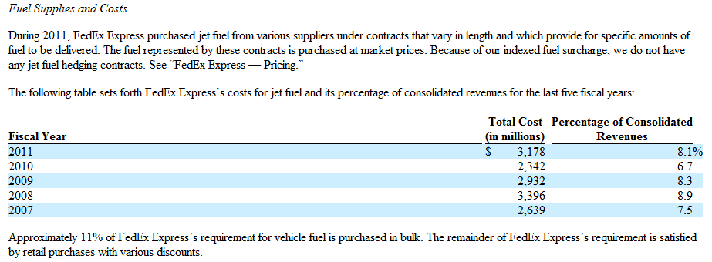
COMMODITY. While we have market risk for changes in the price of jet and vehicle fuel, this risk is largely mitigated by our fuel surcharges because our fuel surcharges are closely linked to market prices for fuel. Therefore, a hypothetical 10% change in the price of fuel would not be expected to materially affect our earnings.
However, our fuel surcharges have a timing lag (approximately six to eight weeks for FedEx Express and FedEx Ground) before they are adjusted for changes in fuel prices. Our fuel surcharge index also allows fuel prices to fluctuate approximately 2% for FedEx Express and approximately 4% for FedEx Ground before an adjustment to the fuel surcharge occurs. Accordingly, our operating income in a specific period may be significantly affected should the spot price of fuel suddenly change by a substantial amount or change by amounts that do not result in an adjustment in our fuel surcharges.

Slide 33
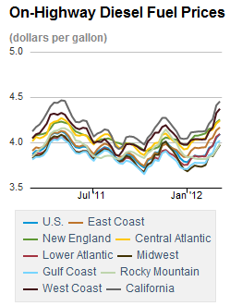
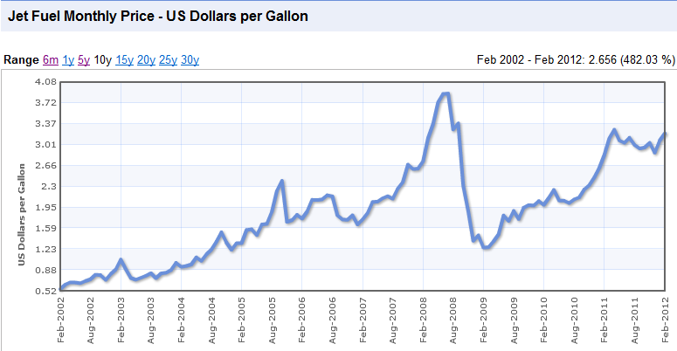
Fuel Surcharge Indexes

Slide 34
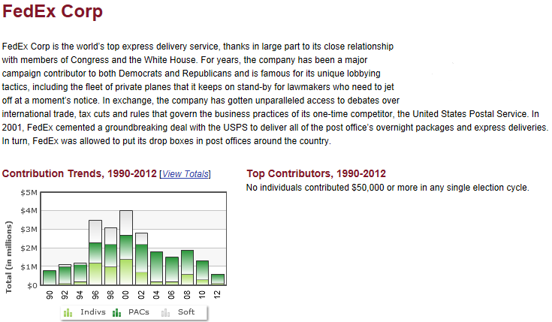
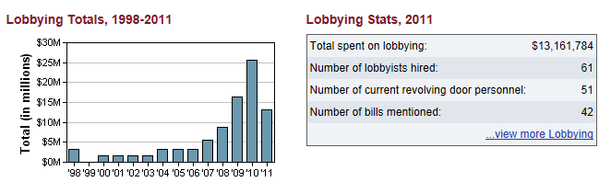

Slide 35
Summary
FedEx Corporation does not employ hedging strategies using futures/forwards/options or other financial instruments
FedEx does use fuel surcharges to minimize its risk to commodity prices.
FedEx is leading in the adoption of electric vehicles, and replacing existing fleets with more fuel efficient, larger capacity planes.
Very Active Politically

Slide 36
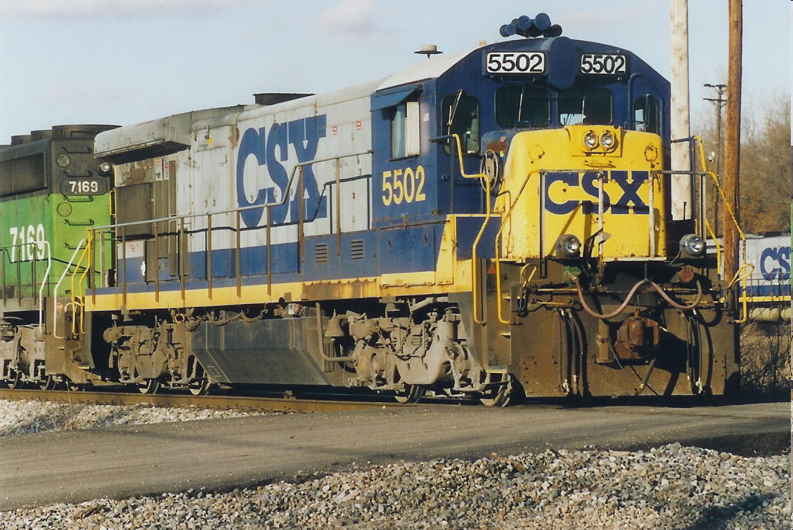

Slide 37
CSX Background
CSX Transportation (reporting mark CSXT) is a Class I railroad in the United States. It is the main subsidiary of the CSX Corporation.
The company is headquartered in Jacksonville, Florida, and owns approximately 21,000 route miles.
CSX operates one of the three Class I railroads serving most of the East Coast, the other two being the Norfolk Southern Railway and Canadian Pacific Railway.
This railroad also serves the Canadian provinces of Ontario and Quebec.
CSX Transportation was formed on July 1, 1986 as a combining and renaming of the Chessie System, Inc. and Seaboard System Railroad into one entity.

Slide 38
Route Map

Slide 39
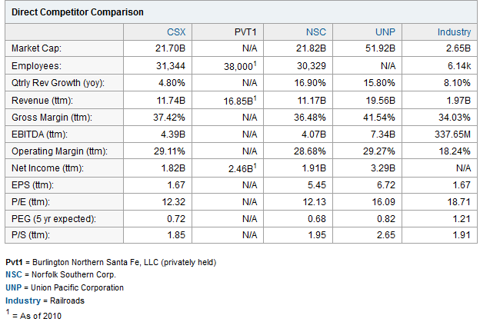
Major Competitors

Slide 40
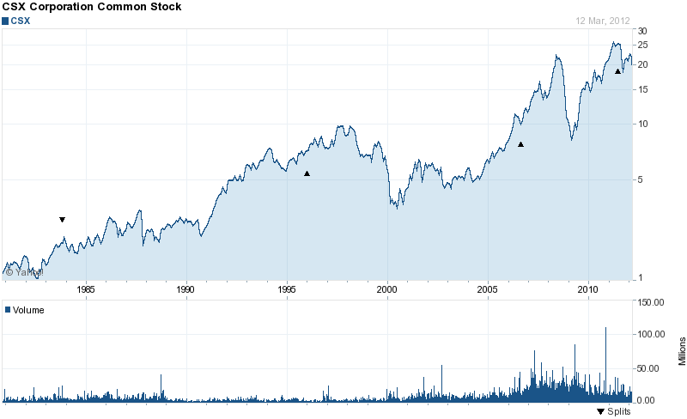
Share price

Slide 41
Project
Clean Air
We consider our responsibility to the environment as vital to our business as shipping goods
Sustainable Infrastructure
Our rails continue to improve shipping efficiency overall while decreasing our economy’s impact on the environment
Fuel Efficiency
We’re constantly working on innovative technologies that lead to even greater gains in fuel efficiency.
Economy
CSX is continuing to do its part to help move the economy in the right direction

Slide 42
Revenue Structure
The merchandise business shipped nearly 2.7 million carloads and generated approximately 54% of revenue and 41% of volume in 2011
The coal business shipped 1.5 million carloads and accounted for nearly 32% of revenue and 24% of volume in 2011.
The intermodal business accounted for approximately 12% of revenue and 35% of volume in 2011.
Other revenue accounted for approximately 2% of the Company’s total revenue in 2011.

Slide 43
Revenue Structure (con’t)

Slide 44
Revenue Structure

Slide 45
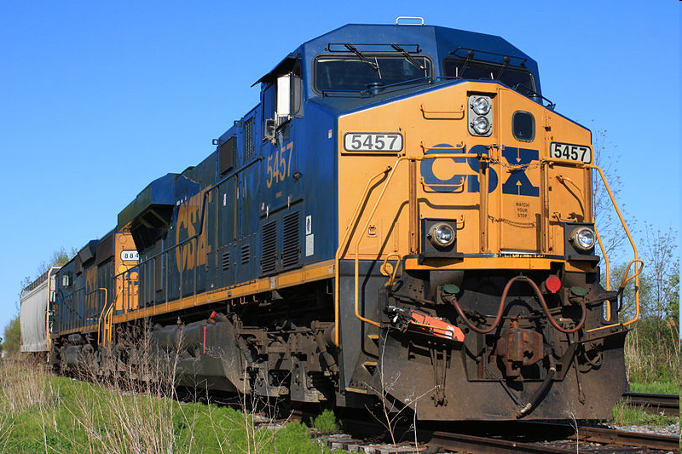
Financial Statements

Slide 48
Income Statement (con’t)
Revenue increased $1.1 billion or 10% to $11.7 billion primarily driven by pricing above inflation and higher fuel recoveries.
Expenses increased $760 million or 10% to $8.3 billion driven primarily by higher fuel prices and inflation

Slide 50
Risk Factor
New legislation changes
General economic conditions
Required by law to transport hazardous materials, which could expose the Company to significant costs and claims.
Environmental laws and regulations that may result in significant costs.
Relies on the stability and availability of its technology systems to operate its business.
Disruption of the supply chain
Failure to complete negotiations on collective bargaining agreements
Competition from other transportation providers
Future acts of terrorism, war or regulatory changes to combat the risk of terrorism
Severe weather or other natural occurrences
Increases in the number and magnitude of property damage and personal injury claims

Slide 51
Quantitative and Qualitative Disclosures about Market Risk
CSX does not hold or issue derivative financial instruments for trading purposes. Historically, the Company has used derivative financial instruments to address market risk exposure to fluctuations in interest rates and the risk of volatility in its fuel costs.
At December 2011, CSX had $44 million of outstanding floating rate debt obligations outstanding. A 1% fluctuation in interest rates on these notes would cause a $1 million change in interest expense. This amount was determined by considering the impact of an interest rate fluctuation on the balances of our floating rate debt at December 30, 2011.

Slide 52
Stock Option
Outstanding stock options were granted with 10-year terms and all are fully vested and exercisable;therefore, there is no current or future expense related to these options. The exercise price for optionsgranted equals the market price of the underlying stock on the grant date.

Slide 53
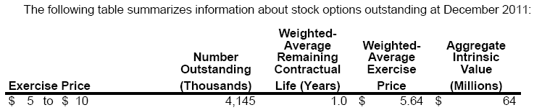
Stock Option (con’t)
The aggregate intrinsic value represents the amount employees would have received if the options were exercised as of December 30, 2011 at a closing market price of $21.06. The total intrinsic value of options exercised for fiscal years ended 2011, 2010, and 2009 was $84 million, $88 million, and $41 million,
respectively. This value represents the value realized by current and former employees who exercised options.

Slide 54
Pension Plan Assets
Pension plan assets are reported at fair value on the consolidated balance sheet. The Investment Committee targets an allocation of pension assets to be generally 60% equity and 40% fixed income.

Slide 55
Pension Plan Assets
Common stock (Level 1): Valued at the closing price reported on the active market on which the individual securities are traded on the last day of the plan year and classified in level 1 of the fair value hierarchy.
Common trust funds (Level 2): The net asset value of the common trusts is determined by reference to the fair value of the underlying securities of the trust, which are valued primarily through the use of directly or indirectly observable inputs. These assets are classified in level 2 of the fair value hierarchy.
Corporate bonds, derivatives, government securities, and asset-backed securities (Level 2): Valued using price evaluations reflecting the bid and/or ask sides of the market for a similar investment as of the last day of the calendar plan year. Asset-backed securities include commercial mortgagebacked securities and collateralized mortgage obligations. These assets are classified in level 2 of the fair value hierarchy.
Partnerships (Level 3): Private equity valued using the fair market values associated with the underlying investments at year end using net asset per share and is classified in level 3 of the fair value hierarchy.

Slide 57
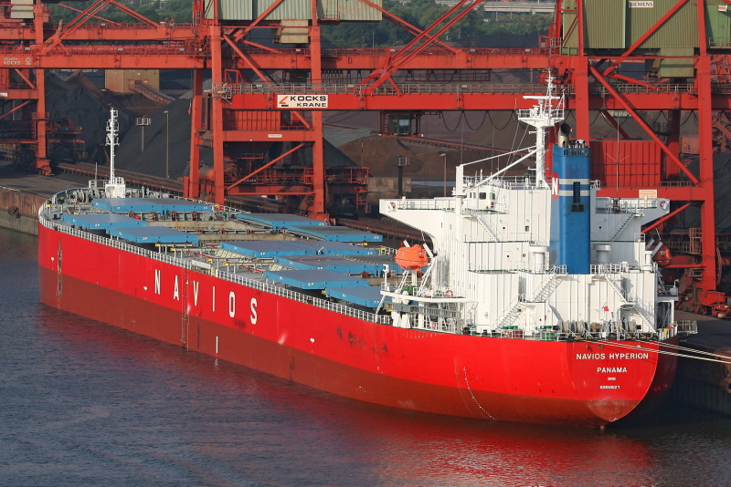
Navios Maritime Holdings Inc.
THE ANALYSIS OF MARITIME SHIPPING INDUSTRY

Slide 58
Facts about the Industry
About 90% of world trade is carried by the international shipping industry
Without shipping:
Half of the world would starve
The other half would freeze!!
Regulated globally by the international maritime organization (IMO)
The least environmentally damaging form of commercial transport

Slide 59
Industry Info.
As with all industrial sectors, shipping is not immune to economic downturns (their beta is close to one according to CAPM)
2009 witnessed the worst global recession in over seven decades and the sharpest decline in the volume of global merchandise trade
In 2009, volume contracted by 4.5% and total goods loaded went down to 7.8 billion tons
In 2010, bounced back and grew by 7%, taking the total goods loaded to 8.4 billion tons

Slide 60
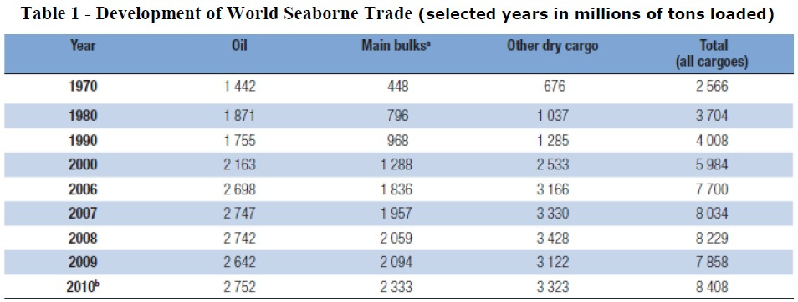
Industry Info.
-4.5%
+7%
Financial Crisis
Global Recession

Slide 61
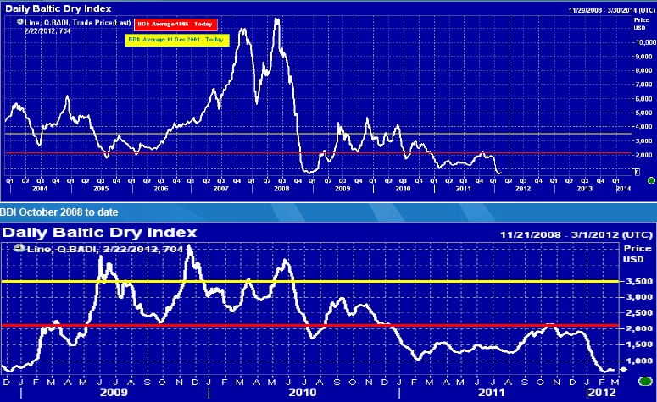
Baltic Exchange Dry Index
Notes:
The Baltic Dry Index (BDI) is a number issued daily by the London-based Baltic Exchange. Not restricted to Baltic Sea countries, the index provides "an assessment of the price of moving the major raw materials by sea.

Slide 62
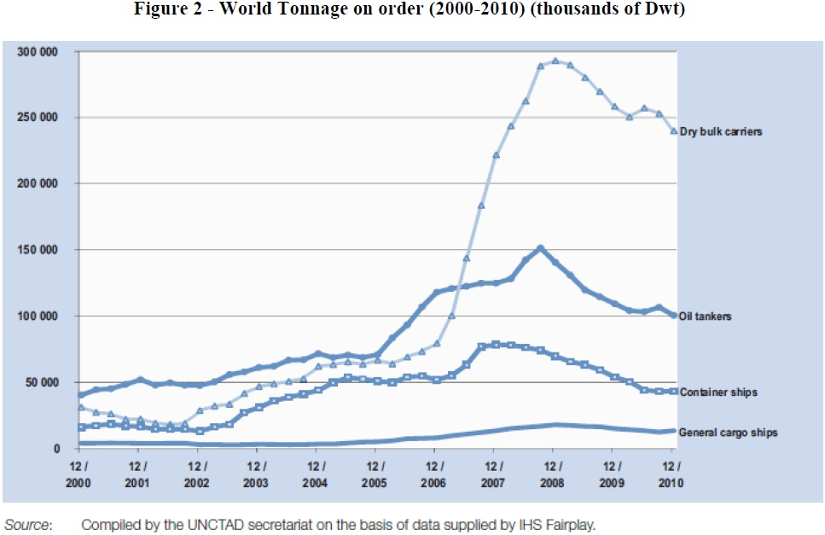
Shipbuilding orders

Slide 63
Shipbuilding orders
Due to orders placed prior to the 2008 crisis, new building deliveries reached a new record in the history of shipbuilding
Of gross tonnage, 45.2% were of dry bulk carriers
27.7% were of tankers
15.2 were of new containerships

Slide 64
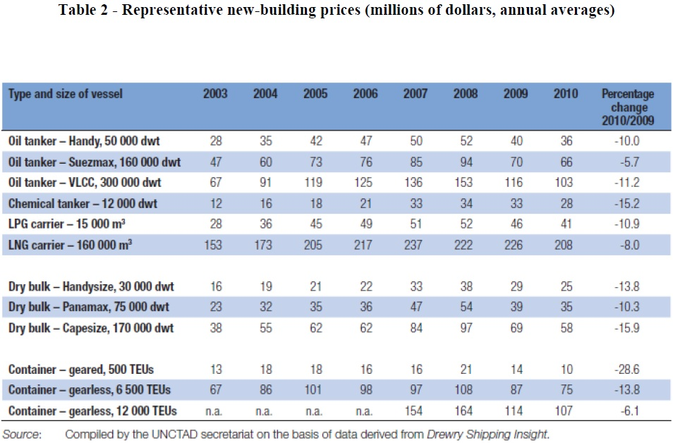
Prices of new-buildings

Slide 65
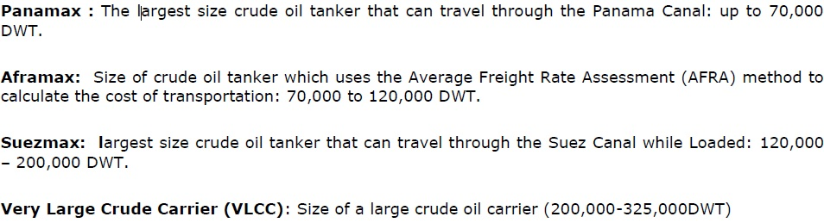
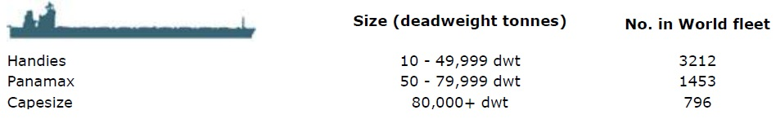
Overview of Ship Types
Tankers:
Dry bulk carriers:

Slide 66
Industry Jargons
Available days = (total number of days a vessel is controlled by a company) – (aggregate number of days that the vessel is off-hire)
Used to measure the number of days in a period during which vessels should be capable of generating revenues
Operating days = (available days) – (off-hire days)
Used to measure the aggregate number of days in a period during which vessels actually generate revenues
Fleet utilization = operating days/available days
TCE = [voyage and time charter revenues + gain(loss) on FFA – voyage expense] / available days
A shipping industry standard performance measure used to compare daily earnings generated by vessels on time charters with daily earnings generated by vessels on voyage charters
Equivalent vessels = available days/number of calendar days
Notes:
TCE (Time Charter Equivalents)

Slide 67
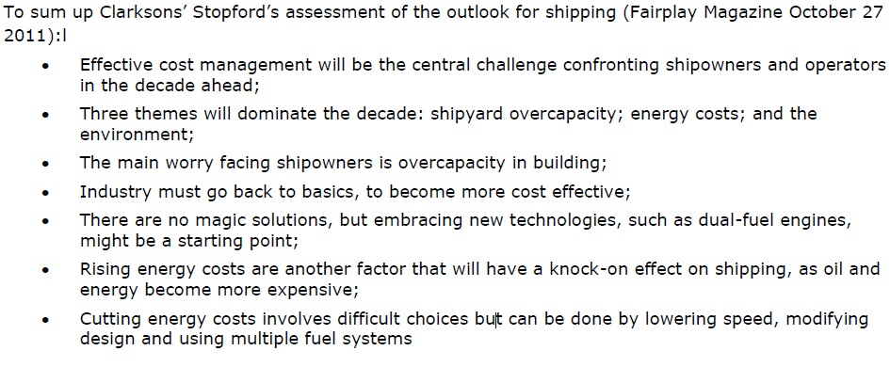
Industry Outlook
A managing director of Clarksons, a UK based- shipping company

Slide 68
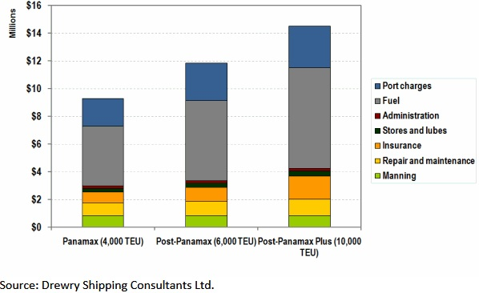
Operating costs

Slide 69
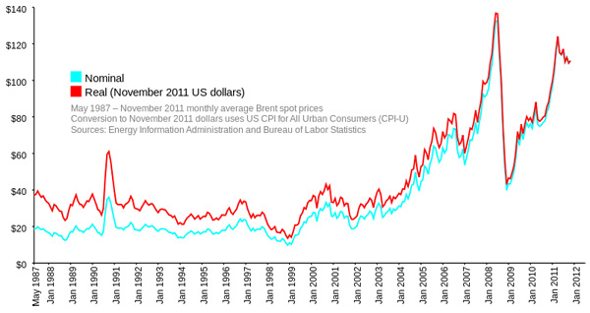
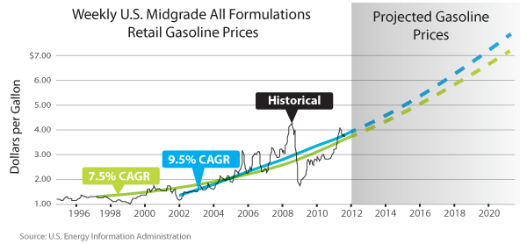
Increasing Fuel cost

Slide 70
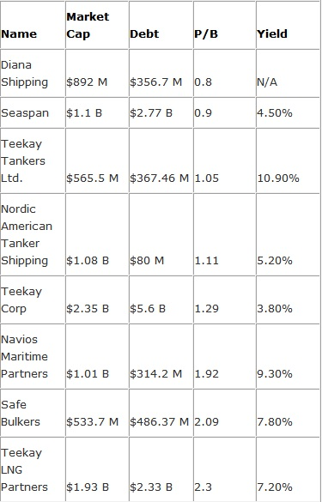
Competitors similar in size
Rank
6 (Greece)
3 (Vancouver)
7 (Vancouver)
4 (Bermuda)
1 (Vancouver)
5 (Greece)
8 (Greece)
2 (Vancouver)

Slide 71

Historical Prices: NYSE

Slide 72
Corporate Profile
Based in Piraeus, Greece
Vertically integrated seaborne shipping and logistics company
Operations in 3 segments:
Drybulk vessel operations (handling of bulk cargoes)
Logistics business (operating ports and transfer station terminals, handling of barges, push boats as well as upriver transport facilities)
Tanker vessel operations (transportation and handling of liquid cargoes)
Navios Holdings offers in-house commercial and technical services to its affiliates such as Navios Partners’ and Navios Acquisitions’ fleets

Slide 73

Income Statement

Slide 74

Revenue Breakdown by Operations

Slide 75

Revenue Breakdown by Region
North America
Europe
Asia
South America
Other
Total

Slide 76

The Southern Trade Routes

Slide 77

Balance Sheet
61%

Slide 78

Balance Sheet

Slide 79

Cash Flow Statement

Slide 80

Cash Flow Statement

Slide 81
Risk Factors
The cyclical nature of the international drybulk shipping industry may lead to decreases in charter rates and lower vessel values
The economic slowdown in the Asia Pacific region has reduced demand for shipping services and has decreased shipping rates
Continued uncertainty and renewed disruptions in world financial markets and resulting governmental action in the US and in other parts of the world could have a material adverse impact on our ability to obtain financing, our results of operations, financial condition and cash flows and could cause the market price of our common units to decline
When our contracts expire, we may not be able to successfully replace them
We may employ vessels on the spot market and thus expose ourselves to risk of losses based on short-term decreases in shipping rates
Notes:
The demand for vessels has generally been influenced by, among other factors:
• global and regional economic conditions; • developments in international trade; • changes in seaborne and other transportation patterns, such as port congestion and canal closures; • weather and crop yields; • armed conflicts, acts of piracy and terrorist activities; • political developments; and • embargoes and strikes.
The supply of vessel capacity has generally been influenced by, among other factors:
• the number of vessels that are in or out of service; • the scrapping rate of older vessels; • port and canal traffic and congestion; • the number of newbuilding deliveries; and • vessel casualties.

Slide 82
Risk Factors (continued)
We are subject to certain credit risks
Trading and complementary hedging activities in freight, tonnage and FFAs subject us to trading risks
Subject to certain operating risks including vessel breakdowns or accidents
Subject to various laws, regulations, and environmental laws that require significant expenditures both to maintain compliance with such laws and to pay for any uninsured environmental liabilities
Because we generate all of our revenues in US dollars but incur a portion of our expenses in other currencies, exchange rate fluctuations could cause us to suffer exchange rate losses

Slide 83
Risk Management
“Navios Holdings seeks to manage risk through a number of strategies, including vessel control strategies (chartering and ownership), freight carriage and FFA trading.”
Vessel Control Strategy: seeking the appropriate mix of owned vessels, long- and shor-terrm charter-in vessels, coupled with purchase options, when available, and spot charters
Enters into COAs (contract of affreightment), which gives Navios, subject to certain limitations, the flexibility to determine the means of getting a particular cargo to its destination
FFA trading strategy: taking economic hedges to manage and mitigate risk on vessels that are on-hire or coming off-hire to protect against the risk of movement in freight market rates

Slide 84
Types of Financial Risks
Freight Rate Risk
Credit Risk
Interest Rate Risk
Foreign Exchange Risk

Slide 85

Forward Freight Agreements
FFAs used both to utilize them as economic hedging instruments and to take advantage of short-term fluctuations in the market prices
FFAs settle monthly in cash on the basis of publicly quoted indices
Through OTC, NOS (Norwegian Clearing House), and LCH (London Clearing House)
Notes:
The Company actively trades in the FFAs market with both an objective to utilize them as economic hedging instruments that are highly effective in reducing the risk on specific vessel(s), freight commitments, or the overall fleet or operations, and to take advantage of short-term fluctuations in the market prices.

Slide 86
Interest Swaps
Enters into interest rate swap contracts to hedge its exposure to variability in its floating rate long-term debt
Floating
Fixed
Notes:
The interest rate swaps allow Navios Holdings to convert long-term borrowings issued at floating rates into equivalent fixed rates.

Slide 87
Sensitivity Analysis
FFAs:
10% change in underlying freight market indices -> $0.1 million effect on net income per year
Interest Swaps:
100bps change in interest rates -> effect on interest payment by $0.08 million

Slide 88

Total Derivatives and Financial Instruments

Slide 89
Credit Risk Management
Credit exposure to charterers and FFAs counterparties
Insured charter-out contracts through a “AA+” rated governmental agency of a European Union member state, which provides that if the charterer goes into payment default, the insurer will reimburse Navios for the charter payments under the terms of policy

Slide 90
FX Risk Management
All of Navios’s revenues are denominated in US $
19.4% of its expense, related to its Navios Logistics segment operating in South America, are in several different currencies (i.e. Argentinean Peso, Uruguayan Peso, etc.)
6.5% of its expense related to operation of its Piraeus and Belgian office are in Euros
Monitors its FX exposure against long-term currency forecasts and enters into foreign currency contracts when considered appropriate
In most of the time, foreign currency transactions are translated into the measurement currency rates prevailing at the dates of transactions (i.e. unhedged)

Slide 91
Other Derivative Used
Stock-based options
The fair value of all stock option awards has been calculated based on the modified Black-Scholes method
Assumptions:
Expected term: The “simplified method” was used which includes taking the average of the weighted average time to vesting and the contractual term of the option award. The option awards vest over three years at 33.3%, 33.3% and 33.4% respectively, resulting in a weighted average time to vest of approximately 2 years. The contractual term of the award is 7 years. Utilizing the simplified approach formula, the derived expected term estimate for the Company’s option award is 4.5 years
Expected volatility: The historical volatility of Navios Holdings’ shares was used in order to estimate the volatility of the stock option awards
Expected dividends: The expected dividend is based on the current dividend, our historical pattern of dividend increases and the market price of our stock.
Risk-free rate: Navios Holdings has selected to employ the risk-free yield-to-maturity rate to match the expected term estimated under the “simplified method”

Slide 92

Stock Options (continued)

Slide 93
Fuel Cost Risk
Under time charter agreements, the charterer is responsible for substantially all of the voyage expenses, including port and canal charges and fuel costs and vessel operating expenses
Because of the terms of the agreement, the cost of fuel is a significant factor in negotiating charter rates.
In response, Navios tries to obtain more fuel efficient vessels and to keep their fleets’ average age as low as possible (average age of Navios’ fleets is 4.5 years and industry average is 8 years) instead of directly managing fuel costs using derivatives

Slide 94

Thank you
Thank You

