Slide 1
Global Airline
Prepared by: Kenneth Nishi
Anderson Kao
Xueying Zheng
Rongyuan Zhang

Slide 2
Agenda
Airline Industries
Southwest Airlines
Singapore Airlines

Slide 3
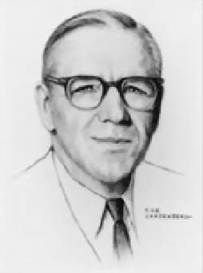
“Running an airline is like having a baby :
fun to conceive , but hell to deliver.”
C.E. Woolman
Principal founder,
Delta Air Lines

Slide 4
Airline Industry
The airline industry is characterized by:
• high competition arising from low barriers to entry and excess industry capacity;
• cyclicality that is generally in line with the overall economy with occasional economic shocks, such as 9/11 or energy crises;
• high costs, particularly for the legacy ﬁrms, including ﬁxed costs, such as capital and labour, as well as variable costs, such as fuel;
• regulation focused on safety, maintenance, hours of operation per month for personnel and restrictions on routes, landing rights and slots.

Slide 5
Industry Purpose
Global Airline Industry provides :
• Services to virtually every corner of the globe
• has been an integral part of the creation of a global economy
• Air transportation of passengers and cargo

Slide 6
Generic Business Model
Network Carriers
Charter carriers
- Flag carriers
- Maintain hub and spoke networks
-Consolidate traffic at key hub airports
-Low unit costs
-Target holiday travelers
-Vertically integrated organizations
Low cost carriers
Regional airlines
- Undercut the ticket prices of the full cost carriers
-Administration structures slim
- Operate shorter sectors
- Usually aircrafter less than 100 seats

Slide 7
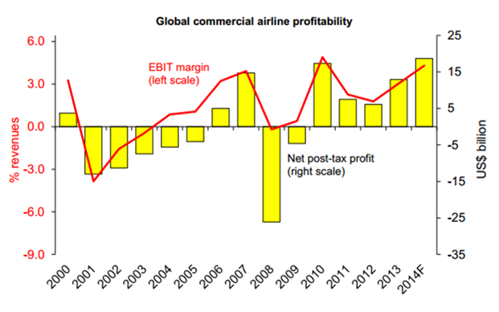
Commercial Airlines Profitability
Commercial airlines profitability

Slide 8
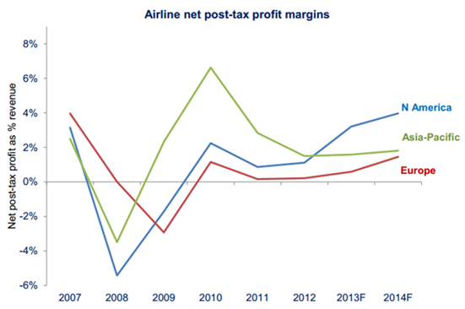
Airline net post-tax profit margins 2007-2014

Slide 9
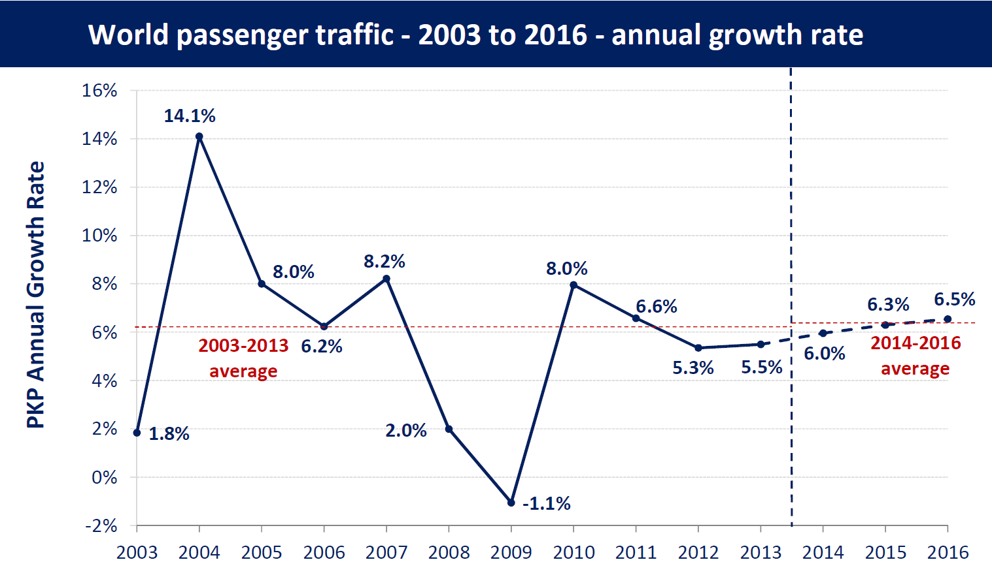
Global Passenger Traffic
Notes:
http://www.icao.int/sustainability/pages/eap_fp_forecastmed.aspx

Slide 10
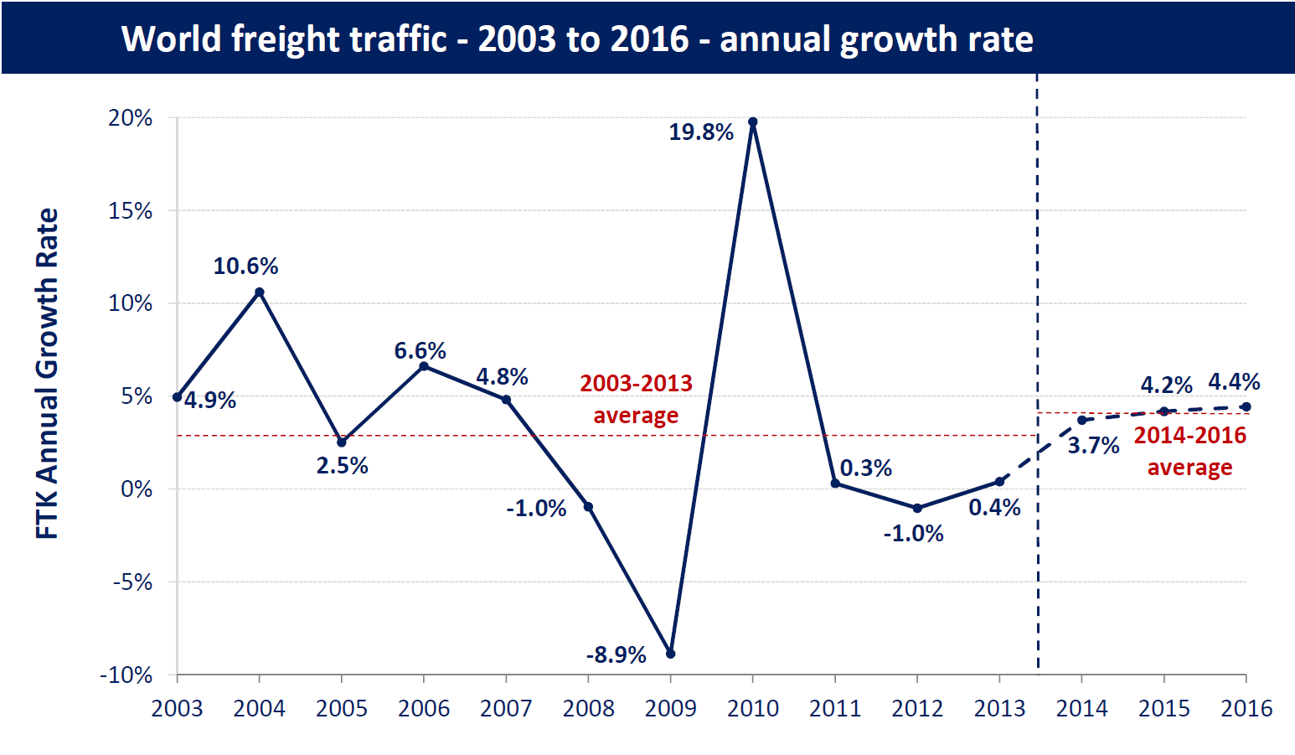
Global Freight Traffic
Notes:
http://www.icao.int/sustainability/pages/eap_fp_forecastmed.aspx

Slide 11
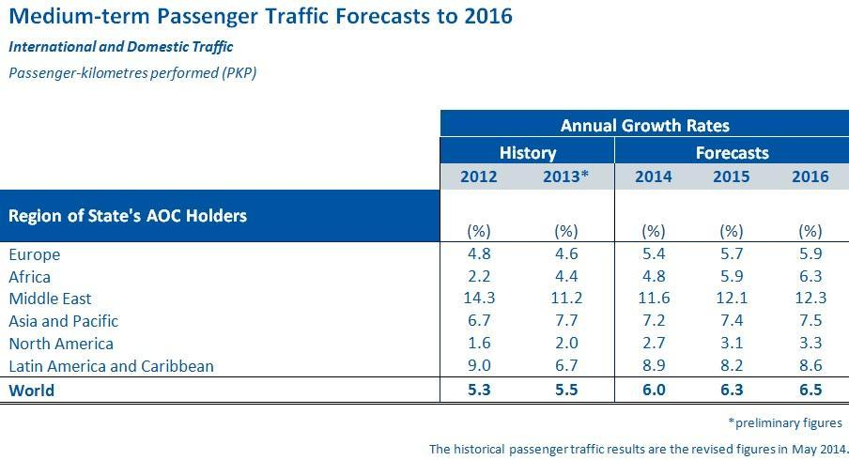
Air Traffic
Notes:
http://guyanaaviation.com/2014/07/icao-forecasts-more-than-6-percent-passenger-growth-through-2016/

Slide 12
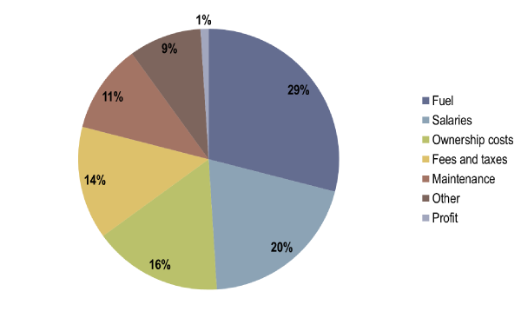
Airlines Cost Structure
Source: adapted from McCartney, S. (2012)How Airlines spend your Airfare, WSJ.
Notes:
https://people.hofstra.edu/geotrans/eng/ch3en/conc3en/cost_structure_domestic_flight.html

Slide 13
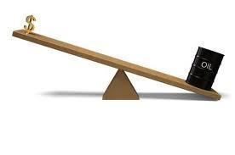
Fuel Hedging
It is used to reduce or eliminate a company’s exposure to fluctuating fuel costs
The use of derivatives does not guarantee profitability or reduction in risks

Slide 14
Hedging Practices
Hedging stabilize fuel prices and therefore overall costs, cash flows, and profits.
Advantage of investment opportunities arises when fuel prices are high and airline operating cash flows and values are down.
The value premium associated with hedging increases with the level of the firm’s capital investment.

Slide 15
Hedging Contracts
Fuel price risk can be managed in a number of ways:
Forward contracts
Futures contracts
Options, collars, swaps

Slide 16
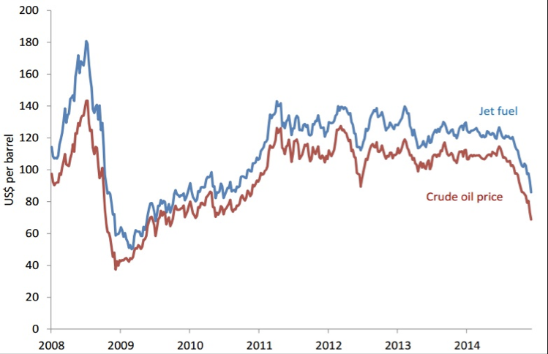
Jet Fuel and Crude Oil Price
(Source: IATA | Platts)
Notes:
http://cwan.ca/crude-oil-prices-remain-weak-opec-holds-output-steady/

Slide 17
Risks

Slide 18
Types of Risks
Basis Risk
Exchange Rate Risk
Counterparty Risk
Market Price & Liquidity Risk
Credit Risk
Interest Rate Risk
Economic Risk
Fuel Risk

Slide 19
Basis Risk
Basis Risk describes the relation (correlation factor) between the value of the commodity being hedged and the value of the derivative contract used to hedge the price risk.
Basis risks can be divided into 3 for airline companies:
Product basis risk
Time basis risk
Locational basis risk

Slide 20
Exchange Rate Risk
Largest exposures are from $, €,£,CHF, AUD, NZD, ¥, ₹ , HKD, CNY, ₩ and MYR.
Companies usually generates a surplus in all of these currencies, with the exception of $.
The deficit in $ is attributable to capital expenditure, fuel costs and aircraft leasing costs – all conventionally denominated and payable in $

Slide 21
Counterparty Risk
In order to hedge the risk that exposure by airlines, some contracts are done but these contracts bear counterparty risks, such as the danger of bankruptcy of the airline or the trading partner.

Slide 22
Market Price & Liquidity Risk
Liquidity risk is related to the generated cash flows of the airline companies if we examine the financial instruments we can see company is a sufficient to pay off the next fiscal year’s expense
Market Price determine the competitiveness of company.

Slide 23
Credit Risk
Limit exposure to individual counterparties and sometimes create provisions that require counterparties to provide security if their credit falls.

Slide 24
Interest Rate Risk
Interest rate risk is relevant in many investment funds where longer term investments may be bought with the risk that interest rates may increase during the term of the investment purchase.
If interests rate rise the portfolio will face a drop in overall value

Slide 25
Economic Risk
Airline industry is particularly sensitive to changes in economic conditions
Affects customer travel patterns and related revenues. In harsh economic times, customers will cut back on both leisure and business travel
Hampers the ability of airlines to raise fares to counteract increase in fuel, labor and other costs.

Slide 26
Fuel Risk
Jet Fuel has been one of the largest expense categories for domestic airlines
Inherently dependent upon jet fuel to operate
Unpredictable price movements
Difficult to compensate an increase in price with fare prices due to competitive nature the industry
Fuel usually makes up at least 1/3 of operating expenses

Slide 27
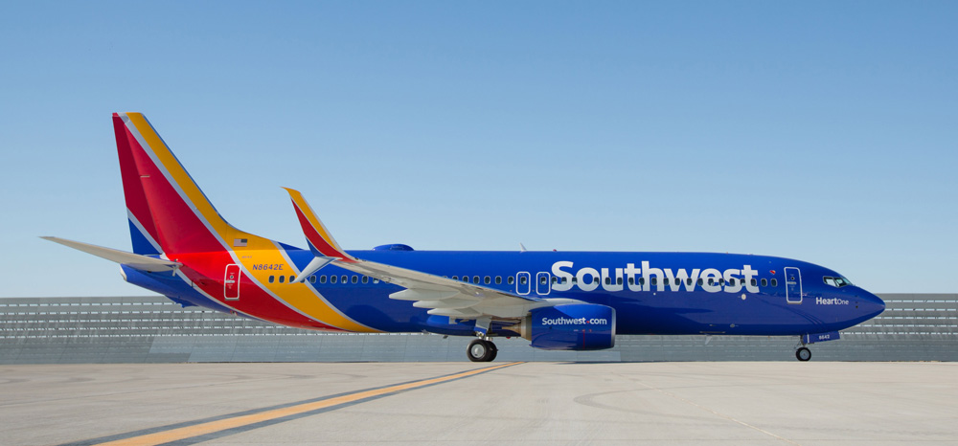
Southwest Airlines

Slide 28
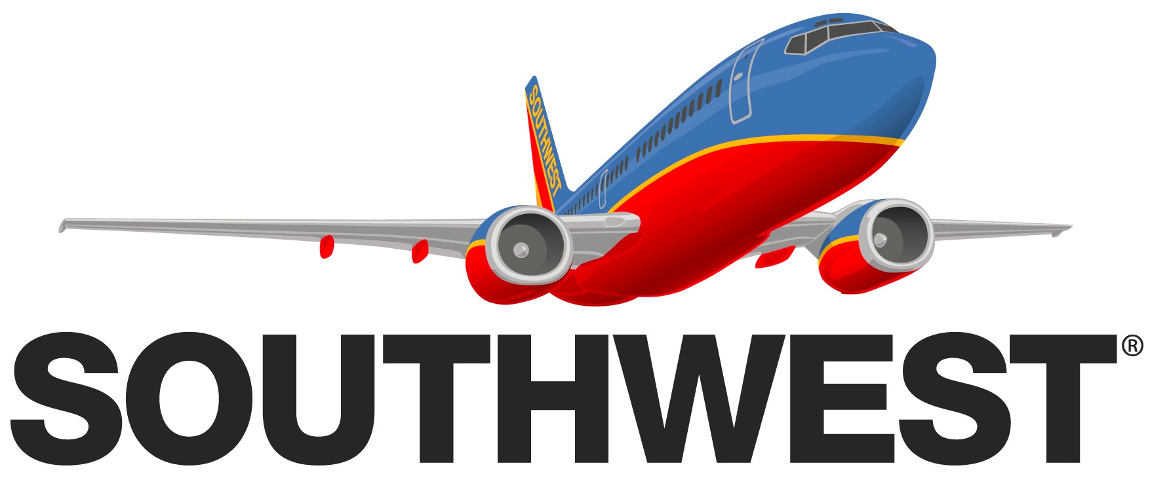
Agenda
Background Information
Financials
Risk Factors
Risk management

Slide 29
The Mission of Southwest Airlines
The mission of Southwest Airlines is dedication to the highest quality of Customer Service delivered with a sense of warmth, friendliness, individual pride, and Company Spirit.

Slide 30
Company Overview
Major U.S. airline
Established in 1967
Commenced service in 1971
World’s largest low-cost carrier
Uses point-to-point, high frequency model
The most successful low-fare carrier in U.S.
665 Boeing 737 aircraft

Slide 31
Company Model
Low-cost structure
Key component of company’s business strategy
Lower unit costs
Single aircraft type (Boeing 737)
Secondary airports

Slide 32


Board of Directors
Chairman and Chief Executive Officer David W. Biegler
Education: Bachelor’s in Physics from
St. Mary’s; Advanced Management at Joined: 2006 Harvard
Chairman of the Board, President, Gary C. Kelly
and Chief Executive Officer
Education: BBA from University of Texas Joined: 1986

Slide 33
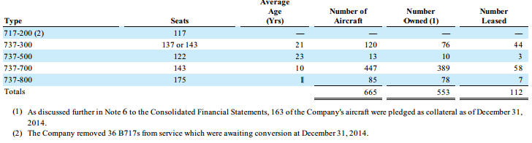
Fleet Profile

Slide 34
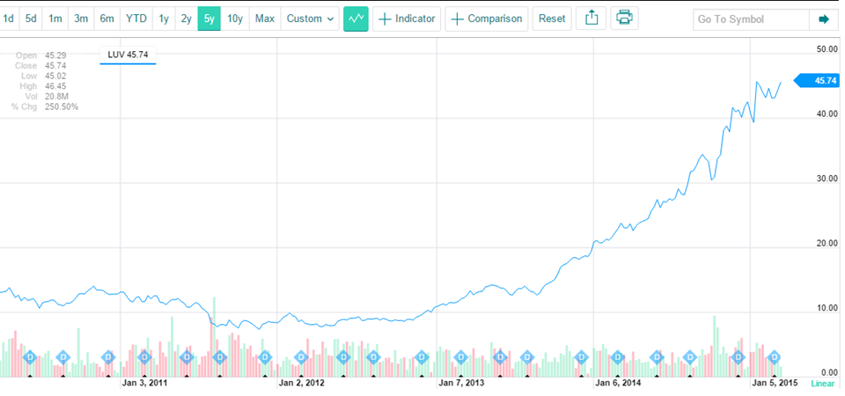
Stocks

Slide 35
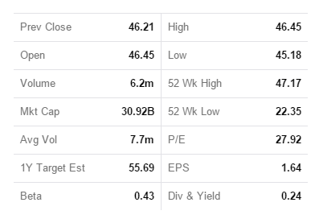
Stock Information

Slide 36
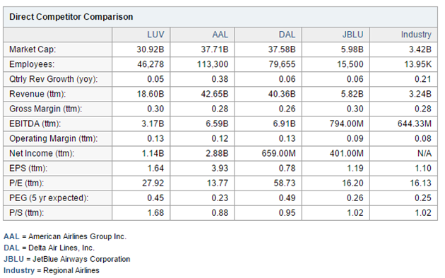
Competitors Comparison

Slide 37
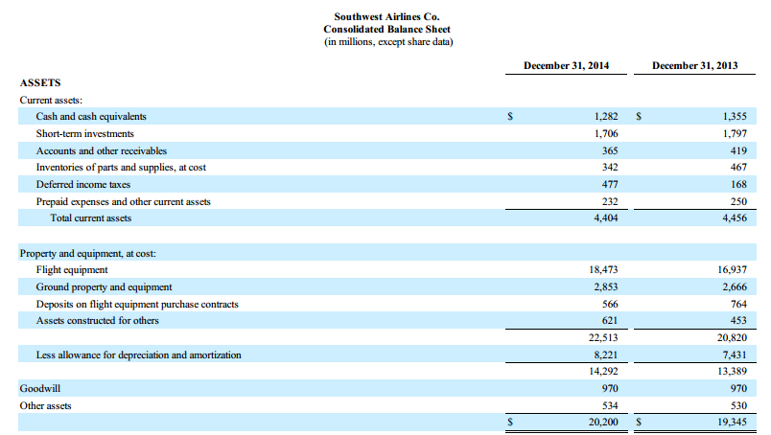
Financial - Balance sheet

Slide 38
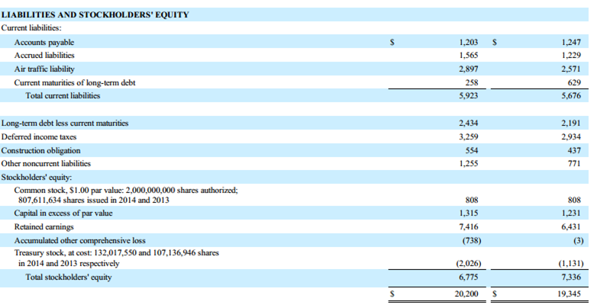

Slide 39
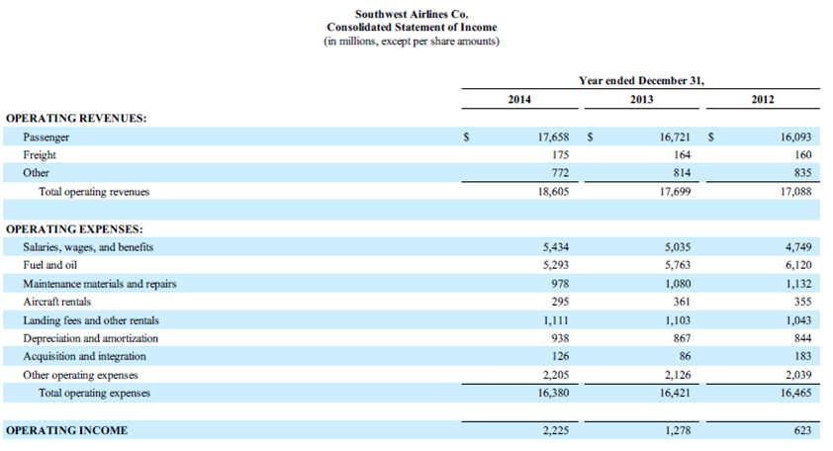
Income Statement

Slide 40
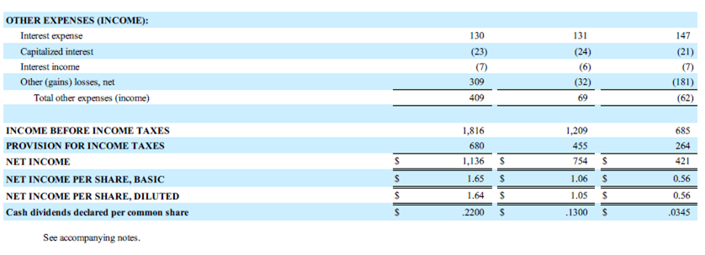
Income Statement

Slide 41
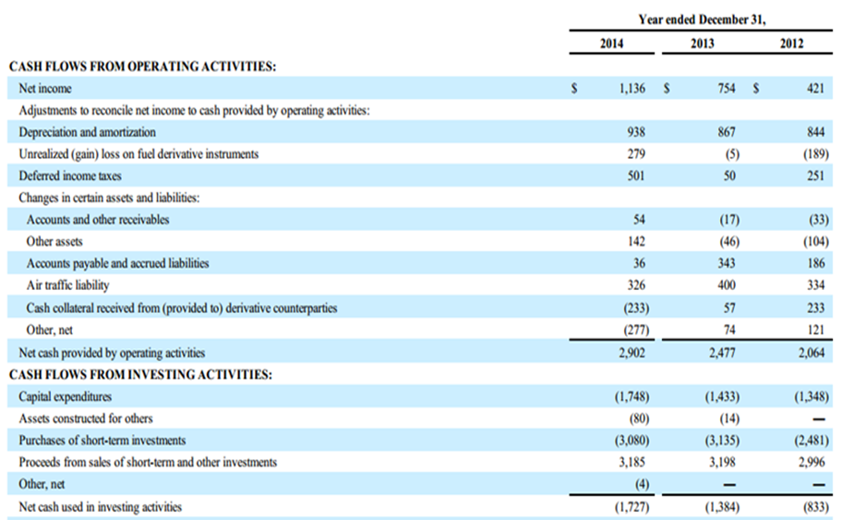
Cash Flows

Slide 42
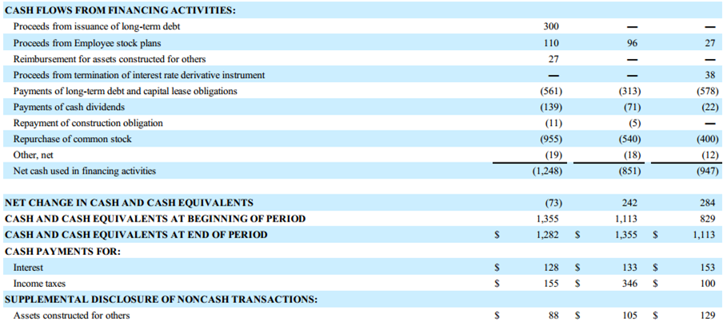
Cash Flows

Slide 43
Risk Factors
Sensitive to changes in economic conditions; unfavourable economic conditions or uncertainty can negatively impact operations
Significantly impacted by volatile/high fuel prices; potential to be disrupted by supply of fuel
Plans and profitability are likely to be impacted by ability to address fuel price increases, volatility, and availability.

Slide 44
Risk Factors (cont.)
Low-cost structure is a competitive advantage; improve ability to control costs
Dependent on technology to operate, with constant changes being made to its information systems; sensitive to failures or disruptions
Labour intensive business; must remain satisfactory relations with its employees and their representatives.

Slide 45
Risk Factors (cont.)
Dependent on single aircraft and engine suppliers; would be adversely affected if unable to obtain equipment or support from suppliers.
Required to maintain the security of customer-related information in order to uphold reputation.
Instability of credit, capital, and energy markets can result in pressure on the Company’s credit ratings and can also negatively affect the Company’s ability to obtain financing on acceptable terms and the Company’s liquidity generally.

Slide 46
Risk Factors (cont.)
Air Tran is currently subject to pending antitrust litigation, and if judgment were to be rendered against AirTran in the litigation, such judgment could adversely affect the Company’s operating results.
The application of the acquisition method of accounting resulted in the Company recording a significant amount of goodwill in connection with the acquisition of AirTran, which could result in significant future impairment charges and negatively af ect the Company’s financial results.

Slide 47
Risk management
The Company utilizes financial derivative instruments primarily to manage its risk associated with changing jet fuel prices, primarily to reduce volatility in operating expenses firm uses a fuel hedging program
“The Company endeavors to acquire jet fuel at the lowest possible cost and to reduce volatility in operating expenses through its fuel hedging program.”

Slide 48
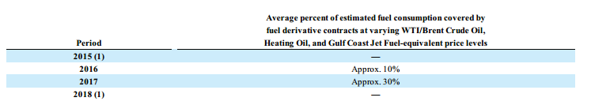
Risk Management (cont.)
“In response to the precipitous decline in oil and jet fuel prices during the second half of 2014, the Company took action to offset its 2015 and 2018 fuel derivative portfolios and is now effectively unhedged at current price levels.”

Slide 49
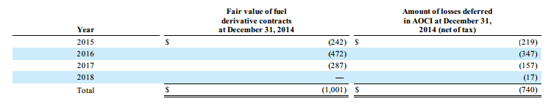
Risk Management (cont.)

Slide 50
Hedging Governance Structure
Create and maintain a comprehensive risk management policy
Provide for proper authorization by the appropriate levels of management
Provide for proper segregation of duties
Maintain an appropriate level of knowledge regarding the execution of and the accounting instruments
Have key performance indicators in place in order to adequately measure the performance of its hedging activities

Slide 51
Risk Management Committee
Audit committee charter deals with risk management; purpose is to:
“Discuss the company's major financial risk exposures and its policies with respect to risk assessment and risk management and the steps management has taken to monitor and control or mitigate such exposures.”

Slide 52
Types of Risks
Market Risk
commodity price risk (Fuel price)
Financial Market Risk
Interest Rate Risk
Credit Risk
Liquidity Risk

Slide 53
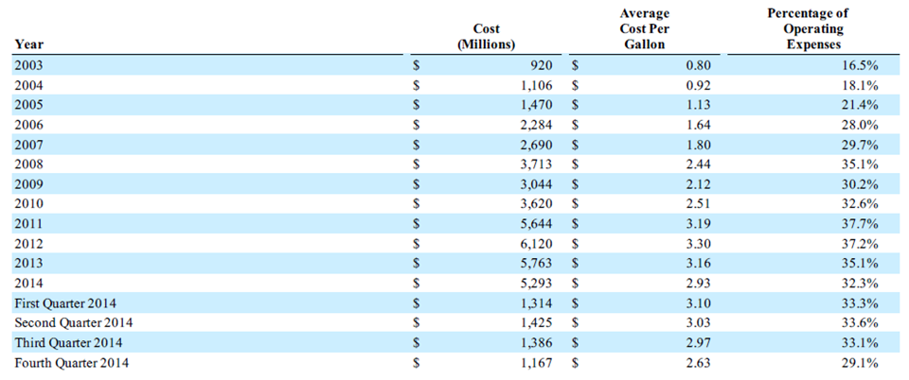
Fuel Expense

Slide 54
Jet Fuel Hedging
“Jet fuel is not widely traded on an organized futures exchange, therefore there are limited opportunities to hedge directly in jet fuel”
Instead, Southwest cross-hedges in the OTC market using:
Crude oil
Heating oil
Unleaded gasoline
Notes:
The Company purchases jet fuel at prevailing market prices, but seeks to manage market risk through execution of a documented
hedging strategy. The Company utilizes financial derivative instruments, on both a short-term and a long-term basis, as a form of
insurance against the potential for significant increases in fuel prices. The Company believes there can be significant risk in not hedging
against the possibility of such fuel price increases, especially in energy markets in which prices are high and/or rising. The Company
expects to consume approximately 1.9 billion gallons of jet fuel in 2015. Based on this anticipated usage, a change in jet fuel prices of
just one cent per gallon would impact the Company’s Fuel and oil expense by approximately $19 million for 2015, excluding any
impact associated with fuel derivative instruments held.

Slide 55
Derivatives Used
Call Options
Collars
Buy call option, write put option
Call Spreads
Buy call option and write call option
Swaps

Slide 56
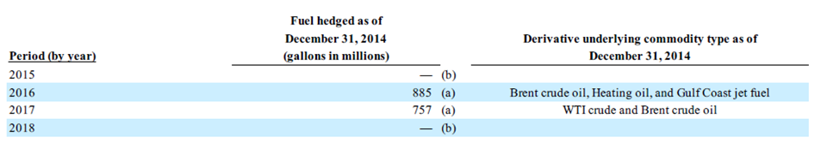
The following table provides information about the Company’s volume of fuel hedging for the years 2015 through 2018 on an “economic” basis considering current market prices:
Notes:
For 2014, the Company had fuel derivative instruments in place for up to 34 percent of its fuel consumption, and, as a result,
recognized $56 million in cash gains in Fuel expense from the settlement of those positions. As of December 31, 2014, the Company
has reduced its hedge position related to future years, and thus has no "economic" hedge in place for its 2015 estimated fuel
consumption. This reduction in the Company's hedge primarily was accomplished through entering into offsetting derivatives that will
also settle in the same periods as the economic hedge derivative. Although a portion of the offsetting derivatives were sold swap
positions and thus required no cash payment, the Company did pay $217 million to counterparties during fourth quarter 2014 to
purchase offsetting derivatives that will settle in 2015 and 2018.

Slide 57
Interest Rate Risk
Fluctuations of interest rates affect the firm’s interest obligation on their long term debt
Can potentially have impact on the firm’s liquidity position
Southwest mainly uses interest rate swaps to switch between fixed and floating rates on debt instruments where they deem appropriate, usually to better match the value of their assets and liabilities

Slide 58
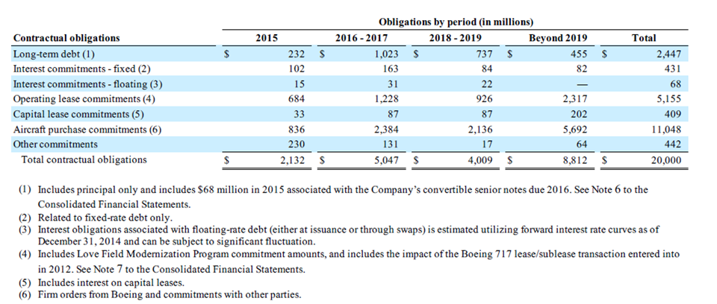

Slide 59
The Company has floating-to-fixed interest rate swap agreements associated with its $600 million floating-rate term loan agreement due 2020 and its $332 million term loan agreement due 2019 that are accounted for as cash flow hedges. These interest rate hedges have fixed the interest rate on the $600 million floating-rate term loan agreement at 5.223 percent until maturity, and for the $332 million term loan agreement at 6.315 percent until maturity.
Notes:
The Company is party to certain interest rate swap agreements that are accounted for as either fair value hedges or cash flow
hedges, as defined in the applicable accounting guidance for derivative instruments and hedging. Several of the Company's interest rate
swap agreements qualify for the “shortcut” method of accounting for hedges, which dictates that the hedges are assumed to be perfectly
effective, and, thus, there is no ineffectiveness to be recorded in earnings. For the Company’s interest rate swap agreements that do not
qualify for the "shortcut" method of accounting, ineffectiveness is required to be measured at each reporting period. The ineffectiveness
associated with all of the Company’s, including AirTran’s, interest rate swap agreements for all periods presented was not material.

Slide 60
Credit Risk
To manage credit risk, the Company:
selects and periodically reviews counterparties based on credit ratings,
limits its exposure with respect to each counterparty, and
monitors the market position of the fuel hedging program and its relative market position with each counterparty.
Notes:
Credit exposure related to fuel derivative instruments is represented by the fair value of contracts that are an asset to the
Company at the reporting date. At such times, these outstanding instruments expose the Company to credit loss in the event of
nonperformance by the counterparties to the agreements. However, the Company has not experienced any significant credit loss as a
result of counterparty nonperformance in the past.

Slide 61
Liquidity Risk
Liquidity and Financing
Agreements with financial institutions
Outstanding debt agreements
Potential to reduce availability of cash or increase costs to maintain agreements
Southwest strategy goals
Maintain minimum credit ratings, asset fair values and covenant ratios for outstanding debt agreements\
Results: Company has met or exceeded standards set forth in all their agreements

Slide 62
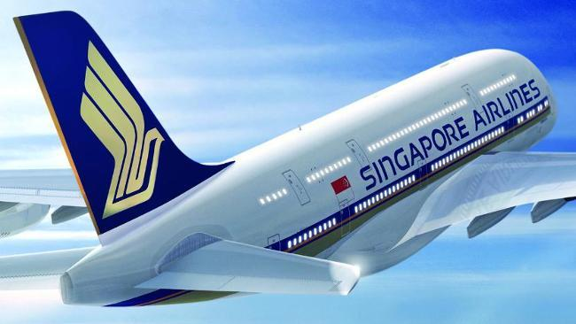


Slide 63

Agenda
Company Overview
Stocks
Financials
Risk Factors
Risk Management

Slide 64
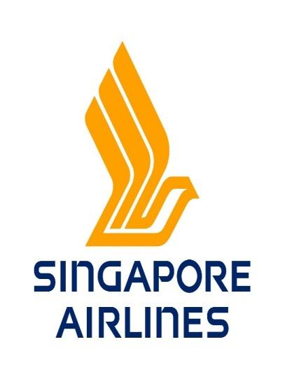
Singapore Airlines （SIA）
Singapore Airlines' Mission Statement
"Singapore Airlines is a global company dedicated to providing air transportation services of the highest quality and to maximizing returns for the benefit of its shareholders and employees."

Slide 65
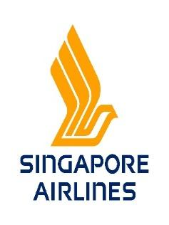
Singapore Airlines （SIA）
Singapore Airlines began with the incorporation of Malayan Airways Limited (MAL) on 1 May 1947
The flag carrier of Singapore, which operates from its hub at Changi Airport
Subsidiaries: Scoot, SilkAir, Singapore Airlines Cargo
Majority-owned by Singapore government investment and holding company Temasek Holdings which holds 56% of voting stock
Has a strong presence in the Southeast Asia, East Asia, South Asia, and Oceania

Slide 66

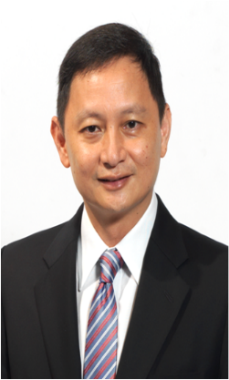
Board of Directors
Chairman | Mr Stephen Lee Ching Yen Joined: 2004 Education: MBA from Northwestern University
Chief Executive Officer | Mr Goh Choon Phong Joined: 1990 Education: MSc, BSc from MIT

Slide 67
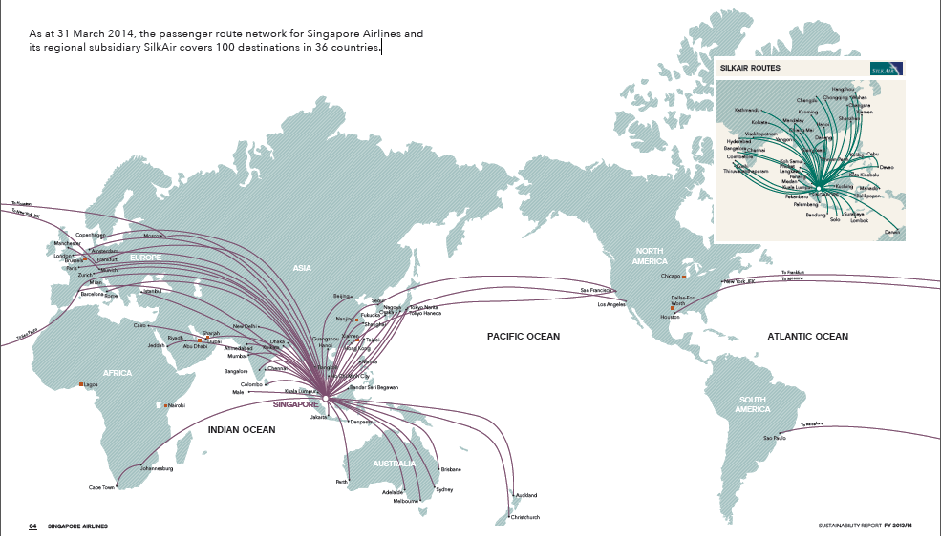
As at 31 March 2014, the passenger route network for Singapore Airlines and its regional subsidiary SilkAir covers 100 destinations in 36 countries

Slide 68
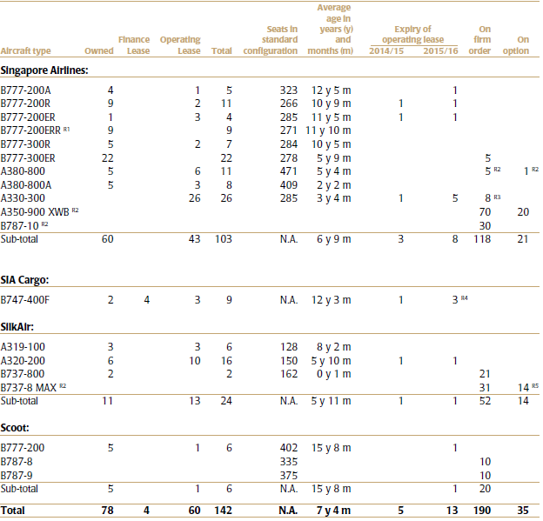
SIA Fleet Profile

Slide 69

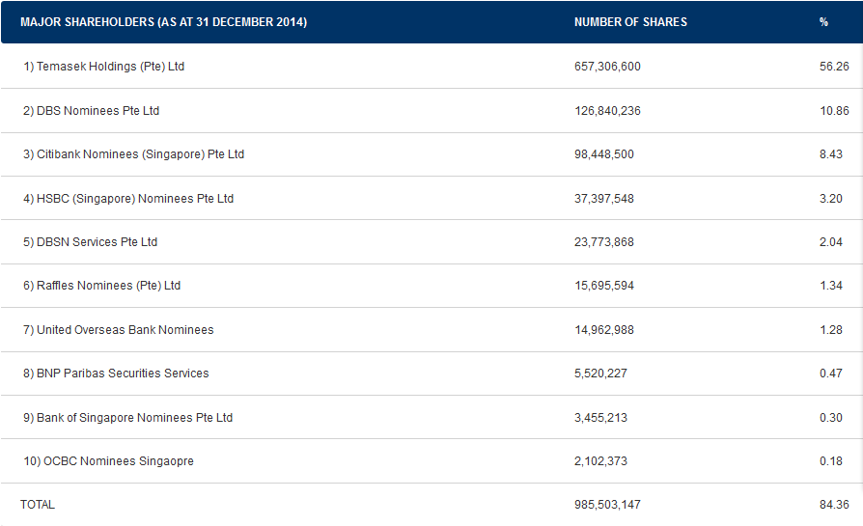
Major Share Holders

Slide 70
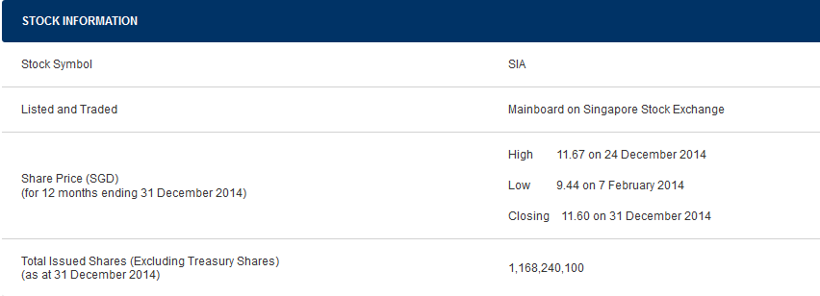

Stock Information

Slide 71

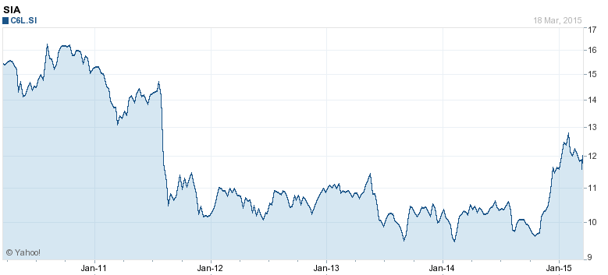
Stock Price

Slide 72
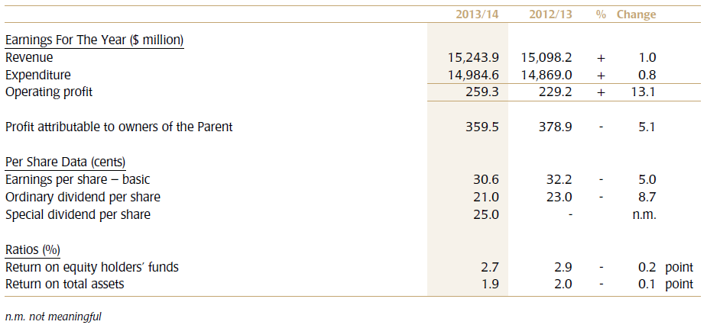
Financial Overview

Slide 73
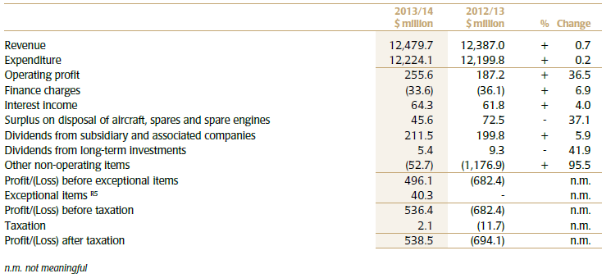
Earnings

Slide 74
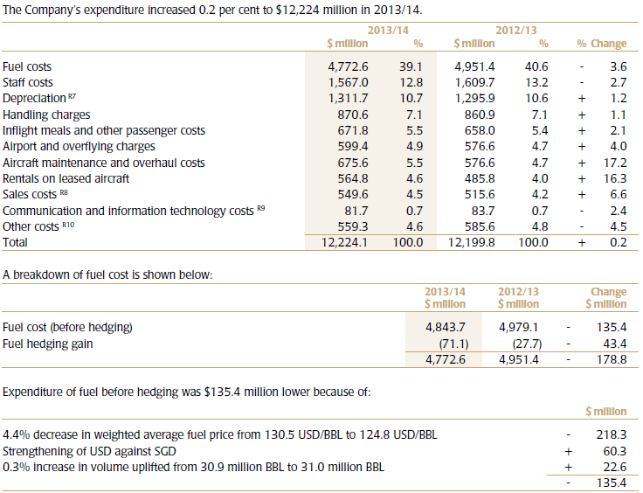
Cost Structure

Slide 75
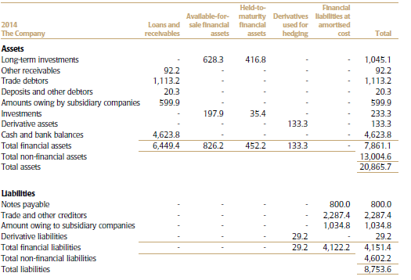
Financial Instruments

Slide 76
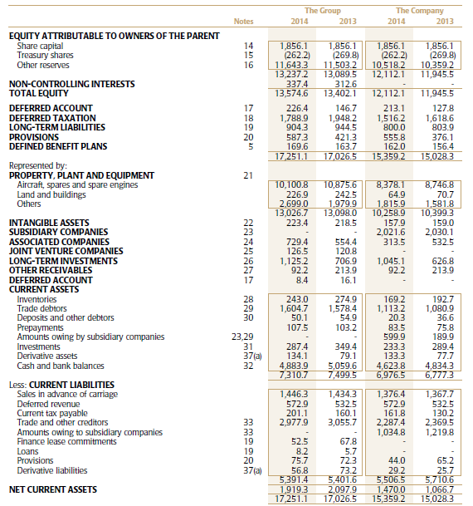
Statements of Financial Position

Slide 77
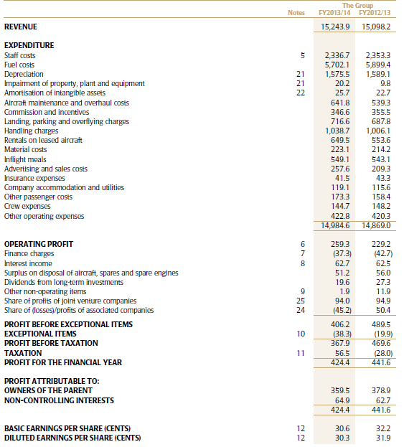
Consolidated Profit and Loss Account

Slide 78
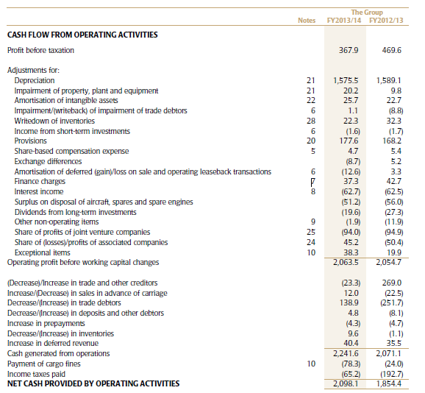
Cash Flow

Slide 79
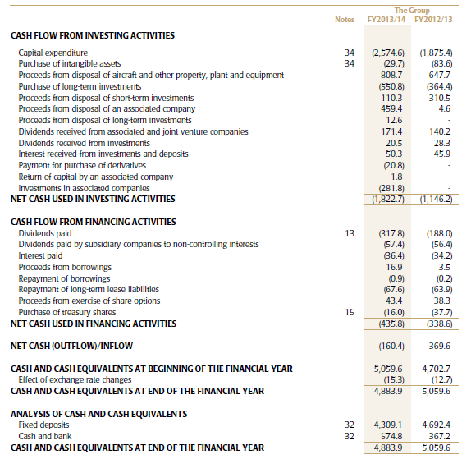
Cash Flow (cont’d)

Slide 80
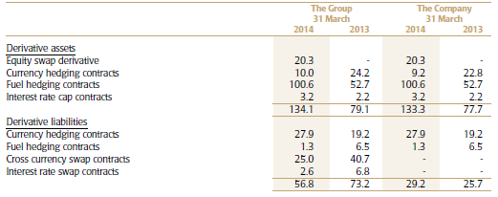
Derivative Financial Instruments

Slide 81
Risk Management
The Group’s airline operations carry certain financial and commodity risks, including the effects of changes in:
Jet fuel prices
Foreign currency exchange rates
Interest rates
The market value of its investments
The Group’s overall risk management approach is to moderate the effects of such volatility on its financial performance through the use of derivatives to hedge specific exposures.
Financial risk management policies are periodically reviewed and approved by the Board Executive Committee (“BEC”).

Slide 82
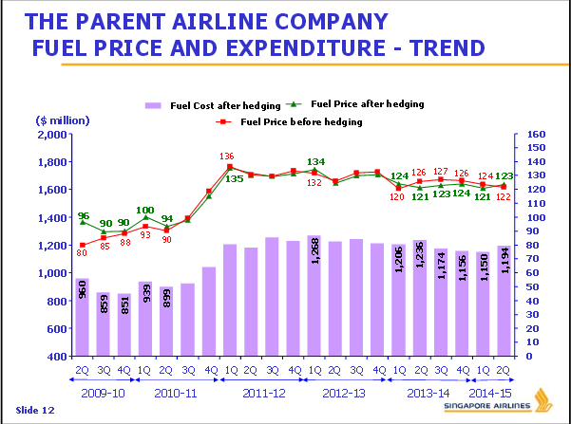
Jet Fuel Price

Slide 83
Jet Fuel Price Risk
BEC provide the Group with protection against sudden and significant increases in jet fuel prices.
The Group manages this fuel price risk by using swap, option, and collar contracts and hedging up to eight quarters forward using jet fuel swap, option and collar, Brent swap and crack swap contracts.
Cash Flow Hedges:
The Group has applied cash flow hedge accounting to these derivatives as they are considered to be highly effective hedging instruments. A net fair value gain before tax of $85.5 million (2013: loss before tax of $309.6 million), with a related deferred tax charge of $13.8 million (2013: deferred tax credit of $92.0 million), is included in the fair value reserve in respect of these contracts.

Slide 84
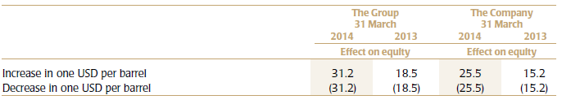
Sensitivity Analysis on Outstanding Fuel Hedging Contracts:

Slide 85
Foreign Currency Risk
The Group is exposed to the effects of foreign exchange rate fluctuations because of its foreign currency denominated operating revenues and expenses.
For the financial year ended 31 March 2014, these accounted for 53.1% of total revenue (FY2012/13: 56.4%) and 66.9% of total operating expenses (FY2012/13: 68.7%).
Cash Flow Hedges:
As of 31 March 2014, the Company holds USD285.3 million (2013: USD256.0 million) in short-term deposits to hedge against foreign currency risk for a portion of the forecast USD capital expenditure in the next 10 months. A fair value loss of $0.4 million (2013: gain of $4.9 million) is included in the fair value reserve in respect of these contracts.

Slide 86
Foreign Currency Risk (cont'd)
Fair value through profit or loss
In addition, the Group has cross currency swap contracts in place with notional amounts ranging from $10.8 million to $47.0 million (2013: $17.5 million to $68.9 million) where it pays SGD and receives USD at USD/SGD exchange rates ranging from 1.3085 to 1.6990 (FY2012/13: 1.3085 to 1.6990).
These contracts are used to protect the foreign exchange risk exposure of the Group’s USD-denominated finance lease commitments. The maturity period of these contracts ranges from 21 August 2015 to 14 February 2018.

Slide 87
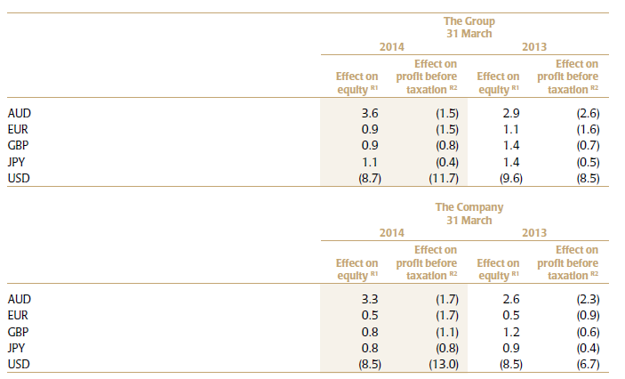
Foreign Currency Sensitivity Analysis

Slide 88
Interest Rate Risk
The Group’s earnings are also affected by changes in interest rates due to the impact such changes have on interest income and expense from short-term deposits and other interest-bearing financial assets and liabilities.
Cash flow hedges
As at 31 March 2014, the Company has interest rate cap contracts at a strike rate of 6.50% (2013: 6.50%), maturing in three to four years, to hedge against risk of increase in aircraft lease rentals.
The cash flow hedges of the interest rate cap contracts are assessed to be highly effective. A net fair value loss before tax of $16.7 million (2013: $17.6million), with a related deferred tax credit of $2.8 million (2013: $3.0 million), is included in the fair value reserve in respect of these contracts.

Slide 89
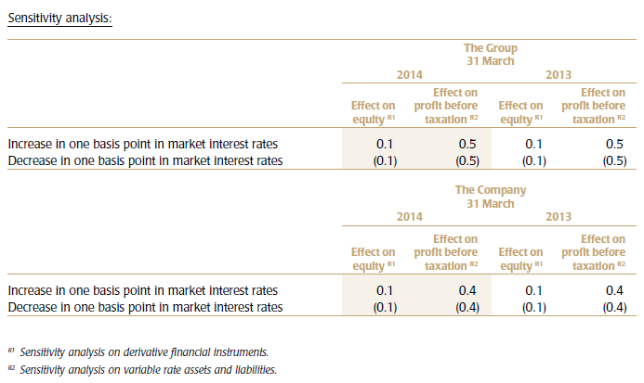
Interest Rate Sensitivity Analysis

Slide 90
Market Rate Risk
At 31 March 2014, the Group and the Company own investments of $1,313.7 million (2013: $957.4 million) and $1,259.6 million (2013: $897.4 million) respectively, which are subject to market rate risk. The market risk associated with these investments is the potential loss resulting from a decrease in market prices.

Slide 91
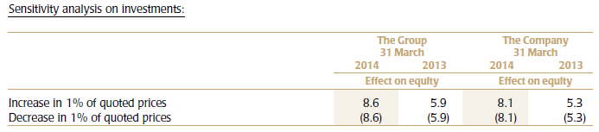
Market Rate Risk (cont'd)
Market price sensitivity analysis
If prices for these investments increase or decrease by 1% with all other variables being held constant, the before tax effects on equity are set out in the table below.

Slide 92
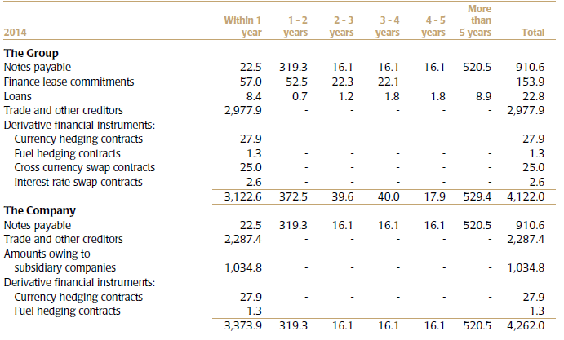
Liquidity Risk
The Group’s holdings of cash and short-term deposits, together with committed funding facilities and net cash flow from operations, are expected to be sufficient to cover the cost of all firm aircraft deliveries due in the next financial year.

Slide 93
Credit Risk
The maximum exposure to credit risk for the Group and the Company is represented by the carrying amount of each financial asset in the statement of financial position.
The Group has an independent Group Debts Review Committee to review the follow up actions on outstanding receivables monthly.
On a day-to-day basis, the respective Finance divisions have the primary responsibility for measuring and managing specific risk exposures.

Slide 94
Counterparty Risk
Counterparty risk is the potential financial loss from a transaction that may arise in the event of default by the counterparty.
Surplus funds are invested in interest-bearing bank deposits and other high quality short-term liquid investments.

Slide 95

Counterparty risk (cont’d)
The table below shows an analysis of credit risk exposures of balances that exceed 5% of the financial assets of the Group and the Company as at 31 March:

Slide 96


