Slide 1
Risk Management: Global Airlines
Presented By:
Manpreet Sidhu
Engin Vurgun
Nikola Gasic
November 10, 2010

Slide 2
Agenda
Industry Introduction
Singapore Airlines
Introduction
Risk Management Philosophies
Financials
Risk Management Strategies
Southwest Airlines
Introduction
Financials
Risk Management Strategies

Slide 3
Airlines
Provide air transport services for passengers or freight
Categories of airline services include:
International
National
Regional
Domestic

Slide 4
Air Line Alliances
Star Alliance, Sky Team, Americas and Oneworld
Cost Reduction
Sales offices, maintenance facilities
Traveler benefits
More departure times
Optimizes transfers
Traveler disadvantages
Less competition

Slide 5
Major Issues
Weather
Fuel Cost -15-35% of an airline's total costs
Labor - 40% of an airline's expenses
Other
Airport capacity, route structures, technology, and costs to lease or buy the physical aircraft

Slide 6
Pressures from External Forces
Threat of new entrants
Power of suppliers
Power of buyers
Availability of substitutes
Competitive rivalry

Slide 7
Key Success Factor
Attracting customers
Managing its fleet
Managing its people
Managing its finances

Slide 8
Industry Profit Pattern
Cyclical industry
Four or five years of poor performance precede five or six years of improved performance.
Mature industry → consolidation trend

Slide 9
Profits

Slide 10
Major Risks Faced by Airlines
Strategic risk
Business design choices
Financial risk
Variability of revenue and costs
Operational risk
Tactical aspects of running the business
Hazard risk
Safety of physical assets

Slide 11
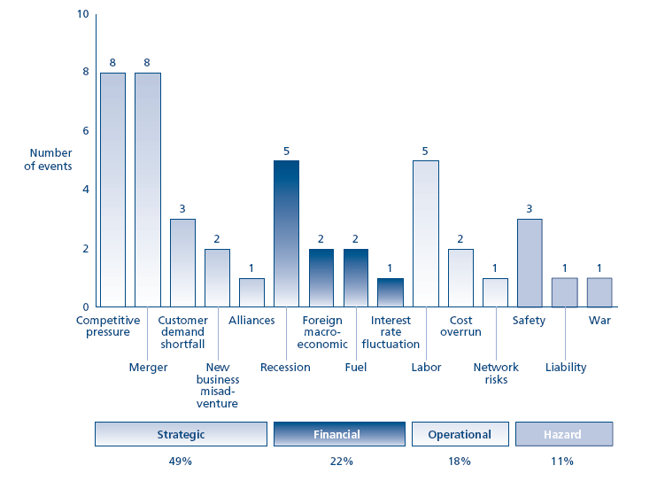
Risk Events Causing Stock Drops 1991-2001

Slide 12
Government Regulations
Government has extensive regulation for economic, political, and safety concerns
Some countries (e.g. US and Australia) have "deregulated" their airlines.
The entry barriers for new airlines are lower in a deregulated market,
far greater competition
average fares tend to drop 20% or more.

Slide 13
International Regulation
Groups (e.g. International Civil Aviation Organization) establish worldwide standards for safety and other vital concerns.
Most international air traffic is regulated by bilateral agreements between countries.
Bilateral agreements are based on the "freedoms of the air“
In the 1990s, "open skies" agreements became more common

Slide 15
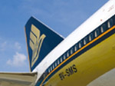
Agenda
General Information
Risk management philosophies
Financial statements
Risk management strategies

Slide 16
General Information
Founded in 1947 as Malaysian Airlines
Public company since 1972 in Singapore Stock Exchange
SIA’s passenger network covers 110 cities in 42 countries
Own parts of
Singapore Airlines Cargo (100%)
SIA Engineering Company (SIAEC) (81.9%)
Singapore Airport Terminal Services (81.9%)
SilkAir (100%)
Singapore Flying College ( 100%)
Virgin Atlantic Airways Limited (49%)

Slide 17
Singapore Airline Company Structure
Subsidiaries: SilkAir, Tradewinds Tour and Travel, SIA Engineering Company, SIA Cargo, and SATS
All the companies are in closely related business
SIA accounts for about 75% of the total revenue
Notes:
SIA is wholly-owned subsidiary of the Singapore government through Temasek Hldgs (Pte) Ltd. And actually Singapore airline also have 4 subsidiary companies, which are Silk Air, Tradewinds Tour and Travel, SIA Engineering Company, SIA Cargo, and SATS. All 4 of them are in closely related business with Singapore Airline, for example, Trades Tour and Travel deals with travelling, SIA cargo deals with the cargo transportations, SATS deals with the baggage handling business. And they all work together to provide a full line of services to its customers.
Singapore Airline, being the parent company of the 4, accounts for about 75% of the total revenue of the group.

Slide 18
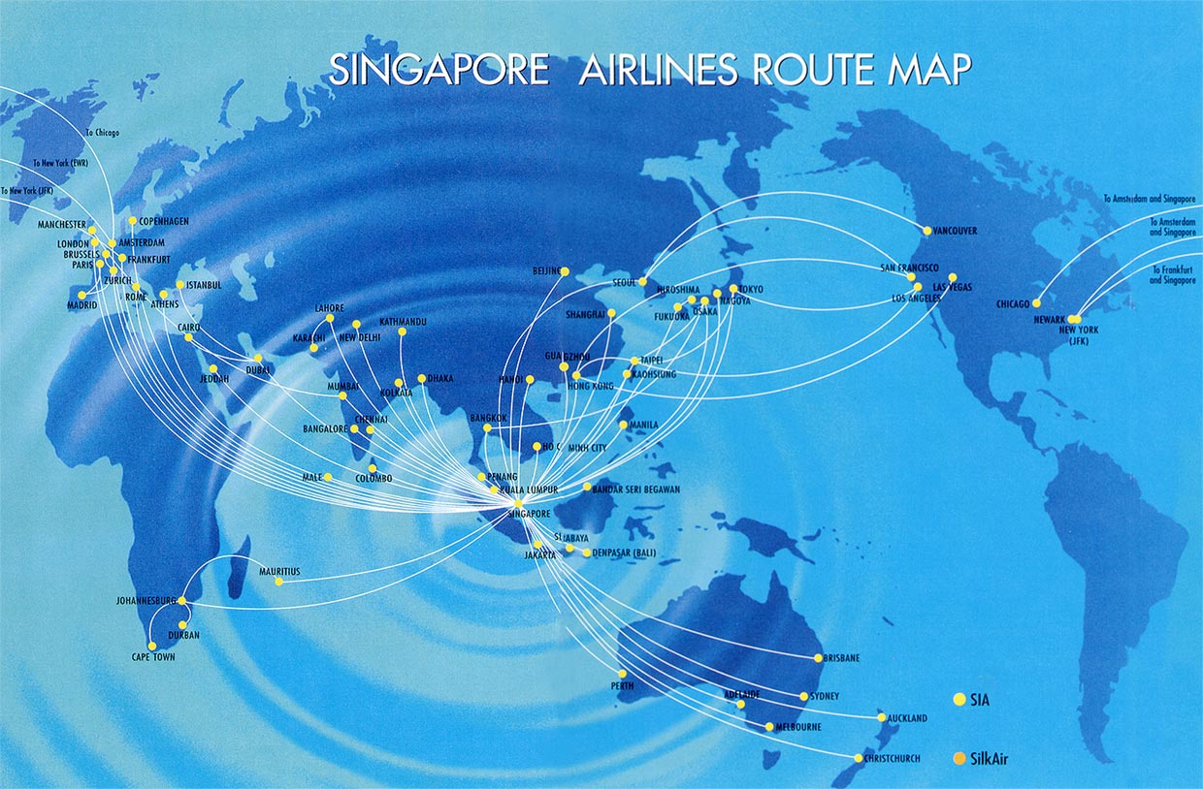
International Route Map

Slide 19
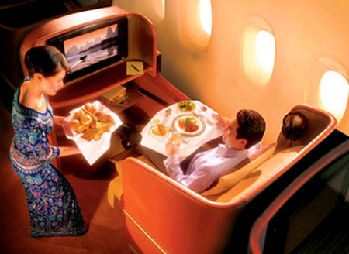
Marketing and Branding
Company slogan “A great way to fly”
Singapore emphasis
their staff
Singapore Girls

Slide 20
Competitive Advantage : Fleet Age Comparison
Notes:
One is the biggest competitive advantage for Singapore airline is Fleet Age. Fleet age is the length of time that an airplane has been flying for. While the industry average of fleet age is around 150 months or more than 12 years, the fleet age of Singapore Airline is around 80 months or 6 to 7 years. This graph shows that the fleet age of Singapore Airline is only about half of industry average. It can be expected that airplanes of Singapore Airline are generally newer, better, safer and will last longer. That is a big competitive advantage for SIA because airplanes are critically important assets for the airline companies.

Slide 21
Awards
Singapore airlines claims to be “Worlds Most Awarded Airline”
Zagat Survey
Placed first in premium and economy classes for comfort, service and food
Fortune
Was ranked 33rd World’s Most Admired Companies rankings in 2009 by Fortunes

Slide 22
Risk Management Philosophy
Risk management embedded throughout organizational processes
Business unit bottom-up approach
Corporate committee bottom-down guidance
Formalized across the entire SIA Group

Slide 23
Risk Management Philosophy
Benchmarking against International Standard
ISO 31000: Risk Management – Principles and guidelines
Introduced in November 2009

Slide 24
Headquartered in Geneva, Switzerland
Non-governmental organization
Founded in 1947
Sets worldwide standards on industrial and commercial activities
Standards often become laws

Slide 25
ISO 31000
Generic guidelines on enterprise wide risk management
Defines risk as:
“effect of uncertainty on objectives”
provides a common approach in support of standards dealing with specific risks and/or sectors

Slide 26
ISO 31000
“to be used by any public, private or community enterprise, association, group or individual”
Not specific to any industry or sector
“can be applied to any type of risk, whatever its nature, whether having positive or negative consequences”

Slide 27
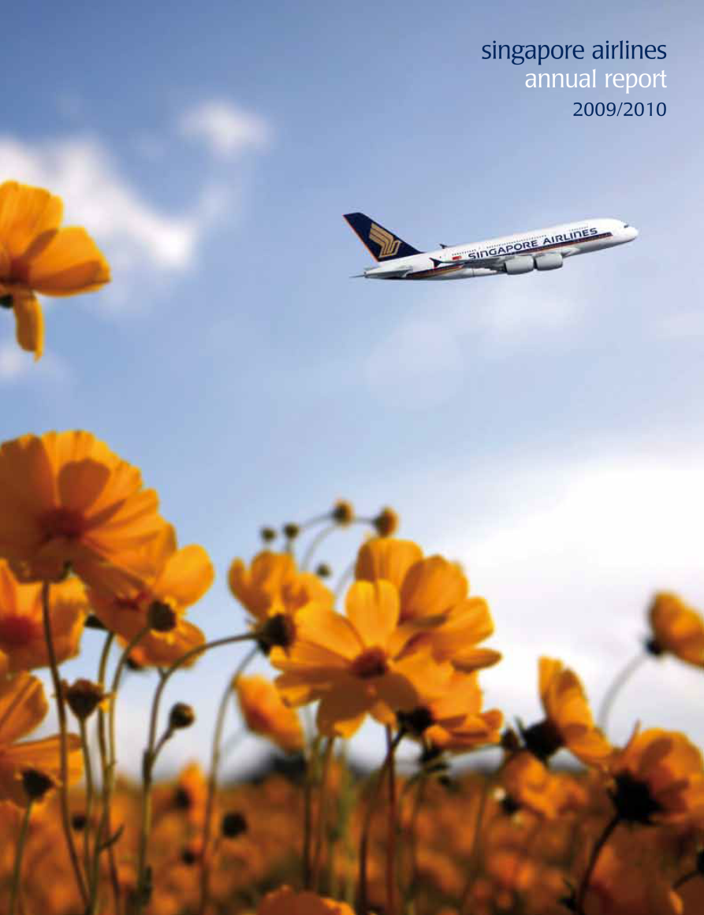
Financial Statements

Slide 28
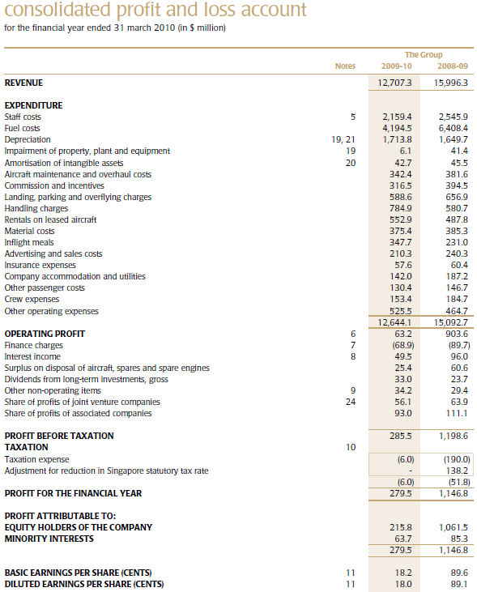

Slide 29
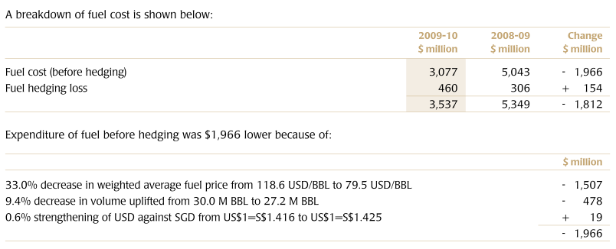
Fuel Cost

Slide 31
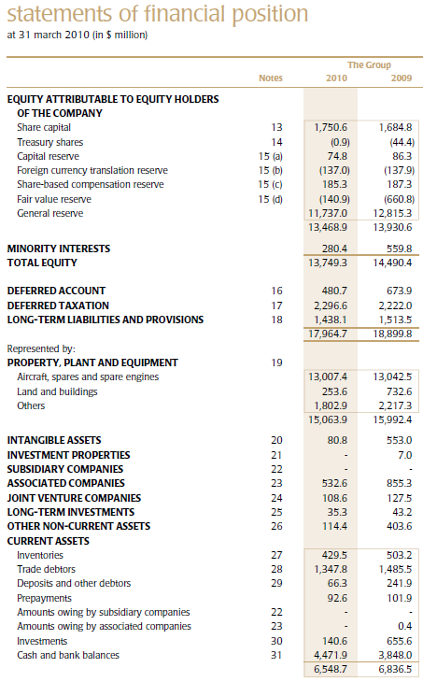

Slide 32
Continued

Slide 33
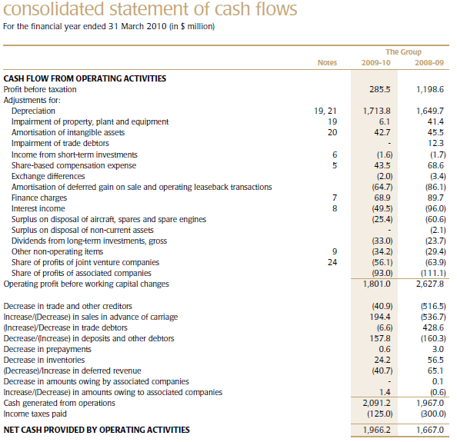

Slide 35
Risks and Risk Management

Slide 36
Financial Risks
Jet fuel price risk
Foreign currency risk
Interest rate risk
Market price risk
Liquidity risk
Credit risk
Focus

Slide 37
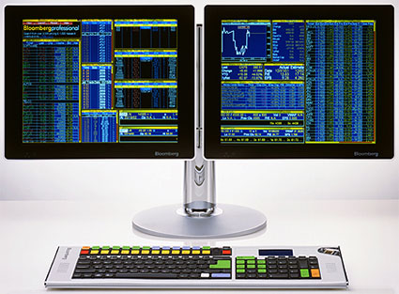
Tools for Managing Risks
Forward currency contracts
Foreign currency options
Cross currency swaps
Gasoil swaps
Regrade swaps

Slide 38
Derivatives

Slide 39
Jet Fuel Price Risk
Use swap and option contracts
Hedging up to 15 months forward
No longer entering into new gasoil hedges
Existing gasoil swaps to be rolled up into gasoil jet-fuel regrade

Slide 40
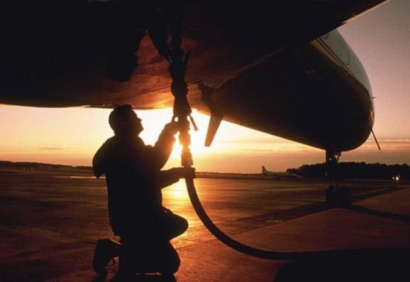
Jet Fuel Price Risk
Sensitivity analysis

Slide 41
Jet Fuel Price Risk
Taken from analyst briefing on May 24, 2010

Slide 42
Jet Fuel Price Risk
Q&A from analyst briefing on May 24, 2010
Question:
Hi, good afternoon, Mark Webb, HSBC. Just a quick question on your fuel
hedging. Your aim is to hedge 20% for this year. How much have you
hedged at the moment? That’s the first question, and secondly do you think
opportunities like the recent fall in jet fuel prices is a good opportunity to
hedge more fuel?

Slide 43
Jet Fuel Price Risk
Q&A from analyst briefing on May 24, 2010
Mr. Chew Choon Seng (CEO): Well Mark, I think the words are very important. It is our intention to hedge at least 20%. We did not say we intend to hedge 20%. So at this juncture, as you know we have always exercised what we call a wedge profile in our hedging, meaning further out in the horizon, it is the thin edge of the wedge and in the nearer quarters it would be the thick end of the wedge. As I said, our mandate is to hedge on a full year basis anywhere between 20% to 60%, so when we say it’s our intention to hedge at least 1/5th , that is just describing the lower end of the hedging profile that we want to adopt.

Slide 44
Foreign Currency Risk
Foreign currency accounts for:
62.4% of total revenue
58.6% of total expense
Policy of matching as far as possible receipts and payments in each currency

Slide 45
Foreign Currency Risk
USD payments are set aside 10 months prior to the payment date
Derivatives usage:
Foreign currency forwards
Foreign currency options
Settlement dates 1 month to 1 year

Slide 46
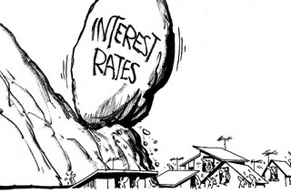
Interest Rate Risk
Sensitive to rates because of:
Short term deposits
Interest bearing assets
Interest bearing liabilities

Slide 47
Interest Rate Risk
Use:
Interest rate swaps
Maturing October 2015
Interest range of 3.00% to 4.95%
Interest rate caps
Strike rate of 6.50%
Maturity of 7-8 years
Used to hedge the cost of leasing aircraft

Slide 48
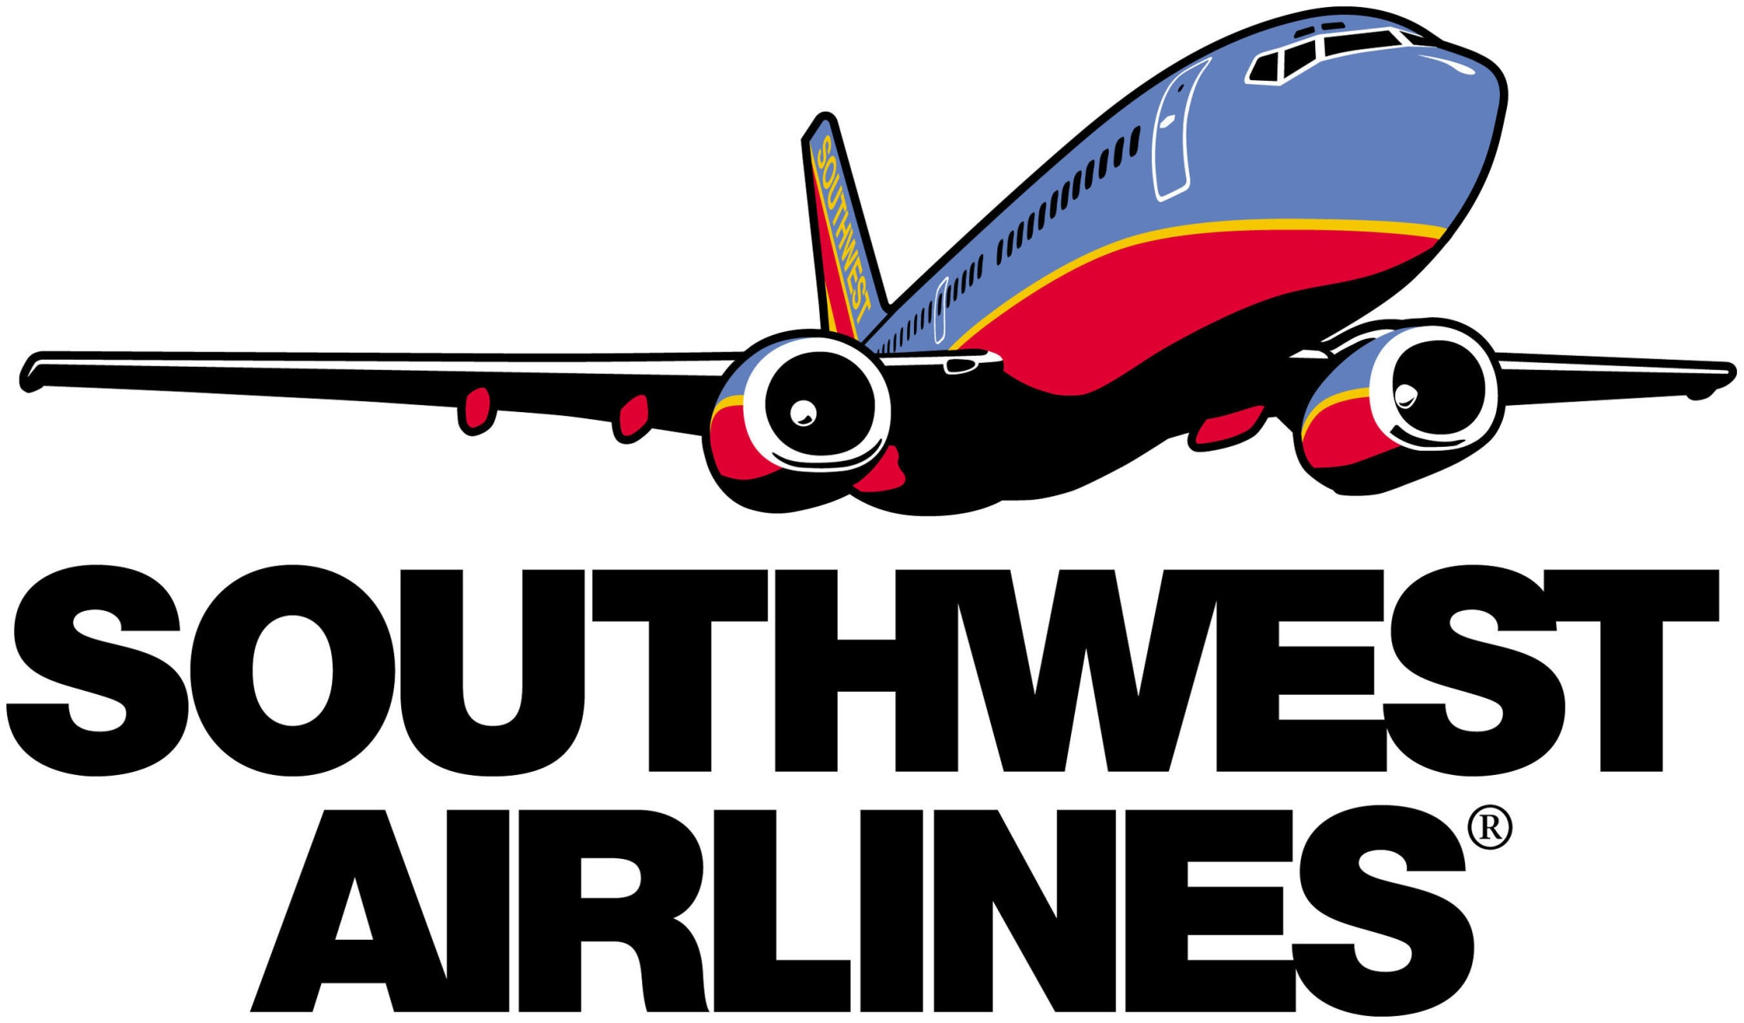

Slide 49
Agenda
General Information
Financial statements
Risk management strategies

Slide 50
History
1971 – Founded, flights between Dallas, Houston and San Antonio.
1977 – Stock is listed on the New York Stock Exchange as “LUV.”
1988 – Celebrates the sixty year in a row as a recipient of the Best Consumer Satisfaction record of any continental U.S. Carrier.
largest U.S. carrier based on domestic passengers carried as of March 31, 2010.
Southwest is the United States’ most successful low-fare, high frequency, point-to-point carrier

Slide 51
Fact Sheet
Daily Departures – 3200 flights per day
Flies 69 cities in 35 states.
Employees - 35,000 total employees
Flies almost 100 million passengers a year.
2009 Financial Statistics:
Net income: $99 million
Total passengers carried: 86 million
Total RPMs: 74.5 billion – (Revenue Passanger Mile)
Total operating revenue: $10.4 billion
Average passenger load factor: 76 %

Slide 52
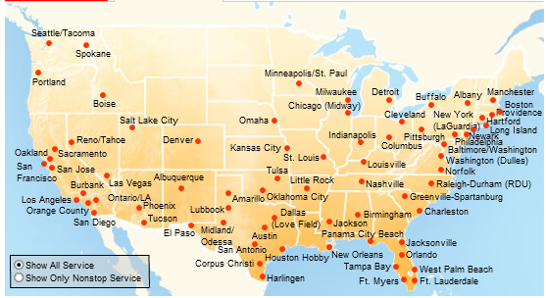
Southwest Route Map

Slide 53
Company Fleet Profile
Southwest currently operates 537 Boeing 737 jets (as of December 31, 2009).
The Company’s fleet has an average age of approximately 10.5 years.
737 Type | Seats | Average Age (yrs) | Number of Aircraft | Number Owned | Number Leased
300 | 137 | 18.0 | 172 | 104 | 68
500 | 122 | 18.7 | 25 | 16 | 9
700 | 137 | 6.1 | 340 | 320 | 20
Totals |  | 10.5 | 537 | 440 | 97

Slide 54
Operating Strategy
Point-to-point, rather than hub-and-spoke (Cheaper and more Efficient)
Frequent, conveniently timed flights
Decreased labour force to control CASM (cost per available seat mile) not related to passengers
Low fares
Notes:
Use Secondary Airports
Shortest turnaround time in the industry (10 minutes) (Industry average ~15-20 min)
Low cost structure from it’s hedging
6.25 flights per day, or almost 11 hours and 45 minutes per day.

Slide 55
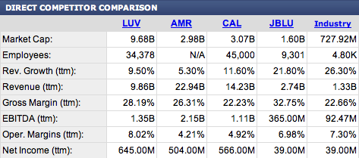
Competitors
AMR corporation
Continental Airline
JetBlue Airways

Slide 56
Southwest Airlines Market Share
Despite only operating in the United States, Southwest still remains a top controlling company

Slide 57
Stock Performance

Slide 58
Above Average Industry Performance
"Southwest is the only airline that has
made money since 1973 with stock value
up more than 500% since 1990"
Notes:
"Southwest is the only airline that has made money since 1973 with stock value up more than 500% since 1990" (1). Also, Southwest was the only airline to post a profit after the attacks on the World Trade Center. Southwest is able to compete with their market even though they are smaller because of their competitive advantage. This advantage leads to above average industry performance .

Slide 59
General Airline Cost Structure
Notes:
Others may include service costs, airport gate fees

Slide 60
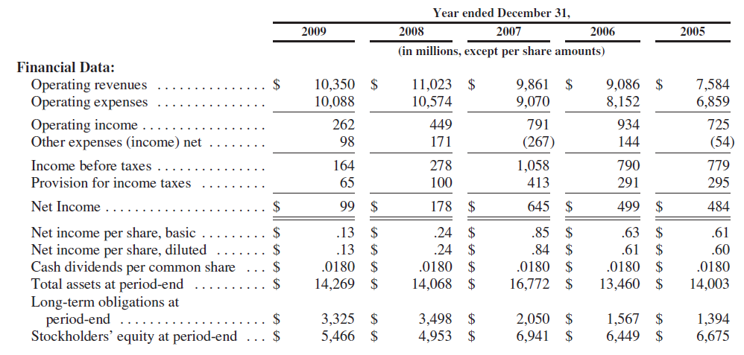

Slide 61
Financial Data Comparision 2008 and 2009
 | 2009 | 2008 | $ Reduction | % Reduction
Financial Data
Operating Revenues | 10,350 | 11,023 | 673 | 6.11%
Operating Expenses | 10,088 | 10,574 | 486 | 4.60%
Operating Income | 262 | 449 | 187 | 41.65%
Other Expenses (Income) Net | 98 | 171 | 73 | 42.69%
Net Income | 99 | 178 | 79 | 44.38%
Net income per share, diluted | 0.13 | 0.24 | 0.11 | 45.83%
Stockholders' equity at period-end | 5,466 | 4,953 | -513 | -10.36%

Slide 62
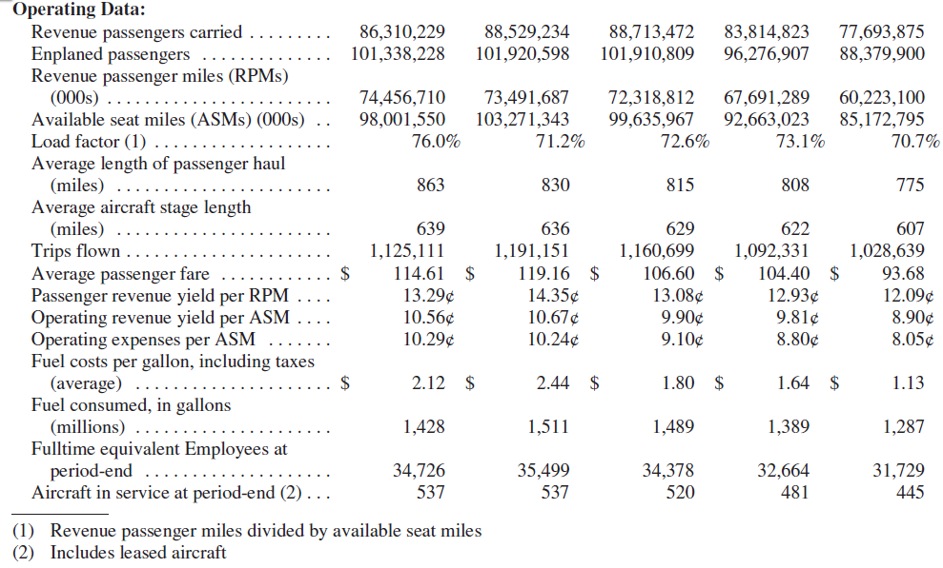

Slide 63
Operating Data Comparison of 2008 and 2009
 | 2009 | 2008 | Change
Operating Data
Revenue Passengers Carried | 86,310,229 | 88,529,234 | -2.51%
Revenue Passenger miles (RPMs) (000s) | 74,456,710 | 73,491,687 | 1.31%
Available Seat Miles (ASMs) (000s) | 98,001,550 | 103,271,343 | -5.10%
Passenger Load Factor | 76% | 71% | 6.74%
Average Passenger Fare | $114.61 | $119.16 | -3.82%
Passenger Revenue Yield per RPM | 13.29¢ | 14.35¢ | -7.38%
Operating Revenue Yield per ASM | 10.56¢ | 10.67¢ | -1.00%
Operating Expenses per ASM | 10.29¢ | 10.24¢ | 0.49%
Average Fuel costs per gallon with taxes | $2.12 | $2.44 | -13.11%
Fuel consumed, in gallons (millions) | 1,428 | 1,511 | -5.49%
Fulltime Employees at period-end | 34,726 | 35,499 | -2.18%
Size of Fleet at period-end | 537 | 537 | 0.00%

Slide 64
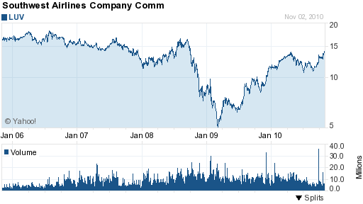
5- Year Stock Price

Slide 65
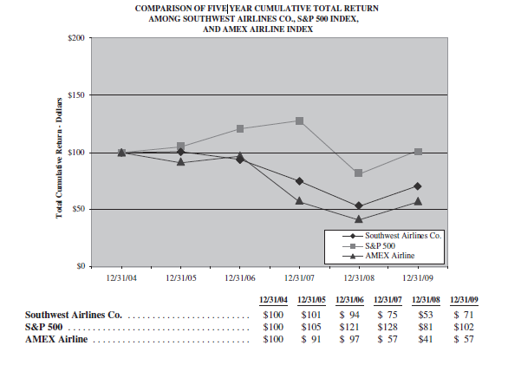
5-year Performance Comparison

Slide 66
Revenue Source in millions

Slide 67
Revenue Source Comparison 2008 and 2009
 | 2009 | 2008 | Change
Operating Revenues
Passenger | $9,892 | $10,549 | -6.23%
Freight | $118 | $145 | -18.62%
Other | $340 | $329 | 3.34%
Total Operating Revenues | $10,350 | $11,023 | -6.11%

Slide 68
Operating Expenses in Millions

Slide 69
Operating Expenses Comparision 2008 and 2009
 | 2009 | 2008 | Change
Operating Expenses
Salaries, Wages, and Benefits | 3,468 | 3,340 | 3.83%
Fuel and Oil | 3,044 | 3,713 | -18.02%
Maintenance materials and repairs | 719 | 721 | -0.28%
Aircraft Rentals | 186 | 154 | 20.78%
Landing fees and other rentals | 718 | 662 | 8.46%
Depreciation and amortization | 616 | 599 | 2.84%
Other operating expenses | 1,337 | 1,385 | -3.47%
Total Operating expenses | 10,088 | 10,574 | -4.60%

Slide 70
Company’s estimated fair value of remaining fuel derivative contracts
AOCI – Accumulated other Comprehensive Income

Slide 71
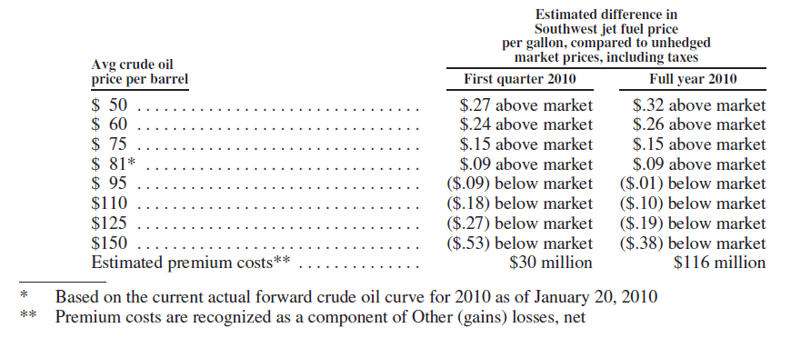
Sensitivity table for Jet fuel Prices at different crude oil assumptions as of January 20,2010

Slide 72
Company’s meterial expected contractual obligations and commitments as of Dec 31, 2009

Slide 73
Company’s estimated obligations related to its fuel derivative positions for the years 2010 through 2013 As of December 31, 2009 (in millions)

Slide 74
Risk Factors
Fuel prices
Economic condition
Company’s low cost structure
Unstable credit, capital, and energy markets
The company is very dependent on Boeing
Airline business is labor intensive
Security concerns
Airport capacity constraints and air traffic control inefficiencies
Global conditions

Slide 75
1) Fuel Prices
Airlines are inherently dependent upon energy to operate
The cost of fuel is largely unpredictable (why?)
Fuel Prices can be impacted by political and economic factors such as
Dependency on foreign imports of crude oil and the potential for hostilities or other conflicts in oil producing areas
Limited refining capacity
Changes in governmental policies on fuel production, transportation, and marketing.

Slide 76
Fuel and Oil Expenses in Detail

Slide 77
2) Economic Condition
Why it is important ?
It affects Customer travel patterns and related revenues. (customers cut back travel expenses)
It also impacts the ability of airlines to raise fares to counteract increased fuel, labor, and other cost.

Slide 78
3) Company’s low cost structure
Why it is important ?
It is the company’s main competitive advantage. It enables the Company to offer low fares and drive traffic volume.
However if oil, fuel, and labor costs increase, the company can loose its competitive advantage.

Slide 79
4) Unstable Credit, Capital, and Energy Markets
Could result in future pressure on the Company’s credit ratings.
Why it is important?
Impact the company’s abilitiy to obtain financing on acceptable terms.
Impact on the Company’s liquidity in general
Availabity and cost of insurance.
EX: Standard & Poor’s and Fitch downgraded the company’s credit rating from BBB + to BBB because of lower demand, and continued volatility in fuel prices.

Slide 80
5) High Dependence on Boeing
Boeing is the only aircraft and engine supplier for the company.
Supplier (Boeing) has the power.
What if Boeing were unable or unwilling to provide adequate support for its products ?

Slide 81
6) The Airline Business is Labor Intensive
Salaries, wages, and benefits represented approximately 34 % of the Company’s operating expenses.
82 % of its employees were represented for collective bargaining purposes by Labor Unions
What may happen if there are conflicts between the union and the company ? (Ex: Strike)

Slide 82
7) Security Concerns
Threatened or actual terrorist attacts.
Ex: 9/11, Volcanic eruptions
It will affect the demand for air travel.
Also, it will increase the security and safety cost of the company.

Slide 83
8) Airport Capacity Constraints and Air Traffic Control Inefficiencies
Airport Capacity constraints increase the airport rates and charges.
Limited gate capacity
Increase in taxes
Decrease the service that can be offered by the Airline Companies.
Therefore, They should choose their destination routes very carefully.

Slide 84
9) Global Conditions
Adverse weather and natural disasters
Outbreaks of disease
Changes in consumer preferences, perceptions, spending patterns, or demographic trends.
Actual and potential disruptions in the air traffic control system
Changes in the competitive environment due to industry consolidation, industry bankruptcies, and other factors.
Actual or threatened war, terrorist attacks, and political instability.

Slide 85
Company Hedging Governance Structure
Create and maintain a comprehensive risk management policy
Provide for proper authorization by the appropriate levels of management
Provide for proper segregation of duties
Maintain an appropriate level of knowledge regarding the execution of and the accounting for derivative instruments
Have key performance indicators in place in order to adequately measure the performance of its hedging activities

Slide 86
Jet Fuel Price Risk
Company uses various derivative instruments, including crude oil, unleaded gasoline, and heating oil-based derivatives, to attemp to reduce the risk of its exposure to Jet Fuel price increases.
These instruments primarily consist of purchased call options, collar structures, and fixed – price swap agreements.
The company does not purchase or hold any derivative financial instruments for trading purposes.

Slide 87
Jet Fuel Price Risk Cont
The company must estimate the future prices of jet fuel because there is not a reliable forward market for jet fuel.
Forward jet fuel prices are estimated with data from market forward prices of like commodities. (Crude Oil, Heating Oil, Unleaded Gasoline)

Slide 88
Jet Fuel Price Risk cont
The company expects to consume approximately 1.4 billion gallons of jet fuel in 2010.
Therefore, a change in jet fuel prices of just on cent per gallon would impact the company’s “Fuel and Oil expense” by approximately 14 million per year.

Slide 89
Jet Fuel Price Risk cont
As of December 31, 2008, contracts approximately 10 % of its anticipated jet fuel purchases for each year from 2010 through 2013.
At the end of 2008, Fuel prices decline.
Company reduced its fuel hedging losses by entering into additional derivative contracts (fixed –price SWAP derivatives)

Slide 90
Forecasted % of Jet fuel consumption and Fuel Hedged
For 2009, the company had fuel derivative in place related to approximately 27 % of its fuel consumption.
For 2010, the company had derivative contracts in place for approximately 50 % of its estimated 2010 fuel consumption.

Slide 91
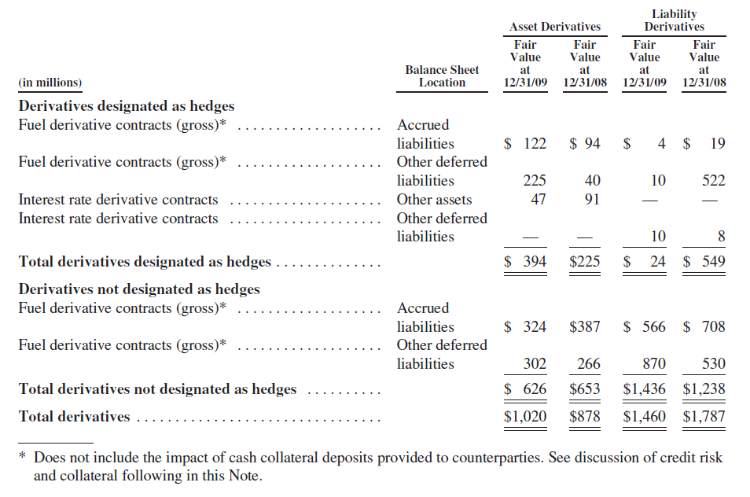
All Assets and Liabilities Associated with Hedging Instruments in Balance Sheet

Slide 93
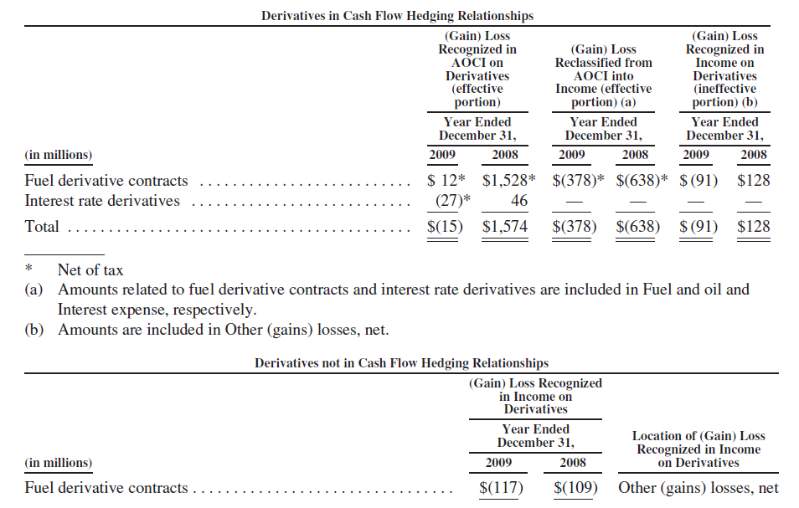
Derivative Instruments and Consolidated Statement of Operations

Slide 94
Interest Rate Risk
The company uses Interest Rate SWAPs to hedge the risk.
The Primary objective for the Company’s use of these interest rate hedges is to reduce the volatility of net Interest income by better matching the repricing of its assets and liabilities.

Slide 95
Interest Rate SWAPs
Table contains the floating rates paid during 2009, based on actual and forward rates at December 31, 2009.

Slide 96
Thank You!
Questions?

