Slide 1
Goldman Sachs Risk Management
November 17 2010
Presented by:
Ken Forsyth
Jeremy Poon
Jamie Macdonald

Slide 2
Agenda
Overview of Goldman Sachs
Market risk
Credit risk
Liquidity risk
Operational Risk
Regulatory risk
Conclusion

Slide 3
Goldman Sachs Overview

Slide 4
Introduction
Founded in 1869 by Marcus Goldman
  Son in law, Samuel Sachs, joined in 1882
One of 18 Primary Dealers
IPO in 1999 → As of 2009, 67% of GS owned by shareholders
September 21, 2008 following the collapse of Lehman Brothers, Goldman became a bank holding company
  Now under the supervision of bank regulators
  Easier access to capital

Slide 5
Introduction
Offices in over 30 countries with 32,500 staff members
44% of revenue generated outside of the Americas
CEO Lloyd Blankfein
  Former trader at Goldman
  BA JD from Harvard
2009 Net Income of 13.39B
Total Assets of 910B as of 3Q
Market Cap of 84.3B

Slide 6
Introduction
Global investment banking and securities firm operating in three main financial services areas:
  Investment Banking
  Trading and Principle Investments
  Asset Management and Securities Services
…mainly for institutional clients; however, some PCS.

Slide 7
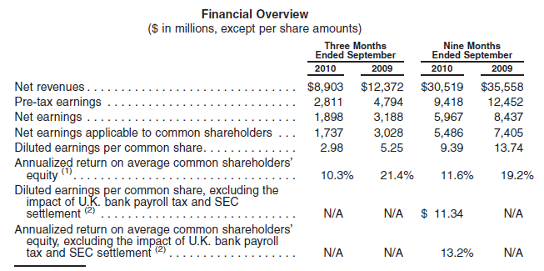
Q3 Results from Operations

Slide 8
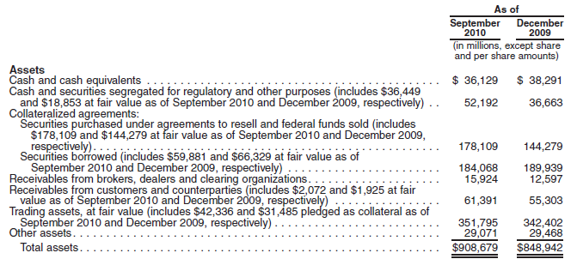
Balance Sheet as of Q3 2010

Slide 9
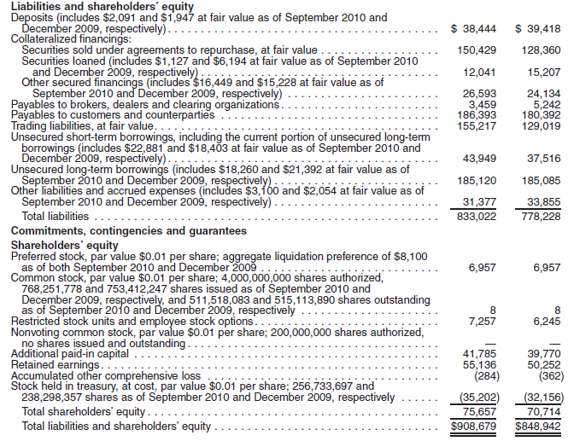
Balance Sheet Continued

Slide 10
Investment Banking
Financial Advisory
  Mergers and Acquisitions
  Divestitures, corporate defense
  Financial Restructuring
Underwriting
  Debt and Equity Underwriting Services
  Public offerings, private placements
  Underwrite a wide range of securities & financial instruments

Slide 11
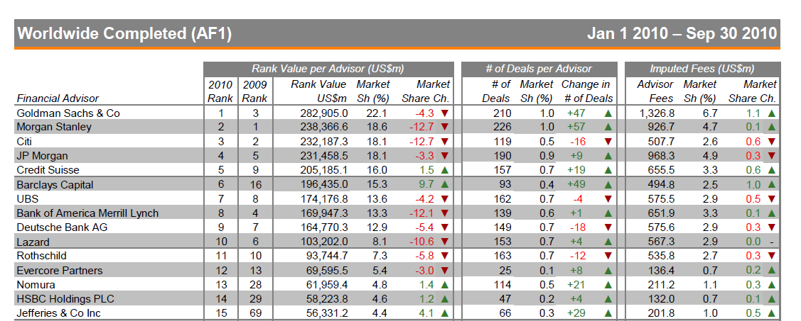
M&A League Table

Slide 12
Asset Management & Security Services
Asset Management
  Investment advisory services, financial planning and investment products across all major asset classes and exchanges
  Management of merchant banking funds
Securities Services
  Prime Brokerage
  Financing Services
  Securities Lending

Slide 13
Trading & Principle Investments
Fixed Income, Currency & Commodities
  Commodities & commodity derivatives
  Credit products, derivatives, investment-grade, high-yield, and distressed debt among many others
  Currencies & currency derivatives
  Interest rate derivatives
  Mortgage-related securities and loan products and other asset backed instruments

Slide 14
Trading & Principal Investments
Equities
  Equity securities and derivatives
  Equities and options exchange-based market-making activities
  Securities, futures and options clearing services
  Insurance Activities
Principal Investments
  In connection with merchant banking activities
  ICBC (come back to this)

Slide 15
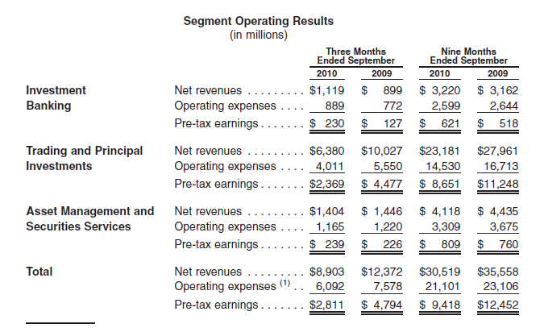
Operations by Segment in Q3

Slide 16
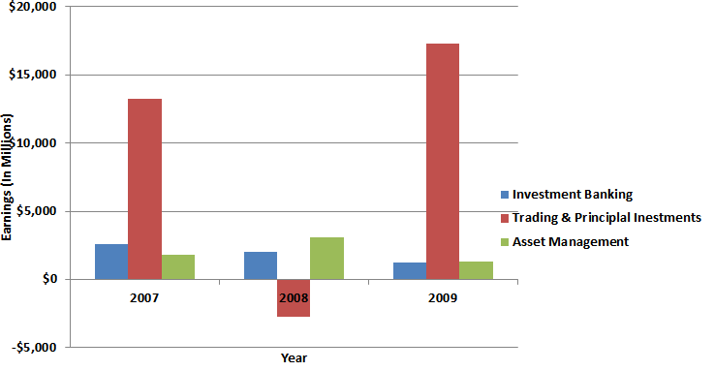
Earnings Breakdown

Slide 17
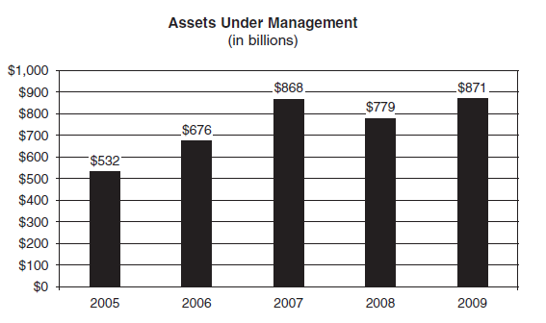
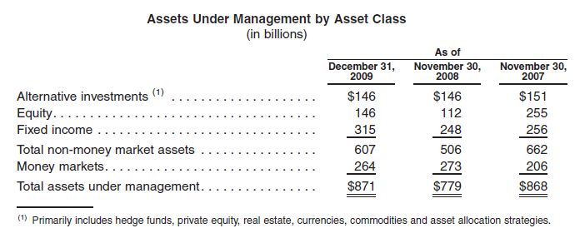

Slide 18
 | 1Q | 2Q | 3Q | Total | Trading Revenue as a % of Total Revenue
Credit Suisse
Trading Revenue | $3,453 | $3,629 | $938 | $8,020
Total Revenue | $8,961 | $8,420 | $6,284 | $23,665 | 33.89%
Deutsche
Trading Revenue | $4,746 | $2,776 | $2,886 | $10,408
Total Revenue | $8,999 | $7,155 | $4,985 | $21,139 | 49.24%
RBC
Trading Revenue | $1,041 | $936 | $125 | $2,102
Total Revenue | $7,334 | $6,967 | $6,827 | $21,128 | 9.95%
Morgan Stanley
Trading Revenue | $3,411 | $3,353 | $1,439 | $8,203
Total Revenue | $9,078 | $7,953 | $6,779 | $23,810 | 34.45%
Goldman Sachs
Trading Revenue | $10,250 | $6,551 | $6,380 | $23,181
Total Revenue | $12,775 | $8,841 | $8,903 | $30,519 | 75.96%

Slide 19
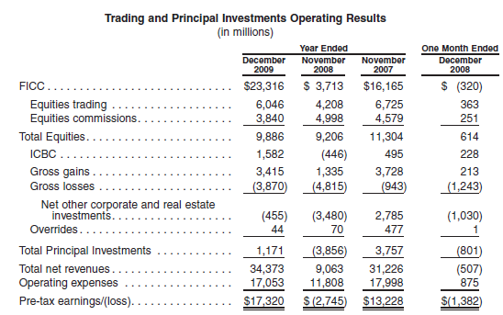

Slide 20
Trading Revenue
High volume transactions in large, highly liquid markets for smaller spreads and fees
Transactions undertaken in less liquid markets where spreads and fees are generally larger
Structuring and execution of complex transactions

Slide 21
Goldman, MBS & TARP
One of many who were involved in the structuring and issuing of MBS
Received massive public pressure for betting against the securities they created
Received $10B preferred stock investment from the U.S. Treasury
Goldman repaid TARP funds in June 2009

Slide 22
Market Risk

Slide 23
Overview of Market Risk
Market risk is the potential for changes in the market value of trading and investment positions
Primary exposures include interest rates, currencies, equities (and other asset prices), and commodities
Notes:
Net long positions; market making requires large capital commitments; all are marked to market – declines in asset values have a direct and immediate impact on earnings when the positions are unhedged.

Slide 24
Overview of Market Risk cont’d
High sensitivity to the business environments being operated in
These depend on:
  Global GDP growth
  Efficient capital markets
  Low inflation
  High business and investor confidence
  Geopolitical conditions
  Business earnings

Slide 25
Market risk effect on Investment Banking
Market for M&A and underwriting is limited by investor and CEO confidence in the economy
Clients are also highly dependent on liquid credit markets to finance major transactions
These large transactions are the major driver of Goldman’s M&A revenue

Slide 26
Market risk effect on Trading & Arbitrage
Trading & Arbitrage opportunities depend on market volatility
A volatile market can therefore increase trading revenues
Conversely increased volatility increases VaR as trading activity becomes more risky – this may force the firm to reduce trading activities to reduce VaR

Slide 27
Market Risk effect on Asset Management
Asset Management fees are directly based on the value of client’s portfolios
Uncertainty, volatility, adverse economic conditions and lower asset values can reduce these values and ultimately lower revenues
Risk of inability to attract new clients or hold onto existing clients

Slide 28
How Market Risk is Managed
Diversify exposures
Control Position Sizes
Economic hedges in related securities or derivatives
  E.g. hedging a portfolio of common stocks by taking an offsetting position in an equity index

Slide 29
Tools for Managing Market Risk
VaR; Value at Risk is a summary of market risk exposure
Sensitivity/scenario analyses, stress tests, other analytical tools to measure effect of variables such as widening credit spreads, decline in equity markets, emerging market moves
Inventory position limits for selected business units

Slide 30
VaR
Potential loss in value of trading positions due to adverse market movements
A one-day time horizon is used with a 95% confidence interval

Slide 31
Benefits of VaR
Covers linear and nonlinear risk exposures
Responds to the change in the composition of trading portfolios
Estimates aggregate risk
Reflects risk reduction due to diversification

Slide 32
Weaknesses of VaR
Past changes do not necessarily reflect future performance
Trading gains/losses due to market movements may differ from the model

Slide 33
VaR
Components of Goldman’s VaR:
  Interest rate risk arises primarily from exposure to changes in level, slope, and curvature of the yield curve; interest rate volatility, mortgage prepayment speeds, and credit spreads
  Equity price risk arises from exposure to individual equity prices, baskets of equities, and equity indices

Slide 34
VaR
Components of Goldman’s VaR
  Currency rate risks arise from changes in spot and forward prices and volatility of currency rates
  Commodity price risk arises from changes in spot prices, forward prices, and volatilities of various commodities

Slide 35
Average Daily VaR at year-end
VaR increased from 180 to 218 from 08 to 09. Due to increase in interest rates category (widening spreads) and reduction in diversification benefit across risk categories.

Slide 36
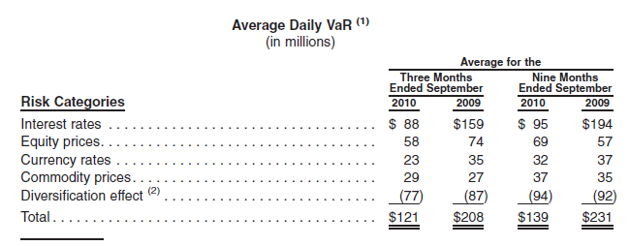
Average Daily VaR at Q3 2010

Slide 37
Year-end Daily VaR
VaR as of December 2009 decreased due to a large reduction in interest rate category and a reduction in currency rates category (lower volatility in FX markets), offset partially by an increase in equity prices category (due to higher levels of exposure).

Slide 38
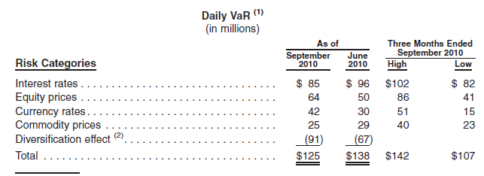
Q3 2010 Daily VaR

Slide 39
Daily Trading Net Revenues in 2009
Daily trading revenues are compared with prior day VaR for risk management purposes. In 2009, daily trading losses did not exceed VaR on any day.

Slide 40
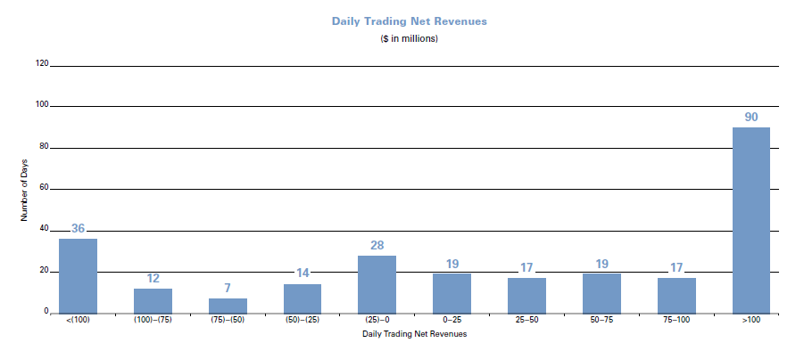
Daily Trading Net Revenues in 2008
In 2008, daily trading losses exceeded VaR on 13 occasions.

Slide 41
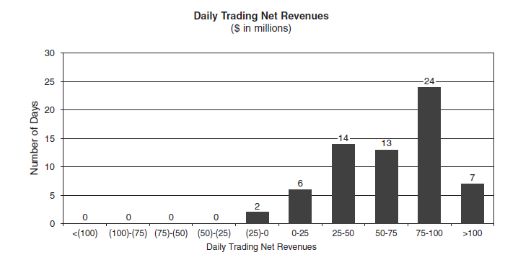
Daily Trading Net Revenues during Q3
Daily trading losses did not exceed VaR on any one day.

Slide 42
Analysis of VaR
The interest rates category is by far the largest component, at 44% and 68% of pre-diversification effect VaR in 2009 and 2008 respectively
 | 2009 | % | 2008 | %
Interest Rates | 122 | 44% | 228 | 68%
Equity Prices | 99 | 36% | 38 | 11%
Currency Rates | 21 | 8% | 36 | 11%
Commodity Prices | 33 | 12% | 33 | 10%
Pre-Diversification VaR | 275 |  | 335
Diversification Effect | (122) |  | (91)
Total VaR | 153 |  | 244

Slide 43
Analysis of VaR
In Q3 this composition changed dramatically:
 | Q3 | %
Interest Rates | 85 | 33%
Equity Prices | 64 | 25%
Currency Rates | 42 | 16%
Commodity Prices | 65 | 25%
Pre-diversification VaR | 256

Slide 44
Daily VaR during 2009
VaR at year-end was lower than in the previous year but average daily VaR was much higher in 09 than in 08 VaR – was very high in the first to quarters of 2009

Slide 45
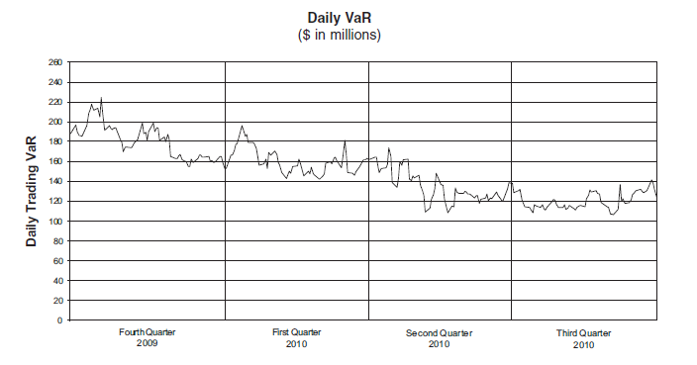
Daily VaR since Q4 2009

Slide 46
Other Market Risk Measures
VaR does not include the impact of changes in the credit spreads of derivative counter-parties or Goldman’s own credit spreads
A one basis point increase in these credit spreads would produce a $1M loss of net revenue and a one basis point decrease would produce an $8M gain for net revenue

Slide 47
Other Market Risk Measures
For inventory positions not included in VaR, sensitivity analysis is used, Goldman analyzes the effect on net revenues of a 10% decline in the underlying value of the positions

Slide 48
Sensitivity of Other Positions

Slide 49
Credit Risks

Slide 50
What is credit risk
The loss that GS would incur if
  Counterparty in a security of other financial instrument defaults on GS
  Value of securities GS holds decrease due to decrease in credit quality / ratings
    Securities include OTC derivatives

Slide 51
Sources of Credit Risk
Arises from running its core businesses
  Trading
    OTC Derivatives, Counterparties in trades, etc
  Investing (Principal investments)
    Issues faced by all Hedge funds & PE firms
      Investments defaulting, portfolio companies’ client defaulting, etc
  Financing Activities
    Used to win investment banking mandates, as competitors (JPM, BoA ML, Citi, etc) all have huge balance sheets to be used to win mandates.

Slide 52
Managing Credit Risks
A significant amount of GS’ credit is concentrated within the financial services industry
  Significant amount of counterparties are firms within the same industry
Netting agreements with counterparties in regards to payables and receivables
  Similar to how in interest rate swaps work
  Only the net amount between A/R and A/P changes hand

Slide 53
Managing Credit Risks (2)
For select clients / firms:
  Obtain upfront or contingent collaterals
  Have 3rd party as guarantor for the counterparties’ obligations
  Transfer credit risk through hedging with available derivatives
    If no direct hedges are available, structure a new derivatives contract to hedge the risk
There is no credit exposure bigger than 2% of the firm’s balance sheet other than US government securities

Slide 54
Measures of Credit Risks
Potential Exposure to credit risks
  Estimate credit exposure within a given confidence level, during the life of the transaction and market movements
Changes in Credit Spread
  VAR
Scenario Analysis
  To supplement the other measures
  Credit Spread widening scenarios
  Stress tests

Slide 55
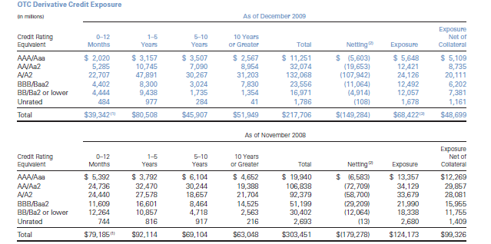
Exposure in OTC Derivatives

Slide 56
OTC Derivatives Exposure by Grade

Slide 57
Liquidity Risks

Slide 58
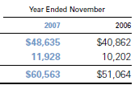
Overview of Liquidity Risk
Since the financial meltdown, Goldman Sachs and many other financial institutions have taken a renewed interest in managing liquidity risk
For GS, there have been significant change in the size of its liquid assets reserve

Slide 59
Use of liquidity
Excess liquidity to prepare for:
  Upcoming maturity of debts
    Long term debt, commercial paper, promissory notes, term deposits, and other funding sources
  Potential buyback of outstanding unsecured funding
  Potential withdrawal of client deposits
    GS, as a bank holding company, will have to worry about bank runs

Slide 60
Use of liquidity(2)
Excess liquidity to prepare for:
  Adverse changes in the quality of underlying assets used for financing
  Outflow of cash from OTC derivatives, when counterparty takes delivery
  Collateral related issues
  Cash outflow from prime brokerage
  Tax payments to the government, and other fines and expenses

Slide 61
Makeup of Liquidity Reserve
Cash reserve kept in highly liquid securities that allows same day conversion to cash
Consists of:
  Foreign Sovereign securities – ‘unencumbered’ bonds, overnight cash deposits
    Only Japan, French, German, UK
  US Government and agency securities, also US Agency backed mortgage-backed security
    All can be used as collateral to borrow from Federal Reserve

Slide 62
Policy regarding ‘Global Core Excess’
‘Global Core Excess’ is not to be used for any other purpose than provide liquidity
  No speculation with the reserve
In addition to $166 billion reserve, GS has an additional $40 billion worth of unencumbered securities from operations
  which can be used to provide liquidity, given the that $166 billion is not enough
  However, at that point, $40 billion probably won’t make a difference

Slide 63
Asset - Liability Management
Assets
  All inventory are marked to market on a daily basis
  Inventories include all bonds, equities, and derivatives contracts it holds from the operation of its business
  Where possible, inventory is aged and limited to ensure each business unit (trading desk) does not hold onto inventories of an extended period of time.

Slide 64
Term Structure
Liabilities managed under 3 principles:
  Term Structures
    Manage maturity of both secured and unsecured debts so they do no mature at the same time
    Create a stream of maturing debts rather than blocks of maturing debts

Slide 65
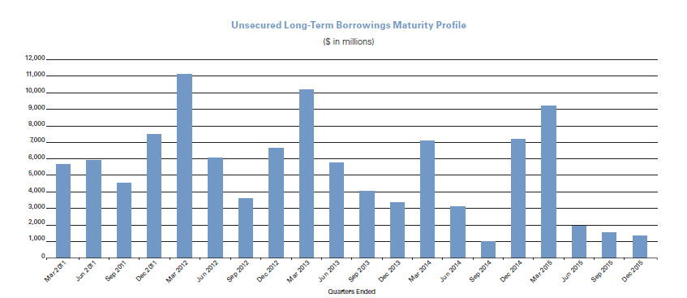
Equal payments of debt

Slide 66
Asset - Liability Management (3)
  Funding Sources
    Funds will be raised through all channels
    Issuance of corporate bonds in both the US and internationally
    Short-term U.S. and non-U.S. Commercial Paper
    Bonds and commercial paper will be sold maily through own sales team which already has a global reach
      Occasionally through other financial institutions
    There is a limit as to how much debt a single owner may own

Slide 67
Asset - Liability Management (4)
Structured Protection
  All liabilities are structured to avoid refinancing or repurchase its debts before maturity
    Significant preparation is made to ensure made to ensure debtors cannot request for more collateral in the case of a credit downgrade by a rating agency
    As seen by AIG, a credit downgrade can require significant upfront cash ($10b in AIG’s case)

Slide 68
Secured Financing
GS tends to prefer to operate on secured financing
  Less sensitive to credit ratings of company
  Substantial part of its liabilities are in the form of long term secured financing
    Average life is 100 days
Recognize that overnight secured funding will evaporate as the economy plunges / loses confidence
All financing is done evenly among multiple sources, to reduce any counterparty risks

Slide 69
Unsecured financing
Issuance of short term promissory notes
  Current total at $37.5 billion
  Preference over commercial paper due to the fact that GS does not make market in.
Long term unsecured boring average at 7 years in length
  As debt matures, will be converted into short-term floating rate obligations to mitigate interest risks

Slide 70
Fixed Rate to Floating Rate

Slide 71
Deposits
Goldman Sachs, as a bank holding company, will have to worry about bank runs
Currently $39.4b in deposits as of Q4 2009
  This amount can be covered by the ‘Global Core Excess’ cash reserve
  Access to Federal Reserve Bank funding programs and discount windows to fund any run to liquidity
    However, these fund sources are not included in internal stress tests and analysis of liquidity

Slide 72
Government Programs
The conversion to become a bank holding company grants Goldman Sachs access to programs established by the Government to counter the economic downturn
TARP has been repaid
  However, GS still involved with the government
  $20.76b of senior unsecured debt guaranteed by FDIC through the TLGP
    Temporary Liquidity Guarantee Program
    All of the debt will mature by June 15, 2012
    No issuance of new debt under TLGP since Mar 2009

Slide 73
Funding Policy
Goal is to have enough capital (unsecured long-term borrowings + Shareholder’s equity) to fund balance sheet for atleast 1 year
  Avoid asset sales (other than ‘Global Core Excess’)
Borrowings is planned with respect to these considerations
  Trading assets that (they believe) cannot be funded on a secured basis
  Derivative and other margin / collateral requirements
  Goodwill and other identifiable intangible assets
  Illiquid assets and unplanned subsidiary cash requirement
  Anticipated cash outflow from unfunded loan commitments

Slide 74
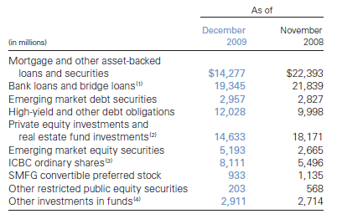
Assets unfunded by secured financing

Slide 75
Subsidiary Funding
Each subsidiary operates on their own budget and income
  Unless legally allowed, funding are not freely available
  Many subsidiaries are not allowed to give money back to parent company until maturity of financing agreement
  Significant amount of cash are invested in such subdiaries
    Roughly $100b of loans in addition to equity investments

Slide 76
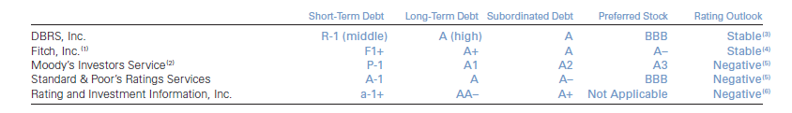
Credit Ratings
Credit Ratings play a huge role in securing financing for the company.
  Just being downgraded a notch by a rating agency can have significant adverse effects on the cost of borrowing for GS
    Particularly important for GS in the areas of OTC derivatives and other long term transactions in various markets

Slide 77
Credit Downgrade
  GS’ non-cumulative preferred stock got downgraded by Moody’s from A3 to Baa2 and Trust Preferred from A2 to A3
    Debtors and counterparties could have asked for an additional $1.12b collateral in the case of a one notch downgrade
      $2.36b additional collateral in the case of a two notch downgrade.
    GS evaluates its liquidity needs in the situation of a two notch downgrade
  AIG got downgraded from AAA to AA, and required $10.5b in additional collateral overnight.

Slide 78
Other Risk Factors

Slide 79
Operational Risk Factors
Risk of loss due to internal failures
Operational risk also stands to cause reputational harm
Managed through continual development of control standards

Slide 80
Operational Risk Factors
Investment banks have a legal separation between their investment banking and sales & trading businesses – known as a Chinese Firewall
This presents a risk of operational failure and reputational harm when information is leaked between these two lines of business

Slide 81
Regulatory Risk

Slide 82
Regulatory Risks
On January 14th, 2010, President Barack Obama
Proposed a Financial Crises Responsibility Fee
Purpose is to recoup every last penny for American Taxpayers
The proposed fee would include the following:
  Require the financial sector to pay back for the extraordinary benefits received: taxpayer dollars used to support largest financial firms are reimbursed by financial sector to reduce deficit

Slide 83
Regulatory Risks
  Responsibility Fee will remain in place to fully pay back TARP
    Fee would last for 10 years
    If costs were not recouped at end, fee would remain in place
    Treasury Department would be asked to report after five years on the effectiveness of the fee as well as its progress in repaying projected TARP losses
  Raise up to $117B to repay projected cost of TARP

Slide 84
Regulatory Risks
  Provide plan for taxpayer repayment
    Originally required by 2013; however, President Obama has already put forward a plan
    Again, recoup TARP funds to ensure the burden does not add to the deficit or national debt

Slide 85
Regulatory Risks
  Apply to the largest and most highly leveraged firms
    Firms with more than $50B in consolidated assets
    Heaviest burden will fall on those firms that have taken on the most debt
    Estimated over 60% of revenues will be paid by the 10 largest financial institutions

Slide 86
Graham-Leach-Bliley Act
Enacted November 12th, 1999
Repealed part of the Glass-Steagall Act, allowing institutions to act as any combination of an investment bank, commercial bank, and insurance company
Goldman Sachs become bank holding company in September 2008 and a financial holding company in August 2009

Slide 87
Regulatory Requirements
As a bank holding company, Goldman Sachs is subject to consolidated regulatory capital requirements administered by the Federal Reserve Board
Capital levels must meet specific requirements as calculated under regulatory reporting practices
Capital levels are subject to qualitative judgments by regulators regarding components, risk weightings and other factors

Slide 88
Capital Requirements
Currently Goldman Sachs is in accordance with the minimum capital requirements outlined in the Basel I Accord
  Tier 1 Capital > 4%
  Total Capital > 8%
  To be considered a “well capitalized” bank holding company:
    Tier 1 Capital > 6%
    Total Capital > 10%

Slide 89
Capital Requirements Cont.
For bank holding companies that have received the highest supervisory rating under regulatory guidelines or implement Fed’s market risk measures:
  Tier 1 leverage ratio > 3%
Other bank holding companies must have a minimum Tier 1 leverage ratio of 4%

Slide 90
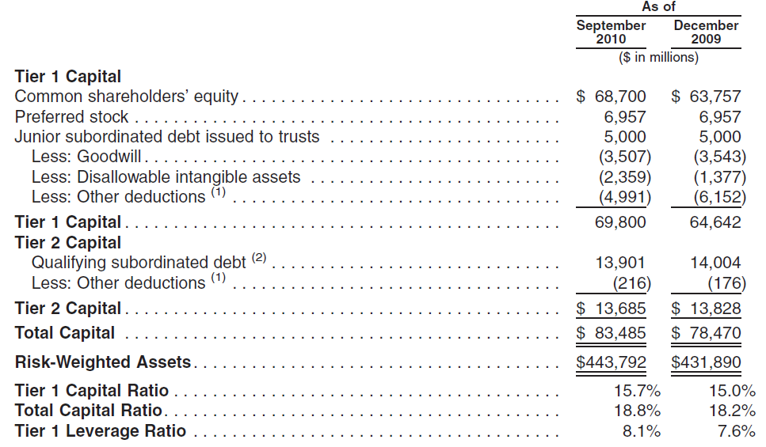
Goldman’s Capital Ratios

Slide 91
Basel I to Basel II
U.S. banking regulators have incorporated the Basel II framework into the existing capital requirements by requiring internationally active banking organizations, of which Goldman Sachs is included, to transition to Basel II over several years

Slide 92
Subsidiary Capital Requirements
GS Bank USA is required to maintain cash reserves with a Federal Reserve Bank
Currently, GS Bank USA holds excess reserves
GS Bank Europe is regulated by the Irish Financial Services Regulatory Authority and is in compliance with their respective capital requirements

Slide 93
Subsidiary Capital Requirements
GS & Co. and Goldman Sachs Execution & Clearing are registered U.S. broker-dealers and futures commission merchants subject to regulation by the SEC and the Commodity Futures Trading Commission
SEC and CFTC specify minimum capital requirements and require a significant part of the registrants; assets be kept in relatively liquid form
As of Dec 2009, GS & Co. and GSEC exceeded the minimum capital requirements by $11.81B and $1.86B respectively

Slide 94
Subsidiary Capital & Dividends
Regulatory requirements restrict Goldman Sachs Group from withdrawing capital from subsidiaries
Instead, subsidiary assets are restricted as to the payments of dividends to GS Group
The Federal Reserve Board and FDIC have authority to prohibit or limit payment of dividends if they feel payment of a dividend would constitute an unsafe or unsound practise

Slide 95
Basel III Changes
Recent Changes to the Basel Rules that have
been formalized in Basel III include:
  Increase in Tier 1 Capital from 4% to 6%
  Minimum requirement for common equity raised from 2% to 4.5%
  Capital conservation buffer set at 2.5%
  New liquidity requirements involving short-term liquidity coverage ratio and long-term net stable funding ratio
In addition, financial instruments that qualify as
Tier 1 Capital may become stricter

Slide 96
Dodd-Frank Wall Street Reform Act
The act is divided into 16 titles
The aim of the legislation is:
“To promote the financial stability of the United States by improving accountability and transparency in the financial system, to end ‘too big to fail,’ to protect the American taxpayer by ending bailouts, to protect consumers from abusive financial services practices, and for other purposes.”

Slide 97
Dodd-Frank Wall Street Reform Act
Title I – Financial Stability
Two agencies created: Financial Stability Oversight Council and the Office of Financial Research
FSOC has three main goals:
  Identify risks to the financial stability of the U.S.
  Promote market discipline
  Respond to any threats to financial stability

Slide 98
Dodd-Frank Wall Street Reform Act
Title I Continued
FSOC can force financial institutions with assets exceeding $50B to submit reports regarding:
  The overall financial condition of the firm
  Firm’s current systems in place to monitor and control risks
  The extent to which any of the company’s activities could impact financial markets

Slide 99
Dodd-Frank Wall Street Reform Act
Title II – Orderly Liquidation Authority
Purpose to assist in the orderly liquidation of bank and financial institutions
Orderly Liquidation Fund: FDIC run fund used in the event of financial company’s liquidation that is not covered by the FDIC
Title III – Transfer of Powers
Intended to streamline banking regulation and reduce competition and overlaps between regulators

Slide 100
Dodd-Frank Wall Street Reform Act
Title IV – Regulation of Advisors to Hedge Funds
and Others
Introduces significant regulation of hedge funds by increasing reporting requirements
Title VI – Improvements to Regulation (Volcker)
Title VII – Wall Street Transparency and
Accountability
Focuses on increasing regulation of OTC swaps markets (CDS & CDs)
Encourages trading through exchanges or clearinghouses

Slide 101
Dodd-Frank Wall Street Reform Act
Title IX – Investor Protections and Improvements
to the Regulation of Securities
Subtitle C: Involves expanding the regulation of credit rating agencies
Subtitle D: Improving the transparency and securitization of asset-backed securities

Slide 102
The Volcker Proposal
Proposal introduced by former Federal Reserve Chairman Paul Volcker
  Chairman under Jimmy Carter and Ronald Reagan Administration
  Graduate of Princeton, Harvard, & LSE
Mr. Volcker was appointed as the chair of the President’s Economic Recovery Advisory Board in February 2009
Board created to advise Obama Administration on economic recovery matters

Slide 103
The Volcker Proposal
The proposal will aim to do the following:
  Limit the Scope – Ensure that no bank or financial institution that contains a bank will own, invest in or sponsor a hedge fund or a private equity fund, or proprietary trading operation unrelated to serving customers for its own profit.
  Limit the Size – Limit the consolidation of our financial sector and place broader limits on the excessive growth or the market share of liabilities at the largest financial firms.

Slide 104
Regulatory Effect on Goldman Sachs
Goldman is well known for having one of the most aggressive and profitable proprietary trading outfits on Wall Street
Generates about 10% of total revenue for the firm
Dodd-Frank Act allows banks at least four years to comply with a potential extension of up to 3 years
Reports indicate that Goldman and other Wall Street firms are disbanding proprietary units early…

Slide 105
Will it Work?
Does Goldman really intend on ridding of
such a profitable unit?
Wall street insiders say they are merely disguising activity
  Ex. JP Morgan Chief Investment Office supposedly a hedging operation, but makes massive bets with JP Morgan’s capital
Loophole in the bill = definition of “principal”

Slide 106
Goldman Sachs Capital Partners
GSCP is the private equity arm of the bank
Currently holds $40B in assets
If and when forced to disband:
  Seller friendly economic climate
  Fire sale prices
  What sort of impact would this have on revenue?

Slide 107
Goldman Sachs Asset Management
As of 2009, 9th largest Hedge Fund with $20.59B assets under management
What sort of impact would it have on revenues?

Slide 108
Use of Estimates
Goldman admits the inherent difficulty in predicting costs that may arise out of litigation and regulatory proceedings, but offers estimating techniques as follows:
  Precedent cases
  Estimate of probable losses after considering the progress of each case
  Firm’s experience in similar proceedings
  Advice of legal counsel

Slide 109
Thank you for listening

