Slide 1
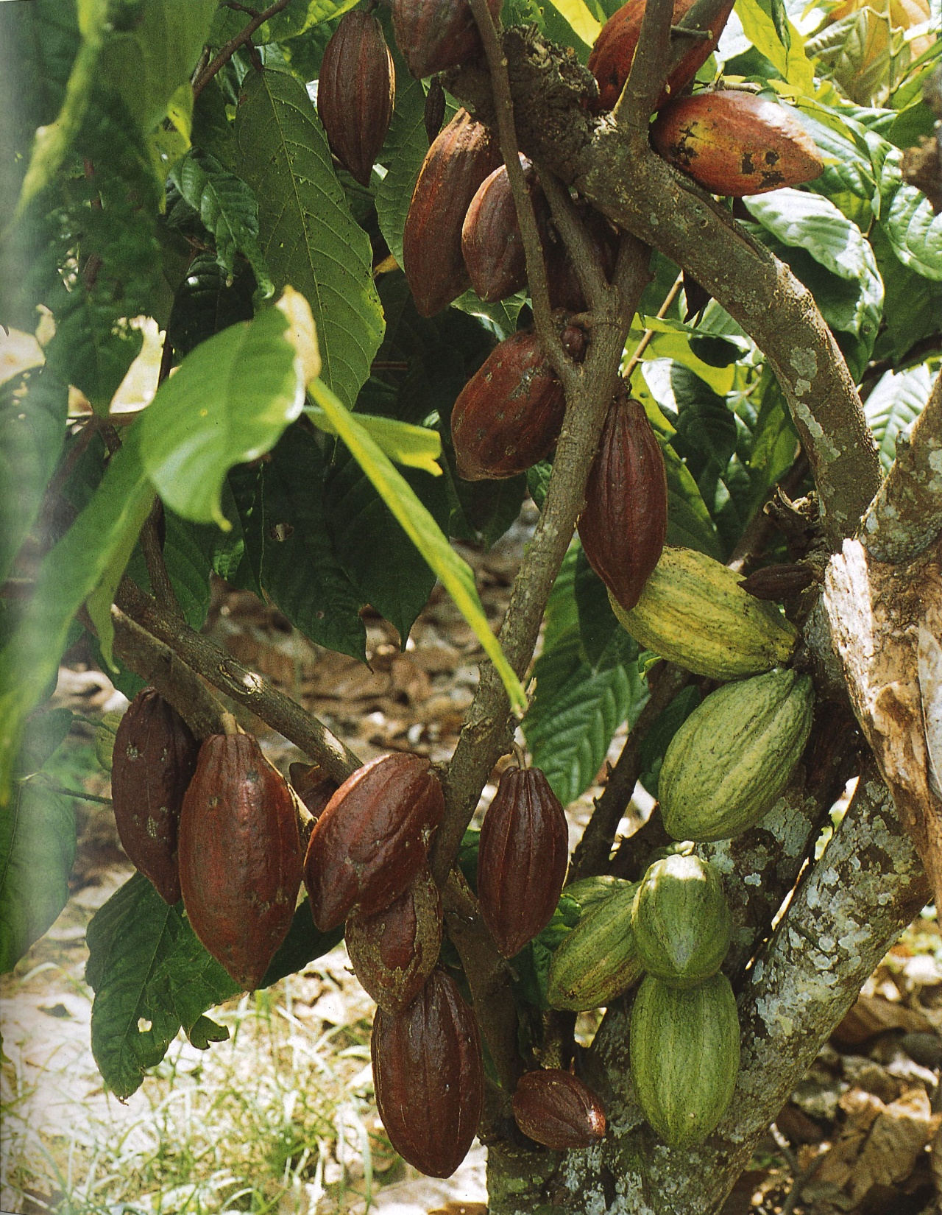
Money Does Grow on Trees: The Dark Side of Chocolate? Marja Karelia Simon Fraser University Vancouver, Canada

Slide 2
Social Justice
Social justice as a concept of fair and just relations between the individual and society
Reference to the process of ensuring fulfillment of individual’s social roles
Critique of the concept of social justice

Slide 3
Theobroma cacao travels
Escaping the Amazon rainforest
Cocoa bean travels from Ecuador to Mexico
Many uses of the cocoa bean: currency or aphrodisiac?

Slide 4
The Cocoa Bean Travels to Europe
Transmission of chocolate to Spain and to rest of Europe
Transportation by the Three-Way-Trade system
Cocoa bean in European coffee houses: Madrid, Vienna and
White’s in London

Slide 5
Cocoa Bean Travels to Africa and Beyond *
How did the cocoa bean travel to Africa and why did it
go there?
Journey to Asia: Travels to East Indies and Philippines
Cocoa bean on the commodities markets

Slide 6
Problems on Cocoa Farms
Issue of child labor and ‘trafficking’: Reports on child slavery
Smallholder farmers at center stage: Question of family labor
Boycott of cocoa beans? Useful or not?

Slide 7
Possible Solutions
Solutions and explanations: What about helping farmers become better farmers?
What has been accomplished? Mission and Vision of World Cocoa Foundation and its many commitments
Cadbury’s and Fairtrade Foundation

Slide 8
exploitation and the cocoa bean
Cocoa bean comes full circle: From New World to Old World and back
Transformation of the cocoa bean over time
What happened to social justice?

Slide 9
Global considerations
Is child labour and ‘trafficking’ unique to African cocoa
plantations?
Social justice issues on global cocoa farming communities?
Some Covid effects on African cocoa plantations?

