Slide 1
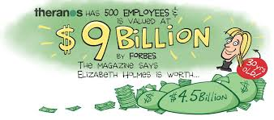
Corporate GREED $$$$ A case study of Theranos and Elizabeth Holmes

Slide 2
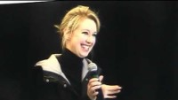
Elizabeth Holmes and her company Theranos is a cautionary tale of a start up company in Silicon Valley that goes horribly wrong and adversely affects many people.

Slide 3
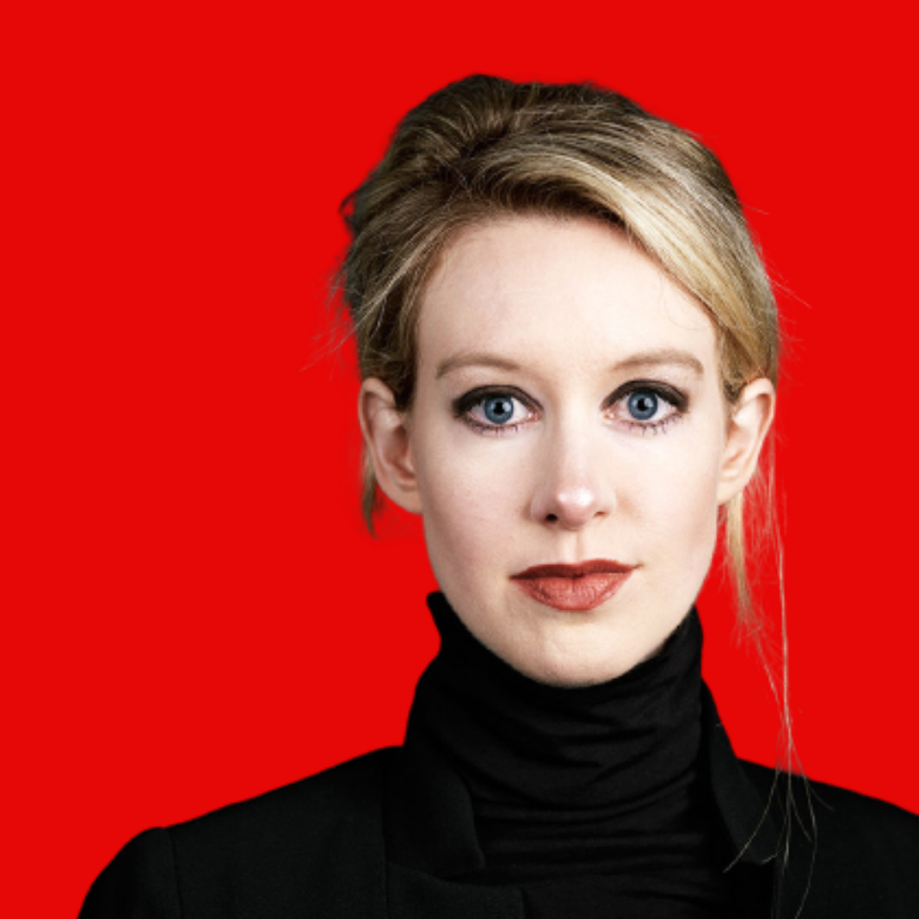
Who is Elizabeth Holmes? A Delusional Entrepreneur or Con-Artist maybe even possibly a Psychopath? Understandably it is hard to break into a male-dominated industry but that does not give anyone a free pass!!!
Also this presentation will try to address how the system needs to change so this does not happen again!

Slide 4
Table of Contents:
1) Biography of Elizabeth Holmes
2) Relationship to Ramesh (Sunny) Balwani
3) Description of Theranos Company
4) Investors to Theranos (networks & alliances)
5) Marketing Strategies
6) Corporate Culture
7) Deceptive Strategies/Ethical Considerations
8) Whistleblowing/Lawsuits
9) Court Case
10) Conclusion

Slide 5
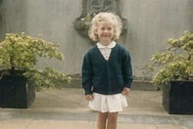
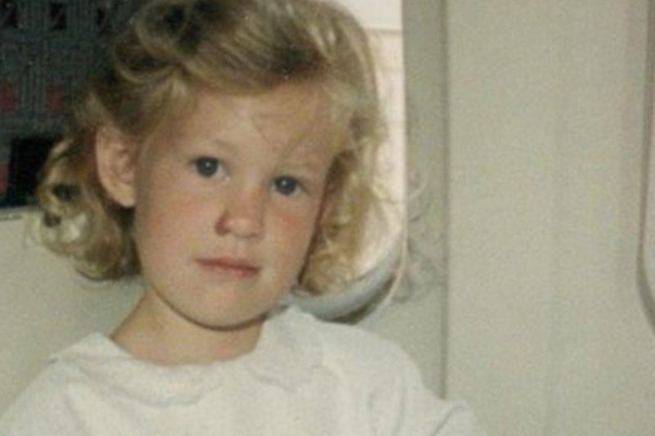
Early beginnings: Who is Elizabeth Holmes? When someone asked her what she wants to be when she grows up…her response was a billionaire.

Slide 6
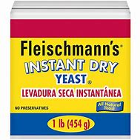
Elizabeth Holmes was born February 3, 1984, in Washington, D.C. Her father, Christian Rasmus Holmes IV, was a vice president at Enron, an energy company that later went bankrupt after an accounting fraud scandal. Her mother, Noel Anne (née Daoust), worked as a Congressional committee staffer. Elizabeth's third great-grandfather) Charles Louis Fleischmann was a Hungarian immigrant who founded Fleischmann's Yeast. Her family’s affluence was becoming less prominent over the years and Elizabeth always resented that.

Slide 7
Elizabeth Holmes had the entrepreneurial spirit since high school she started her first business selling compilers to Chinese universities. During high school, her parents had arranged her to learn Mandarin Chinese at home. She then went to study Mandarin in Beijing where she first met her partner in crime, Ramesh Balwani. At the time, she was 19 and he was 37. After the trip, Holmes and Balwani stayed connected through email. In 2002, Holmes attended Stanford, where she studied chemical engineering and worked as a student researcher and laboratory assistant in the School of Engineering. In March 2004, she dropped out of Stanford's School of Engineering and used her tuition money as seed funding for a consumer healthcare technology company. Holmes moved in with Balwani in 2005, two years after she founded Theranos and around a year after she’d dropped out of Stanford. When Elizabeth met Sunny; he had made 40 million from selling his company, CommerceBid.com. Her family lived in a very affluent neighborhood with richer families than her own. Her neighbour Richard Fuisz was much wealthier than her family and sources say she always resented that. Richard Fuisz is a medical doctor and owner of a few companies. Keeping up with the Joneses!

Slide 8
Theranos is considered a Unicorn Start up.
What is a unicorn in Silicon Valley?
"Unicorn" is a term used in the venture capital industry to describe a privately held startup company with a value of over $1 billion.
The term was first popularized by venture capitalist Aileen Lee, founder of Cowboy Ventures, a seed-stage venture capital fund based in Palo Alto, California.
https://www.forbes.com/sites/amyfeldman/2021/10/12/next-billion-dollar-startups-2021/?sh=59549963f1cd

Slide 9
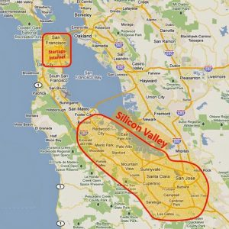
Silicon valley

Slide 10

Theranos – company established by Elizabeth Holmes in 2004. Word comes from the integration of therapy and diagnosis.

Slide 11
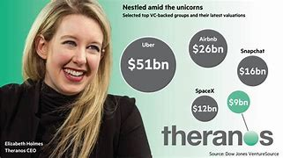
Success amid the Unicorns:

Slide 12
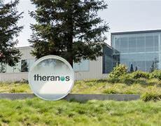
Theranos moved to 700-acre land Stanford Research Park. Home to many of the world’s most cutting-edge and influential companies since 1951. Employed 8oo people and was valued near 10 billion while 4 years later its value was basically zero. Her claim to fame was that her medical devices can detect over 100 diseases from a single drop of blood.

Slide 13
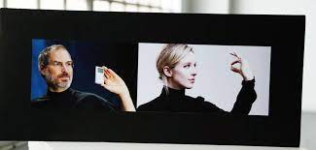
Elizabeth Holmes wanted to be the next Steve Jobs

Slide 14
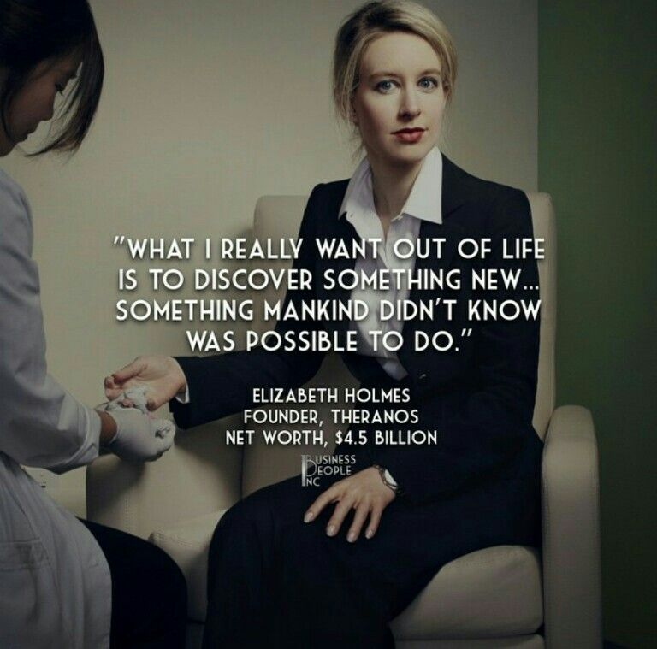
ELIZABETH HOLMES AND HER THOUGHTS ON HER BUSINESS ENTERPRISE:

Slide 15
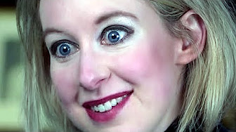
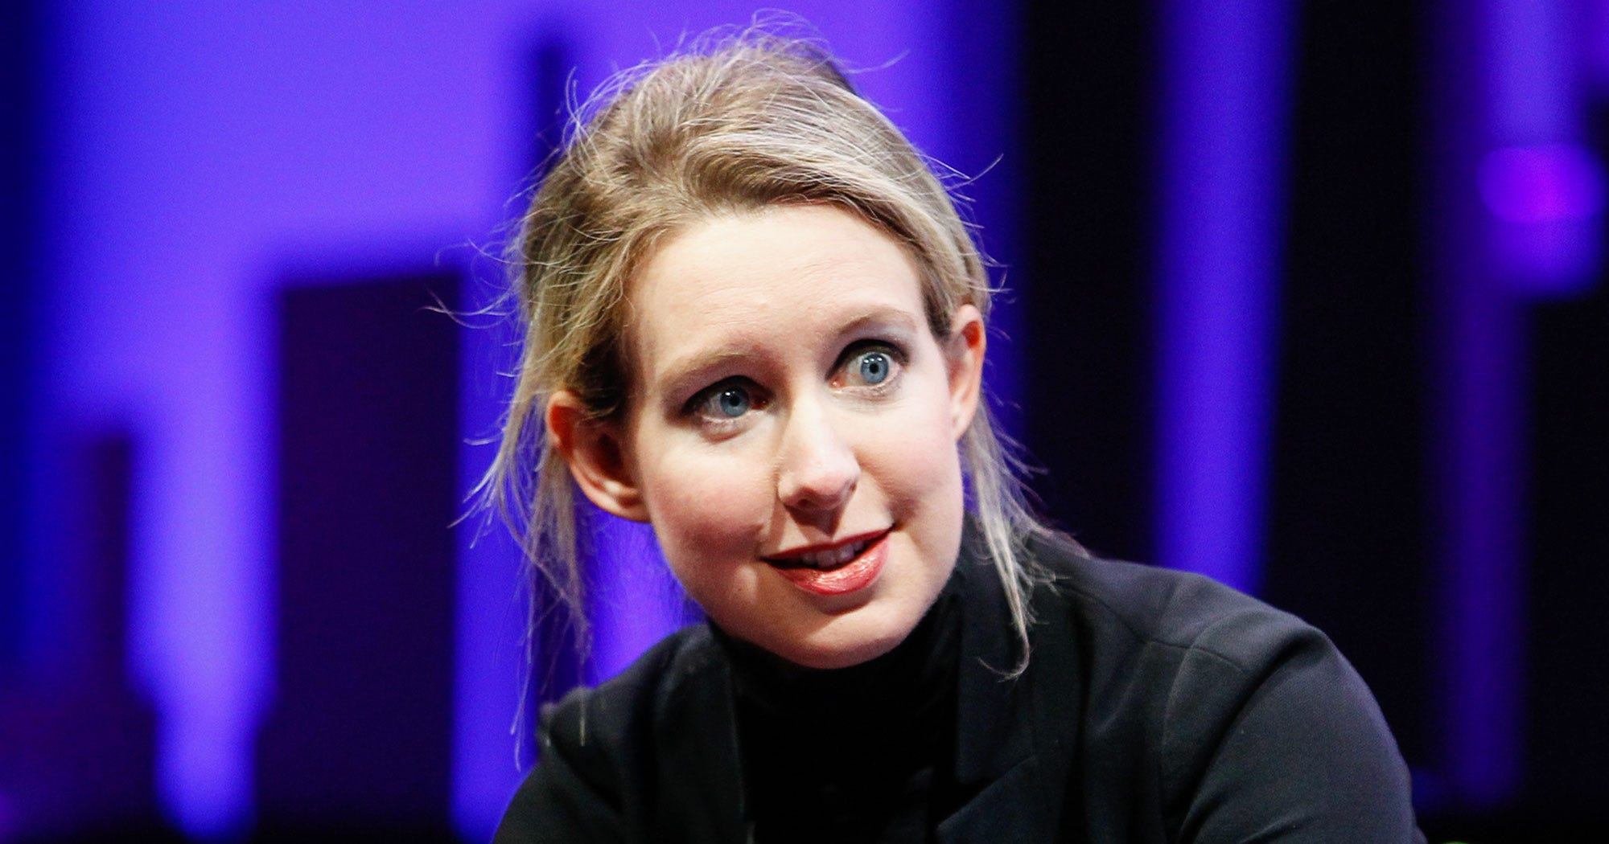
Is Elizabeth Holmes Delusional: You Decide?
The eyes say it all
Her clothes are always black turtlenecks like steve jobs

Slide 16
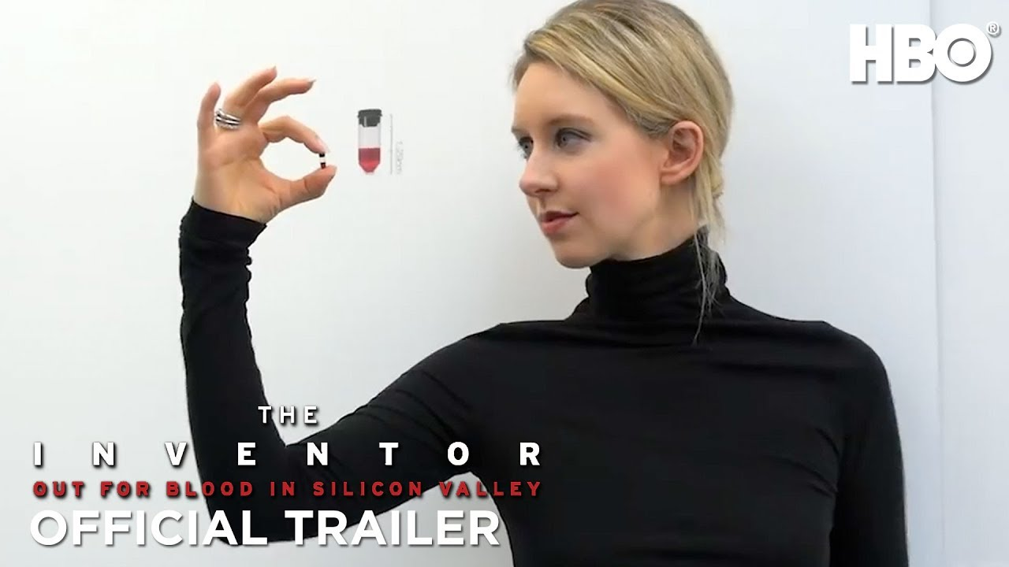
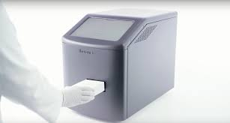
Theranos soon claimed to have developed several proprietary methods. One eliminated the need to collect blood samples through traditional needles, instead using a fingerstick that collected tiny amounts of blood into a small tube called a “nanotainer.” #1 Another was a laboratory machine that was able to run dozens of tests on the same, minute amount of blood, testing for everything from diabetes to cancer to heart disease. #2 https://www.biography.com/business-figure/elizabeth-holmes
1) Nanotainer :prick of blood
2) minilab: The sample is placed in here for processing.

Slide 17
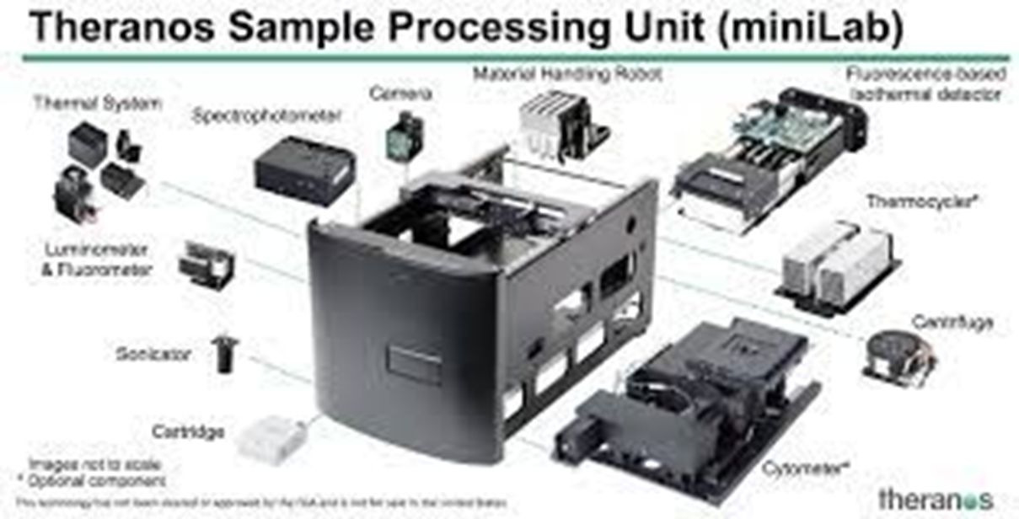
In the minilab below you’ll see the different components. A cartridge with the blood sample is inserted and this box can do diagnostics for all the tests Holmes claims. (https://techcrunch.com/2016/08/05/unpacking-theranoss-magic-zika-detection-box/)
PROBLEMS WITH THE MINILAB:
1) Too many compartments in one small box to make it functional.
2) According to the Laws of Thermodynamics, the box was too small to work. She was told this by her scientists, but she decided not to believe them.

Slide 18
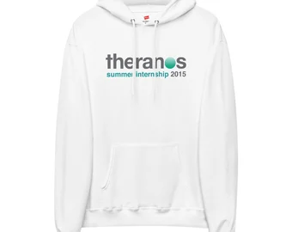
MARKETING
Holmes claims “This will revolutionize healthcare. Every person SHOULD HAVE access to healthcare.
A world in which we would not have to say, “If only I known sooner.” A world in which we don’t have to say goodbye to soon. This future is beginning now.”
“Health care is a basic human right.”
Her speech resonated with many people who did not have good health insurance coverage since Theranos offered lab tests at a more affordable fee.
Another marketing strategy was she spoke in a deeper voice for a masculine tone to be taken more seriously in a male dominated industry.
She also wore black turtlenecks all the time which gave the impression of someone successful like Steve Jobs who she idolized.
Theranos was selling gift cards for purchasing lab results; for example; you could buy a Herpes or Cancer test from Walgreens.
You can also purchase Theranos v-neck T-shirts, hoodies, travel mugs, tote bags and iPad cases.,
Holmes was known for giving many presentations and being interviewed by Forbes, Fortune, and many others.
She hired an expensive marketing and public relations firm, the same one as Steve Jobs had hired for APPLE.
FAKE IT TILL YOU MAKE IT…THIS HOWEVER SHOULD NEVER HAPPEN IN HEALTH CARE!!!

Slide 19
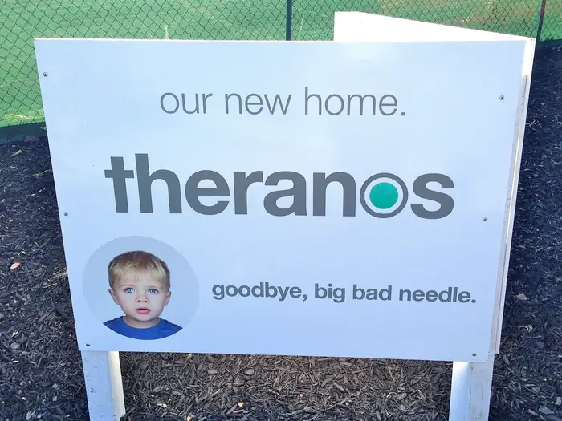

Slide 20
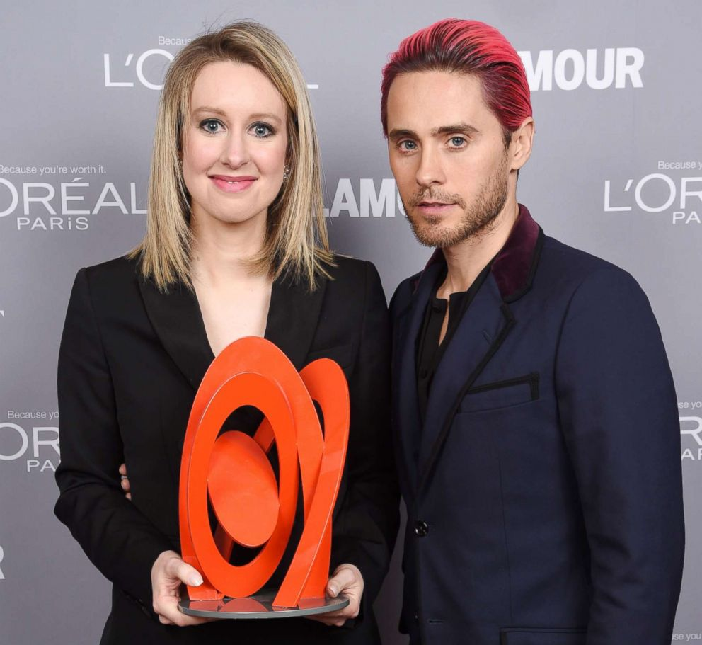
Honoree Elizabeth Holmes poses backstage with her award and actor Jared Leto at the 2015 Glamour Women Of The Year Awards at Carnegie Hall, Nov. 9, 2015, in New York. From Glamour magazine.

Slide 21
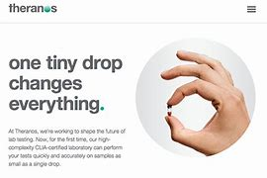
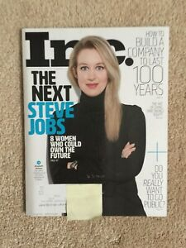
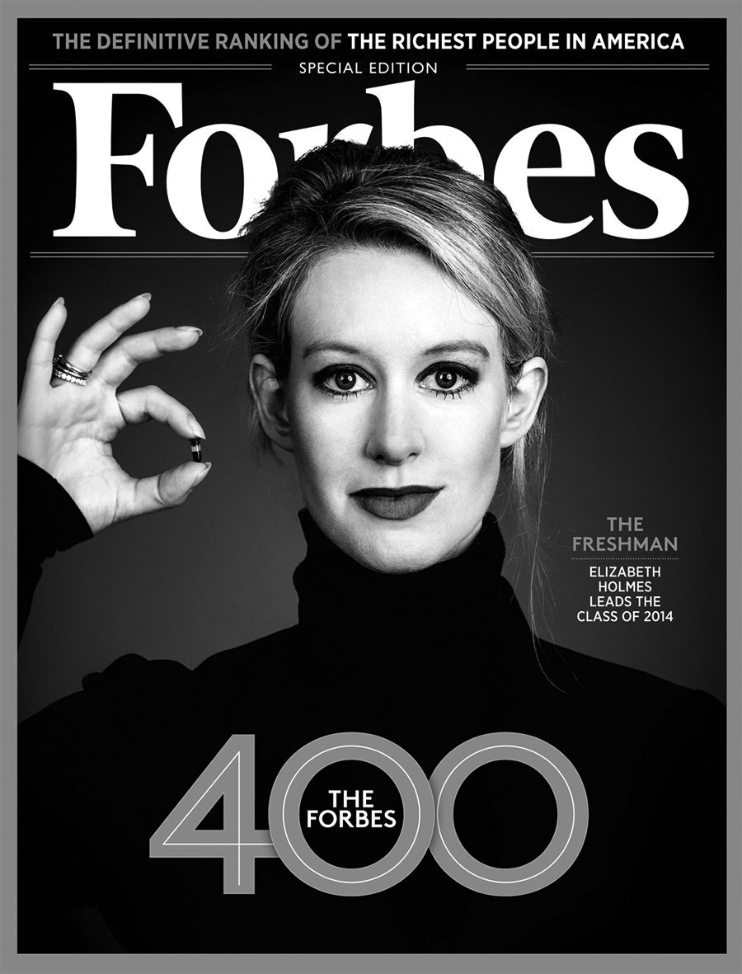
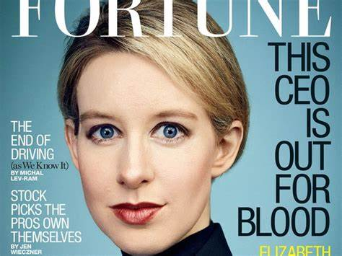
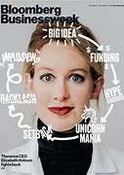
Marketing tactics She spoke at Forbes' "30 under 30" and was featured on CNN, "CBS This Morning" and CNBC.
.

Slide 22
Bill Clinton and Elizabeth Holmes Holmes attended the 2015 Clinton Global Initiative Closing Plenary at Sheraton Times Square, Sept. 29, 2015, in New York. Bill Clinton praised her for being so young when she started Theranos. She manages to get known with the wealthy and influential crowd.

Slide 23
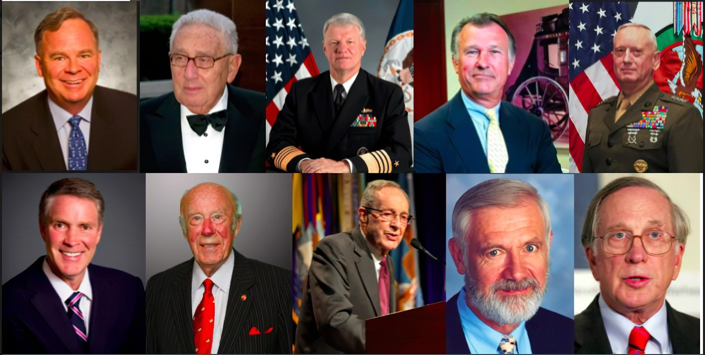
BOARD OF DIRECTORS:White, rich, powerful men$$$

Slide 24
George P. Shultz — former US secretary of state Gary Roughead — retired US Navy admiral William J. Perry — former US secretary of defense Sam Nunn — former US senator who served as chairman of the Senate Armed Services Committee and the Permanent Subcommittee on Investigations James N. Mattis — retired US Marine Corps general Richard Kovacevich — former CEO of Wells Fargo Henry A. Kissinger — former US secretary of state William H. Frist — heart and lung transplant surgeon and former US senator William H. Foege — former director of the Centers for Disease Control and Prevention Riley P. Bechtel — chairman of the board of the Bechtel Group Inc., a construction company Sunny Balwani — president and COO of Theranos Elizabeth Holmes — CEO and chairman of the board of Theranos note: Unlike any other health companies, Theranos did not have any health professionals on its board! As you can see above only many rich, influential white men!

Slide 25
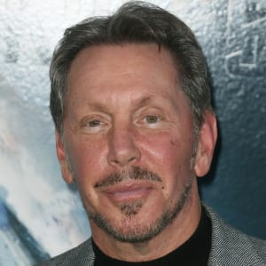
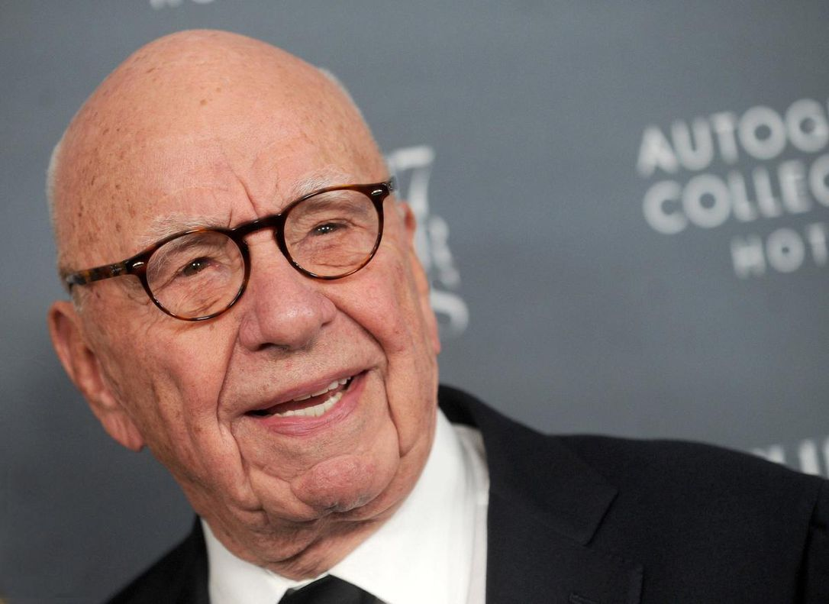
INVESTORS
Oracle Executive Chairman and founder Larry Ellison
Media Mogul, Rupert Murdoch $125 million
Betsy DeVos (former Secretary of Education for Trump era) and Richard Marvin "Dick" DeVos Jr. (Amway), $100 million
The Waltons, $150 million
Atlanta based media company; The Cox family $100 million
Henry Kissinger $3 million
Tim Draper and Donald Lucas (Venture Capitalists)

Slide 26
NETWORKING
Who you know is very important in getting business contacts…leads to opportunity growth..
At Stanford she was determined to work in the lab of Dr. Channing Robertson who was also the Dean of Engineering. She impressed him so much that she got him to work at Theranos and he quit his tenured position at Stanford. He also applauded her for her “brilliance” and referred to her as the next Steve Jobs.
Tim Draper (family friend, investor and venture capitalist) introduced Holmes to Don Lucas (investor) who sets her up with a meeting with Larry Ellison from Oracle.
Once her contact with Larry Ellison then she starts forming alliances with Henry Kissinger, George Schultz, Matthis, etc,,, someone recommends someone else and so forth..
Many of the marquee names that made up the Theranos board — former Secretary of State Henry Kissinger, former Defense Secretary William Perry, former Sen. Sam Nunn — were recruited by Shultz. Shultz was also taken in by her charm.

Slide 27
PARTNERSHIPS
She approached Safeway and Safeway pulled out.
Walgreens– She convinced Walgreens to invest in her company and set up wellness clinics with out due diligence or inspection of her labs and machines.
She told Walgreens that CVS was interested in her company and if they did not act fast that she would go with CVS. In order for Walgreens to beat the competition they went with Theranos. BE THE FIRST to get on board. She pitted one against the other.
She initially wanted the Pharmaceutical companies to invest but they said “NO” because they wanted research studies done and proof her devices worked. So Elizabeth thought that retailers would be easier to convince and she was right.

Slide 28
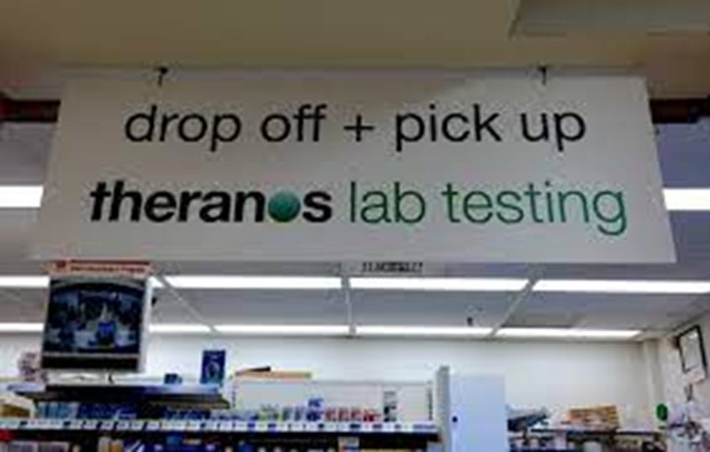
The Wellness clinics started in Arizona and a few later opened up in California. Holmes led Walgreens believe that lab machines will be installed in every wellness clinic; however ,the lab results were flown to the lab in Palo Alto leading to tainted blood by the time it reached the lab which led to inaccurate results.
The inaccuracies showed patients’ having a disease when they didn’t.
1) One patient went to Emergency thinking she was having a stroke because of her results.
2) Another patient had an inaccurate result predicting a miscarriage, but she decided to go through with the pregnancy and had a healthy baby.
3) Another patient received a lab report from Theranos stating that he was HIV positive when he was not. The health of the thousands of patients was seriously affected based on the inaccuracies of the results.

Slide 29
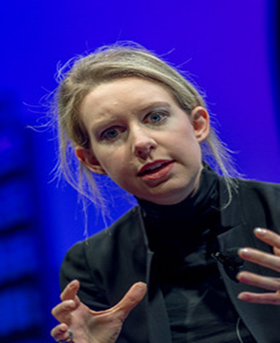
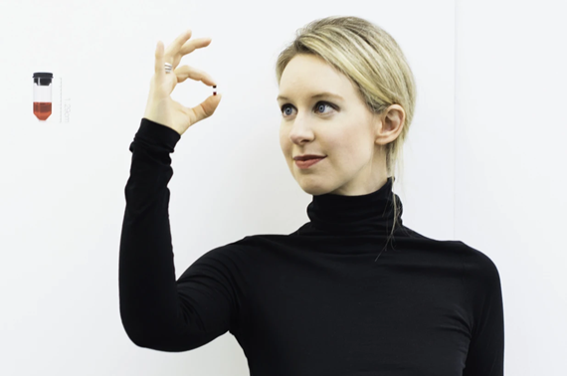
LIES Elizabeth repeatedly claimed that.. “Over the course of 11 years we made it possible to run comprehensive lab tests with a few drops of blood that could be taken from a finger. We made it possible to eliminate the tubes and tubes of blood that traditionally have to be drawn by the arm and replaced it with a nanotainer. If I had one wish standing with you no one has to go through the pain with traditional phlebotomy. I was always terrified of giving blood…that was my biggest fear…she compared it to being tortured.”
Look at her body language as she is presenting her lies (her intensity as she tries to convince her audience).
Nanometer

Slide 30
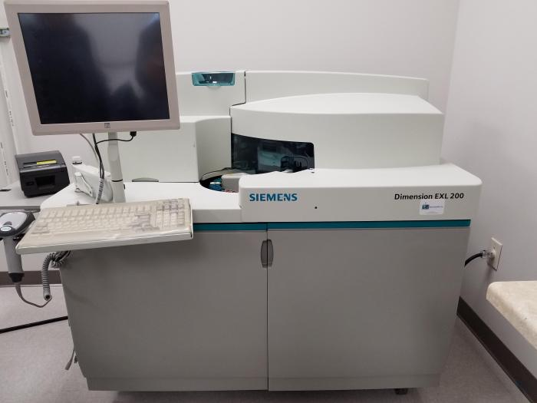
More lies and manipulative tactics
Elizabeth Holmes, got state lawmakers and Gov. Doug Ducey to change Arizona law in 2015 to financially benefit her company, This law allowed companies to market laboratory tests directly to consumers even though her devices were not working.
Elizabeth Holmes emailed Roger Parloff (who worked as a journalist for Fortune) falsely stating that Pfizer and Schering-Plough commended Theranos on the efficiency of its technology. This was a lie.
The Mini lab did not work. The scientists would have to dilute the blood and then use the commercial Siemens technology which she denied using. And still the results were inaccurate.
.

Slide 31
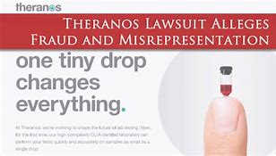
More lies
Elizabeth Holmes led Walgreens astray by sending the company documents with the unauthorized use of Pfizer's logo. They thought Theranos was endorsed by Pfizer.
Holmes claims that Theranos worked with the military,
None of this was true.
Holmes said that Theranos could do 1,000 tests on its proprietary machines. But only 200 tests are offered on the website, she claimed, because “we have operationalized certain tasks, expecting a certain set of ordering patterns.”
The 200 are the most commonly-done ones, she said, “but we are adding to it.” This was not true either.

Slide 32
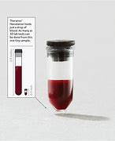
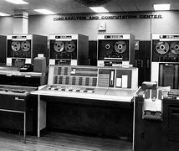
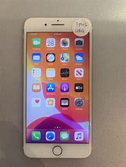
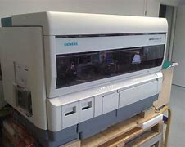
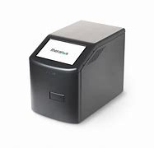
ELIZABETH’S LOGIC
Elizabeth Holmes claims that the clinical lab infrastructure has not changed much since the 1950’s…she keeps complaining about all the tubes that are used to draw blood. And to her there is a lot of blood unnecessarily drawn for tests.
She is certain that there should be a better system out there and that the current system is archaic.
She compares the need for change from how the mainframe computer has changed over the years to a smaller unit as the mobile phone.
“Now the time is right to change this paradigm”, Elizabeth says.
Elizabeth Holmes found a niche in the system and is taking this opportunity to invest in it before anyone beats her to it. Her ambitious dream transforming the biotechnical industry is commendable but she has skipped many stages along the way. The large computer mainframe changed over the years but has gone through many stages of development. Comparing a technical computing device to a biotechnical machine that analyzes human disease is like comparing oranges with apples.

Slide 33
CORPORATE CULTURE
Secrecy; She kept saying that there are “Trade Secrets” when she did not want to be accountable for her lies.
The Staff were monitored and their key strokes were looked at.
If someone sent an email to another staff member, they would hear from Balwani even though he wasn’t copied in on the email. He would look at all correspondence among the employees.
Sunny Balwani would be the bull dog of the company…she would act polite and get him to bully and intimidate staff.
It got to the point that Paranoia set in from Holmes and Balwani and creeped down to the staff.
The staff would be scared to talk to anyone in case Holmes and Balwani found out.
Each Department was separated and the staff members could not talk to each other. Chemistry department could not talk to Engineering and so forth. Communication was cut off and so was productivity, as a result.
The morale of the staff was low and anxiety increased for all of them.
Many of the top management and scientists quit or were fired if they had any questions or suggestions for improvement.
Holmes and Balwani acted as if they knew more than the scientists and would not listen to them.
Both of them hid information from their employees and kept them in the dark.
They hired many security guards to keep their staff under their control.

Slide 34
Non Disclosure Agreements & Lawsuits
Staff could not communicate with each other because of the secrecy and were told that there were “Trade Secrets” that could not be shared.
Staff could not discuss their work even to their families.
They all had to sign a very lengthy and detailed non-disclosure agreement; and sometimes several if they were thought to be non-compliant.
The employees were threatened with lawsuits if they were thought of saying anything negative about Theranos.
Elizabeth Holmes hired the “shark of a lawyer” David Boies.

Slide 35
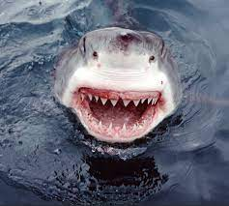
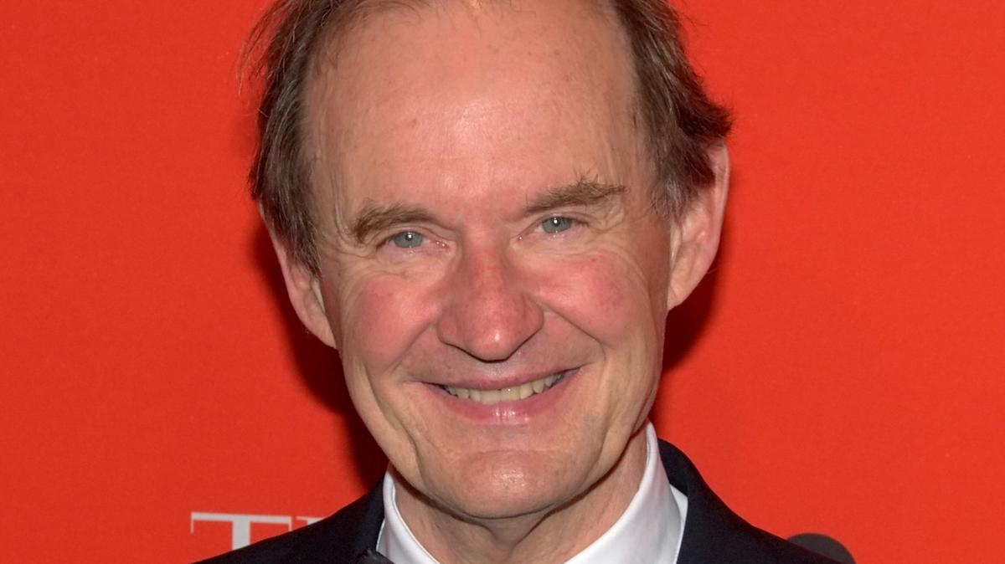
Lawyer: David Boies A shark in lawyer’s clothing. Fights with intimidation, threats, nondisclosure agreements and lawsuits. To fight against him, you need $$$$$$ Tyler Schultz’ parent paid $400,000 in legal fees after being sued by Theranos. Boies charges $2000 per hour in his legal fees. Holmes gave him shares of Theranos as well so he is more vested in her company. Boies sat on Theranos Board of Directors. Lawyer David Boies, called "The Man Who Ate Microsoft" by Vanity Fair and "Corporate America's No. 1 Hired Gun" by Fortune, is a high-profile litigator for high-profile cases. https://www.bizjournals.com/sanjose/blog/techflash/2015/10/legal-shark-david-boies-joining-theranos-board.html Other clients include Harvey Weinstein, lead counsel for Oracle Corporation in its lawsuit against Google, Goldman Sachs and the New York Yankees. represented Democratic nominee Al Gore, who was going up against Republican George W Bush,.and more

Slide 36
Patents
Elizabeth Holmes had 200 patents.
Most of the patents are with the scientist, Ian Gibbons. These patents are Ian Gibbons’ ideas that Elizabeth adopted as her own and he being secondary. Elizabeth acted as she owned her employees, and all their knowledge was hers for profit.
Richard Fusiz ,her neighbour and competitor, took out a patent on a “Bodily Fluid Analyzer”.
Elizabeth got David Doies to sue Fuisz over this patent which affects Theranos. She claims he stole it from her.
In turn, this lawsuit involved Ian Gibbons to testify that Elizabeth’s patents are all her idea. Ian did not want to testify because that is not true. He knew these patents were her employees’ (scientists’) ideas.

Slide 37
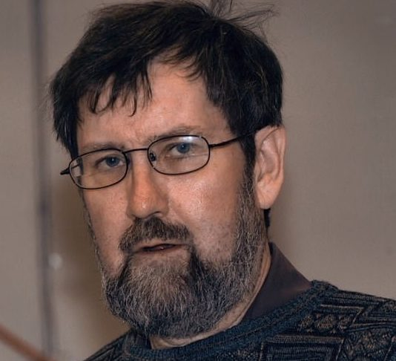
Ian Gibbons
Ian Gibbons was a British biochemist (PhD in biochemistry from the University of Cambridge)and chief scientist. Gibbons had 30 years experience as a chemist. Channing Robertson, recommended him to work at Theranos. Ian was the first experienced scientist hired by Theranos.
Gibbons became very nervous and depressed when he learned that he would be subpoenaed to testify. He wanted to avoid being deposed because he was afraid his job depended on his testimony. Gibbons believed that if he told the truth, he would lose his job, and have limited future job prospects due to his age of 67. The truth was that Holmes lied as being the originator of all the patents.
Death Gibbons was notified that he needed to appear at the Fuisz lawyers' offices to give his deposition. After Theranos had been actively discouraging him from testifying. Before he had to appear in court to testify, he took his own life. He died, aged 67, of liver failure due to an overdose. When Ian’s wife called Holmes' office to report his death, Holmes did not return her call. Instead, his wife received an email from a Theranos lawyer requesting she immediately return Gibbons' company laptop and any confidential information he might have had in his possession.

Slide 38
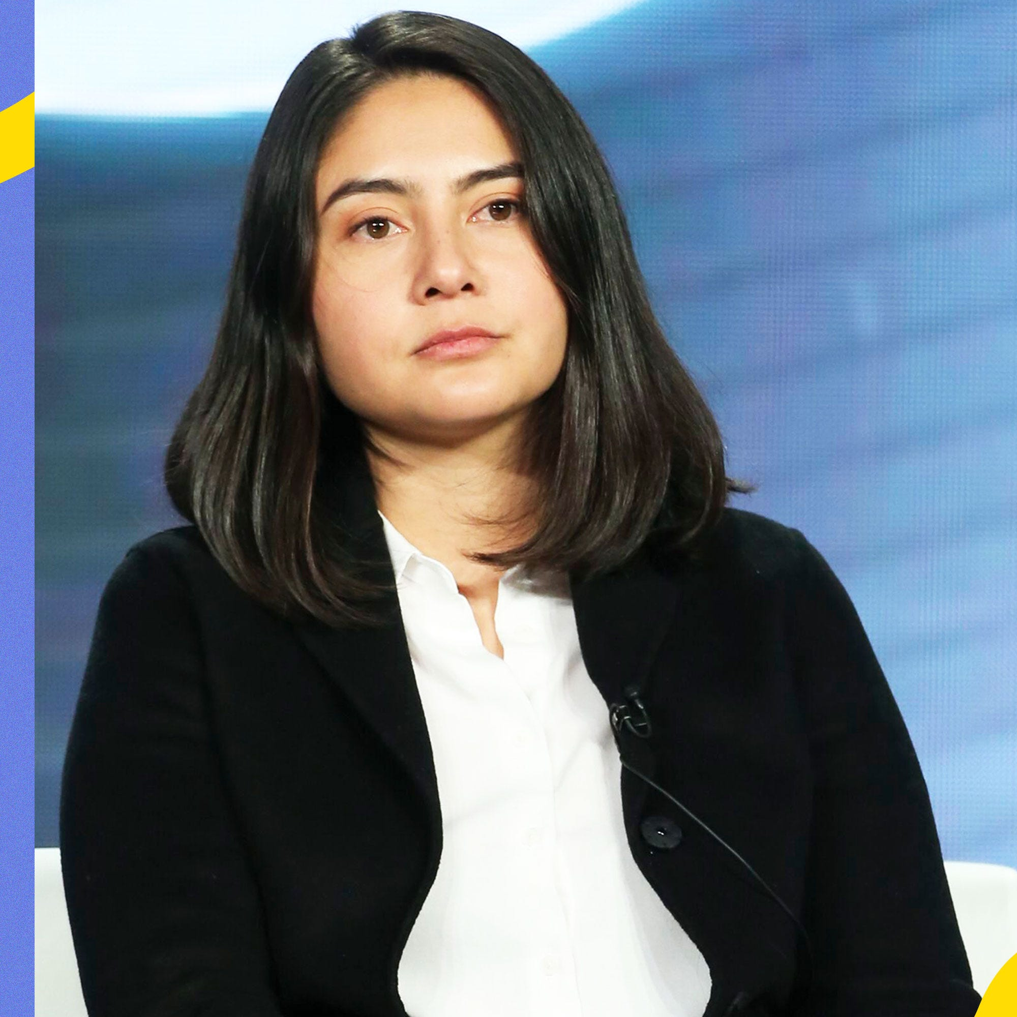
Whistleblowers
Erika Cheung:
She was accused of disclosing trade secrets and Theranos threatened to sue her. She consulted a lawyer, who told her to report what she had witnessed to federal health regulators and to ignore the lawsuit. She never received another legal threat. She went under the WHISTLEBLOWER PROTECTION ACT.
Erika connected with Theranos at a job fair after graduating from the University of California Berkeley in 2013.
She blew the whistle and announced that the devices that Elizabeth claimed were the biggest invention of all time, did not work!
"It was clear that there was an open secret within Theranos that this technology simply didn't exist,“ she stated .

Slide 39
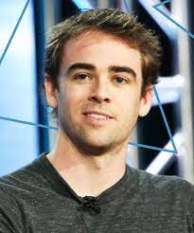
Tyler Shultz
Tyler met Elizabeth from his father , George Shultz, who introduced him to her. He later interned at Theranos.
Tyler Shultz, one of the first people to call attention to questionable practices at the blood-testing startup Theranos Inc
Tyler went to his managers, with the vice president, with the CEO, the board members, with regulators, and with journalists.
Tyler says that “Elizabeth Holmes is very charismatic and can convince you that anything can work even when you know it doesn’t. Holmes has a distorted view of reality and is very convincing”.
George Schultz went against his grandson and would not believe him thinking his grandson was mistaken. His grandfather would align with Holmes against him until after Tyler relentlessly pursued to expose the truth. Tyler said his grandfather never apologized but told Tyler he did the right thing.

Slide 40
Dr. Phyllis Gardner
Phyllis Gardner warned everyone about Elizabeth Holmes — But No One Listened
Phyllis Gardner knew from the moment the 19-year-old student started talking about her “brilliant” idea that it wouldn’t work.
Dr, Gardner talks about when she met HoImes in 2002, “She had acne, brown hair, and a voice no lower than the next female undergrad”.
Gardner had been employed as a Professor of Medicine at the university since 1984 and was no stranger to mentoring. Gardner said that “something about this student was different. She wouldn’t take no for an answer.”
Gardner continues to say that “Elizabeth came to me with [an idea for] a patch that would test for a microbe and then deliver antibiotics. I said, ‘Oh, that’s a lovely idea, but it won’t work.’ It was so naive. Antibiotics are not potent. That’s why you have big IV bags.”
Gardner wanted to ask Holmes if she was “smoking dope,” but she didn’t. Instead, she told Holmes her idea wouldn’t work. The student, she says, refused to listen.
https://www.refinery29.com/en-us/2019/03/226452/phyllis-gardner-elizabeth-holmes-professor-interview-the-inventor

Slide 41
FDA approval
FDA did not approve any of lab machines. Typically, medical devices are among the most highly regulated products in the modern economy. The U.S. Food and Drug Administration regulates any products that match the legal definition of medical devices.
FDA approved only one test for Herpes in 2015. That was it for approval!
The FDA had long decided not to enforce pre-market review of this type of test, meaning Theranos was not required to have its tests evaluated by regulators before offering them to patients. That was the loophole.
Medical professionals have called the Theranos incident a “wake-up call” for the FDA that exposed the current regulatory weaknesses.
With barely any pre-market checkpoints, faulty tests can cause profound damage – and deeply affect the health and life of patients – as testimony in the Theranos trial is a reminder.

Slide 42
Trial of Elizabeth Holmes
Holmes faced 11 different charges. She was found guilty on two counts of wire fraud and two counts of conspiracy to commit fraud. She was acquitted on three counts of defrauding patients. The jury was deadlocked on the three remaining charges. She could face up to 20 years.
Ramesh Balwani, her ex-boyfriend and partner in crime, is being tried for fraud charges. His trial began in March 2022 and is currently underway.
The court will decide her sentencing after hearing statements from Sunny Balwani. Holmes sentencing is scheduled for September 26, 2022.
As of March 2022, Balwani also pleaded not guilty to a dozen charges of wire fraud and conspiracy to commit wire fraud. His lawyer is saying he was just the CEO and Holmes is totally responsible for defrauding investors and the public.
Elizabeth blamed Sunny that it was his idea to defraud the public and he convinced her to go along with it. She also said he was abusive and controlling, and she was intimidated by him.
Elizabeth Holmes is now married to Billy Evans (heir to hotel chains in Southern California).
Evans and Holmes met at a party back in 2017 and tied the knot during the summer of 2019. She is now staying at his parents' estate while awaiting sentencing.
Billy Evans is 29 and Elizabeth is 37 years old. She has a newborn son with Evans.

Slide 43
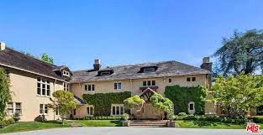
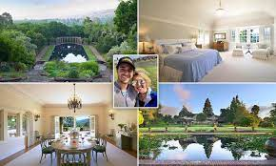
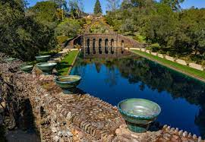
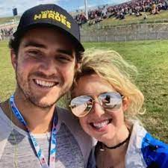
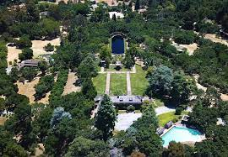
Holmes is staying at the Evans’ estate: waiting for sentencing on September 26, 2022

Slide 44
Dr. Robert Hare and his book, “Without Conscience, The Disturbing World Among Us”; he is also the inventor of the Psychopathy checklist.
The Psychopathy Checklist:
SOCIAL DEVIANCE
Impulsive
Poor behaviour controls
Need for excitement
Lack of responsibility
Early behaviour problems
Adult antisocial behaviour
The Psychopathy Checklist:
EMOTIONAL/INTERPERSONAL
Glib and superficial
Egocentric and grandiose
Lack of remorse and guilt
Lack of empathy
Deceitful and manipulative
Shallow emotions

Slide 45
Psychopaths according to Dr. Robert Hare
White collar criminals’ deceit and manipulation are not confined to simply making money; these qualities pervade their dealings with everyone and everything, including avoiding prison, and even if caught and convicted they usually receive a light sentence and an early parole, only to continue where they left off.
They use their charm, social skills and family connections to gain the trust of others.
After obtaining our trust, they betray it with stunning callousness.
Given their personality, it comes as no surprise that psychopaths make good imposters.
They have no hesitation in forging and brazenly using impressive credentials to adopt, chameleonlike, professional roles that give them prestige and power.
There is certainly no shortage of psychopaths who con people into doing things for them, usually to obtain money, prestige, power, or, when incarcerated their freedom. In a sense, it is difficult to see how they could do otherwise, given a personality that makes them “naturals” for the job. Add those universal door openers-good looks and the gift of gab-and we have a potent recipe for a life of scams and swindles.

Slide 46
Chapter 7 - White-Collar Psychopaths (cont’d.)
Most of us would be devasted and humiliated by public exposure as a liar and a cheat, but not the psychopath. He or she can still look the community straight in the eye and give impassioned assurances, or their “word of honour”.
Many psychopaths never go to prison or any other facility. They appear to function reasonably well –as lawyers, doctors, psychiatrists, academics, mercenaries, police officers, cult leaders, military personnel, businesspeople, writers, artists, entertainers, and so forth-without breaking the law or at least without being caught and convicted. These individuals are every bit as egocentric, callous and manipulative as the average criminal psychopath; however, their intelligence, family background, social skills and circumstances permit them to construct a façade of normalcy and to get what they want with relative impunity.
An article in FORBES headed SCAM CAPITAL OF THE WORLD, described the Vancouver Stock Exchange as “infested with crooked promoters, sons of crooked promoters, and sons of friends of crooked promoters”.

Slide 47
Conclusion
Elizabeth Holmes founded the company that became known as Theranos in 2003 with a plan to develop a new blood testing technique.
Despite a lack of transparency about how the technology actually worked, investors poured money into the company.
The US FDA has long admitted that the lack of pre-market review of laboratory-developed tests can lead to a host of problematic outcomes.
There are many start up companies that pop up and many are doing very well; but due diligence and updated audited financial records should be available!
The most disturbing part of this sordid tale is the harmful effects on patients and how she treated her employees. Holmes blames her partner and ex-boyfriend, Sunny Balwani, and he blames her!
Investors spent much of their money but most of them were multi-billionaires, so I was not as upset about their losses as I was at the fact the verdict did not have her convicted of patient fraud.

Slide 48
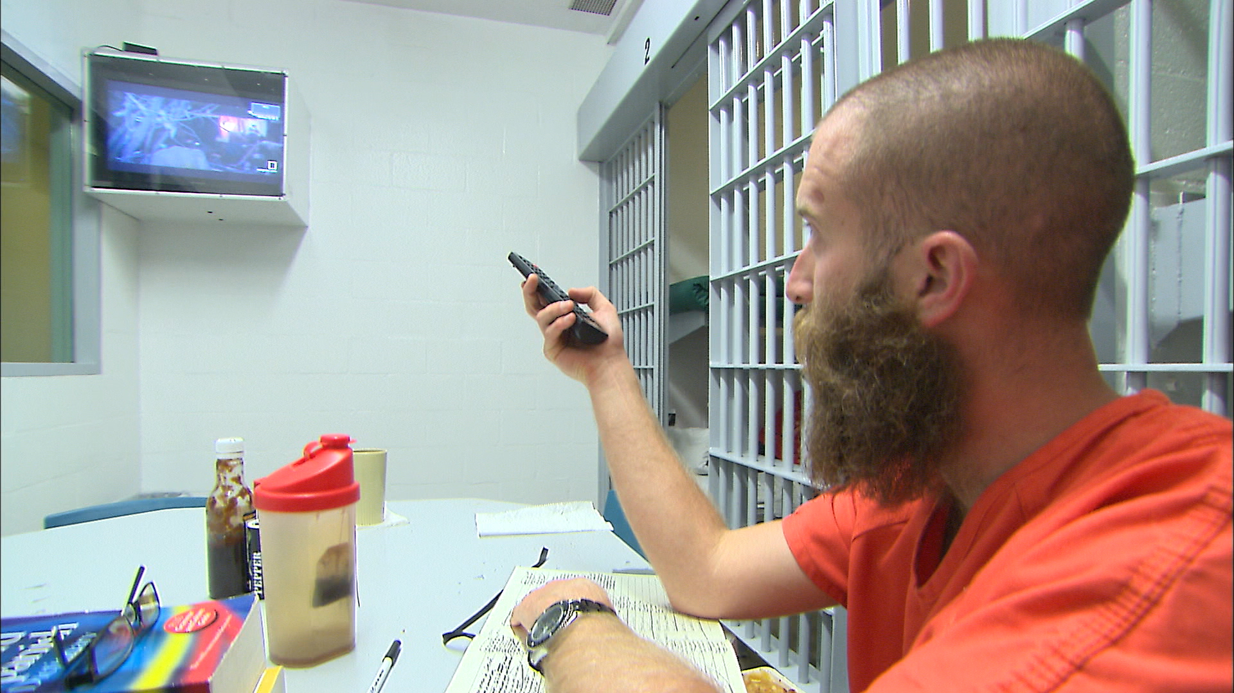
PRISONS FOR THE RICH FOR $100 PER NIGHT- TWO TIERED SYSTEM
https://nypost.com/2017/03/10/even-prison-life-can-have-frills-if-you-have-the-cash
Prisoners can pay a hundred dollars a day to stay in the upscale city jail in Seal Beach, Calif., where they have access to computers and flat-screen TVs. Seal Beach Jail.
/

Slide 49
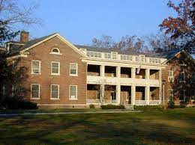
FPC Prison same as Martha Stewart called Camp Cup Cake
Alderson Federal Prison Camp in West Virginia
Built in 1928, the prison is actually the first federal prison for women. It uses a reformatory model where women are housed in "cottages" and there's no barbed wire. The had one famous escapee who took advantage of the low security there.

Slide 50
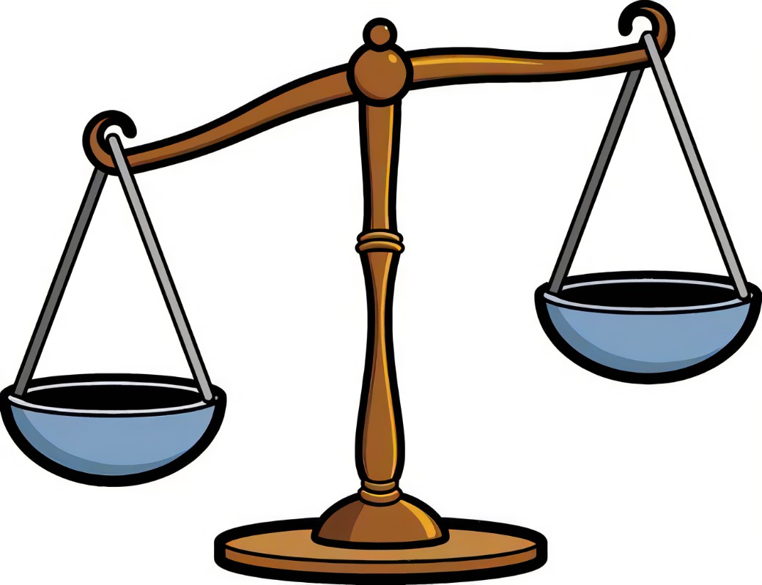
CONCLUSION: THERE NEEDS TO BE MORE LEGISLATION AS YOU HAVE SEEN FROM THIS CAUTIONARY TALE OF ELIZABETH HOLMES.

Slide 51
The system needs change:
1) Higher sentencing for these offenses.
2) Demand due diligence especially in the health care industry!
3) Require more accountability and transparency in how these trade secrets are managed in the HEALTH CARE industries!!!
4) More legislation and regulations and FDA APPROVAL mandatory!!!
5) No gaps in the system so that corporations can’t sneak around the regulations.
6) More guidelines and health laws for these start-up companies.
7) These corporations need to submit their financial records to regulatory bodies and more inspections need to be done!!!
8) Who cares who you know or who is on your board…you need to be accountable…no different rules for the privileged!!!

Slide 52
THE END

Slide 53
Last slide:Bibliography https://www.refinery29.com/en-us/elizabeth-holmes-family-worth-rich-parents-grandparents https://www.britannica.com/biography/Elizabeth-Holmes Bad Blood John Carryrue https://www.theguardian.com/technology/2022/jan/13/elizabeth-holmes-sentence-september-fraud https://www.theguardian.com/technology/2022/jan/04/elizabeth-holmes-from-next-steve-jobs-to-convicted-fraudster https://www.theguardian.com/commentisfree/2022/jan/04/downfall-elizabeth-holmes-theranos-founder-silicon-valley https://www.theguardian.com/commentisfree/2021/sep/04/elizabeth-holmes-theranos-girlboss https://www.theguardian.com/technology/2022/jan/05/techscape-elizabeth-holmes-theranos https://www.wsj.com/articles/theranos-and-elizabeth-holmes-history-of-the-wsj-investigation-11629815129 https://www.nytimes.com/2022/01/24/opinion/theranos-venture-capital.html https://www.cbsnews.com/tag/elizabeth-holmes/ https://www.entrepreneur.com/article/346212 https://www.wsj.com/articles/at-theranos-many-strategies-and-snags-1451259629 https://www.webmd.com/a-to-z-guides/news/20211025/theranos-trial-what-to-know https://techcrunch.com/2016/08/05/unpacking-theranoss-magic-zika-detection-box/
The company founded by Peter Thiel, Elon Musk, and Max Levchin has spawned three billionaires, many, many millionaires, and generation-defining companies. Here, we break down the key players from the most notorious group in Silicon Valley.

