Slide 1
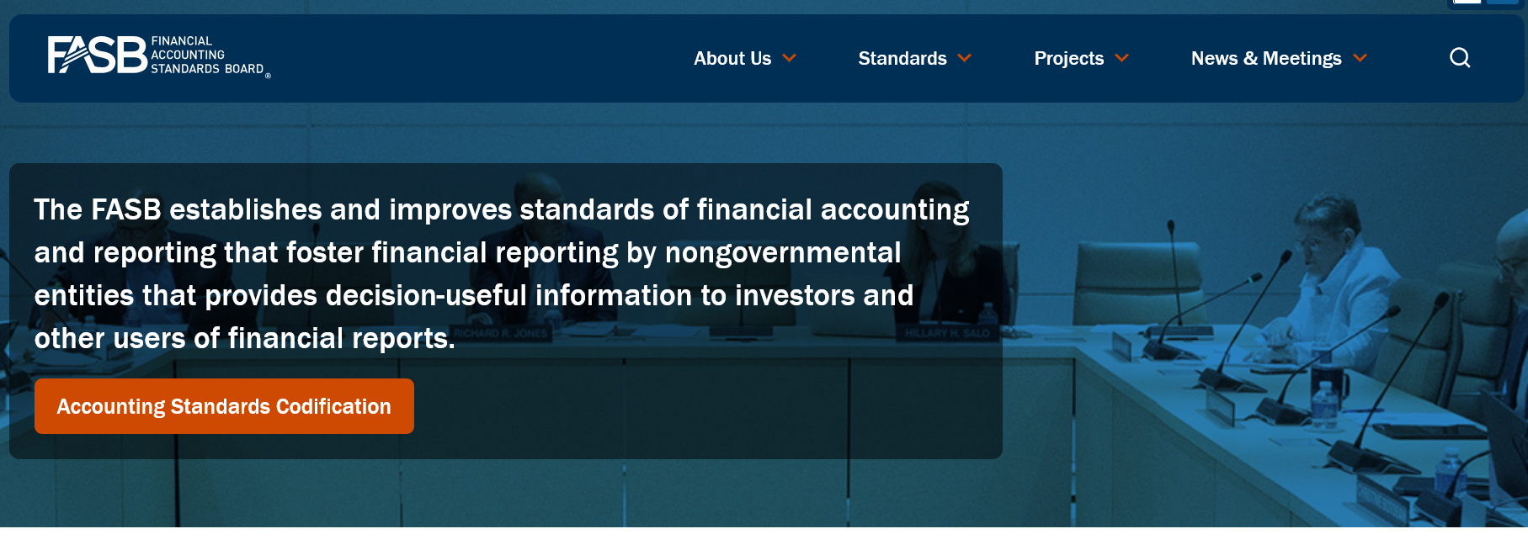
On the FASB site (www.fasb.org) click the Accounting Standards Codification (ASC)

Slide 2
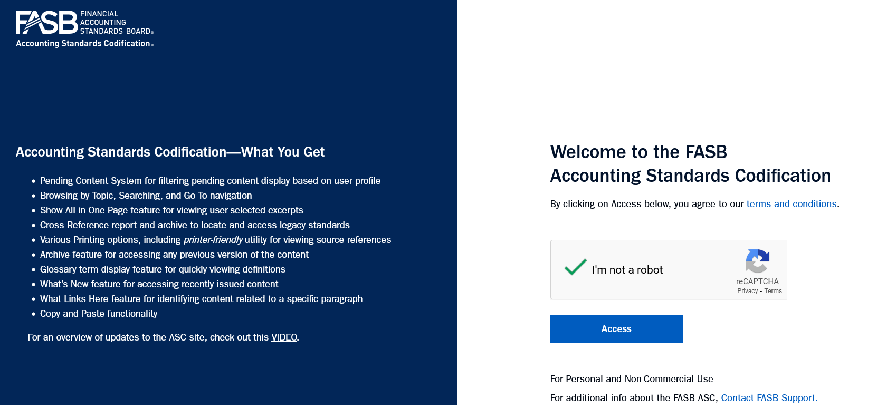
Verify ‘I’m not a robot’ and click Access

Slide 3
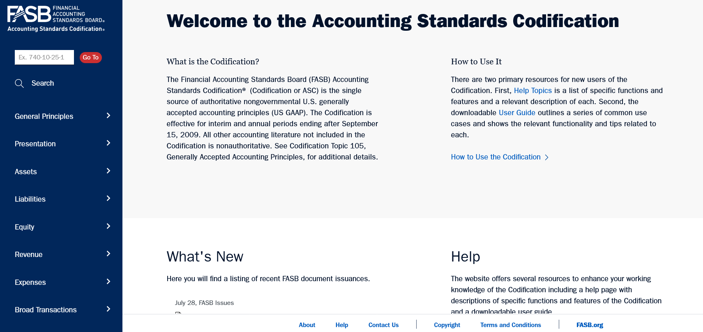
There will appear a Licence pop-up, scroll to the bottom and Accept to get to →

Slide 4
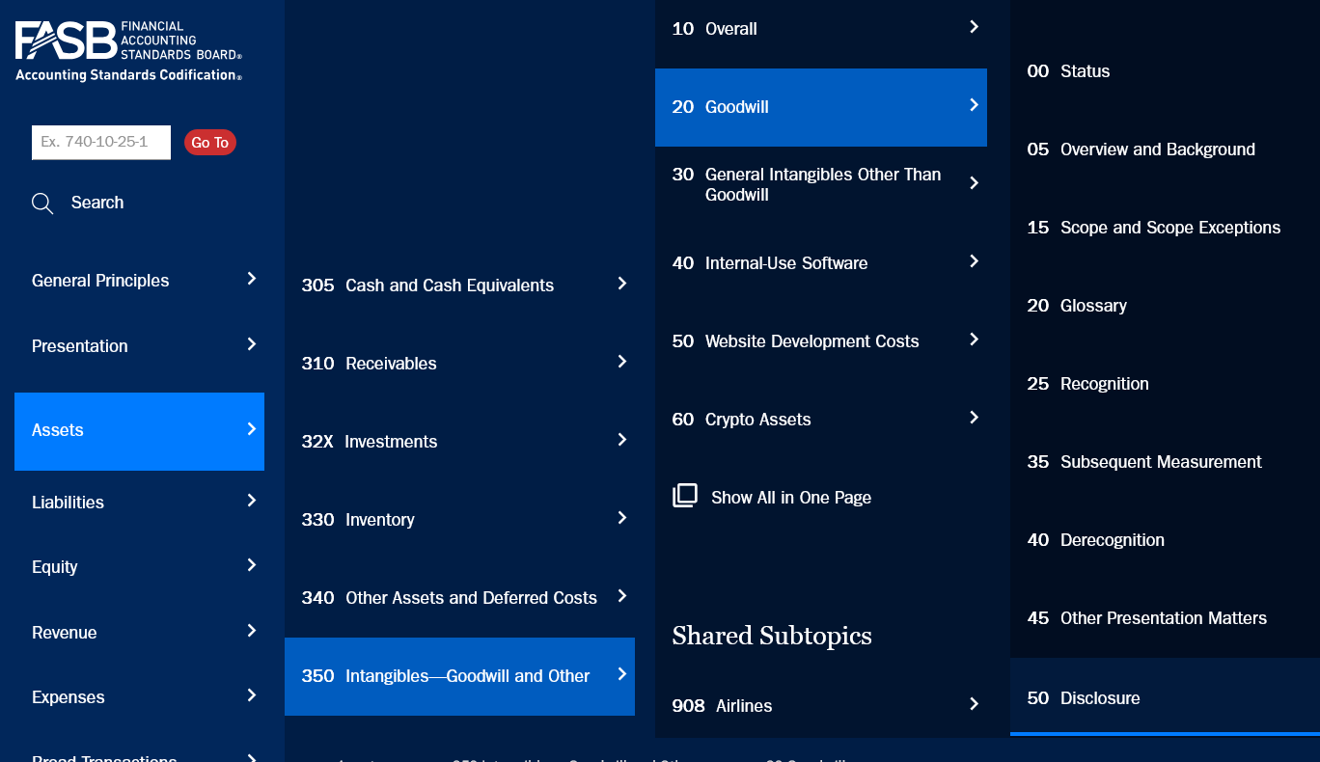
The Accounting Standard for Goodwill ASC 350-20

Slide 5
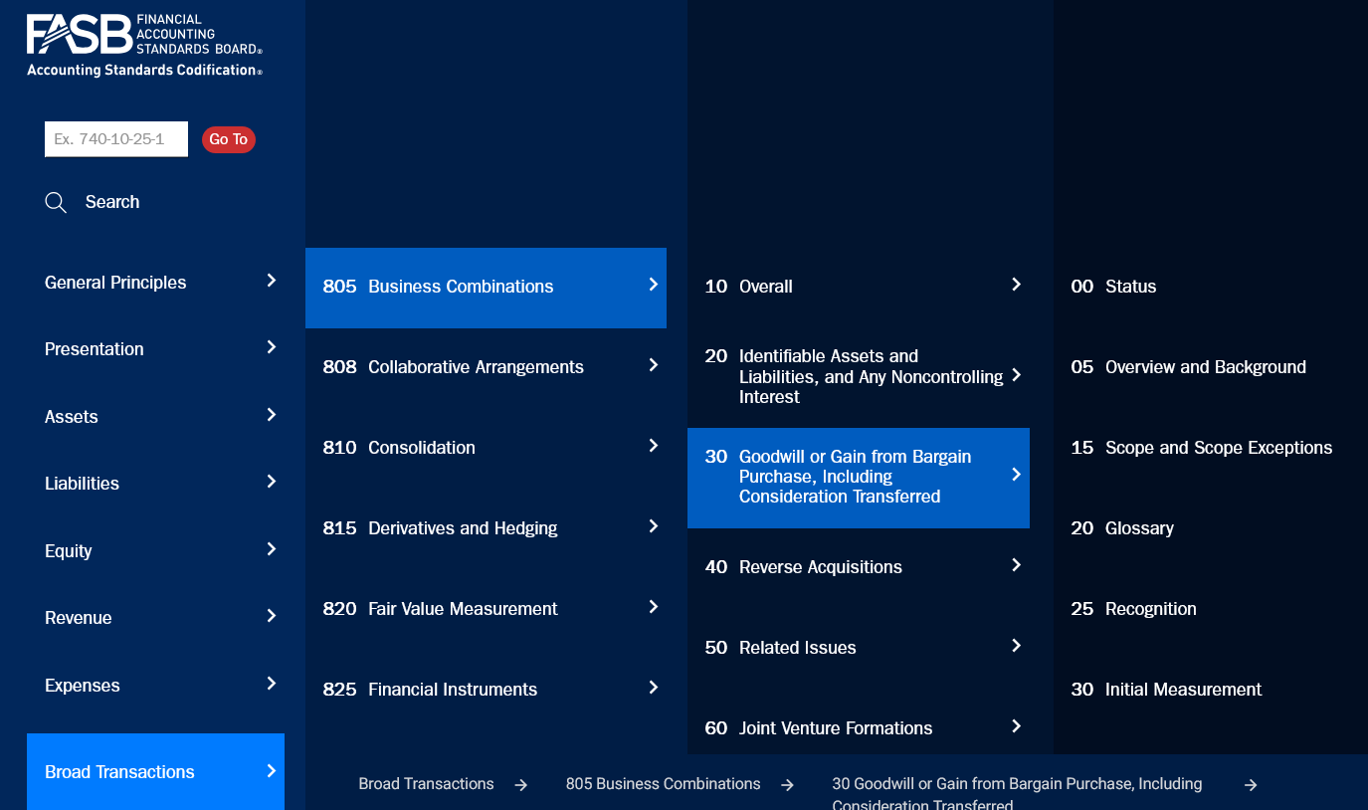
Treatment of Goodwill not limited to ASC 350

Slide 6
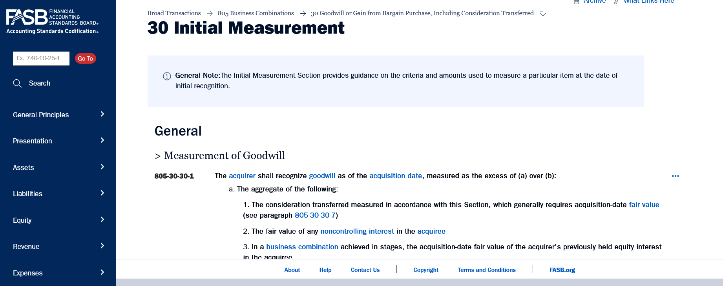
As for the fair value measurement of Goodwill

Slide 7
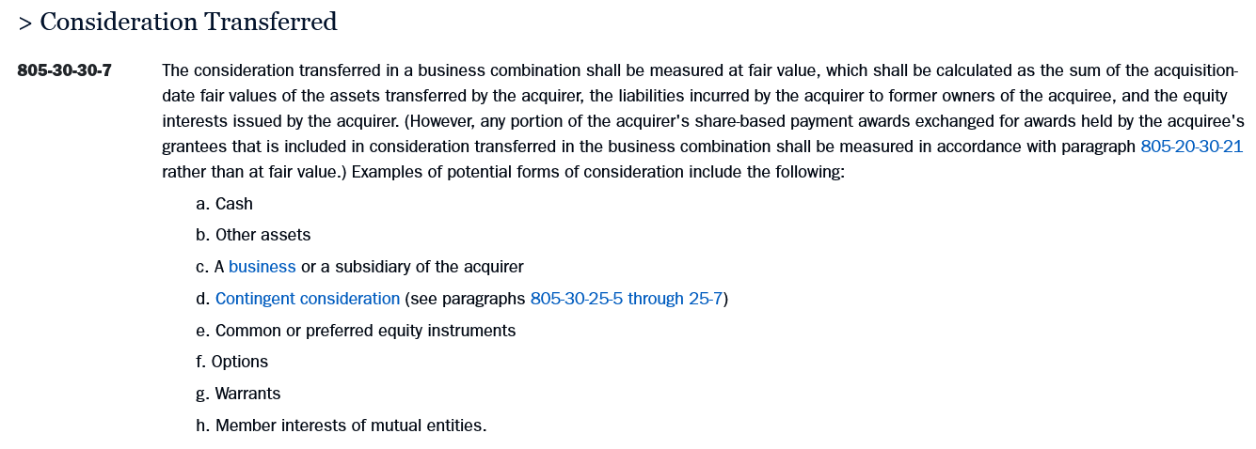
The key statement is the following

Slide 8
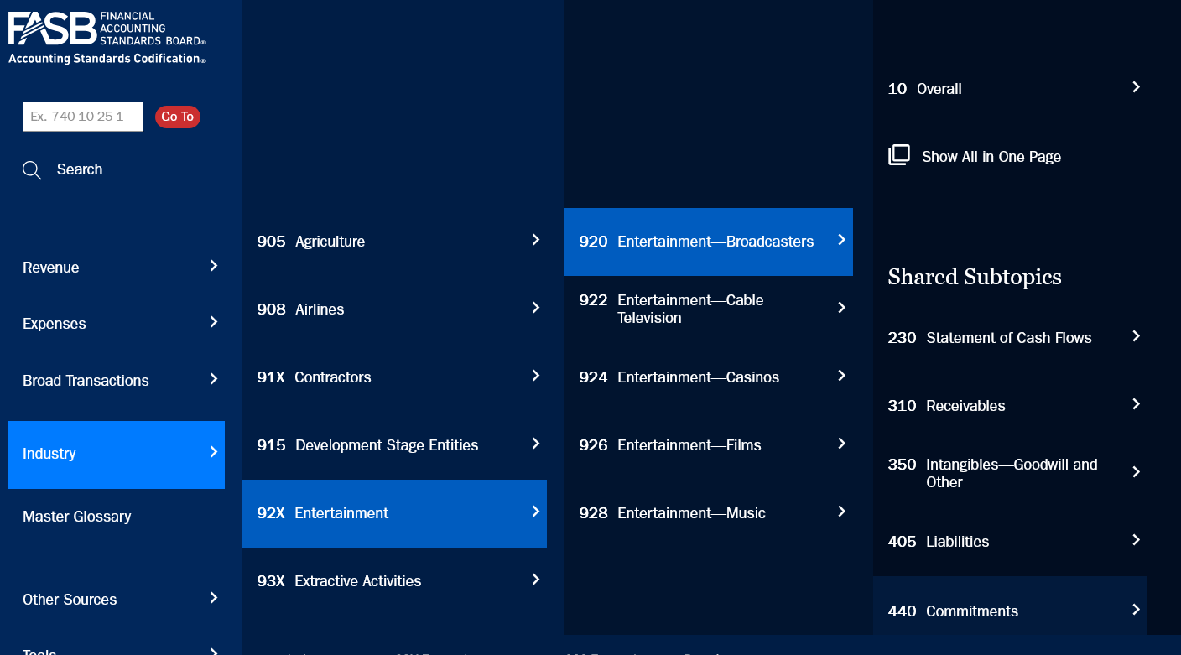
NETFLIX
ASC 920: Entertainment – Broadcasters ASC 926: Entertainment - Films

Slide 9
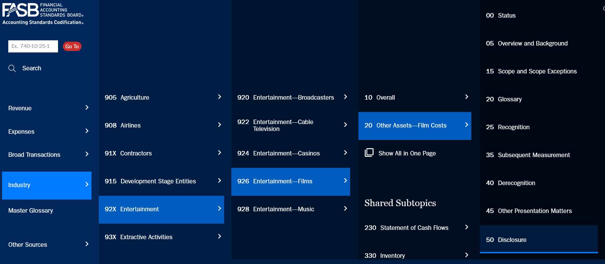

Slide 10
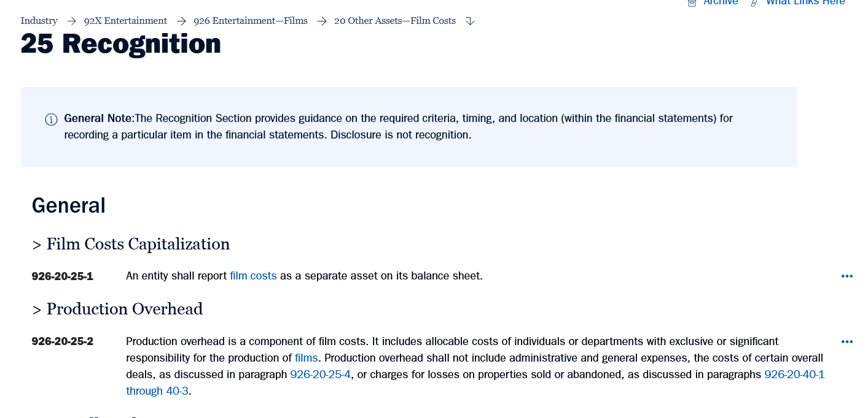

Slide 11


Slide 12
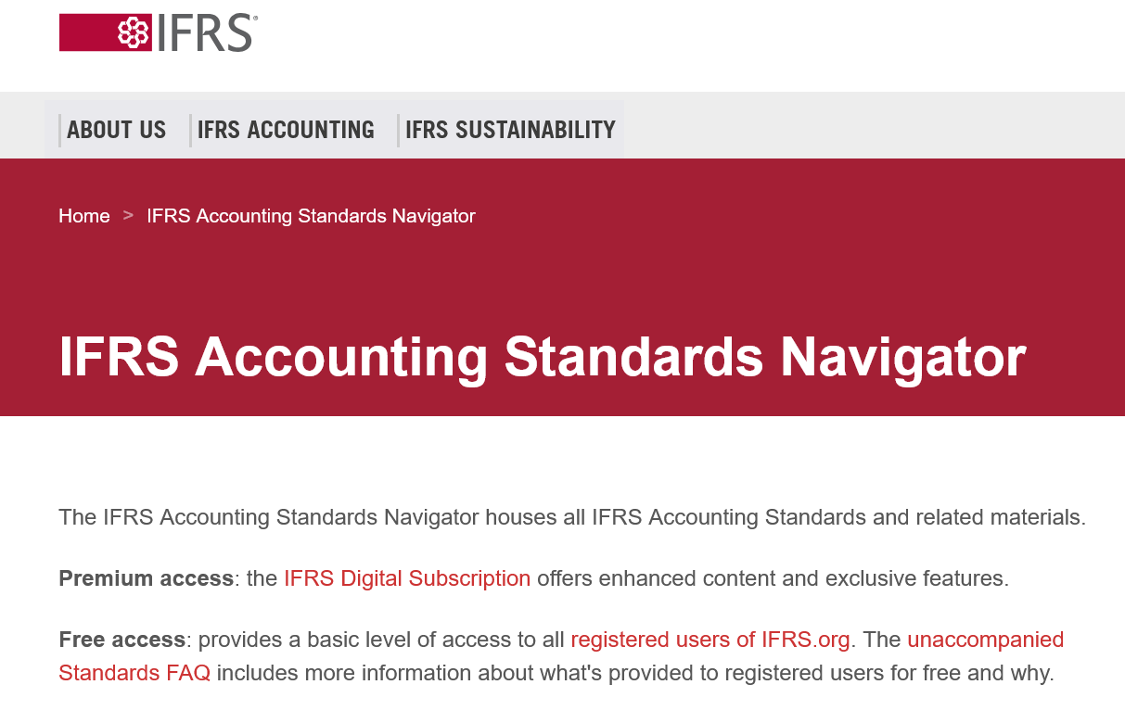
Hover on IFRS Accounting and click Accounting Standards

Slide 13
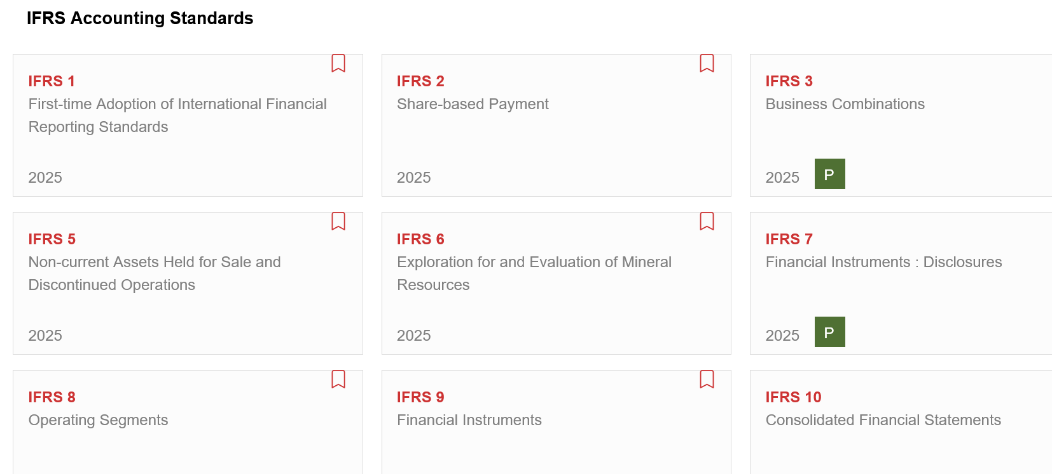
Scroll down to the standards → IFRS 3 deals with Goodwill

