Slide 1
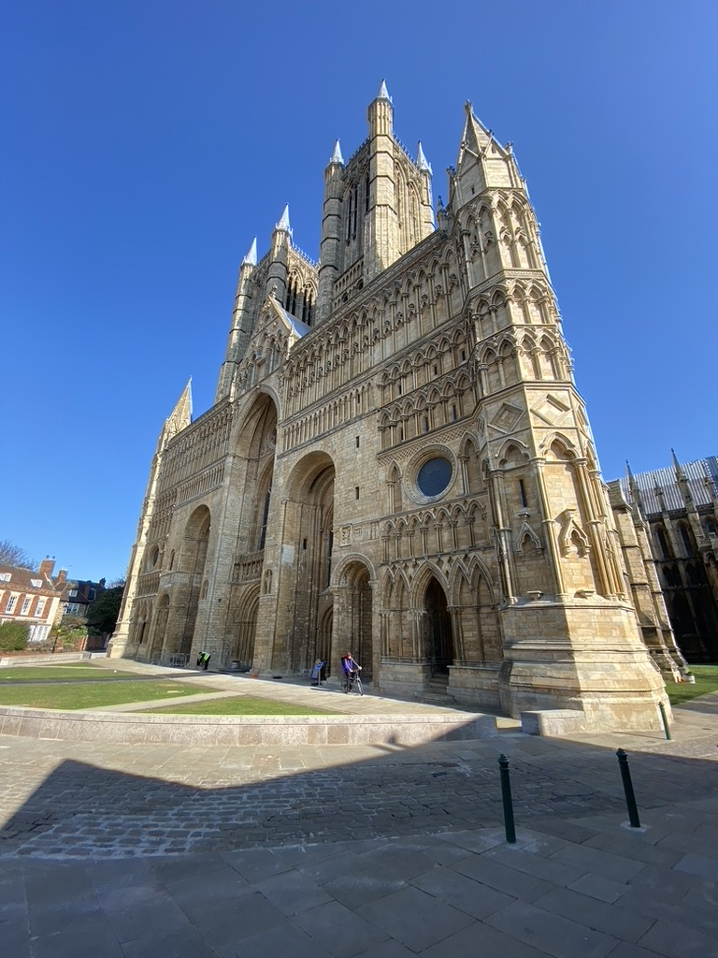
CRYSTAL PALACES
The Societal Function of English Cathedrals in the Gothic Period*
Richard Fisher GLS812 April 2022
*[typeface: Franklin Gothic]

Slide 2
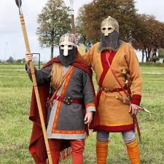
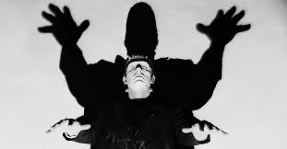
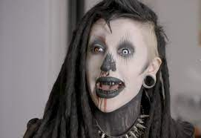
Not these kinds of Gothic
Visigoths Gothic novels Goths

Slide 3
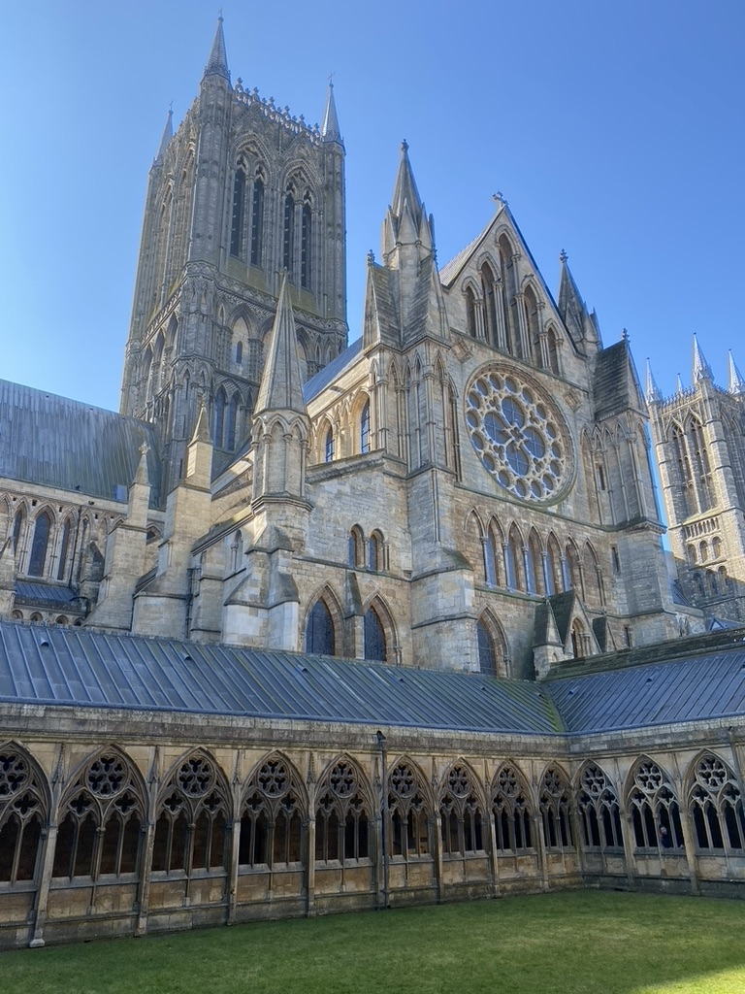
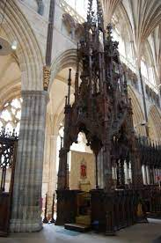
So what is a Cathedral, anyway?
A Cathedral must have a cathedra
The principal church of a bishop’s diocese, containing the episcopal throne [cathedra]
Abbots, who are ‘bishop-equivalents’, do not have cathedrals but abbeys
A cathedral is not necessarily a basilica
St. Peter’s is a basilica not a cathedral
La Sagrada Familia is a minor basilica (2010)
ND is both a cathedral and a basilica (rare)
The Bishop of Rome (Pope’s) cathedral is St. John Lateran in Rome NOT St. Peter’s
It’s not about size…

Slide 4
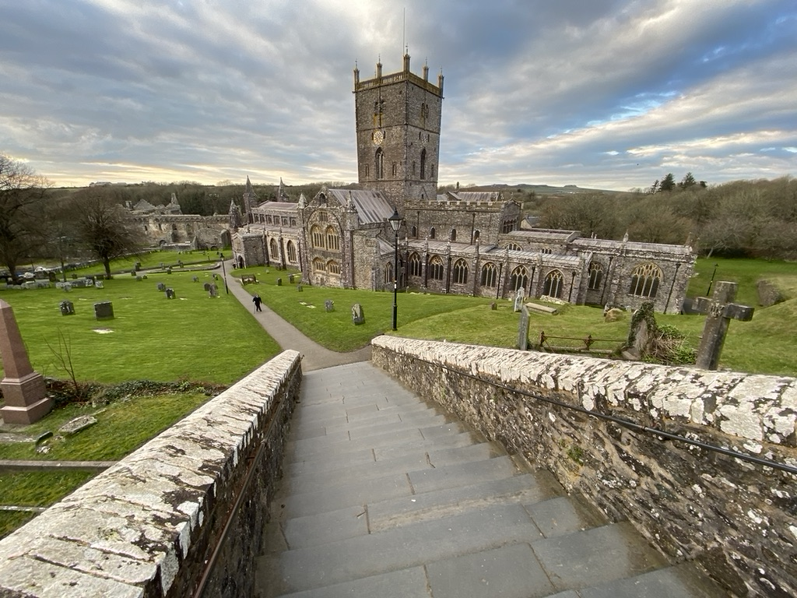
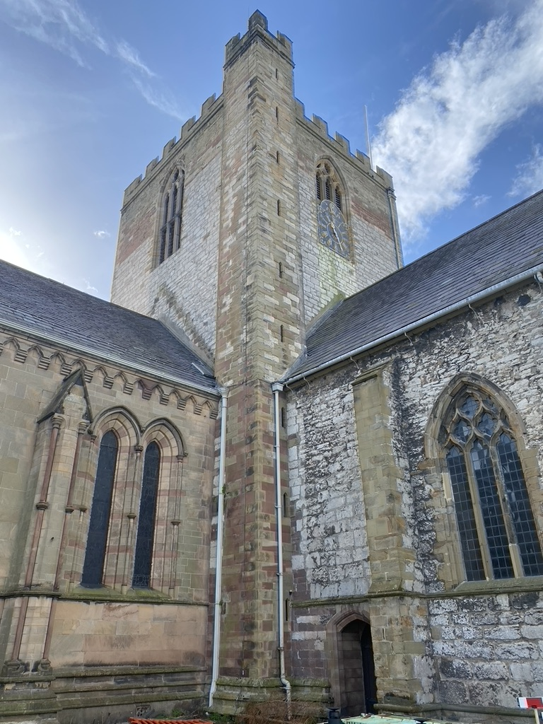
Wales seems to have cornered the market in small gothic cathedrals…
ST. DAVID’S 485/1131 [SMALL]
ST. ASAPH’S 560/1282 [TINY]

Slide 5
When was the ENGLISH Gothic period?
There are three main periods of English Gothic:
Early English Gothic (1180-1250)
Decorated Gothic (1250-1350)
Perpendicular Gothic (1350-1520)
Initially ‘gothic’ was a slur hurled by Renaissance Italians at non-classical architecture i.e. barbarian

Slide 6
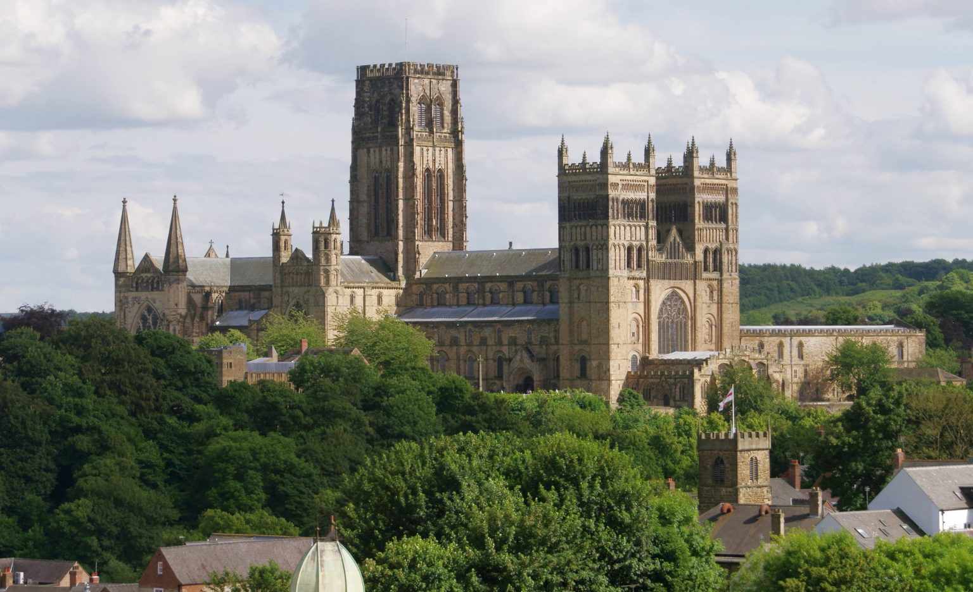
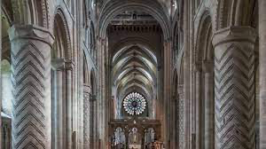

Early English Gothic (1180-1250)
Durham Cathedral (1093)
Transitional elements of Norman architecture
- ‘Romanesque’ on the continent
Functional
Minimal decoration
Rounded arches
Lack of glass
Beginning to be embellished
Paving the way for Decorated Gothic...

Slide 7
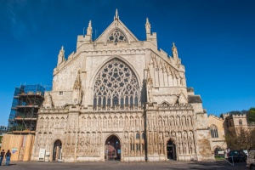
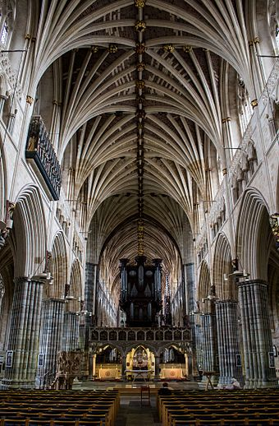
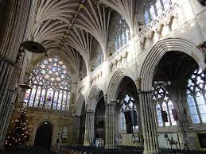
Decorated Gothic 1250-1350
Exeter Cathedral (1275)
Saxon/Norman/Gothic
Broader, more European style
Milan, Barcelona
Longest uninterrupted medieval stone vaulted ceiling in the world!!!
Paved the way for Gothic Perpendicular…

Slide 8
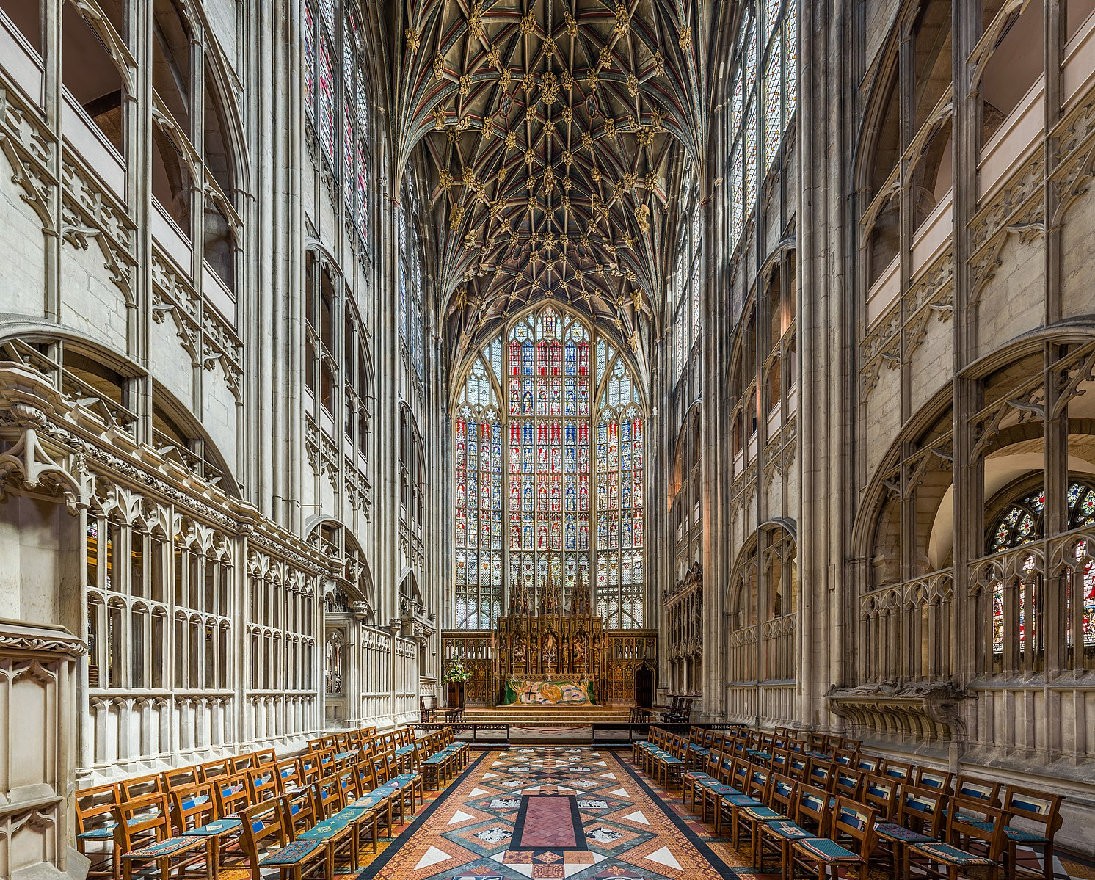
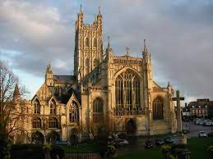
Gothic Perpendicular (1350-1520)
Gloucester Cathedral (678) - perpendicular elements added 1337
More about proportion than height or size
Gothic buildings flourished for centuries

Slide 9
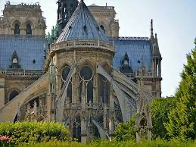
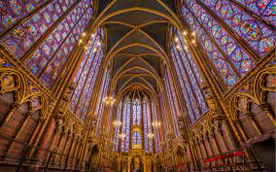
What was the breakthrough that made Gothic architecture possible?
Flying buttresses!
Walls took less of the load
Allowing for pointed arches (asthetics)
And most importantly – glass
Or more specifically - light!
Allowed Gothic to take on more natural forms than Greco-Roman or Norman architecture
Light, sun, trees
Allowed buildings to be larger, lighter and more colourful

Slide 10
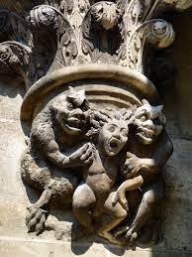
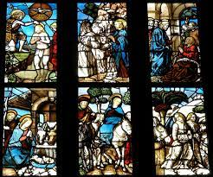
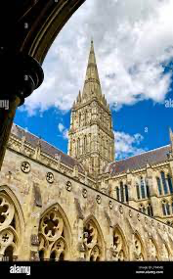
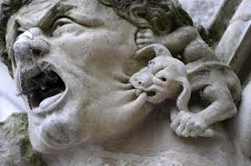
What was the role of the Cathedral in English medieval society?
Physical manifestation of heavenly realm in an age of Faith –
Skyscrapers ‘touching the face of God’
Impressive on every level – and frightening
Storytellers – windows, pictures

Slide 11
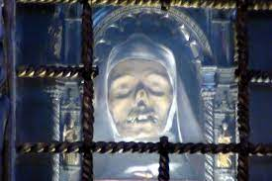
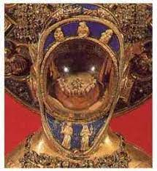
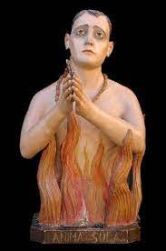
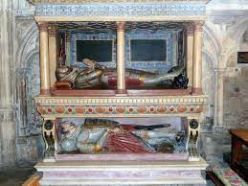
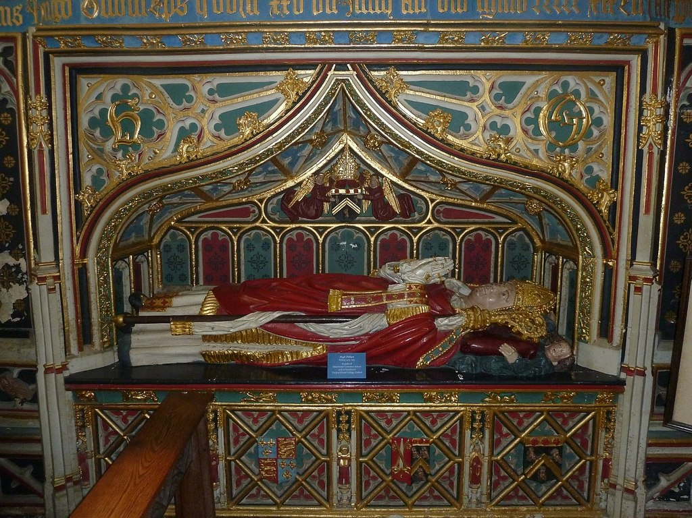
What was the role of the Cathedral in English medieval society?
Reliquaries – big biz
The grosser the better
Indulgences
Discounts on Purgatory
Reinforces status quo
Nobility
Clergy
Impressive liturgy in
gobbledegook

Slide 12
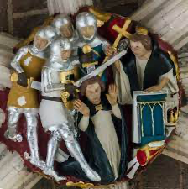
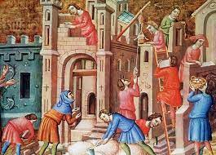
What was the role of the Cathedral in English medieval society?
Huge [skilled] labour creator over many decades/centuries
Masons, carpenters, sculptors, glaziers, artists, clerics, lawyers, administrators, accountants etc.
Led to formation of Guilds
Beginning of complex, civilized co-operation required for completion - 50 years +
Very few cathedral cities die – magnets for skilled labour, business and wealth

Slide 13
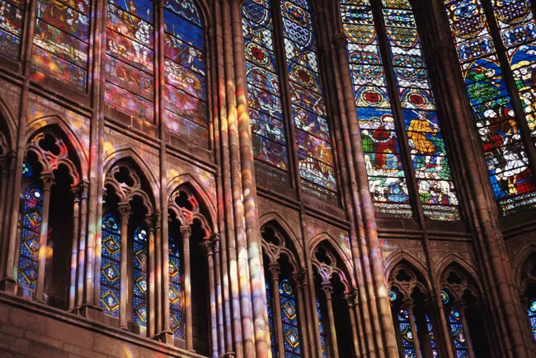
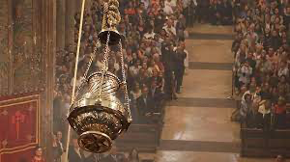
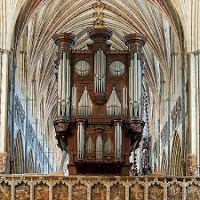
What was the role of the Cathedral in English medieval society?
Carnival of life and death
Centres of (holy) conspicuous consumption
A riot of colours, sounds and smells
Latin, organ, choir,incense, candles, peasants
Access for all to impressive, built beauty
All in the name of God (and the status quo)
Raising cost of entry to new denominations
Barrier to exit
Protestantism stronger in non-gothic countries
Why would you go anywhere else?

Slide 14
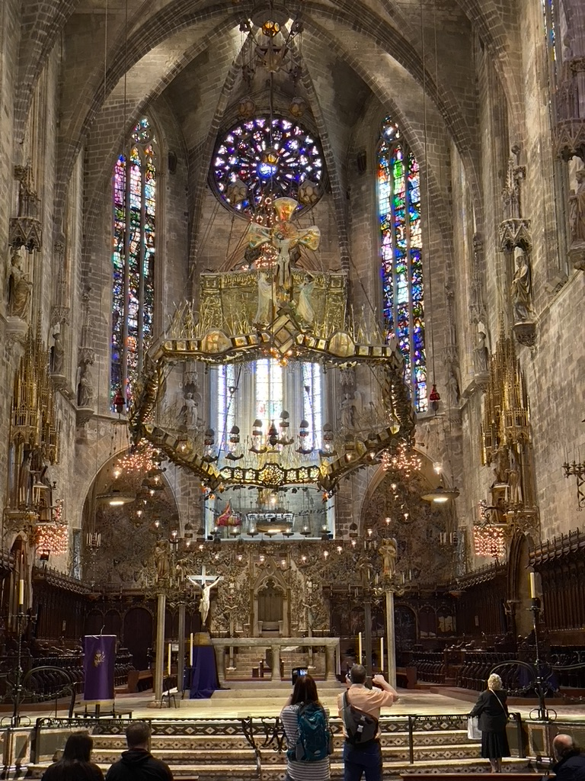
How did they pay for all this?
The odd Crusade
Donations from bishops, nobility
The first income taxes – on the clergy!
Pilgrimages, indulgences, offerings
Weddings, funerals, bar mitzvahs…
Loyalty programs, speaker circuit
Tourism – ND can turnover 50,000 visitors per day

Slide 15
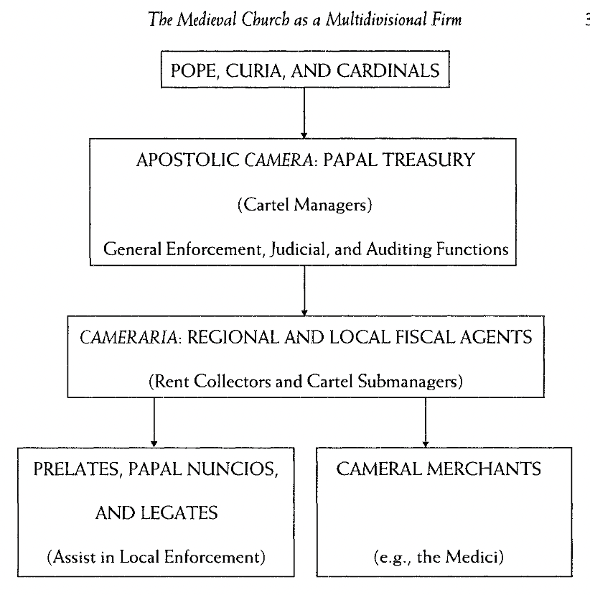
A Sacred Trust The Medieval Church as an Economic Firm (Ekelund et al)
Top down model
Bishops > Diocese > Priests > Parishioners (Laity)
Abbots > Abbey > Monks
Cathedrals fell under the aegis of the Bishop (Regional Manager)
Linchpin between the Diocese (sales area) and the Cardinal (Country Manager)
Country Manager reports to Global CEO (Pope)

Slide 16
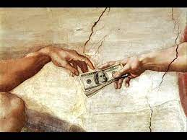
A Sacred Trust The Medieval Church as an Economic Firm (Ekelund et al.)
Surprising amount of local decision-making – as long as the money kept coming
But not on doctrinal issues (product consistency)
Architectural movements (e.g. Gothic) based on vogue/competitiveness/envy
“Thou shalt not covet thy neighbour’s cathedral”
was not one of the Ten Commandments
Knights Templars were the first ‘international bankers’
Was the Church adopting business practices or is it the other way round?

Slide 17
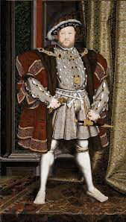
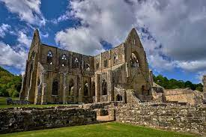
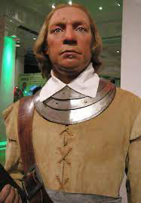
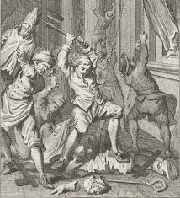
Those PHILISTINES Henry VIII & Cromwell
Polygamist, murderer, ecclesicide
6’ 2” vs. 5’ 5” average
400 + pounds vs. 2 pounds average
Genocide, regicide, iconoclast, killjoy, short
5’ 4” vs. Napoleon 5’ 5”
‘Puritan Euphoric Iconoclasm’

Slide 18
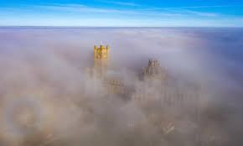
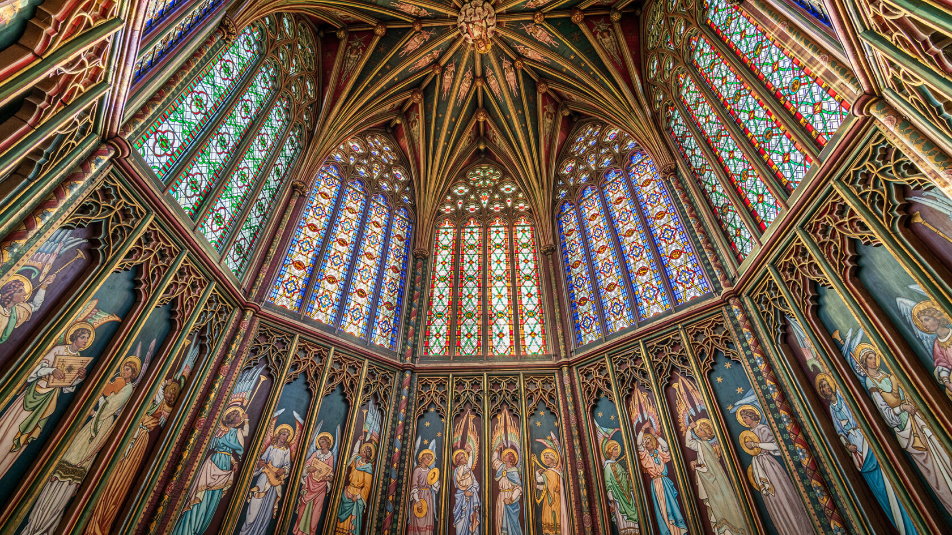
Has Gothic architecture ever really been surpassed?
Great Gothic architecture seems to float outside and inside despite weighing thousands of tonnes
So which buildings float your boat and why?

Slide 19
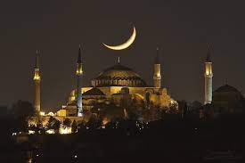
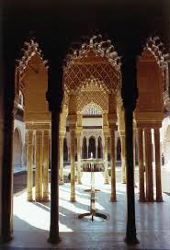
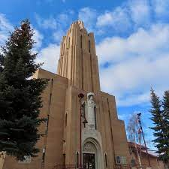
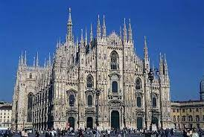
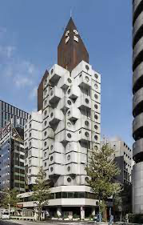
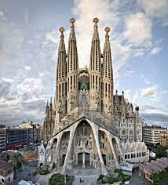
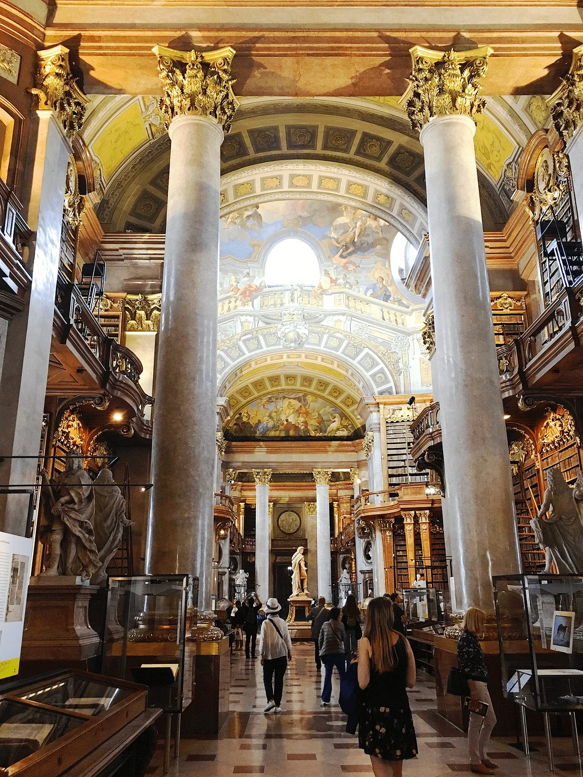
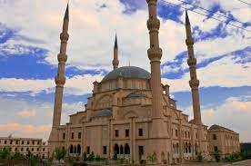
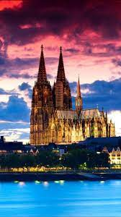
Our ‘boat-floating’ buildings

Slide 20
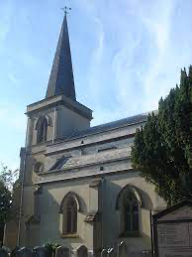

Which story do you prefer?
“So tell me, since it makes no factual difference to you and you can’t prove the question either way, which story do you prefer?”

Slide 21

Comments?
LEICESTER

