Slide 1
Indigenous Youth Homelessness in the DTES
Social justice and the urban rEz

Slide 2
“As long as the capitalist mode of production continues to exist, it is folly to hope for an isolated solution to the housing question or of any other social question affecting the fate of the workers.” — Friedrich Engels, 1872
“Homelessness exists not because the system is not working but because this is the way it works.” — Peter Marcuse

Slide 3
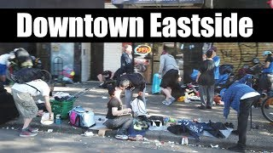

Slide 4


Slide 5


Slide 6
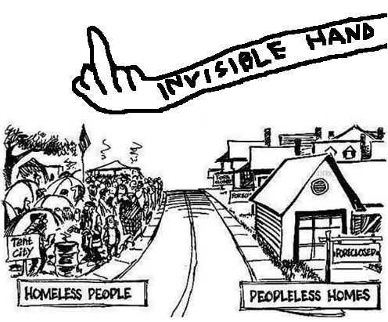

Slide 7
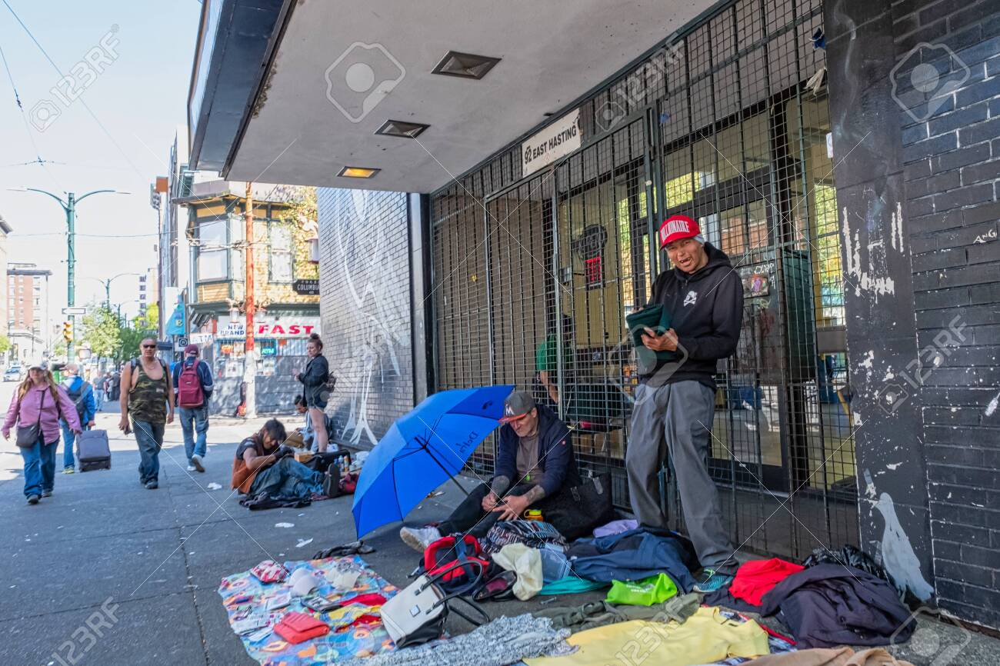

Slide 8
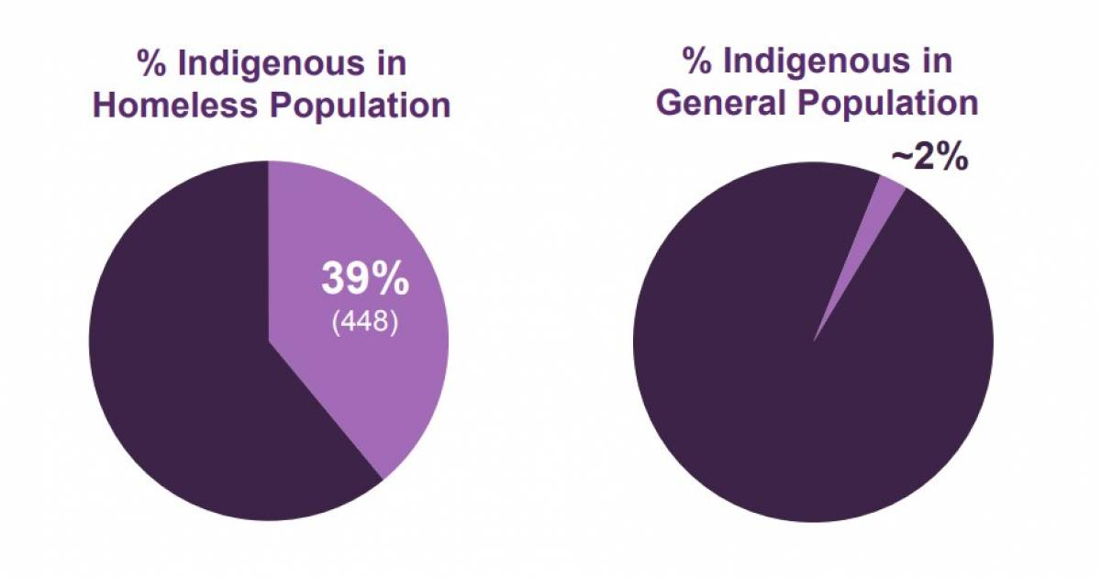

Slide 9
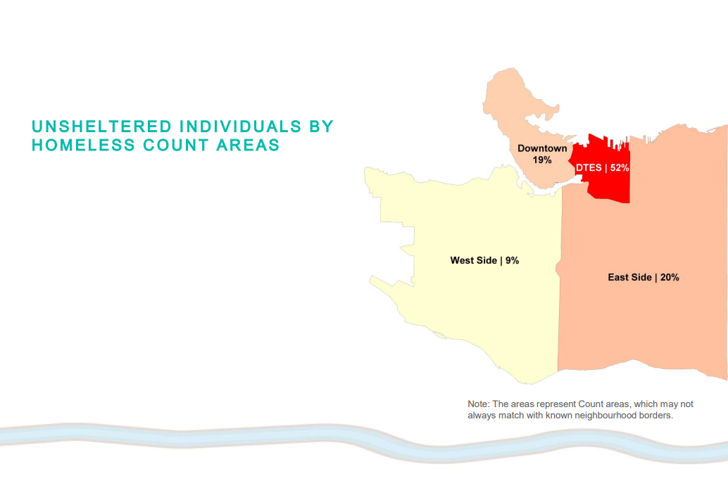

Slide 10
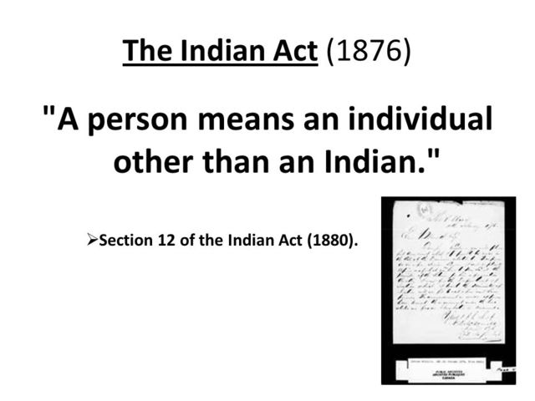

Slide 11


Slide 12
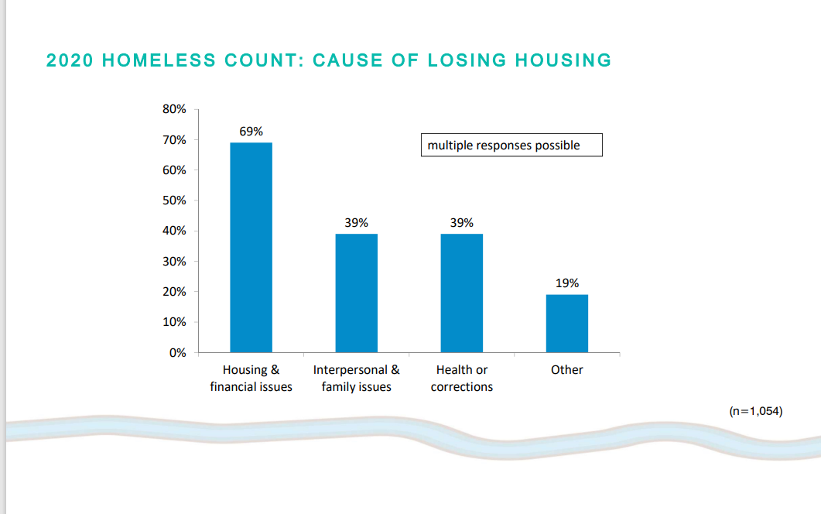

Slide 13


Slide 14
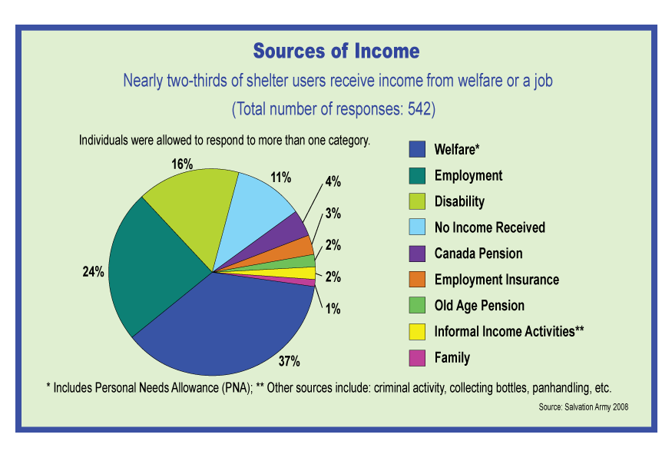

Slide 15
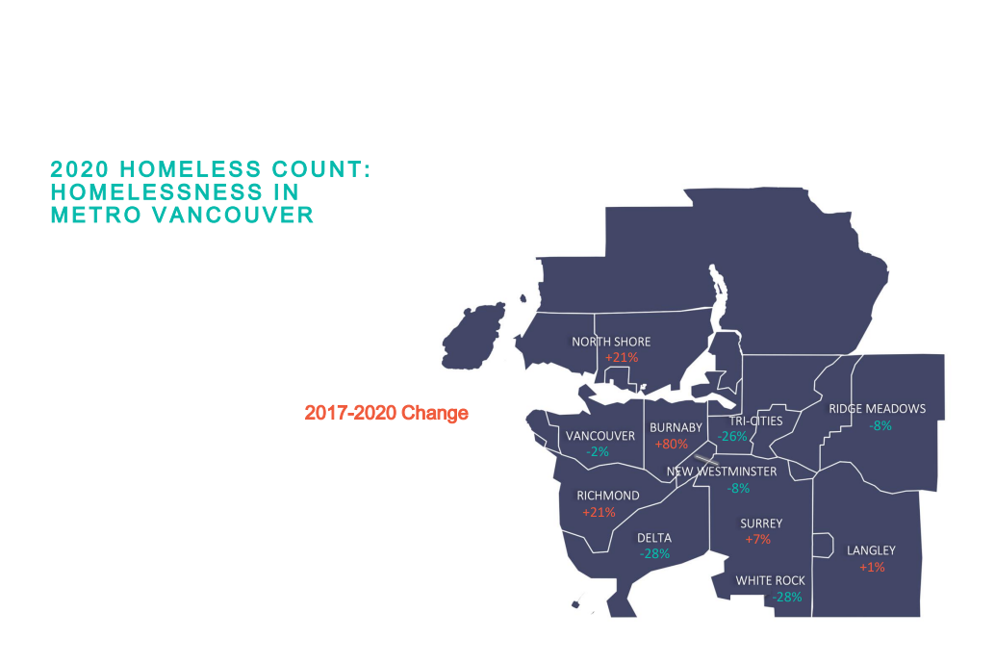

Slide 16
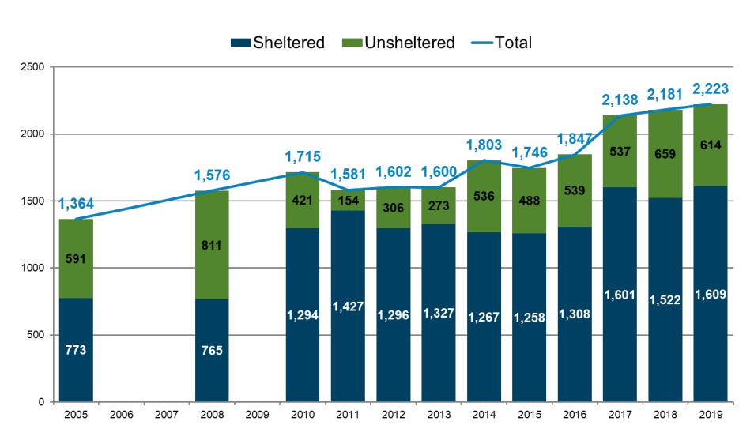

Slide 17
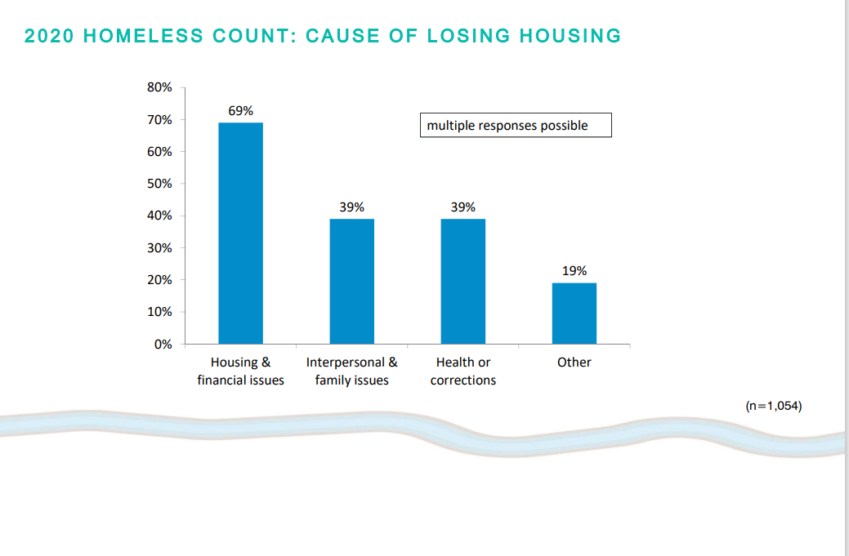

Slide 18
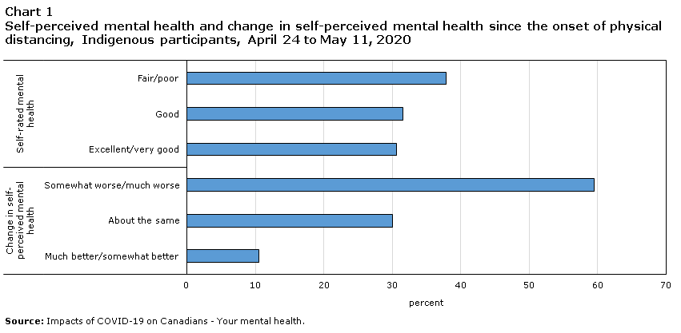

Slide 19
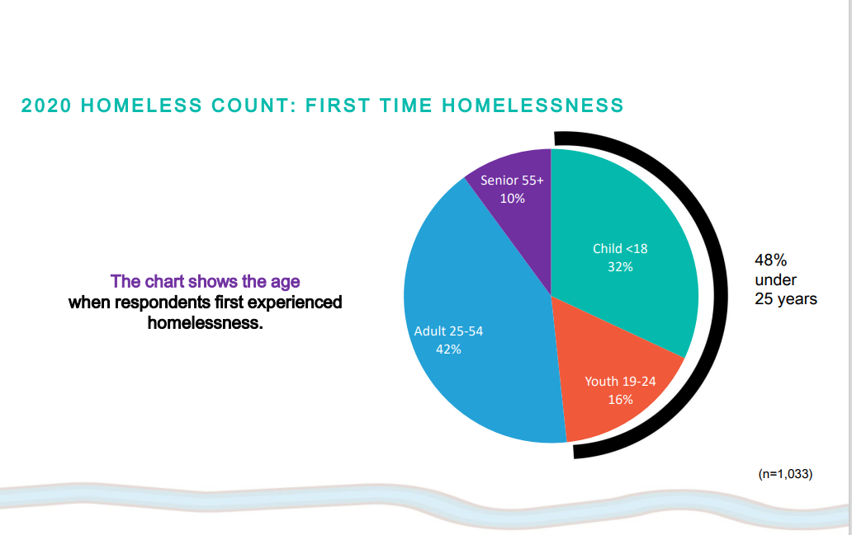

Slide 20


Slide 21
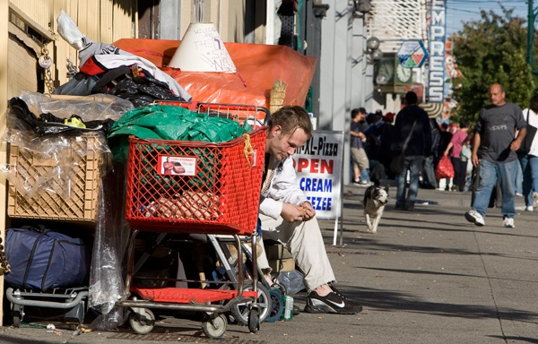

Slide 22
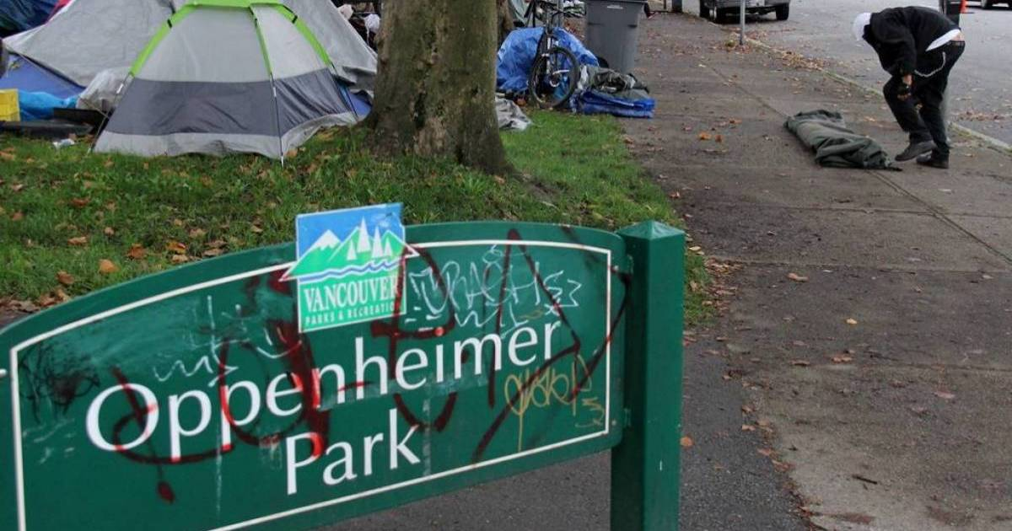

Slide 23


Slide 24


Slide 25
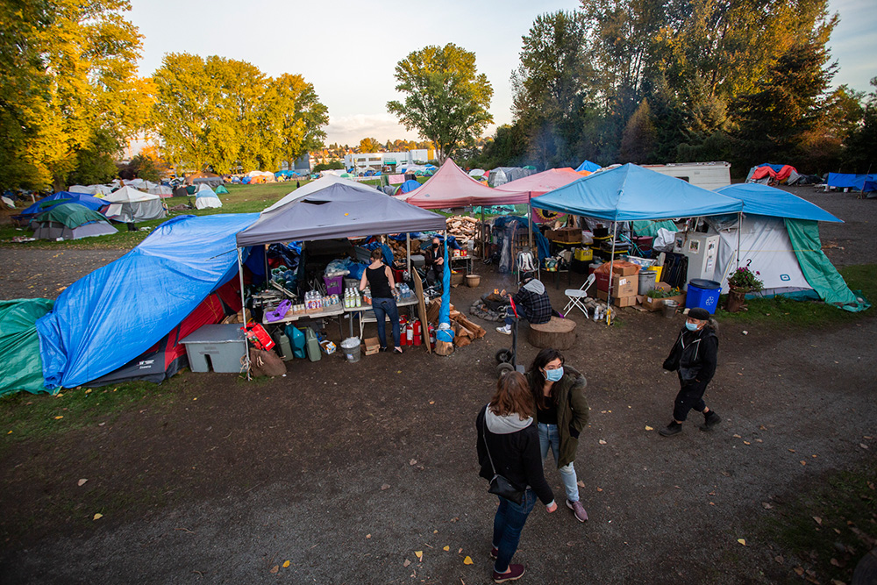

Slide 26
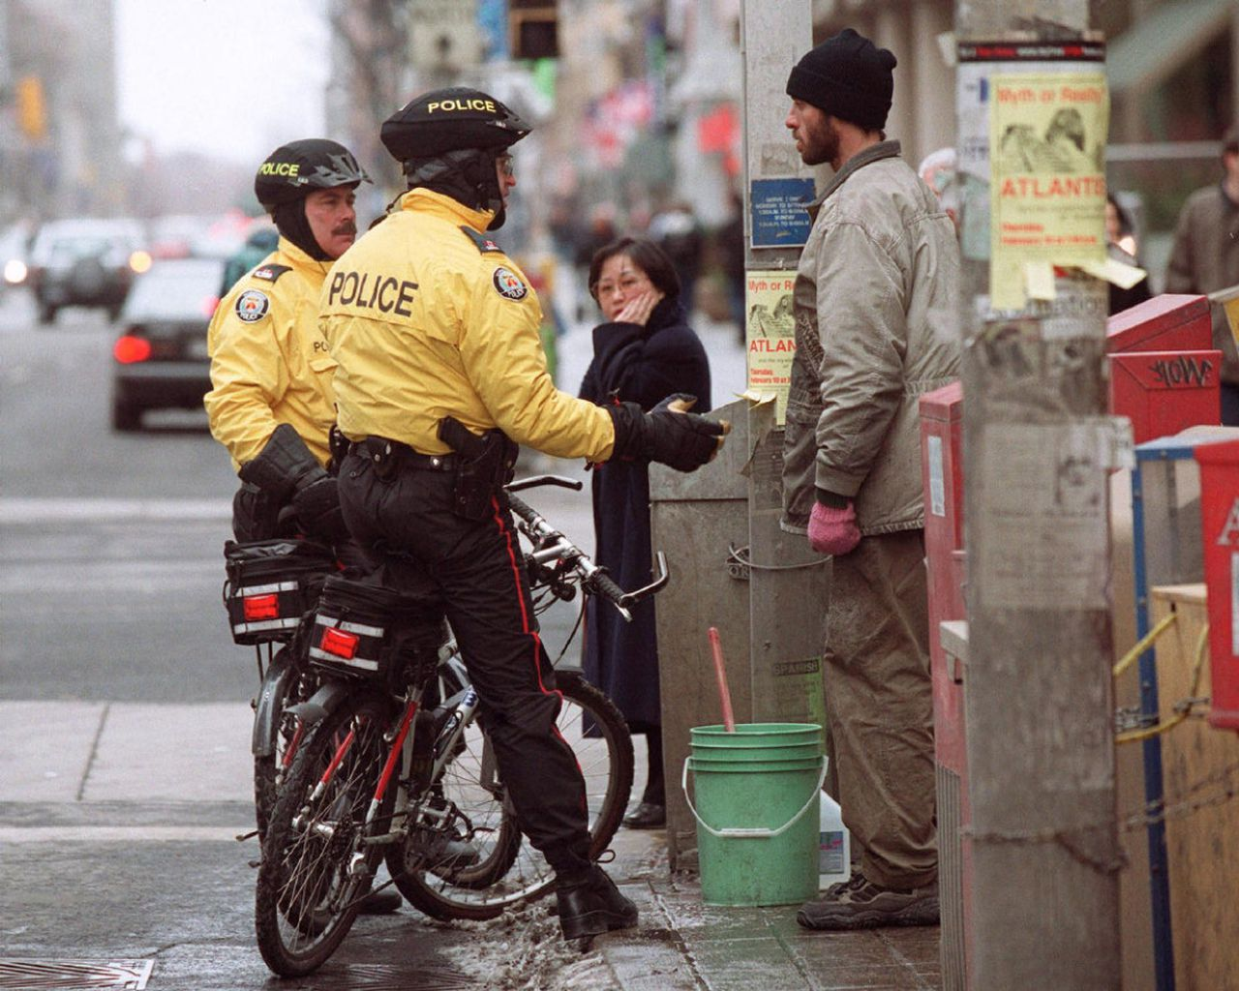

Slide 27


Slide 28


Slide 29
