Slide 1
THE BUSINESS OF BELIEF
CREATING A MONOPOLY

Slide 2
ROME IN THE FIRST CENTURY
SETTING THE STAGE - Roman Society and the Religious Marketplace
Religious market crowded, competitive, vibrant, open to all.
Polytheistic – Gods and Spirits
State and Religion woven together.
Economically still fairly stable
Society is tolerant – assimilates Gods and practices of other nations
“follow your cult as you wish and let everyone else do the same.”
Only requirement is loyalty to the state.

Slide 3
A NEW MESSAGE IN AN OLD MARKET
A small Jewish sect joins the market
Who are they?
Meeting spiritual demands with an appealing new message
Building the product
Creating the Story (Gospels written 60 -70 CE)
Finding a demographic
Developing Market techniques – Spreading the Word
New cult disliked and viewed with suspicion
“A secret society that speaks in a private code – Men following a malefic superstition.” Nero 64 CE

Slide 4
CREATING THE CHURCH
Who has “The Official Story”
Infighting begins between Gnostics, Christian Gnostics, Christians, Jewish Gnostics, Essenes and Apostles over interpretation and teaching:
Establish basic Clerical Administration: Bishop, Deacon, Priest
In 96 Bishop Clements writes to the Church in Corinth -
“God delegates his authority of reign to rulers and leaders on earth.
The designated rulers are bishops, priests and deacons. Anyone who does not obey this is disobeying God.”
70 AE The destruction of the temple in Judea

Slide 5
Who are the Gnostics?
Until the discovery of the Nag Hammadi in 1945 the only references to Gnostics were from Church writings
Central belief - the world was created by an inferior god – demiurge, two worlds - spirit and matter - varied beliefs and interpretations
Freeing the soul from material world
Possess a secret oral tradition directly from Jesus
Divinity is discovered through inner seeking rather than through an external Saviour or Institution
To know oneself at the deepest level is to know God. This is the secret of gnosis
Whoever has known himself has at the same time already achieved knowledge about the depths of all things.” Book of Thomas the Contender

Slide 6
EARLY CHRISTIAN GNOSTICS
Valentinus (100 – 160) Early Christian Gnostic Theologian
“God. Unbegotten. Creator of the universe. The ineffable one who dwells alone in silence. No one was before him.” Gospel of Truth
“The Ineffable, The Depth” – The Father, “Grace, Silence, the womb” – The Mother
From the power of Silence appeared “a great power, the Mind of the Universe which manages all things and is a male… the other a great Intelligence is a female which produces all things.” The Gospel of Truth
“The origin of the world is Error. Error emanating from the unknown and alien father and in its turn engendering Oblivion, Anguish and Terror in the immense void of the universe in gestation.” The Gospel of Truth
The fruit of Error, Oblivions, Anguish and Terror, the world of deficiency

Slide 7
EARLY CHRISTIAN GNOSITCS
Basilides (c 100 – 139) Religious teacher in Alexandria
Believed faith was inborn, not a choice
Salvation involved the disentanglement of Spirit from Matter
Sin came from a preoccupation with materiality
Passions were appendages – irrational souls in turmoil and confusion
Prescribed five years of silence to his disciples
Followers formed a movement that lasted two centuries

Slide 8
Quotes from Gnostic Gospels
“Do not tell lies, and do not do what you hate.” Gospel of Thomas
“If you bring forth what is within you, what you bring forth will save you. If you do not bring forth what is within you, what you do not bring forth will destroy you.” Gospel of Thomas
“Truth must be clothed in symbols.” Gospel of Phillip
“And in her/him dwells an infinite power – the root of the universe.” Simon Magus
“He is calling upon us to become fully human” Gospel of Mary

Slide 9
Gnostics A Threat TO the Early Church
Gnostic teachings are beginning to spread and take hold amongst Pagans and Jews
Church accuses Gnostics of Heresy
Controversy and attention creates credibility for Gnostic and other heretics
A Heretic is anyone who -
Questions the Authority of the Church
Teaches a different interpretation
Deviates from the emerging “truth”
Asks “Why are we here, what happens when we die?”

Slide 10
LEADING THE CHARGE AGAINST GNOSTICS AND OTHER HERETICS
Bishop Irenaeus – (c 200 CE) Bishop of Lyon – Early Church Father
Wrote “Against Heresies” (c 175 – 185) attack on Gnosticism
“The Destruction of Falsely So-Called Knowledge”. Specifically attacks “The Gospel of Truth” - Exposing Gnostic heresies so everyone could “avoid such an abyss of madness and of blasphemy against Christ.”
Believed Christian unity depends on one doctrine. Interpretations of scriptures belongs to the bishops. He speaks to God’s goodness
“They say one thing and do another. They appear to be sheep but inwardly they are wolves.”
“Gnostics craftily put truth and fiction together - according to them, man must perpetrate every possible infamy in order to be saved”

Slide 11
LEADING THE CHARGE (CONT’D)
Tertullian (160 – 240 AD) Pagan convert to Christianity. Contempt for Philosophy – considered it profane.
Wrote “Prescription Against Heresies”
Speaks to God’s goodness arguing the question permeating Pagan, Gnostic, Jewish religions “If God is goodness how can he tolerate evil?”
Church received its Scripture directly from the Apostles
Argued Gnostics' claim to esoteric knowledge: "What in so many congregations is always recognizable as the very same cannot be erroneous: it must be tradition.”
“The heretics will not listen and understand that a search is sensible when one does not yet know the truth – with Christ and His gospel, we have reached the end and goal of our seeking. True faith is always simple”

Slide 12
THE GNOSTICS COUNTER
Gnostics accuse the Church of Heresy
The Apocalypse of Peter denouncing Church officials
“Others call themselves Bishops and Deacons as if they had received their authority from God. Those people are waterless canals.”
The Tripartie Tractate
Gnostic – “children of the father” gather as equals but “the offspring of the demiurge” – orthodox Christians – “wanted to command one another in their empty ambition, lust for power – each one imagining that he is superior to the others.”

Slide 13
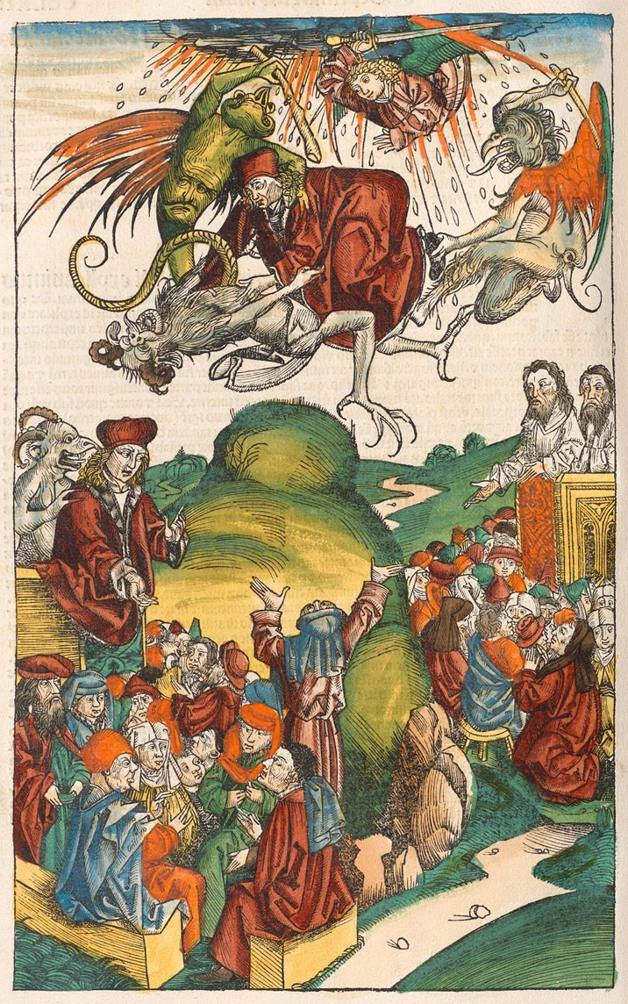
DEATH OF SIMON MAGUS
Notes:
Simon Magus – Simon the Magician. A Samaritan, Gnostic, heretic. Convert to Christianity, is baptized by Philip. A Sorcerer who could levitate and fly at will. Irenaeus hated him. Accused of lawlessness. Simony is named for him.

Slide 14
AN EMPIRE IN DISTRESS
Are your nerves shot from too many invasions? High infant mortality rate? Life threatening illnesses? Going from a peaceful bucolic life to being enslaved? Do you suffer from anxiety and depression? Do you have difficulty studying, remembering, learning, do you suffer from nightmares, flashbacks, numbing, sleep problems, guilt, worry, are you easily startled, tense, on edge, raging?
You may be suffering from Post Traumatic Stress Disorder.
NOTE: Highest risk population for post traumatic stress disorder are: refugees, immigrants, slaves, people living in war zones, vets, women, children, the poor, victims of sexual assault, torture, and invasion—if it’s true now why wouldn’t it have been true then?
Low economic status, government sanctioned injustice, invisibility, powerlessness, and helplessness, disenfranchised.

Slide 15
THE 2ND AND 3RD CENTURIES
The Antonine Plague, CE 165–180 Total deaths 5,000,000
Infighting continues over Authority to speak for Christ until his return
Conversion to Christianity and Judaism becomes illegal, Government actively pursues Christians
(C 249-251) Emperor Decius starts a series of Christian persecutions
(251 – 270) Plague of Cyprian – 5000 die daily in Rome. Decimates Army and manpower shortages: Christians blamed
257 – 258 Valerian continues persecutions after Decius
293 Diocletian institutes Tetrarchy (lasts until 313)

Slide 16
NATION BUILDING
301 - Diocletian attempts wage and price controls – fiscal disaster.
“the poor were driven by their afflictions into various criminal enterprises
losing sight of the law – feelings of loyalty – entrusted their revenge into
crime.” De rebus bellicus 368 Anonymous.
Diocletian Persecutions 303-305
Apollo (when asked) endorsed the persecutions.
Purged the army of Christians
Arrested so many clergy they had to free the criminals – created Martyrs
“Christians “hate the human race – practice incest and cannibalism, use black magic.”
Roman North Africa - The Donatists

Slide 17
IMPORTANT DATES
Diocletian Persecutions end April 311
May 311 Emperor Galerius edict of toleration
312 Battle of Milvian Ridge - Constantine's vision
312 Constantine converts to Christianity
313 Edict of Milan legalizes Christian worship. Anyone can practice religion of choice
Promises the church protection not the Donatists
314 becomes involved with the Donatist issue
316 Is called in to act as judge over in the Church in Carthage. ruling against the Donatists
First Christian to Christian persecutions

Slide 18
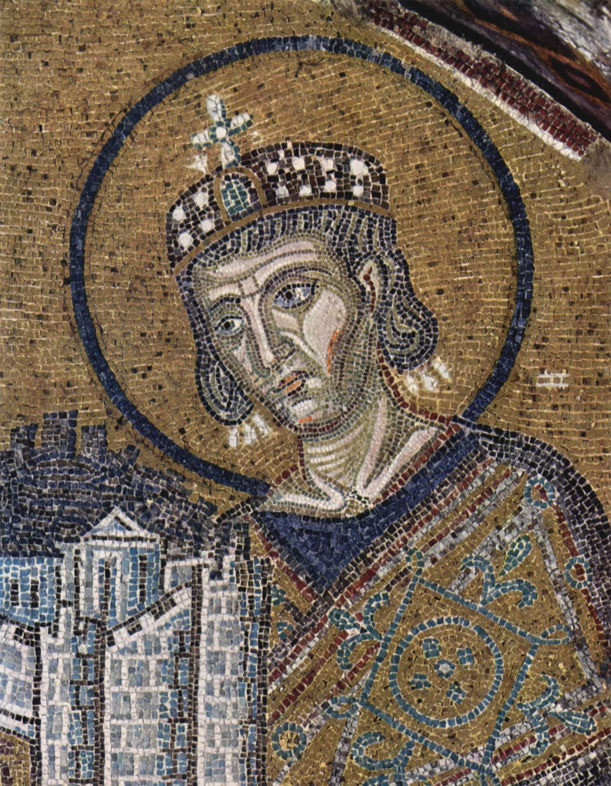
CONSTANTINE

Slide 19
SOCIOLOGY AND THE NEW RELIGION
Thinking patterns of the Empire: A new message joins the old form
Population 250 CE 1.9 % Christian
Population 350 CE 56.5% Christian
Christian Population rose from 6,000,000 in 300 to 10,000,000 in 315
By 380 CE Christianity is the official state religion holding total Authority on the interpretation of Scripture, the Resurrection, the afterlife, and the form of worship
Increase in Christian conversions across all strata of the population makes a Monopoly possible.
Homogenized message and unique product takes over the market

Slide 20
BRANDING
The American Marketing Association defines a brand as a "name, term, sign, symbol or design that identifies the goods and services of one seller and differentiates it from others.
Branding is about getting your prospects to see you as the only service that provides a solution to their problem – the only real choice.
A good brand:
Delivers the message clearly
Confirms its credabiliy
Connects your target prospects emotionally
Motivates the buyer
Solidifies User Loyalty
To succeed in branding you must understand the needs and wants of your customers and prospects.

Slide 21
THE FIRST COUNCIL OF NICEA
325 First Council of Nicaea – First effort to define the product
We believe in one God the Father Almighty, Maker of heaven and earth, and of all things visible and invisible
Constantine presents himself as the Divine Unifier
Invites 1800 Bishops and entourage. east and west. 300 Bishops attend.
Settles the issue of the Trinity - Jesus Divinity
Outlaws Arianism and Donatisism
Four gospels are chosen
Authority and exclusive rights to interpretation of gospels and scriptures awarded to the Church
Establishes Easter as separate date from the Jewish calendar (Passover)

Slide 22
What does the monopoly offer?
One stop shopping for all your spiritual needs
The Official Story – The Official Truth
Salvation, forgiveness and an afterlife all in one place
A guaranteed and well defined after-life (happy, peaceful, everlasting)
Easy rules anyone can follow to achieve the kind of afterlife you want
Answers to all your existential questions – What does it mean? Why are we here? Where are we going and what about death?
Affordable fees; easy to understand contracts – basic do’s and don’ts
Membership open to all .
No more messy sacrifices to endless numbers of Deities - Less time spent in ritual
Classic Vertical Top Down Tiered structure keeps everyone safe and secure

Slide 23
Membership has its privileges.
Get more for less
Instant community and belonging. Fellowship in a bleak world is a precious commodity
Networking material/physical protection – Business connections
Membership provides an instant favorable reputation, credibility and trust (Atheists need not apply for presidency)
Nothing succeeds like success
Why should I believe it?
Monopolies tend to validate their “correctness” This Firm must be good; it’s the only one to chose!
Everyone’s converting. It’s all the proof you need (The more that convert, the more that converts)
Willingness of Christians to go to their deaths. The afterlife must be real!
Giant churches are also proof of truth. Conspicuous consumption of space is proof that a firm is a success

Slide 24
Self knowledge leads to the divine but is it good for business?
2011 Mercedes Benz – 2 door - $135,900.00 - $243,000.00
A pair of Minolo Blahnik shoes – $1595.00
Ticket to the Stanley Cup Playoffs – $2500.
Cost of the Riot to City of Vancouver – approximately $1.8 billion
Apartment at 834 5th Ave – $20 – 30 million
Roman Soldier Outfit- $549 - $1549
Slaves – as low as 500 and up to 6000 Denarii (small silver coin = $50.)
Life - Cheap
Gnosis - Priceless

Slide 25
TODAY
The New Age
Psychology and the Soft Sciences
Evangelical Ministries

