Slide 1
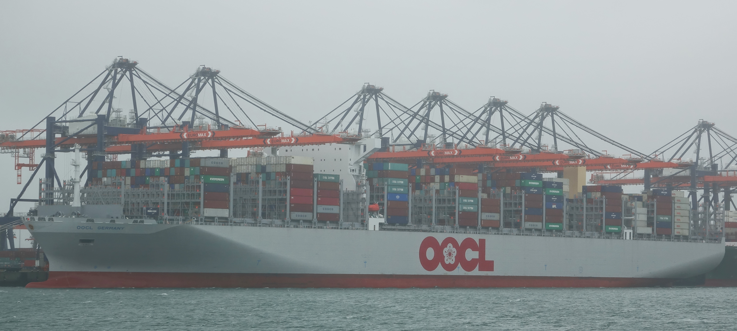
“The World in a Box”
containerization – a journey to facilitate globalization
Diana Leung
One of Six World Biggest Containership in TEU
CC BY-SA 2.0
File:OOCL HONG KONG (36410952374) (cropped) 2.jpg

Slide 2
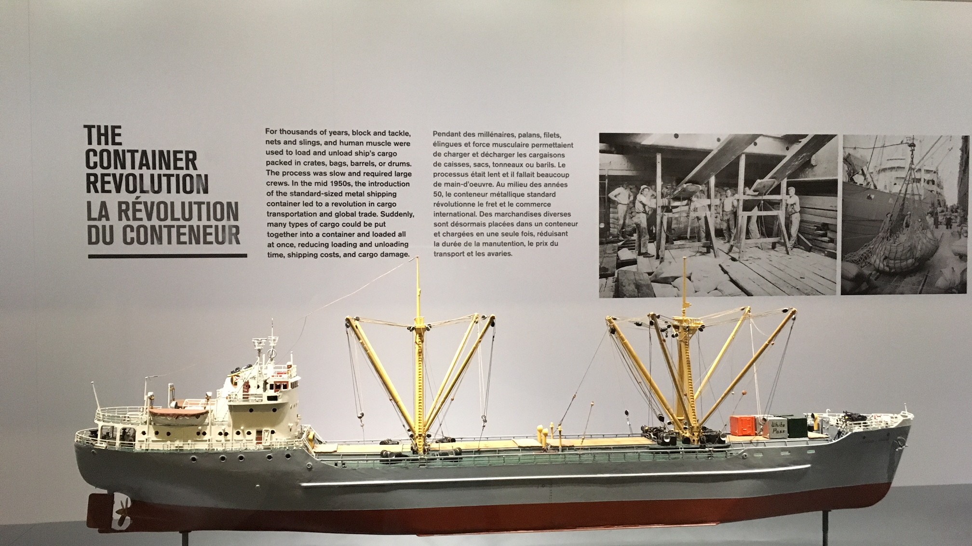
Port of Vancouver Archive
Notes:
Port of Vancouver Archive

Slide 3
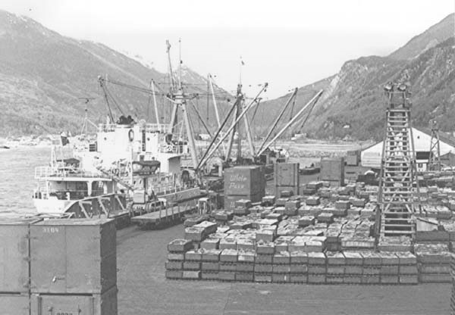
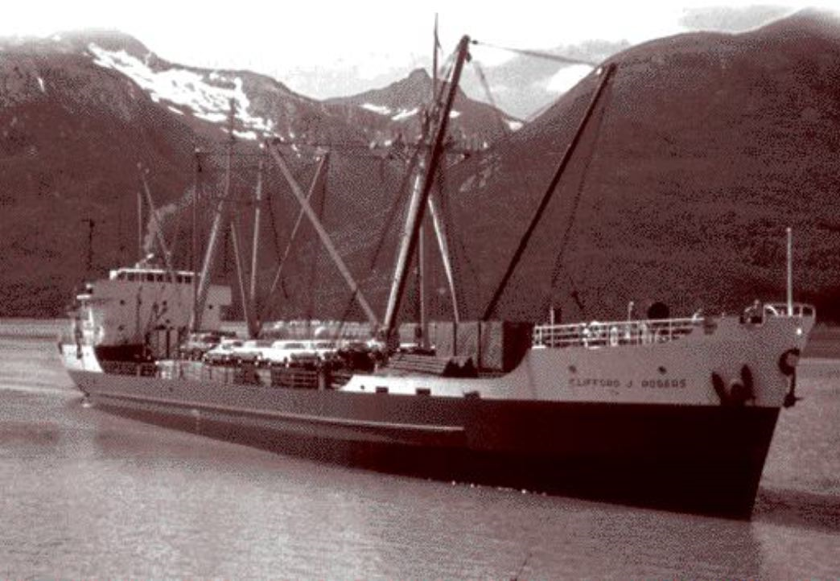
Clifford J. Rogers
Vancouver to Skagway, docking
CLIFFORD J. ROGERS - IMO 5076054
Canadian First: The world's first purpose-built containership
Notes:
https://www.canadianshipper.com/features/the-box-that-transformed-the-world/
http://www.shipspotting.com/gallery/photo.php?lid=1339873
Built by Canadian Vickers Ltd, Montreal, for British Yukon Ocean Services Ltd the Clifford J. Rogers was delivered in 1955. Designed to trade between Vancouver and the Yukon territory she would carry general cargo northbound and palletised lead and zinc concentrates along with containers of asbestos ore southbound. On the basis that she was designed to carry 168 containers, stowed two abrest and three high in the hatch squares, she is sometimes touted as the first deepsea container ship. She was powered by two British Mirrlees 4-cycle engines geared to a single screw. Seen arriving at Tauranga. In 1969 she was renamed Lampsis and in 1972 Drosia. On 11 December 1975, while en route Jamacia to New York with sugar, she sank 90 miles east of Cape Hatteras with the loss of eight crew.

Slide 4
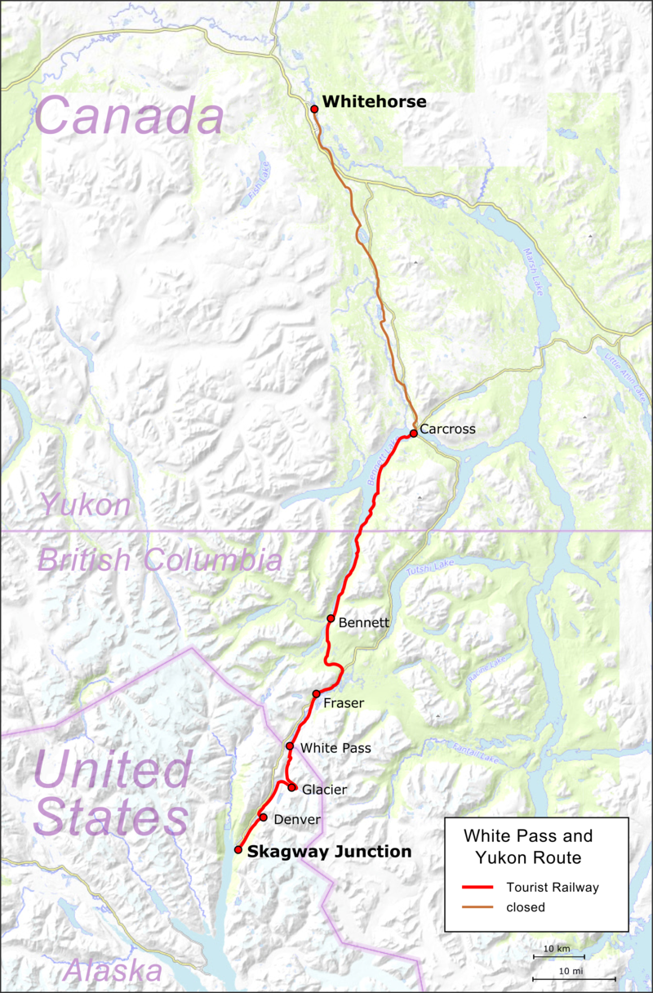
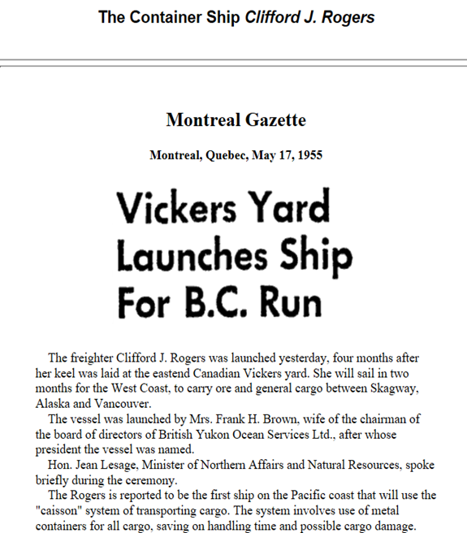
Clifford J. Rogers
The first container ship, November 25, 1955
White Pass and Yukon Route
Built by Canadian Vickers Ltd. Montreal
Supplies for workers in Gold Rush before
Vancouver to Skagway
M.V. Kooringa of Associated Steamships, Melbourne, may have been the first ship designed specifically to carry containers.
Notes:
https://en.wikipedia.org/wiki/Clifford_J._Rodgers
https://en.wikipedia.org/wiki/White_Pass_and_Yukon_Route
The railroad was an early pioneer of intermodal freight traffic, commonly called containerization; advertising of the time referred to it as the Container Route. The WP&YR owned an early container ship (the Clifford J. Rogers, built in 1955), and in 1956 introduced containers, although these were far smaller than the truck-sized containers than came into use in the United States in 1956 and could not readily be handed off to other railroads or ship lines.
http://hougengroup.com/yukon-history/yukon-nuggets/white-pass-the-container-pioneers/

Slide 5
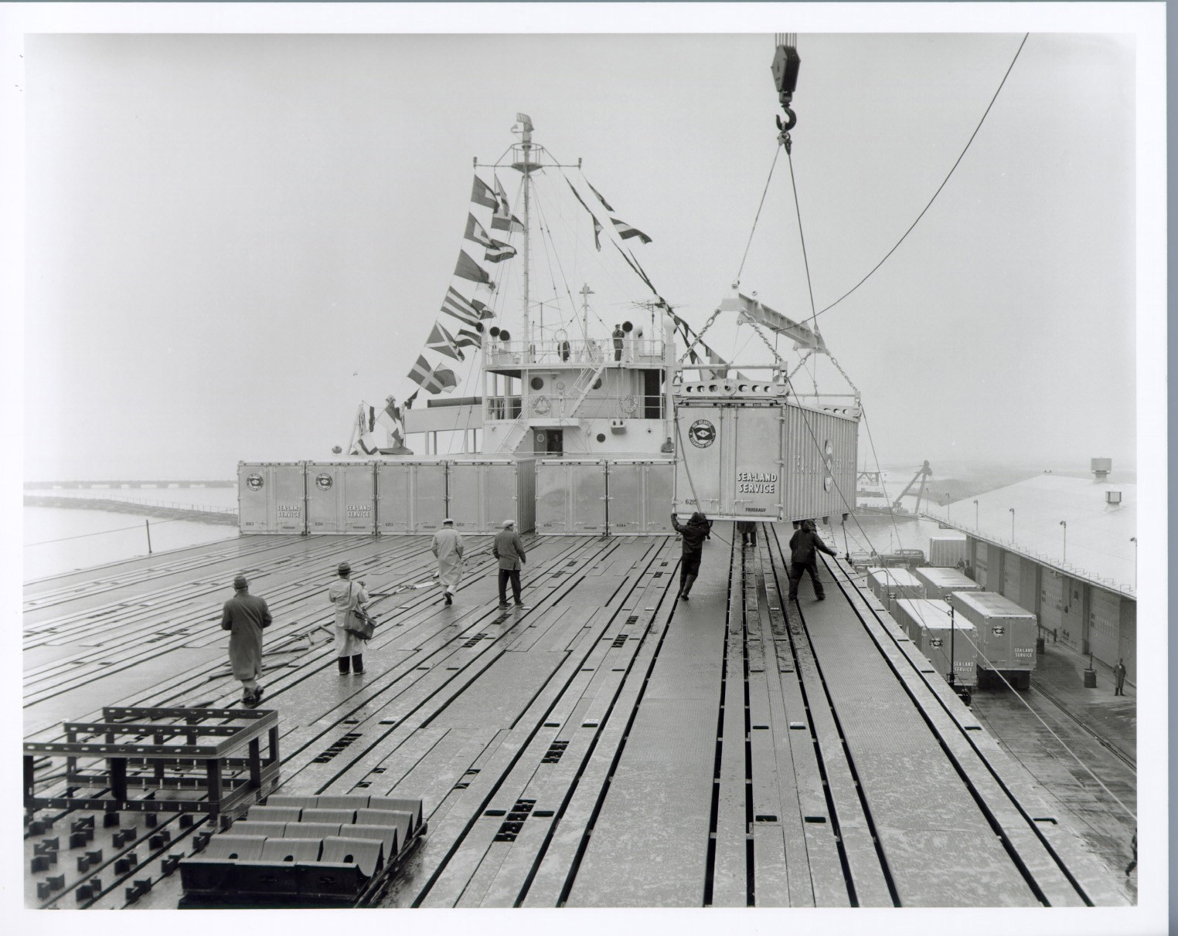
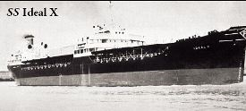
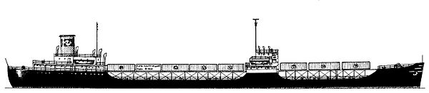
SS Ideal X
First successful container ship
Converted from WWII T2 oil tanker
A spar deck to hold 58 containers, size of truck van
First voyage April 26, 1956 Port of Newark to Port of Houston
Notes:
https://en.wikipedia.org/wiki/SS_Ideal_X

Slide 6
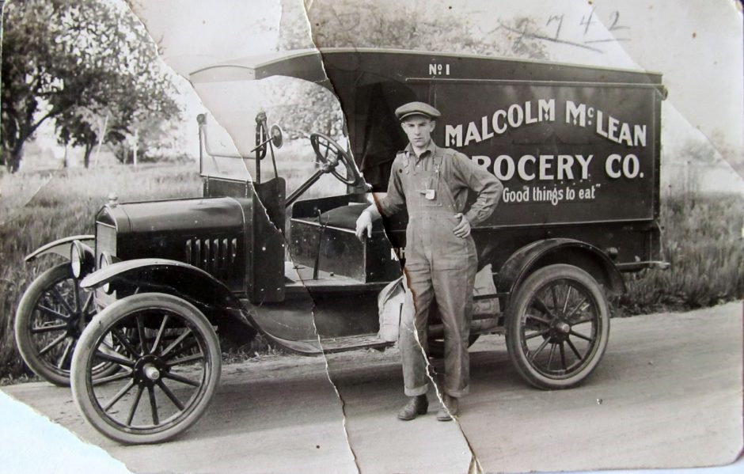
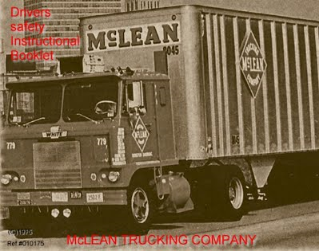
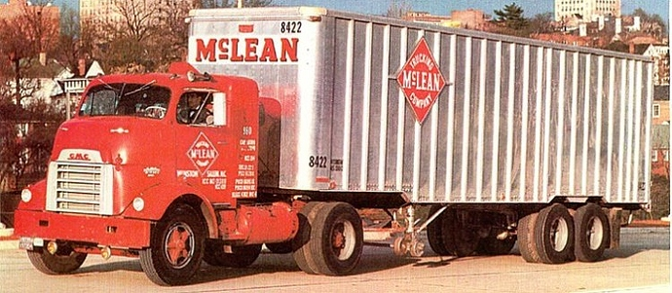
Malcom P. McLean
Truck driver, also owner of the McLean Trucking Co.
Built ops in WWII 10 times up in 6 years
162 trucks, rev. $2.2 m by 1946
Add 600 trucks in 3 years financed by USG
Cost competitive
Notes:
https://en.wikipedia.org/wiki/Malcom_McLean
https://community.intelligentfanatics.com/t/malcom-mclean-the-savior-of-the-shipping-industry/250
https://blog.pcb.ca/2017/02/malcolm-mclean-salute-brilliance-carriers-02-2017/9137
https://www.google.ca/search?q=malcom+mclean+trucks&dcr=0&source=lnms&tbm=isch&sa=X&ved=0ahUKEwjMlIDZ3LfeAhU8GTQIHaXmDrMQ_AUIDigB&biw=1280&bih=571#imgrc=lWQ0_hw5QHz83M:

Slide 7
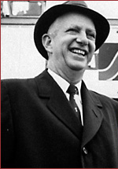
Malcom P. McLean
Developer of intermodal shipping container
Truck-ship arrangement violated ICC – legal battle
1955 net worth: $25 m ($220 m: 2015)
Acquired terminal in Newark via revenue bonds
Waterman Steamship/Pan-Atlantic: complex stock/loan scheme
1913 – 2001
Maxton, North Carolina

Slide 8
Truck to Ship
Developed “trailerships” in 1952, put trucks on ships, but..
Inefficient cargo space used
Ship trailer bodies instead of trailers
Trailer chassis to allow removable container
Mechano decking – wooden shelter below and above deck
Developed improved metal box, revolving cranes, spreader bar, auto hooks, deck extension, not invention
First container sized 35 ft, 8-ft high/8-ft wide
Reduced dock loading cost from $5.86/ton to 16 cents/ton

Slide 9
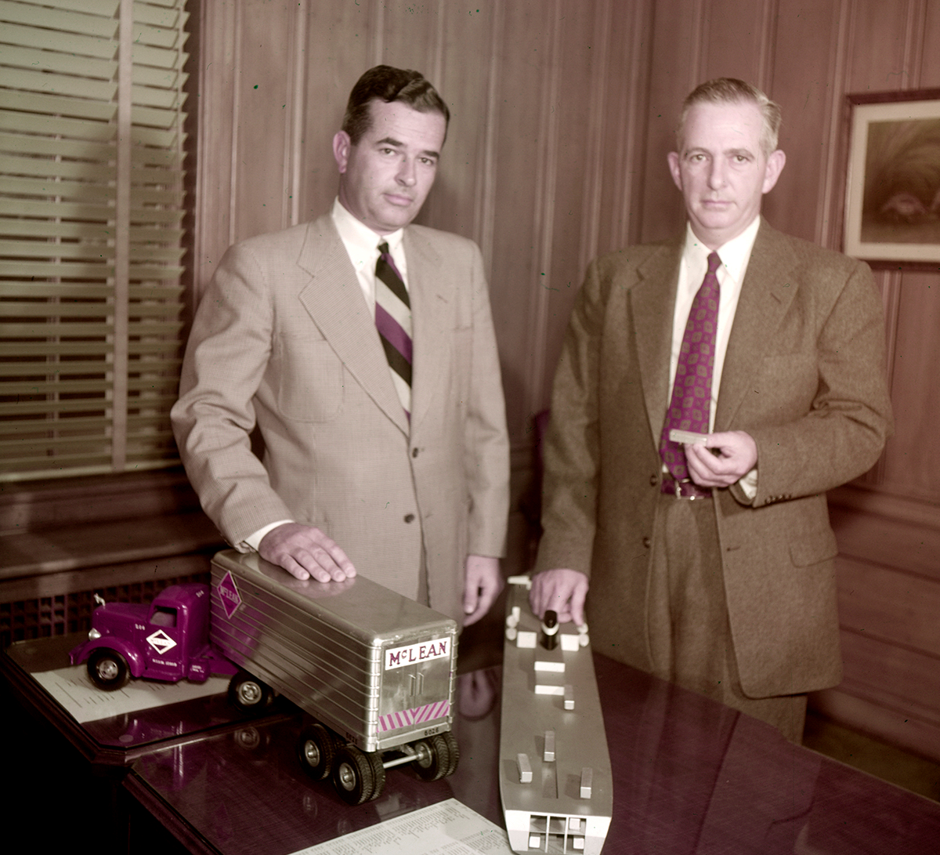
Appeal to ICC
Jim and Malcom McLean demonstrate their shipping plans, Winston-Salem, North Carolina, photo Frank Jones, 1954.
Notes:
https://stories.anmm.gov.au/container/
Reproduced courtesy of Forsyth County Public Library Photograph Collection, North Carolina, USA

Slide 10
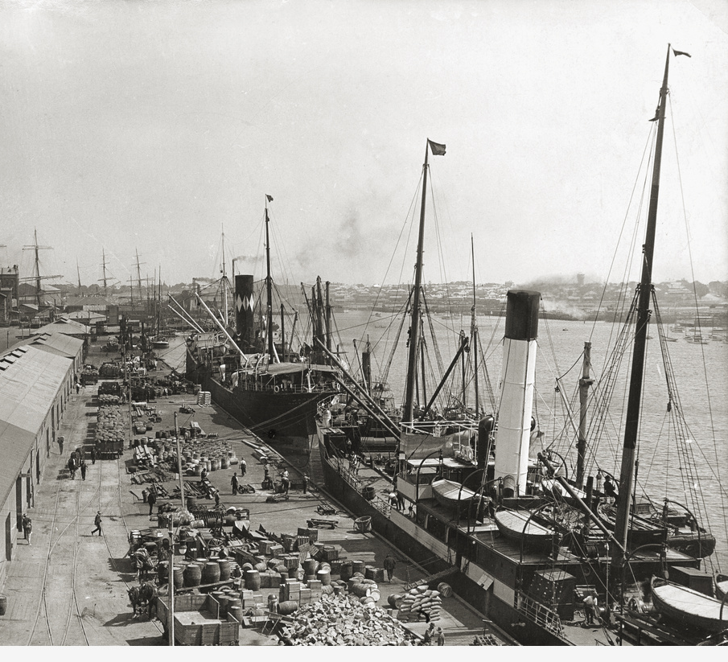
Break Bulk Shipping
Goods loaded individually from dockside to ship
Need goods in ships to be unloaded first
Labour intensive
Need intermediary warehousing
Theft and damage
This Photo by Unknown Author is licensed under CC BY-SA
Notes:
https://en.wikipedia.org/wiki/File:Queens_Wharf,_Port_Adelaide,_before_1927.jpeg

Slide 11
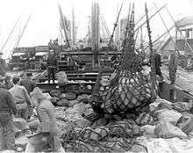
Break Bulk Shipping
Complex Stevedoring
Union Controlled Ports
Longshoreman
Gridlock on the docks

Slide 12
It Is About Moving Cargo, Not Sailing Ships
“A History of containerization”, Donald Fitzgerald:
“Rather than a revolution, containerization of the 1950’s was a chapter in the history of development of maritime cargo transportation.”
Every part of shipping would have to be changed: ports, ships, cranes, storage facilities, trucks, trains, operations of shippers…

Slide 13

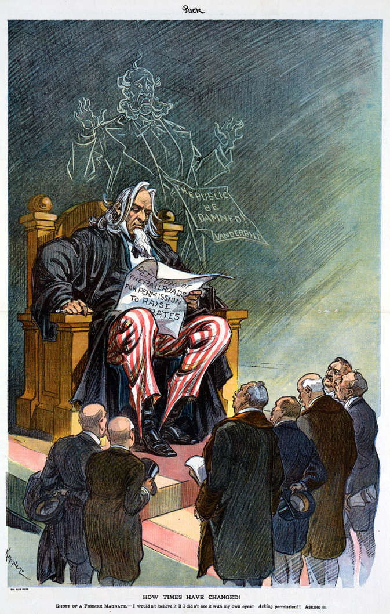
Maritime Industry
Maritime industry subsidised by government
Shipping Lines in cartels: Conferences set freight rates
Ricardo’s wrong assumption zero shipping cost
Ocean freight cost was trade barrier: higher than tariffs – 12%-25% of product, 50% related to port
ICC
Transport efficiency – highly automated standardised
Notes:
https://en.wikipedia.org/wiki/Interstate_Commerce_Commission#/media/File:How_times_have_changed_U._Keppler_1914.jpg
https://en.wikipedia.org/wiki/Interstate_Commerce_Commission

Slide 14
Port Unions
Automation a major labour-relation issue
Non Automation productivity increase 70%-130%
Employers asked to share benefits of automation with unions
Guaranteed annual income from automation, some still valid
Worker dockside skills outdated as container terminals moved away from docks
Transformed jobs outlook forever

Slide 15
American Ports – First 10 Years
Maritime traffic drawn to a small number of very large ports
Established maritime commerce centres became obsolete
Thousands of jobs disappeared
Ports to compete to survive
Required huge port side investments
Large waterfront land
Enormous crane and marshalling yards
Off-dock infrastructure of roads and bridges
Government agencies to manage finance and operation
East Coast v West Coast; New York, Oakland

Slide 16
International Ports
Ports, governments, trade unions around the world watched US in the first ten years
Long distance routes came in 1967
Britain – London, Liverpool, Tilbury, Felixstowe
Europe – Rotterdam, Antwerp, Bremen
Australia – Sydney, Melbourne
Asia – Yokohama, Taiwan, Hong Kong, Singapore
Rise and fall of cities and hinderland

Slide 17
Ship Investments
Large and fast containerships work with dockside cranes
Expensive e.g. 1967-1972 $10 billion ($60B, 2015)
Individual maritime carriers unable to raise finance
Maritime consortia
Conglomerates investments purely for profit, RJ Reynolds
Soon overcapacity
Rate wars

Slide 18
1968
Tet offensive
Assassinations of Robert Kennedy and Martin Luther King
Riots in many US cities
Attempts in Prague to gain some independence
Cultural revolution
Students revolts and in Paris May
“Spring 1968 everything changed”
“There was Germanic spirit in the air, combination of Marxism (early version), Freudian psychoanalysis, and existentialism”.

Slide 19
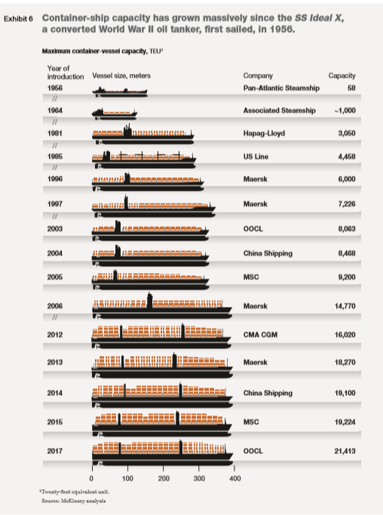
Containership Capacity
1956 to 2017
1966 was infant industry
1969 3,000 TEU
Notes:
file:///C:/Users/DianaLeung/sfuvault/LS812_Poitras/Project/McKinsey-Container-shipping-The-next-50-years-2017_10.pdf

Slide 20
Vietnam War
65,000 U.S. soldiers and marines in South Vietnam in 1965
Lack of deep water ports, port delays, cargo theft, push supply system
Military cargo used unitized packaging, wood pallets, on/off ships
Contracted Malcolm McLean – radical change for containerization
Sea-Land provided container ships, chassis, trucks and terminals at a fixed price, 7 ships in 1967 at $70 million, made Cam Ranh Bay port
1969 supply and feed 540,000 soldiers, containerization was vital war effort
By 1970, 50% military cargos containerized in swift transition
Empty return containers operated at a loss

Slide 21
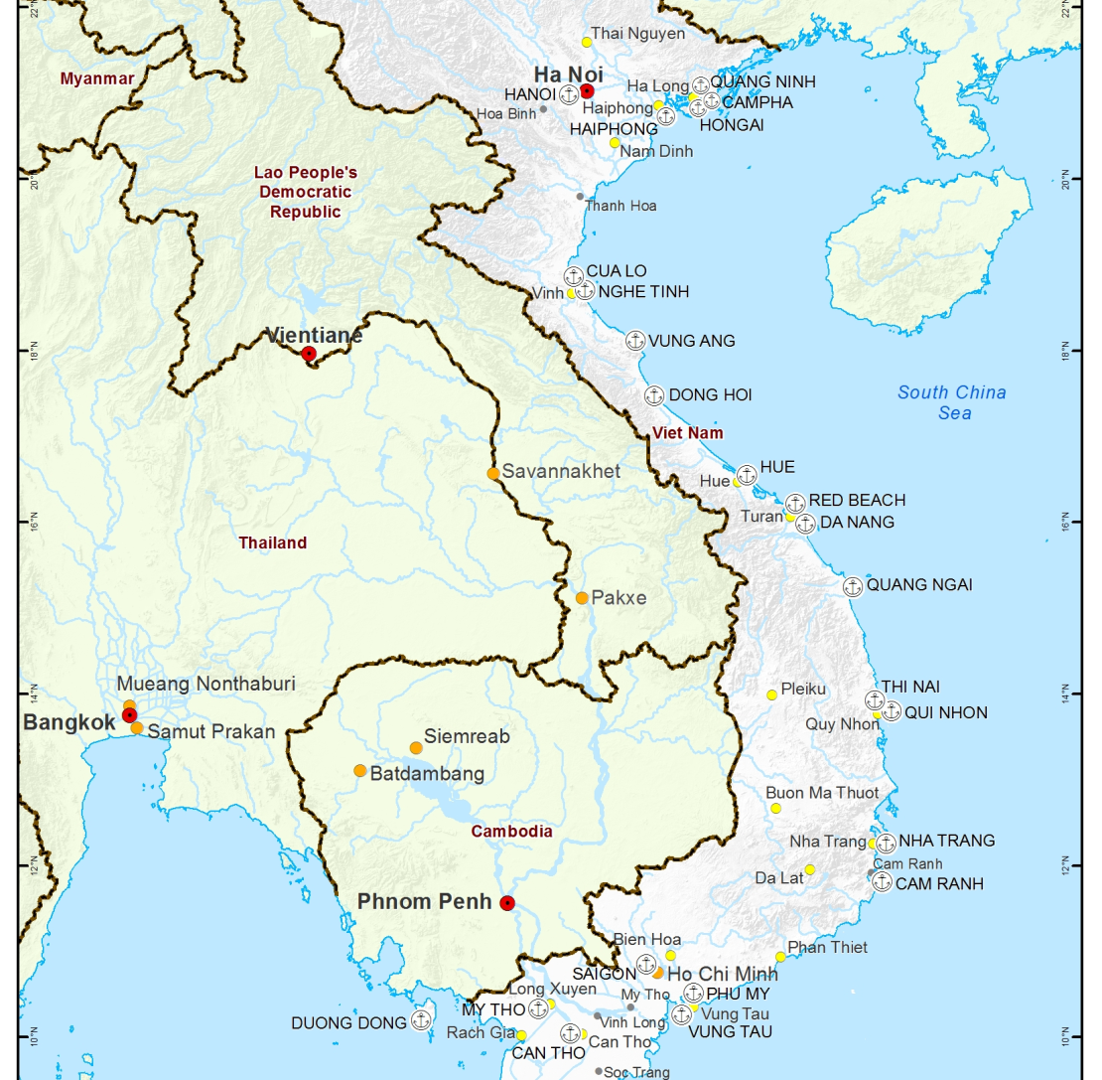
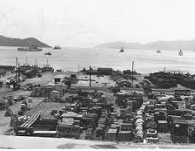
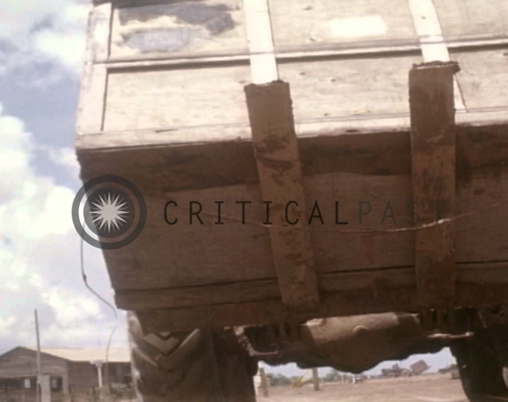
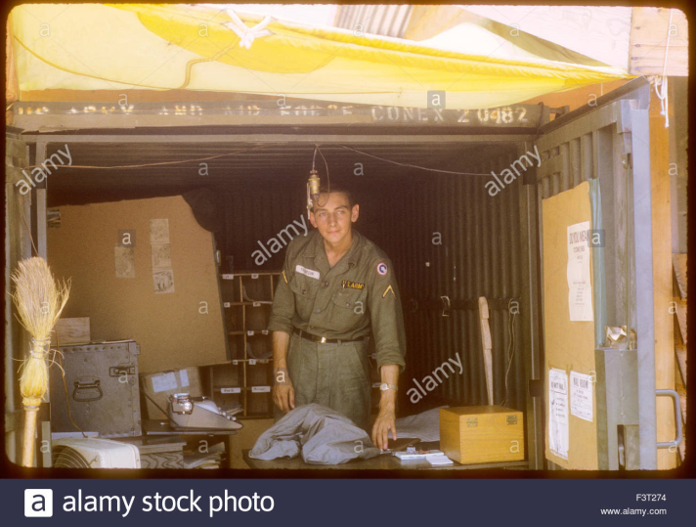
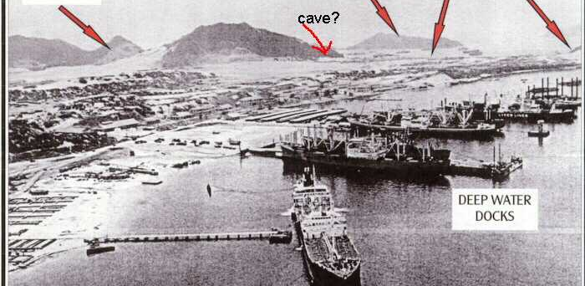
Vietnam War
Vietnam ports
Cam Ranh Bay
In transit cargo Cam Ranh Bay
Containers not returned

Slide 22
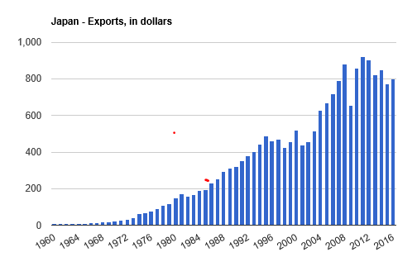
Exports
1969 Japan exports to US surged 21%, 1/3 of all exports containerize
Electronics turned into US everyday items (fragile, high theft)
Television 100% up from 3.5 million in 1971
Korean exports to US treble
Hong Kong foreign trade rose 35%
Taiwan, Singapore exports increased 300%
Australia exports moved away from resourced based economy to industrial based
Entering advanced industrialized culture

Slide 23
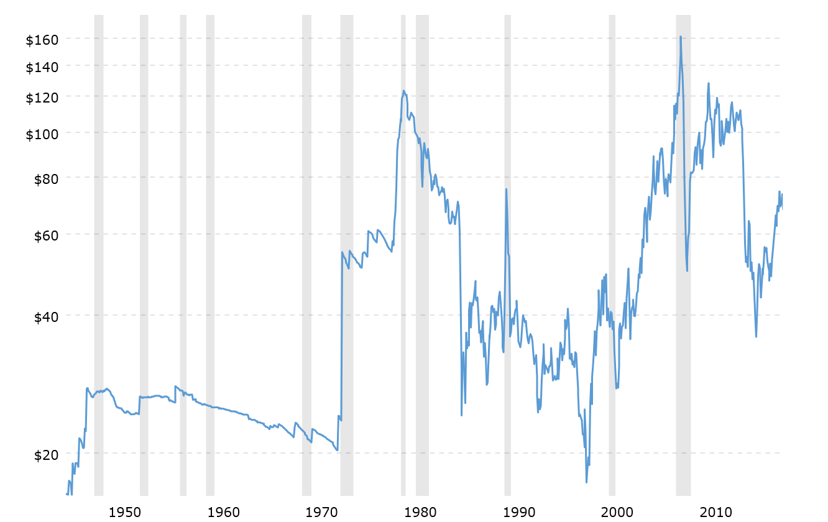
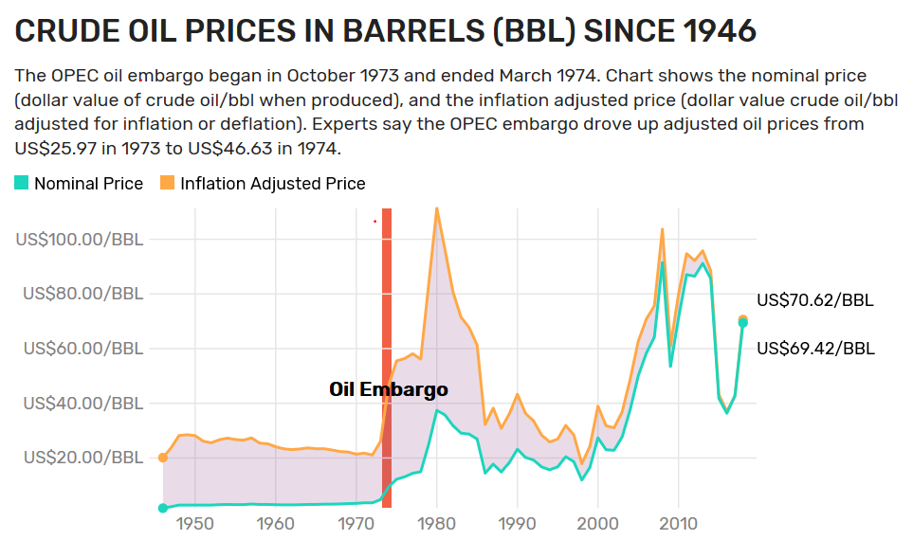
Oil Crisis
143 new containerships in 1972, 1973
Containerised ocean cargos grew 40% 1973
New ships designed for high speed due to Suez canal closure – Arab Israel war - cheap oil then
Sharp rise in oil price increased 25% freight cost
Bunker fuel $22 to $70 per ton. Oil price $3/bbl to $12/bbl
World economy in recession in 1975
Carriers stuck with wrong vessels
Shipping Industry devastated
Notes:
https://www.thebalance.com/opec-oil-embargo-causes-and-effects-of-the-crisis-3305806
https://www.macrotrends.net/1369/crude-oil-price-history-chart

Slide 24
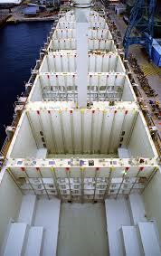
Intermodal Freight
Standardized metal box
Standardised ports gantry system
Intermodal container allows movement in multiple modes of transportation
Trucks – rails – ships
Reduce cargo handling, freight damage
Increase security

Slide 25
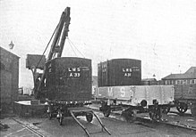
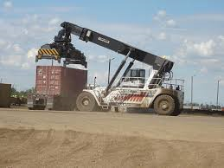
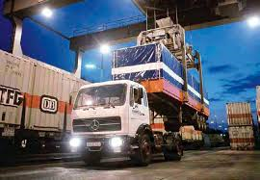
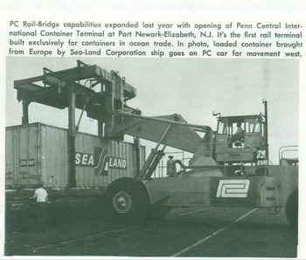
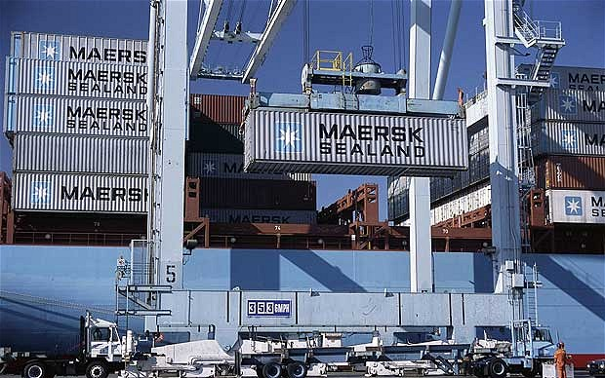
Evolution in Moving the Box
Notes:
https://en.wikipedia.org/wiki/File:LMS_freight_containers_on_lorry_and_rail_wagon_(CJ_Allen,_Steel_Highway,_1928).jpg
http://www.wheelsotime.com/ho-wheels-of-time-limited/

Slide 26
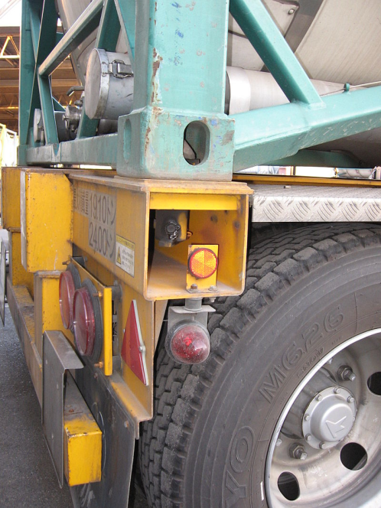
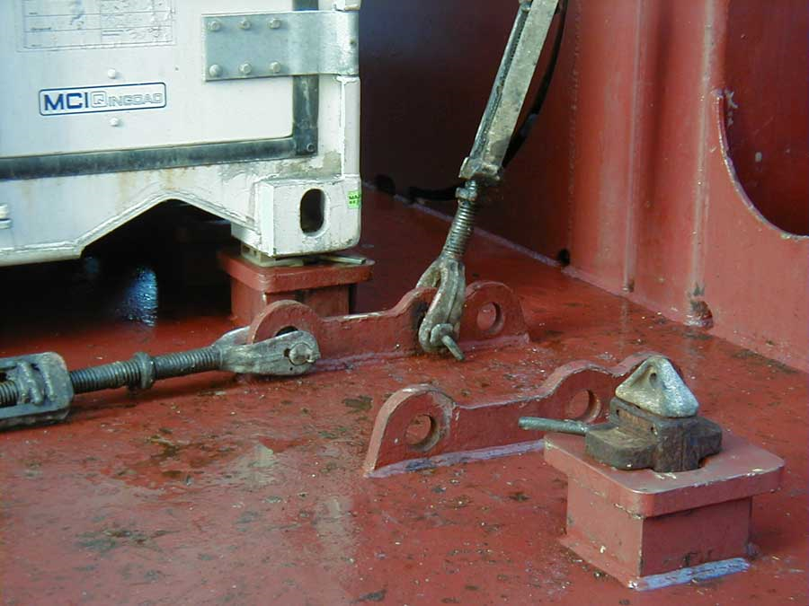
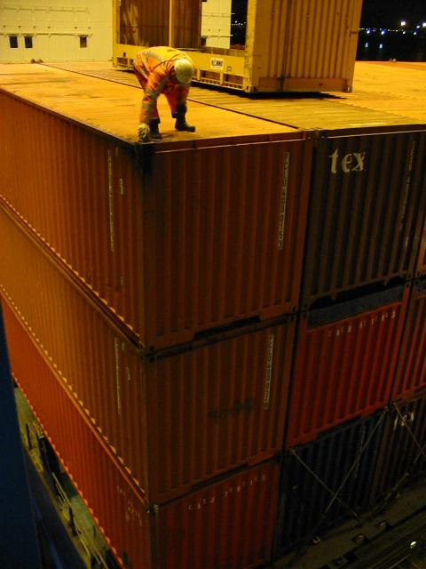
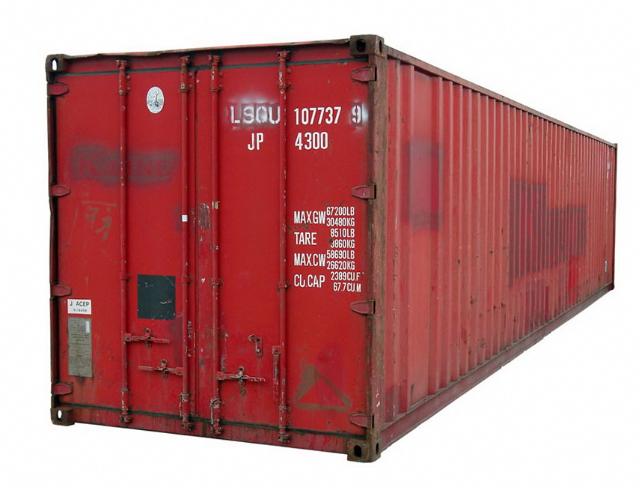
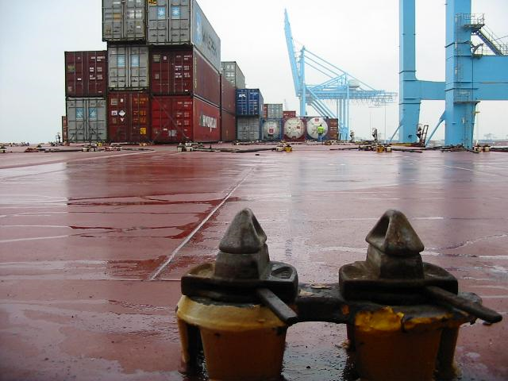
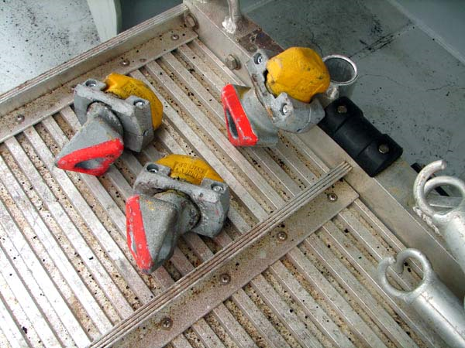
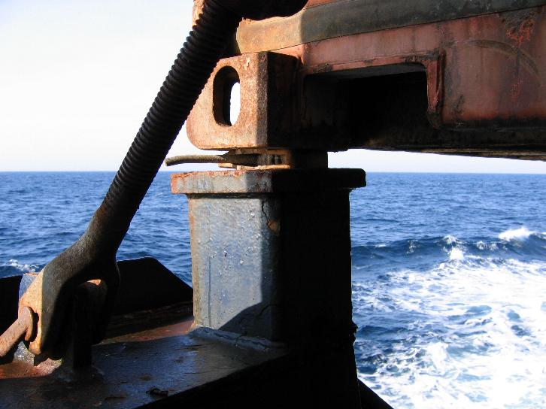
Twist Lock and Corner Casting to Secure Box
e
Lock on base of ship By Hervé Cozanet - http://www.marine-marchande.net/, CC BY-SA 3.0,
Twist lock attachment to trailer Provided by Gazouya under GFDL
Twist lock on deck of container ship http://www.portpictures.nl/
Mid lock - automatic lock when stacked
Notes:
https://en.wikipedia.org/wiki/Twistloc
https://en.wikipedia.org/wiki/Twistlock#/media/File:Container_on_trailer_with_twistlocked.jpg
https://en.wikipedia.org/wiki/Twistlock#/media/File:Automatic_twistlock.jpg
https://en.wikipedia.org/wiki/Twistlock#/media/File:Dockworker_on_a_high_stack_of_containers.jpg
https://en.wikipedia.org/wiki/Twistlock#/media/File:Twistlock_and_lashing_rods.jpg
https://en.wikipedia.org/wiki/Twistlock#/media/File:Container_01_KMJ.jpgk#/media/File:Container_on_trailer_with_twistlocked.jpg

Slide 27
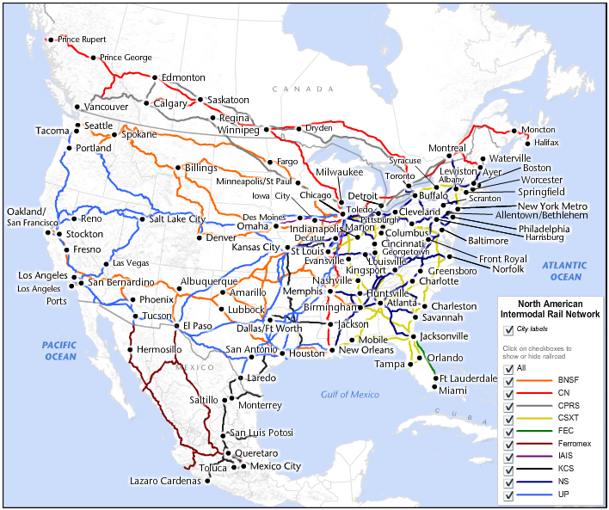
Notes:
https://www.google.ca/search?q=Most+intermodal+terminals+are+clustered+around+major+ports&rlz=1C1CHBD_enCA765CA765&source=lnms&tbm=isch&sa=X&ved=0ahUKEwjE9tqi4dXeAhWLJTQIHVRKAgEQ_AUIDygC&biw=1163&bih=510#imgrc=BQiV_htuPtm0QM:

Slide 28
Railway Terminals
Most intermodal terminals are clustered around major ports
Inland ports - multimodal facilities paired with distribution centers located far from the sea
Trending
Extensive logistics hubs - combine warehousing (often with a foreign-trade zone (FTZ) designation) and distribution with rail intermodal, truck, barge, and in some cases, air freight operations
generate local economic benefits – jobs, taxes, efficiencies
Notes:
http://newharborllc.com/2016/08/05/inland-ports-on-track-for-growth/

Slide 29
Maritime Economics
Break bulk – operating costs
Containership – high fixed costs
Every cargo carries spread out fixed costs
Mortgage payments - need cash flow
Port lease charges
Fuel efficiency
Big ships -> big ports -> big cranes -> fast turnaround logistics

Slide 30
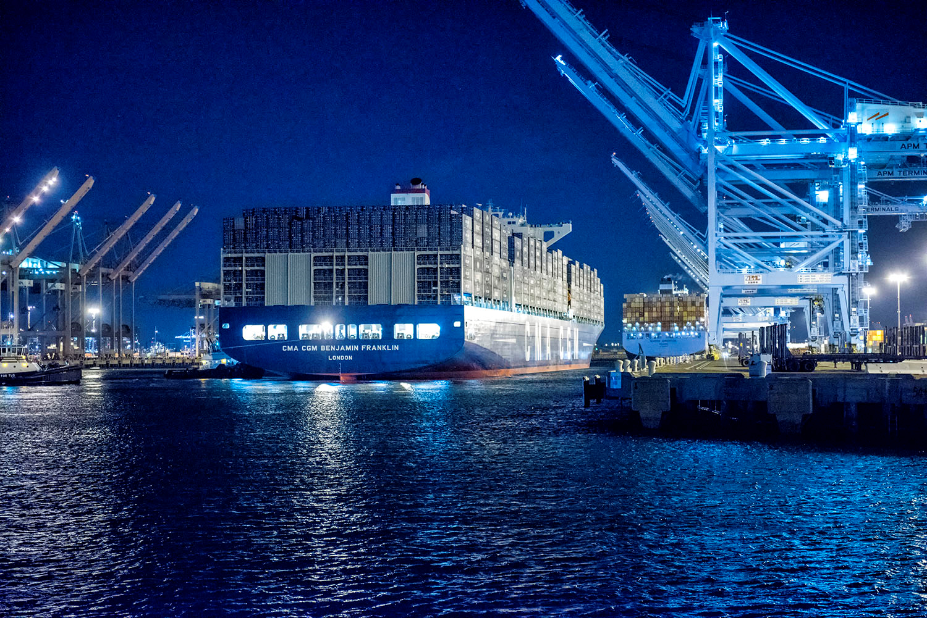
Ll
ll
Notes:
https://upload.wikimedia.org/wikipedia/commons/0/05/CMA_CGM_Benjamin_Franklin.jpeg

Slide 31
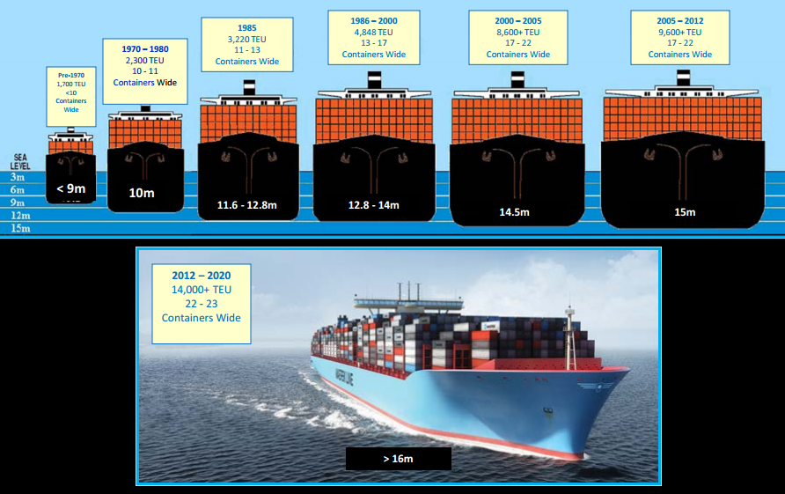

Slide 32
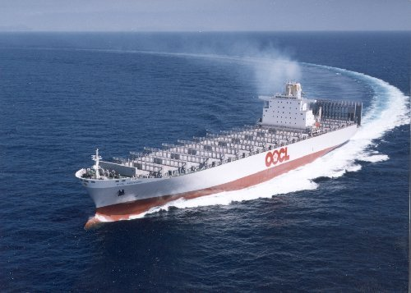

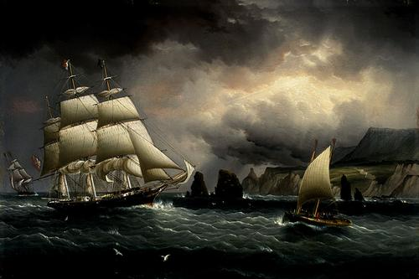
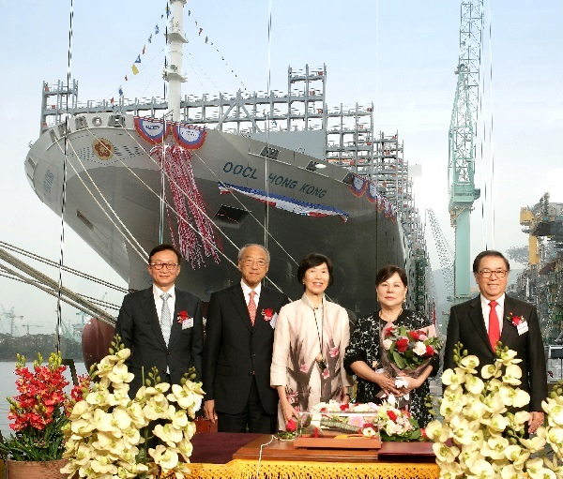
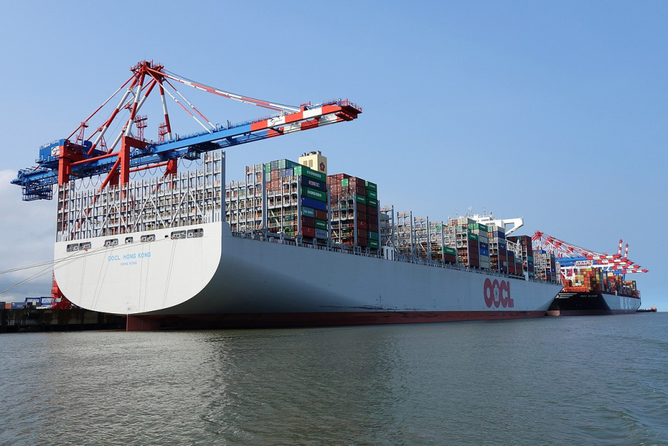
Ships
ULCS – Ultra Large Container Ship
OOCL Hong Kong
Why so big?
Maiden voyage of HK registered ship after return to China
Notes:
https://www.maritime-executive.com/editorials/snapshot-the-world-s-ultra-large-container-ship-fleet
https://www.championfreight.co.nz/largest-container-ship
https://safety4sea.com/msc-mega-container-ships-to-feature-23000-teus/
https://en.wikipedia.org/wiki/OOCL_Hong_Kong#/media/File:OOCL_HONG_KONG_1674.jpg
https://www.mardep.gov.hk/en/publication/pressrel/pr970909.html
https://www.oocl.com/eng/pressandmedia/pressreleases/2017/Pages/12may17.aspx
https://en.wikipedia.org/wiki/Maritime_history#/media/File:Buttersworth_-_flying_cloud.jpg

Slide 33
Reorganising Cities
Sea freight volume increased
Freight rates decreased
Consumer goods: import replaced domestic, prices decline, 0 inflation
Cities rise and fall with containerization in major ports in differ time
New ports sprout out: Busan, Charleston, Le Havre, Chittagong, Haiphong, Colombo, Salalah, Shenzhen, Zhoushan (exports)
Global alliances of shipping companies dominated success of ports
Business locations in turn dominated by access to ports

Slide 34
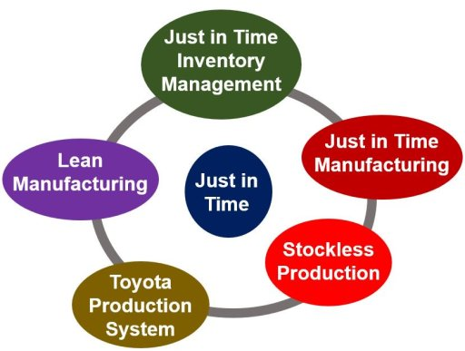
JIT Just In Time Production
Toyota’s concept in 1980 to eliminate large inventories for efficiency
Suppliers specialised in narrow components with precision
Narrow time windows delivery -> low margin of errors
Brought concept to GM in 1984
Logistics Management in 1985 scheduling production, storage, transportation and delivery
Transformed transportation to on time delivery
Evolved as management concept of minimum wastes: time etc.
Notes:
https://www.ifm.eng.cam.ac.uk/research/dstools/jit-just-in-time-manufacturing/

Slide 35


Global Supply Chain
Retailers manage own supply chain, cutting out wholesalers
Enabled by modern communication and container shipping
Designer shirt: retailer design, Thailand labour, Chinese fabric, American cotton, Malaysian buttons with Taiwanese plastics, Japanese zippers, embroiled decorations in Indonesia
Retailers like Walmart or Dell: business strategies around moving goods from factory floor to customers with minimal time in between
Inventories reduction saved US business $100 billion p.a.
Transportation was a trade barrier

Slide 36
Globalization Changed Characteristics
International trade dominated by intermediary goods
Goods partially processed in one place to be further processed in another place
In bound containers orchestrated by Distribution Centre
No warehousing
Focus most economic location for each part of the process
Low transportation costs remove trade barrier
Jeopardise local production employment
Notes:
Cudahy, Box Boats, P170
Levinson, P355-374

Slide 37
Globalization and Inequality of Nations
Globalization – close integration of world markets
Paul Krugman, “Globalization and the Inequality of Nations, divergent->convergent model:
“At high transport costs all countries have some manufacturing, but when transport costs fall below a critical value a core-periphery pattern spontaneously forms, and nations that find themselves in the periphery suffer a decline in real income. At still lower transport costs there is convergence of real incomes, in which peripheral nations gain and core nations may lose.”

Slide 38
Materialism and Happiness
Marcuse: the working class is victim of capitalist’s brain washing in false needs, and fulfil them. Freedom is a mirage. Life is alienation. Repressive desublimation leads to self satisfied conformity
Schmitt: sense of purpose and meaning of life came from belonging to a community; capitalism destroys national cultural distinctiveness as it treats individuals as consumers and producers
Freyer: capitalism creates more and more choices but without providing us with shared criteria for choosing. More and more life lose connection with shared national particular culture and shared collective purpose. Capitalism and technology has no respect of national border. Pursue with individual choices leads to a decline of community.
Humanity absorbed into rationalised order of objective relations and economic trading companies
Capitalism does not bring higher meaning in life as it lacks collective purpose, therefore happiness is superficial.

Slide 39
Port Automation
Fully electric, from the Automated Guided Vehicles (AGVs) to the quay cranes
Powered by wind turbine
Container cranes unmanned – fully automated
Drone ships
Robotic
Sustainable

Slide 40
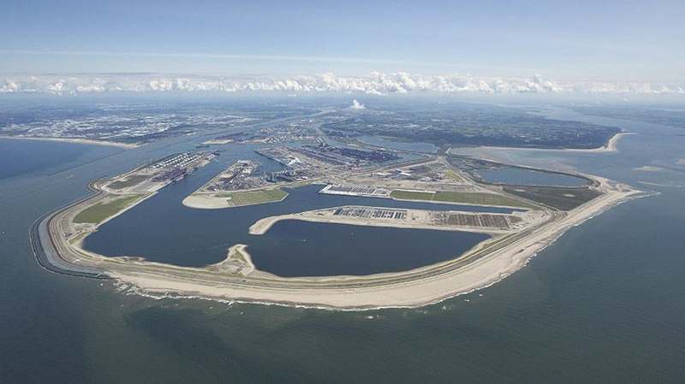
Notes:
https://www.google.ca/search?q=maasvlakte+2&rlz=1C1CHBD_enCA765CA765&tbm=isch&tbo=u&source=univ&sa=X&ved=2ahUKEwiDzKbJ6dXeAhWoIjQIHXAhB9wQiR56BAgGEBM&biw=1163&bih=510#imgrc=h1GB9tlQIb7_SM:

Slide 41
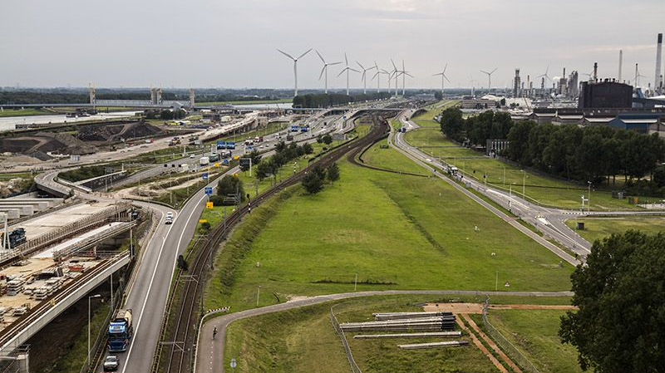
Notes:
https://www.portofrotterdam.com/en/our-port/our-themes/a-sustainable-port/maasvlakte-2

Slide 42

Notes:
https://www.rethinkrobotics.com/sawyer/

Slide 43
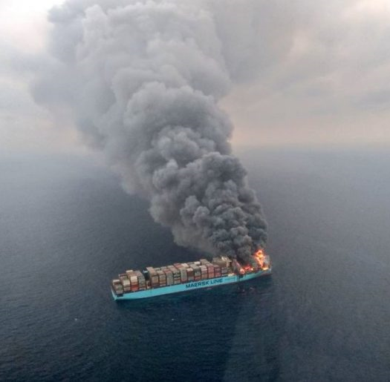




Disasters
Hyundai Fortune – Gulf of Aden, 2006
MSC Napoli – English Channel, 2007
Rena – New Zealand, 2011
MOL Comfort – Indian Ocean, 2013
Maersk Honam – Arabian Sea, 2018
Notes:
https://www.vesselfinder.com/news/9694-Dramatic-Drop-in-Containers-Lost-at-Sea

Slide 44

Environmental Challenges
Worsen climate Change – bunker and fuel
Endanger marine mammals and ocean lives
Pollution and oil spills
Deep dredging seabed – ecological harm
Container trucking issues on road and city
Terminal congestion
Water front property
Urban planning, bridges and tunnels

Slide 45
Emerging Maritime Administrative Systems
Emerging Blockchain technology
Paperless trading transactions
Smart contracts embedded LC and ports documents as part of software
As a secured, decentralised and encrypted public ledger, while transparent
Canadian Border Services begins Testing digitizing containers-trace – create a singular, trusted digital supply chain for all shipments entering Canada, with Port of Montreal, end of year
Reduce transit time by 40%
EY Maritime blockchain insurance technology
Bitcoins – for offshore flags, countries with currencies restrictions, inaccessible to bank loans, began January 2018
Notes:
https://opensea.pro/blog/blockchain-for-shipping-industry
https://www.coindesk.com/eys-maritime-blockchain-insurance-tech-is-now-live/
https://www.coindesk.com/canadian-border-services-begins-testing-ibm-blockchain-for-shipping/

Slide 46

One Belt One Road
Maritime Silk Road
This Photo by Unknown Author is licensed under CC BY-SA
Notes:
https://upload.wikimedia.org/wikipedia/commons/c/cb/One-belt-one-road.svg
https://en.wikipedia.org/wiki/Belt_and_Road_Initiative

Slide 47

Busiest Container Ports

Slide 48


BC Terminals
Fairview Terminal Prince Rupert
Roberts Bank Terminal 2 Proposed

Slide 49
Reference
The Box. How the Shipping Container Made the World Smaller and the World Economy Bigger. Second Edition. Marc Levinson. Princeton University Press. 2016
Box Boats. How Container Ships Changed the World. Brian J. Cudahy. Fordham University Press. 2006
Container Shipping: The Next 50 Years. Travel, Transport and Logistics. Steve Saxon, Matt Stone. McKinsey & Company, October 2017.
Globalization and the Inequality of Nations. Paul Krugman, Anthony J. Venables. National Bureau of Economic Research. April 1995
Maritime Economics, Martin Stopford, Harper Collins, 1988
Container: The Box That Changed the World. Dr Mary-Elizabeth Andrews. Australian Maritime National Museum. Link: https://stories.anmm.gov.au/container/
Intermodal Industry Overview: History of Container and Intermodal Industry. TRAC Intermodal

Slide 50
Links
https://en.wikipedia.org/wiki/Container_ship
http://www.edgehillstation.co.uk/resources/the-dockers-umbrella-a-history-of-liverpool-overhead-railway/
https://www.vesselfinder.com/news/9694-Dramatic-Drop-in-Containers-Lost-at-Sea
https://www.marinetraffic.com/en/ais/home/centerx:-12.0/centery:25.0/zoom:2
https://en.wikipedia.org/wiki/List_of_largest_container_ships
https://safety4sea.com/msc-mega-container-ships-to-feature-23000-teus/
https://www.portoflosangeles.org/
https://en.wikipedia.org/wiki/Port_of_Los_Angeles
https://www.ecfr.eu/publications/summary/blue_china_navigating_the_maritime_silk_road_to_europe
https://en.wikipedia.org/wiki/Belt_and_Road_Initiative
https://unctad.org/en/Pages/Publications/Review-of-Maritime-Transport-(Series).aspx

