Slide 1
Faith and Science
Mat Burke

Slide 2

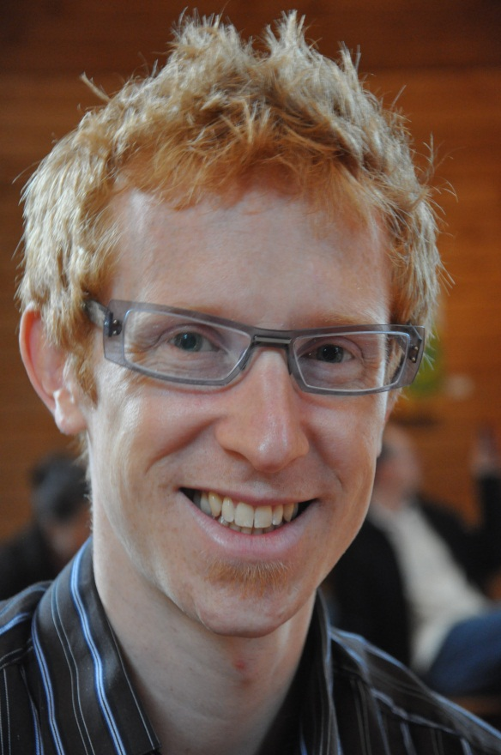
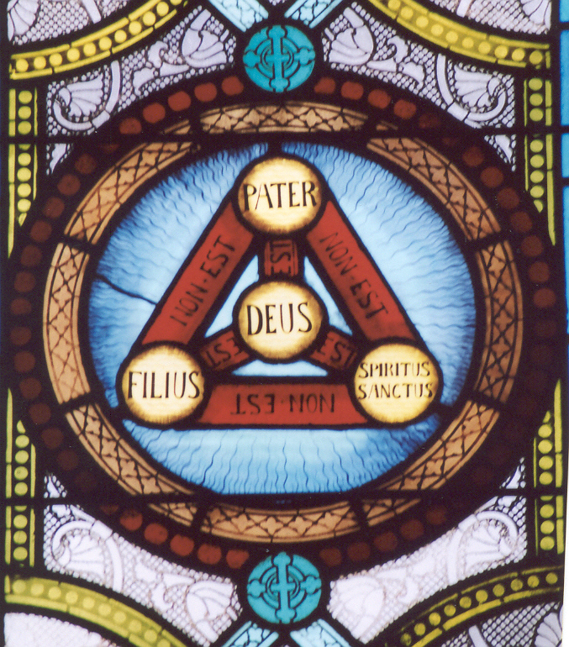
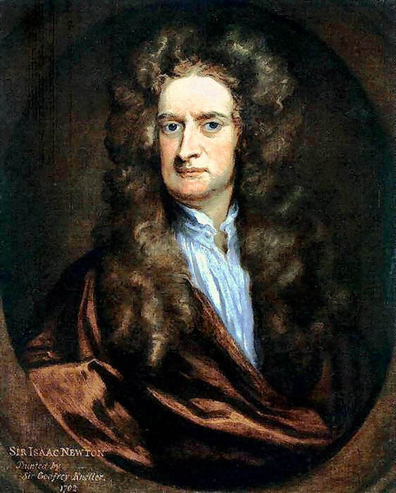
Go ahead, follow your passion
Notes:
Geoff said we could really do what we wanted with this presentation and could follow our passions. I decided to indulge and pursued three different courses, all of great interest to me but not necessarily thematic together
The early history of my own faith, Unitarianism
Dogmatic arguments about the trinity (the rejection of which ultimately led to my own faith). We’ll track it before Nicaea, talk about the Nicene creed, through the reformation and beyond.
How scientists and rationalists develop their own religious views
We’ll talk through the trinity doctrine and specific tweaks as we explore the rise of the Unitiarian faith
Afterwards we’ll talk about the faith of certain scientists until we run out of time.
The “Rationalist Unitarianism” I subscribe to stemmed from the “biblical Unitarianism” which ultimately began with a rejection of Trinitarianism

Slide 3
Unitarianism
Religion | millions
Roman Catholic Church | 989
Pentecostalism | 450
Russian Orthodox Church | 90
Anglican Communion | 77
Lutheran Church | 48
Presbyterian Church | 48
Ethiopian Orthodox Christian Church | 45
Baptist Church | 37
Methodism | 33
Jehovah's Witnesses | 16
Seventh-day Adventist Church | 16
Church of Jesus Christ of Latter-day Saints | 13
New Apostolic Church | 9
Apostolic Church | 6
Congregational Christian Church | 2.2
Plymouth Brethren | 1
Mennonite Church | 1
Unitarian Universalism | 0.6
Church of Christ, Scientist | 0.4
Religious Society of Friends | 0.3
Barely 0.03% of Christianity
Notes:
In terms of size, it’s tiny, making up only .03% of Christianity.

Slide 4
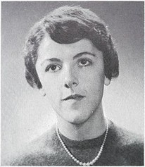
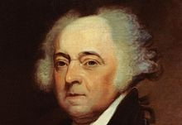
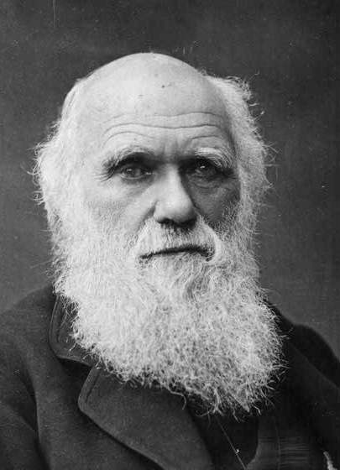
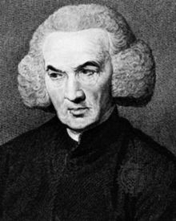
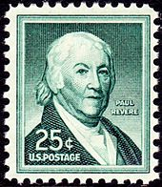
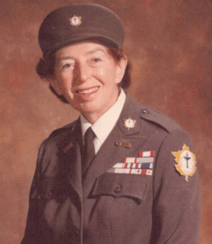
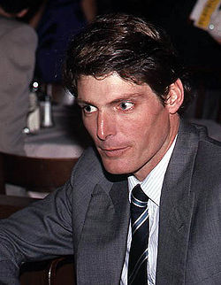
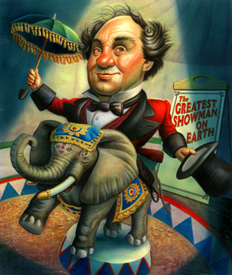
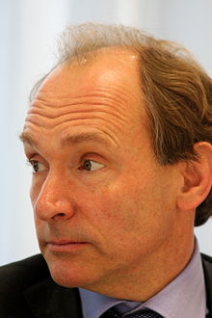
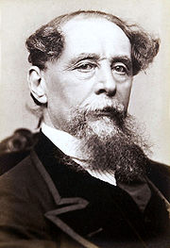
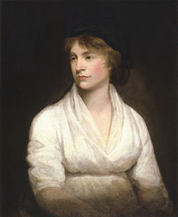
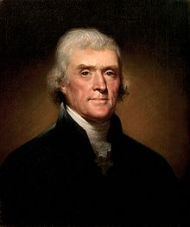
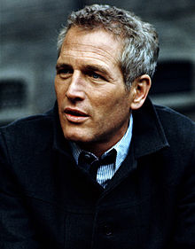
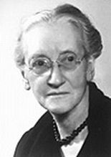
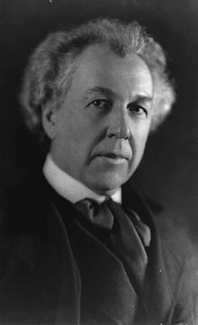
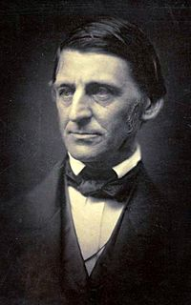
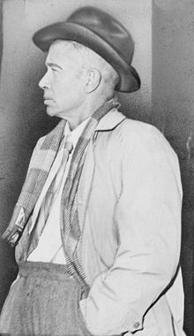
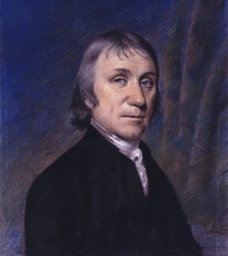
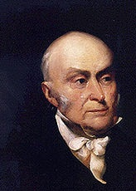
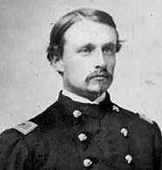
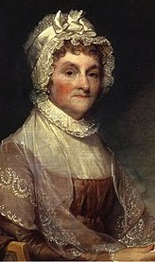
Unitarianism
Notes:
It’s mighty, though
Activists -- Robert Gould Shaw – first man to lead a black troup, Lotta Hitschmanova (Unitarian Service Committee), Paul Revere (midnight ride) , Roger Nash Baldwin (founded american civil liberties union), Emily Greene Balch (Nobel Peace for Women’s International Leage for Peace and Freedom)
US Presidents – John Adams, John Quincy Adams, Thomas Jefferson, William Howard Taft
Scientists and Philosophers – Tim Berners-Lee (WWW inventor), Richard Price, Jason Priestly, Charles Darwin
Writers – Charles Dickens, Mary Wollstonecraft, Ralph Waldo Emerson
Entertainer – Paul Newman, Christopher Reeve, PT Barnum
Architects - Frank Lloyd Wright
Ann Dunham, Barack Obama’s mother

Slide 5
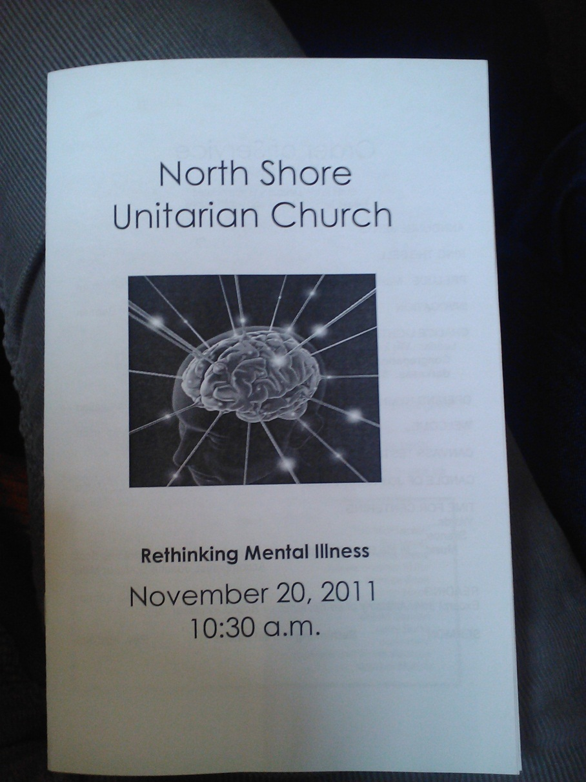
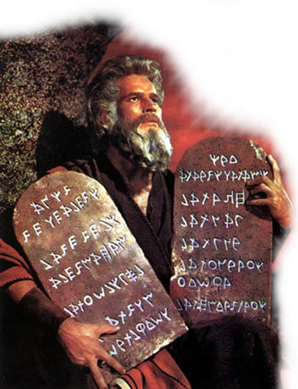
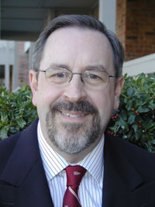
Principles of Unitarianism
We affirm and promote:
The inherent worth and dignity of every person;
Justice, equity and compassion in human relations;
Acceptance of one another and encouragement to spiritual growth in our congregations;
A free and responsible search for truth and meaning;
The right of conscience and the use of the democratic process within our congregations and in society at large;
The goal of world community with peace, liberty and justice for all;
Respect for the interdependent web of all existence of which we are a part
Notes:
THEOLOGY
A second/third generation Reformation sect.
In the form I know it, it’s a dogma-free liberal religion with no central creed. Really, it’s more of a social justice club than a religion. There are no Bibles. Instead there are seven principles _suggested_ by the central body.
It draws thinkers, activists, lawyers, doctors.
One, each person is worthwhile
Two, be kind in all you do
Three, we help each other learn
Four, in search for what is true
Five, all people have a say
Six, work for a peaceful world
Seven, the web of life’s the way
That will bring us back to Me & UU!

Slide 6
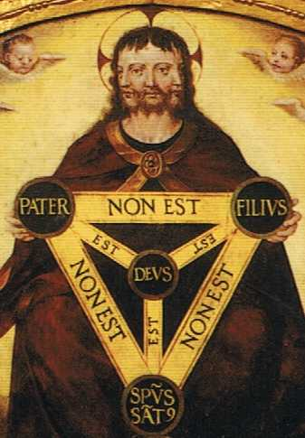
Now, we turn to the trinity
Go, therefore, and make disciples of all nations, baptizing them in the name of the Father, and of the Son, and of the Holy Spirit
Matthew 28:19 KJB
Notes:
SING: a hymn about the trinity. There is no Rose.
The Trinity is the central doctrine that God exists as the Son, Father, and Holy Ghost/Spirit. Three persons, one God. They are distinct yet eternally co-exist and are co-equal. It is considered a mystery of Christianity.
The Shield of the Trinity is a graphic reminder.
The next phase of the presentation will delve into the history of the Trinity, review the events of Nicaea, and discuss how the Reformation affected the Trinitarian doctrines
=============
PIC: Jeronimo Cosida's Trinity Spain, c. 1570
Holding the “shield of the trinity” Scutum Fidei

Slide 7
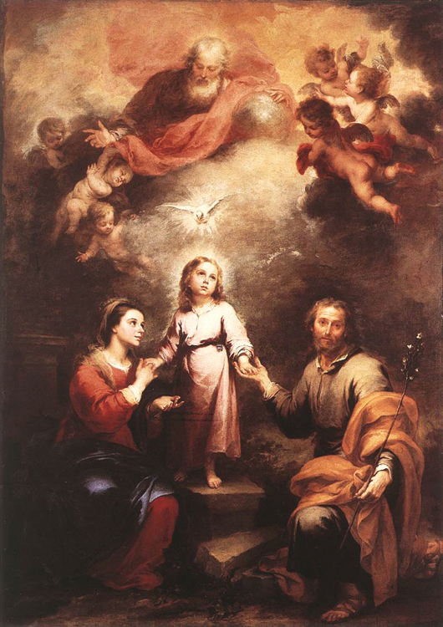
Trinity in the early Church
Christianity began within Judaism
“Christ”, Greek for Messiah
Anointed One who will lead to time of universal peace (Talmud)
A leader sent by God, but not necessarily God-like
Notes:
Trinity as an idea took a while to get going. Very unlikely that the original Christians subscribed to the idea.
Christianity began as a movement within Judaism, whose adherents viewed Jesus as a messiah (Greek word is “Christ”) – a man sent by god but a man nonetheless. To attribute God-ness to someone other than God would transgress the monotheistic Oneness of God
Matthew’s baptism in the name of the three persons was almost certainly added later. Biblical historians and an eyewitness (Eusebius of Caesaria) indicate it was baptism in the name of christ.
PIC: The Heavenly and Earthly Trinities about 1675-82, Bartolomé Esteban Murillo

Slide 8
Trinity in the early Church
The Word became flesh and made his dwelling among us … [the] Son, who came from the Father …. John 1:14
Word = Logos = Holy Sprit. Divine principle regulating all things
Competing ideas: Gnosticism, Adoptionism, Sabellianism, Arianism, Trinitarianism
Is there one God, two, or three?!? Uh oh!
Notes:
As Christianity spread beyond its Judaic roots, Greek philosophy (Hellenism) became more invested.
Three layers of existence – Heaven spirit world, Creation.
Logos was a 600-year-old Greek idea of a divine force or principle that regulated all things. Naturally led to suppositions about Christ’s divinity. Over three hundred years, competing views develop. The Bible is very clear on the one-ness of God
Gnostics – not human, only appeared to be human
Adoptionism –Christ was an ordinary human who became the Son of God at his baptism
Sabellianism – all three are “modes” of one God we humans encounter. Essentially, a Oneness view
Arianism – Father came before Son, Holy Spirit was distinct
By 4th century, church hierarchy had developed, persecutions had abated for the moment, and attempts were made to iron things out
===============
Homoousios = consubstantial = “of the same being”
No Latin active present ὁμοούσιοι).
Isaiah 7:14 Hebrew “almah” could mean virgin or “young woman”.
PIC: The Heavenly and Earthly Trinities about 1675-82, Bartolomé Esteban Murillo

Slide 9
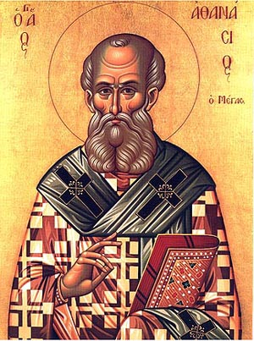
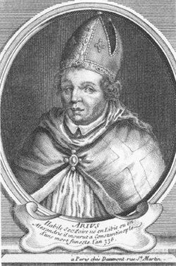
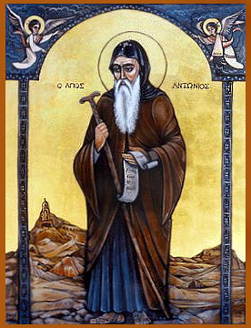
Trinity at Nicaea and the aftermath
Humans < Jesus < God the Father
Athanasius
Arius
Alexander
Jesus has eternal divinity, same substance as God the Father
Notes:
1. The lead up
By 4th century, church hierarchy had developed, persecutions had abated for the moment, and attempts were made to iron things out
Alexander, Bishop of Alexandria proposed Jesus had eternal divinity, same substance as God the Father
One of his priest’s Arius, proposed Jesus was a demi-God ...more than human but less than God the Father.
Bitter argument spread throughout Christendom, leading Constantine to call for a council at Nicaea. It was to be the first ecumenical council; trying to bring consensus.
PIC: Athanasius
PIC: Alexander
PIC: Arius
====
Arius was libyan

Slide 10
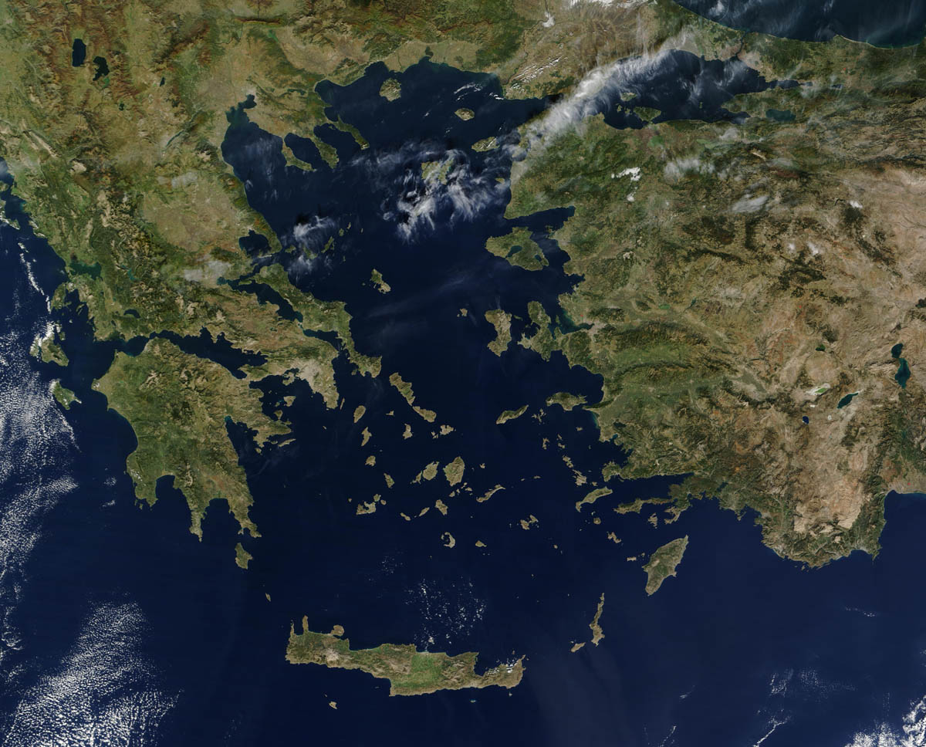
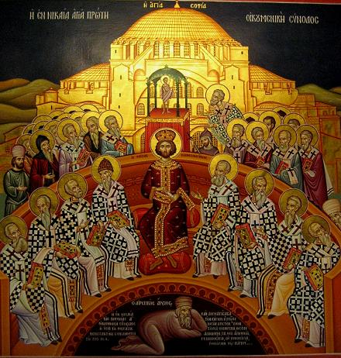
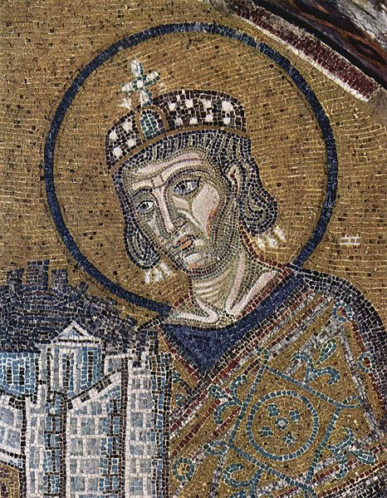
Trinity at Nicaea and the aftermath
Notes:
2. The council
Athanasius spoke for Trinitarian view (325 CE). Arius spoke for the Arian view.
Two months of discussion. Not a slam dunk at all. Arius and Eusebius of Nicomedia on one side. Eusebius was a political force to be recommended with (was the baptizer of Constantine)
So heated that at one point, Arius was struck in the face by none other than St. Nicholas.
Constantine himself presided over final session and proposed the term “homoousios” (of one essence”). 198/200 bishops sided with Athanasius. Nicene Creed was the result and all signed it.
PIC: Athanasius
PIC: Arius
PIC: Constantine
MAP: Nicaea
PIC: Icon from the Mégalo Metéoron Monastery in Greece
=====================
East and West split over "filioque"
Outcomes: nicene creed, calculation of Easter, early canon law

Slide 11
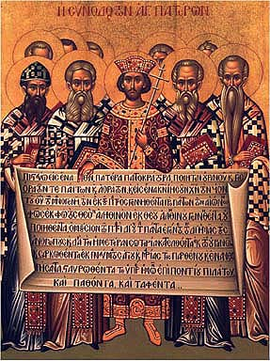
Trinity at Nicaea and the aftermath
“Now the Catholic faith is this: that we worship one God in a Trinity and the Trinity as a unity … the divinity of the Father, and of the Son, and of the Holy Spirit, is one, the glory eternal, the majesty co-eternal”
Notes:
3. Outcome and aftermath
Adopted a Nicean creed which was later reformed into the Athanasian Creed in Constantinople (381 CE)
Arius was exiled and his writings burned (was allowed to return home later)
Key precedents
Ecumenical councils
Politician gives a religious group semi-judicial powers
Non-scripture terms become critically important
Arianism didn’t go away immediately, in fact Constantius II was openly pro-Arian. Within 50 years Arianism had disappeared from the non-German empire.
Sixth century Codex Justinianeus codified Trinity into Roman Law. Heretical views were viewed more seriously than murder because it affected a person’s immortal soul.
While plenty of conflict over Church doctrine over the centuries ahead, the Trinity was largely set in place from the sixth century until the Reformation
PIC: Constantine and bishops displaying the Nicene Creed, unknown souce
=====================
East and West split over "filioque"
Outcomes: nicene creed, calculation of Easter, early canon law

Slide 12
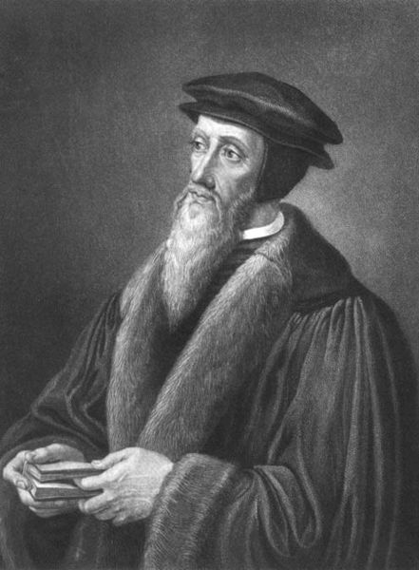
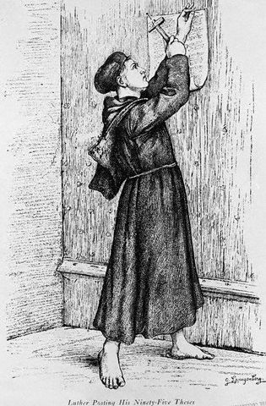
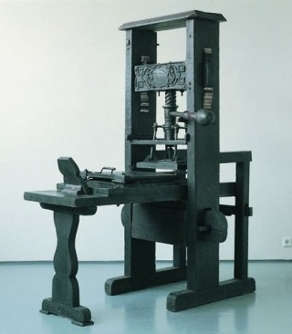
Trinity in the early Reformation
Humanism + printed bibles = discovery
Indulgences and simony = Thesis
Calvin and Luther
Augsburg Confession: Lutherans confirm Trinity
Notes:
And now to the reformation, the fracturing of western European Christian faith.
Tying into the course themes, it’s interesting that it was the business practices of the Church (indulgences), not the ecclesiastical ones, that led Luther to nail his thesis to the church door. Additionally, it was the science/technology innovation of the printing press that broke the monopoly the church had on the interpretation of scripture
Calvin and Luther were the front runners of the reformation and didn’t rock the boat much in terms of Trinity doctrine.
Luther: justification by faith. Focus on scripture
Calvin: the Elect, human depravity
Diet of Augsburg, Luther affirms his belief in the Trinity in front of the Holy Roman Emperor
Incidentally, in 1516 Erasmus (arguably the greatest of the Humanists) re-translated 1 John 5:8 from “there are three that bear record in Heaven: the Father, the Word, and the Holy Spirit, and these three are as One” to “There are three on earth that bear witness: the Spirit, the water, and the blood and these three are as one”. This seems to have been an academic work that raised little dialogue
The first great test of the Trinity comes from Michael Servetus
PIC: Luther and his thesis
PIC: replica printing press
PIC: Calvin by Hans Holbein the Younger

Slide 13
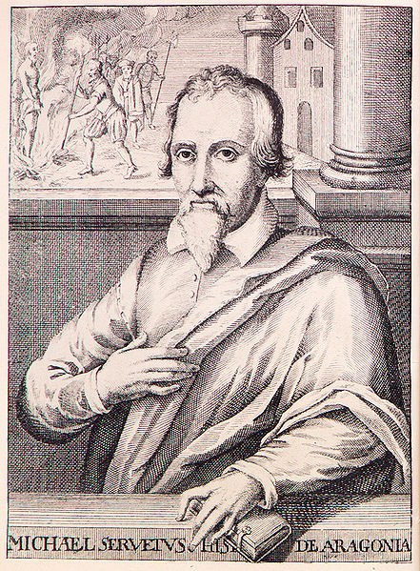
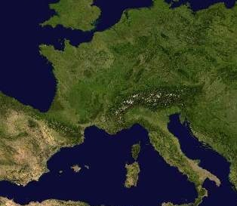
Trinity and Michael Servetus
Lyon, France
Writes Restoration of Christianity, rejecting infant baptism; conceives of universe as a manifestation of God.
Exchanges letter with Calvin; angers Calvin tremendously
Geneva, Switzerland
While bound for Italy, is spotted in Geneva
Arrested, tried, burned at the stake
Lyon, France
Spends 15 years living as Michael de Villeneuve
Works as an editor and doctor
Villanueva de Sigena, Spain
Reads Bible in Hebrew, Latin, and Greek
Perplexed by lack of “Trinity”, “Persons” “Essence”, “Substance” in scripture
Rome, Italy
Part of delegation at Emperor Charles V coronation.
Disgusted by opulence
Decided to become a reformer
Basel, Switzerland
Writes on the Errors of the Trinity
Holy Spirit is not a “Personal”, Christ is not eternal
Book was banned and panned
Servetus wanted by inquisition in Spain and France
Lyon, France
Calvin and friends alert the French inquisition
Sentenced to death but escapes!
Notes:
How to believe in God and get yourself burned at the stake in seven easy steps
Background
Born in Spain, was a physician, theologian, scientist, humanist. Scientific contribution was his recognition of the heart’s pulmonary circulation function, and some work with viscous liquids. We’re concerned with his work as a theologian, his fate at the hands of Calvin, and his legacy
Born 1511
2. Early education
Learns to read Bible in original languages – Hebrew, Greek, Latin
Perplexed by lack of “Trinity”, “Persons” “Essence”, “Substance” in scripture
Concerned that a generation earlier Jews and Muslims were expelled for not adhering to something that he finds no basis for in scripture
3. Rome
Visits Rome with Juan de Quintana, confessor to Charles V for coronation. 1529
Disgusted by opulence of Papal Rome: “vilest of beasts, most brazen of harlots”
Decides to become a Reformer and heads north
4. Basel
Writes On the Errors of the Trinity while staying with Johannes Oecolampadius, the city’s leading reformer.
Son was not eternal, Father and Word are eternal
Holy Spirit is not a distinct Being, but is God’s spirit working within our hearts.
He was Sabellian
Has it printed anonymously in Strasbourg (1531). Book was banned in Basel, by Luther, in Strasbourg, elsewhere
Very negative reaction from Protestants and Catholics alike. Inquisition in Spain sends his brother to try and lure him home
5. Lyon
Goes underground for two decades in Lyon
Works as an editor, then goes to med school (probably graduates).
Discovers pulmonary heart function
Publishes a tome on the properties of syrups
Stays out of trouble
5. Back on the horse
1546 writes (1553 publishes) Restoration of Christianity. Rejects infant baptism, universe is a manifestation of God
Before publishing, has a 30-letter dialogue with Calvin. Angers Calvin immensely when he doesn’t see reason and even send Calvin an editted copy of his own book
Calvin: “If I consent he come here … O will not suffer him to get out alive”
Calvin and friends alert the French inquisition
Caught and sentenced to death; Calvin submits the incriminating evidence
Of 1000 copies printed, only three survive
6. Geneva
Spotted while on way to Italy, Aug 13, 1553
Arrested, tried
Burned at the stake Oct 27, with the last copy of his book chained to his leg.
“Oh Jesus, Son of the eternal God, have pity on me!”
Calvin’s friend remarks that if he had only moved the word “eternal” his soul would have been saved.
7. Aftermath
Calvin and others had real fear that their whole Reformation movement was risked by the likes of Servetus
Flurry of publications after his execution
Catalyst that led towards religious toleration
Propagation of his ideas
De trinitatis erroribus ("On the Errors of the Trinity")
De Iustitia Regni Christi ("On the Justice of Christ's Reign")
PIC: Servetus, by Christian Fritzch

Slide 14
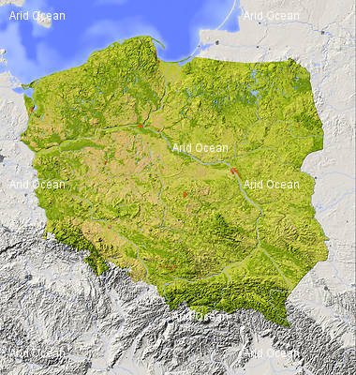
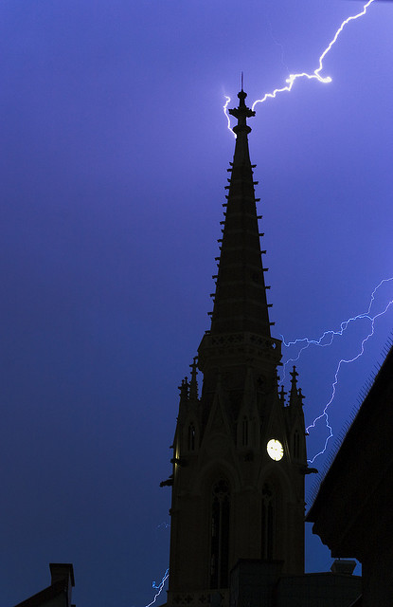
Early Unitarians in Poland
Rakow
Tolerance:
“no one wishing to impose his faith upon another [could], since this is the gift of God”
Debates:
Modal views
Jesus as Man
Ditheism
Tritheism
Krakow
Notes:
Another great outbreak of non-Trinitarian thinking was happening in Poland and Hungary. This was the time of the Polish Brethren, known outside Poland as Socinians, who later called themselves Unitarians
1. Formation of the PB
Very healthy theological debates at the time in Krakow where Catholics, Calvinists, Bohemian Brethren, and Lutherans all had a large presence. The nature of the trinity was openly discussed within the Reformed Church, including modal views, Jesus as man, Jesus as lesser God, tritheism, more.
On Trinity Sunday (1562) lightning struck the cathedral in Krakow while a non-trinitarian preacher was giving a sermon. This omen helped solidify the non-trinitarian movement [CLICK]
1565 first entirely non-trinitarian synod, forming a separate movement from the other Reformers; this became known as the Polish Brethren
Within the new sect debate over infant baptism and Christology came to a novel result: tolerance of discordant ideas. Each congregation could choose as it saw fit.
“no one wishing to impose his faith upon another [could], since this is the gift of God”
Eventually drifted to Unitarian view: Word was God in the world, Jesus was mortal
Religious tolerance always has a limited shelf-life
1570 Sandomierz Agreement : other Reformed sects exclude Polish Brethren. Violence mounts in Krakow.
[CLICK]
PIC: lightning on the cathedral
2. Rakow
Jadwiga Sienienska, wife of rich Calvanist is Arian and saves the day by buying a town as a haven for the PB’s. She names it Rakow (Krakow without the K)
First few years was a commune: no private property. Anarchy.
Things settled down and the town became an educational and publishing center
At its peak, had population of 15,000
=======
1539 80-year-ld woman burned for stating christ wasn’t the son of God

Slide 15
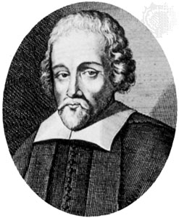
Early Unitarians in Poland
Racovian Catechism
Bible is source of truth, man-made additions are destructive
Jesus is the human son of God
Word (Logos) is the power of God in this world
Strict morality: ten commands and sermon on the mount
No predestination or original sin
Faustus Socinus
Notes:
The name of the movement is Socianism after its more prolific writer, Faustus Socinus (Fausto Sozzini in his native Italian). In fact, he was never officially a member of the Church as he rejected adult baptism! Nonetheless he was the church’s spokesman and thought leader.
Writings, many published posthumously in Rakow, were very well distributed and influenced Richard Price, Isaac Newton, and others.
Chief text:
Racovian Catechism
God is one person, no trinity
No predestination
Disciplined human conduct
No original sin
Pacifist
400 pages
4. The Fall
The Rakow Unitarians had seventy good years, but the counter reformation caught up with them. After some teens from the town knocked over a cross which had been provocatively set up, the Polish Senate ordered that the school and press be destroyed. Further persecution and invasions by Cossacks and Swedes caused the Socianians to flee. By 1700, the town that had peaked at 15 000 now had only 700 inhabitants.
Many of those who fled, headed for Transylvania where another Unitarian group was on the rise.
PIC: Faustus.

Slide 16
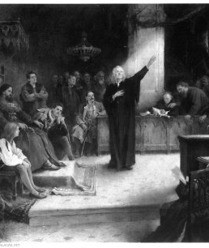
“Egy az Isten”:Transylvanian Unitarians
King Sigismund and the Edict of Torda: toleration
Unitarian became a “received religion”
First and only Unitarian King
Unitarianism survives to this day in Hungary/Transylvania
Notes:
Very, very important to Unitarian history, but we didn’t cover this stuff in class so we will be brief.
Similar beginning to Poland in terms of timing and format. 1568 things got going. Socinus and Servetus were both influential; Socinus visited before going to Poland. Similar to Poland, anti-trinitarian views extended from religious debate. Very fashionable to debate Trinity and doctrine! Francis David was a leading thinker
King Sigsmund called an ecumenical council and the outcome was an edict of religious toleration. Several more debates follow, some in the lay language, Hungarian.
Here’s where the Unitarians in Transylvania were different from Poland: they won the debate and joined the establishment.
1571, Unitarianism is recognized by the King as a “received religion”, equal to Calvinism, Lutheranism, and Catholicism. “Egy az Isten” sigmismund converted, the first and only Unitarian King.
Periods of persecution have come and gone, but Unitarianism is still strong in Hungary and Transylvania; we have a partner church in Hodmezovasarhely.
PIC: Francis David at the Diet of Torda, unknown
===
Francis David
Catholic -> luterhan -> calvanist -> unitarian and stayed
"egy az isten" = "God is one“
Actually went too far and said we shouldn't even worship jesus. Oops!

Slide 17
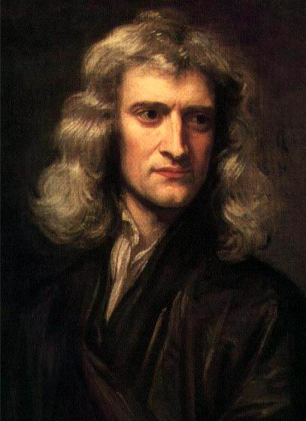
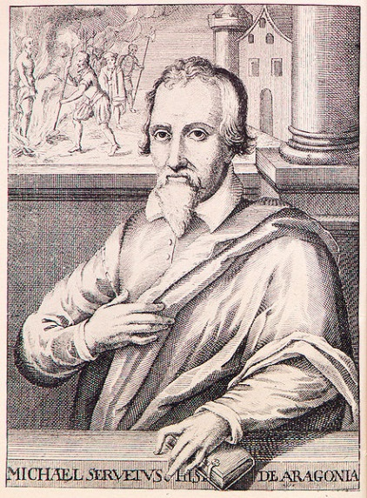
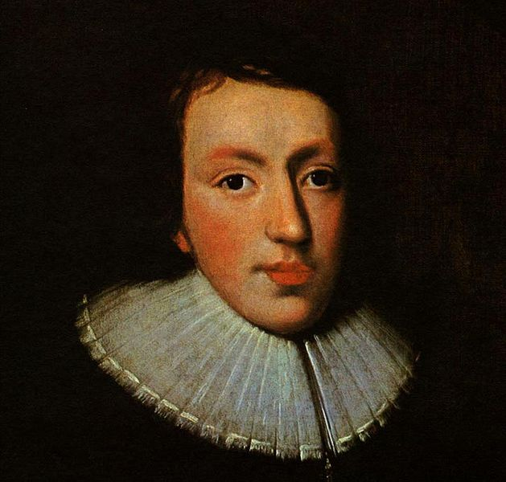
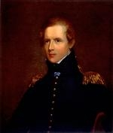
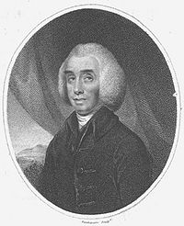
Trinity in Britain
Notes:
Last stop on the tour. Tired yet?
In addition to Transylvania, Unitarianism grew permanent roots in Britain and then America.
At the time, there were Catholics, Anglicans and Dissenters (aka non-conformists) in Britain. Anglicans and Catholics of course were firm Trinity believers as were many dissenters. Some dissenters were Arian anabaptists and others that had fled from the continent
Socinian books were well circulated despite bans; Newton, Milton, others would have been influenced
Home-grown innovation as well.
John Biddle 1647 arguments drawn out of scripture. Denied trinity and divinity of Christ and spend his life in and out of prison.
Theophilus Lindsey, Anglican minister who started the first avowedly Unitarian congregation in London (1774). Ben Franklin attended. Friend of Joseph Priestly
Jason Priestly was minister of most liberal church in England (Birmingham) He wrote Corruptions of Christianity , making the case that early church was Unitarian. He was a materialist, rejected free will. “Priestly riots” rocked Birmingham (anniversary of Bastille day). He became a Unitarian minister and eventually went to Philidelphia, US
Unitarian got a big boost for an attempt to squash conformity. Post-Cromwell, Pro-Anglican backlash led to Act of Uniformity which required assent to the entire Book of Common Prayer. 2000 dissenting ministers refused. Five Mile Act meant that most had to leave their communities; many of these ministers joined the Unitarian faith.
Remained illegal to deny the Trinity until 1813
Priestly and others went to America and that’s just about as far along the Unitarian tree as we need to go.
PIC: Faustus Socinius
PIC: Michael Servetus
PIC: Isaac Newton Godfrey Kneller's 1689 portrait of Isaac Newton
PIC: John Milton, 1629. National Portrait Gallery
PIC: John Biddle, unknown
PIC: Theophilus Lindsey
===========================
Trinitarian Controversy within the Anglican faith
Samuel clarke “arian movement” within anglican faith

Slide 18



Notes:
So that’s where the trinity and unitarian thoughts took me. I also have been reading about the faith of rational scientists. That’s where we’ll go now until we run out of time.
Isaac Newton
Albert Einstein
Leibniz
Dawkins
Collins

Slide 19


Isaac Newton
“This most beautiful system of the sun, planets, and comets, could only proceed from the counsel ... of an intelligent Being” = Natural Theology
Hidden theology comes to light 1936, Newton private letters auctioned
Arian: Trinity was a Hellenistic corruption. Only the Father was God.; Jesus was united in will, not substance.
Love thy God, Love thy Neighbor (reciprocity!)
Notes:
Newton’s public and private life were very different . Publically, he was a devout Anglican and patron saint of the Age of Reason. He wrote a little on Natural Theology, but mostly on mathematics, optics, physics, etc. This is the public persona handed down through ages.
Private life was very different; only uncovered in 1936 when Earl of Portsmouth auctioned his treasure trove of materials. Only in 1991 were they properly available for academic study.
Wrote 1 million lines on Alchemy, 4x that much on theology.
Believed himself to be one of a select chosen few who would find hidden meaning in the Bible
Keynes called him “not the first of the age of reason … the last of the magicians”
Found hidden meansings in early greek philosphers that to him implied they had a heliocentric view of the universe and understood gravitation
Began studying the bible while getting ready to be ordained. Got an exemption Jesus and Father are united in will but not in substance.
Two fundamental principles: love thy God, love thy neighbor – reciprocity
Anti-papacy. Believed they corrupt the messages of the primitive church
Prophecy: thought he was part of a select group chosen to understand the Bible. Sought hidden passages
World would end some time after 2060
Wrote a rulebook.
4 million words on theology
Raised Anglican, then through his studies took on views that are unorthodox
God’s existence is proved by the complexity of nature. God steps in straighten the orbit of planets and ensure stars don’t collide, and to ensure that all motion in universe doesn’t ultimately dissipate to friction.
Sacred studies consumed much more of his time than science. Studied the Bible daily
Leibniz: God would create a perfect world that required no intervention.
PIC:
PIC: “Newton” by Blake 1795. fixated on geometric figures and refusing to look at the sky

Slide 20

Gottfried Wilhelm von Leibniz
Polymath: calculus, library science, politics, finance, computer science (binary notation)
Emphasized rational nature of religion
World is imperfect but is the best among all possible worlds
Theology and philosophy cannot contradict; both “gifts of God”
Notes:
With Descartes and Spinoza, was one of the three great 17th Century rationalists
Calculus, mathematics
Polymath – export contracts, finance, library science, computer science (
Lutheran
Tried to reconcile Protestantism (free inquiry) and Catholicism (authority). Much more public experience with religion than newton
Theodicy. This world is imperfect but it is the best among all possible worlds. It must be so because it was created by God. Theology and philosophy can’t contract either because they are both “gifts of God”. Trying to bring to light the idea that Christianity was rational and enlightened. Evil comes from imperfection of humanity.
PIC: Portrait of Gottfried Leibniz (1646-1716

Slide 21

David Hume
Very likely an atheist
Natural History of Religion: basis of religion is fear of unknown, not reason. Polytheism predates monotheism
Argued against Argument by Design and Argument by Revelation (miracles)
Notes:
Not much known about his personal religious life. Not a time in history to be loud and proud. Probably agnostic – against organizated religion, but not atheist
1744. didn’t get Uni of Edinburgh / Uni of Glasgow chair because he was believed to be an aethist
Both his works on religion were published posthumously “a miralce is a violation of the laws of nature”
PIC: Hume, national gallery of scotland, 1766
The primary religion of mankind arises chiefly from an anxious fear of future events; and what ideas will naturally be entertained of invisible, unknown powers, while men lie under dismal apprehensions of any kind, may easily be conceived. Every image of vengeance, severity, cruelty, and malice must occur, and must augment the ghastliness and horror which oppresses the amazed religionist. ... And no idea of perverse wickedness can be framed, which those terrified devotees do not readily, without scruple, apply to their deity.
—David Hume, The Natural History of Religion

Slide 22

Richard Price
Unitarian minister
Free agency, immateriality of the soul, perfectability of human nature, miracles, immutability of right and wrong
Influenced Bayes, Malthus, Wollstonecraft, American Fathers, Priestly, Lindsay
Notes:
We know and love Price for his stats and actuarial science, for helping Bayes get published, for his fashionable hair. He was a unitarian minister. I love that too.
In opposition to Priestly, he argued for free agency against determinism, and the immateriality of the human soul against materialism.
Preached the perfectability of human nature.
Right and wrong are immutable ideas

Slide 23

Adam Smith
Not much is known: personal letters burned
Very quirky: absent-minded, imaginary friends, talked to himself
Likely a deist. Obit: “disciple of Voltaire in matters of religion”
Notes:
Mr. Wealth of Nations and Hume’s colleague in the Scottish Enlightenment
We don’t know a lot because his personal letters were destroyed after his death at his request. We know he was immensely absent minded, lived with his mother, had imaginary friends. Thought that speaking about his ideas might reduce the sale of his books so he was unimpressive at dinner parties.
At Oxford, was caught readying Hume’s Treatise on Human Nature and was punished for it. He had a terrible time at Oxford and may have had a nervous breakdown. One thing he didn’t find there was religion. While raised Anglican, it’s likely he was a deist.
PIC: etching by Cadell and Davies (1811) of a paste medallion by James Tassie

Slide 24


Albert Einstein
Secular Jew -> religious Jew -> deist
“If something is in me which can be called religious then it is the unbounded admiration for the structure of the world so far as our science can reveal it”
Spinoza’s God: God as the natural world
Atheists “in their grudge against traditional religion as the 'opium of the masses‘ cannot hear the music of the spheres”
Notes:
Preferred the God of Baruch de Spinoza, 17th Century Dutch Jewish philosopher
Denies immortability of the soul, rejects the notion of a providential God,
God and Nature are two names for the same reality. God as the deterministic symptom of which everything in nature is a part. God is the natural world and has no personality
Everything is pre-determined
Emotion trumps reason
Good and Evil are related to human pleasure and pain.
Raised secular Jewish. Was quite religious as a youngster. Through reading science books, came to the conclusion that the stories in the bible could not be true.
Didn’t like aethieist, “personal God”. Disbelieved afterlife and immortality
"God is a mystery. But a comprehensible mystery. I have nothing but awe when I observe the laws of nature. There are not laws without a lawgiver, but how does this lawgiver look? Certainly not like a man magnified”
“science without religion is lame, religion without science is blind”
“universe is not ruled by wishful thinking, but by immutable laws”
PIC: Official Nobel Prize photo, 1921
PIC: Spinoza, Gemäldesammlung der Herzog-August-Bibliothek, Wolfenbüttel, Germany 1665

Slide 25

John Maynard Keynes
Attended Church in his teens, but was agnostic by university.
Regarding Christians: “they don't want to admit that a position they've taken up with confidence is untenable”
Notes:
Thoroughly bi-sexual
Bloomsbury Group

Slide 26
Appendices

Slide 27

Bloosmsbury Group

Slide 28
Biblical passages supporting Trinity
Go, therefore, and make disciples of all nations, baptizing them in the name of the Father, and of the Son, and of the Holy Spirit, teaching them to observe all that I have commanded you. And behold, I am with you always, until the end of the age. Gospel of Matthew 28:19-20
Crucially, it is “name” not “names”

Slide 29
Biblical passages supporting Trinity
The grace of the Lord Jesus Christ and the love of God and the fellowship of the Holy Spirit be with you all.
Corinthians 13:14

Slide 30
Biblical passages supporting Trinity
THE BAPTISM OF JESUS In those days Jesus came from Nazareth of Galilee and was baptized by John in the Jordan. And when he came up out of the water, immediately he saw the heavens opened and the Spirit descending upon him like a dove; and a voice came from heaven, "Thou art my beloved Son; with thee I am well pleased." Gospel of Mark 1:9-11 THE ANNUNCIATION Then the angel said to her, "Do not be afraid, Mary, for you have found favor with God. Behold, you will conceive in your womb and bear a son, and you shall name him Jesus. He will be great and will be called Son of the Most High, and the Lord God will give him the throne of David his father, and he will rule over the house of Jacob forever, and of his kingdom there will be no end." But Mary said to the angel, "How can this be, since I have no relations with a man?" And the angel said to her in reply, "The Holy Spirit will come upon you, and the power of the Most High will overshadow you. Therefore the child to be born will be called holy, the Son of God. Gospel of Luke 1:30-35

Slide 31
Biblical passages supporting Trinity
THE TRANSFIGURATION About eight days after he said this, he took Peter, John, and James and went up the mountain to pray. While he was praying his face changed in appearance and his clothing became dazzling white. And behold, two men were conversing with him, Moses and Elijah, who appeared in glory and spoke of his exodus that he was going to accomplish in Jerusalem. Peter and his companions had been overcome by sleep, but becoming fully awake, they saw his glory, and the two men standing with him. As they were about to part from him, Peter said to Jesus, "Master, it is good that we are here; let us make three tents, one for you, one for Moses, and one for Elijah." But he did not know what he was saying. While he was still speaking, a cloud came and cast a shadow over them, and they became frightened when they entered the cloud. Then from the cloud came a voice that said, "This is my beloved Son; listen to him." Gospel of Luke 9:28-35

Slide 32
Biblical passages supporting Trinity
Jesus said to him, "Have I been so long with you, and yet you have not come to know Me, Philip? He who has seen Me has seen the Father; how can you say, 'Show us the Father'? "Do you not believe that I am in the Father, and the Father is in Me? The words that I say to you I do not speak on My own initiative, but the Father abiding in Me does His works. Gospel of John 14:9-10
"But the Counselor, the Holy Spirit, whom the Father will send in my name, he will teach you all things, and bring to your remembrance all that I have said to you. Peace I leave with you; my peace I give to you; not as the world gives do I give to you." Gospel of John 14:26-27

Slide 33
Biblical passages supporting Trinity
THE PROMISE OF THE SPIRIT 1 In the first book, O Theophilus, I have dealt with all that Jesus began to do and teach, 2 until the day when he was taken up, after he had given commandment through the Holy Spirit to the apostles whom he had chosen. 3 To them he presented himself alive after his passion by many proofs, appearing to them during forty days, and speaking of the kingdom of God. 4 And while staying with them he charged them not to depart from Jerusalem, but to wait for the promise of the Father, which, he said, "you heard from me, 5 for John baptized with water, but before many days you shall be baptized with the Holy Spirit." Acts of the Apostles 1:1-5 The grace of the Lord Jesus Christ, the love of God and the fellowship of the Holy Spirit be with you all. Second Letter of St. Paul to the Corinthians 13:13 Because you are sons, God sent the Spirit of his Son into our hearts, the Spirit who calls out, "Abba, Father." St. Paul to the Galatians 4:6

Slide 34
Biblical passages supporting Trinity
For to us God revealed them through the Spirit; for the Spirit searches all things, even the depths of God. For who among men knows the thoughts of a man except the spirit of the man which is in him? Even so the thoughts of God no one knows except the Spirit of God. Now we have received, not the spirit of the world, but the Spirit who is from God, so that we may know the things freely given to us by God, which things we also speak, not in words taught by human wisdom, but in those taught by the Spirit, combining spiritual thoughts with spiritual words. But a natural man does not accept the things of the Spirit of God, for they are foolishness to him; and he cannot understand them, because they are spiritually appraised. But he who is spiritual appraises all things, yet he himself is appraised by no one. For who has known the mind of the LORD, that he will instruct him? But we have the mind of Christ. First Letter of St. Paul to the Corinthians 2:10-16

