Slide 1

Where is Neo?
The Great-Leader Narrative and the Lack of Change in the Age of Financial Crisis

Slide 2
Cast of Characters
The Matrix – Efficient Market Hypothesis
Agent Smith – the Villain (aka Agents of the System)
Neo – Our Hero, The Leader

Slide 3
Problems, problems, problems...

Slide 4
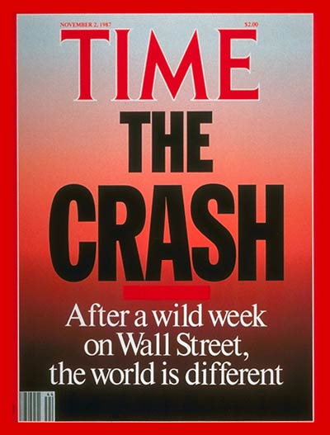
Ups & Downs Always Happen

Slide 5
But, This Time it is Different...

Slide 6
Housing Led Recession
Over Leveraged Financials
Fallings Asset Prices
Frozen Credit Markets
Weak Household Balance Sheets
Globally Synchronized Slowing
Forces of Inflation versus Forces of Deflation

Slide 7



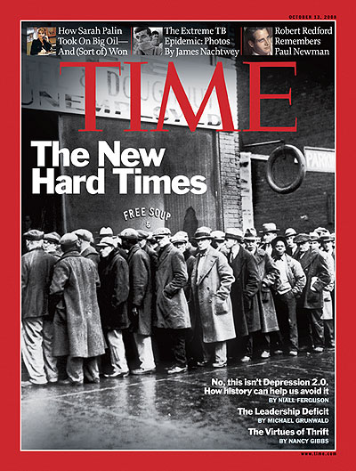


Slide 8

Where is Neo?

Slide 9
Why Do We Look For Neo?

Slide 10
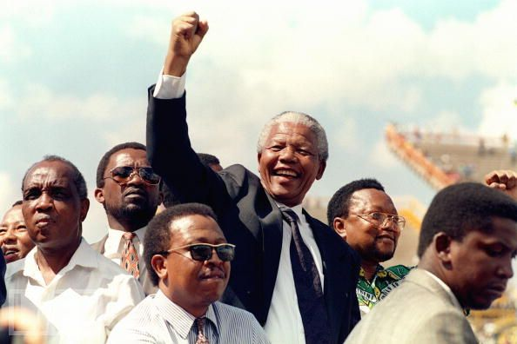
The Notion of Neo, The Leader, THE HERO is Deeply Embedded into our Psyche
The Statesman

Slide 11
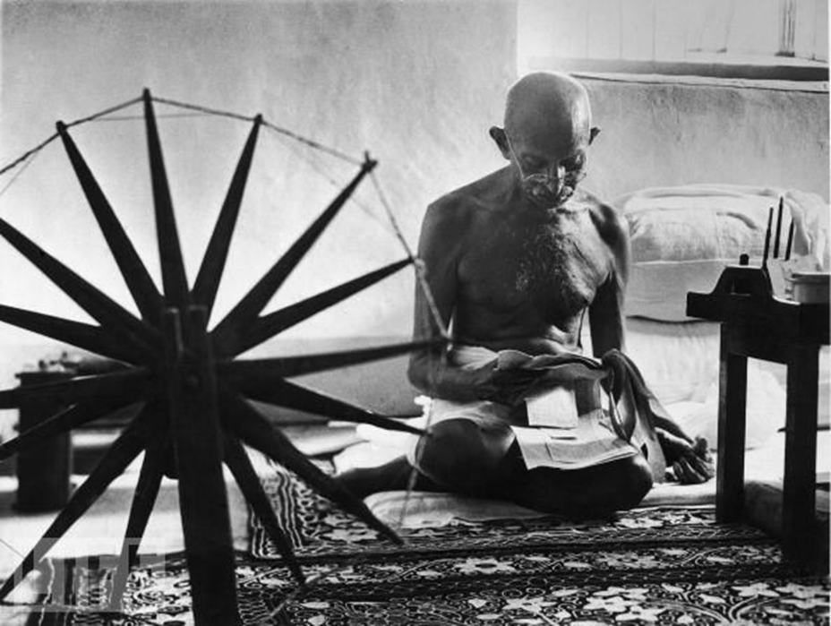
Expresses a Deep Psychological Aspect of Human Existence
The Freedom Fighter

Slide 12

Expression of our Personal and Collective Unconscious

Slide 13
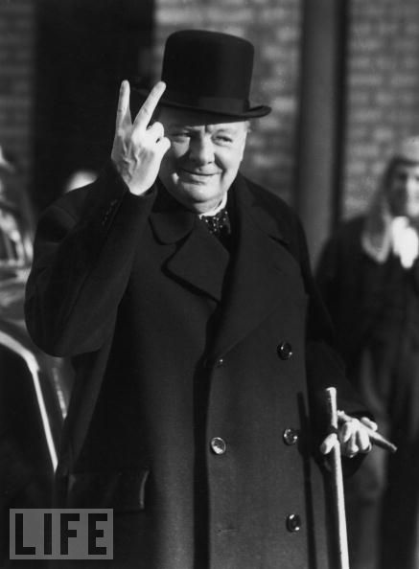
Neo,
The Hero, The Leader Shows US the PATH
The Lion

Slide 14
“The images of the hero conquering death or returning from a successful battle provide the restricted conscious mind with new raw material into which to expand, thereby forcing the consumers of the hero stories to expand their conscious image of themselves” (Davies, et. al. 331).
Notes:
Davies, Robert, James Farrell, and Steven Matthews. "The Dream World of Film: A Jungian Perspective on Cinematic Communication." The Western Journal of Speech Communication. 46 (1982): 326-343.

Slide 15
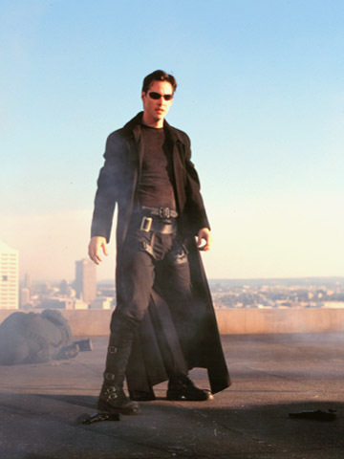
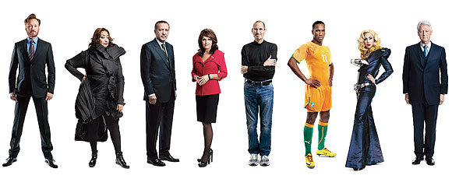
Making of Neo?

Slide 16
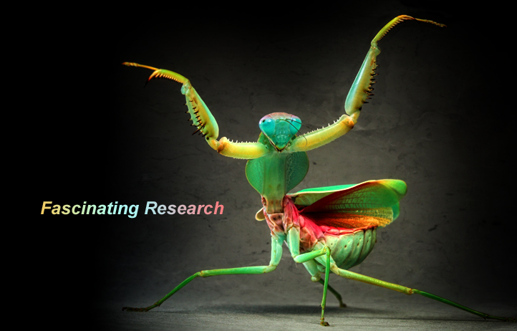
Billions of Dollars Spent on Leadership Research

Slide 17

Billions More Spent on Leadership Training

Slide 18

Leadership Books are the Fastest Growing Sector in the Publishing World

Slide 19

"It is an old saying that great emergencies produce men who are competent to deal with them“…

Slide 20
Have We Created a Neo?

Slide 21
NO!

Slide 22
Why??????

Slide 23
Liberal Markets: Efficient Market Hypothesis “The Matrix”
The Inherent Paradox
Notes:
Corner stone of modern liberalism:
Unimpeded markets will distribute resources efficiently
Belief rests on:
Markets are efficient and self-organizing
Individuals who participate in exchanges behave rationally; they act in their own self interest in order to maximize return
EMH (1970): market as a rational system that is both efficient and can be trusted to govern itself because stock prices constitute a form of knowledge that reflect all relevant information about an individual company and the economy as a whole

Slide 24

The Paradox
An individual can HAVE character but not be unique;

Slide 25

The Paradox
the individual can be a CHARACTER but not depart radically from the norms that render all individuals interchangeable

Slide 26
The Beginnings of the Matrix
Adam Smith – Wealth of Nations 1776
Utility replaces Labour Theory of Value – 1870
Political Economy Based on Mathematics
Business Schools placed in Universities – 1881
Depression – 1930’s
Rise of Econometrics
Anglo – American Financial Agreement – 1945
US replaces Britain as the Most Powerful Financial Nation in the World
Notes:
Jevons

Slide 27
The Beginnings of the Matrix
Bretton Woods Agreement
Overwhelmingly Favours the US
The Age of Market Perfection 1950 – 1980
Random Walk
Portfolio Theory
Employee Retirement Security Act
Rise of the Financial Professional
Reagan and Thatcher
Supply – Side Economics
Efficient Market Hypothesis Fully Cemented

Slide 28
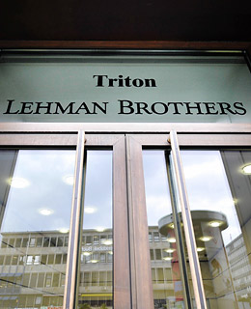
The Matrix Rises
Every Banking Restriction Repelled

Slide 29
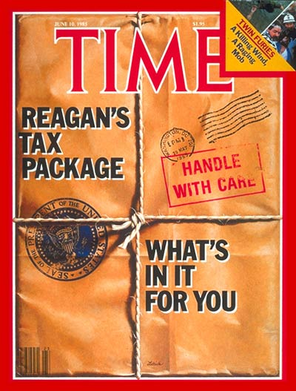
The Matrix Rises
Reduction of Taxes

Slide 30
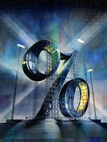
The Matrix Rises
Raising of Interest Rates

Slide 31
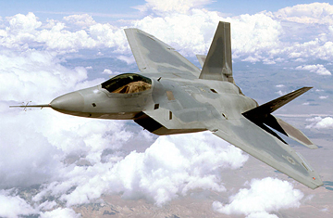
The Matrix Rises
Increased Military Spending

Slide 32
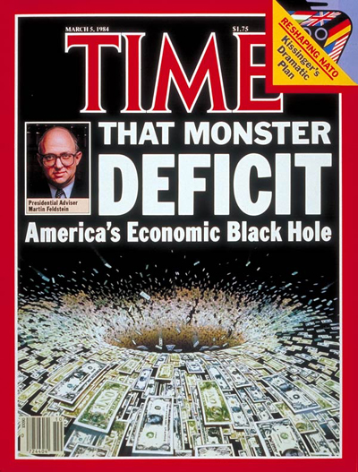
The Matrix Rises

Slide 33
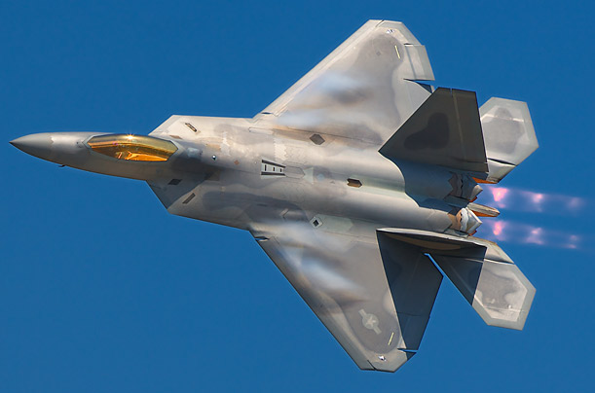

A strong domestic economy, increased consumption, and escalating military spending led to a sustained period of non-inflationary growth

Slide 34
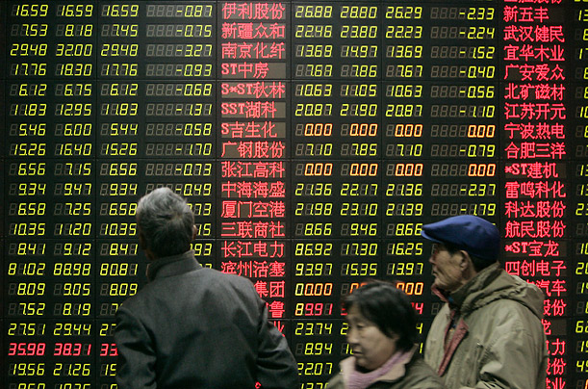

Agent Smith
Interests of Company Executives Should be Aligned With Those of the Shareholders; in the Free Markets , Prices Reflect Available Information About The Company and The Executive Performance
Notes:
Agency Theory

Slide 35

Agent Smith
Maximizing Shareholder Returns
Performance, Performance, Performance
Increase Assets on Balance Sheets
Beat the NUMBER
Executive Stock Options
Notes:
Maximizing Shareholder Returns
Performance, Performance, Performance
Increase Assets on Balance Sheets
Out Sourcing
Load Up on debt
Beat the NUMBER
Manipulations of Earnings
Executive Stock Options
Volatility vs Productivity

Slide 36
Agent Smith Replicates and Mutates
Derivatives
Credit Default Swaps

Slide 37
The Paradox
An individual can HAVE character but not be unique; the individual can a CHARACTER but not depart radically from the norms that render all individuals interchangeable
Notes:
We are cogs in a larger system
Characters can be creative and merit narrative attention, but they can’t depart from the larger patterns of liberalism

Slide 38
In Seriousness….

Slide 39
Efficient Market Hypothesis has Led to Market & Economic Complexity

Slide 40
The Ugly Side of Complexity
Complexity Contributes to an Organization`s Vulnerability
Complexity Suddenly Pushes Leaders to a New Equilibrium
Complexity Causes Organizational Failures to Look Like Falling Dominoes
Complexity Contributes to an Organizational Uncertainty
(Dixon – Homer, 2011, p. 6)

Slide 41
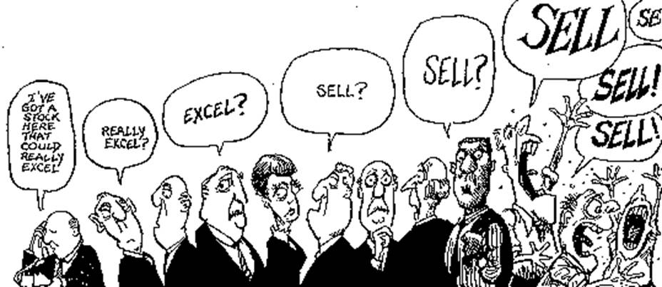

Slide 42
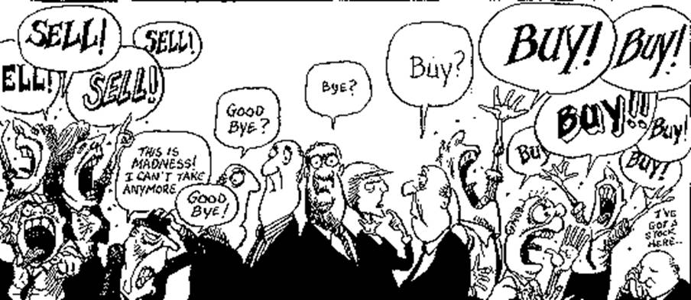

Slide 43
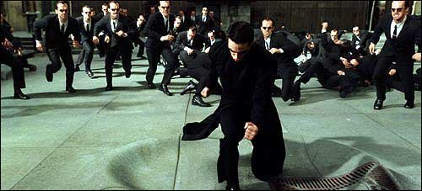

Slide 44
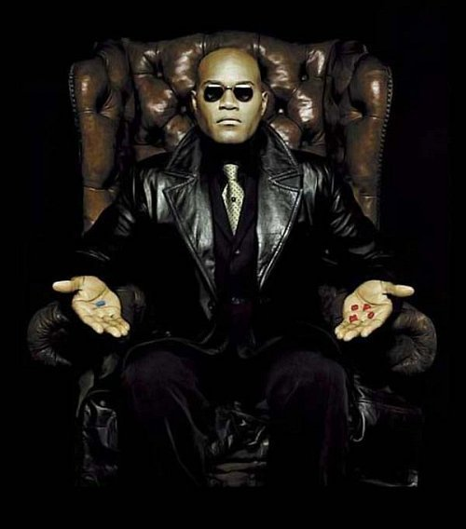
So...
Morphesus will have to Wait…Don’t Expect Neo or Harper or Obama to Make Any Changes…

