Slide 1
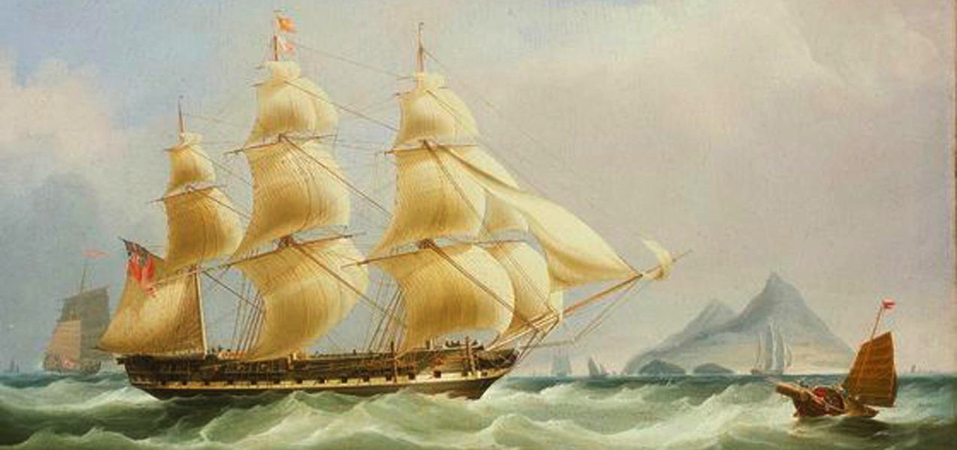
Opium Wars
Presented by Han Tjandra + Verna Gene
Notes:
National Maritime Museum [cwSP_1836_nmm_BHC3209]
“The East Indiaman Asia,” 1836 by William John Huggins (British, 1781–1845) https://www.revolvy.com/page/William-John-Huggins
The East Indiamen were the largest ships belonging to the British East India Company and some of the largest merchant sailing ships ever built. They also carried guns to protect themselves on the high seas, ensuring British domination of the China trade. This painting shows the ship Asia off of Hong Kong in the 1830s, flying its distinctive flags next to smaller Chinese junks. The ship was built in 1811 and is shown off Hong Kong between 1831 and 1832, towards the end of her career. The artist has depicted her in starboard broadside, flying the red ensign and distinguishing flags. Chinese junks have been shown to left and right of her, with more European shipping in the right distance depicted in front of an island. The subject of Indiamen in the East was a familiar one to Huggins who had probably begun his working life at sea and served in the East India Company as a steward and assistant purser on board the 'Perseverance', which sailed for Bombay and China in December 1812, returning in August 1814 .
Response Getter: What do you notice in this image? Who’s perspective? And who records history?
A seascape, a foreign ship in a foreign land, national flags in full sight with winds billowing in the sails of the British vessel; and in contrast note the scale of the Chinese Junk, single mast. Realistic composition with one point perspective i.e. vanishing point. What do you see on the horizon? Depicting the power, speed and ability to harness wind power into newly chartered waters.
Note: British East India Company by 1833 was no longer a monopoly
https://www.qdl.qa/en/brief-history-english-east-india-company-1600–1858
The Co’s mercantile monopoly came increasingly under attack + its commercial operations were at first scaled down by Parliament after years of pressure from the free trade lobby + then wound up completely by the Charter Act of 1833. The Company continued in its imperial role until 1858 when, in the aftermath of the military + civil rebellion in the north of the sub-continent, the Government of India Act transferred its powers to the India Office , a department of state. The EIC was finally dissolved on 1 June 1874, after shareholders received compensation from Parliament.
https://en.wikipedia.org/wiki/Asia_(1815_ship)
Asia was a merchant ship launched at Calcutta in 1815 for Charles Hackett. She made 4 voyages transporting convicts from GBR to AUS, and 2 voyages under charter to the British East India Company (EIC) between 1826-1830. She was hulked or broken up c.1860. Between 1815 + 1826, Asia was a "country ship", sailing along India's coasts. She also traded with England as a "licensed ship", i.e., a vessel that traded with England with the permission of the EIC.^{[1]} Asia was sheathed in copper in 1822. Repairs were undertaken to the copper sheathing in 1824. Under the command of William Pope + surgeon Thomas Davies, she left Portsmouth, England on 6 Jan 1825 with 200 male convicts. She arrived in Sydney on 29 April;^{[2]} 1 convict died during the voyage. On her first voyage under charter to the EIC, Captain William Adamson sailed Asia to China. She left the Downs on 1 Jul 1826 and arrived at Whampoa on 19 Dec. She left Whampoa on 13 Apr 1827, stopped at St Helena, + arrived at East India Dock on 5 June.^{[3]} Asia was re-sheathed in copper in 1826 + her owner changed to William Pope in 1827. On her 2nd convict voyage, under the command of Henry Ager and surgeon George Fairfowl, she left Portsmouth on 17 Aug 1827 and arrived in Hobart on 7 Dec 1827.^{[4]} She carried 200 male convicts and had 2 deaths enroute. She was doubled + sheathed in copper in 1829, rated at 513 tons. For her second voyage for the EIC, Captain Henry Ager left the Downs 6 Jun 1829. Asia arrived at Whampoa on 9 Feb 1830. She then reached Halifax on 29 Aug, before arriving back at the River Thames on 12 Nov.^{[3]} Between 1830 and 1860 she traded to the Far East and Australia.^{[1]} On her 3rd convict voyage, she was under the command of Captain Henry Ager + her surgeon was George Birnie. She left Cork, Ireland, on 6 Aug 1831, arrived in Sydney on 2 Dec. On her 4th convict voyage she under the command of Captain Benjamin Freeman, + her surgeon was John Gannon. She left Torbay, England, on 4 Aug 1837 and arrived in Sydney on 2 Dec.^{[6]} She carried 280 male convicts, of whom 3 died during the voyage.

Slide 2
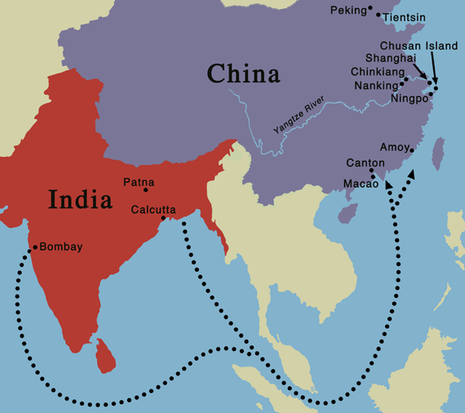
China Trade
Canton’s natural advantages gave it the preferred position on the China coast for foreign trade.
Monsoon winds from the southwest, allowed sailing ships to ride smoothly downwind across the Indian Ocean, Arabian Sea and the South China Sea.
Notes:
Wiltshire, Trea. The China Trade. Encounters with China: Merchants, Missionaries and Mandarins, p.12.
China’s wealth had always excited merchants + adventurous mariners. Eventually every sea-faring nation worth its salt would join the race to dominate the rich trade in Eastern spices and chart a route to the China Sea. As a chartered company with far-reaching powers, the British East India Company undertook much of the early exploration and enterprise. The British East India Company had the authority to annex territory, establish trading bases, and engage in hostilities.
Perdue, Peter, C. Rise and Fall of the Canton Trade System: China in the World (1700-1860s).
Canton’s natural advantages—its location and its local topography—gave it the preferred position on the China coast for foreign trade. The monsoon winds determined the access of trading ships to the south China coast. From June to September the winds blew from the southwest, allowing sailing ships to ride smoothly downwind across the Indian Ocean, the Arabian Sea, and the South China Sea. When the monsoon ended in October, ships remained in the Canton region for a four-month trading season. The northeast monsoon winds beginning in January gave them smooth sailing back to India and ultimately England. The Pearl River leading from Macau to Canton was easily accessible on the monsoon winds to foreigners. At the same time, since Canton itself was not on the coast, imperial officials could control foreigners who came and went along the sea.
Hayes, Jack, P. Opium Wars in China (pg. 3).
For many years, Great Britain worked within this system to run a three-country trade operation It shipped Indian cotton +British silver to China, and Chinese tea and other goods to Britain Because of its trade imbalance, Britain increasingly had to use silver to pay for its expanding purchases of Chinese goods. In the late 1700s, Britain tried to alter this balance by replacing cotton with opium, also grown in India. In economic terms, this was a success for Britain. By the 1820s, the balance of trade was reversed in Britain’s favour, and it was the Chinese who now had to pay with silver.

Slide 3
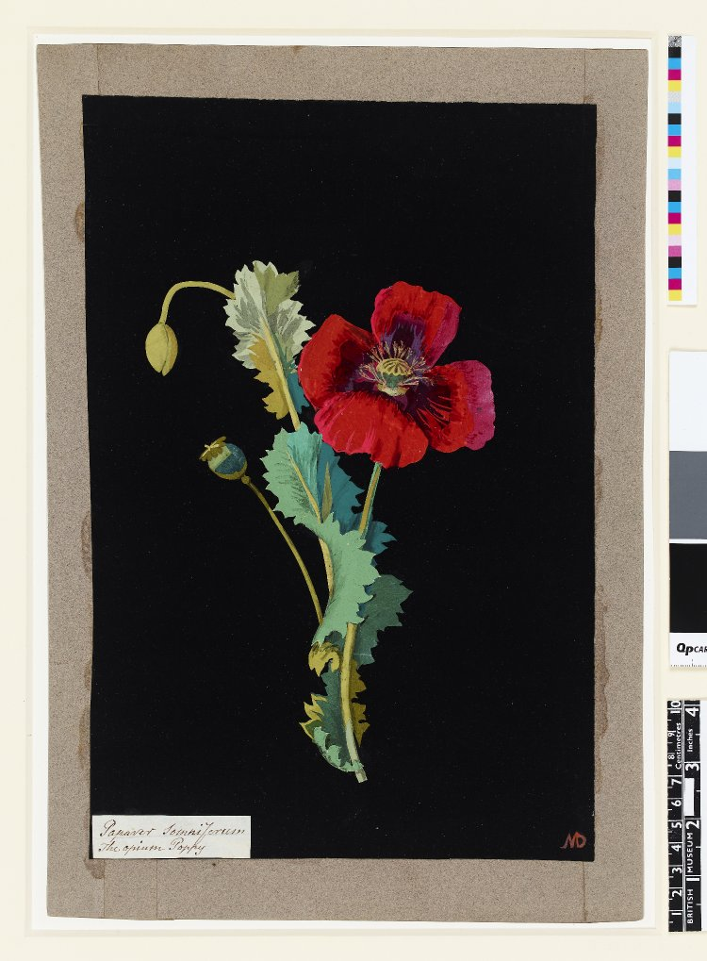
History of Opium
Few histories so critical about the relationship between the West and the East as the opium monopolies.
Apart from the obvious analysis of trade, profits and losses, and their contexts, all this is also part of the problem.
A fixed element in all this is the generalizing abstract language, which is immediately neutralized by asking about concrete details.
Notes:
https://www.britishmuseum.org/research/collection_online/collection_object_details/collection_image_gallery.aspx?assetId=1164254001&objectId=729283&partId=1
Museum number: 1897,0505.648 / Artist: Mary Delaney
Papaver Somniferum (Polyandria Monogynia), formerly in an album (Vol.VII, 48); The Opium Poppy. 1776 Collage of coloured papers, with bodycolour and watercolour, on black ink background
Dirks, Hans, 2012. History of the Opium Problem: The Assault on the East, ca. 1600-1950.
There are few histories so critical about the relationship between the West and the East as the opium monopolies, their enormous accumulation of capital in the ‘world’s most valuable single commodity trade in the 19th century’ (pg. 3). Apart from the obvious analysis of the trade, profits and losses, and their contexts, all this is also part of the problem (pg. 7). A fixed element in all this is the generalizing abstract language, which is immediately neutralized by asking about the concrete details. The European 19th century, with all its new ideologies, was the richest in inventions of this kind (pg. 8).
Hayes, Jack, P. Opium Wars in China , pg. 4
The opium the British sold in China was made from the sap of poppy plants, and had been used for medicinal and sometimes recreational purposes in China and other parts of Eurasia for centuries. After the British colonized large parts of India in the 17th century, the British East India Company, which was created to take advantage of trade with East Asia and India, invested heavily in growing and processing opium, especially in the eastern Indian province of Bengal. In fact, the British developed a profitable monopoly over the cultivation of opium that would be shipped to and sold in China.
By the early 19th century, more and more Chinese were smoking British opium as a recreational drug. But for many, what started as recreation soon became a punishing addiction: many people who stopped ingesting opium suffered chills, nausea, and cramps, and sometimes died from withdrawal. Once addicted, people would often do almost anything to continue to get access to this drug. The Chinese government recognized that opium was becoming a serious social problem and, in the year 1800, it banned both the production and the importation of opium. In 1813, it went one step further by outlawing the smoking of opium and imposing a punishment of beating offenders 100 times.
Note: The East India Company did not carry the opium itself but, because of the Chinese ban, farmed it out to “country traders”—i.e., private traders who were licensed by the company to take goods from India to China. The country traders sold the opium to smugglers along the Chinese coast. The gold + silver the traders received from those sales were then turned over to the East India Company. In China, the company used the gold + silver it received to purchase goods that could be sold profitably in England.

Slide 4
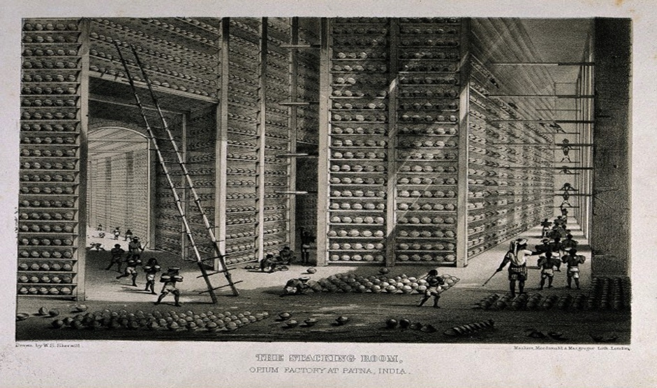
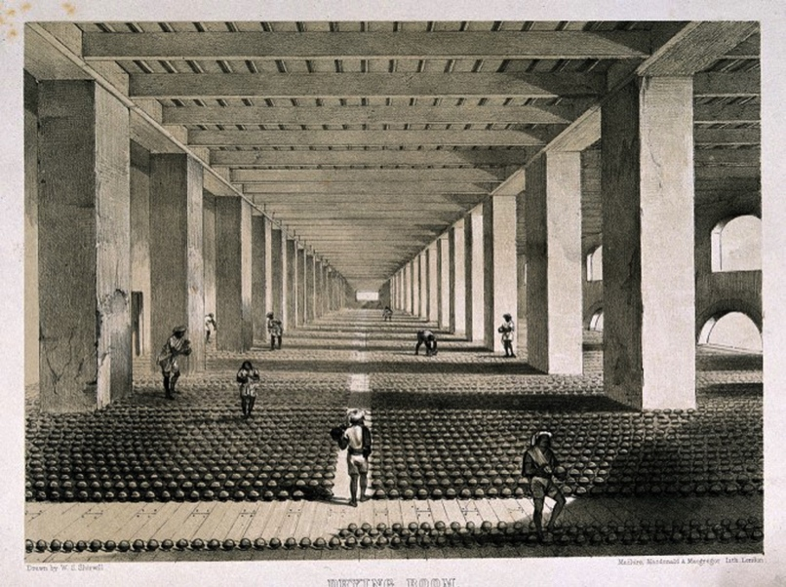
Opium Wars Overview
1839 - 1842
1856 - 1860
Critical Juncture in Modern Chinese History
China Weakened by Trade, Treaties and Civil Unrest
Notes:
Figure 1 + 2: A “stacking room” in an opium factory in Patna, India. On the shelves are balls of opium that were part of Britain’s trade with China.
Hayes, Jack, P. Opium Wars in China, pg.1
The Opium Wars in the mid-19th century was a critical juncture in modern Chinese history.
The1st Opium War was fought between China + Great Britain from 1839 to 1842.
In the 2nd Opium War, from 1856 to 1860, a weakened China fought both Great Britain + France.
China lost both wars.
From China’s historical perspective, the first Opium War was the beginning of the end of late Imperial China, a powerful dynastic system and advanced civilization that had lasted thousands of years. The war was also the first salvo (barrage) in what is now referred to in China as the “century of humiliation.” This humiliation took many forms. China’s defeat in both wars was a sign that the Chinese state’s legitimacy and ability to project power were weakening.
The Opium Wars further contributed to this weakening. The unequal treaties that western powers imposed on China undermined the ways China had conducted relations with other countries and its trade in tea. The continuation of the opium trade, moreover, added to the cost to China in both silver and in the serious social consequences of opium addiction. Furthermore, the many rebellions that broke out within China after the first Opium War made it increasingly difficult for the Chinese government to pay its tax and huge indemnity obligations.
[Transition] – Why are the lessons of the opium wars still relevant today? … Economic, Social and Political legacies …

Slide 5
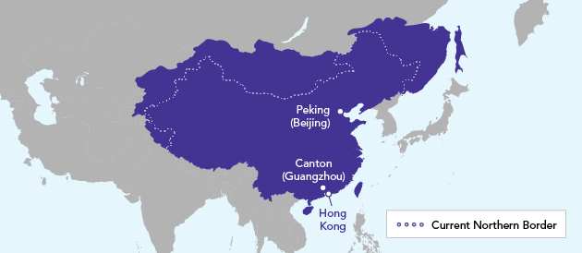
Free Trade or Retribution?
Restricted foreign trade was subjected to regulations imposed by the Imperial Chinese government, which reflected China’s strength.
Notes:
Hayes, Jack, P. Opium Wars in China, pg. 2 / China’s Borders as of 1820 (Map 1):
In the decades leading up to the 1st Opium War, trade between China and the West took place within the confines of the Canton System, based in the southern Chinese city of Guangzhou (also referred to as Canton). An earlier version of this system had been put in place by China under the Ming Dynasty (1368-1644), and further developed by its replacement, the Qing Dynasty, also known as the Manchu Dynasty. (The Manchus were the ethnic group that ruled China during the Qing period). In the year 1757, The Qing emperor ordered that Guangzhou/Canton would be the only Chinese port opened to trade with foreigners, and that trade could take place only through licenced Chinese merchants. This effectively restricted foreign trade and subjected it to regulations imposed by the Imperial Chinese government. It’s ability to impose and enforce these rules reflected China’s strength at the time.
https://en.wikipedia.org/wiki/Opium_Wars
In 1820, China's economy was the largest in the world, according to British economist Angus Maddison.^{[3]} Within a decade after the end of the Second Opium War, China's share of global GDP had fallen by half.^{[4]} In another research paper published by Michael Cemblast of JP Morgan^{[citation needed]} and updated by the World Economic Forum, similar conclusions were reached—i.e. China was the largest economy in the world for many centuries until the Opium Wars.^{[3]}
-----
Was it free trade or retribution?

Slide 6
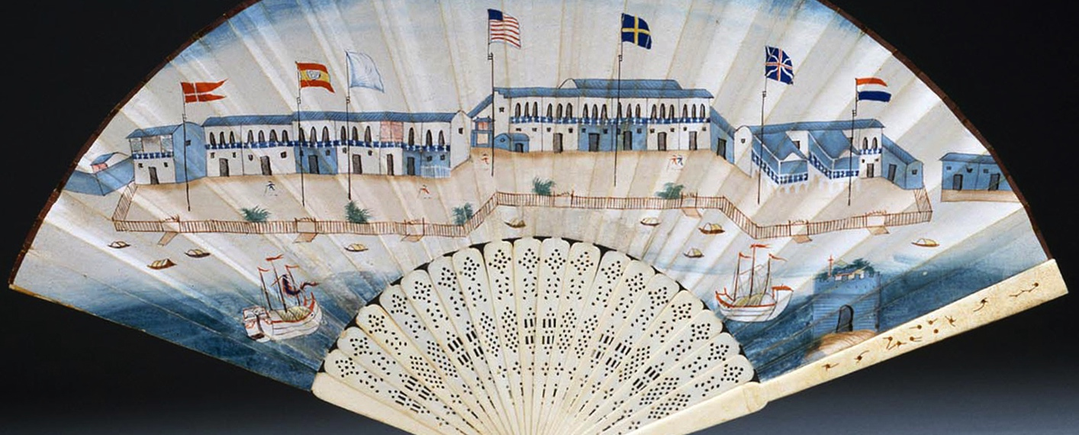
The Canton Trade System
China art and luxury items were prized in upper class circles in Europe and the United States.
Notes:
Source: Peabody Essex Museum [cwOF_1790c_E80202_fan]
Fan with View of Foreign Factories, Canton, 1790-1800. China Ivory, gouache on paper Gift of Mr. & Mrs. John E. Rogerson, 1977 E80202 From the catalogue:
This paper fan is decorated with a charmingly native painting of the foreign Factory site at Canton, where the business of trade was primarily conducted during this period, is depicted on this fan created for the foreign market. Seven national flags fly from the Western headquarters that line the shore.
What are the 7 national flags? POR, ESP, FIN, USA, SWE, GBR, FRA.
Perdue, Peter, C. Rise and Fall of the Canton Trade System: China in the World (1700-1860s).
In Western eyes, the Canton trade system became the source of a romanticized image of both Western commercial activity and China itself. Fine examples of Chinese art and luxury items – porcelain, lacquer, silk, and furniture – were prized in upper-class circles in Europe and the United States. Tea became a favourite import in the West. And at the same time, foreign merchants commissioned both Western and Chinese artists to provide a visual record of their own involvement in the China Trade. What we encounter in these visuals, in short, is the Canton trade system as portrayed largely through (and for) the eyes of the non-Chinese – colourful, romantic, sometimes exotic, often heroic, and exceedingly incomplete.
Reference: https://en.wikipedia.org/wiki/Thirteen_Factories
As Geoff noted previously, the "factories" were offices, trading posts, and warehouses of foreign factors,^{[1]} where mercantile fiduciaries who bought and sold goods on consignment for their principals. The word derives from “feitoria” which means trading post in Portuguese (the first westerners to engage in trade with China). The foreign agents were known at the time as "supercargos" in English and as daban (大班) in Chinese. This term's Cantonese pronunciation, tai-pan, only came into common English use after the rise of private trading from 1834 on.^{[2]} A private captain might be his own supercargo; a large East Indiamen might have five or more, which were ranked "chief supercargo", "2nd supercargo", and so on. A team of supercargos divided their work, some overseeing sales, others tea purchases, silk purchases, and so forth.^{[3]} Permanent supercargos might divide their work by the order ships arrived. The bookkeepers who attended them were called "writers"; those serving with the ship, who also checked these accounts, "pursers".^{[4]}
Transition: "Hong" is the Cantonese pronunciation of 行, the Chinese term for a properly-licensed business.[2] By analogy, it was applied to its chief, the Hong merchant, and its property, the factories themselves.

Slide 7
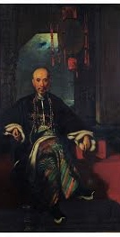
China Markets
Western traders conducted business through licensed monopoly companies, and co-hong system of trade.
GBR demanded greater access to China markets as silver was draining out of England for tea and porcelain.
Failed trade missions convinced Britain that only force would induce the Qing government to open China’s ports.
Notes:
Source: George Chinnery (1748-1847). Hoqua. 1830? Oil on Canvas, 25 x 18 5/8 in. (63.5 x 46.3 cm).
Bequest of W. Gedney Beatty, 1941 (41.160.405). © The Metropolitan Museum of Art.
Wu Bingjian (Howqua) a leading Hong merchant in Guangzhou.
Perdue, Peter, C. The First Opium War: Anglo-Chinese War of 1839-1842
Western traders, for their part, mainly conducted trade through licensed monopoly companies, like Britain’s East India Company and the Dutch VOC. Despite these restrictions, both sides learned how to make profits by cooperating with each other. The Chinese Hong merchants, the key intermediaries between the foreign traders and the officials, developed close relations with their Western counterparts, instructing them on how to conduct their business without antagonizing the Chinese administration or bureaucracy.
As the volume of trade grew, however, the British demanded greater access to China’s markets. Tea exports from China grew from 92,000 pounds in 1700 to 2.7 million pounds in 1751. By 1800 the East India Company was buying 23 million pounds of tea per year at a cost of 3.6 million pounds of silver. Concerned that the China trade was draining silver out of England, the British searched for a counterpart commodity to trade for tea and porcelain. They found it in opium, which they planted in large quantities after they had taken Bengal, in India, in 1757.
British merchants blamed the restrictions of the Canton trade for the failure to export enough goods to China to balance their imports of tea and porcelain. Thus, Lord George Macartney’s mission to the court in Beijing in 1793 aimed to promote British trade by creating direct ties between the British government and the emperor. Macartney, however, portrayed his embassy as a tribute mission to celebrate the emperor’s birthday (Qianlong). He had only one man with him who could speak Chinese.
When he tried to raise the trade question, after following the tribute rituals, Macartney’s demands were rejected. His gifts of astronomical instruments, intended to impress the Qing emperor with British technological skills, in fact did not look very impressive: the emperor had already received similar items from Jesuits in earlier decades. Macartney’s failure, and the failure of a later mission (the Amherst embassy). in 1816, helped to convince the British that only force would induce the Qing government to open China’s ports.
Hayes, Jack, P. Opium Wars in China, pg. 5
In response, the British East India Company hired private British and American traders to transport the drug to China. Chinese smugglers bought the opium from British and American ships anchored off the Guangzhou coast and distributed it within China through a network of Chinese middlemen. By 1830, there were more than 100 Chinese smugglers’ boats working the opium trade. This reached a crisis point when, in 1834, the British East India Company lost its monopoly over British opium. To compete for customers, dealers lowered their selling price, which made it easier for more people in China to buy opium, thus spreading further use and addition.
Ross, Monique and Quince, Annebelle. Modern China and the Legacy of Opium. https://www.abc.net.au/news/2018-09-02/modern-china-and-the-legacy-of-the-opium-wars/10172386 Retrieved 24-November-2018.
The illegal drug being used by China's elite suddenly became accessible to the masses. "What the British did is they fuelled the consumption by supplying more, by making it possible for the middle classes to join in,” Yang-Wen Zheng, a professor of Chinese history at the University of Manchester. The British argued that the war was not about the right to trade opium, but rather the right to free trade across China. Once Britain had opened the door, France and America also came knocking.

Slide 8
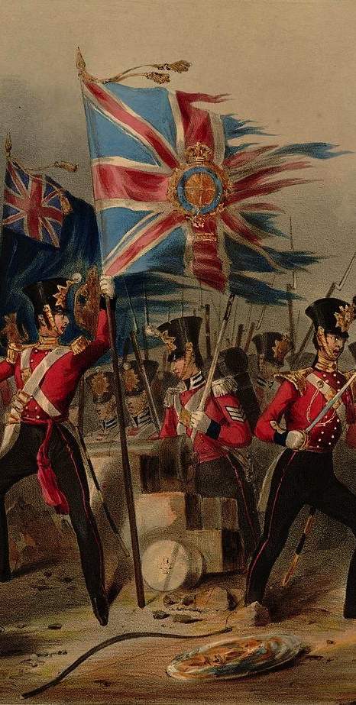
East Meets West
Western Imperial powers such as GBR, FRA and USA were aggressively expanding their influence around the world through their economic and military strength.
China was not effective in responding to the ‘modern’ West with its growing industrialism, mercantilism, and its military strength.
Notes:
Hayes, Jack, P. Opium Wars in China, pg. 1
By the mid-19th century, western imperial powers such as GBR, FRA + USA were aggressively expanding their influence around the world through their economic + military strength + by spreading religion, mostly through the activities of Christian missionaries. These countries embraced ideas of free trade + their militaries had become so powerful they could impose such ideas on others. In one sense, China was relatively effective in responding to this foreign encroachment; unlike its neighbors, including present-day India, Burma (now Myanmar), Malaya (now Malaysia), Indonesia, + Vietnam. China did not become a full-fledged, formal colony of the West. In addition, Confucianism, the system of beliefs that shaped + organized China’s culture, politics, + society for centuries, was secular + therefore was not necessarily an obstacle to science + modernity in the ways that Christianity, Islam + Hinduism sometimes were in other parts of the world.
In another sense, China was not effective in responding to the “modern” West with its growing industrialism, mercantilism, and military strength. 19th Century China was a large, mostly land based empire (see Map 1), administered by a 2,000 year old bureaucracy and dominated by centuries-old Confucian ideas of political, social and economic management. All of these things made China, in some ways, dramatically different from the European powers of the day, and it struggled to deal effectively with encroachment. The ineffectiveness resulted in, or at least added to, longer-term problems in China, such as unequal treaties, repeated foreign military invasions, massive internal rebellions, internal political fights, and social upheaval.
While the 1st War of 1839-1842 did not cause the eventual collapse of China’s 5,000 year imperial dynastic system seven decades later, it did help shift the balance of power in Asia in favour of the West.
[Image] Title: The 18th. (Royal Irish) Regiment of Foot: at the storming of the Fortress of Amoy. August 26th 1841
Subtitle: at the storming of the Fortress of Amoy. August 26th 1841
Series: Prints, Drawings and Watercolors from the Anne S.K. Brown Military Collection
Contributors
Hayes, Michael Angelo, 1820-1877 (artist)
Lynch, James Henry, died 1868 (lithographer)
J. Graf (printer)
Spooner, William (publisher)
Date Issued: 1840-1844
Abstract 26th in coll. of 34 (of 53?) col. lith. pl., 3 variants, 2 watercolour originals of uniform groups by J.H. Lynch after Hayes; infantry unit with 2 tattered flags storming over fortress wall with cannon, driving off defenders wearing strange striped cat-like uniforms.
https://en.wikipedia.org/wiki/Battle_of_Amoy
The Battle of Amoy or Xiamen was fought between British and Qing forces at Xiamen (then known as "Amoy" from the local pronunciation of the name) on Xiamen Island, Fujian, in the Qing Empire on 26 August 1841 during the First Opium War. The British captured the forts at Xiamen and on nearby Gulangyu Island("Kulangau").
Rosa Luxemburg provides a brief account of the battle in her book The Accumulation of Capital.
"On August 25, 1841, the British approached the town of Amoy, whose forts were armed with a hundred of the heaviest Chinese guns. These guns being almost useless, and the commanders lacking in resource, the capture of the harbour was child’s play. Under cover of a heavy barrage, British ships drew near the walls of Kulangau, landed their marines, and after a short stand the Chinese troops were driven out. The twenty-six battle-junks with 128 guns in the harbour were also captured, their crews having fled. One battery, manned by Tartars, heroically held out against the combined fire of three British ships, but a British landing was effected in their rear and the post wiped out."^{[9]}

Slide 9
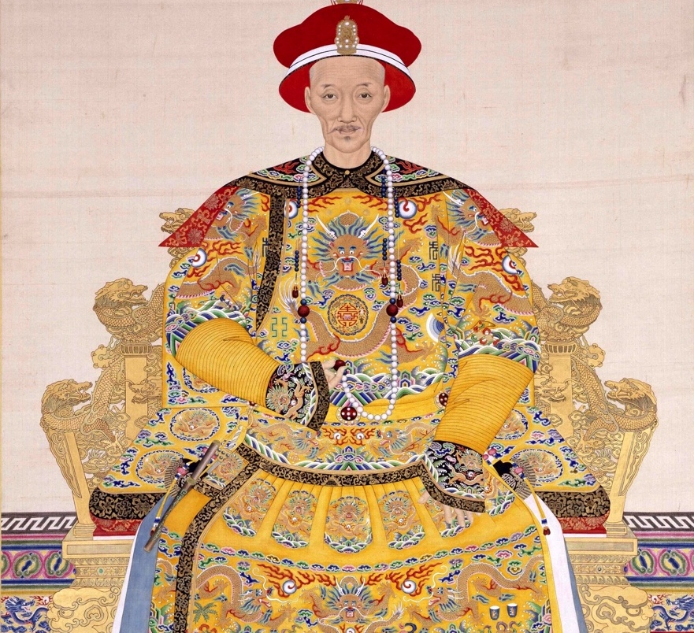
Daoguang Era
Son of Heaven miscalculated European ideology
Limited knowledge of basic economics of a war on drugs
Dependency on Duty Import Tax
Notes:
[Reference: https://en.wikipedia.org/wiki/Daoguang_Emperor]
The historian Jonathan Spence characterizes the Daoguang Emperor as a "well meaning but ineffective man," who promoted officials who "presented a purist view even if they had nothing to say about the domestic and foreign problems surrounding the dynasty."^{[1].}. Daoguang Emperor (16 September 1782 – 26 February 1850) was the eighth emperor of the Manchu-led Qing dynasty and the sixth Qing emperor to rule over China proper, from 1820 to 1850. His reign was marked by "external disaster and internal rebellion," that is, by the First Opium War, and the beginning of the Taiping Rebellion which nearly brought down the dynasty.
The Daoguang Emperor ultimately had a poor understanding of the British and the industrial revolution that Britain and Western Europe had undergone, preferring to turn a blind eye to the rest of the world. It was said that the emperor did not even know where Britain was located in the world. His 30-year reign introduced the initial onslaught by Western imperialism and foreign invasions that would plague China, in one form or another, for the next one hundred years.
The Daoguang Emperor failed to understand the intention or determination of the Europeans, or the basic economics of a war on drugs. Although the Europeans were outnumbered and thousands of miles away from logistical support in their native countries, they could bring far superior firepower to bear at any point of contact along the Chinese coast. The Qing government was highly dependent on the continued flow of taxes from southern China via the Grand Canal, which the British expeditionary force easily cut off at Zhenjiang.

Slide 10
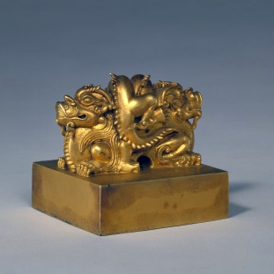
Qing Dynasty
British merchants import opium > 30,000 chests
Imperial edicts banning opium in 1820’s + 1830’s
Imperial High Commissioner appointed in 1839
Notes:
[Reference: https://en.wikipedia.org/wiki/Daoguang_Emperor]
During the Daoguang Emperor's reign, China experienced major problems with opium, which was imported into China by British merchants. Opium had started to trickle into China during the reign of the Yongzheng Emperor, (x-x) but was limited to approximately 200 chests annually. By the time of the Qianlong era (x-x), this amount had increased to 1,000 chests, 4,000 chests by the Jiaqing era (x-x) and more than 30,000 chests during the Daoguang era (x-x). The Daoguang Emperor issued many imperial edicts banning opium in the 1820s and 1830s, which were carried out by Lin Zexu, whom he appointed as an Imperial Commissioner.
Image: Palace Museum (Seal)

Slide 11
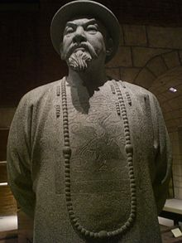
Lin Zexu
Mandate to enforce a total ban on opium imports
Efforts led directly to the 1st Opium War
Exposed technological and military inferiority.
Notes:
Hong Kong Museum of History – Didactic Panel
His integrity and dedication earned him an appointment of Imperial Commissioner, and he arrived in Guangzhou 1839 with instructions from Emperor Daoguang to enforce a total ban on the importation of opium. Unswervingly honest, he never flinched from his duty.
Hayes, Jack, P. Opium Wars in China, pg. 6-7
He arrested over 1,600 Chinese dealers and seizing and destroying tens of thousands of opium pipes. He also demanded that foreign companies (British companies in particular) turn over their supplies of opium in exchange for tea. When the British refused to do so, Lin stopped all foreign trade and quarantined the area to which these foreign merchants were confined.
After 6 weeks, the foreign merchants gave in to Lin’s demands and turned over 2.6 million pounds of opium (over 20,000 chests). Lin’s troops also seized and destroyed the opium that as being held on British ships – the British Superintendent claimed these ships were in international waters, but Lin claimed they were anchored in and around Chinese islands.
Lin then hired 500 Chinese men to destroy the opium by mixing it with lime and salt and dumping it into the bay. Finally, he pressured the Portuguese, who had a colony in nearby Macao, to expel the uncooperative British, forcing them to move to the island of Hong Kong.
Taken together, these actions raised the tensions that led to the outbreak of the 1st Opium War. For the British, Lin’s destruction of the opium was an affront to British dignity and their concepts of trade. Many British merchants, smugglers, and the British East India Company had argued for years that China was out of touch with ‘civilized’ nations, which practised free trade and maintained ‘normal’ international relations through consular officials and treaties.
More to the point, British representatives in Guangzhou requested that merchants turn over their opium to Lin, guaranteeing that the British government would compensate them for their losses. The idea in the short term was that this would prevent a major conflict, keep merchants and the ships safe while reopening the extremely profitable China trade in other goods. The huge opium liability (the opium was worth millions of pounds sterling) and increasingly shrill demands from merchants in China, India, and London when they discovered their profits were destroyed, gave politicians in Great Britain the excuse they were looking for to act more forcefully to expand British imperial interests in China.
Lin Zexu's efforts to halt the spread of opium in China led directly to the First Opium War. With the development of the First Opium War, Lin Zexu was made a scapegoat. The Daoguang Emperor removed his authority and banished him to Yili. Meanwhile, in the Himalayas, the Sikh Empire attempted an occupation of Tibet but was defeated in the Sino-Sikh war (1841–1842). On the coasts, the Qing Empire lost the war, exposing their technological and military inferiority to European powers, and ceded Hong Kong to the British in the Treaty of Nanjing in August 1842.

Slide 12
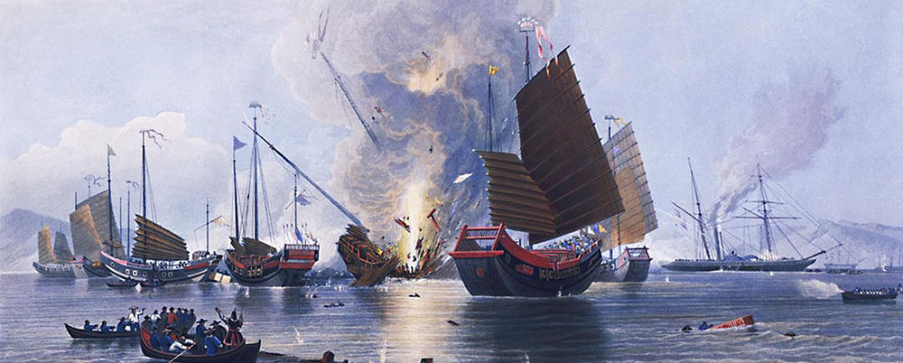
Wars of Aggression
Britain proclaimed their aim was to fight government officials and soldiers who abused the people, but Britain exploited a deep rift between the government and the people, a weakness in Qing society.
Notes:
Image: Battle in Anson’s Bay (1841)
Battle in Anson's Bay on 7 January 1841 - painted by Edward Duncan in about 1843. Duncan (1803-1882) was a prolific British painter who specialised in maritime subjects.
The Nemesis (right background) destroying Chinese war junks in Anson's Bay.
https://www.britannica.com/place/China/The-first-Opium-War-and-its-aftermath#ref590493 Retrieved November 17, 2018
The Qing had no effective tactics against the powerful British navy. They retaliated merely by setting burning rafts on the enemy’s fleet and encouraging people to take the heads of the enemies, for which they offered a prize. The imperial banner troops, although they sometimes fought fiercely, were ill-equipped and lacked training for warfare against the more-modern British forces. The Green Standard battalions were similarly in decay and without much motivation or good leadership. To make up the weakness, local militias were urgently recruited, but they were ineffective.
The British proclaimed their aim was to fight the government officials and soldiers who abused the people, not to make war against the Chinese population. And indeed there was a deep rift between the government and the people that the British could easily exploit, a weakness in Qing society that became apparent during the crisis of the war.

Slide 13
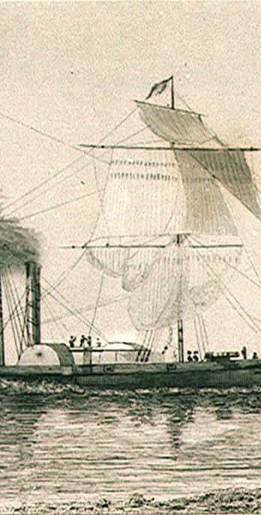
Foreign Trading Ships
Each time British navel forced its way through those in charge of the forts were publicly disgraced.
The flawed emplacements became a symbol of China’s refusal to respond to a changing world.
It showed the ineffectual chain of command between the Emperor and provincial viceroy in the south.
Notes:
Wiltshire, Trea, 2004. Encounters with China: Merchants, Missionaries and Mandarins (pg,15).
Foreign trading ships that approached Canton, moved between forts guarding China’s southern gateway. It was soon appreciated that a fast-moving frigate could easily elude the fixed cannon, and at the same time reduce the forts to rubble. Each time a British naval vessel forced its way through, those in charge of the forts were publicly disgraced. But the flawed emplacements themselves were never strengthened, and became a symbol of China’s refusal to respond to a changing world, and of the ineffectual chain of command between the Emperor and his provincial viceroy in the south.
Image: Nemesis and other British ships engaging Chinese junks in the Second Battle of Chuenpi, 7 January 1841
Source: Thomas Allom; G. N. Wright (1858). The Chinese Empire Illustrated. Volume 2. London: London Printing and Publishing Company. p. 125.
Nemesis arrived off the coast of China in late 1840,^{[3]} although when she set sail from Liverpool it was publicly intimated that she was bound for Odessa to keep the voyage a secret.^{[5]} A British officer wrote that the outbreak of the First Opium War "was considered an extremely favourable opportunity for testing the advantages or otherwise of iron steam-vessels."^{[11]} She first saw action in the Second Battle of Chuenpi on 7 January 1841 against the Chinese fleet at the Bocca Tigris forts. In the Battle of First Bar (27 February), Nemesis sank Cambridge, an old, but re-armed East Indiaman that the Chinese had purchased. Due to Nemesis's shallow draught, Nemesis was able to move through shallow water during the Broadway expedition on 13–15 March and aided in the capture of Canton on 18 March. Based in Chusan, she also saw action at Taisam in February 1842, in a successful skirmish associated with repulse of a much larger Chinese attack on Ningbo.^{[4]}

Slide 14
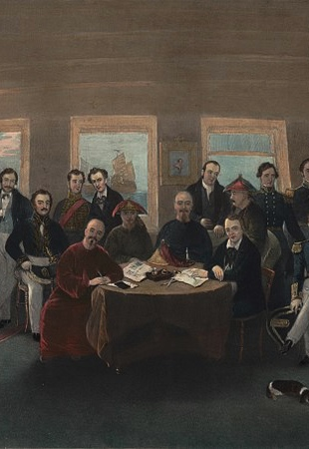
Treaty of Nanking
China ceded Hong Kong to British control, opened treaty ports to trade with Foreigners, and granted special rights.
Opium trade increased in the name of free trade with no regard for the Chinese government and people.
Notes:
“The Signing and Sealing of the Treaty of Nanking in the State Cabin of H. M. S. Cornwallis, 29th August, 1842” (detail) / Painted by Capt. John Platt
Hayes, Jack, P. Opium Wars in China, pg.1
The terms of defeat was a bitter pill to swallow: China had to cede the territory of Hong Kong to British control, open treaty ports to trade with foreigners, and grant special rights to foreigners operating within the treaty ports. In addition, the Chinese government had to stand by as the British increased their opium sales to people in China. The British did this in the name of free trade and without regard to the consequences for the Chinese government and Chinese people.
Perdue, Peter, C. The First Opium War: Anglo-Chinese War of 1839-1842
Under the Treaty of Nanking, signed on August 29, 1842, China agreed to open the 5 ports requested (Canton, Amoy, Foochow, Ningpo, and Shanghai), pay an indemnity of 20 million silver dollars, abolish the Co-hong monopoly that controlled trade in and through Canton, and adhere to a fixed schedule of customs duties. In addition, the British were granted the right to occupy Hong Kong in perpetuity; this was their sole outright territorial acquisition.
https://www.britannica.com/place/China/The-first-Opium-War-and-its-aftermath#ref590493 Retrieved November 17, 2018
The Treaty of Nanjing was followed by two supplementary arrangements with the British in 1843. In addition, in July 1844 China signed the Treaty of Wanghia (Wangxia) with the United States and in October the Treaty of Whampoa (Huangpu) with France. These arrangements made up a complex of foreign privileges by virtue of the most-favoured-nation clauses (guaranteeing trading equality) conceded to every signatory. All in all, they provided a basis for later inroads such as the loss of tariff autonomy, extraterritoriality (exemption from the application or jurisdiction of local law or tribunals), and the free movement of missionaries. With the signing of the treaties—which began the so-called treaty-port system—the imperial commissioner Qiying, newly stationed at Guangzhou, was put in charge of foreign affairs. Following a policy of appeasement, his dealings with foreigners started fairly smoothly. But, contrary to the British expectation, the amount of trade dropped after 1846, and, to British dissatisfaction, the question of opium remained unsettled in the postwar arrangements. The core of the Sino-Western tension, however, rested in an anti-foreign movement in Guangdong.

Slide 15
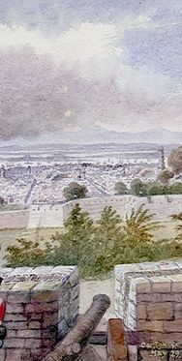
Effect of 1st Opium War
The war brought great death and destruction to China, and the treaty that followed was far more detrimental.
The Treaty of Nanjing served to exploit China for further economic gains, as it allowed the Europeans residency for the purpose of mercantile pursuits.
The Opium Trade continued to flourish and the situation in China worsened. For Britain, opium brought great wealth and economic development.
Notes:
https://upload.wikimedia.org/wikipedia/commons/0/09/Canton_from_the_Heights.jpg
(Fixed) Canton from the Heights, May 29 1841.
Edward H. Cree (1814-1901)
Effect of The War of Opium Part 1:
1. The war brought great death and destruction to China, but the treaty that followed was far more detrimental.
2. the Treaty of Nanjing, which in reality only served to exploit China for economic gain even further, as it allows the European to reside, for the purpose of carrying on their Mercantile pursuits, without molestation or restraint...” The series of unequal treaties that followed the first Opium War left the Chinese powerless. China was eventually forced to give in to the colonial powers that it had resisted for centuries before.
3. As a result, the opium trade continued to flourish, and the situation in China worsened. For Britain, opium brought great wealth and economic development, as well as a justification for its colonial endeavors in India. For China, on the other hand, the opium trade brought both social and economic degradation, a devastating war, and a series of unequal treaties that opened up the country to the exploitation of European imperial powers.

Slide 16
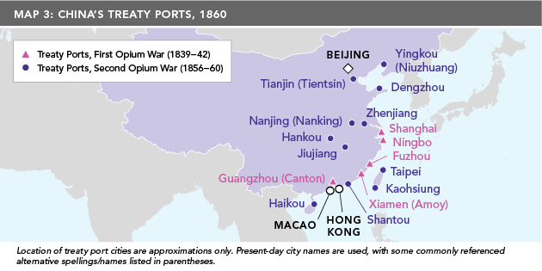
Trade, Treaties + Civil Unrest
Second Opium War broke out and continued when the British and French captured Beijing and forced on China a new round of unequal treaties, indemnities and the opening of 11 more treaty ports.
Notes:
[Hayes, Jack, P. Opium Wars in China, pg. 13]
In 1856, a second Opium War broke out and continued to 1860, when the British and French captured Beijing and forced on China a new round of unequal treaties, indemnities and the opening of 11 more treaty ports. This also led to increased Christian missionary work and legalization of the opium trade. Even though new ports were opened to British merchants after the 1st Opium War, the Chinese dragged their feet on implementing agreements, and legal trade with China remained limited. British merchants pressed their government to do more, but the government’s hands were tied because the Chinese government in the capital city of Beijing restricted who it met with.

Slide 17
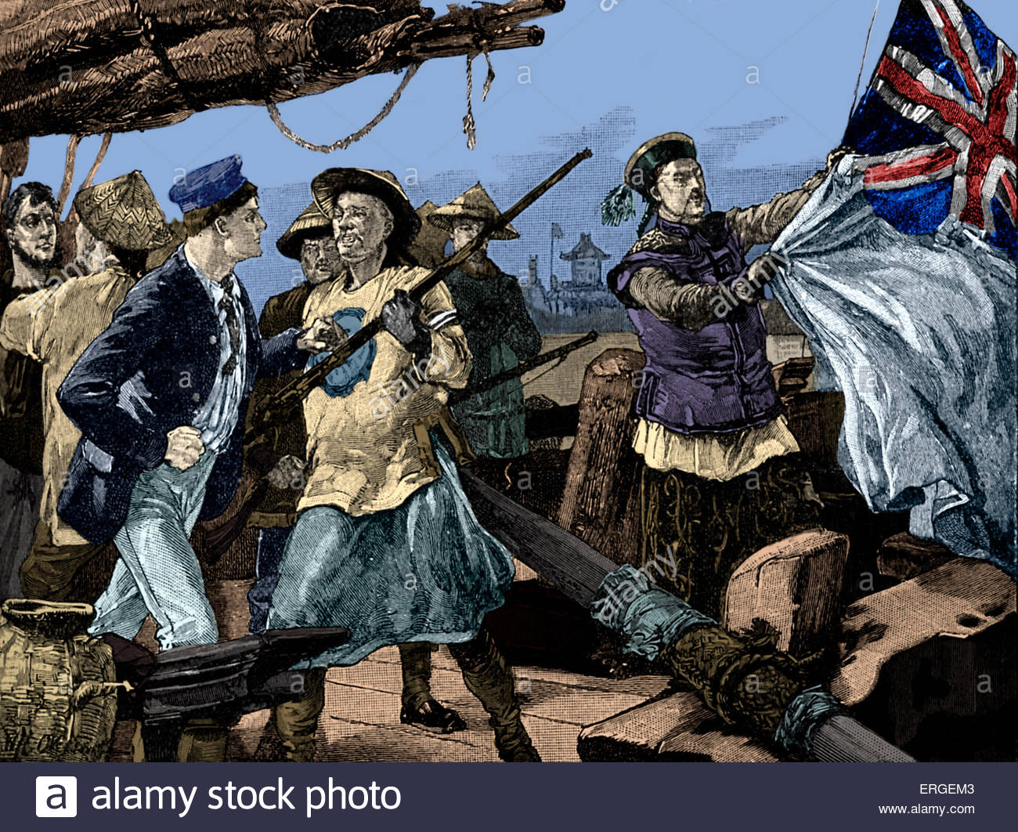
Arrow War
Guangzhou’s authorities seized the Arrow, a Chinese-owned but British-registered ship, and charged its Chinese crew with piracy + smuggling.
Notes:
Image: Getty: Culture Club https://www.abc.net.au/news/2018-08-31/chinese-officials-pulling-down-british-flag-on-ship-the-arrow/10174532
Second Opium War: Chinese officials pulling down British flag on ship the Arrow. On 8 October 1856, Qing officials board Hong Kong - registered Arrow and arrested sailors for smuggling and piracy. British officials in Guangzhou demanded release of the sailors under the rules of Treaty of Nanking. They claimed that Qing officials had insulted the British flag on the Arrow.
The second Opium War (Arrow War)
In the strained atmosphere in Guangzhou, where the xenophobic governor-general, Ye Mingchen, was inciting the Cantonese to annihilate the British, the Arrow incident occurred in October 1856. Guangzhou police seized the Arrow, a Chinese-owned but British-registered ship flying a British flag, and charged its Chinese crew with piracy and smuggling. The British consul Harry Parkes sent a fleet to fight its way up to Guangzhou. French forces joined the venture on the plea that a French missionary had been officially executed in Guangxi.
The British used this as an opportunity to pressure China militarily to open itself up even further to British merchants and trade. France, using the execution in China of a French Christian missionary as an excuse, joined the British in the fight. Joint French-British forces captured Guangzhou before moving north to the city of Tianjin (also referred to as Tientsin). In 1858, the Chinese agreed – on paper – to a series of western demands contained in documents like the Treaty of Tientsin. But then they refused to ratify, which led to further hostilities.

Slide 18
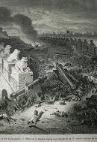
Treaty of Tiensin
Anglo-French forces occupied Guangzhou and took Dagu forts and marched onto Tianjin.
Qing representatives complied with British and French demands for foreign diplomats in Beijing.
Notes:
Image: Palikao's bridge, on the evening of the battle, by Émile Bayard
"Battle of the Eight-Mile Bridge” was fought at the bridge of Palikao by Anglo-French forces against the Qing Empire during the Second Opium War on the morning of 21 September 1860. It allowed Western forces to take the capital Beijing and eventually defeat the Qing Empire.
Émile-Antoine Bayard (November 2, 1837 – 6 December 1891) was a French illustrator born in La Ferté-sous-Jouarre, Seine-et-Marne. A student of Léon Cogniet, he is best known by many for his illustration of Cosette from Les Misérables by Victor Hugo. He died in Cairo.^{[1}
https://www.britannica.com/place/China/The-first-Opium-War-and-its-aftermath#ref590493 Retrieved November 17, 2018
The British government sent an expedition under Lord Elgin as plenipotentiary. The Russians and the Americans abstained but sent their representatives for diplomatic maneuvering. At the end of 1857 an Anglo-French force occupied Guangzhou, and in May 1858 they took the Dagu forts and marched to Tianjin. The Qing representatives had no choice but to comply with the demands of the British and French; the Russian and U.S. diplomats also gained the privileges their militant colleagues secured by force. During June, four Tianjin treaties were concluded that provided for, among other measures, the residence of foreign diplomats in Beijing and the freedom of Christian missionaries to evangelize their faith. The 1858–60 treaties extended the foreign privileges granted after the first Opium War and confirmed or legalized the developments in the treaty-port system. The worst effects for the Qing authorities were not the utilitarian rights, such as trade, commerce, and tariff, but the privileges that affected the moral and cultural values of China. The right to propagate Christianity threatened Confucian values, the backbone of the imperial system. The permanent residence of foreign representatives in Beijing signified an end to the long-established tributary relationship between China and other nations. The partial collapse of the tribute system meant a loss of the emperor’s virtue, a serious blow to dynastic rule in China.
Popular uprising
The third quarter of the 19th century was marked by a series of uprisings, again as a result of social discontent. In particular, the Taiping Rebellion…

Slide 19
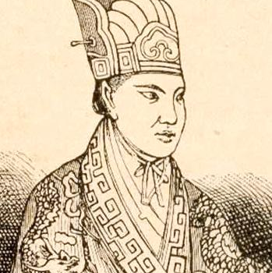
Taiping Rebellion
Hung Hsiu-ch’uan experienced a profound spiritual revelation, which prompted a quasi-Christian movement.
Support for him came from those drawn by the promise of land reform, a better way of life, and and end to the Manchu rule and corruption.
Notes:
Image: Public Domain, https://commons.wikimedia.org/w/index.php?curid=1338887
Wiltshire, Trea, 2004. Encounters with China: Merchants, Missionaries and Mandarins
Was lead by Hung Hsiu-ch’uan, the son of Hakka peasant, who experienced a profound spiritual revelation which prompted him to form a quasi-Christian movement. Eventually the movement became more military than spiritual, and so powerful that it challenged the ruling dynasty, Claiming direct communication with the Holy Trinity and implementing a strictly moral regime that outlawed opium smoking, foot binding, and prostitution. Hung proclaimed himself ‘heavenly king’. Support for him came from those drawn by the promise of land reform, a better way of life, and an end to the Manchu rule and corruption (pg.41-43) .
Weeks before the allies torched the Summer Palace, the Taiping rebels attacked Shanghai. When Major Charles George Gordon arrived in the treaty port in September 1860, on his way to join Lord Elgin’s force, he noted the grisly sight of rebel heads displayed on the city walls. Although Anglo-Chinese force had repelled the attack on Shanghai, residents were fearful as stories of the fanatical, longhaired rebels flooded the city with each wave of refugees. To bolster the defense of the treaty port, foreign merchants put up the money for a force that called itself the Ever Victorious Army. The exploits of tis fighting force – its officers composed of a cosmopolitan band of soldiers of fortune, its ranks of Chinese soldiers attracted by generous pay – soon attracted the attention of a young Chinese commander, Li Hung-Chang (pg. 62). By now, the combined forces had driven the rebels back to their capital, Nanking, where the final battles were fought in July of 1864. Hung, the ‘heavenly king’ poisoned himself with gold leaf and his wives hung themselves over his grave. It was a grisly end to a violent era that, in its final days alone, cost an estimated hundred thousand lives (pg. 64).
Note:
Ross, Monique and Quince, Annebelle (2018). Modern China and the Legacy of Opium. https://www.abc.net.au/news/2018-09-02/modern-china-and-the-legacy-of-the-opium-wars/10172386 Retrieved 24-November-2018.
The rebellion has “a direct link to the arrival of foreign ideas and foreigners on the China coast.”

Slide 20
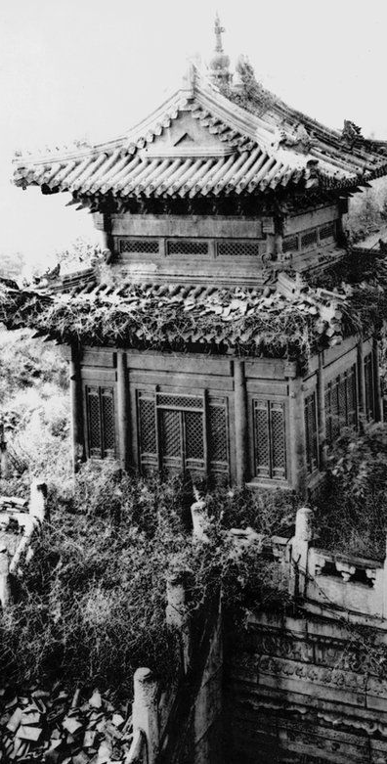
Old Summer Palace
Yuanmingyuan was once the most beautiful collection of art + architecture.
British and French destroyed the Old Summer Palace in 1860.
Controversial legacy in British and French art collections full of looted objects.
Notes:
Getty Image: Old Summer Palace 1860
https://www.bbc.com/news/magazine-30810596. Retrieved xxx
The palace of shame that makes China angry
By Chris Bowlby BBC News, Beijing
2 February 2015
The revenge was taken by Britain, in destroying the old Summer Palace in Beijing in 1860 – it was a moment, says one scholar, that "changed world history”. The Summer Palace was once the most beautiful collection of architecture and art in the country. Its Chinese name was Yuanmingyuan - Garden of Perfect Brightness - where Chinese emperors had built a huge complex of palaces and other fine buildings, and filled them with cultural treasures. . And it has left a controversial legacy in British art collections - royal, military, private - full of looted objects.
The British-French army was sent towards the end of the Opium Wars to force Chinese imperial rulers to open up their country further to Western trade and influence. In command on the British side was the 8th Earl of Elgin, from one of the most famous families in British imperial history. By coincidence, one of the story's central characters is Lord Elgin - son of the man who removed the so-called "Elgin marbles" from Greece. But there's a twist - a hidden side to this story – Thomas Bowlby, one of the first British foreign correspondents who along with other captives were held and tortured to death. Elgin commanded the destruction as retribution to punish the Emperor and not its people ….

Slide 21
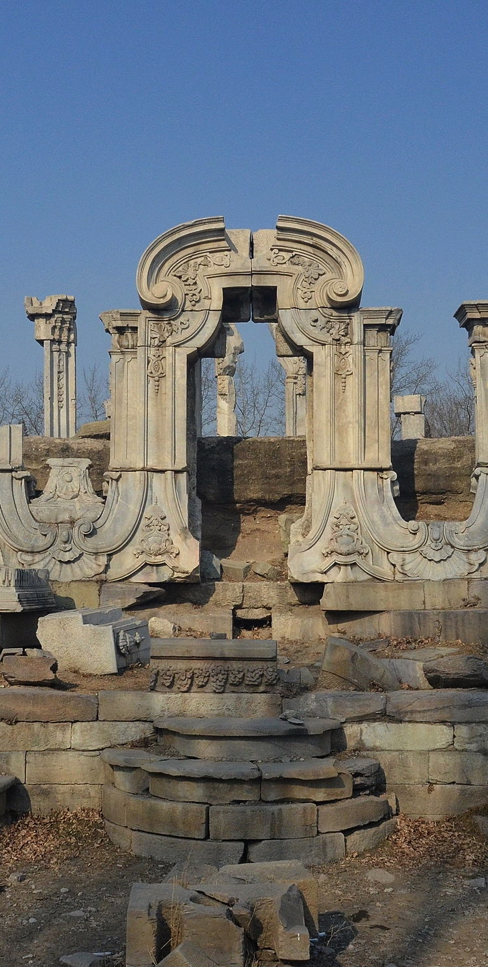
Palace of Shame
There is a deep, unhealed wound in the UK relations with China that stems from the destruction of the country’s most beautiful palace.
The site swarms with Chinese visitors, as part of a government-sponsored ‘patriotic education’ programme.
Notes:
Image: By 颐园新居 - Own work, CC BY-SA 3.0, https://commons.wikimedia.org/w/index.php?curid=24251024
The palace of shame that makes China angry
By Chris BowlbyBBC News, Beijing
2 February 2015
The humiliation of the Opium Wars is a deep, unhealed historical wound in the UK's relations with China - a wound that most British people know nothing about, but which causes China great pain. It stems from the destruction in 1860 of the country's most beautiful palace. It's been described as China's ground zero - a place that tells a story of cultural destruction that everyone in China knows about, but hardly anyone outside.
These days the site lays in ruins - piles of scorched masonry, lakes with overgrown plants, lawns with a few stones scattered where many buildings once stood. However, the site swarms with Chinese visitors, taken there as part of a government-sponsored "patriotic education" programme.

Slide 22
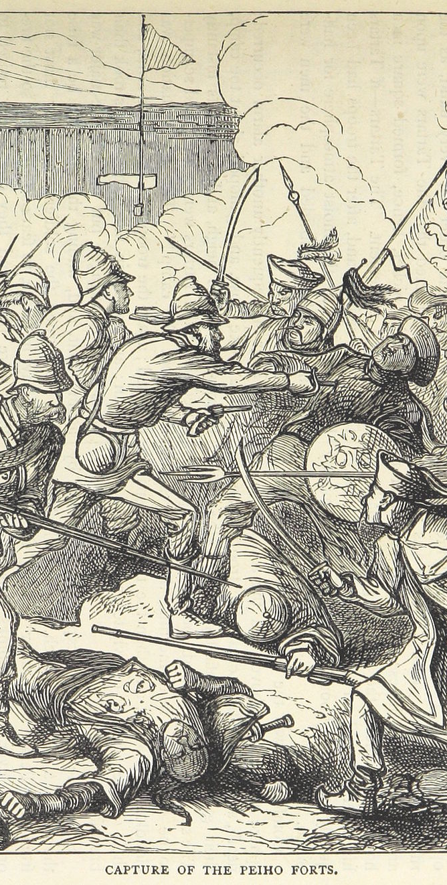
Effect of 2nd Opium War
The Chinese were forced to cede part of Kowloon to Britain, open Tianjin as a trade port, allow religious freedom, legalize opium trade and pay reparations to Britain and France.
Russia took advantage of China’s weakness and concluded the supplementary Treaty of Peking, which ceded 4,000 square miles of territory.
The burning of the Old Summer Palace, greatly damaged the Qing’s prestige and revealed government’s ineffectiveness.
Notes:
Image: Depiction of the 1860 Battle of Taku Forts
Effect of The War of Opium Part 2:
1. the Convention of Peking, the Chinese were forced to accept the validity of the Treaties of Tianjin, cede part of Kowloon to Britain, open Tianjin as a trade port, allow religious freedom, legalize the opium trade, and pay reparations to Britain and France.
2. Russia took advantage of China's weakness and concluded the Supplementary Treaty of Peking which ceded approximately 400,000 square miles of territory to St. Petersburg.
3. the burning of the Old Summer Palace (Yuanmingyuan), greatly damaged the Qing's prestige leading many within China to begin questioning the government's effectiveness.
[Transition]
The palace's fate is still bitterly resented in Chinese minds and constantly resurfaces in Chinese popular films, angry social media debates, and furious arguments/rows about international art sales.

Slide 23
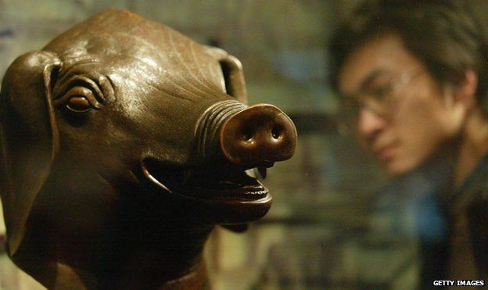
China Art Market
Christie’s auction house in Paris offered two bronze animal heads, part of the set of 12 zodiac figure sculptures at Yuanmingyuan.
The tenuous interactions of China and the West reveal multi-faceted layers of historic record, provoking a complex response and the release of pent up frustrations.
The sale of Chinese artifacts has now surpassed the sale of old Master paintings.
Notes:
Weil, Robert. Socialism and Democracy.
A case in point… In February 2009, Christie’s auction house in Paris offered two bronze animal heads, part of the set of twelve zodiac figure sculptures that had adorned the water clock fountain at Yuanmingyuan, until its looting in 1860. The proposed auctioning of these stolen treasures exposed the still tenuous interactions of China and the West, for given the contradictions that mark their relationship, even a relatively small incident such as this sale could rip the cover off multi-faceted layers of historic record, provoking a complex response + the release of pent up frustrations (pg. 131).
The historic and cultural significance far outweighed that of other auction pieces, and even found their way into present-day conflict as they were in effect held hostage in an effort to blackmail China. This arrogant attempt to use looted treasures to force changes in Chinese domestic policy came just a year after the attacks in Paris on Olympic torch runners by Tibetan advocates (pg. 131).
Christie's also operates in China, where a booming art market, with sales of ancient and modern works, sometimes for millions of dollars, is part of the lifestyle of the new rich. Such collectors have helped drive up prices for both Western and Asian artists around the world. In particular, “the trade of Chinese antiquities is big business. The sale of Chinese artifacts has now surpassed the sale of old Master paintings. The revenue from the sale of Chinese works now exceeds $10 billion annually. Far from harming their market value, evidence that artefacts looted from Yuanmingyuan can even add to their exotic quality and price (pg. 133).
[Summary] –The opium wars was about accessing the largest economy for its riches in the name of free trade, aggressively pursued by the West. And when CHN was not cooperative, the retributive acts that took place exploited civilization, destroyed priceless artifacts and the trauma of othering/having a different culture where colonialism or narco-militarism reigned supreme – a new Imperlism. What are the legacies that we can we take away?

Slide 24
Free Trade or Retribution: Legacies of Opium Wars
The cost of the wars and the reparations paid to foreign countries fell on the farmers. Manchu Imperialism could no longer protect and provide for its people. The growing levels of poverty incensed uprisings against the government.
China realized the country could no longer continue to be isolationist. Intellectuals realized the need to understand western culture, and to beat the West.
For the first time, China sets up a foreign ministry. As well, its’ focus to modernize China’s army and set up factories.
Notes:
What changes China after the war? 1.The cost of the wars and the reparations paid to foreign countries fell on the farmers. The Manchu government could no longer protect and provide for its people. The growing levels of poverty inspired uprisings against the government – hence the fall of the Manchu government
2. China realized that the country could not continue to be so isolationist. Intellectuals realized that they must try to understand western culture, especially if they were to beat the West. Lin Zexu, Xu Ji-yu, and Wei Yuan read translated material from the West and published books on western countries and culture. They learned about western political ideas, social structures, and economies.
3. For the first time, China set up a foreign ministry. They tried to modernize China’s army as well as set up factories.

Slide 25
Free Trade or Retribution: Legacies of Opium Wars
Intellectuals not only thought to modernize its army and open factories for the growth of capitalism, but also to change the entire parliamentary system that marked the 1st time citizens participating in government.
It shaped the rationale for the Chinese Revolution against Imperialism and feudalism that emerged and then succeeded decades later.
Notes:
What changes China after the war?
4. Intellectuals in China began to think that China not only had to modernize its army and open factories, but that the entire political system needed to be changed. They felt that the government needed to help the growth of capitalism. Private enterprises should be formed without government interference and many different companies needed to be created so that there would be competition within the marketplace. They also called for a parliamentary system, which marked the first time the idea of private citizens participating in government appeared in China.
5. It shaped the rationale for the Chinese Revolution against imperialism and feudalism that emerged and then succeeded decades later.
Was it free trade or retribution?
Present-day Chinese historians see the Opium Wars as a wars of aggression that led to the hard lesson that “if you are ‘backward,’ you will take a beating.”

Slide 26
Bibliography
Budetti, Dominic V., "From Silver to Opium: A Study of the Evolution and Impact of the British-Chinese Trade System from 1780 to 1842" (2016). Undergraduate Library Research Award.
Derks, Hans. History of the Opium Problem : the Assault on the East, Ca. 1600-1950 / by Hans Derks. 2012
England and China: The Opium Wars, 1839-60. http://www.victorianweb.org/history/empire/opiumwars/opiumwars1.html. Retrieved 1st-Nov-2018.
Hayes, Jack P. The Opium Wars in China. https://asiapacificcurriculum.ca/learning-module/opium-wars-china. Retrieved 30-Oct-2018.
Hickman, Kennedy. ThoughtCo. Overview of the Second Opium War, April 08, 2018.
Old Summer Place. https://en.wikipedia.org/wiki/Old_Summer_Palace#Destruction. Retrieved 1st-Nov-2018.
Perdue, Peter, C. The First Opium War: Anglo-Chinese War of 1839-1842. https://ocw.mit.edu/ans7870/21f/21f.027/opium_wars_01/ow1_essay01.html . Retrieved 30-Oct-2018.
Perdue, Peter, C. Rise and Fall of the Canton Trade System: China in the World (1700-1860s). https://visualizingcultures.mit.edu/rise_fall_canton_01/cw_essay01.html. Retrieved 30-October-2018.
Ringmar, E. (2006). Liberal Barbarism and the Oriental Sublime: The European Destruction of the Emperor’s Summer Palace. Millennium, 34(3), 917–933.
Weil, Robert (2013). Yuanmingyuan Revisited: The Confrontation of China and the West, Socialism and Democracy, 27:1, pp. 95-135.
Wiltshire, Trea (2009). The China Trade. Encounters with China: Merchants, Missionaries and Mandarins.

