Slide 1
PROFIT
EXPLORING THE BUSINESS OF MAKING MONEY AND MAKING PROGRESS
ELISABETH KYLE
301059882
LS815: BUSINESS, SCIENCE AND RELIGION
PROF. GEOFFREY POITRAS
SIMON FRASER UNIVERSITY
23 NOVEMBER 2011

Slide 2
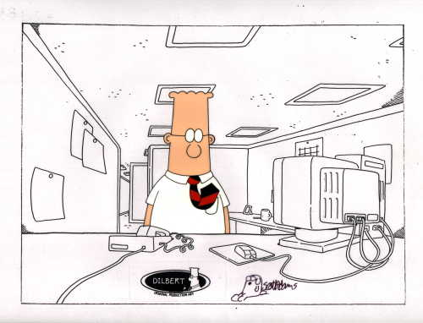
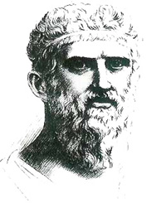
Introduction: What is profit?
“[T]he makers of fortunes have a second love of money as a creation of their own, resembling the affection of authors for their own poems, or of parents for their children, besides that natural love of it for the sake of use and profit which is common to them and all men.”
Plato, The Republic, 360 BCE
“Remind people that profit is the difference between revenue and expense. This makes you look smart.”
Scott Adams, (Cartoonist, b.1957)

Slide 3
Thoughts on Profit
“Profits, like sausages... are esteemed most by those who know least about what goes into them.”
~Alvin Toffler (Science-fiction Author, b.1928)
“Madness is badness of spirit, when one seeks profit from all sources.”
~Aristotle ( 384-322 BCE)
“Profit is the ignition system of our economic engine.”
~Charles Sawyer (American photographer 1868-1954)
“Such is American business, I guess, where the desire for obscene profit mutes any discussion of conscience.
~Bill Watterson (Cartoonist – “Calvin & Hobbes,” b.1958)
“An idealist is one who helps the other fellow to make a profit”
~Henry Ford (1863-1947)
“Corporation: An ingenious device for obtaining profit without individual responsibility.”
~Ambrose Bierce (Writer, Journalist and Editor, 1842-1914)
“If my films don't show a profit, I know I'm doing something right.”
~Woody Allen (Actor, Author, Screenwriter and Film Director, b.1935)
“What shall it profit a man if he gains the whole world but loses his soul.”
~Jesus Christ (Mark 8:36, KJV 1769)

Slide 4
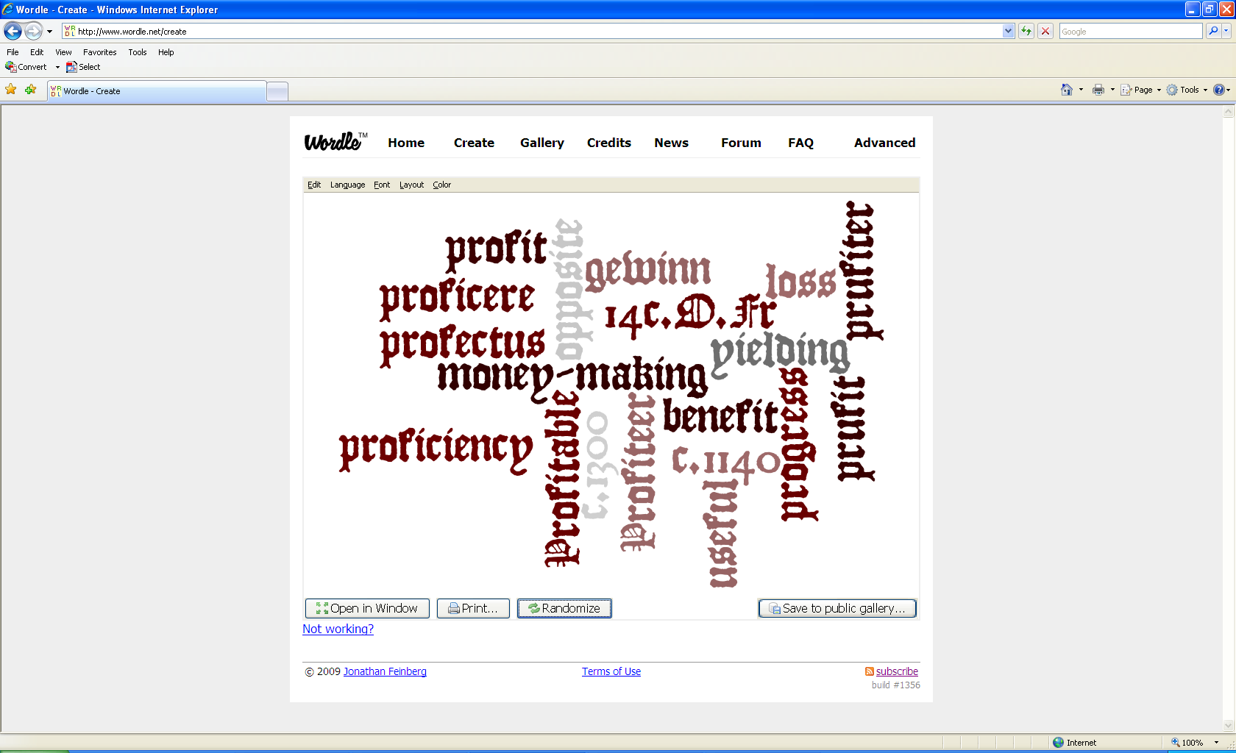
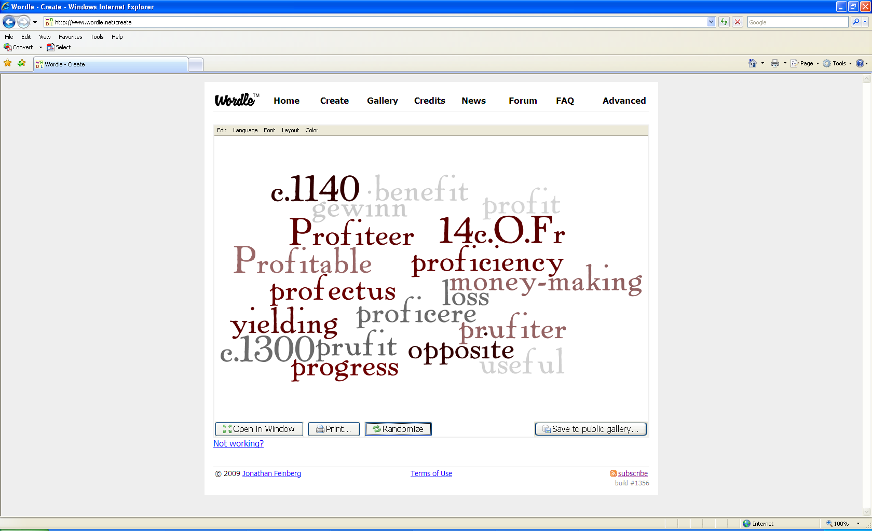
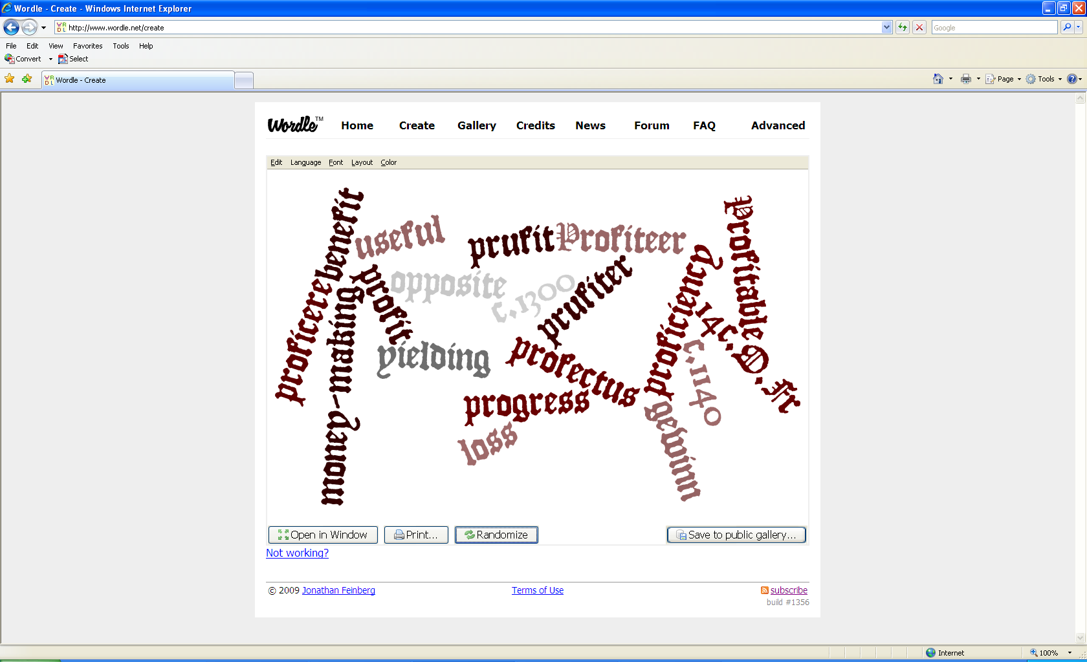
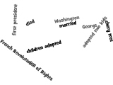

Slide 5
Current Definitions of Profit
Noun
pecuniary gain resulting from the employment of capital in any transaction
the monetary surplus left to a producer or employer after deducting wages, rent, cost of raw materials, etc.
advantage; benefit; gain
Verb
to gain an advantage or benefit: He profited greatly from his schooling
to make a profit
to take advantage: to profit from the weaknesses of others
to be of service or benefit
to make progress
Financial
Profit (accounting): the difference between the purchase price and the costs
Profit (economics): related but distinct meanings: Normal profit and Economic profit
"profit." Merriam-Webster's Dictionary of Law.

Slide 6
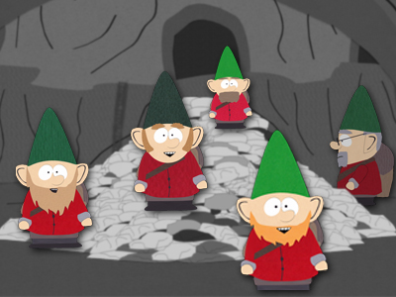
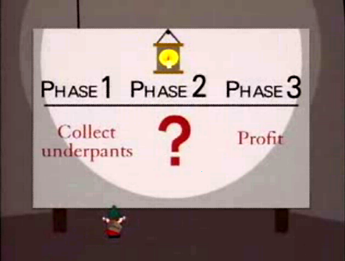
The Gnome PROFIT! Plan
“Following the episode's release, the underpants gnomes and particularly the business plan lacking a second stage between ‘Collect underpants’ and ‘Profit’ became widely used by many journalists and business critics as a metaphor for failed, internet bubble-era business plans and ill-planned political goals.”
http://en.wikipedia.org/wiki/Underpants_Gnomes

Slide 7
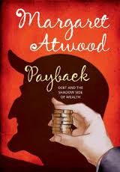
Business in Literature
“The Scrooge pattern: enormous amounts of money, sharp deal-making, the ruthless grinding of those in need, empty ostentation coupled with miserliness”

Slide 8
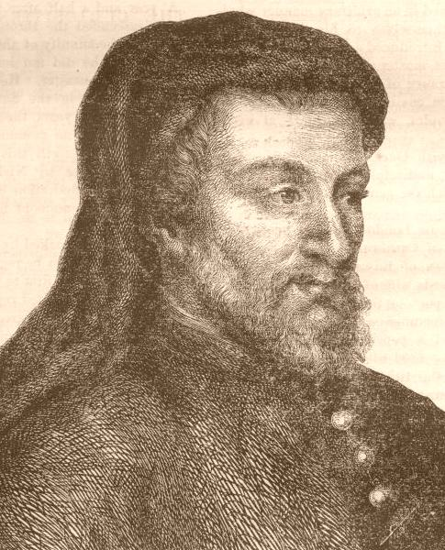
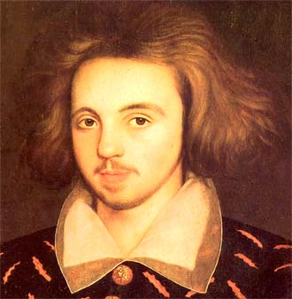
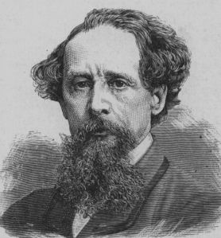
Business in Literature
On Writers: “occupied largely with ethical values, [they] have shown neither the sympathy for nor appreciation of materialistic success and the qualities required for its attainment”
Arthur Pollard. The Representation of Business in Literature. “Introduction.” 2000.

Slide 9
Crooks, Conmen and Clowns
The Media Institute tracked how those in business were portrayed in 200 episodes of 50 prime-time TV shows:
Over half of all corporate chiefs on television commit illegal acts ranging from fraud to murder.
Forty-five percent of all business activities on television are portrayed as illegal.
Only 3 percent of television businessmen engage in socially or economically productive behavior.
Hard work is usually ridiculed on television as ‘workaholism’ that inevitably leads to strained personal relationships.
“Put another way, 97 per cent of business is either illegal (Crooks) or duplicitous (Conmen) or foolish (Clowns) and those who practice it have rotten marriages and unhappy kids... of course they would have because they are all emotionally atrophied.”
John Blundell. The Representation of Business in Literature. “Foreword.” 2000.

Slide 10
Ghosts of Profits Past and Present
Lingering scholastic sentiments
turpe lucrum
Usury – money breeding money
Ideal of justice
Ambiguity of definition
Ambiguous interpretation
What can be considered ‘profit’?
‘Good’ profits vs. ‘Bad’ profit
Lottery winnings?
Inheritance?
You say “potato,” I say “patattah;” You say “thief,” I say “resourceful”
http://www.stlyrics.com/lyrics.Oct29.
Paul Camenisch. “Profit: Some Moral Reflections.” Journal of Business Ethics.

Slide 11
Morality and Profit
“[T]o the right person, to the right extent, at the right time, with the right motive, and in the right way.”
Aristotle, Ethics II.9
Ambiguous justification
WHAT IS IT PAYMENT FOR?
Ambiguous limits
HOW MUCH IS APPROPRIATE?
Concrete Consequence
SIN AGAINST JUSTICE
“Take all the fools out of this world and there wouldn’t be any fun living in it, or profit.”
Josh Billings, American Humorist, 1818-1885

Slide 12
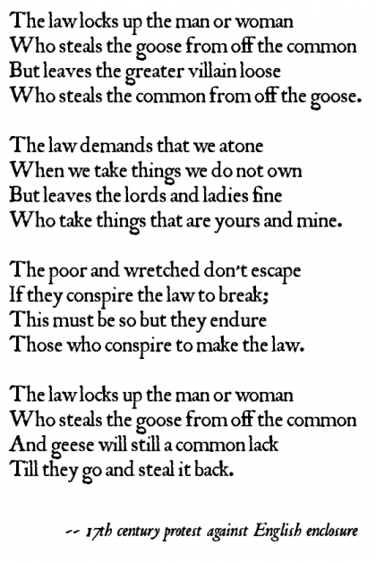
Human Nature and Profit
As a universal human drive
As an instinctual response for self-preservation
Business man = Hungry beggar?
Individual gain = Gain for all?
Maximized self interest = Tragedy?

Slide 13
Business Ethics and Profit
“[T]here is one and only one social responsibility of business–to use its resources and engage in activities designed to increase its profits so long as it stays within the rules of the game, which is to say, engages in open and free competition without deception or fraud.”
Milton Friedman, “The Social Responsibility of Business is to Increase its Profits”
The New York Times, September 13 , 1970

Slide 14
Business Ethics and Profit
Artificial personhood vs. Real personhood
Corporation vs. Corporate Executive
Corporate Social Responsibility vs. Individual Social Responsibility
Voluntary activity
Basic rules of society
What is the responsibility of the Corporate Executive?
To whom are they responsible?
“Insofar as his actions reduce returns to stockholders, he is spending their money.
Insofar as his actions raise the price to customers, he is spending the customers’ money. Insofar as his actions lower the wages of some employees, he is spending their money.”
What is the social responsibility of business?
To increase its profits.
Milton Friedman, “The Social Responsibility of Business is to Increase its Profits.” The New York Times, September 13 , 1970

Slide 15
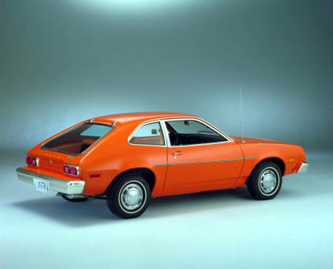
Profit and the Pinto
Ford’s Cost-Benefit Study
Costs:
$11 x 12.5 million = $137 million
Benefits:
(180 deaths x $200K) + (180 injuries x $67K) + (2100 cars x $700) = $49.15 million
Summary:
The $137 million modification to the gas tanks of the Pinto would prevent losses worth $49.15 million
Decision:
Do not modify the gas tank in the Pinto. It is not right to spend $137 million of society’s money on losses it values at only $49.15 million
The utilitarian vehicle: creating the greatest benefits for society while minimizing costs
Manuel Velasquez, “Ethical Principles in Business.” Business Ethics: Concepts and Cases. 2002.

Slide 16
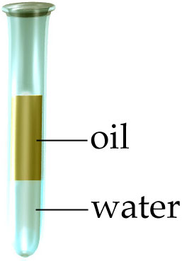
What about Phil(anthrocapitalism)?
“Business thinking not only strengthens individual organizations, but also allows the market to create bold new solutions to enduring social problems”
Philanthrocapitalism
Hybrid Organizations – social enterprise
Operational Principles
Public sector
Public service
Nonprofit sector
Social mission
Private sector
Competitive market forces
Definition: A nonprofit that generates revenues (?)
Formula: Competition + Market forces = Compassion + Collaboration (?)
Optimist on hybrid organizations: The new holy grail
Pessimist on hybrid organizations: The destroyer of civil society as we know it
David Evans. The Rise of the Hybrid: When Sectors Collide. charityvillage.com.2011.

Slide 17
The Problematic Profit Motive
Private sector culture underpinned by business processes and profit generation conflicting with working-for-love-not-money culture of nonprofit
Public service entities reduce/remove funding of programs in expectation of revenues
Revenue generation becomes priority over service provision
Revenue generation uses up already scarce nonprofit resources
Difficult to compete in free market – public sector costs too high
Focus on revenue-generating clients – what happens to others that need the product/service but not high revenue or cannot afford to pay? Whose responsibility are they?
What happens if the social enterprise fails? What happens to any public/private funding received? What happens to their clientele?
David Evans. The Rise of the Hybrid: When Sectors Collide. charityvillage.com.2011

Slide 18
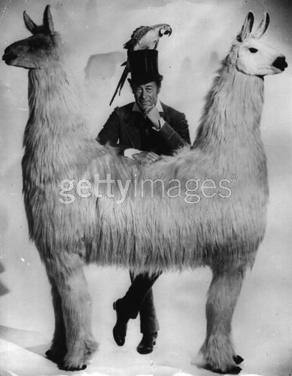
When Profit Worlds Collide
“Like Dr Dolittle's Pushmi-Pulluy, the animal that had trouble moving because its two heads could not agree on a single direction, the hybrid model for non-profits is proving problematic. On occasion, the need to generate returns for investors overwhelms the social mission. In other cases, the business falters altogether and cannot support the nonprofit.”
Stephanie Strom, The New York Times, October 25, 2010
David Evans. The Rise of the Hybrid: When Sectors Collide. charityvillage.com.2011

Slide 19
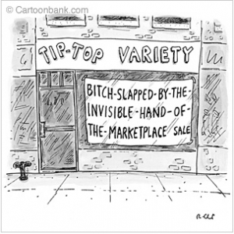
Reappearance of the Invisible Hand?
Invisible Hand
The individual that “intends only his own gain” is “led by an invisible hand to promote … the public interest”
Adam Smith, The Wealth of Nations, 1776
Shared Value
“Creating economic value in a way that also creates value for society by addressing its needs”
Michael Porter, Economist
Right kind of profits
Sophisticated capitalism
“But it is only for the sake of profit that any man employs a capital in the support of industry”
Adam Smith, The Wealth of Nations, 1776

Slide 20
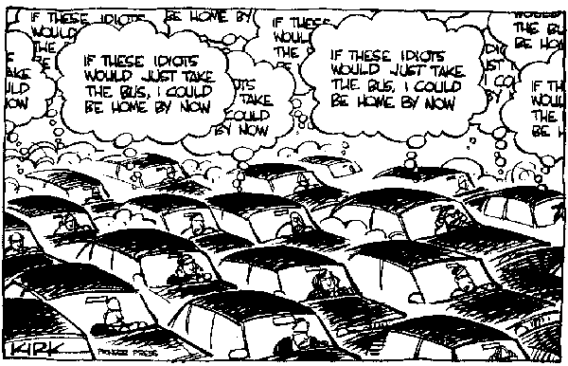
Conclusion: Why Does Profit Dominate?
“You take my life when you do take the means whereby I live”
Shylock, The Merchant of Venice, (370)
How much money is enough?
“Just a little bit more…” John D. Rockefeller

Slide 21
Works Cited/Referenced
Atwood, Margaret. Payback (Debt and the Shadow Side of Wealth). Toronto, ON: House of Anansi Press Inc. 2008.
Beckwith, Tony. “My Mother Tongue..” The ATA Chronicle. Vol. XL, No. 4. Apr. 2011. pp. 20-23.
Blundell, John.“Foreword.”TheRepresentation of Business in Literature. London: The Institute of Economic Affairs. 2000.
Camenisch, Paul. “Profit: Some Moral Reflections.” Journal of Business Ethics. Vol.6, No.3. Apr. 1987. pp. 225-231.
Evans, David. “The Rise of the Hybrid: When Sectors Collide.” charityvillage.com. 2011. <http://charityvillage.com/cv/archive/acov/acov11/acov1143.asp>.
Friedman, Milton. “The Social Responsibility of Business is to Increase its Profits.” New York Times Magazine. 1970.
Hardin, Garrett. The Tragedy of the Commons. 1968. <http://dieoff.org/page95.htm>.
Noonan, John T. The Scholastic Analysis of Usury. Cambridge, MA: Harvard University Press. 1957.
Plato, The Republic. The Internet Classics Archive. 360 BCE. <http://classics.mit.edu/Plato/republic.2.i.html>.
Pollard, Arthur. “Introduction.” The Representation of Business in Literature. London: The Institute of Economic Affairs. 2000.
“profit. Online Etymology Dictionary. 13Oct2010. <http://www.etymonline.com/index.php?allowed_in_frame=0&search=profit&searchmode=none>
"profit." Merriam-Webster's Dictionary of Law. 13Oct2011. <http://dictionary.reference.com/browse/profit>.
“profit.” ThinkExist. 14Oct2011. <http://thinkexist.com/quotes/with/keyword/profit/>.
“PROFIT! Urban Dictionary. 13Oct2011. <http://www.urbandictionary.com/define.php?term=PROFIT%21>.
Shakespeare, William. The Merchant of Venice. 1596-1597. The University of California Internet Archive <http://www.archive.org/stream/merchantvenice00shakrich/merchantvenice00shakrich_djvu.txt>.
Smith, Adam. An Inquiry into the Nature and Causes of the Wealth of Nations. 1776.
“Underpants Gnomes.” Wikipedia. 10Oct2011. < http://en.wikipedia.org/wiki/Underpants_Gnomes>.
Velasquez, Manuel G. “Ethical Principles in Business.” Business Ethics: Concepts and Cases. Fifth Ed. NJ: Prentice Hall. 2002.

