Slide 1
Understanding the Impacts of Computer Technology on Modern Society and Culture
Jessica Chang
1
Notes:
Why am I interested in such topic?
A while ago, when browsing a “not-so legit” website, I fell victim of a drive-by download. A ransomware encrypted all my Word files and demanded $300.00 Bitcoins for the release of my files.
Lesson leanned from that experience:
Always use school computers to do “funny business”, and if access is blocked, use your sibling’s device.
Unless you have Wizard level computer knowledge, use a Mac.

Slide 2
2 perspectives:
Role of computers and internet technology in crime
Radicalization and propaganda
Internet Scams
On-line dating,
the perspective of public policy
Whistle-blowing Snowden - How to balance information privacy and national security?
Canada’s Cyber Security Strategy – is it enough?
Does “hacking back” encourage vigilantism?
Could ordinary citizens decide on values shaping public life – extreme left vs. alt-right
2
Notes:
Online dating:
Modern dating is subjected to geographic mobility, occupational constraints, demographic and cultural changes, so more people now rely on innovations linked to twenty-first-century technology – dating apps. The first Mobile dating Apps emerged in 2003, with the rest following around 2007. the online romance scam is a relatively new form of fraud that appear apparent in about 2008.
people are increasingly using location-based dating to connect with potential mates.
online dating affords participants the opportunity to fantasize about “anonymous others”, creating and recreating the ideal mate or partner. Proposing CBA as moral foundation for dating – chances versus choices. Costs of meeting strangers versus benefits of getting to know persons in reality.
In 2011 the UK National Fraud Authority1 estimated that fraud costs in the United Kingdom equate to over £38 billion a year. 48% (nearly half of of the UK adult population, 23.5 million people) were likely to be targeted by a scam. 8% of the adult population admitted to having been a victim of a scam at some point. Based on their findings, it estimated that 6.5% of the UK adult population will fall victim to scams every year.
paper-mail based fraud - this crime is under-reported
take away lesson - Scams are far less likely to be successful if individuals have heard about them prior to being targeted.
Why is this a secrioous crime? Impacts of ‘‘double hit’’

Slide 3
Crimes related to computer mediated technology
As Targets:
Data Theft
DDoS (Distributed Denial of Service) attacks
As Instruments
Child Exploitation - Child pornography
Mass Marketing Fraud - Online Drug Stores, Investments,
Financial cybercrimes - Money Laundering, fraud
Open Source Intelligence
3
Notes:
Before the 1970s, crimes related to computers consisted mainly of hardware theft and CPU time theft, such as gaining unauthorized access to large timeshared computers, such as making free long distance phone calls
DDoS happens when a perpetrator seeks to make a machine or network resource unavailable to its intended users by temporarily or indefinitely disrupting services of a host connected to the internet. The incoming traffic flooding the victim originates from many different sources. This effectively makes it impossible to stop the attack simply by blocking a single source. While the intention of DDoS attacks is not always clear, the effects could be devastating.
When a computer is the "object" of the crime
Instruments:
When (viruses, worms (that incapacitate normal computer functioning) are launched, a computer becomes the "subject”, or the “instrument” of a crime

Slide 4
Captain Picard – in culture lingo
Trivia Question: T or F - Proving the sexual assault of an adult rather than a child maybe more difficult.
Discussion Question: What are some challenges in prosecuting cybercrimes?
4
Notes:
T – because of the possibility of consent (335).
Gross story – processing a computer crime scene – why protective gloves are required
Forensic Linguistics – in culture lingo - hoe to speak like a cyber criminal

Slide 5
Internet scams
Phishing – How a fraudster got $12 million out of a Canadian university
5
Notes:
An example of Whale phishing
a phishing attack that is specifically aimed at wealthy, powerful, or prominent individuals
University received an email set by Clark Builders, a vendor company, with an attachment letter sent by to Marc Timberman, chief financial officer of CB, asking the accounts receivable department to reroute payments to a new National Bank of Canada account.
Payments did not go through the first time, accounts receivable replied to the email for confirmation, and was asked to redirect payments to an account with TD Bank.
RCMP followed the money to Montreal, then to UK, then to China via Hong Kong, then to Richmond, BC (as an investment in real estate).
Video beginning - 34’ – 1”26’ stop at 1”39’

Slide 6
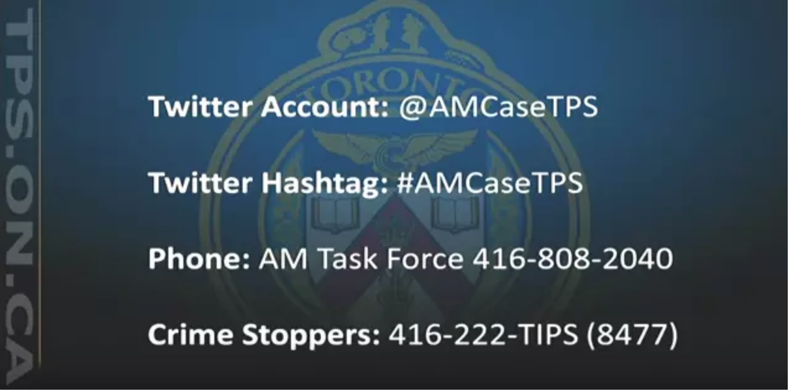
Hacking – Ashley Madison
why the hack: https://www.ashleymadison.com
Discussion Question:
Do you agree with the hack?
What is the moral thing to do if you figured out “whodunnit”?
6
Notes:
15 July 2015, the Canadian online dating service and social networking service marketed to people who are married or in relationships was hacked.
The hackers (referring to themselves as “the impact team”), demanded the immediate shut down of the sites Ashley Maddison, and its sister site, “Established Men”.
Avid Life Media, the owner of these affected sites, did not comply. Consequently, there was a data leak first on July 22, then followed by a major data dump dump in the form of a torrent file. Users' personal information – including real names, home addresses, search history and credit card transaction records were released on 18 Aug, 2015.
Ashley Madison will pay a $500,000 bounty to take down its hackers

Slide 7
A brief History of warfare
First Generation warfare – AD 500-1450
Second Generation warfare – 1989
Third-generation warfare - the end of linear warfare on a tactical level
Fourth Generation warfare - "Post-modern"
Cyber crime as a crime problem
and a war problem
7
Notes:
First generation warfare - from about AD 500 to 1450, referring to medieval battles fought with massed manpower, using line and column tactics with uniformed soldiers governed by the state.
The term second generation warfare was created by the U.S. military in 1989. This period show cases the early modern tactics used after the invention of the rifled musket and breech-loading weapons and continuing through the development of the machine gun and indirect fire.
Third-generation warfare focuses on using late modern technology-derived tactics of leveraging speed, stealth and surprise to bypass the enemy's lines and collapse their forces from the rear. Essentially, this was the end of linear warfare on a tactical level, with units seeking not simply to meet each other face to face but to outmaneuver each other to gain the greatest advantage.
Fourth Generation warfare is characterized by as “post modern”, which is a return to decentralized forms of warfare, blurring the lines between war and politics, combatants and civilians, due to nation states’ loss of their near-monopoly on combat forces, and thus returning to modes of conflict common in pre-modern times.

Slide 8
Radicalization and propaganda – RWE groups
Atalante (QC)
Storm Alliance (QC)
The Three Percent (III%) (AB, ON, +)
Aryan Guard (AB)
Northwest Territorial Imperative (BC, AB)
Cultural Action Party of Canada (BC)
Proud Boys (online)
Incel (online)
5th Generation Warfare
8
Notes:
5th Generation Warfare definition: Identity based group-on-group conflict for the purpose of enacting a change in society.
Cyber crime problem and a war problem
bots checking into a server and forming the sort of digital army that is typically used to wage (DDOS (distributed denial-of-service) attacks, in which hackers crash a network by overwhelming it with visitors.
Atalante Quebec is an extreme right organization based mainly in Quebec City, Quebec. They have about 3000Facebook followers. focuses on ethnic nationalism and anti-immigration.
Storm Alliance : denounced by La Meute
III% - a “prepper” militia group, acting as a self-styled security detail for other RWE.
Aryan Guard (AB): self-identifies as a Neo-Nazi, white supremacist
Northwest Territorial Imperative: a white separatist group, popularized in the 80’s. The intent is to eventually declare the region (Washington, Oregon, Idaho, Wyoming, Western Montana, BC,AB, ). The intent is to eventually declare the region an Aryan homeland.
The Cultural Action Party s a political party. It’s platform claims to promise to preserve Canada's traditional Anglophone and Francophone cultural identity, reduce immigration, and hold a referendum to repeal the Canadian Multiculturalism Act.
Proud Boys: “a group of Western chauvinists who refuse to apologize for creating the modern world”. One of the Proud Boy members had allegedly organized the Charlottesville rallies in 2017, which attracted many neo-Nazi groups.
Incel: - involuntary celibates. Members engaged in: Tallahassee yoga studio shooting (Nov, 2018), Toronto van ramming (April, 2018). Believes in Misogyny & racism

Slide 9

Censoring Social network? Pros & Cons
La Meut
9
Notes:
π The Government of Canada intends for cybercrime prosecution to be under federal jurisdiction. Having a centralized law enforcement agency addresses cross-jurisdictional challenges posed by the very nature of cybercrime, especially when it comes to investigation and prosecution, such as the introduction of Bill C-51. However, there are some unintended consequences. For example, an example, stakeholders’ concern over online surveillance. Protesters and political activists have always advocated for the internet neutrality, and hence balancing privacy and public safety has to be addressed so that online surveillance does not undermine democracy. In addition, a problem related to Internet safety, security, and democracy is having a policy guiding online freedom of expression. The cyber security strategy highlights the importance to “promote and protect rights and freedoms online”. So, how to balance freedom of expression while maintaining a safe space for all internet users is also a priority. We need a policy that circumvents users creating social media as platforms for holding extreme views, if we want to prevent the advent of something similar to “the Gab” network, which is allegedly responsible for the recent Pittsburgh synagogue massacre.
How to evaluate? Utilitarianism?
La Meute – starting at ‘38 – 2” .2”28’ – 3’57
In the case of La Meute, if a person were sympathetic to their cause, would it say about that person?

Slide 10
Hacking back
Ethics & Legality
A new emergent industry – computer insurance
10
Notes:
Quasi-Anarchic Domain - people assuming the risks of conducting business there should be allowed to defend themselves.

Slide 11
References
“Ashley Madison Hacked! 37 Tsagourias, N. “Cyber Attacks, Self-Defence and the Problem of Attribution.” Journal of Conflict and Security Law 17, no. 2 (July 1, 2012): 229–44.
Million Cheating Spouses’ Accounts At Risk Of Exposure!” All Singapore Stuff - Real Singapore News. Accessed November 25, 2018. https://www.allsingaporestuff.com/article/ashley-madison-hacked-37-million-cheating-spouses-accounts-risk-exposure.
Schmidle, Nicholas. “The Digital Vigilantes Who Hack Back,” April 30, 2018. https://www.newyorker.com/magazine/2018/05/07/the-digital-vigilantes-who-hack-back.
Whitty, Monica T., and Tom Buchanan. “The Online Romance Scam: A Serious Cybercrime.” Cyberpsychology, Behavior, and Social Networking 15, no. 3 (March 2012): 181–83.
11
Notes:
Downs JS, Holbrook MB, Cranor, LF. Decision strategies and susceptibility to phishing. Proceedings of the Second Symposium on Usable Privacy and Security (SOUPS 2006); 70–90.
https://www.businessinsider.com/ashley-madison-offers-500000-bounty-to-find-hackers-2015-8

