Slide 1
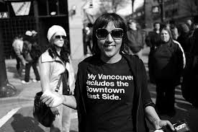
Digging Deeper: Alternative Visions of a Good Life

Slide 2

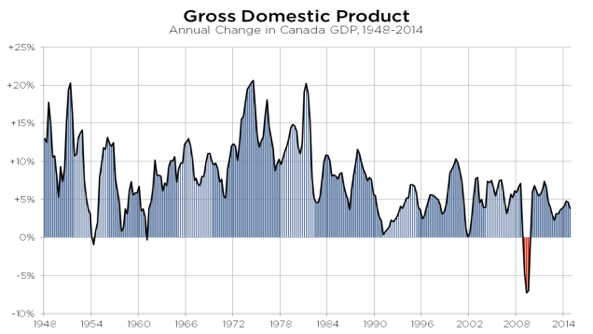
Canadian Context:
Canada’s GDP on the + side

Slide 3
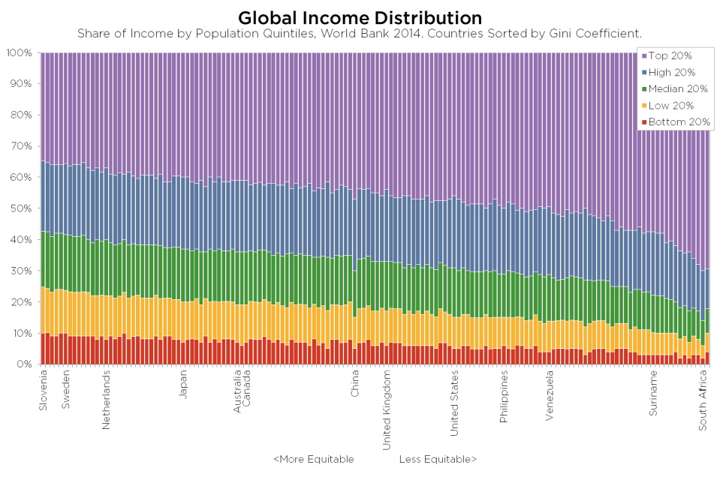
Based on Income Distribution, Canada is ‘more’ equitable than ‘less’
Notes:
Income distribution is more equitable than other countries…(to add Singapore)
Unemployment is around 6%.....but youth unemployment much higher, more than double…which is why we need to dig deeper

Slide 4
Digging deeper:
Canada’s Census
  “..you need the census – a very good indicator of what’s on the ground – to be able to … bring data back to the real world, and to allow us to benchmark and measure how well we’re doing”
  “ I think of these data as a public good … that provides a benefit to all Canadians, either directly or indirectly,”
  Robert Fairholm, Economist, Globe and Mail Feb 6 2015
Notes:
Conducted every 5 years; provides longitudinal, reliable demographic & statistical data to form policy and planning for public services, federal transfer payments, number of Members of Parliament; used by private sector to plan for business development, growth, trends etc.
Applicable readings, lectures:

Slide 5
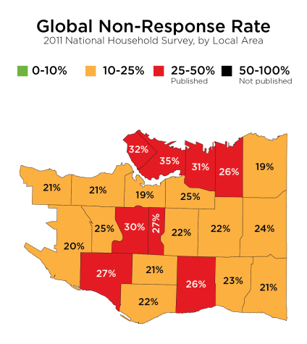
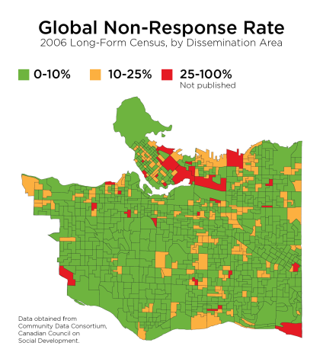
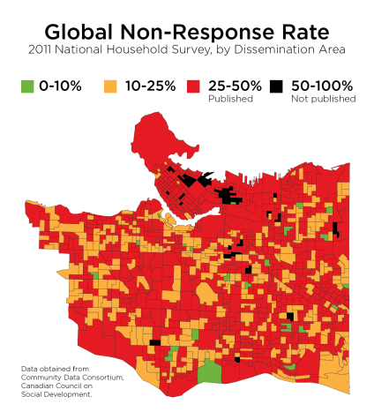
Canada Census Changes
2011: Harper government concerns about individual privacy
Results:
  Increase in number of people not completing long form census (now voluntary)
  Ability to compare over time & data quality compromised
  Other consequences:
  Monetary costs of changes: 22M
  Social & Economic: TBD
  International reputation
  “Values shift” tactic?
Notes:
As most people know, the federal government changed the way the census was conducted in 2011, and the same model will be used in 2016 as well. Up until 2006, there were two “forms” of the mandatory census: a short form, that everyone answered, asked basic questions about age, gender, family structure and living arrangements—while a long form given to a sample of households asked more in-depth questions about language, diversity, income, labour, education and housing.
In 2011, the government eliminated the long form and directed Statistics Canada to create a survey to ask similar questions as were previously asked on the long form census. Switching from a mandatory census to a voluntary survey has had unavoidable impacts on the reliability and validity of data received.
Here are some of the key differences between the long form census and the new National Household Survey:
-DIFFERENT UNIVERSES: the NHS was not administered to people in collective dwellings (e.g. seniors residences) so it only provides estimates for people in private households
-DIFFERENT SAMPLE SIZE: the NHS was administered to a larger sample of households, but…
-DIFFERENT METHODOLOGY: while the census has never been a perfect tool, a voluntary survey is less likely to be completed than a mandatory census. As a result…
-DIFFERENT RISK OF NON-RESPONSE BIAS: when a survey is administered to people on a voluntary basis, there is the risk that people who didn’t complete the survey have particular characteristics, which skew our estimates.
While Statistics Canada has done its best to provide good data, it is NOT POSSIBLE for a voluntary survey to replace a census.
All cities in Canada are struggling with the question of how to use National Household Survey. Some have decided not to use it, or certain parts of it, at all; many others are comparing the NHS data to other sources.
Our approach is to provide as much information as possible, but to make sure people are aware of its limitations. So we will make full use of NHS data, but with caveats. Where possible, we’re using other data sources—for example, this presentation uses income tax data to provide estimates of incomes across Vancouver. And we’re “ground truthing” trends as we’re able with observations and administrative data.
But it’s important to know that we can’t mitigate the change to a voluntary survey. So we need to know overall that the population estimates are going to be less reliable, that we can’t clearly show trends, and that we’re more limited in what we can do for smaller geographies, such as neighbourhoods or census tracts.

Slide 6
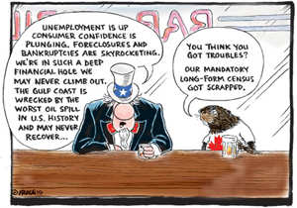
Canadian Values

Slide 7

Canadian Values
  Guaranteed rights and freedoms of individuals… of thought & expression; equality rights; rights to heritage; language
  “….binding Canadians as a means towards freedom and immeasurable joy” – Trudeau, 1981
Notes:
Includes: fundamental freedoms of individuals: thought, religion, conscience, belief, expression; democratic, mobility and language rights
We value: a government that upholds rights of individuals; corrects itself and addresses and remedies harms to others; values the country as a whole (unity)
Does not apply to private sector
We must now establish the basic principles, the basic values and beliefs which hold us together as Canadians so that beyond our regional loyalties there is a way of life and a system of values which make us proud of the country that has given us such freedom and such immeasurable joy.
Trudeau On signing the Canadian Charter of Rights and Freedoms (1981)

Slide 8
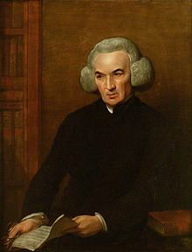
Social Context of Prior Belief
Consistent information is remembered, seen as relevant, and reinforces beliefs
Despite the evidence (e.g. science) - If we believe something – alternatives are ignored or discounted (Confirmatory Bias)
The social context of belief: if groups interact little, they can develop differing perceptions of reality, e.g. :
If the rich believe they obtained wealth through hard work, good luck and chance plays a minor role. People who believe this are less willing to share that wealth with those who they think ‘chose’ to exert less effort. If an individual sees one’s success as a result largely of good luck, one is more willing to share.
Joseph Stiglitz, Price of Inequality, 2013 , pp 191, 199
Notes:
Richard Price –
Proponent of the census and moderately sized cities
prior belief has significant impact on prediction
Used science to prove existence of god
Significant reliance on prior belief
- Beliefs are internalized. Priming a stereotyped identify – for example, putting high and low caste individuals toward same task together - shifts performance in favour of the high caste, & low caste individual’s performance decreased. When asked to perform the tasks separately, results were equal.
Stiglets

Slide 9
Background: Canada and Government Mandates
Federal | Provincial | Municipal
Defence, International Trade, Immigration | Health, Education, Social Services | Land Use by laws, zoning, business licensing
Federal Justice System | Provincial Courts, prisons, probation | Police, Fire Services (delegated by province)
Banking system; Transfer payments to provinces | Welfare, Disability assistance, Employment programs | Libraries, Parks and Recreation
Food & Drug Administration | Environmental | Garbage pick up
Aboriginal Affairs | Housing | Roads, sewers, water

Slide 10
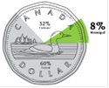
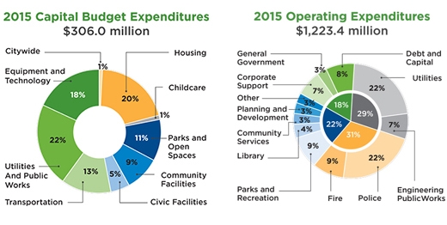
Increasing pressures on municipal governments
Cities in Canada receive 8c of each tax $
Spending on housing, childcare despite senior government mandate
Notes:
Need loonie with dollar figure

Slide 11

Measures used matter for cities because…
Globally, most of us live in cities (54%).
Urbanization increased by 36% between 2000 – 2014 by 1 billion people; 90% of growth came from developed nations, due to changing economy; increase in urban poverty. Revision of World Urbanization Prospects, 2014
World Health Organization (W.H.O.)identified 3 global threats to cities in the 21st century: increasing inequalities, chronic disease and climate change.
Dichotomy: Cities viewed as: a) centres of innovation, services, finance sector, creative economy, high-tech, arts and culture economies AND b) concentrations of ‘wicked’ urban health issues.
Canada is highly urbanized; 85% of us live in cities – (compared to 15% early 20th C).
In the context of people, place and planet: how resilient are we?
Notes:
A billion more people were added to urban areas within a span of 14 years. Global urban population increased fr2,86om 2.86 billion in 2000 to 3.88 billion in 2014. This (1.02 billion) represents a 36% rise in urban population, globally, in just 14 years. The recently released 2014 Revision of World Urbanization Prospects shows that urban population as a proportion of total population has risen from 47% in 2000 to 54% in 2014. More than 90% of this growth has come from less developed countries.
http://en.wikipedia.org/wiki/List_of_slums
Cities and urbanization – since industrial revolution

Slide 12
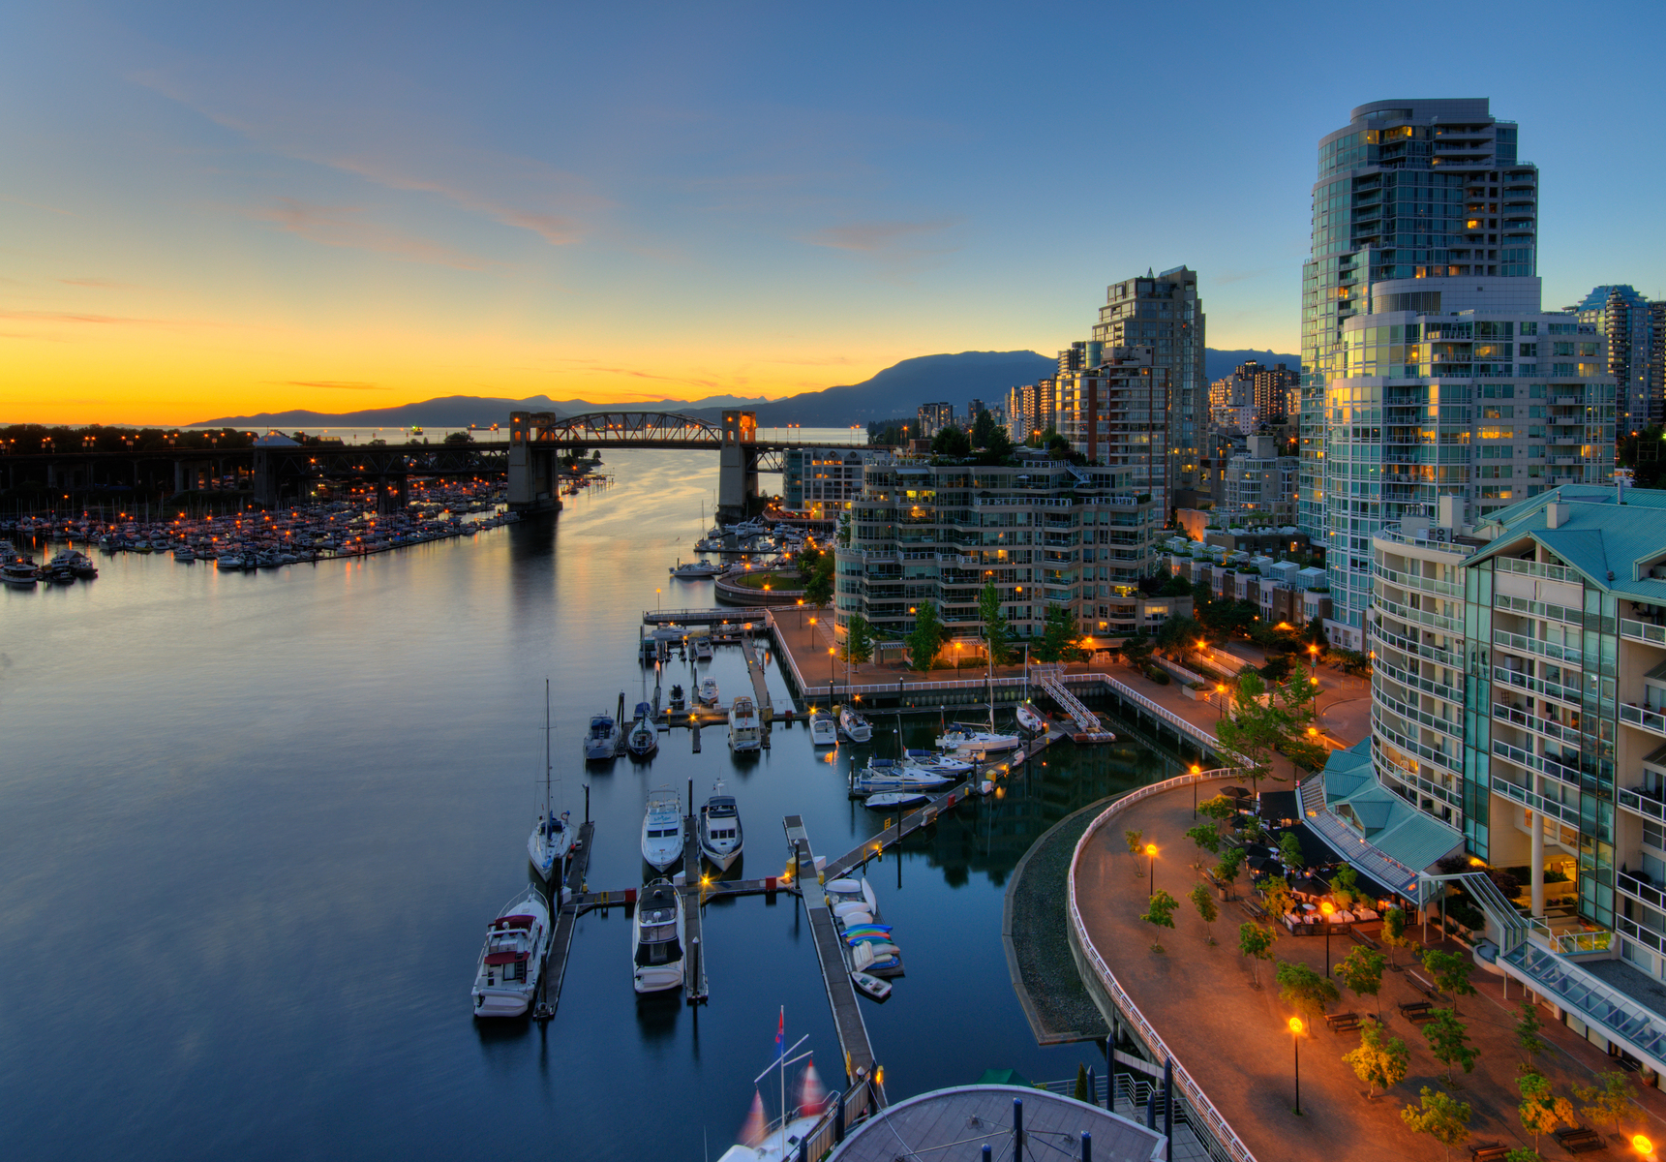
Vancouver:
A utopia with strong brand value
Natural Beauty
Mild Climate
Business Diversity
Sense of Safety
Lifestyle…and
Notes:
Economist Intelligence Unit and Mercer.
Economic Brand is as strong as Sing, San Fran
Dependency on service economy, including tourism, higher than other centres

Slide 13

A strong GDP forecast

Slide 14

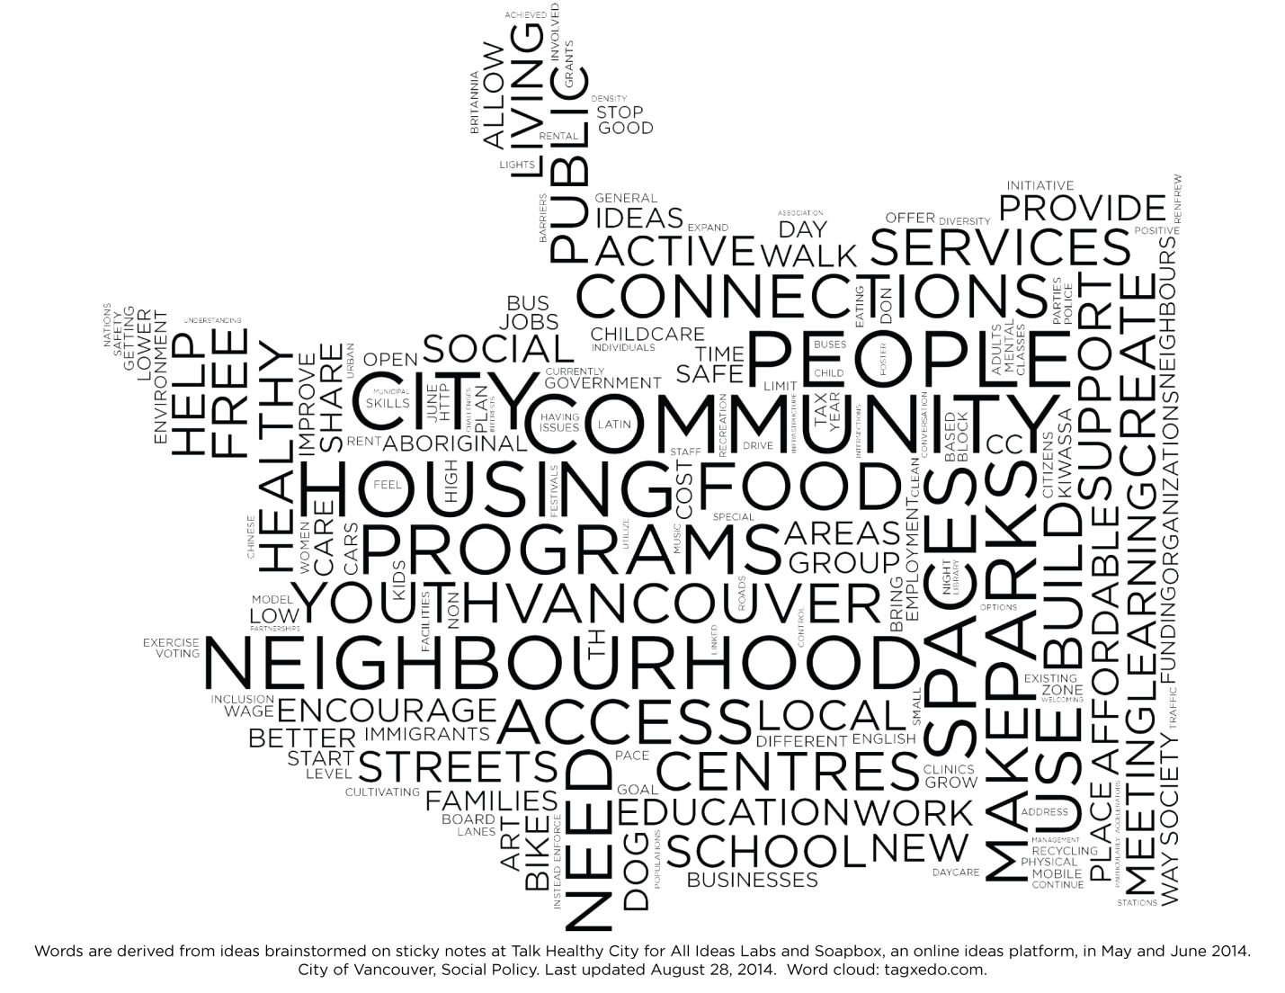
Digging Deeper: What is important to Vancouverites? (values)
Notes:
A word Cloud created as a representation of responses to questions about what mattered for people in Vancouver with respect to health and wellbeing; and what they thought needed to be d
done to improve things and create ‘a healthy city for all’. Over 10,000 people reached. Timeline: 2013.
What we present and what we actually value differ to some extent. (although all of us appreciate our natural environment, the lifestyle remains a myth for most people).

Slide 15
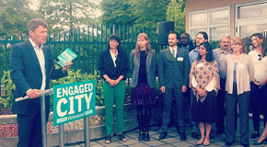
And what kind of city do we aspire to be?
According to Vancouver Foundation study (Connections and Engagement, 2012):
Its a hard place to make friends
Neighbourhood connections are cordial, but weak
Many people are retreating from community life
There are limits to the extent that diversity forges connections
Affordability is having an impact on isolation and what we see as important
Notes:
Belonging and connection – and lack of – identified as an international epidemic of the 21st century.
Loneliness data:

Slide 16

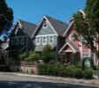
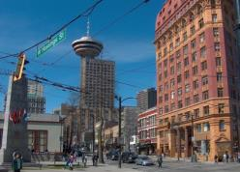
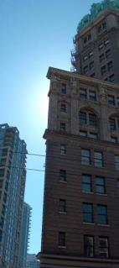
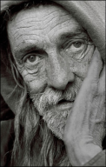
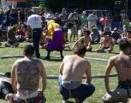
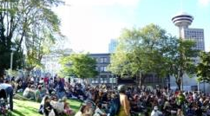
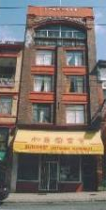

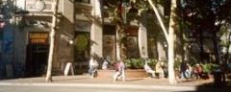
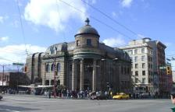
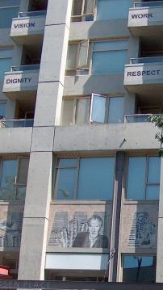
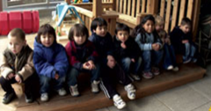
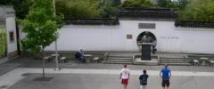

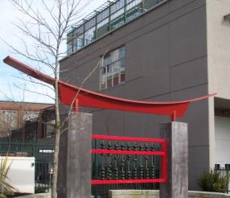



Downtown Eastside Neighbourhood

Slide 17

The balance sheet: compared to other
Vancouver neighbourhoods, the DTES has:
- Highest concentration of poverty; 1/3 on social assistance ($7.2-$10.8k/year)
- Lowest median household income ($13,691 vs. $47,299)
- 2x unemployment (12% vs. 6% )
- Lower life expectancy (but improving)
Highest rate of child vulnerability (readiness for Kindergarten)
Mental health & addictions = costs to health care & police systems – e.g. 44% increase # in visits to St Paul’s emergency 200-2013.
Significant costs to human life.
Diverse economy and mixed land use: residential, industrial, business
Highest concentration of social enterprise and a significant number of artists
Strong diversity: Highest proportion of urban Aboriginal people (10% vs. 2%), Chinese speaking, families
Strong sense of community & history of social activism (stopped a freeway through Vancouver)
Strong rates of volunteerism
Notes:
Insert Patty Daly information
Luuca Piloli – double entry bookkeeping system

Slide 18
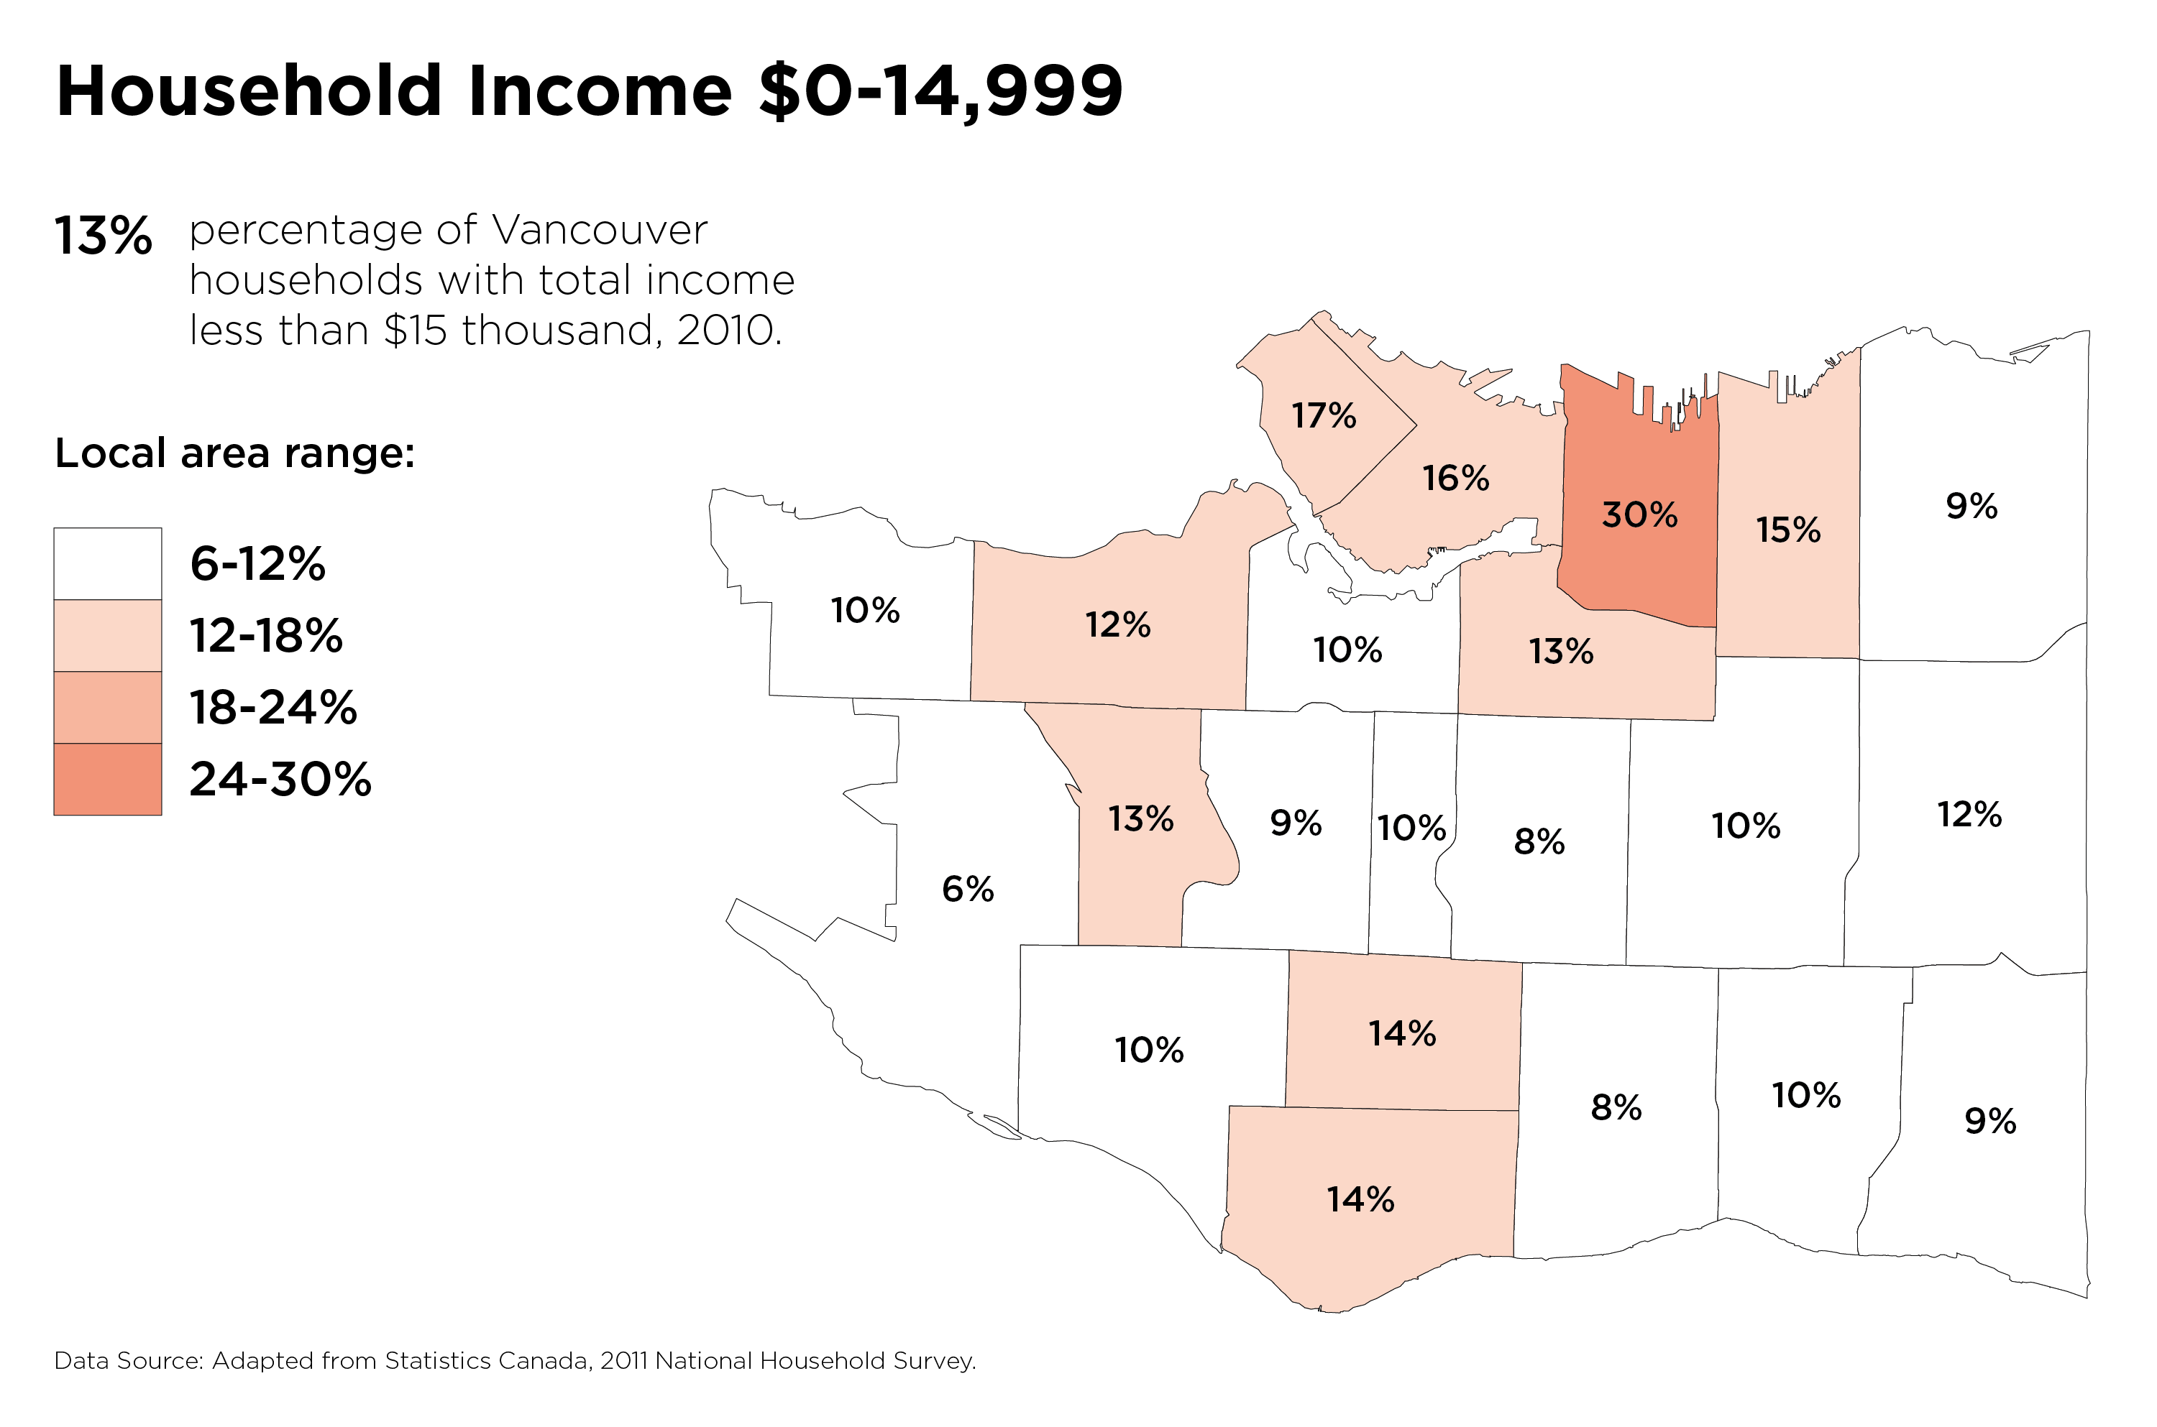

Slide 19
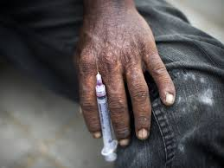
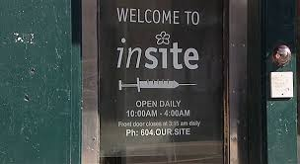
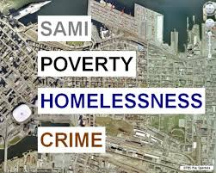
Compared to low income urban areas (Canada, US), the DTES has
Multiple Combinations & Concentrations of:
- Intravenous Drugs: HIV/Aids Epidemic; Hep C
5,000 people with serious mental health & addictions, 2,000 untreated; other chronic conditions: brain injury, diabetes; lack family supports
Deeper levels of poverty (welfare provides $7.3k/year; 10.8k for disability), inadequate housing
- Tragedy of the Missing and Murdered Women
Similar to other urban areas, low income residents face challenges of monetization (gentrification) and related impacts
Displacement: US trend is from inner city to suburb migration – but DTES has more welfare rate housing
Notes:
– Missing and Murdered women: 67 women; all were survival sex workers, struggled with addictions; approx 30% Aboriginal http://www.macleans.ca/news/canada/getting-a-new-lease-on-life/

Slide 20
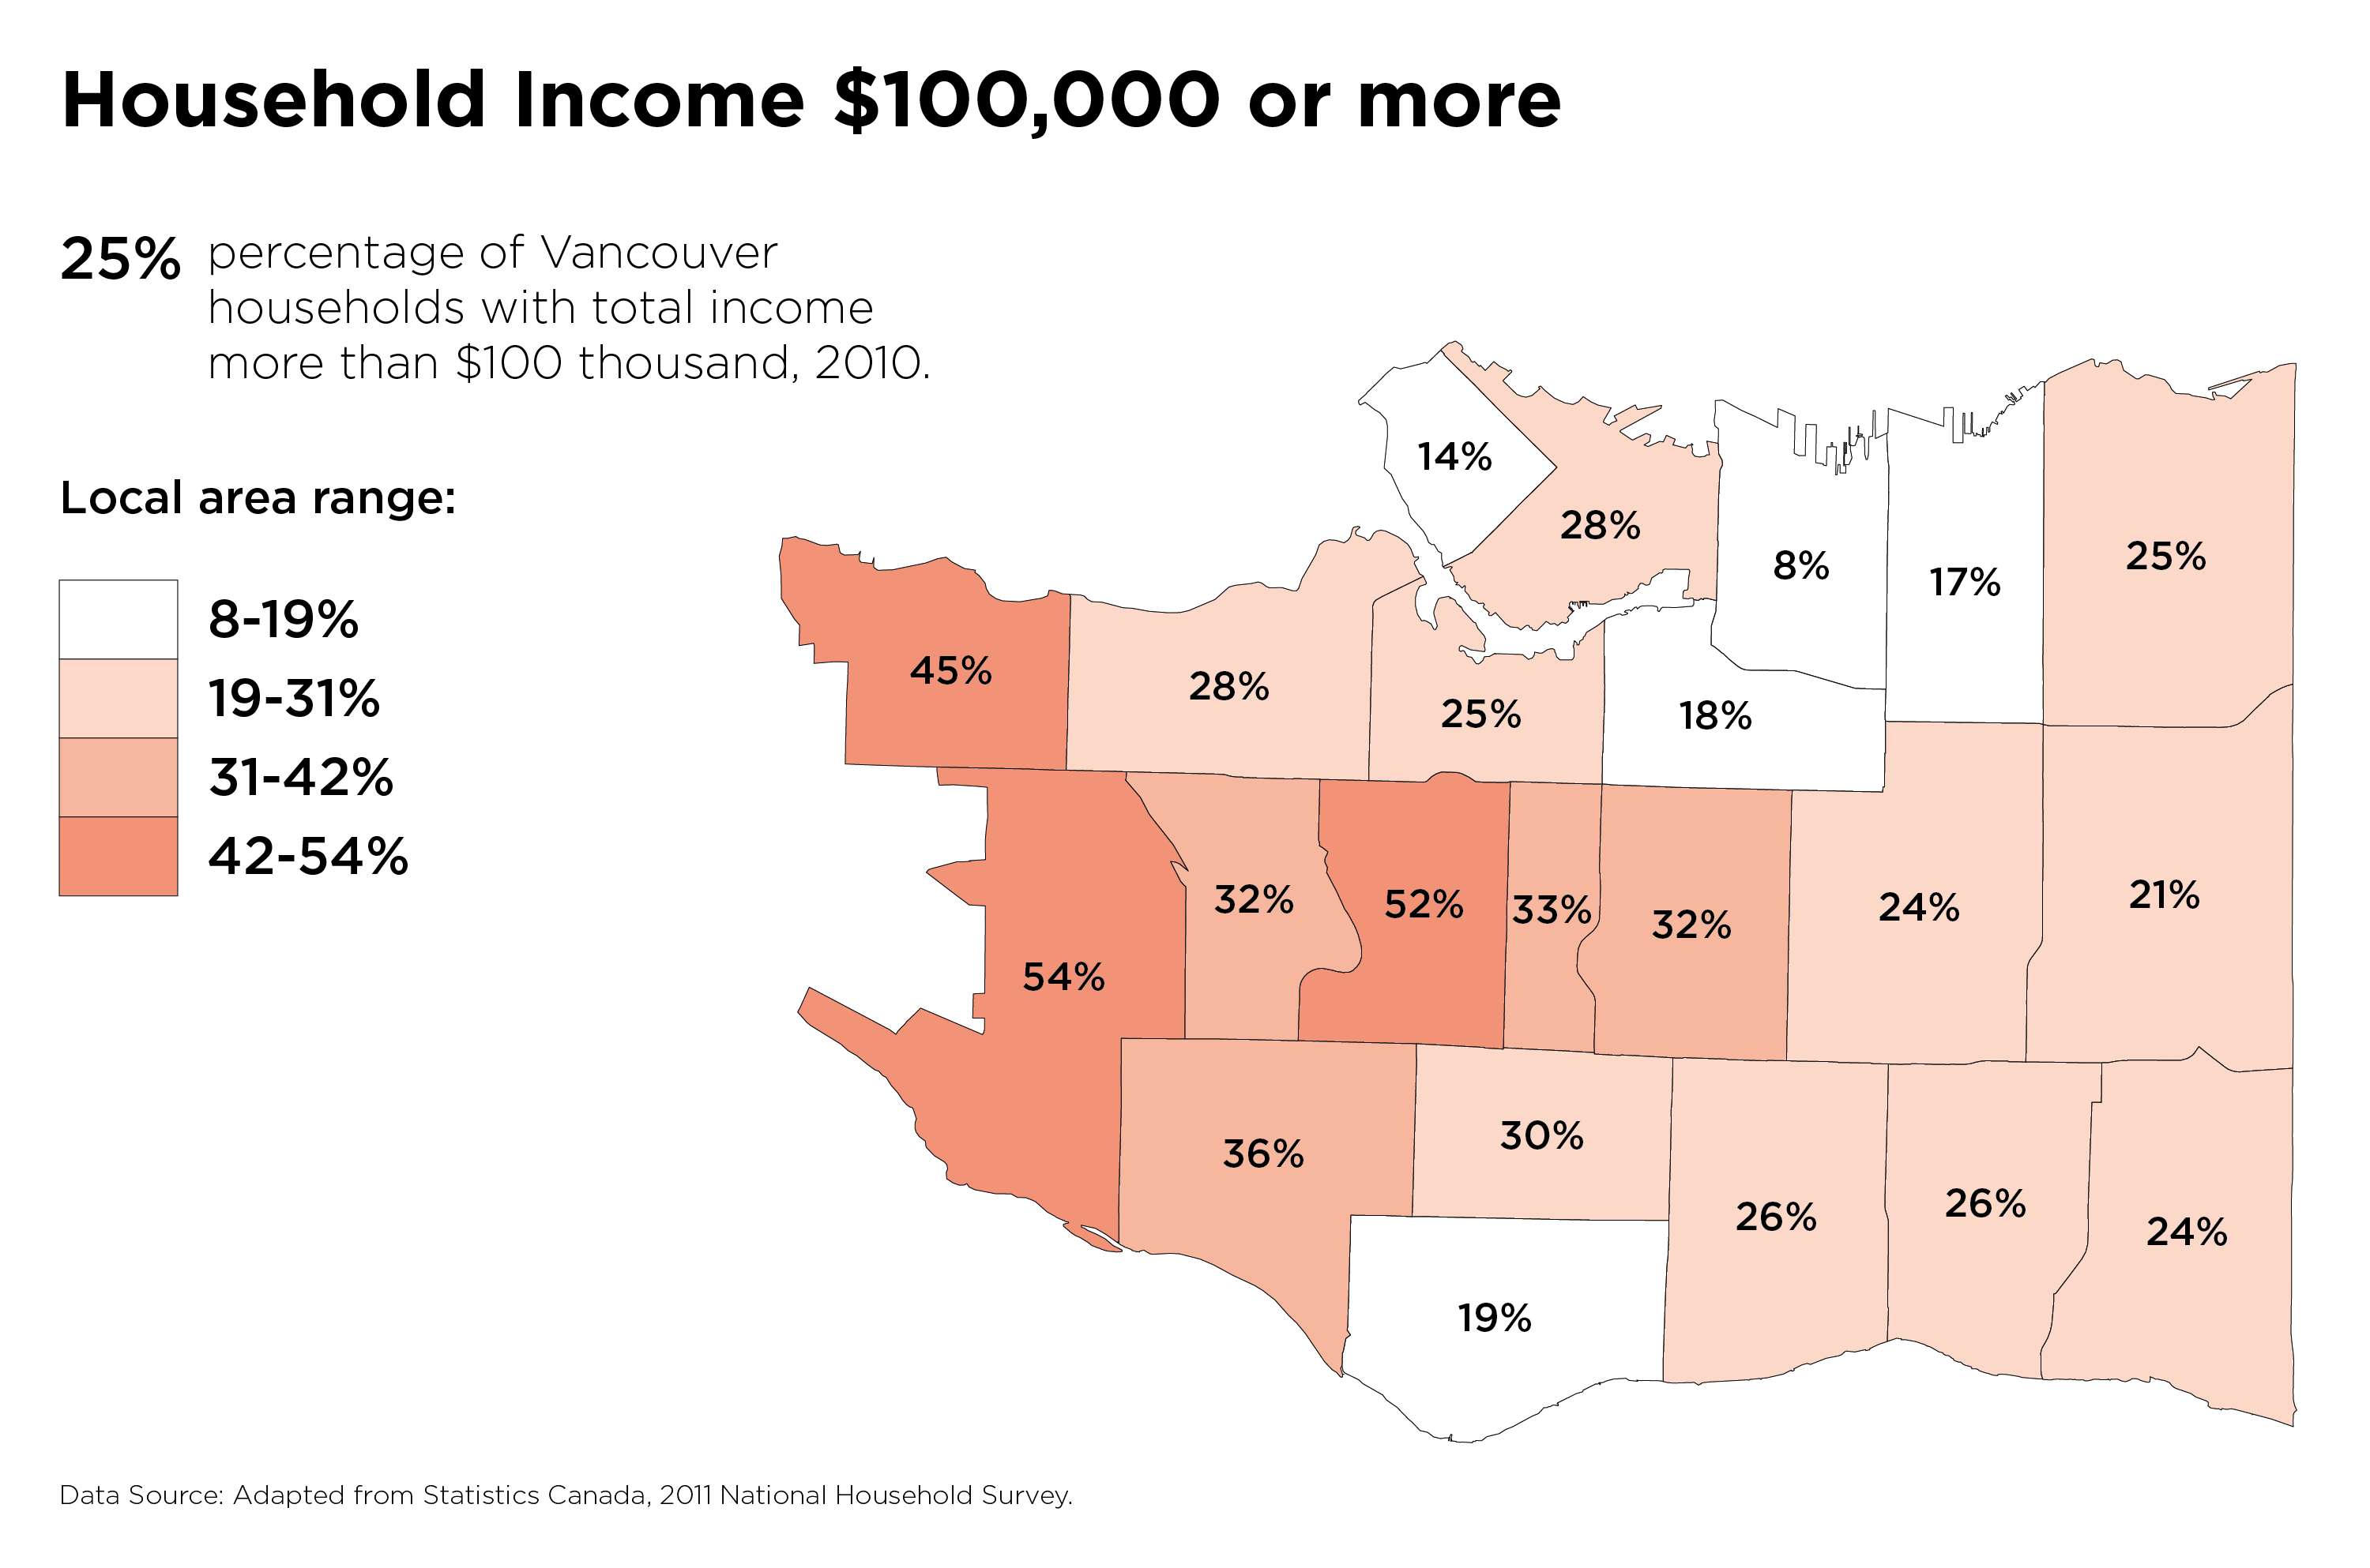

Disparities in income AND wealth: ownership of housing vs rental correlates with income

Slide 21
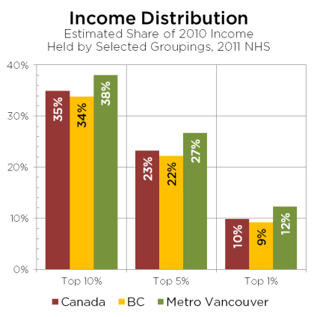
Income inequality: higher in Vancouver compared to BC & Canada
Notes:
Economic inequality is measured by looking at the distribution of wealth and income in a society, not the general wealth of a country. At a basic level, a country’s overall economic success does predict its people’s well-being, but the healthiest and happiest countries in the world are not the richest. Rather, they are countries where wealth is shared widely and more equally.

Slide 22
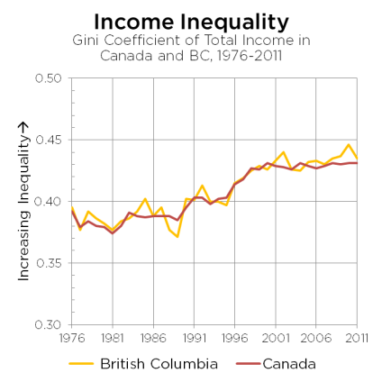
Rising income inequality in BC and Canada over time (GINI coefficient)

Slide 23

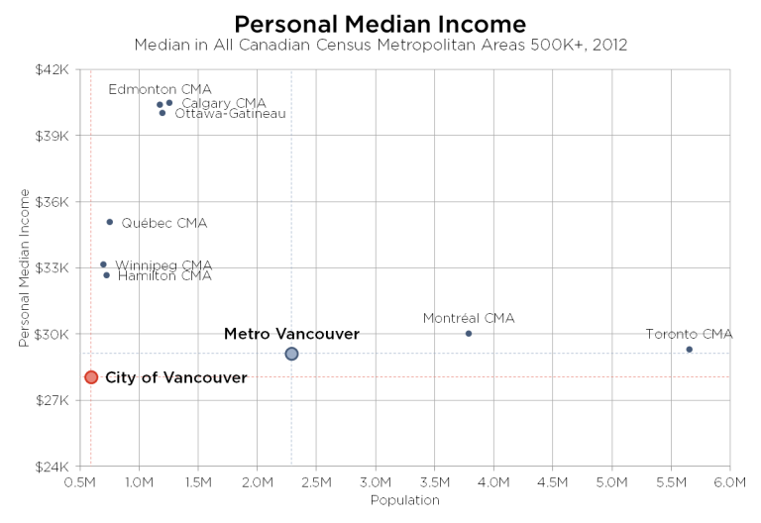
Median incomes in Vancouver lowest among major Canadian cities
Notes:
Vancouver has lowest median income of large metro centres in Canada

Slide 24
Inequality in Vancouver: Shaughnessy Comparison
Shaughnessy: 9,000 residents
Created in 1907 by CP Rail; (major property developer) for the wealthy
Median Income $177,000*
Benchmark price for single family home: $4 M*
Majority own homes; 106 have swimming pools*
Majority vote conservative*
*From Guy Saddy “ If this is our new urban dream, is the west side sleeping through it?” Vancouver Magazine, April 2015
DTES: 18,000 residents
Historically a low income; working class neighbourhood since Vancouver colonized
Median income $13,000
Benchmark price for single family home: approx. $1M
Vast majority renters (90 %)
Increase middle/upper middle income earners
Majority vote left of centre
Notes:
In some select areas, median is appox 700k
Source: Vancouver Magazine, April 2015
DTES Data from City of Vancouver – census and other data

Slide 25

Digging Deeper: Shaughnessy & Eudemonia
“Shaughnessy was invented to be a sanctuary for the wealthy removed from the bustle of city life. But in the midst of a Vancouver that increasingly values community and convenience, its greatest virtues now appear more out of step than ever.”
“I do not know Shaughnessy at all; My neighbourhood is an enigma, largely impenetrable, its desires and devices are hidden behind wrought iron gates…It is beautiful, clean, quiet. It is where I live. It would be a stretch though, to call it home.”
From Guy Saddy “ If this is our new urban dream, is the west side sleeping through it?” Vancouver Magazine, April 2015
Notes:
Humans are social creatures – social connection is vital to survival. We are born for cooperation. (Tomosello); human connection is a matter of survival “ Gabor Mate
Loneliness kills: we die earlier, experience more depression and anxiety, and other physical health ailments
Income inequality exacerbates social isolation, increases stress & depression – true for middle income people, and low income (Marmot)
“We die earlier, experience more depression and anxiety and other social ailments, through loneliness. Human connection is a matter of survival” Gabor Mate

Slide 26
Low income resident concerns about change – and what is valued
Too bad the gentry down here, as we call it,
don’t interact much….don’t come in here to see what’s going on
It’s all so much about money it seems hopeless
My fear is that as things start to build and grow,
we are not going to have this close-knit community. It’s frightening.
We’re not the poorest postal code, we’re the richest
It’s changing. We have to not forget that we were here first.
We want you to see us for who we are and what we are.
Down here it’s safe. We shouldn’t be looked down upon.
Notes:
Resident feedback, DTES Social Impact Assessment consultation, 2012, City of Vancouver. A Social Impact Assessment was created to identify and retain low income assets (housing, places and spaces) and mitigate future impacts of developmentject, VCH, 2007 Provincial Evaluations

Slide 27
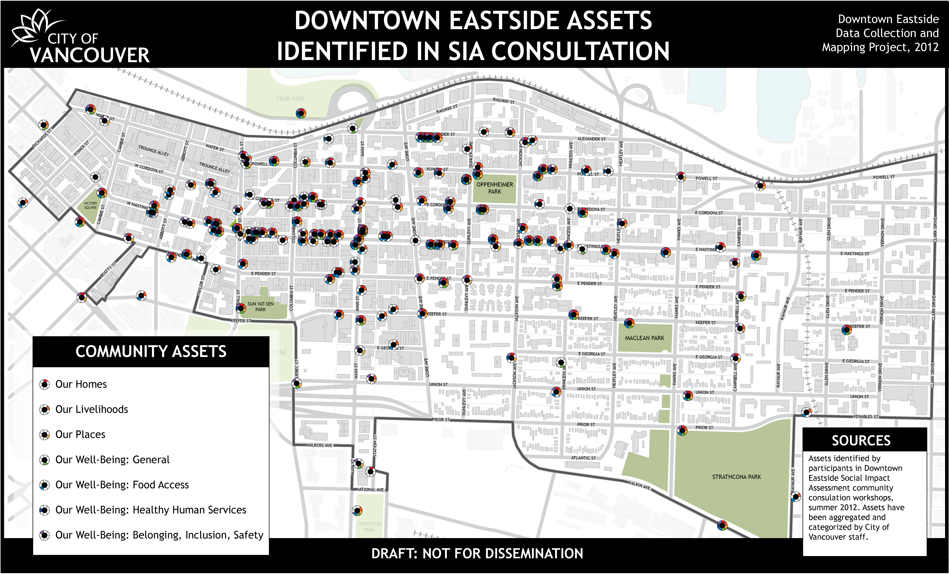
Key assets – homes, livelihoods, belonging - valued by low income community. City of Vancouver Social Impact Assessment (2012).

Slide 28
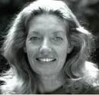
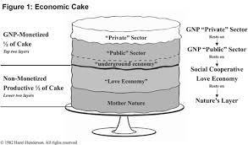
The 3 layer cake in the DTES: Who has the power, who benefits?

Slide 29

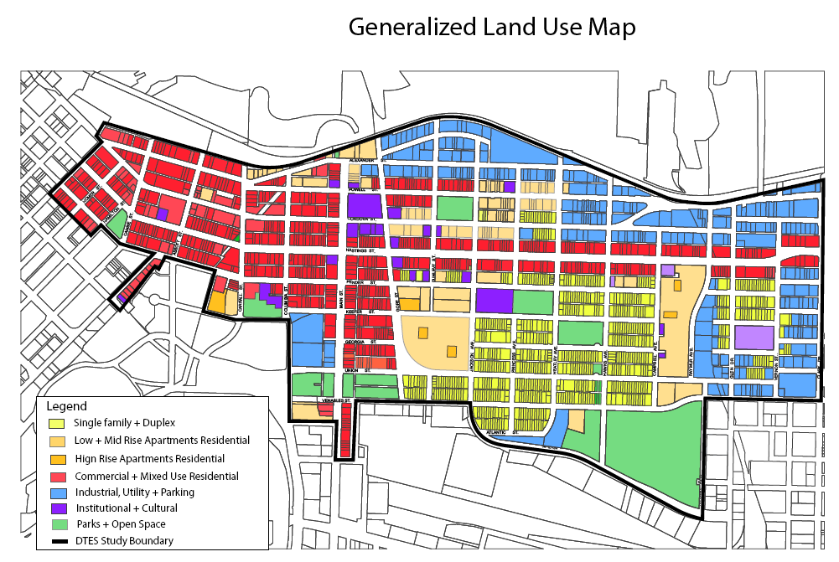
Unique mix of industrial, commercial, residential space = business utopia
Notes:
An economic dream – unique mix

Slide 30
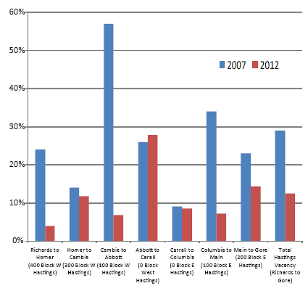
Private Sector Cake Layer: retail storefront vacancy decreases, business increases

Slide 32

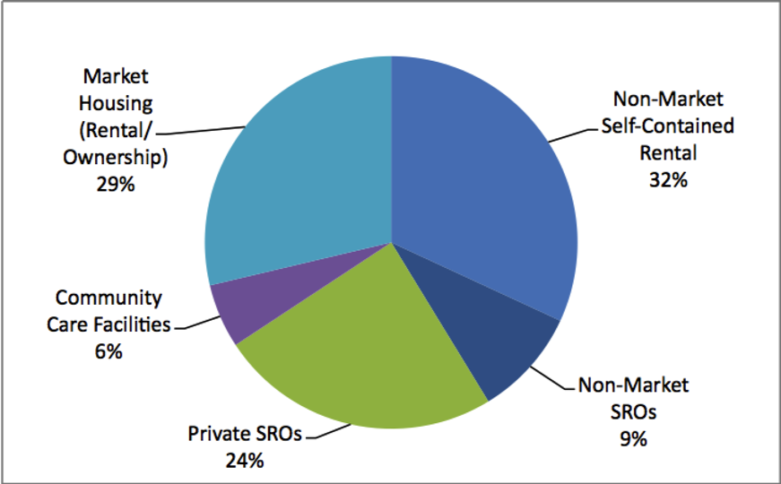
Social Housing: 50% privately owned; 50% publicly owned
Private sector ownership = unstable

Slide 33
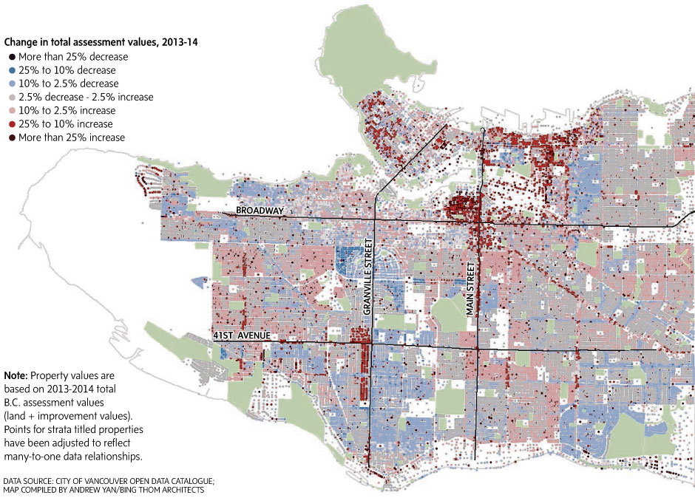

Slide 34

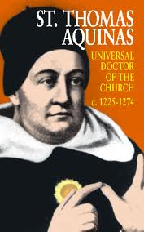
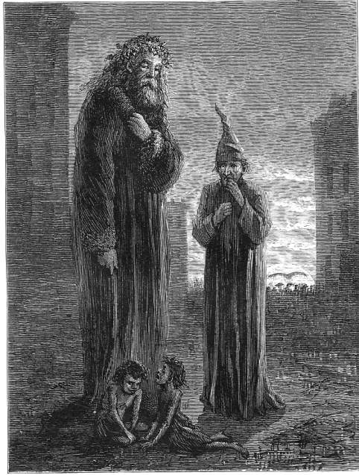


Private Sector Layer: Philanthropy
$100M/year in charitable giving to the DTES
Loving Thy Neighbour incentive = Tax benefit
Digging deeper: Who benefits?
Notes:
Estimated; see Vancouver Sun article, 2013, Pete McMartin

Slide 35








Public Sector Layer
Approximately $260M annually, to approx 200 agencies.
Majority (85%) from provincial government funding.
Remaining 15% divided roughly equally between federal and municipal government.
Range of services: housing, health, policing
Highest concentration of non profit services in Vancouver: least expensive rents (but changing)
Public sector employment: est. approx $200M to moderate- middle income earners*
Peter McMartin, Vancouver Sun 2014. Investigation into
DTES expenditures. 80/20 ‘rule’ used to calculate wages.
Notes:
http://www.vancouversun.com/health/Downtown+Eastside+agencies+housing+sites+crowd+Downtown+Eastside+with+video/9983274/story.html
Three-quarters of that money (360M) comes from taxpayers, as the agencies received funding from the provincial ($231 million), municipal ($15 million) and federal ($17 million) governments”. Vancouver Sun, 2014, Pete McMartin

Slide 36
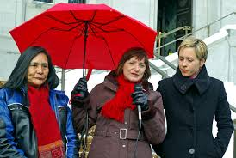
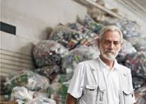
Underground “Survival economy” Cake Layer
Definition: “market transactions taking place on the margins or outside formal economic and legal structure…not contributing to the income of the public sector”*
Increasing in urban areas globally; correlation with poverty
Includes binning, sex work, sale of illicit drugs, clothing, other household goods
Digging Deeper: Paradox of wealth & culture of consumption: Consumption generates ‘waste’ collected by informal recyclers
Contributes to other layers: Private, Public, Love & Mother Nature
*Tremblay, Chrystal. Binners in Vancouver: A socio-economic study on Binners & Traplines in Downtown Eastside. 2001

Slide 37

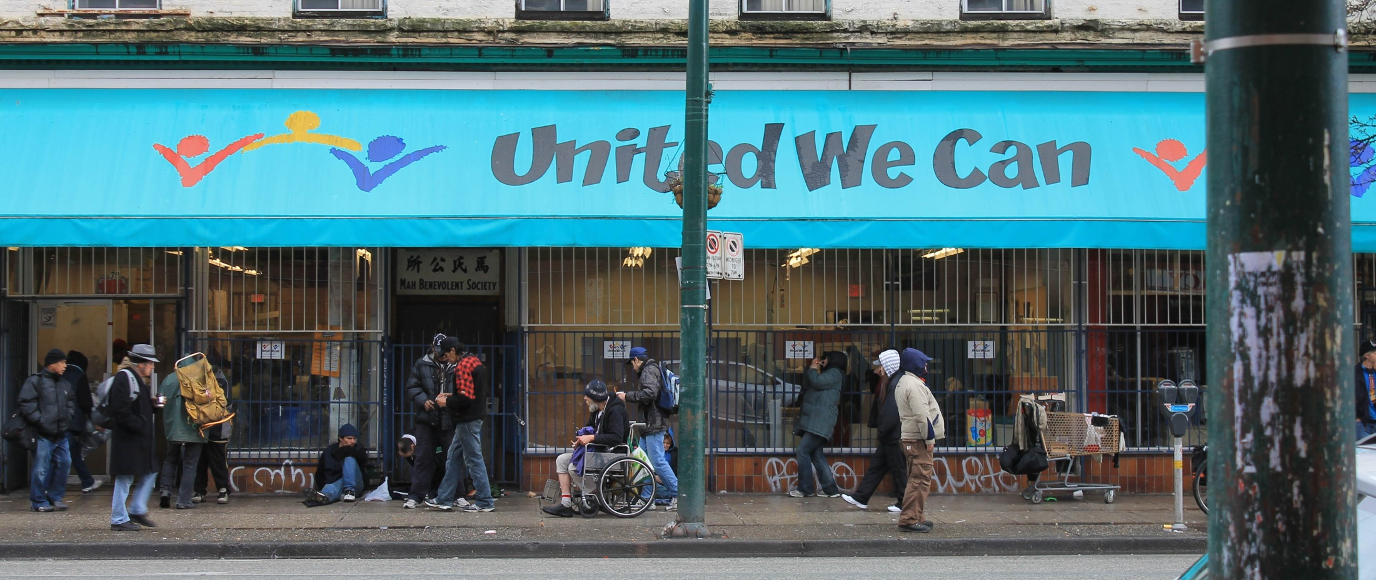
Survival Economy: United We Can
“A street charity that means business”
Supports 700 low barrier jobs
Peer involved: on organization board; provides community for those without family facing social and economic stigma
Invest in building up the capacity of people, and building the relationships between people producing the waste and those gathering and how they see one another as part of something that works better than the way it is
Ken Lyotier, Director United We Can

Slide 38
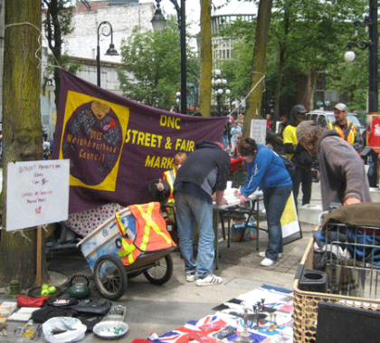
Survival Economy: DTES Street Market
Peer run street market
Supplements income for 200 residents in survival economy
Reduces, Re-uses and Recycles used goods
Provides legal opportunity for vending
Strengthened capabilities:
“We are taking our own initiative to improve”
“My family and community are all at the market…encouraging me to sell”
Camaraderie
Street Market Study: UBC School of Community and Regional Planning, 2014
Notes:
Primary motivation for vendors: to make money; average $48/market day; 76% use earnings to buy food
Secondary motivation: social interaction, cooperation
Strengthened capabilities:
“We are taking our own initiative to improve”
“My family and community are all at the market…encouraging me to sell”
Connecting with other parts of the city: 60% of customers live outside DTES; 97% say it’s a ‘safe place to shop’.
Over $500,000 in sales/year (one day/week)
$5,000 revenues from coffee sales
City subsidy: $ 75,000 grants & in kind parks/city land
Philanthropy: Equipment donations
Social Enterprise; emerged as partial solution to illegal vending
Grassroots effort to fight for safe, legal vending for DTES low income residents
200-300 vendors weekly; peer run and lead by non profit society
Outcomes/Results: some monetary benefit and peer support, skill building; laddering/employment opportunities
camaraderie, citizenship/rights to public space;

Slide 39

Love Economy Cake Layer
Non Monetized contributions: volunteer contributions estimated @ millions annually and often not included
In a small sample of 29 organizations receiving $1.2 M in City grants:
- 2,075 volunteers contributed to 29 organizations; donated108,955 hours of time.*
Converted $ contribution = $2.17M**
Value add: 2:1 ratio (approx.)
*City of Vancouver – DTES local area profile, 2013; figure calculated based on $20/hr (living wage)
Notes:
What is emphasized is the optimal allocation of resources that can be shown to result from the mechanical interplay of individual self-interests. What is neglected is the effect of one persons welfare on that of others through the bonds of sympathy and human community, and the effects of one persons production and consumption activities on others.
Daly “The Common Good…

Slide 40
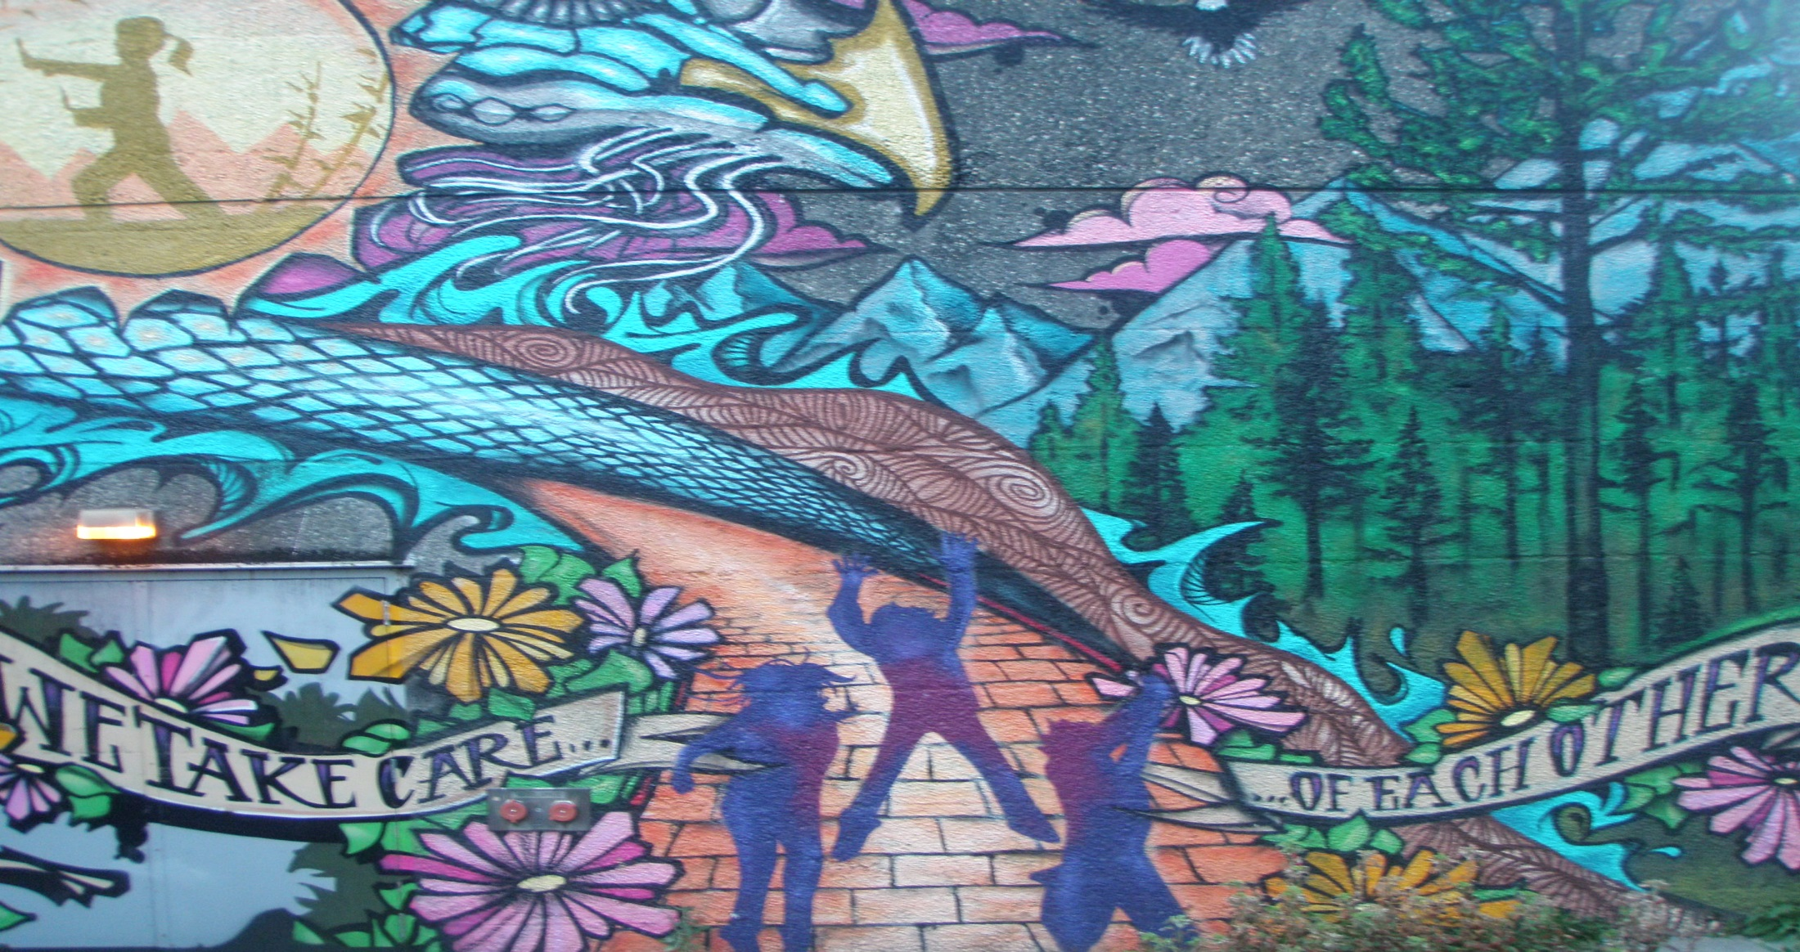
Alternative Visions & Measures

Slide 41
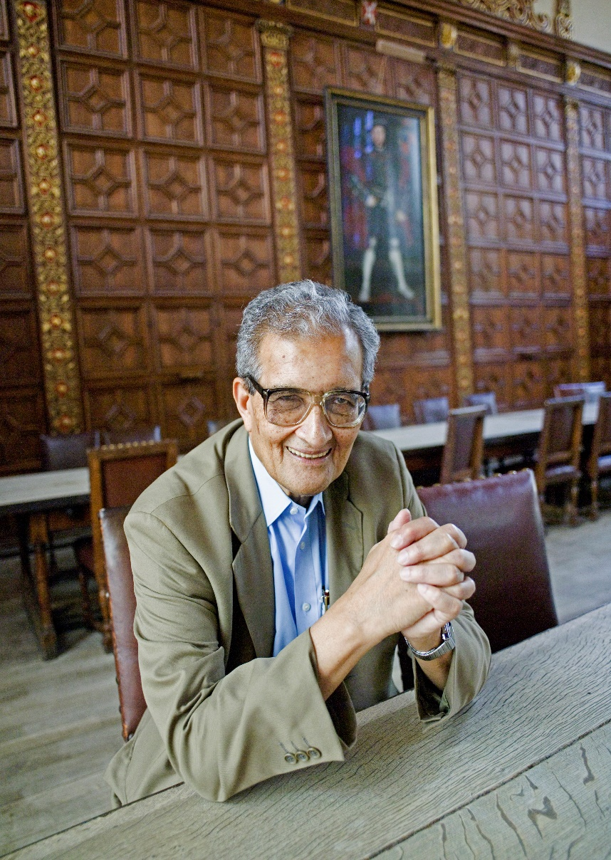
Alternative Visions:
Sen’s Capabilities Approach
Asks: What are human beings capable of?
Political freedom is primary – social and economic freedom evolves from this
Shift in emphasis from public services to political agency of individuals
Recognizes individual and collective agency
Contributed to Human Development Index
Collaboration with Nussbuam introduced concept of “Love” as a key capability & inclusion in concept of ‘justice’.
Notes:
Overall, though resources and income have a profound effect on what we can or cannot do, the capability approach recognizes that they are not the only things to be considered when judging well-being, switching the focus from a means to a good life to the freedom to achieve actual improvements in lives, which one has reason to value.

Slide 42
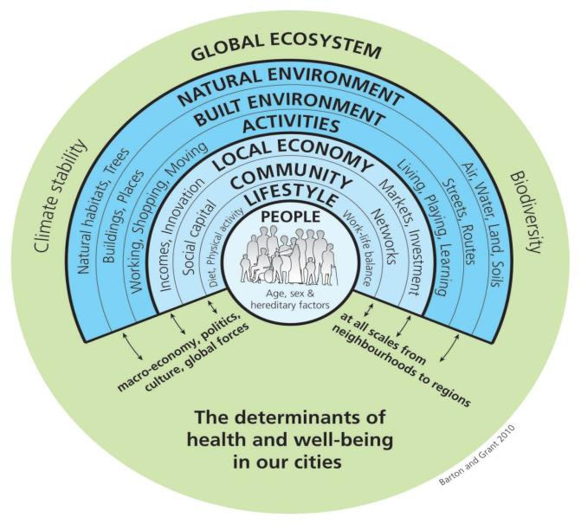
Social Determinants of Health: putting science behind wellbeing
Notes:
Science has demonstrated that conditions in which people are born, grow, live, work and age play key role in determining health outcomes
Health is shaped by distribution of money, power and resources at global, national and local levels
Includes: adequate income, housing & food, access to health services, education and vocational opportunity, and healthy ecological environments. (World Health Organization)
Evidence based (science proven)
Applicable to ‘all’; agency & freedom, equal opportunity, fairness, social justice are inter related values; individual should self determine needs
Some similarities to Sen: Debate as to whether determinants are ‘means’ or ‘ends’. Sen notes that freedom and capabilities are key ‘ends’ by which people can help themselves, support each other and influence the world. (Aristotle, Enlightenment, Locke – other? – communitarian?)
Includes ‘freedom’ of capitalism with the ‘planning’ of socialism? (rebuttle to Hayek)

Slide 43

Healthy City Strategy 2014: Vision & Goals
Long term
Health and Well being
framework for Vancouver
Vision, Goals
Targets, indicators
Adopted by
Mayor
& Council
October 2014
Next Steps:
First 4 year action
plan

Slide 44
Integrates social, economic and ecological considerations into decision making
Ecological
Social
Economic
Sustainable Future

Slide 45

Promotes Local Leadership
Local governments are uniquely placed to provide leadership for health. Many social determinants of health operate at the local and community level. Municipalities have the capacity to influence the determinants of health and inequalities – ‘the causes of the causes’.
World Health Organization, 2013

Slide 46
Focus on Moving Upstream
Prevention Benefits Everyone
WELLNESS
Healthy City for All
Innovation
INDIVIDUALS IN CRISIS
ACUTE INTERVENTIONS: hospital, police, ambulance
COMMUNITY SUPPORTS
CRISIS

Slide 47

Recognizes individual capabilities, but requires collective leadership
Goals led by senior government, business sector, civil society
Goals that are City-led through policy, programs, regulations and financial capacity

Slide 48


Goals, Targets, Indicators

Slide 49

A good start in life
Vancouver’s children have the best chance of enjoying a healthy childhood
By 2025, at least 85% of Vancouver’s children are developmentally ready for school when they enter kindergarten

Slide 50



A home for everyone

Slide 51
Improve access and input into health and social services
TargeVancouverites have equitable access to high-quality social, community and health services.
By 2025, increase the percentage of Vancouverites who report have access to services when they need them by 25% over 2014 levels
By 2025, all Vancouver residents are attached to a family doctor

Slide 52

Ability to make ends meet
Adequate income to cover the costs of basics, and access to a broad range of employment opportunities
By 2025, reduce the City’s poverty rate by 75%
By 2025, increase median income by at least 3% every year

Slide 53

Cultivate connections
Vancouverites are connected and engaged in the places and spaces that matter to us
By 2025, all Vancouverites report they have at least 4 people in their network that they can rely on for support in times of need
By 2025, increase municipal voter turnout to at least 60%

Slide 54

Lifelong Learning
Vancouverites have equitable access to lifelong learning and development opportunities
By 2025, increase participation in lifelong learning by 25% over 2014 levels

Slide 55


Expressing ourselves
Vancouver has a diverse and thriving cultural ecology that enriches the lives of all residents and visitors
By 2025, increase public participation and community engagement in arts and culture by 25% over 2014 levels

Slide 56

Environments to thrive in
Vancouverites have the right to a healthy environment and equitable access to livable environments in which they can thrive
By 2025, every Vancouver neighbourhood has a “Walk Score” of at least 70, meaning most errands can be done on foot

Slide 57
Collaborative Leadership for a Healthy City for All
Leaders from the private, public and civil sectors in Vancouver work in integrated and collaborative ways toward the vision of a healthy Vancouver for all
90% of actions to be developed in Phase 2 of the Healthy City Strategy will be implemented
“The promise of vision exhibited by this plan must be matched by building a network where the contribution of many is valued and adds up to something significant. The days are over when any of us can tackle the big issues and opportunities alone. We all have something to give and get.”
Steve Butz
President and CEO, YMCA Vancouver
Member of the Healthy City for All Leadership Table

Slide 58
How do you think we’ll get there?
A few ideas…GLS 812 ‘fuelled’
Corporate loopholes – how to stay ahead of this?
Tax Wealth (not just income) -& Inheritances
Align role and mandate of cities to today’s realties with funding to match
Paradigm shift: emphasis on capabilities & low barrier employment opportunities & outcome reporting
Address what is ‘enough’ privacy: Enable data sharing, and developing longitudinal systems & tools to measure progress & what works for people’s wellbeing
Include ‘Love Economy’ in GDP
Address ‘culture of consumption’ – increased sharing economies, social enterprise
Invest in prevention, esp. early childhood
Require ‘empty’ houses to be rented – or added tax
Require developers and businesses to hire and procure % local goods, including people with barriers to employment
Establish living wage policies among medium, large employers
Education: focus on ‘education of the heart’ – build empathy 6-12 year olds
Others?.....

Slide 59


